Slide 1
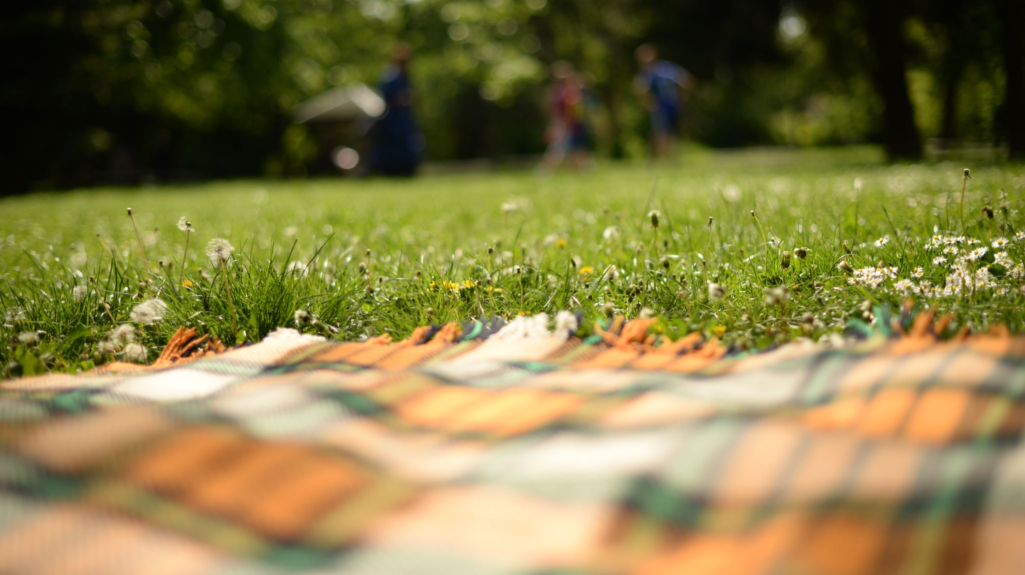
Wellbeing and prayer garden
Our Lady of Perpetual Succour Primary School

Slide 2
It was like this….

Slide 3
Full of weeds and overgrown areas

Slide 4
We wanted to change things

Slide 5
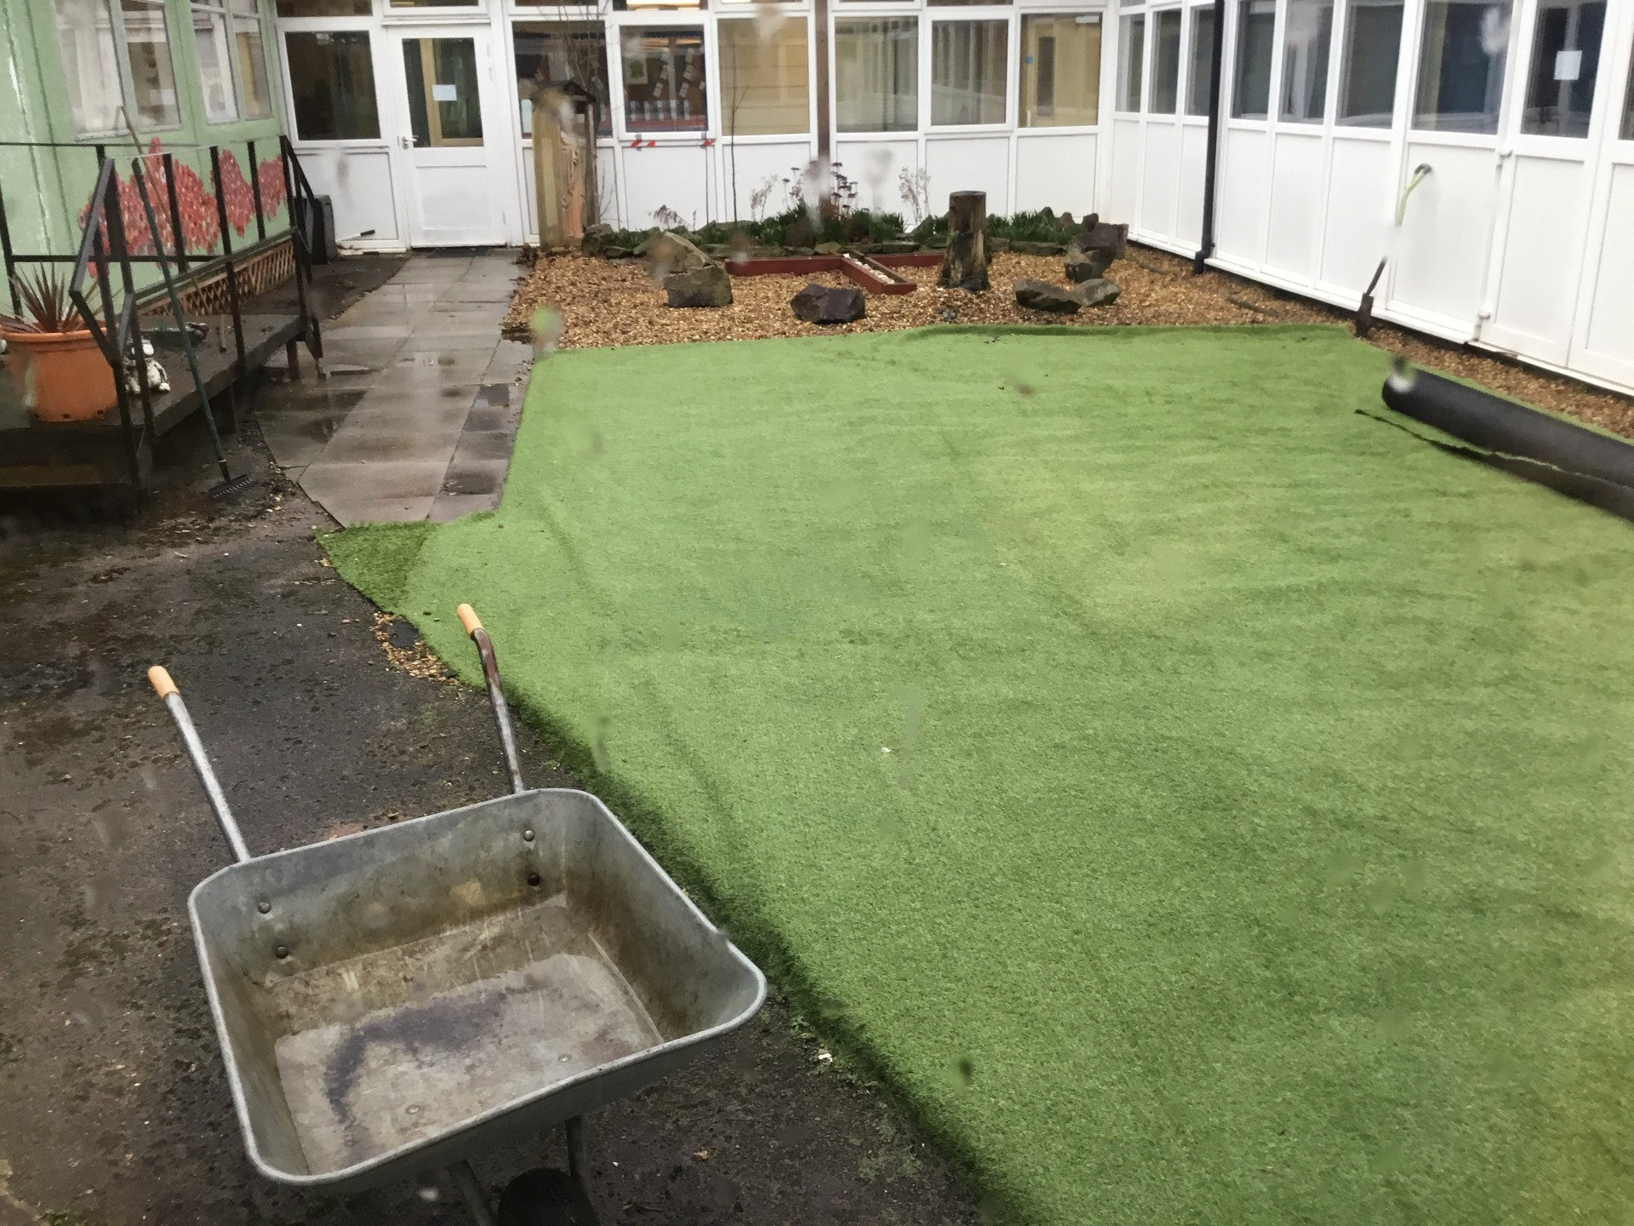
So it began…

Slide 6
And our caretaker worked so hard

Slide 7
And slowly it became better…

Slide 8
It took a while..

Slide 9
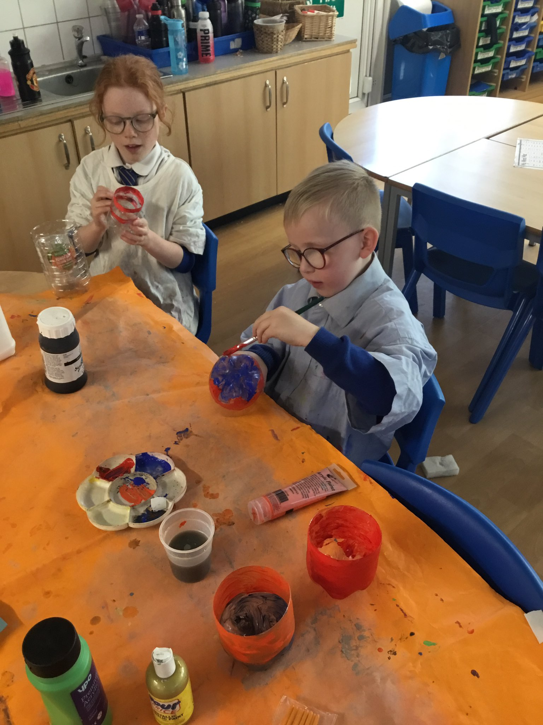
Our Eco Guardians have been busy painting bottles that we are going to use as plant pots in our schoolwellbeing garden!

Slide 10
We have started to make our prayer and wellbeing garden look lovely. We are getting there…..

