Slide 1
Our Lady of Perpetual Succour Primary School.
Special Education Needs Information Report
September 2024
This SEND Information Report has been compiled using the information required as set out in the Special Educational Needs and Disability Regulations 2014. Broad Areas of SEND The Special Educational Needs and Disability Code of Practice: 0 to 25 years (Statutory guidance for organisations who work with and support children and young people with special educational needs and disabilities), effective September 2014, details four broad areas of need as follows:
1. Communication and interaction
2. Cognition and learning
3. Social, emotional and mental health difficulties
4. Sensory and/or physical needs
The photographs used in this report are of a wide range of pupils in school, the images are collected as an example of all the good work we do in school for all pupils. Images used are of the provision, we do on a day-to-day basis to ensure all pupils make progress and succeed.

Slide 2
Our Lady of Perpetual Succour SEND Information Report
What kind of Special Educational Needs are provided for at Our Lady of Perpetual Succour Primary School? | We are a mainstream setting. We provide support for pupils across the 4 areas of need as laid out in the SEND Code of Practice 2014 and section 69 (2) of the Children and Families Act 2014 which also complies with regulation 51 and schedule 1 of the Special Educational Needs and Disability Regulations 2014 Communication and interaction Cognition and learning Social, emotional and mental health difficulties Sensory and/or physical needs
What do we do for our pupils with SEND? | We offer specific support for SEND pupils, this can be as an individual and/or as a small group. The wide range of provision we offer is identified on the provision maps. (See Provision maps on SEND page.) We aim for all of our classrooms to be inclusion friendly. We aim to teach in a way that will support children with dyslexia, ASD, ADHD etc. We offer a variety of opportunities to develop and build on learning styles, thinking skills and confidence.

Slide 3
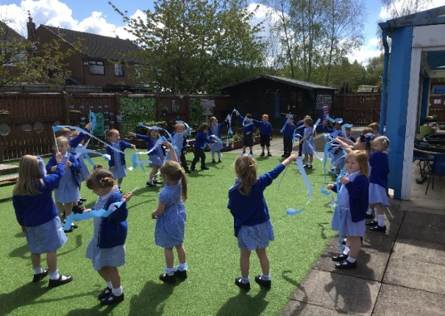

Our Lady of Perpetual Succour SEND Information Report
How do we identify when a pupil has Special Educational Needs (SEND)? | A lot of children receive extra help in school; this does not mean that they have Special Educational Needs. We frequently target children to help them catch up and to give extra help so that they do not struggle. We gather data and analyse it and every pupils is discussed termly to ensure we as a school are doing all we can to help them make progress. Our school provides a wide number of high quality support to enable children to progress and succeed. If then, despite, extra help and support your child is still struggling then we will engage the advice of other professionals. At this point (depending on the advice given) the school would consider your child as needing ‘specialist provision’ and be classed as having a ‘Special Educational Need’. This process would be discussed and shared with parents as soon as any concern was raised.
What happens next ? | Pupils with Specialist Educational Needs will have a support plan in place, detailing how we will provide extra help to support their needs. The progress will be evaluated by staff, pupil and parents, termly (September, January, April). However, informal discussions can take place at any time so if you have any worries, do contact the class teacher or the SENDCO, Mrs Heston.

Slide 4
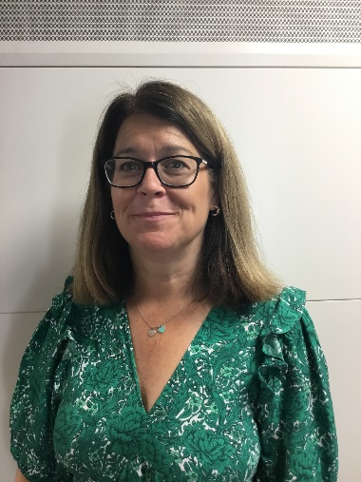

Our Lady of Perpetual Succour SEND Information Report
I have concerns who can I speak to? School SENDCo, Mrs Heston | Parents and Pupils can also refer to the Class teacher or/and Special Educational Needs co-ordinator (Mrs Heston) via the office, at any time in the school year. You can also email us at: sec.olpsprimary@halton.gov.uk Further information is also available on Haltons Local Offer Webpage http://www.halton.gov.uk/localoffer
The school’s approach to teaching pupils with SEND. | In addition to Quality First Teaching, we offer a learning environment which is flexible enough, yet structured, to meet the needs of all members of our school community. We believe our pupils should enjoy learning and that by providing a curriculum that is creative and topic led, this enhances enthusiasm for learning for all pupils. We want to create an inclusive culture in our school and we aim to be more responsive to the diversity of children's backgrounds, interests, experience, knowledge and skills.

Slide 5

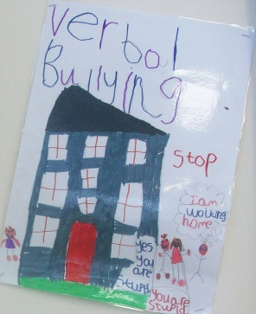

Our Lady of Perpetual Succour Primary School SEND Information Report
What support is available for improving the social emotional and mental health of pupils with special educational needs? | Pupils are well supported by: Extensive pastoral care Caring and respectful ethos An anti-bullying policy that is supported by a whole school ethos Play leaders to support playtime Targeted support for individual pupils Sports Ambassadors School Council Pupil Voice Wellbeing ambassadors ELSA groups EBSNA support MHST support Positive relationships and raised self-esteem in pupils as a result of: After school clubs Regular performances Class assemblies KS2 residential trip, including adventurous activities. Sports Specialist teaches all classes throughout the year. Specialist Language teacher
YEAR 6 RESIDENTIAL
- Plas Menai
Anti- Bullying

Slide 6
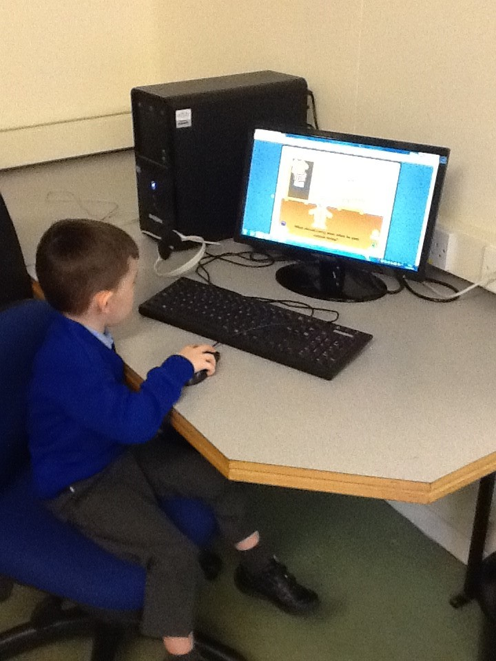
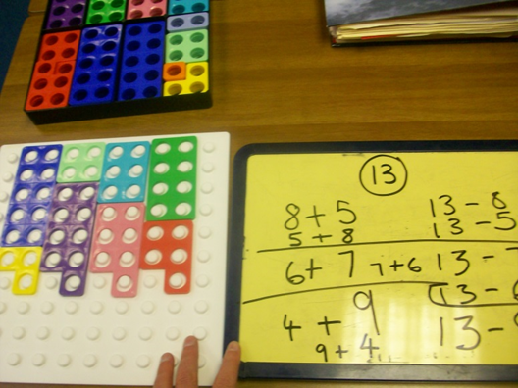
Our Lady of Perpetual Succour SEND Information Report
How do we adapt the curriculum to support our children with SEND? A Reception child using ICT to support English. | We adapt teaching by : Groupings that target specific levels of progress; Using a range of resources to suit the learner e.g. making use of the outdoors, working with materials, using digital technology Employing different teaching styles Appropriate choices of texts and topics Access arrangements for tests and or examinations Additional adult support
What SEND expertise to our staff at Our Lady’s have? | All Staff have had Training on the SEND Code of Practice, Speech and Language support, Growth Mindset, Autism awareness, attachment difficulties and how to be a Dyslexia friendly school. We have individual staff trained in: Early Maths Intervention Talk Boost Colourful Stories Social Scripts Attachment training Lego therapy Elklan training Hearing impairment ELSA (Emotional Literacy) No worries and EBSNA THRIVE The SENDCo has a B.A with Honours, PGCE and the National Award for Special Educational Needs.

Slide 7
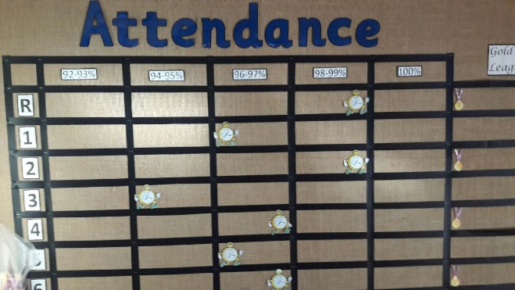

Our Lady of Perpetual Succour SEND Information Report
How do we involve other agencies with meeting the needs of children with SEN and their families? Promotes high attendance | Teaching staff work closely with Halton Support Services, we engage the advice and expertise of professionals including, Specific Learning Difficulties Team, Occupational Therapists, Speech and Language, Woodview Development Centre to name but a few. The school works closely with the Education Welfare Officer and the Social Care Team. We also liaise with the Healthy Schools Team, and Family Support Services. We provide an environment for these teams to work alongside children and families when they need support. The headteacher has been trained in leading and setting up a Multi-Agency plan.
How do we obtain Specialist advice for our SEND children? | We work closely with the Speech and Language Team (Communicate), who advise support and offer training for staff delivering support in this area. If then, despite, extra help and support your child is still struggling then we will engage the advice of Specialist Support Services from Halton Local Authority. In addition, we have access to an Educational Psychologist through half-termly group consultation meetings who can offer guidance and support for work with specific children and parents.
Attendance Display Board

Slide 8


Our Lady of Perpetual Succour SEND Information Report
How can we ensure our pupils with SEND are doing well? We want to know how well we are doing in all areas of the curriculum and school life. We find this out by asking pupils through: pupil voice; pupil questionnaires; end of year evaluations by pupils that reflect on teaching and learning, visits, clubs and other aspects of school life; pupil interviews and School Council meetings. We also ask you what you think about your child and their progress. | A review meeting is held termly, where parents, staff and pupils meet together to discuss progress and how we can all meet the needs of your child. We ask the pupil and we ask you, the parent, and we look at how your child has made progress towards their agreed outcomes on the Support Plan. As a school we collect data and analyse it, every pupils is discussed termly to ensure we as a school are doing all we can to help them make progress. Impacts of intervention is monitored by staff and by the SENDCO, to ensure the provision we provide is effective. Termly SEND information and an annual report is conveyed to the Governing Body. The SEND Governor is Miss Carol Houghton. The SEND Information Report is posted on the school website and reviewed annually.
I would like
more help with reading?

Slide 9
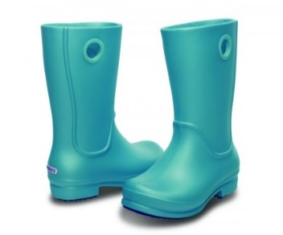

Our Lady of Perpetual Succour SEND Information Report
Preparing for the next step? | Changing classes and schools can be difficult for most children, but more so for learners with SEND. Transition times are managed carefully in order to prepare our learners for the next step. We liaise with Secondary Schools and have transition days in new classes or school to aid their preparation for the upcoming change.
Further Information about support services, Special Educational Needs and Disabilities. | Halton Borough Council has a web page detailing their support service for families and children. This is called the Local Offer. You can find a wealth of information at: www.halton.gov.uk/localoffer
Support for Parents of children with SEND can be obtained from SENDIASS. sendiass@halton.gov.uk TEL: 0151 511 7733

Slide 10
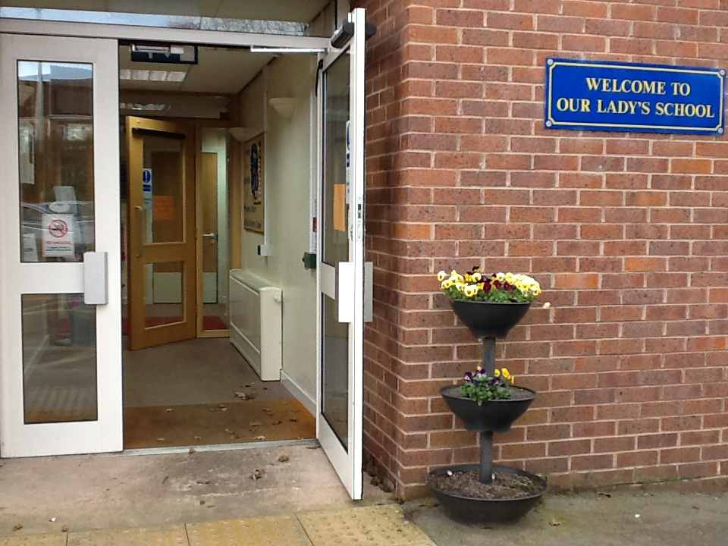
Have your say?
Contact us
Visit the office and ask to speak to a member of staff.
Ring the office; 0151 424 6130
Email:
sec.olpsprimary@haltonlearning.net
Write to us at:
Our Lady of Perpetual Succour Primary School
Clincton View
Widnes
WA8 8JN
This is the current SEND report for our school, but for it to be truly effective we need your views.
Mrs Heston,
SENDCo.
LET’S KEEP WORKING TOGETHER!

