Slide 1
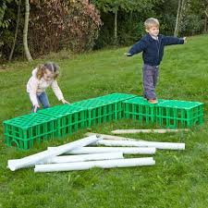
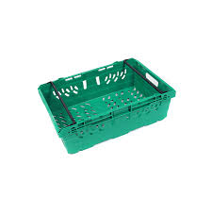
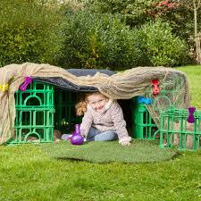
Inform
What will be new?
Plastic crates

Slide 2
Innovate
How can we not use it?
How can we use it?
Don’t jump on crates
Don’t throw crates
Don’t stand of stacked crates
Build with them
Use as steppingstones 1 high
Do an obstacle course

Slide 3


Negotiate
What new rules do we need for
our new activities and equipment?

Slide 4

Negotiate
Crates
Play team will remain vigilant about correct use.
Stack height limit of belly button on tarmac and shoulder height on soft grass.
Stack them for dens but please don’t stand on stacked crates.
Main risk is unstable stacks or toppling of crates so be aware!
Be careful of trapping fingers when stacking crates.
Don’t throw crates.
What rules do we need when with crates?

