Slide 1
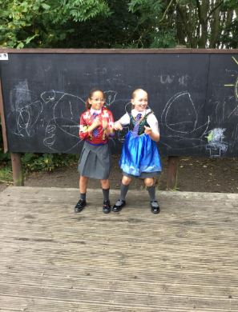
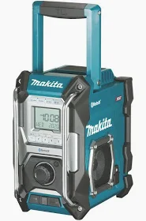
Stage Zone/Costumes
Inform
We have bought a music speaker

Slide 2


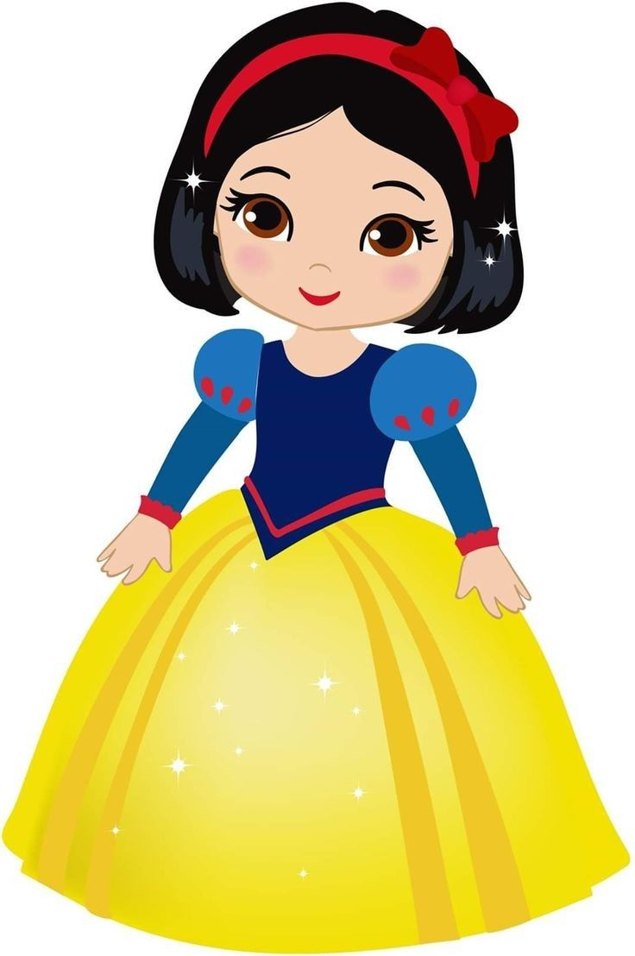
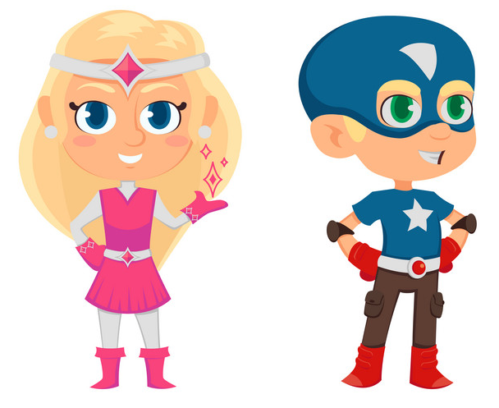
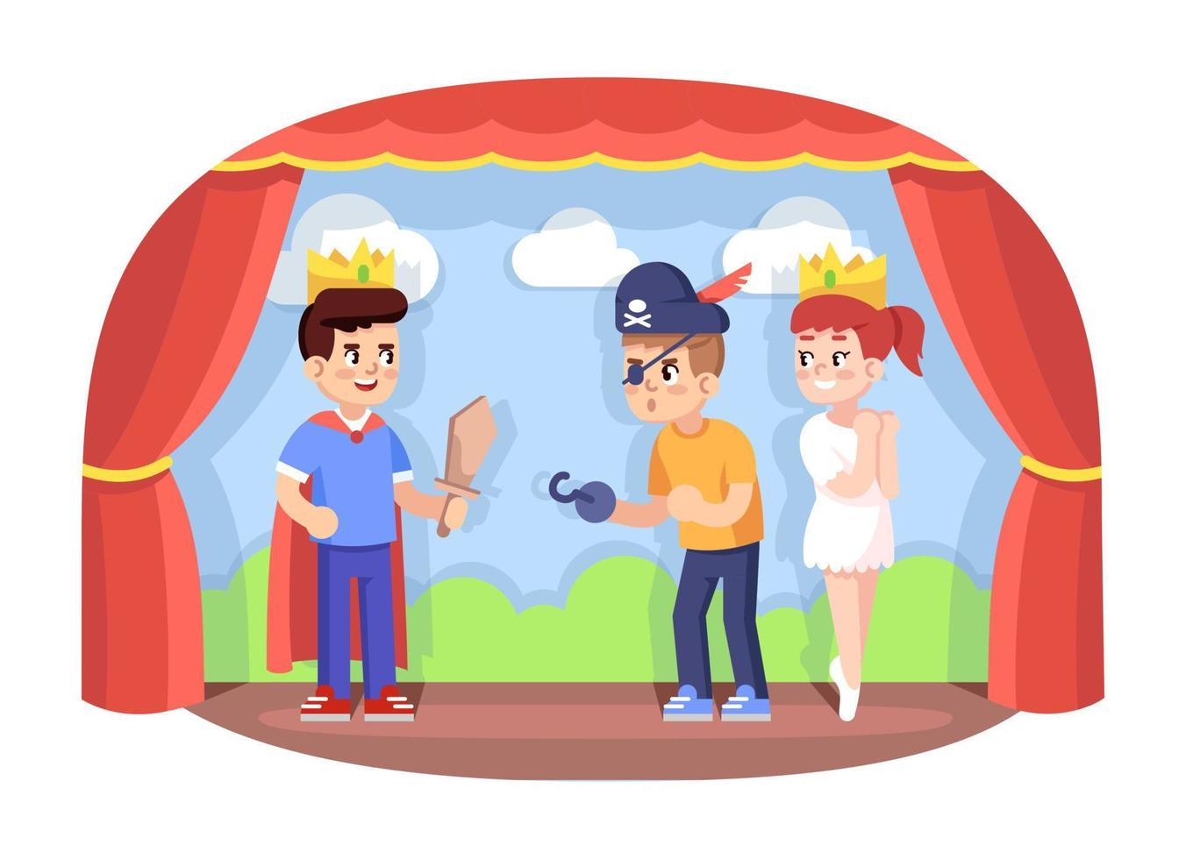

Innovate
Sing
Dance
Dress up
Music
Perform

Slide 3
Be imaginative in the Stage Zone
Be aware when entering (getting on) and exiting (getting off) the stage area
No running on the stage due to wet conditions the stage could be slippery
Wellies to be worn in wet weather
Play team will set u the music please don’t touch the music speaker or turn up the volume.
If you see costumes on the floor, please pick them up.
Before you put a costume on think will it fit me.
Put costume back into the boxes or hang on clothes
Take care of the costumes.
What rules do we need for the Stage Zone
Negotiate

