Slide 1
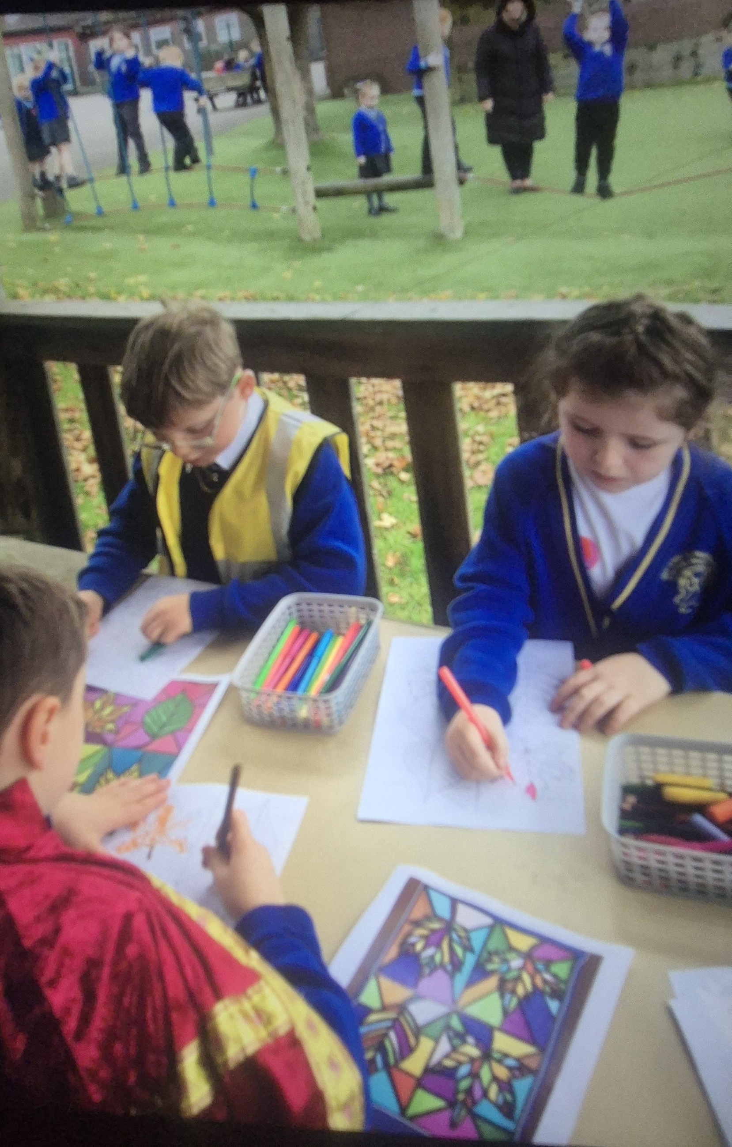
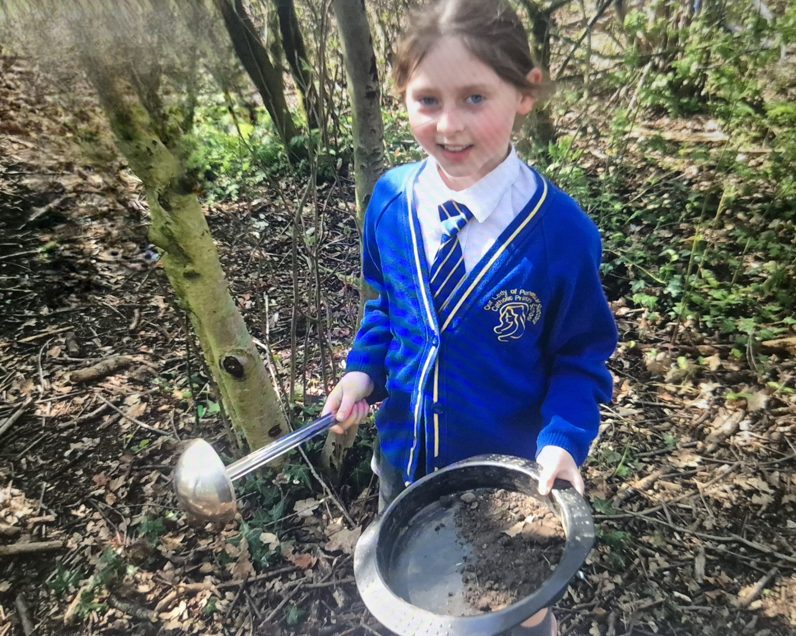
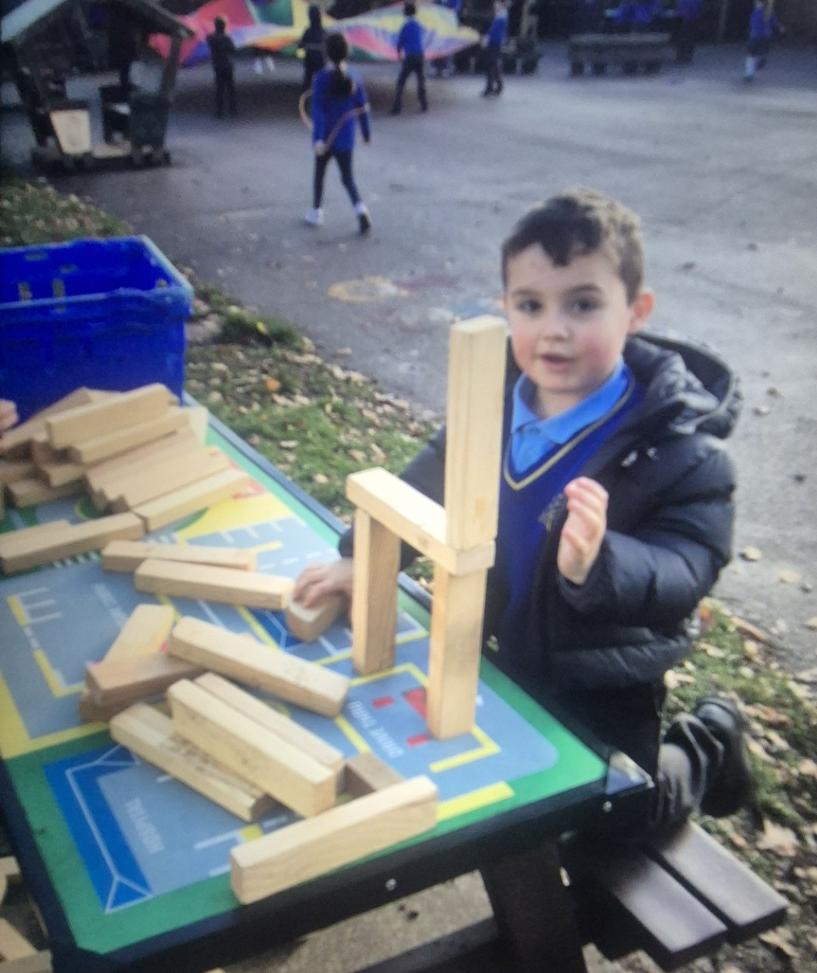


OPAL Play
Assembly

Slide 2
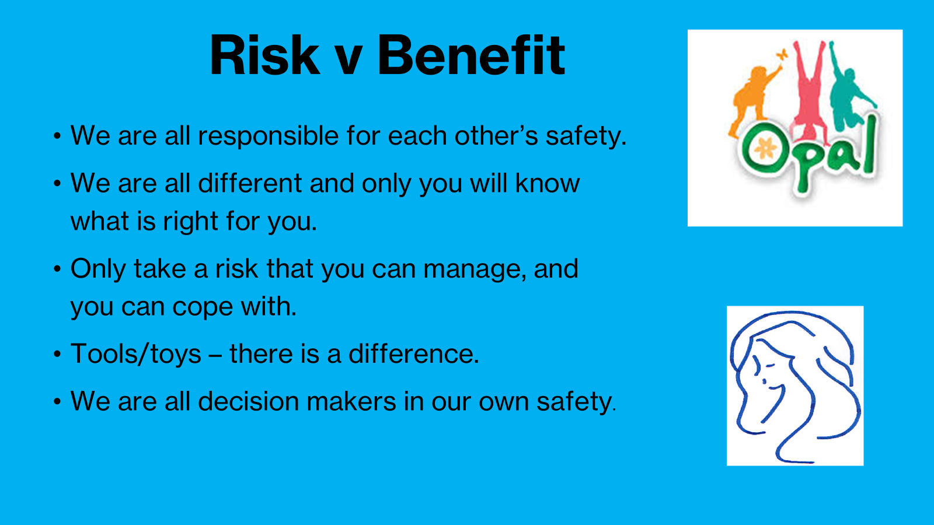

Slide 3
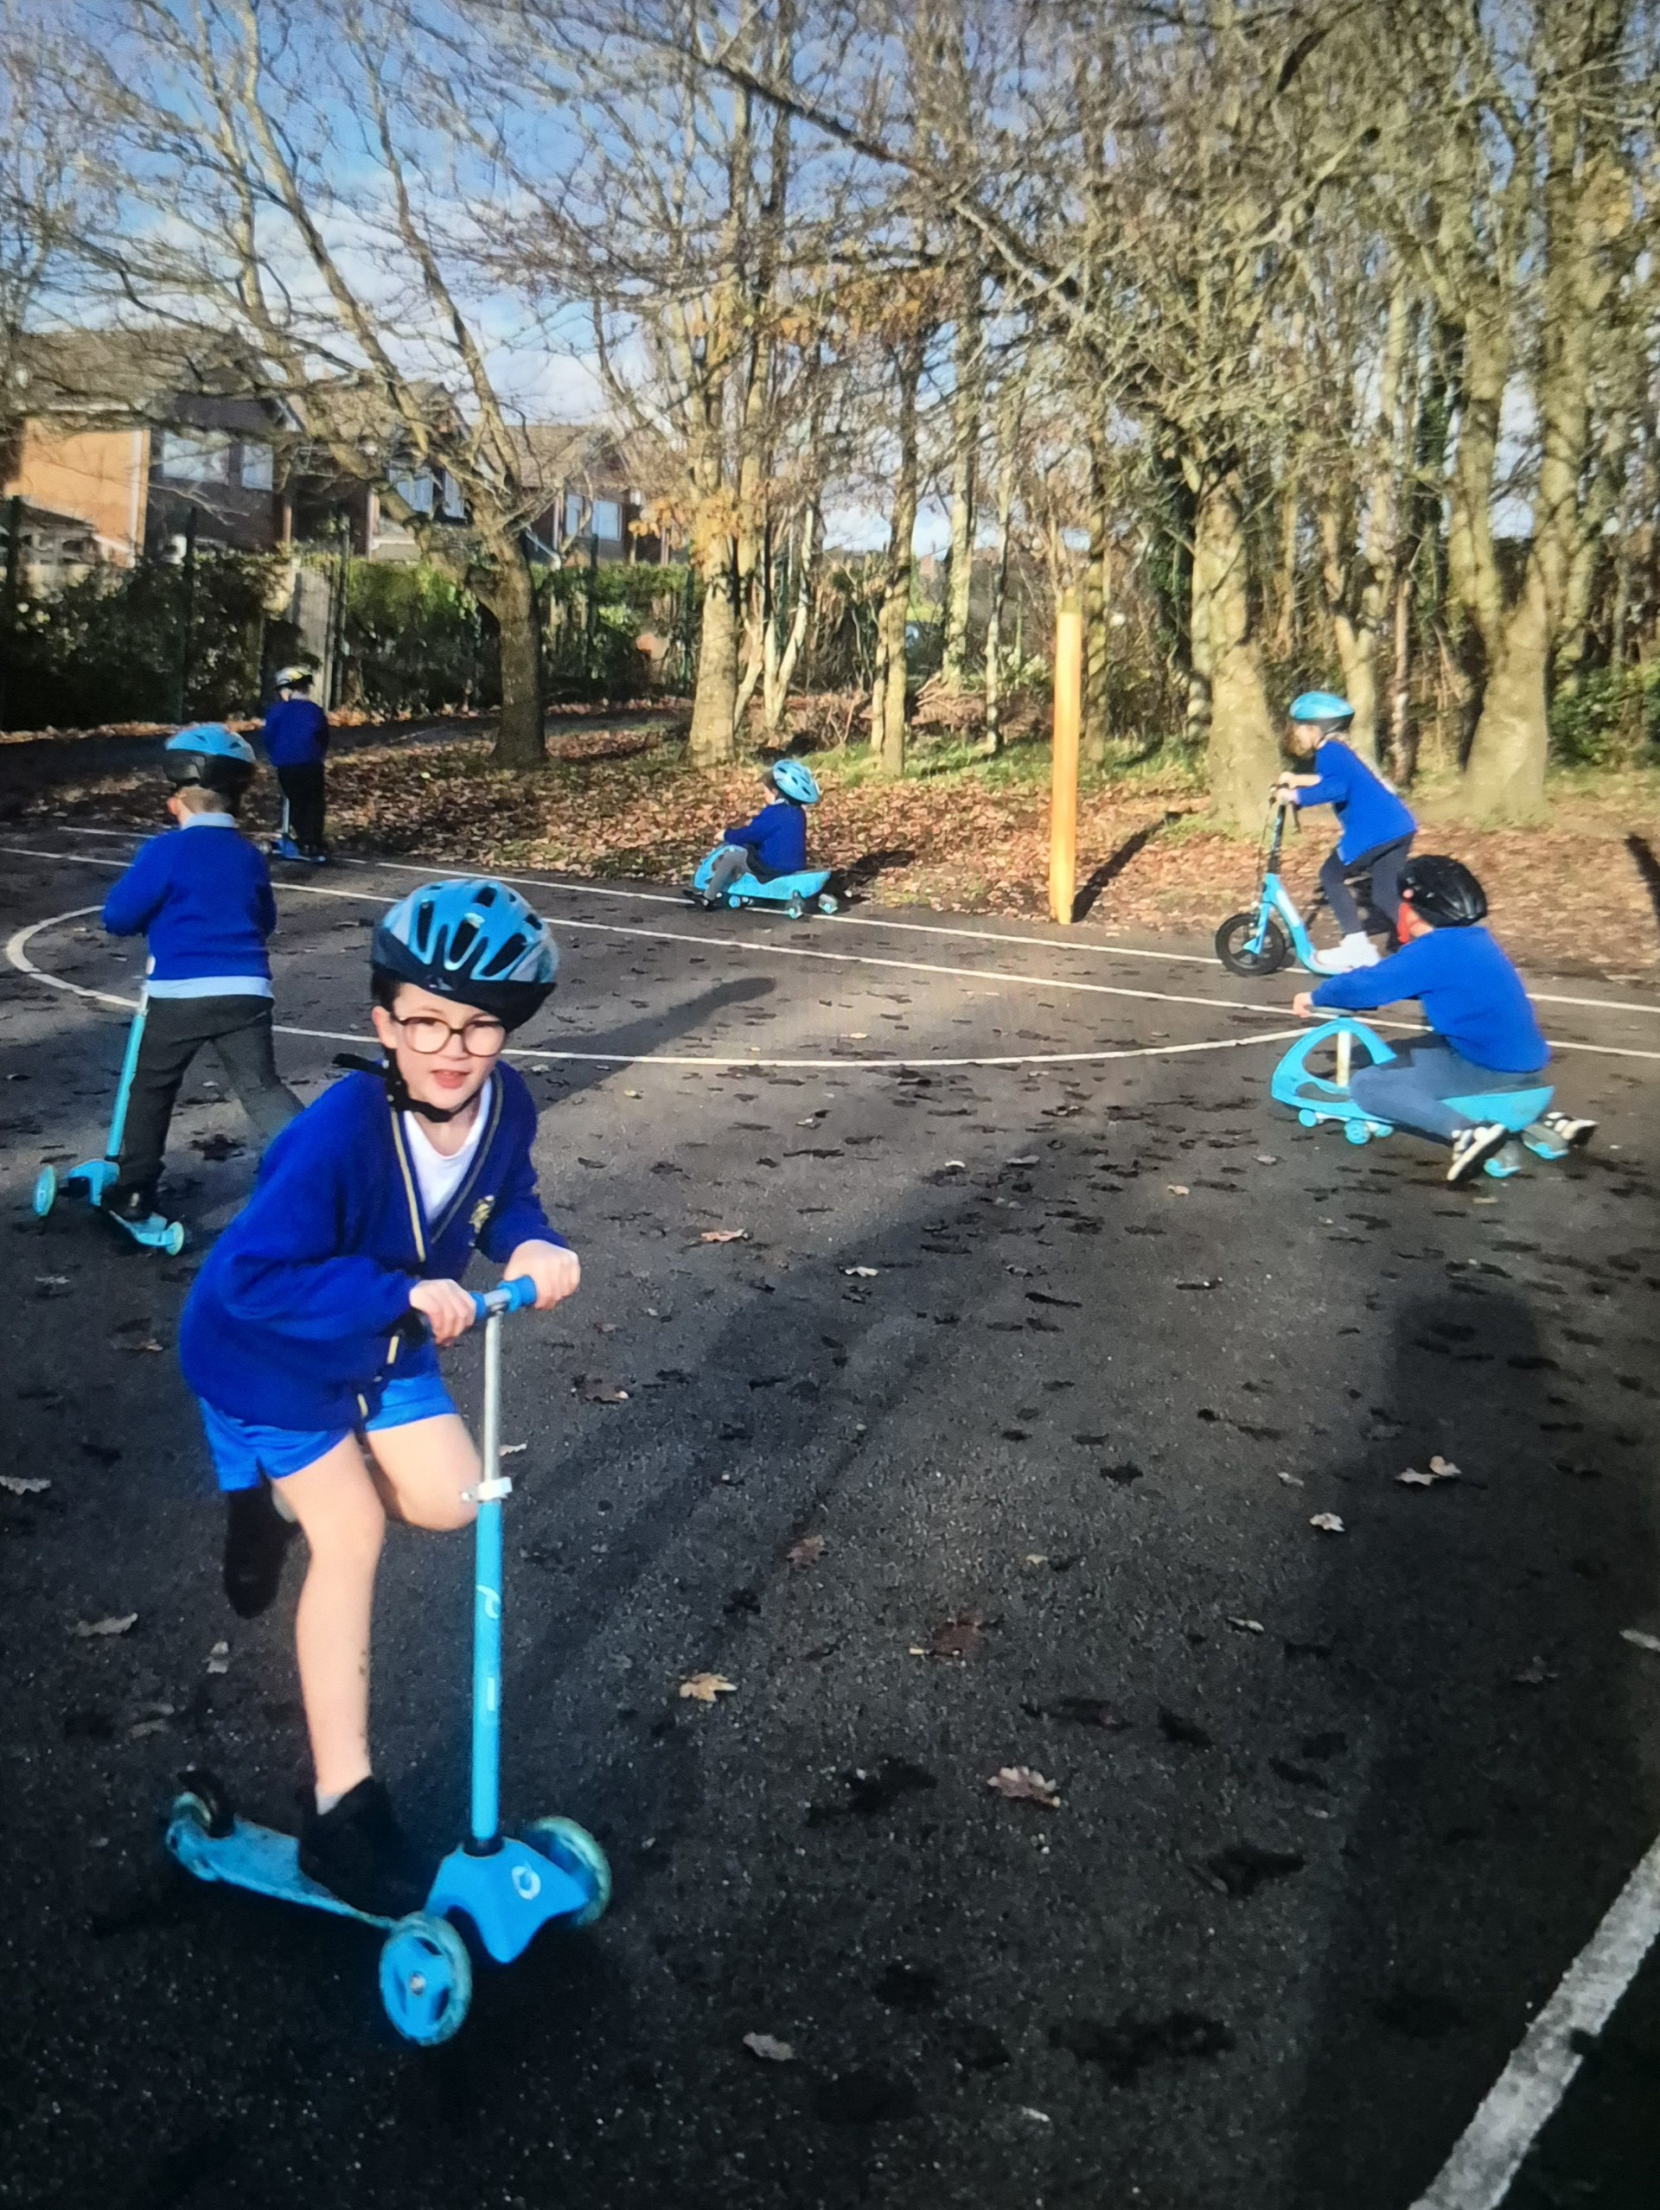
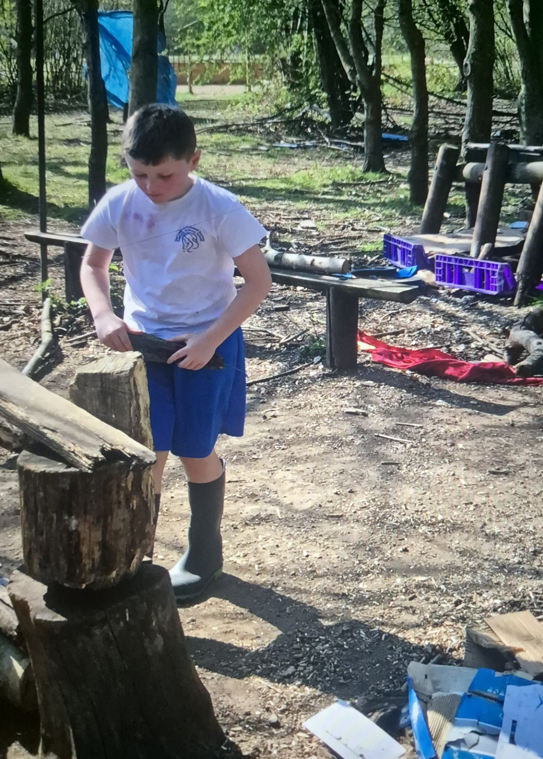

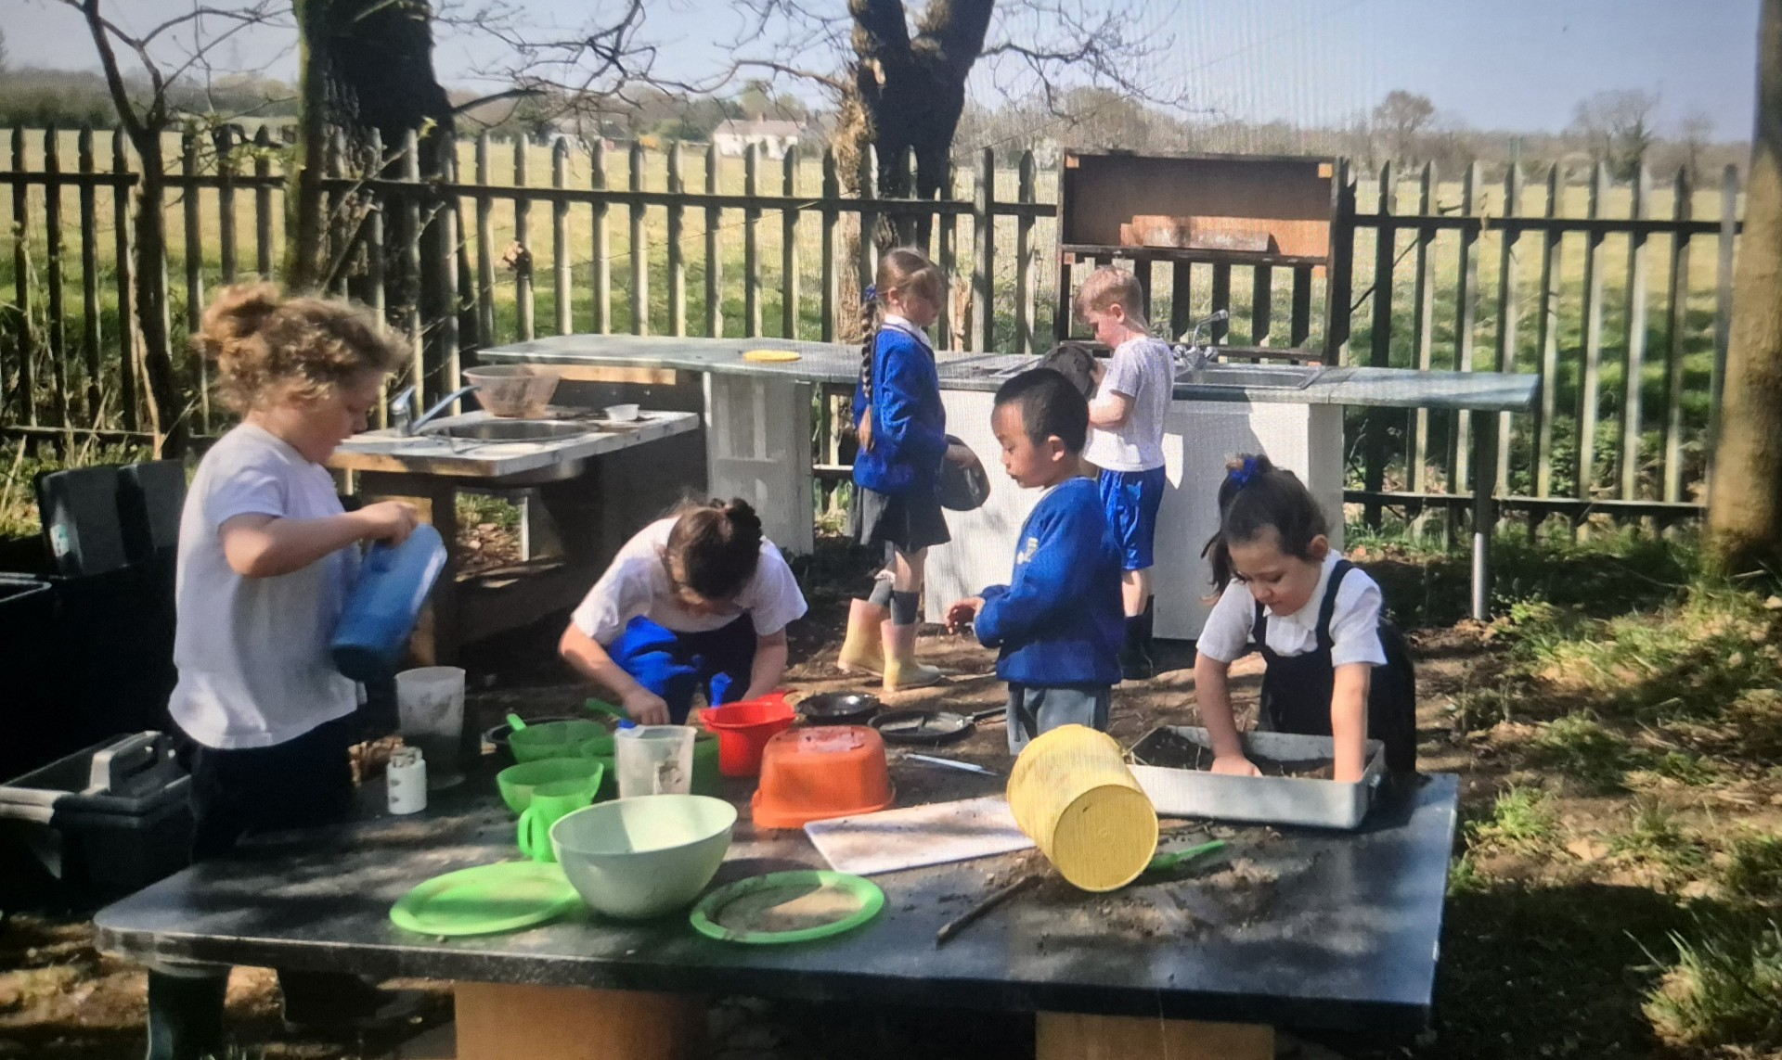
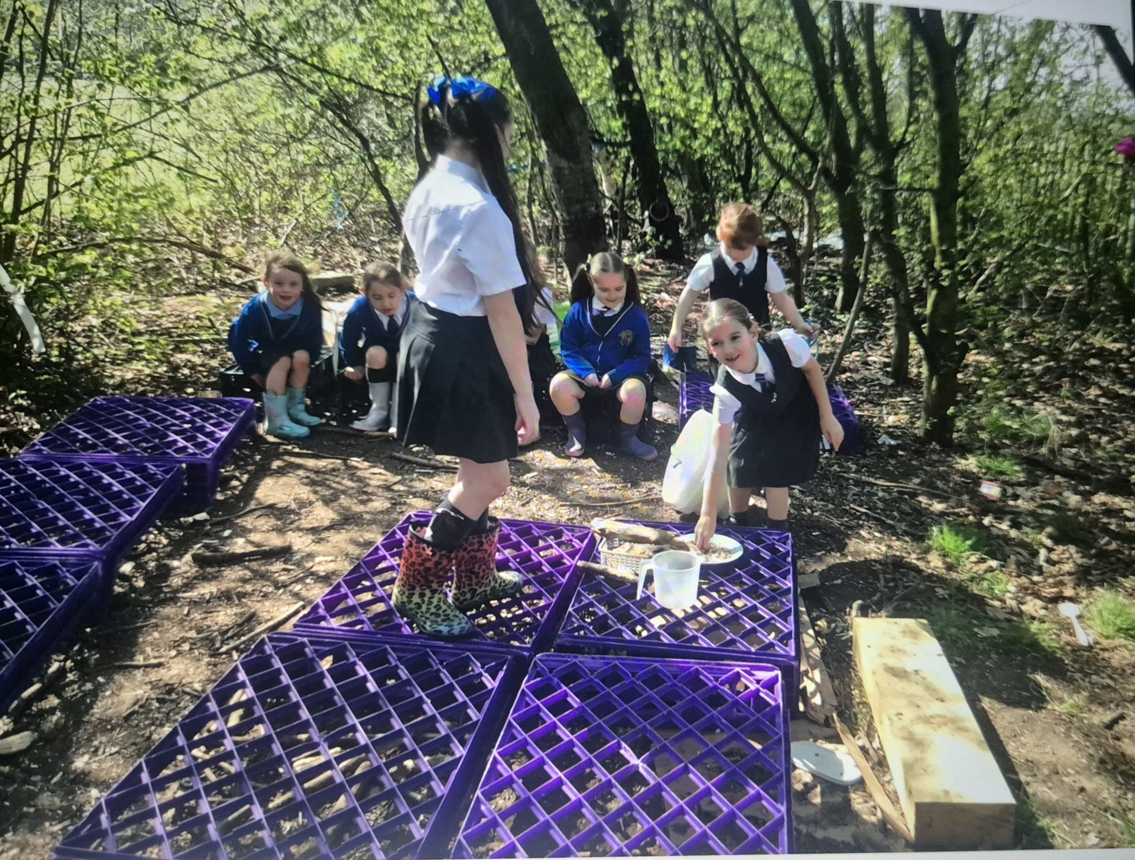
Celebrate
Amazing examples
of play

Slide 4


Celebrate
• We have been given a donation from Halton Helping Hands to develop our grounds.
• We’ve already had lots of donations from families of lots of items that can be used for OPAL play. Thank you!
• We now have storage for all the loose parts.

Slide 5
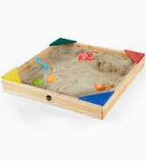
Inform
What will be new over next few weeks?
Construction of our new sand pit will be starting over the next few weeks.

Slide 6

Journeys
Over the next couple of weeks, we are going to be thinking about journeys – these are creative ways we can move from one zone to another when we are outside for OPAL play

Slide 7
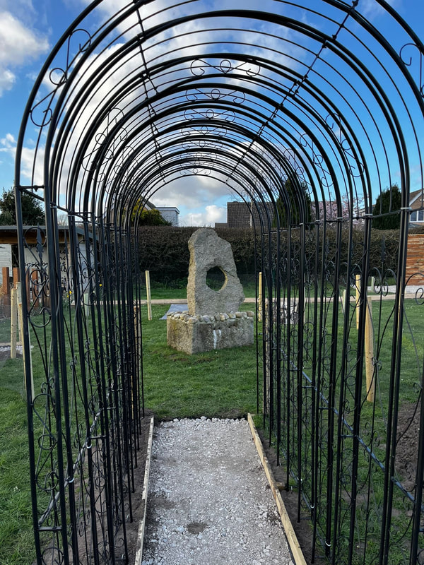
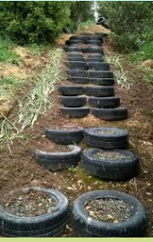

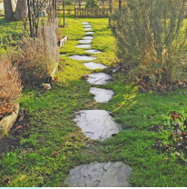
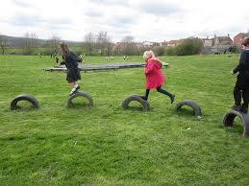
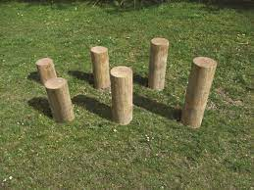

Slide 8

Football
We will introduce football next week (weather dependent) if dry without wellies!
Each class will have their own day.
Year 1 & 2 Monday
Year 6 Tuesday
Year 5 Wednesday
Year 4 Thursday
Year 3 Friday

Slide 9
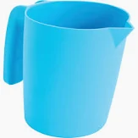
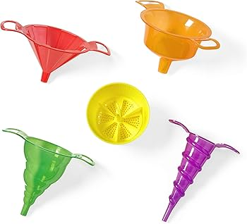
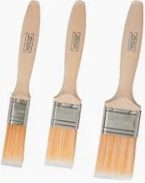
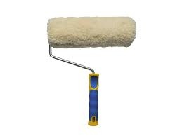
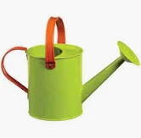
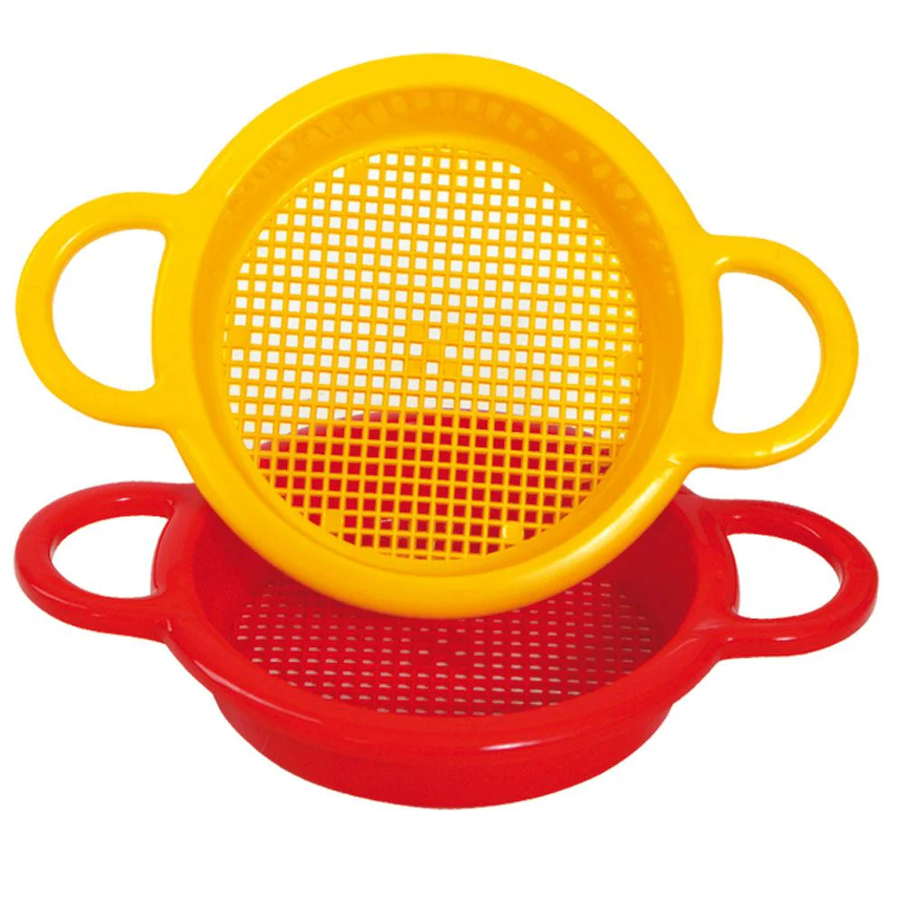
Water Play
In the coming weeks we will introduce a water zone.
How you can help?
We need donations of paint brushes, rollers, watering cans, funnels, jugs.

Slide 10

Negotiate
What new rules do we need for
our existing and new activities
and equipment?

Slide 11
Negotiate
Football:
It is a friendly game of football!
Normal football rules apply keep the ball low.
No deliberate fouls (deliberate kicks).
Be careful when tackling- No tackling too hard or slide tackles.
Only 1 football match in the football area only.
Take it in turns to play different positions.

Slide 12
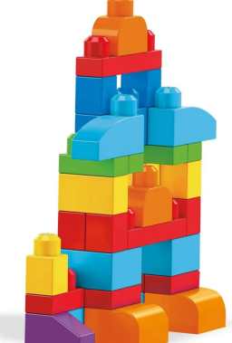
Mega Blocks:
• Think about working together to build something e.g. a tower, a den, a road for the cars, a maze, a robot, a vehicle.
• Don’t take them near the water or mud play.
• If you see pieces on the floor pick them up!
• There isn’t a huge amount so please share.

Slide 13
Cardboard Boxes:
• Build shelters, hide inside or make a den.
• Please don’t tear the boxes up or rip them into pieces – remember that someone else may want to play with them another day.
• No throwing boxes.
• No jumping on the boxes.
• No boxes if it is raining.
• Put all waste in the yellow bin.
• Tidy pile near the storage area at the end of lunch.

Slide 14
Fabric/Dressing Up Clothes
• Design your own outfits, put on a play, turn yourself into a superhero or hold a fashion show.
• Use fabric blankets to make dens.
• Do not swirl the fabric or dressing up clothes around otherwise they’ll get dirty or damaged.
• No wrapping things around your neck.
• Please don't take costumes near the mud or wet.
• Put all the fabric/dressing up items away in the box at the end of lunch.

Slide 15
Tidying Up
• Everybody has to tidy up at the end of lunch.
• Listen for the whistle 5 minutes before the end of lunch.
• Look around and help each others to put everything away.
• Even if you have not played with something, please help to tidy up.
• Make sure everything goes back to where it belongs.
• Put it carefully into the storage boxes, take care as some storage boxes are damaged.

Slide 16
Innovate
How can we use some of the items outside in woods, playground?
What could you do or make?

Slide 17

Lunchtime behaviour recognition
Certificate
The MDA’s will choose a child each week for excellent behaviour, great manners or being helpful and you will now receive an OPAL certificate in Friday assembly.
assembly.

Slide 18
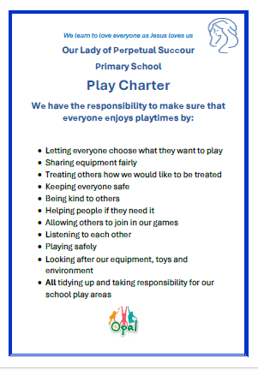
OPAL AWARD
To
_____________________________________
You have been recognised for going
above and beyond during lunchtimes.
Thank you for setting an excellent example and always following our play charter rules.
Signed
_______________________________

