Slide 1

Welcome to
Our Lady of Perpetual Succour Catholic Primary School

Slide 2
Introductions
Mrs McGuffie - Headteacher
Mrs Donnelly – Deputy Headteacher
Mrs Heston- Special Education Needs Coordinator (SENCO)
Miss Beckett – Reception Teacher
Miss Morris – Teaching Assistant
Mrs Stanley - Office Manager
Mrs Houghton- Administrative Assistant

Slide 3
Our aim for when your child starts school
To become settled in their new class.
To make new friendships.
To feel happy and confident.
To become familiar with the routine.
To become familiar with the class teachers/staff at Our Lady's.

Slide 4

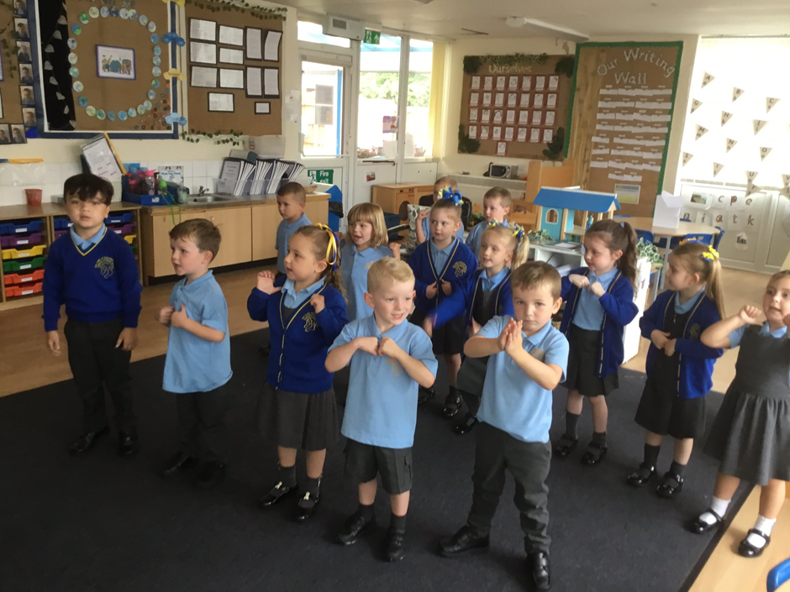
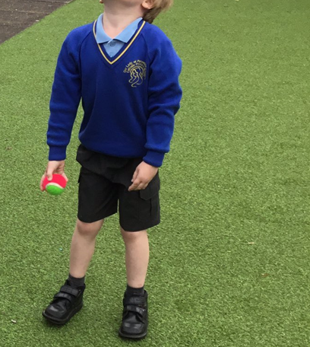
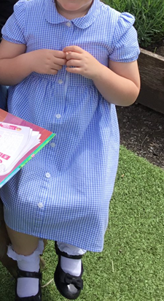
School Uniform
Boys
Blue polo shirt
Grey trousers
Grey shorts (Summer)
Blue jumper with school crest.
Grey socks
Black shoes
Girls
Blue polo shirt
Grey skirt or dress
Blue cardigan with school crest
Grey/ white socks or grey tights
Black shoes
Blue and white dress (Summer)

Slide 5
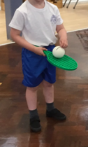
PE Uniform
Blue shorts
White t-shirt with
school crest
Black pumps
Please put your child’s PE kit in a labelled PE bag.
No earrings or jewellery

Slide 6


Clothing for the Outdoor Area
Children will be learning in the outdoor area, we would ask you to provide appropriate clothing for this.
Please bring in:
A large oversized t-shirt
A pair of wellies
These can then be kept in school.
Please ensure all clothing is clearly
labelled with your child's name on them.

Slide 7


The Early Years Foundation Stage

Slide 8
Communication between home and school
Direct communication with staff
School office
Newsletters
School website
Reading record
‘Stay and Play’ sessions
Twitter
Earwig

Slide 9
Homework and reading book
Individual reading book – Sent home on Monday and brought back on Friday.
Homework – Sent home on Monday and brought back on Friday.
Reading books must be returned each week.

Slide 10

Snack Money
Snack money is paid via school COMMS online system, children do not need to bring in any money.
Water Bottle
Please ensure your child brings in
a full bottle of water into school.
We ask you not to bring in any nuts in your child’s packed lunch as there are children with nut allergies.

Slide 11
Key Dates
School visits- 27th June 9:15 / 1:15
4th July 9:15 / 1:15
Parent Interviews- Monday 11th July
Tuesday 12th July
Part time sessions- w/b Monday 5th September AM/ PM
w/b Monday 12th September AM/ PM
Start school full time- Monday 19th September 8:30/8:45

Slide 12
Thank you for coming
Please take home your
child’s information pack which has further information and key dates

