Slide 1
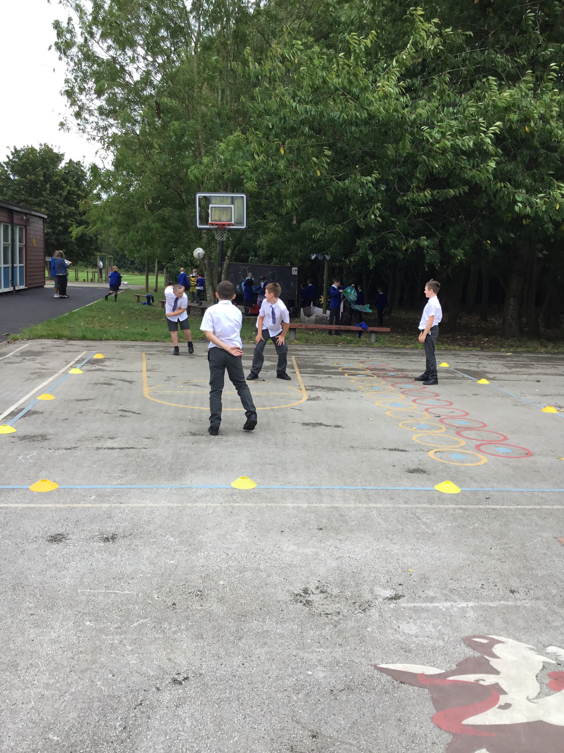
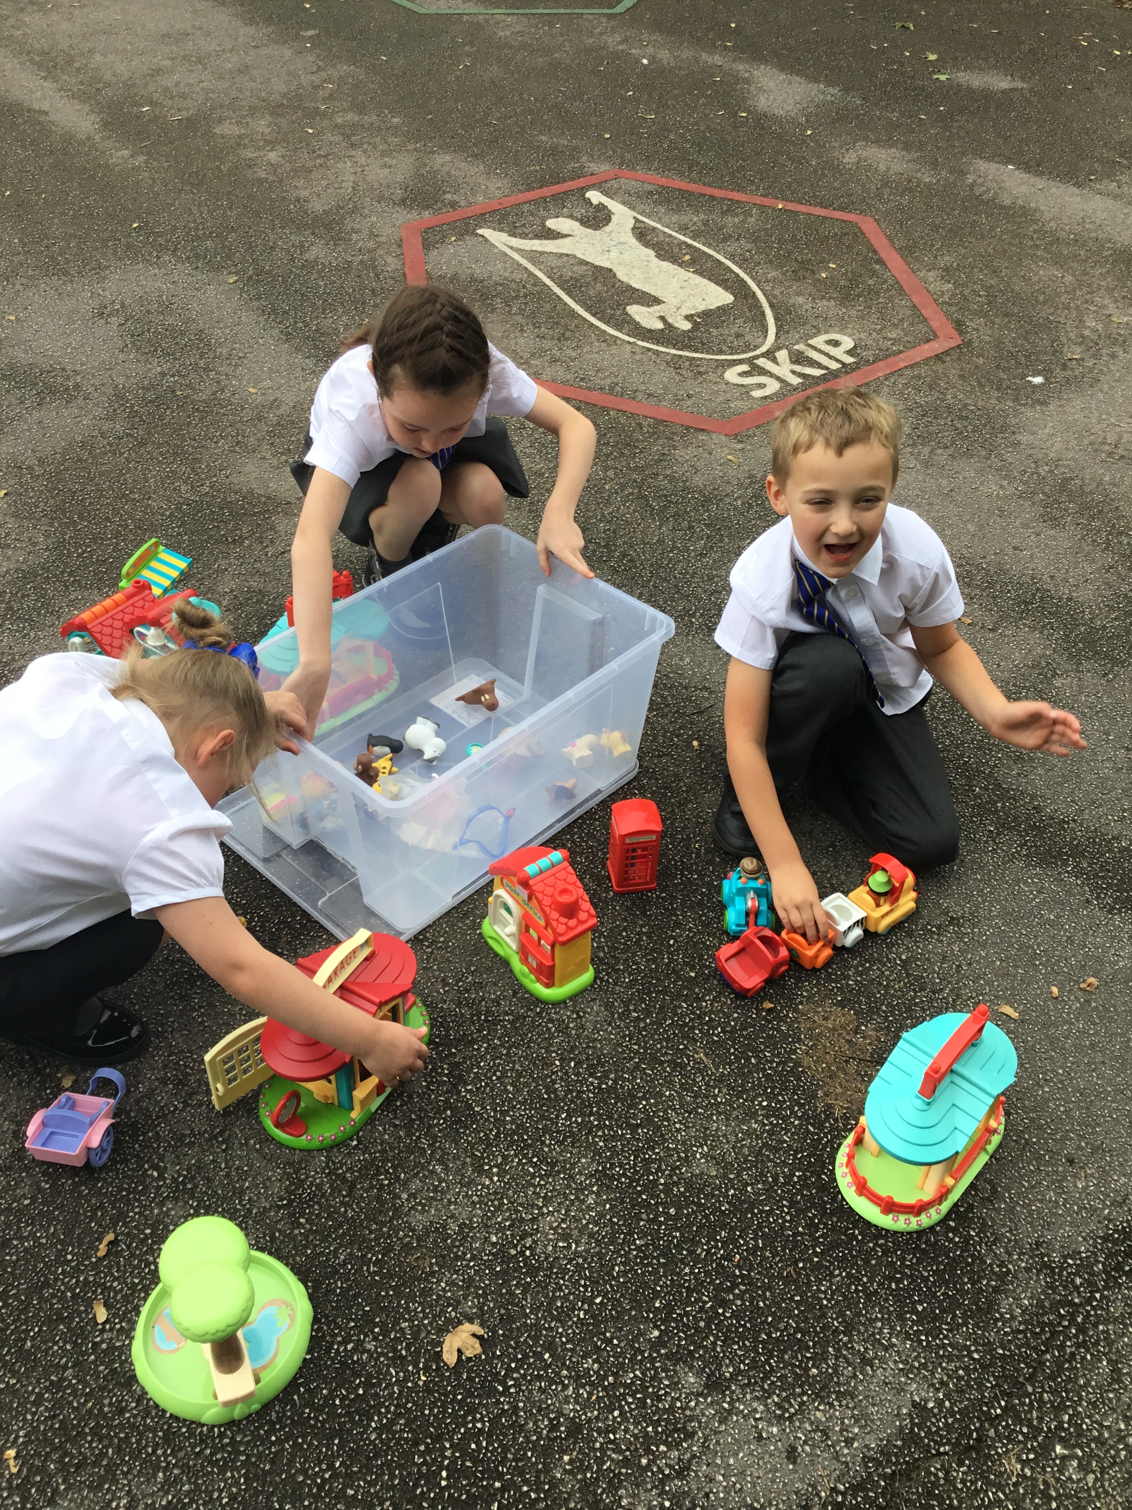
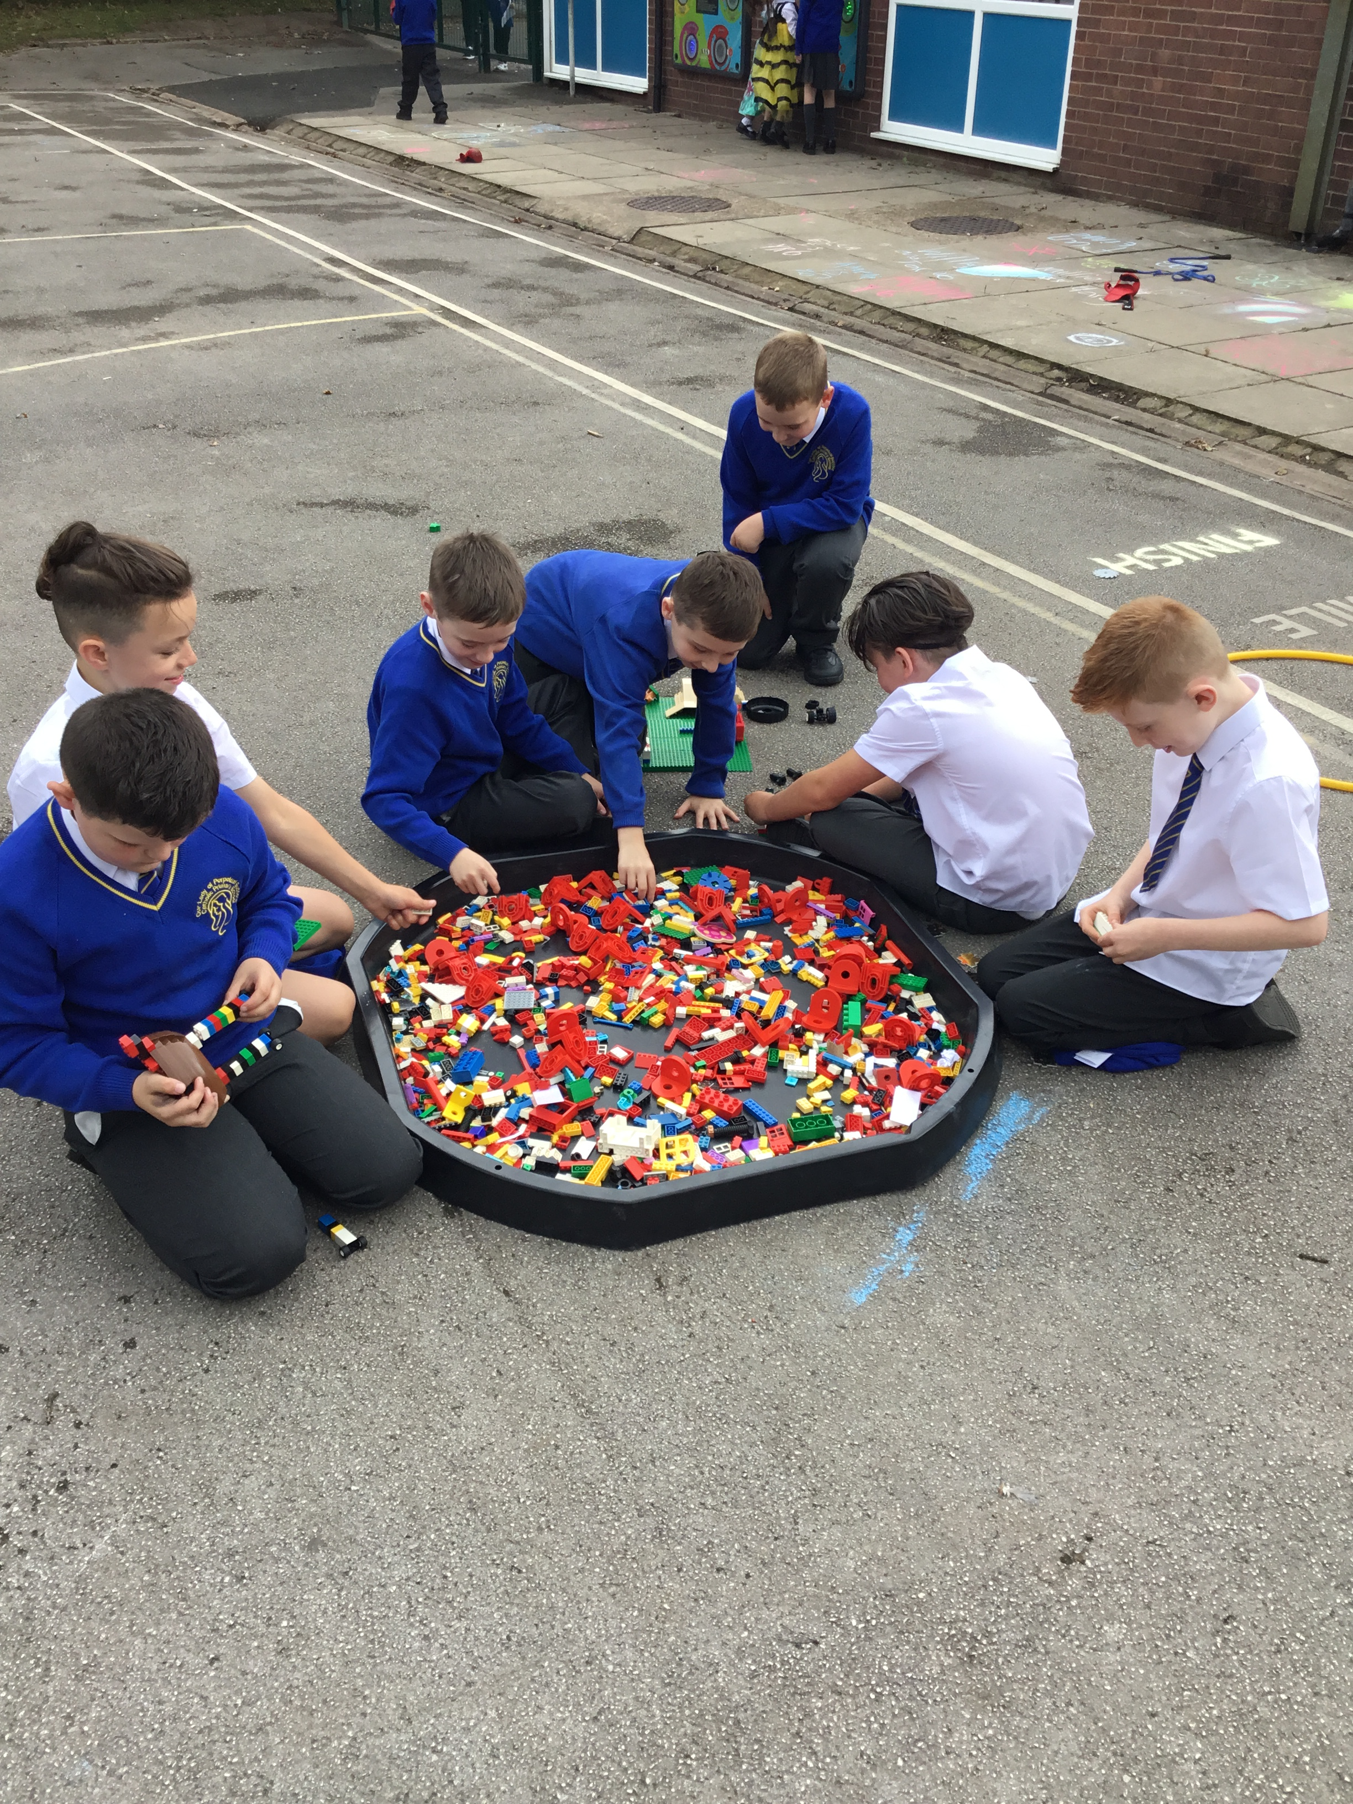


OPAL Play
Assembly

Slide 2
What do we have to do to make
sure that everyone enjoys their play?

Slide 3
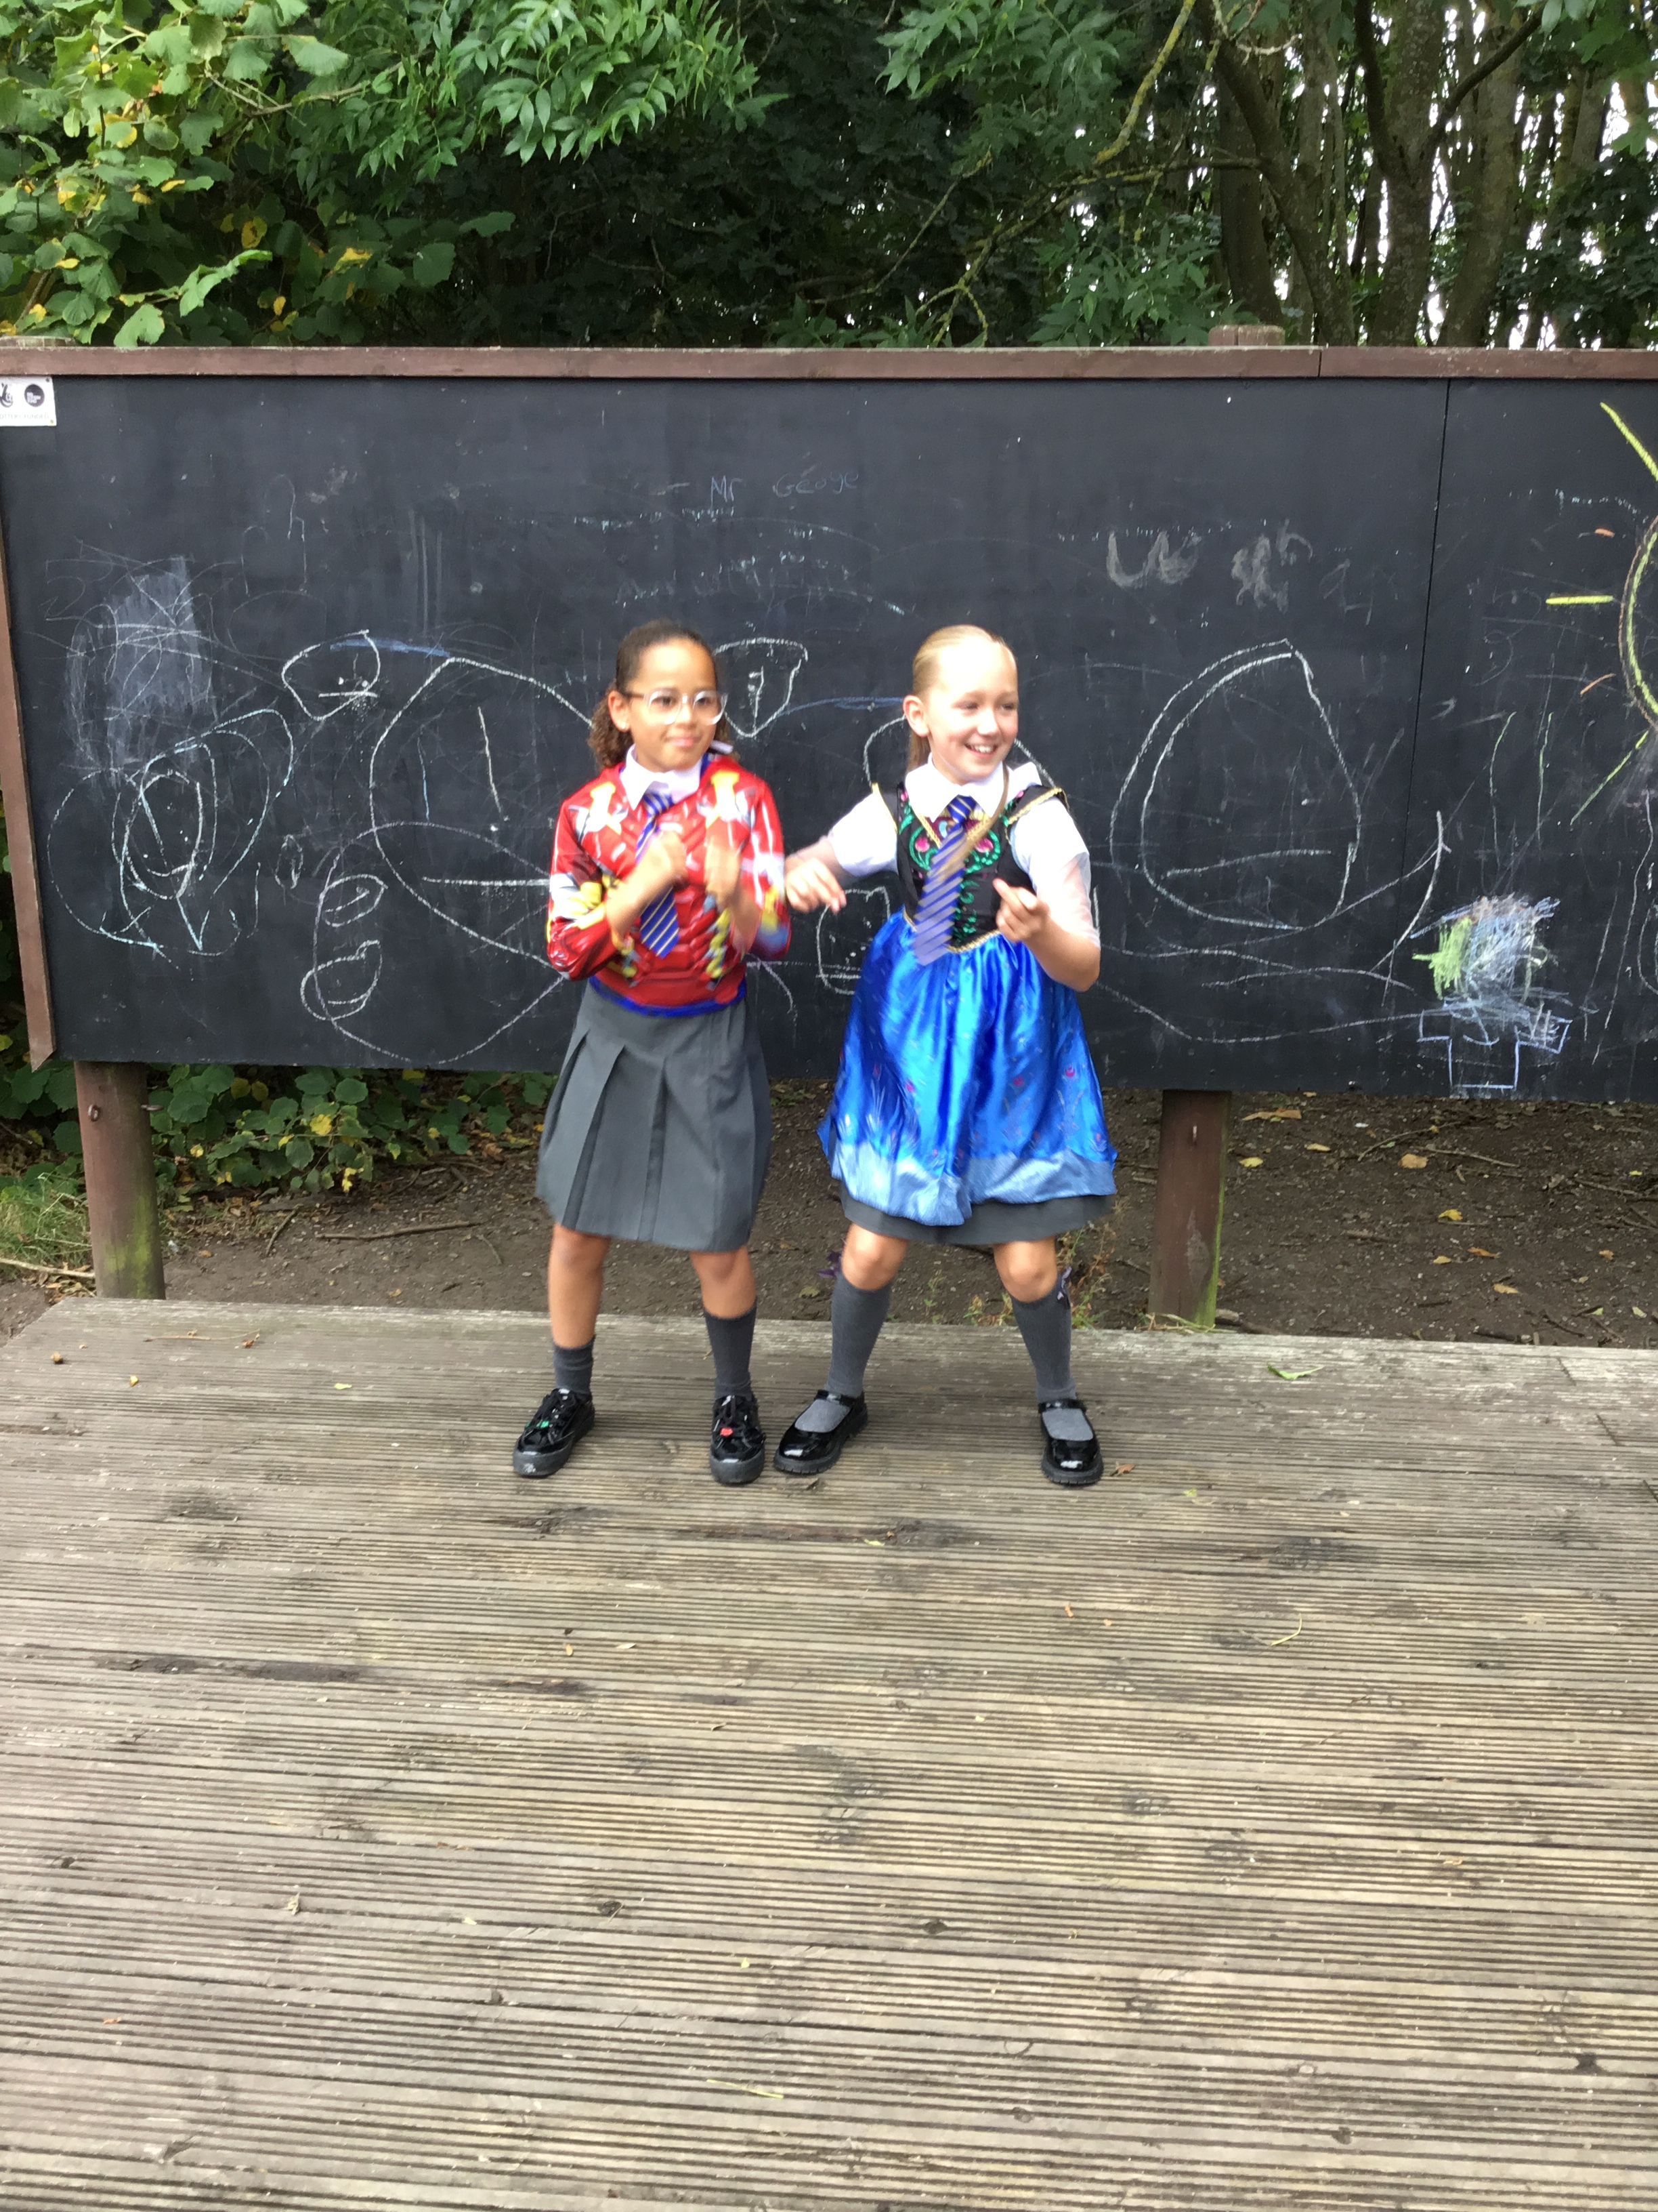
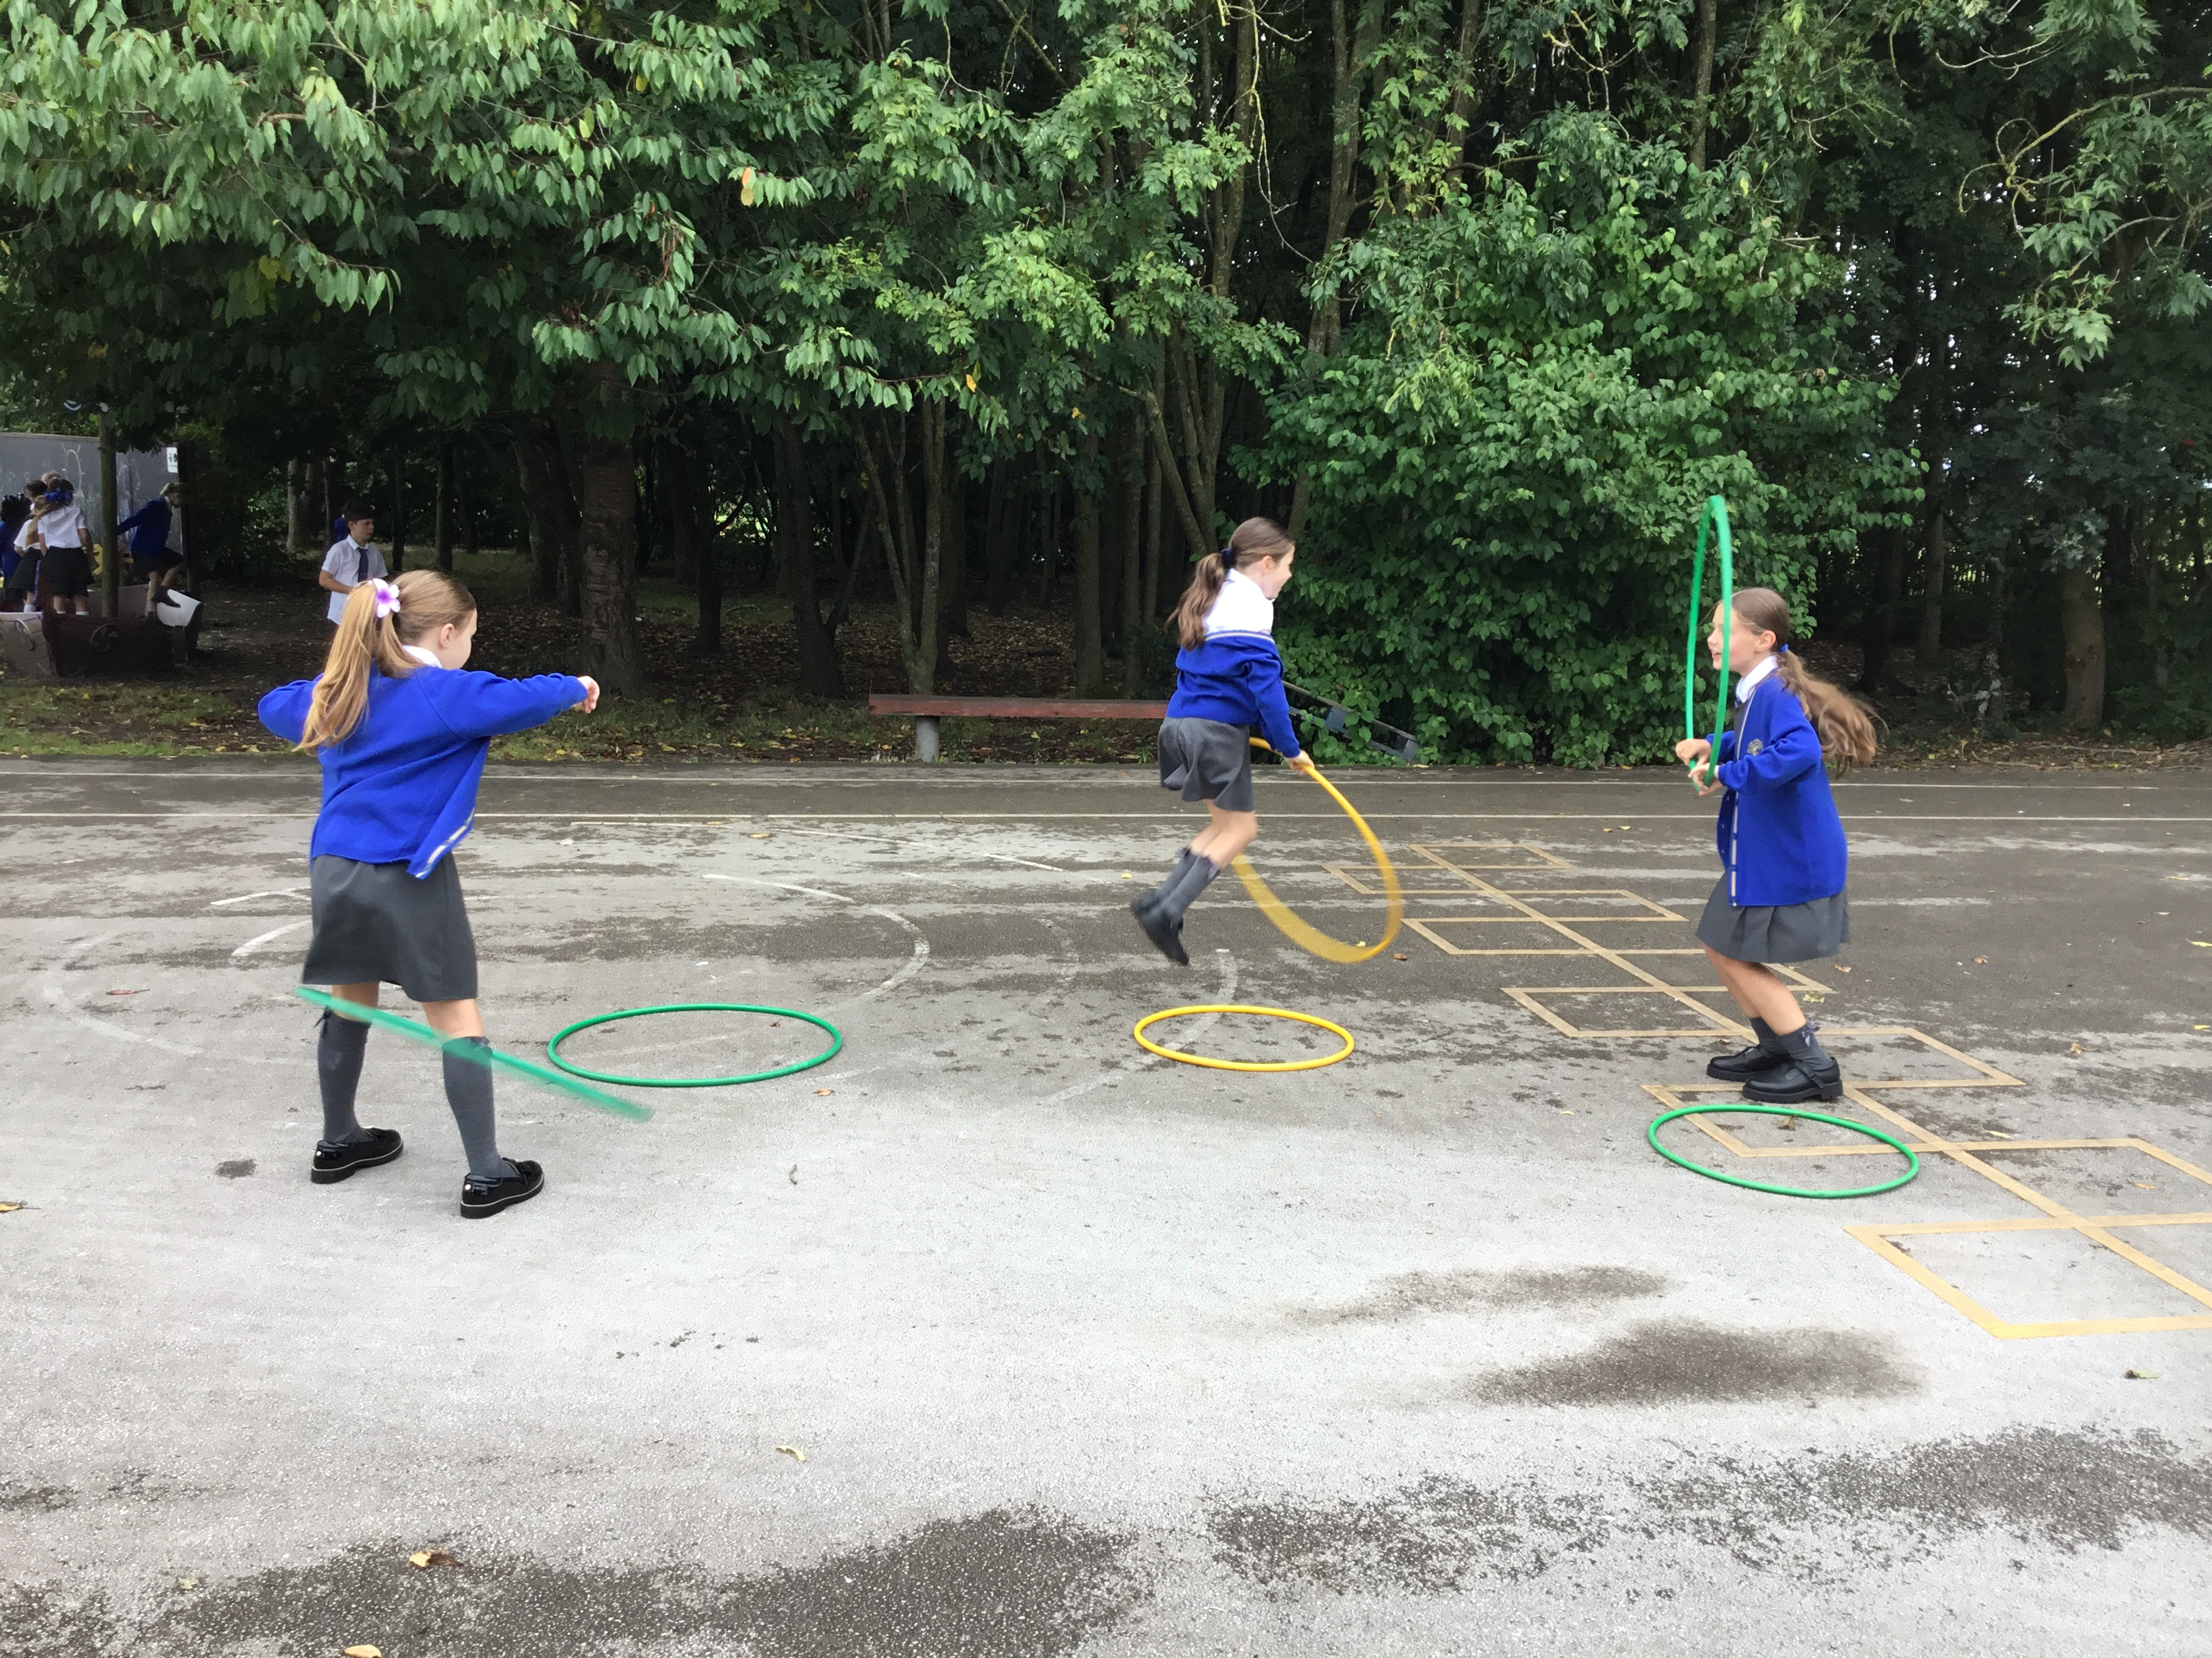
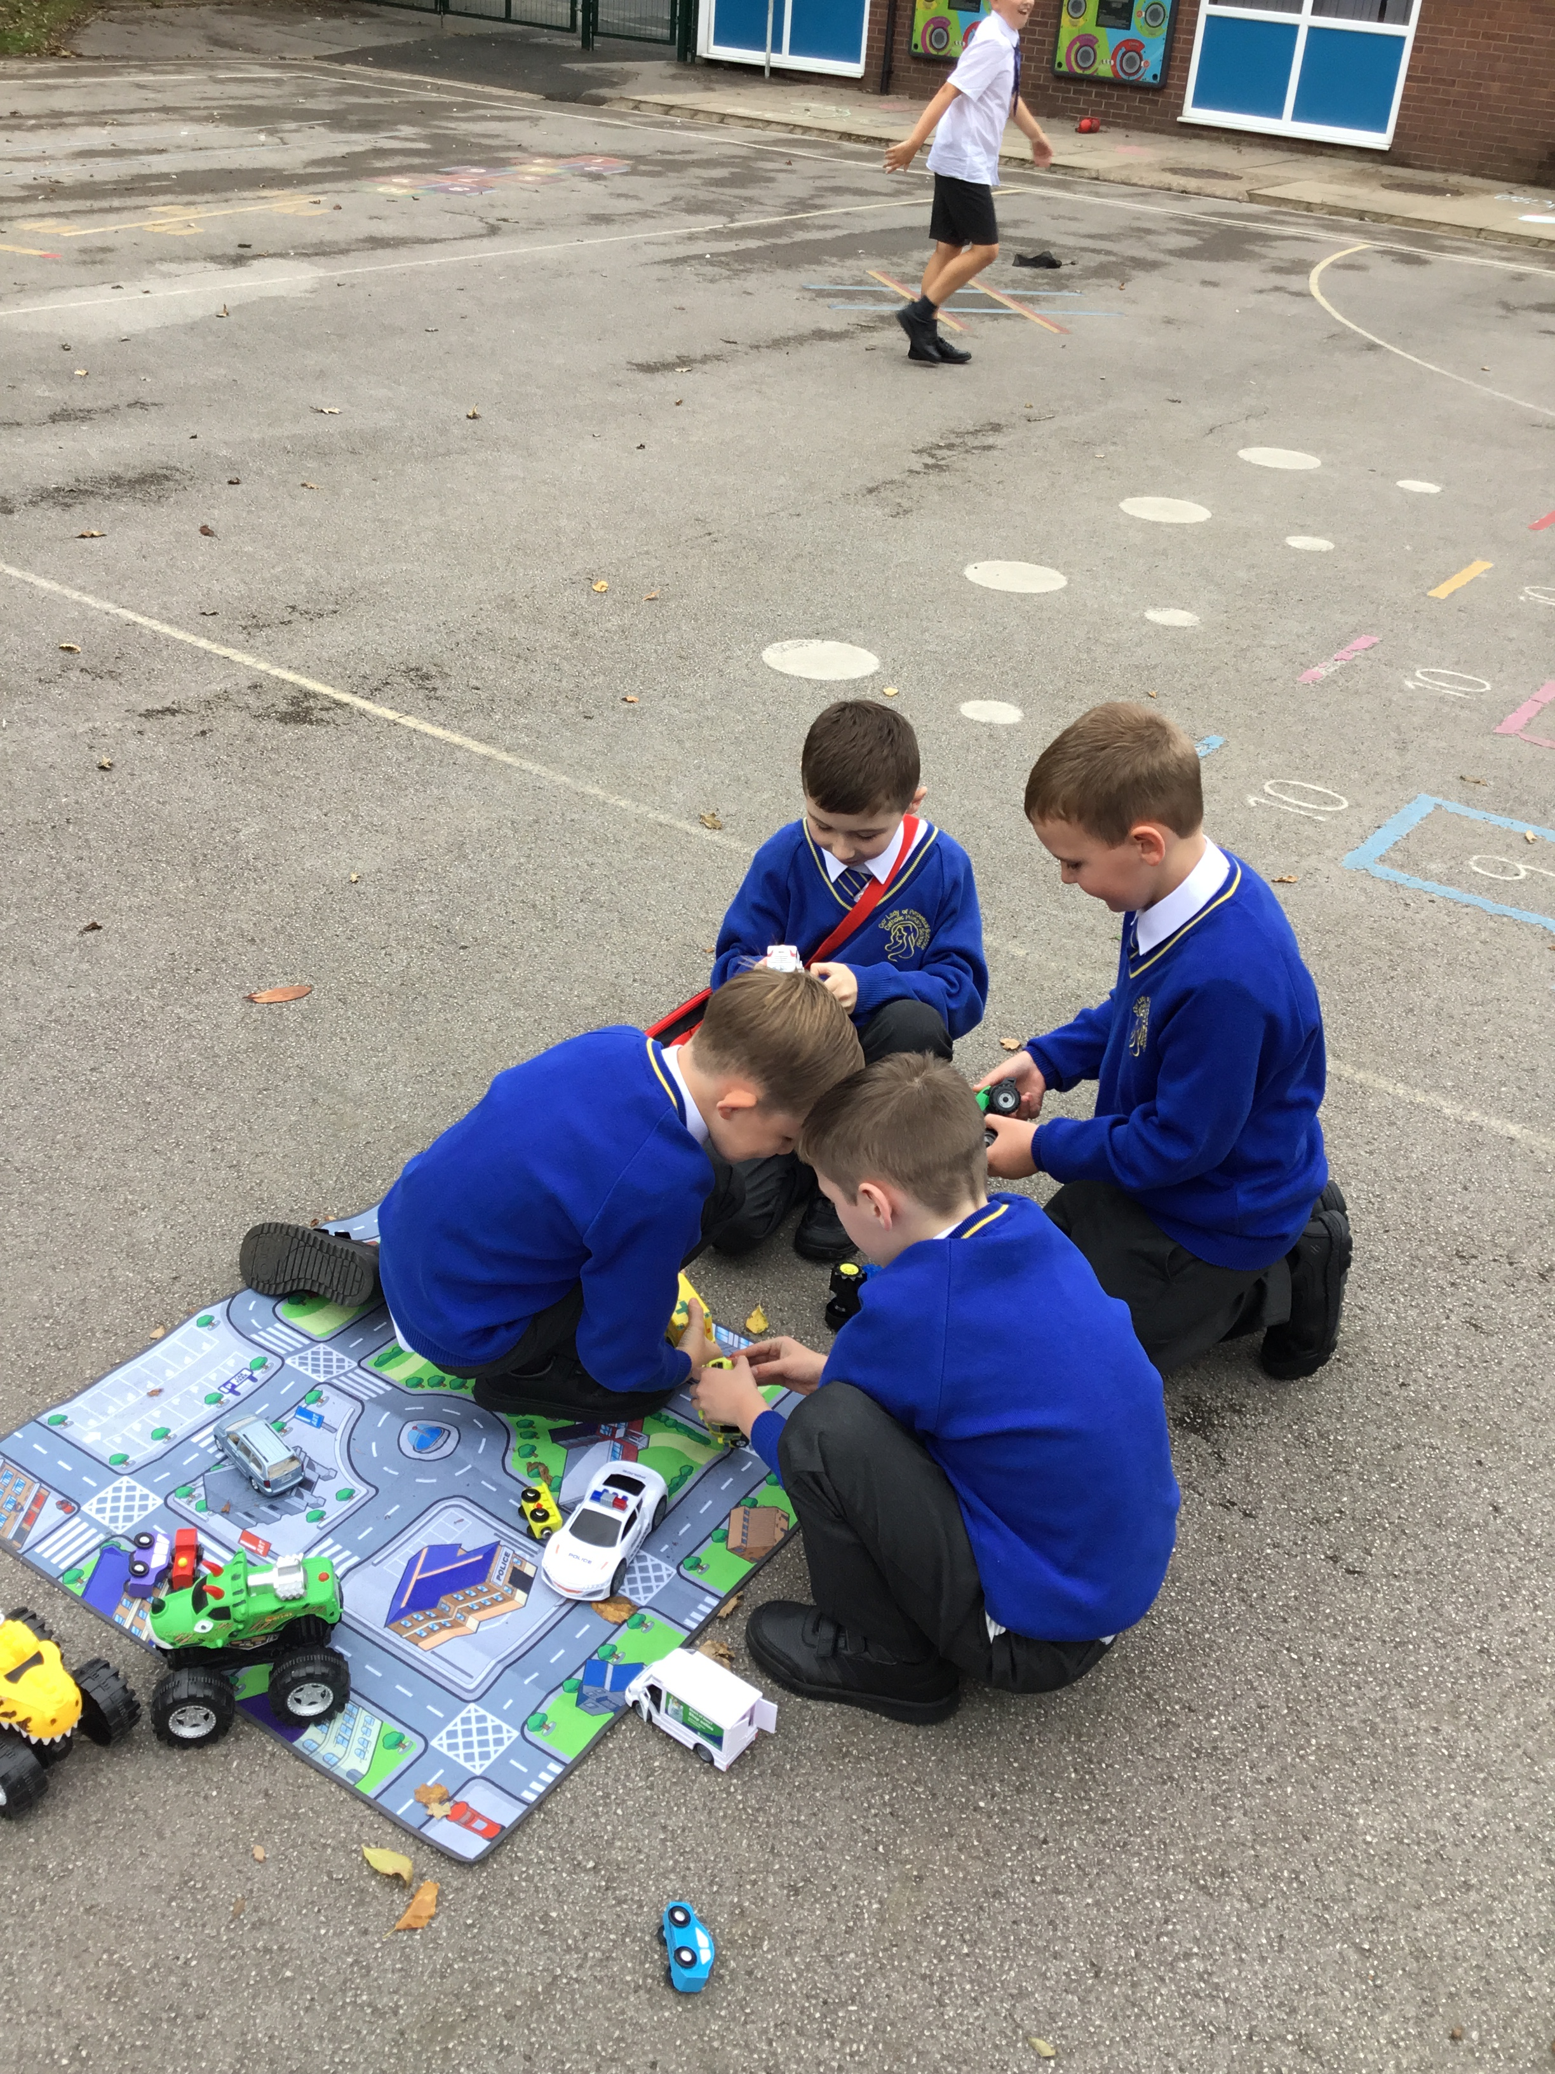
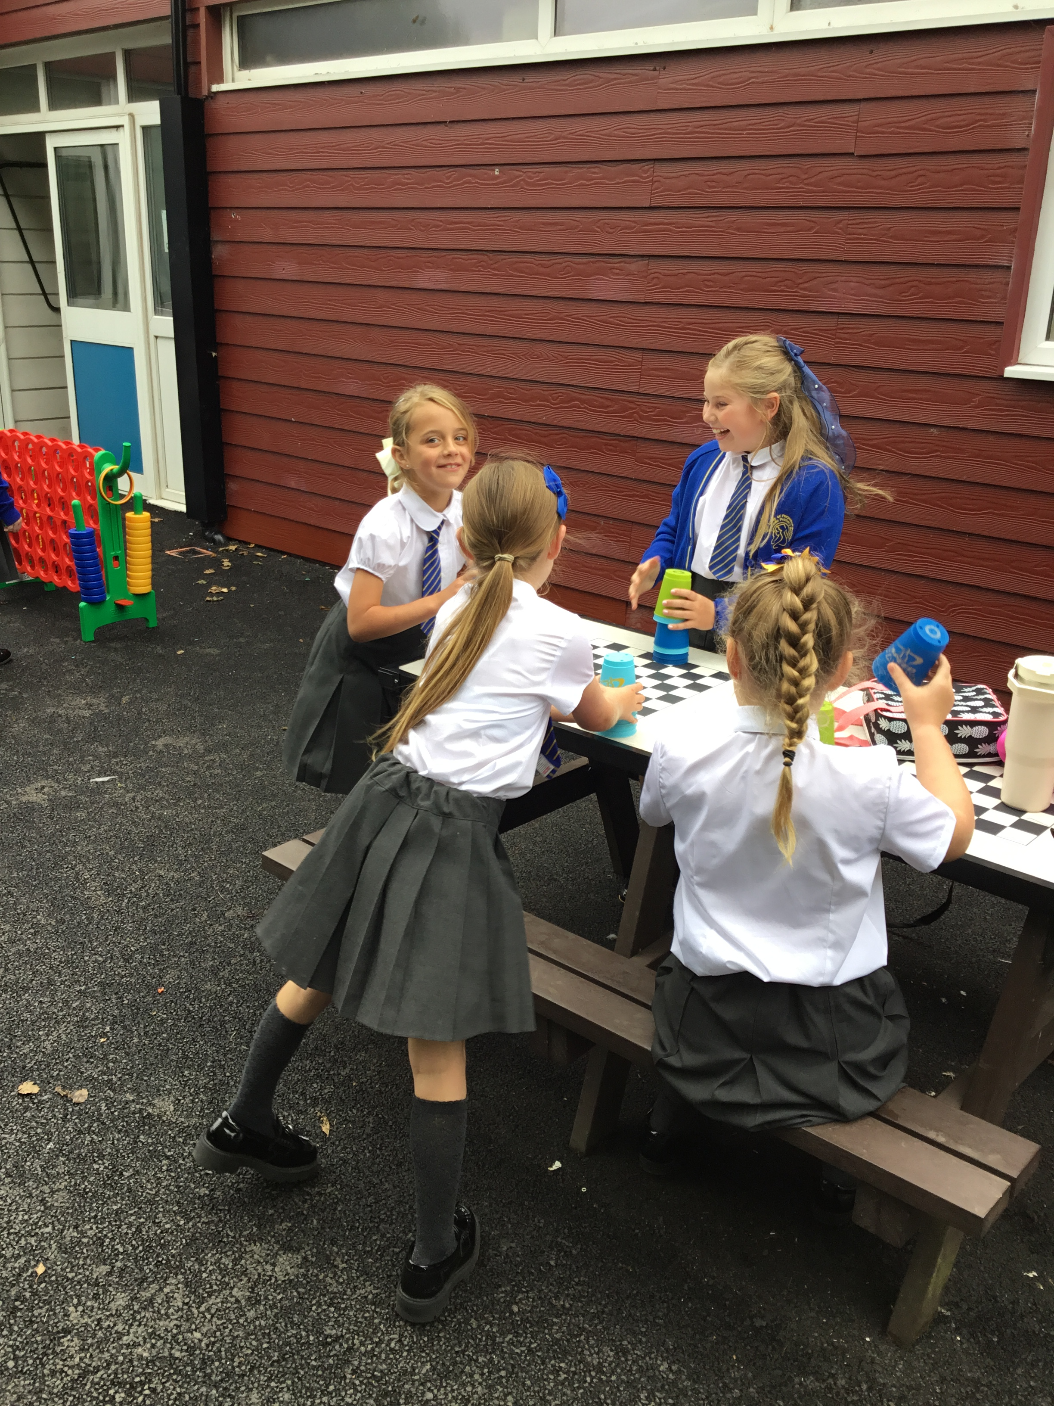

Celebrate
Amazing examples
of play

Slide 4
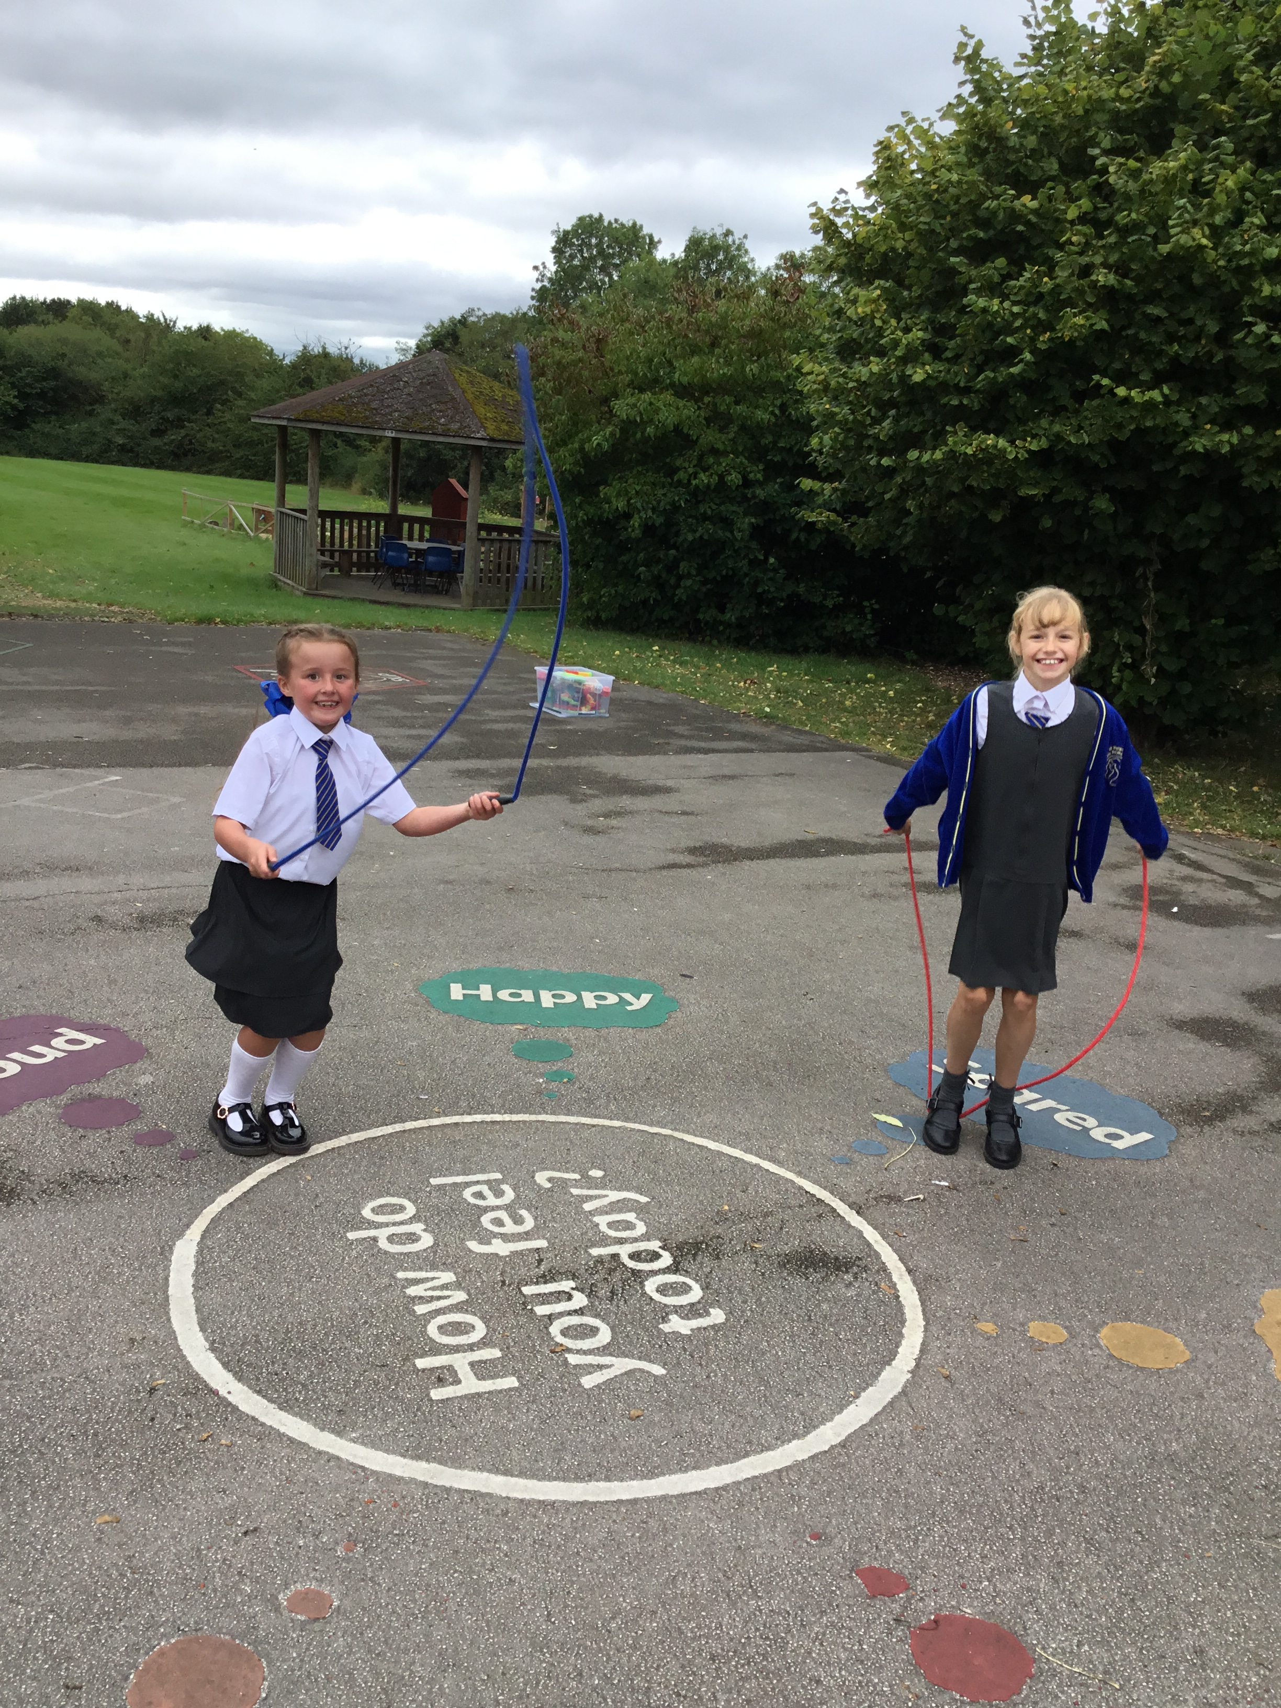
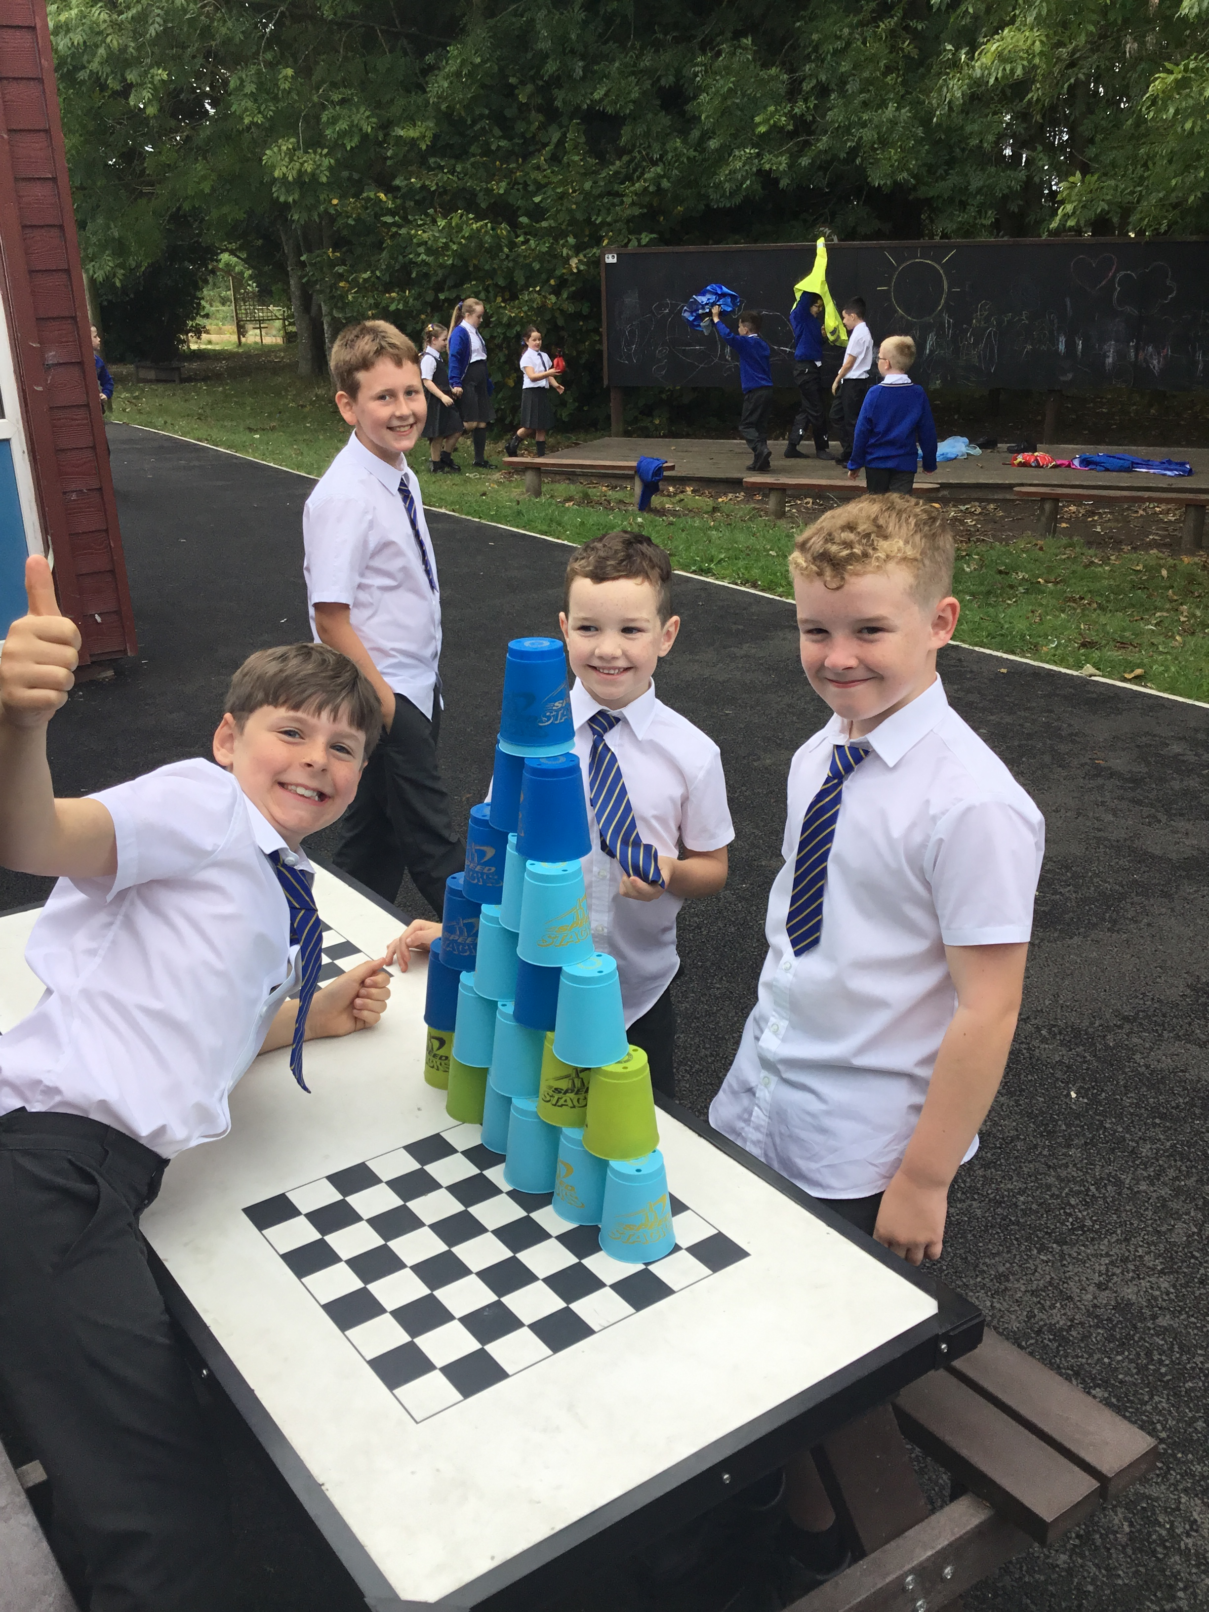
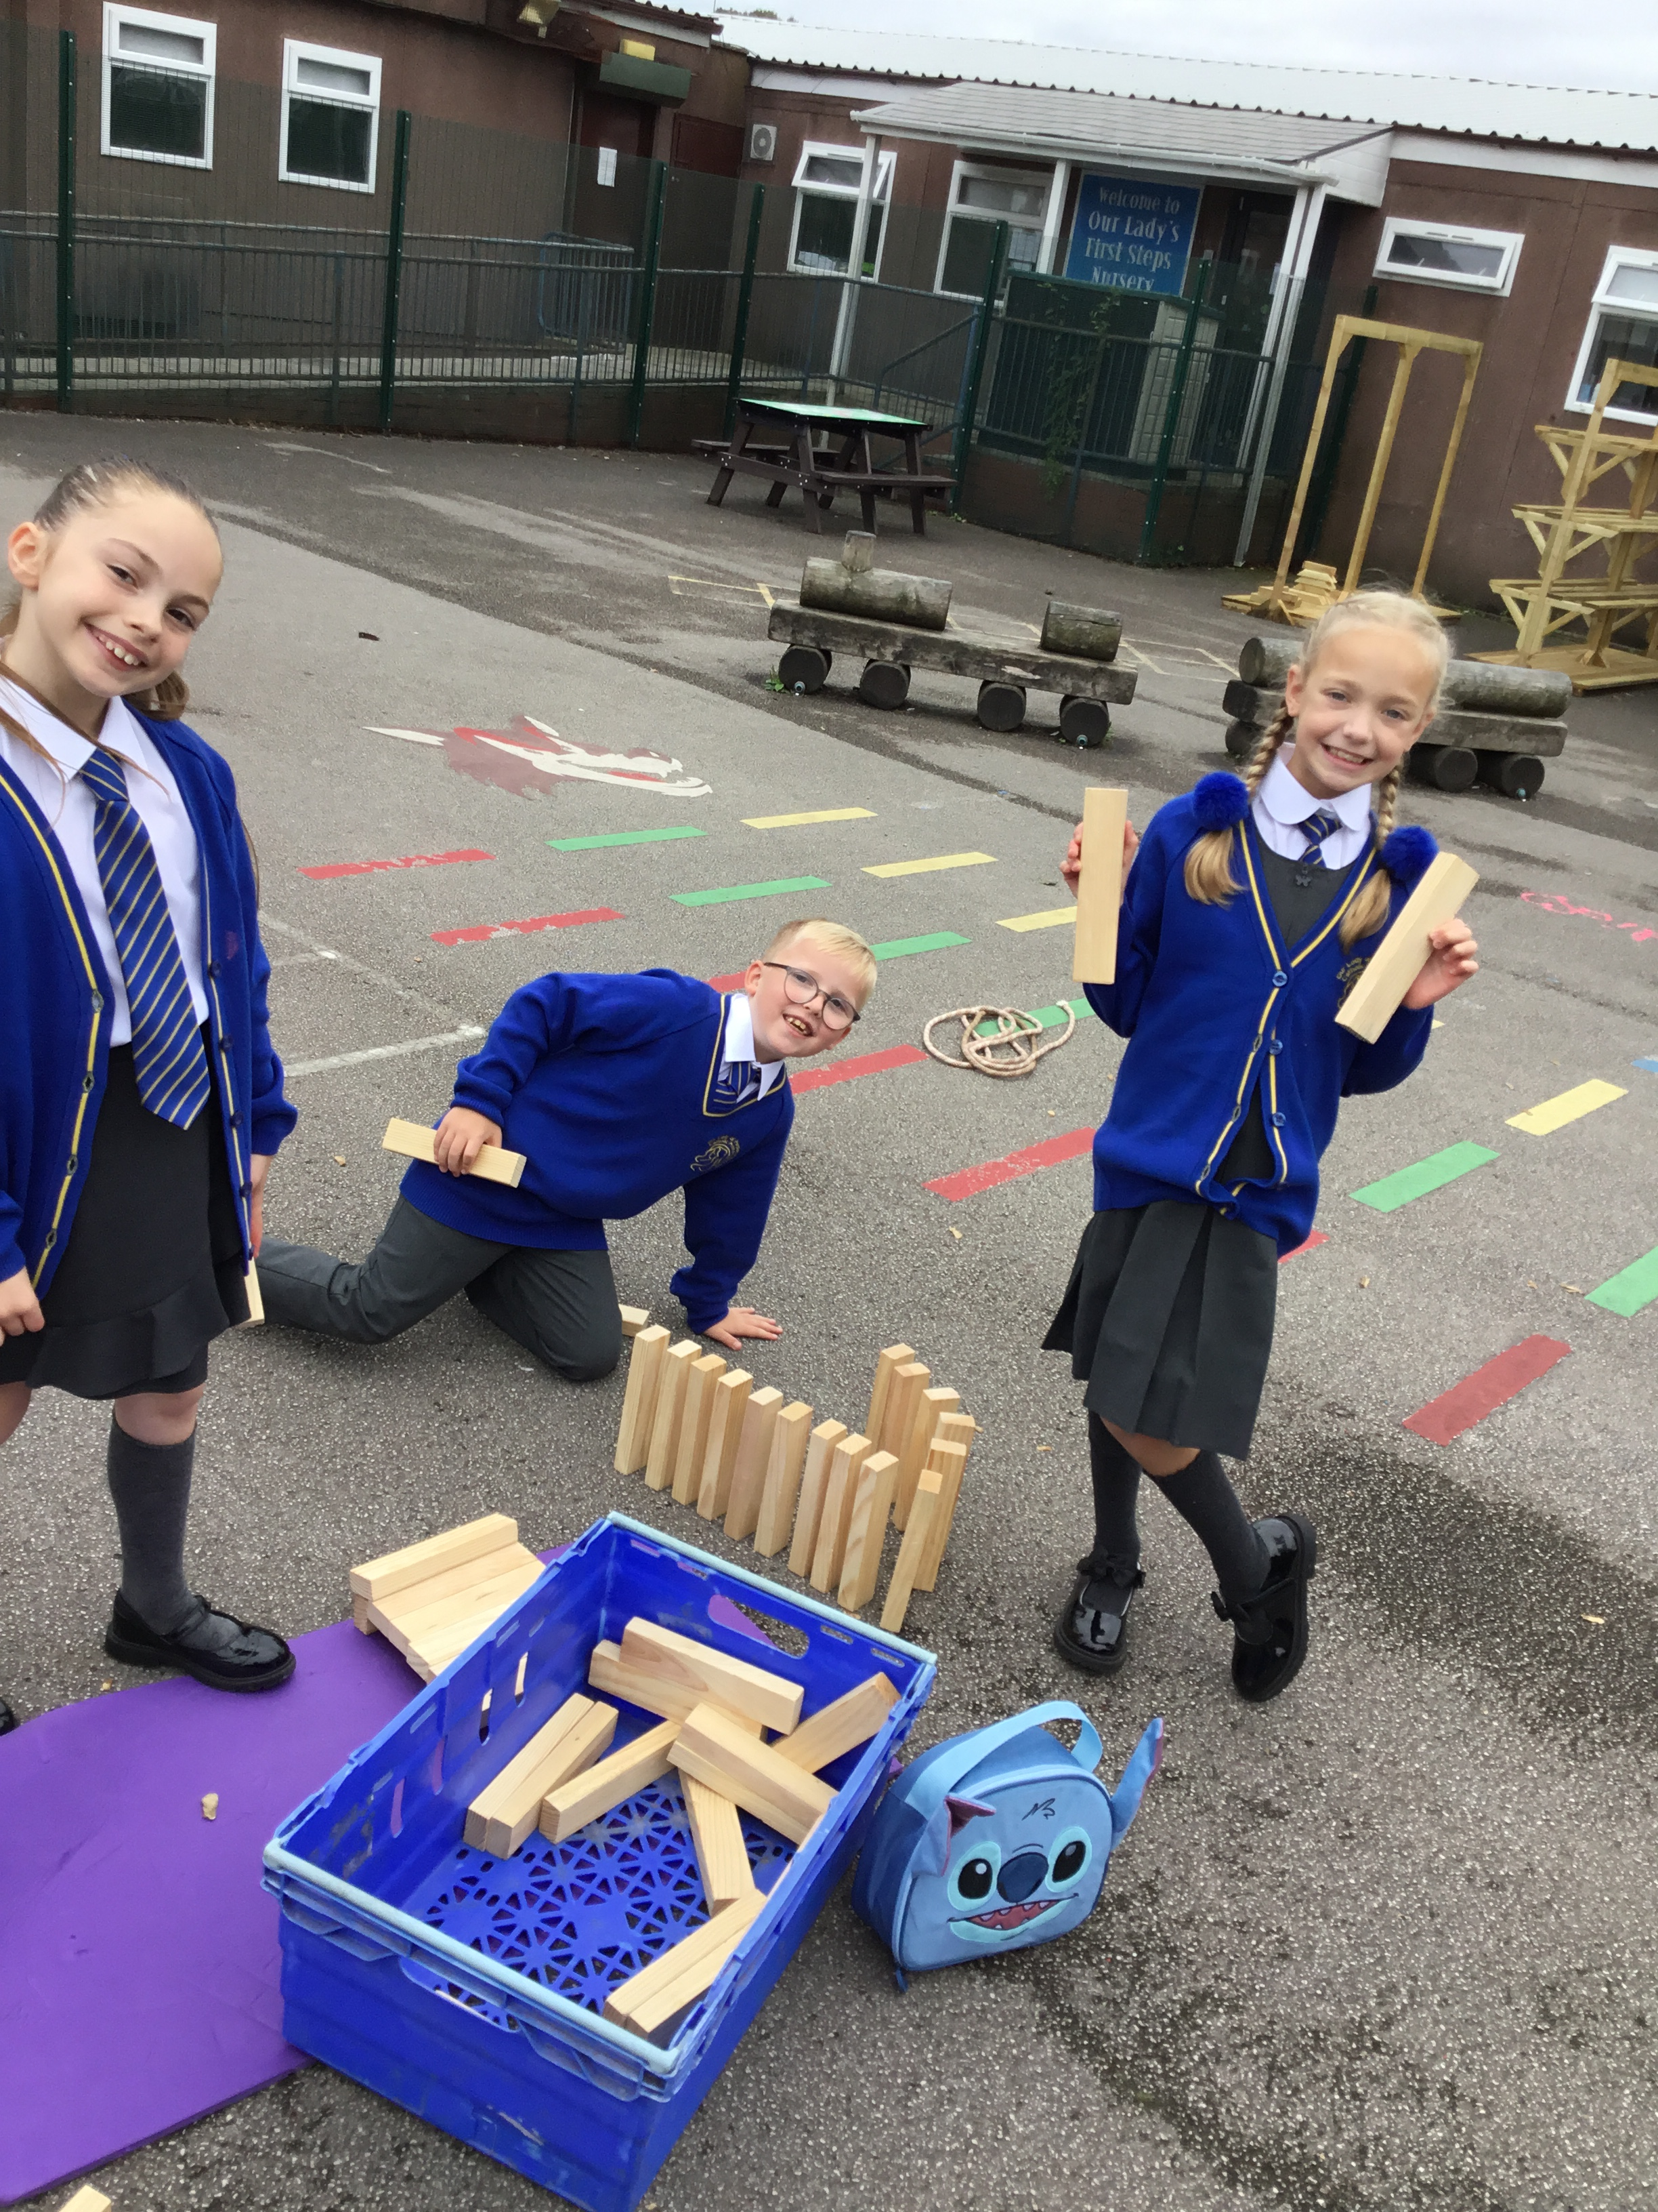

Slide 5
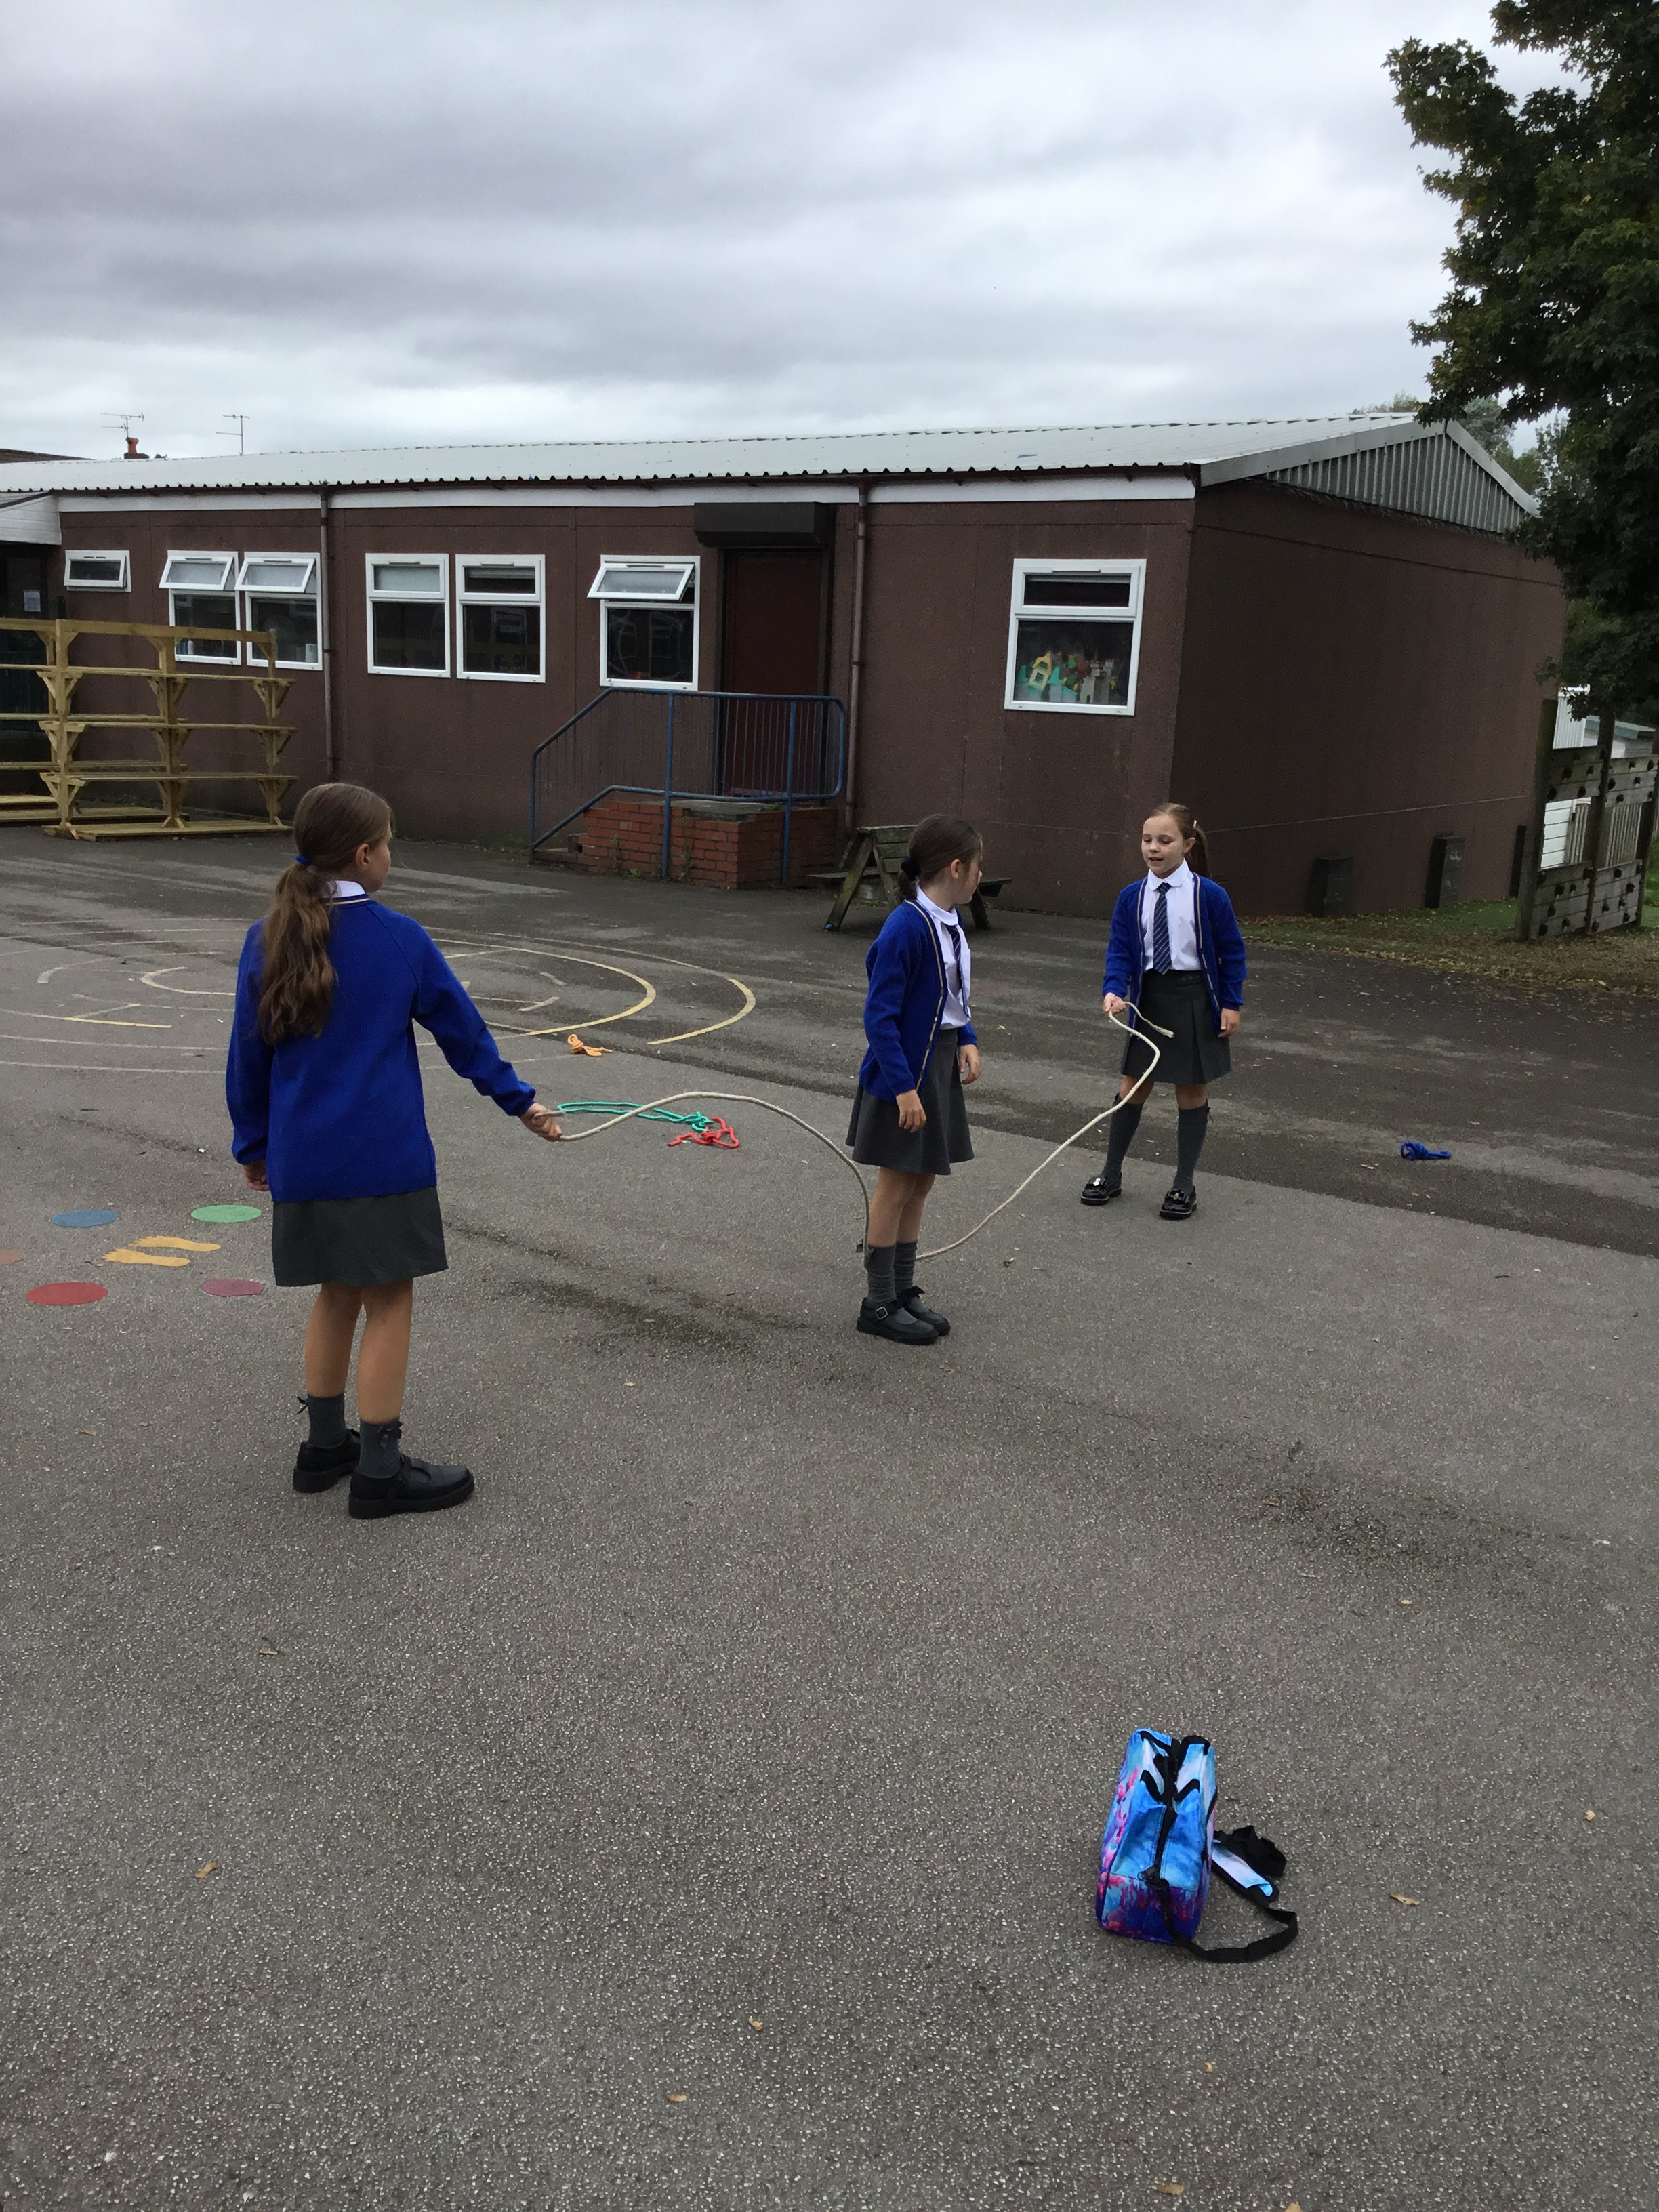
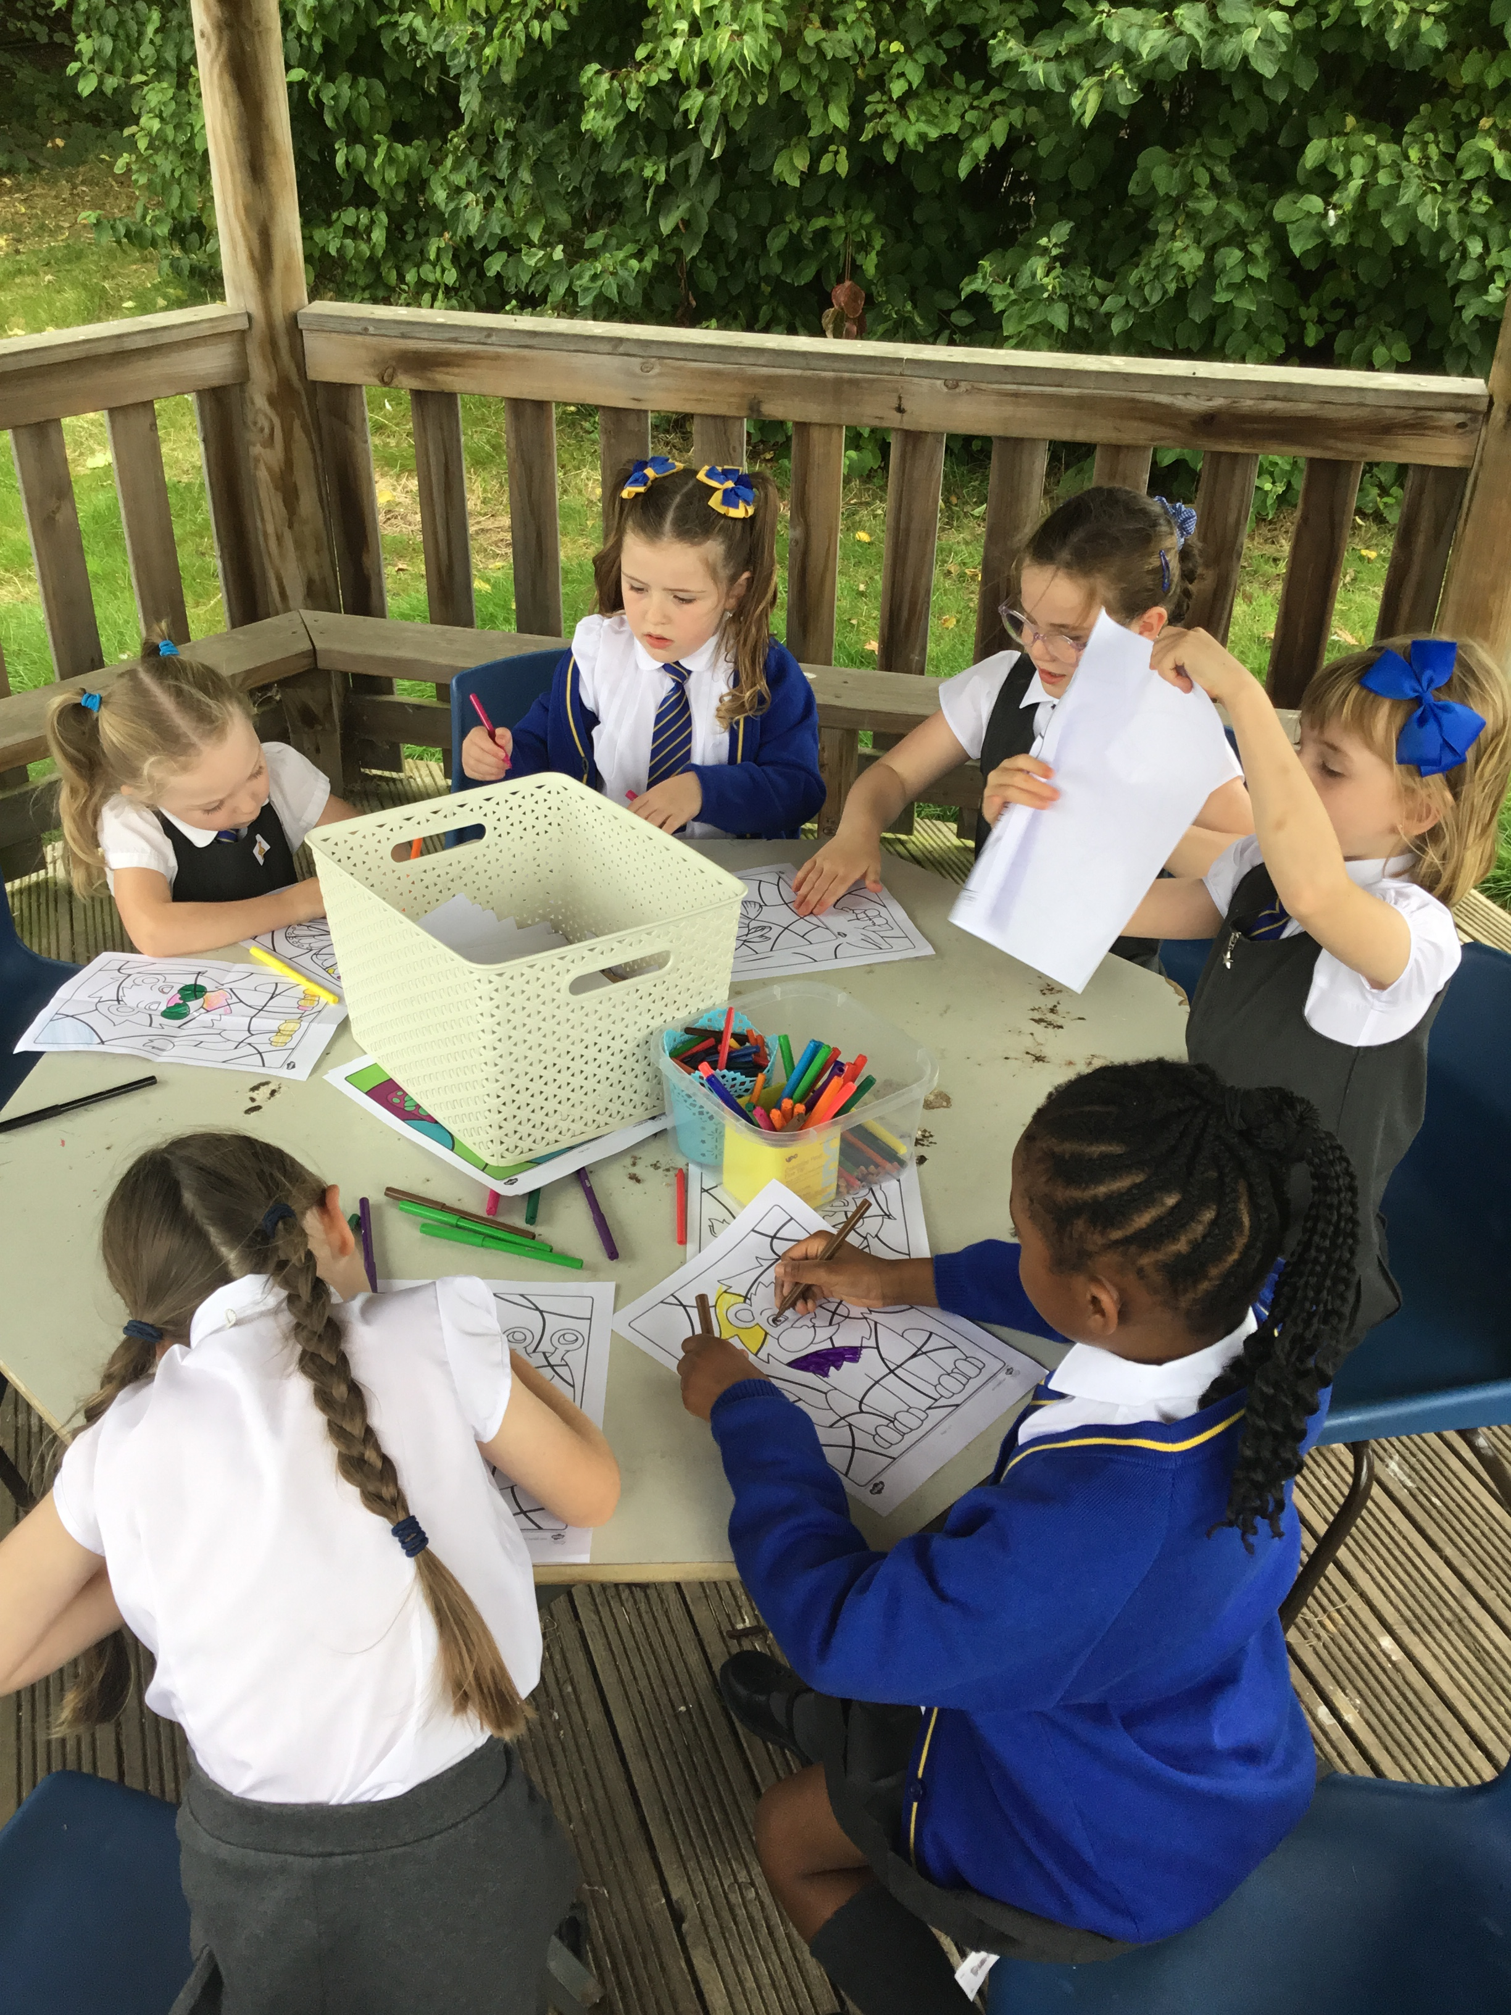
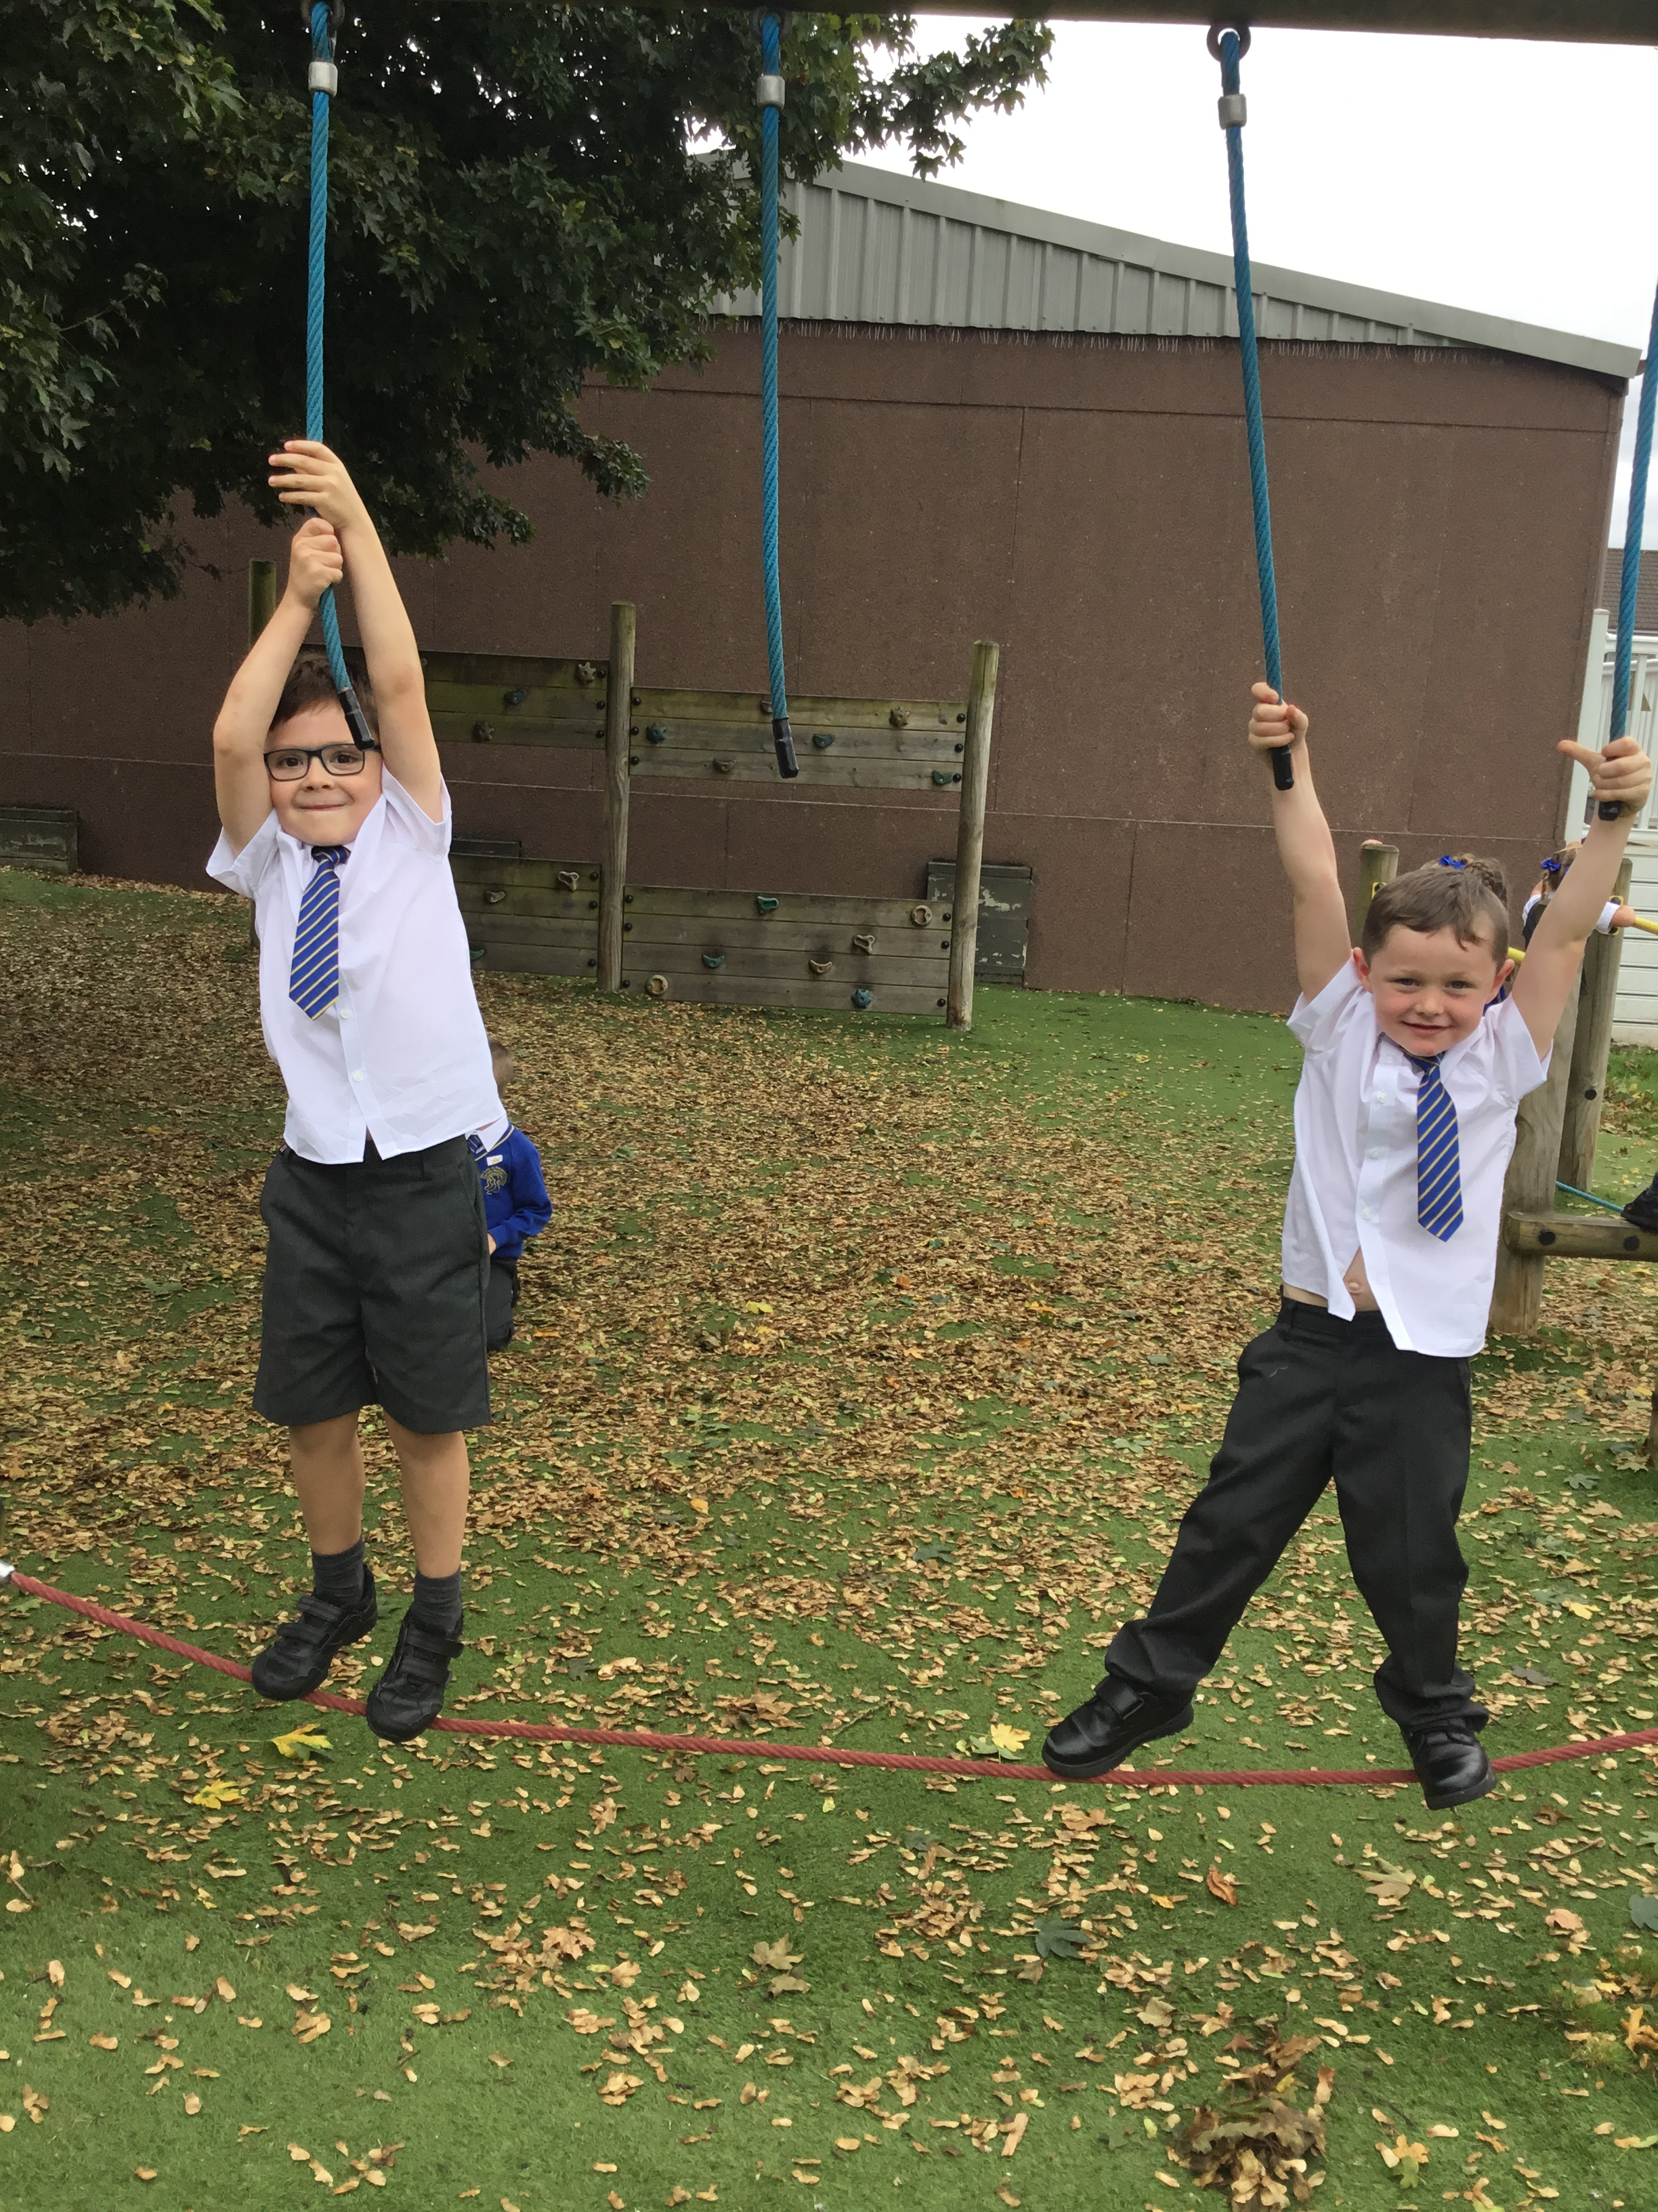

Slide 6
What do we already have out on the playground?
Construction-Lego Knex
Role play- dressing up costumes
Stage-Music and performance Zone
Wheelie Zone- Scooters
Active zone- Space hoppers, bats/balls football
Creative Zone-arts and crafts

Slide 7
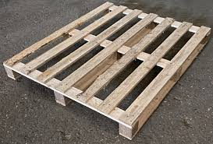
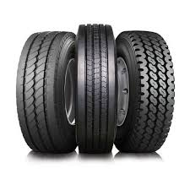
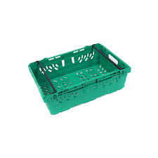
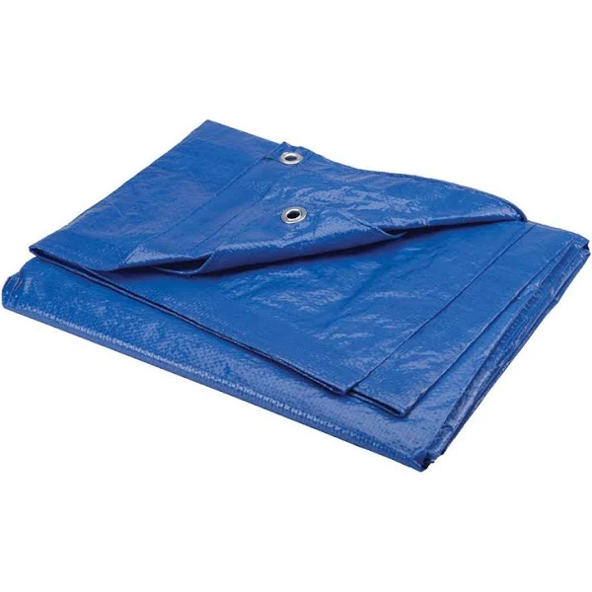
Inform
What will be new this week?
Pallets
Tyres
Plastic crates
Tarpaulin

Slide 8

Negotiate
What new rules do we need for
our new activities this week?

Slide 9
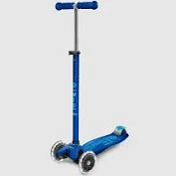
Scooters
Always wear a helmet.
Safe use of scooters no ‘bunny hops’ or stunts.
Scooting area is clearly marked out using cones.
All movement is to be within designated area and direction travel clockwise.
Don’t run across the scooter zone.
Reminder of correct size scooter.
Be aware and avoid crashing into others.
Awareness of finger trap risks.
Play team to make sure all scooters have proper rubber handles daily.

Slide 10
Pallets
Safe stacking –
When den building only stack to waist height no higher than 4 pallets high.
When den building the stability of all pallet structures needs to be tested before playing in them.
Moving -
“Ready, steady, lift” – bent knees and straight back.
KS1 Four children one in each corner to move.
KS2 Two children either side to move.
As it’s a heavy object they must not be carried above head height.
Look out for damage to pallets. splinters or sharp points.
Tell member of play team if you notice anything and they will be removed from the play environment

Slide 11

Crates
Main risk is unstable stacks, or from toppling of crates.
Stack them waist height no higher than 4 pallets high.
Build with them.
Use them as stepping stones (one high).
Be aware of catching fingers in between crates when stacking.
Don’t stack higher than your head.
Don’t throw them.
Don’t stand on a stack of them.

Slide 12
Innovate
Use equipment correctly
Everybody tidy up after playtime
Take care of equipment
Be responsible for positive play
Only equipment out is to be used

Slide 13
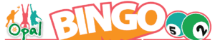
Eyes down for
Opal Loose Parts Bingo time!
Each class will be given a bingo board with lots of items to collect.
You will work as a team to collect as many items as possible.
The more the better to make our OPAL journey even more fun.
Items are to be given to your class teacher.
The first class to collect all the items will get an extra 20 minutes of OPAL play during the day.

Slide 14
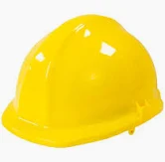
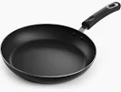
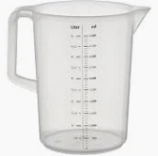
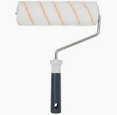


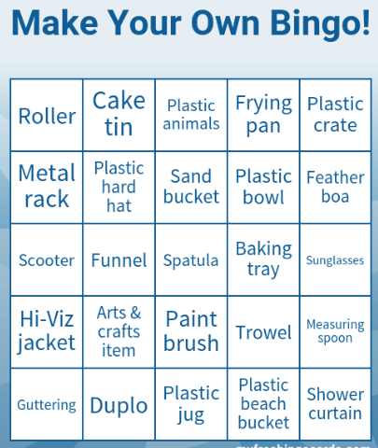

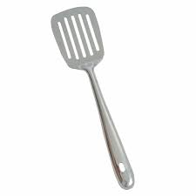
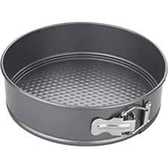
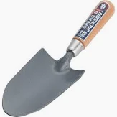
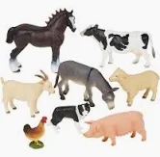

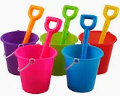

Slide 15
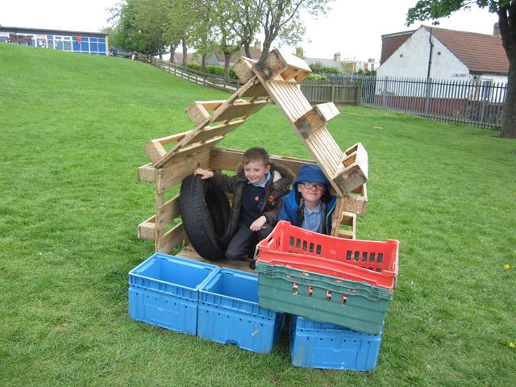
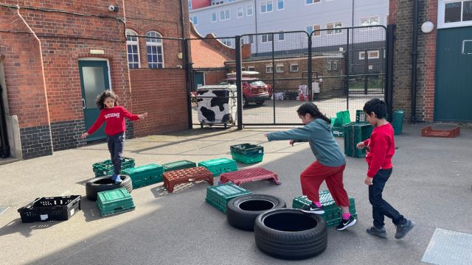
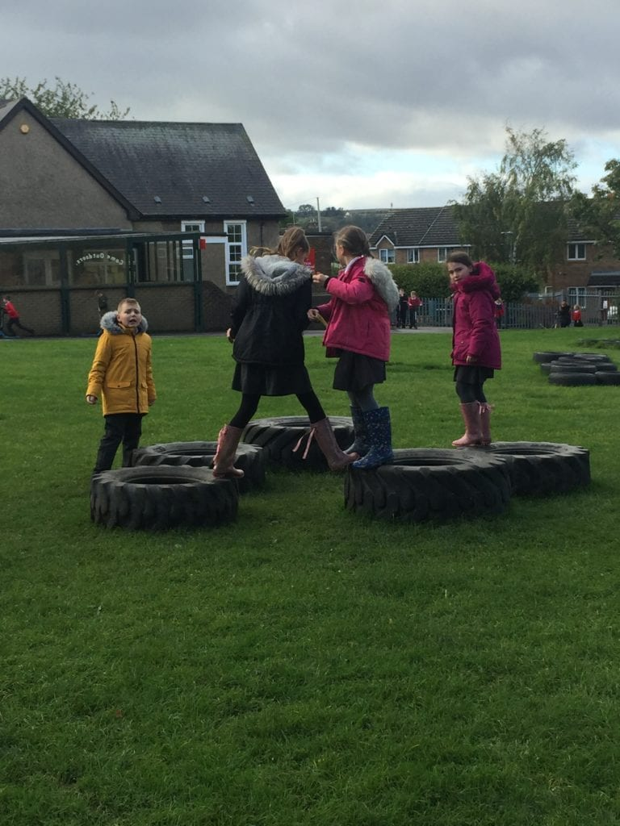
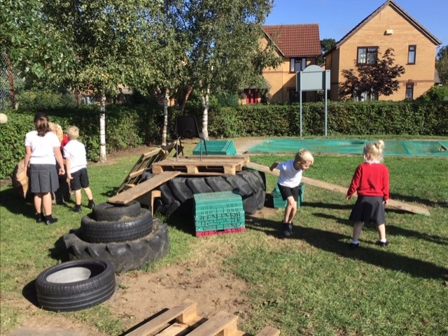
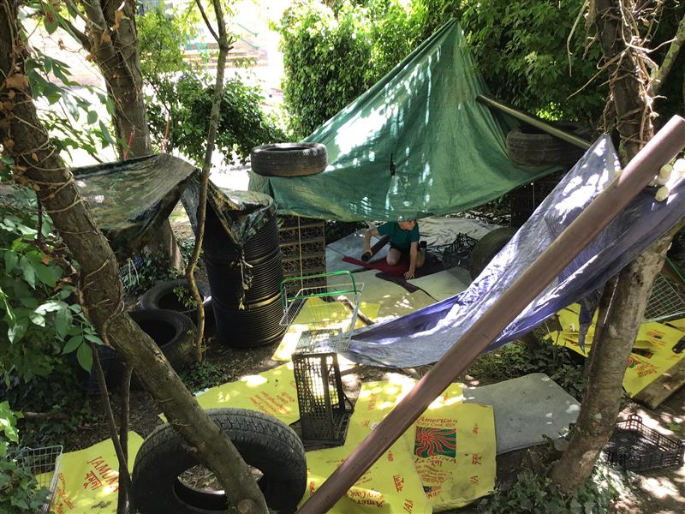

Slide 16
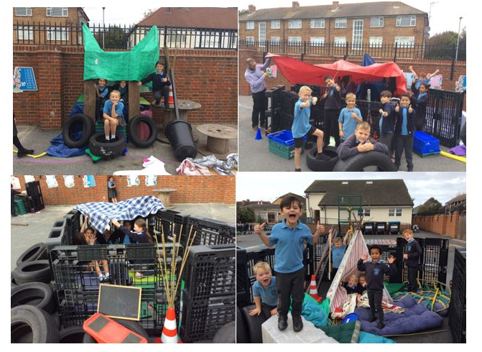

Slide 17
Celebrate you school’s culture of play and children’s creativity.
• Inform children of changes, rights, and agreements.
• Negotiate with children on issues such as risk, tidy-up and expected behaviours.
• Innovate around what children are currently playing to deepen children’s engagement.

