Slide 1
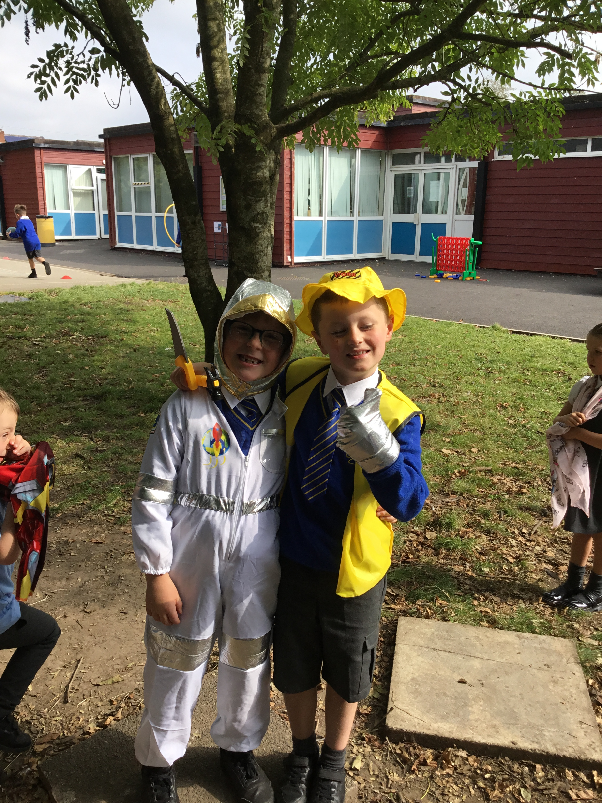
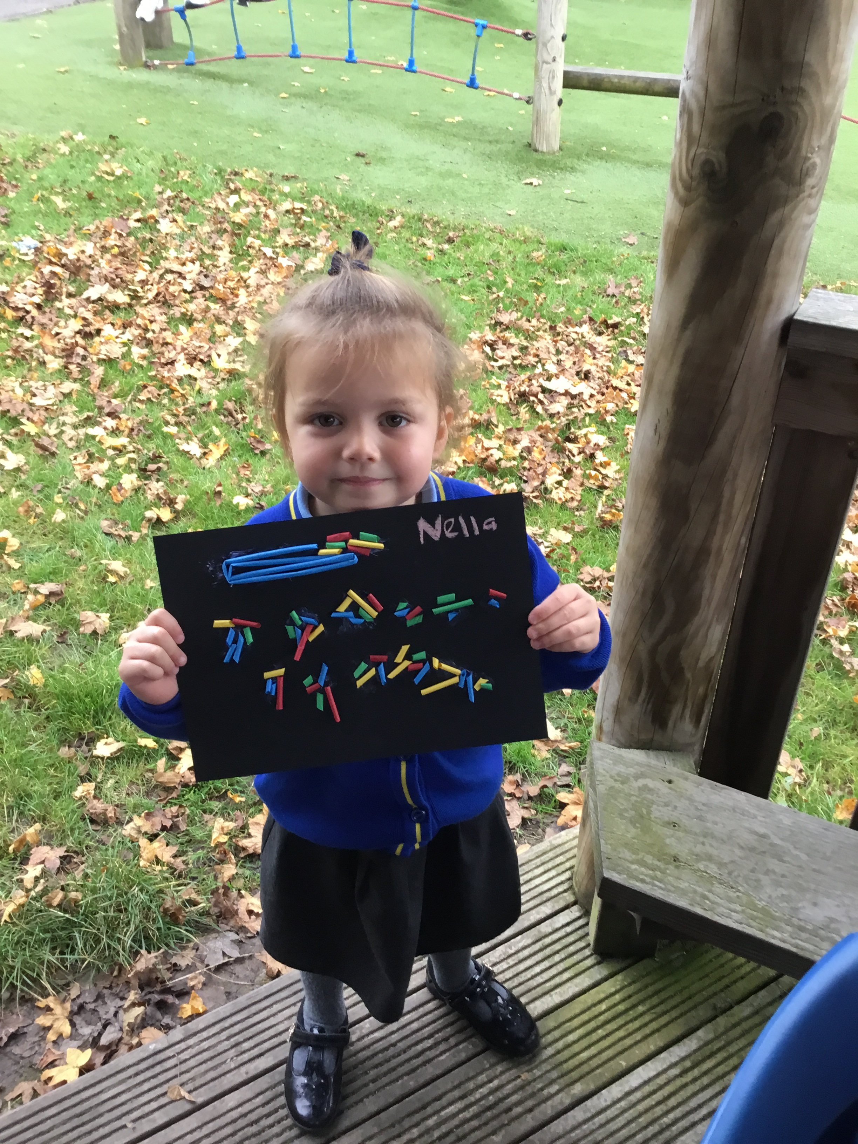
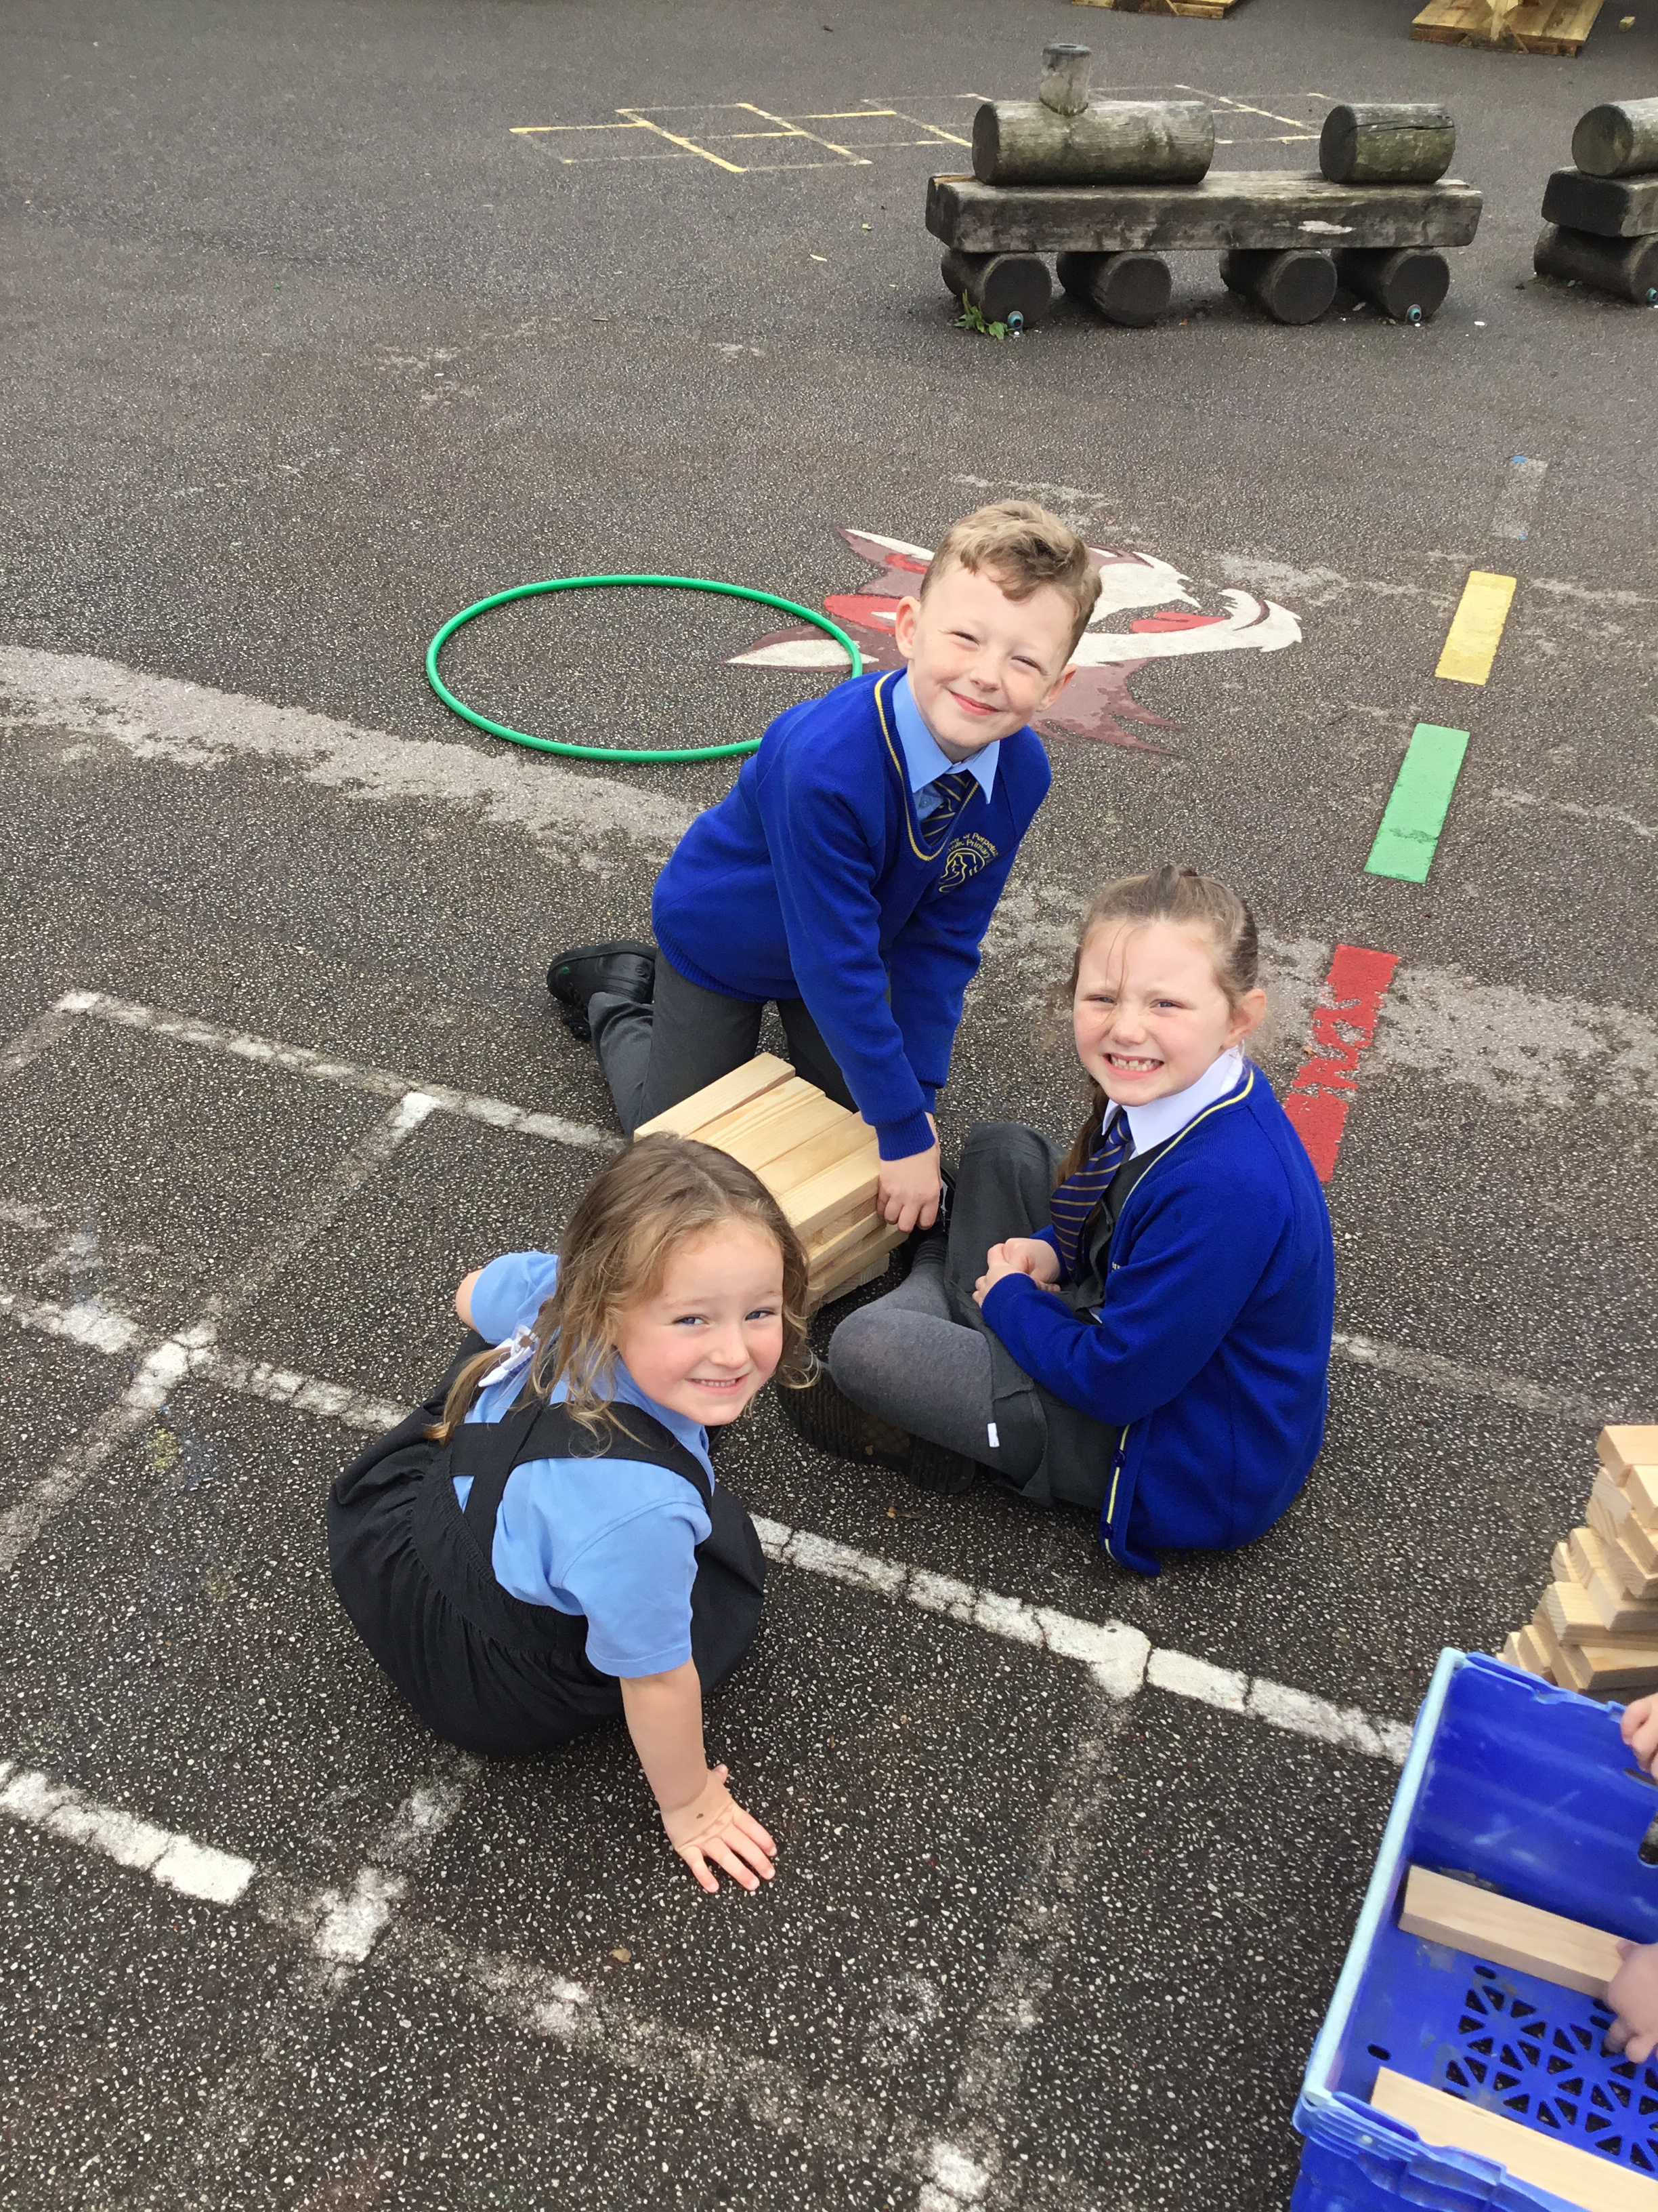


OPAL Play
Assembly

Slide 2
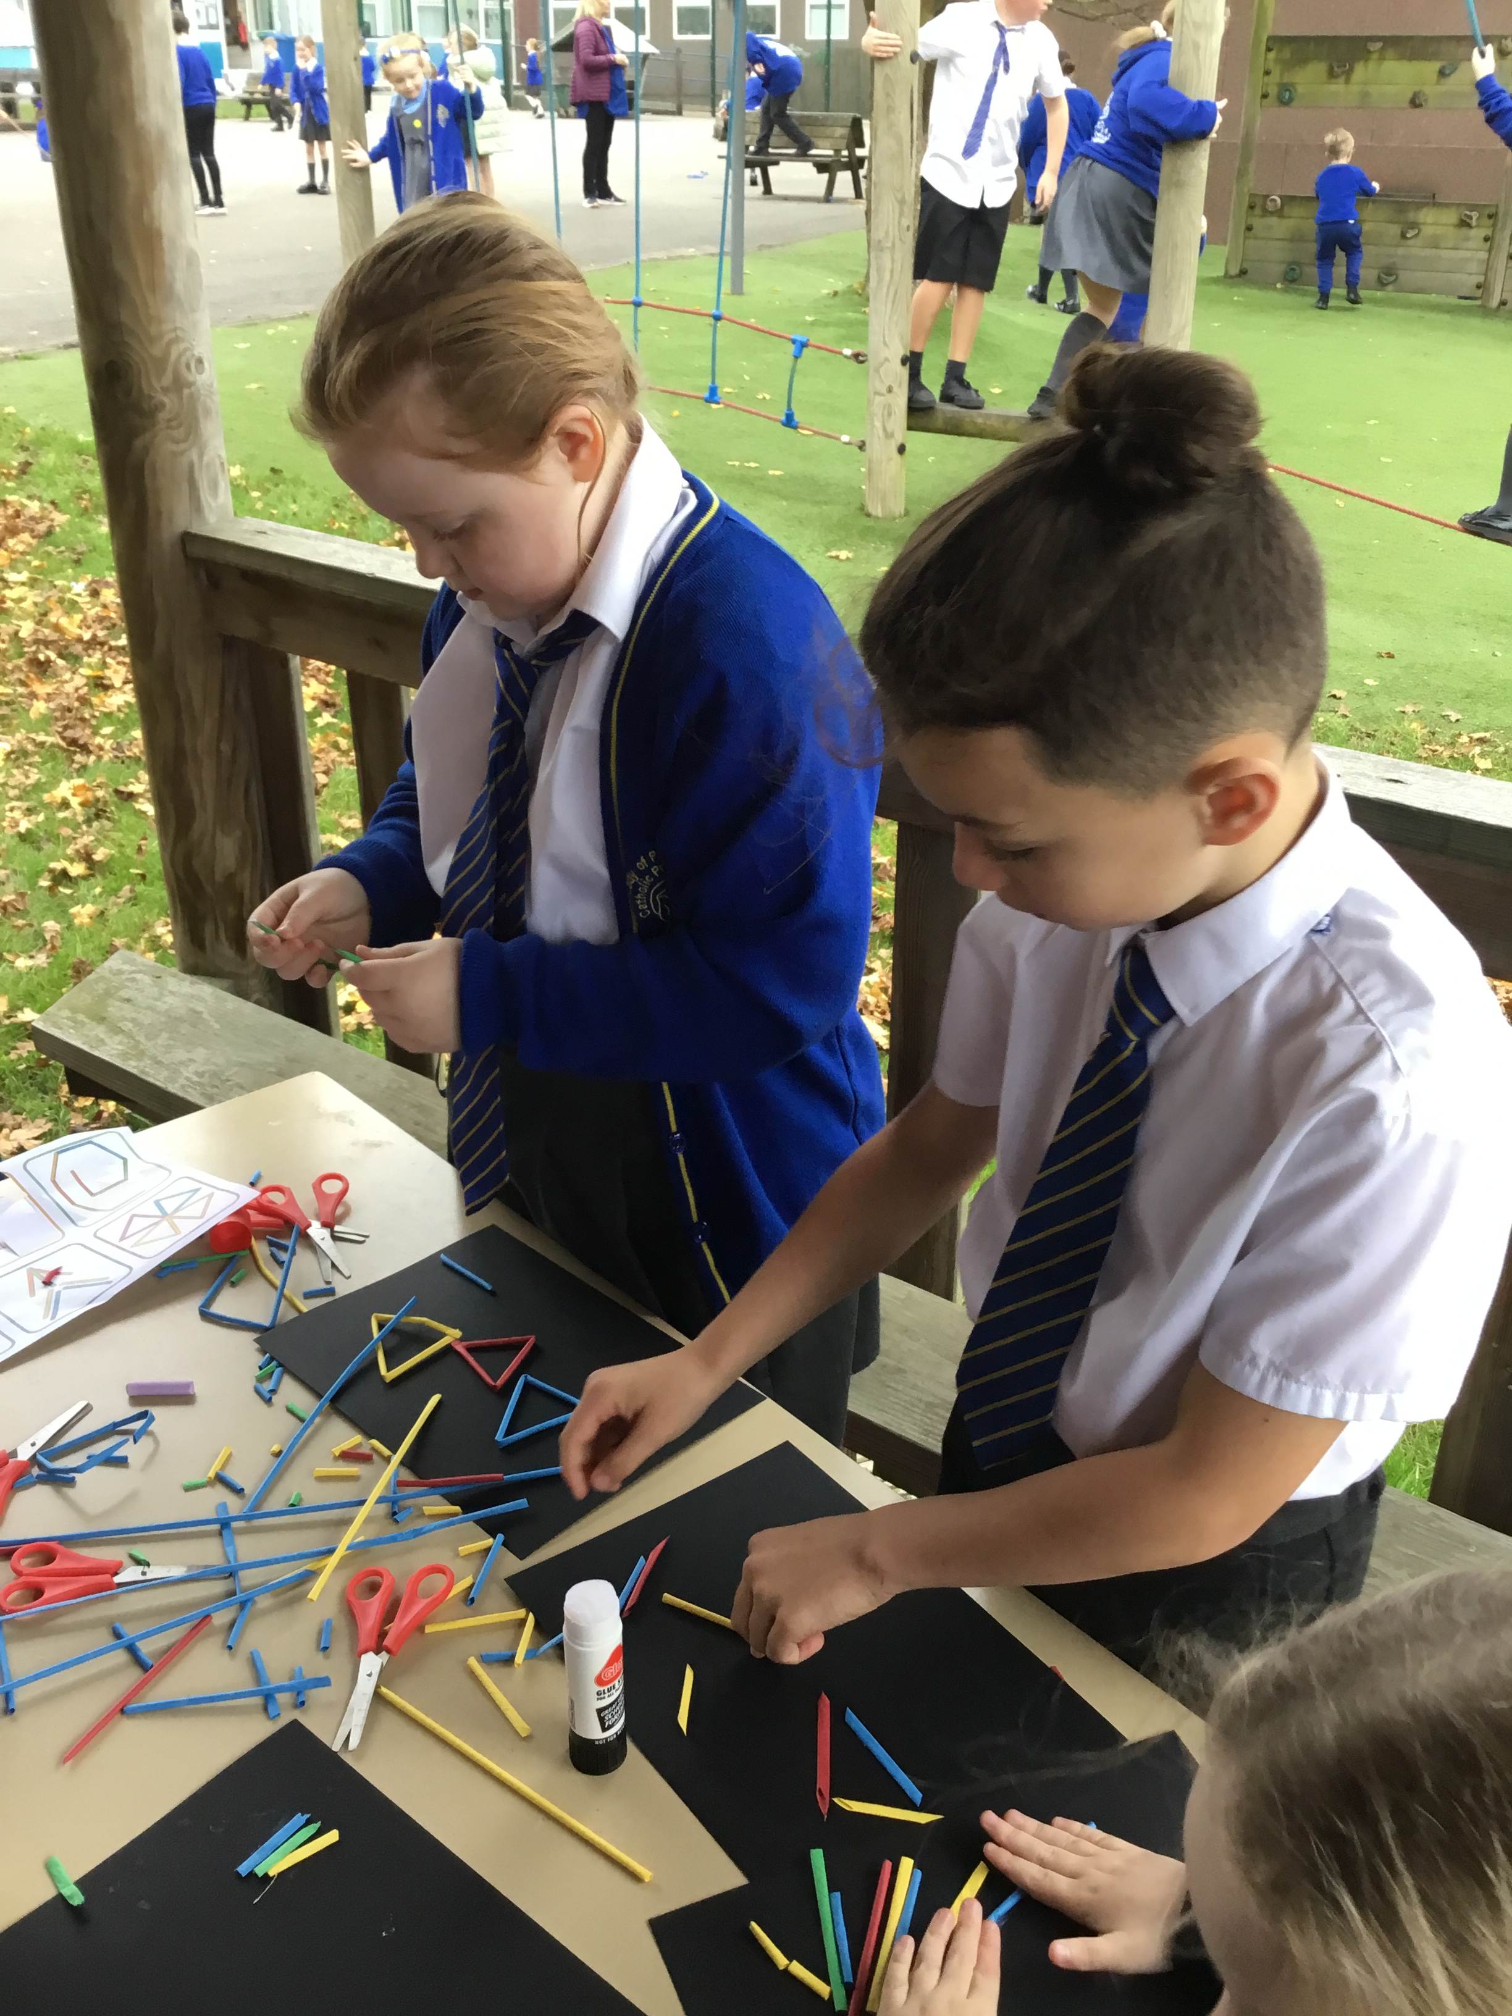
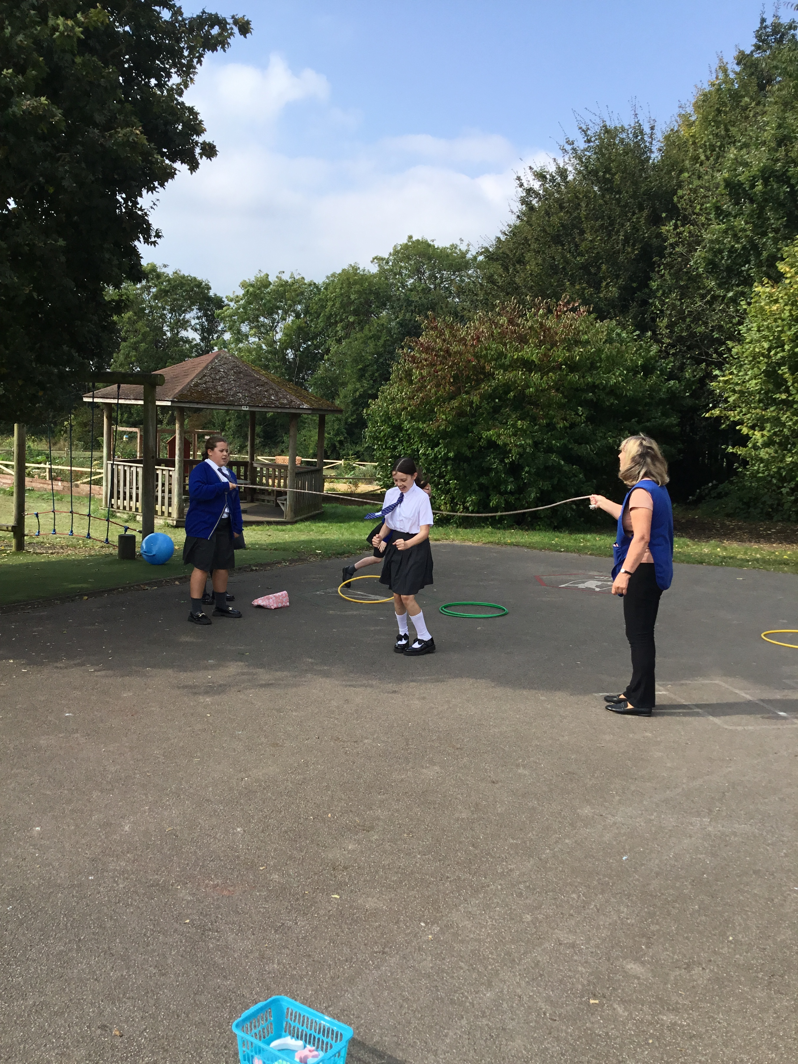

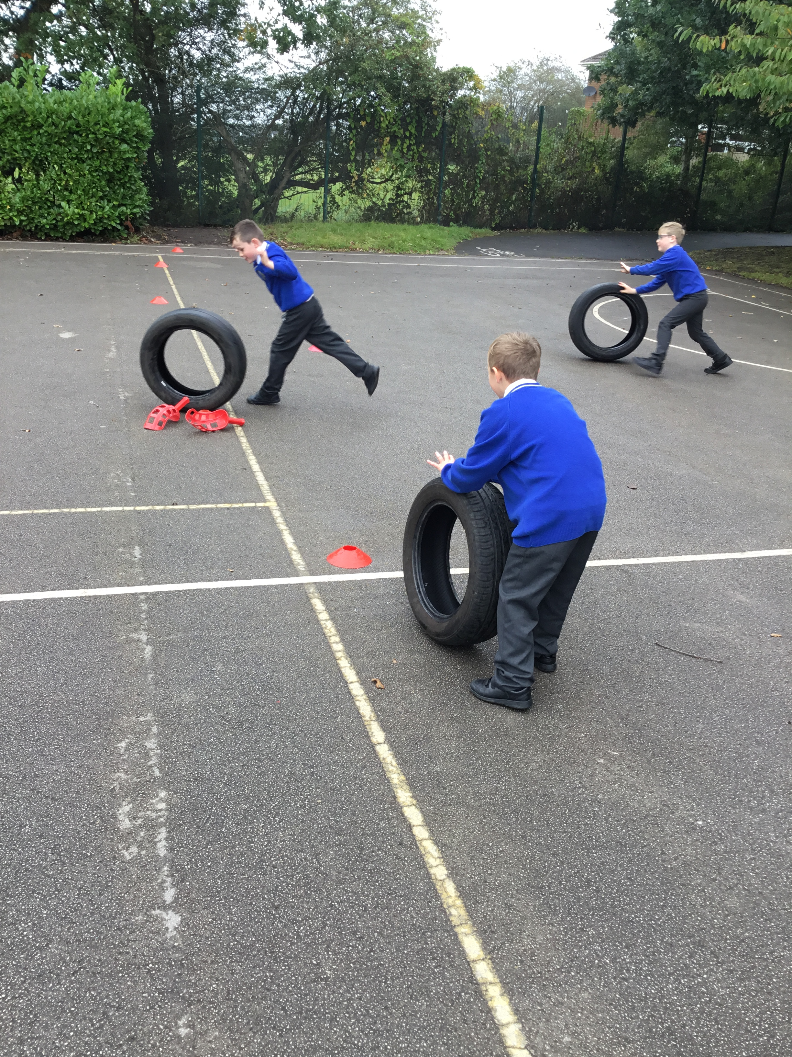
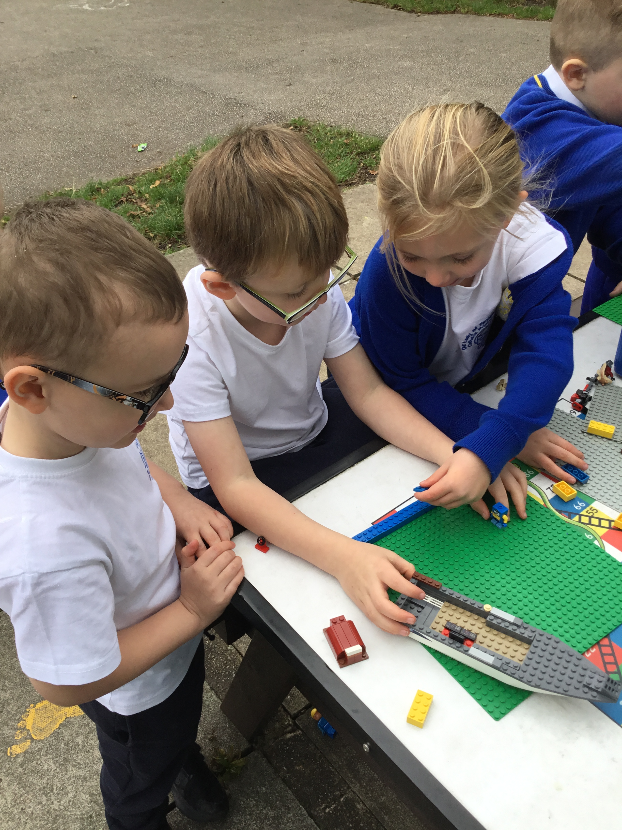
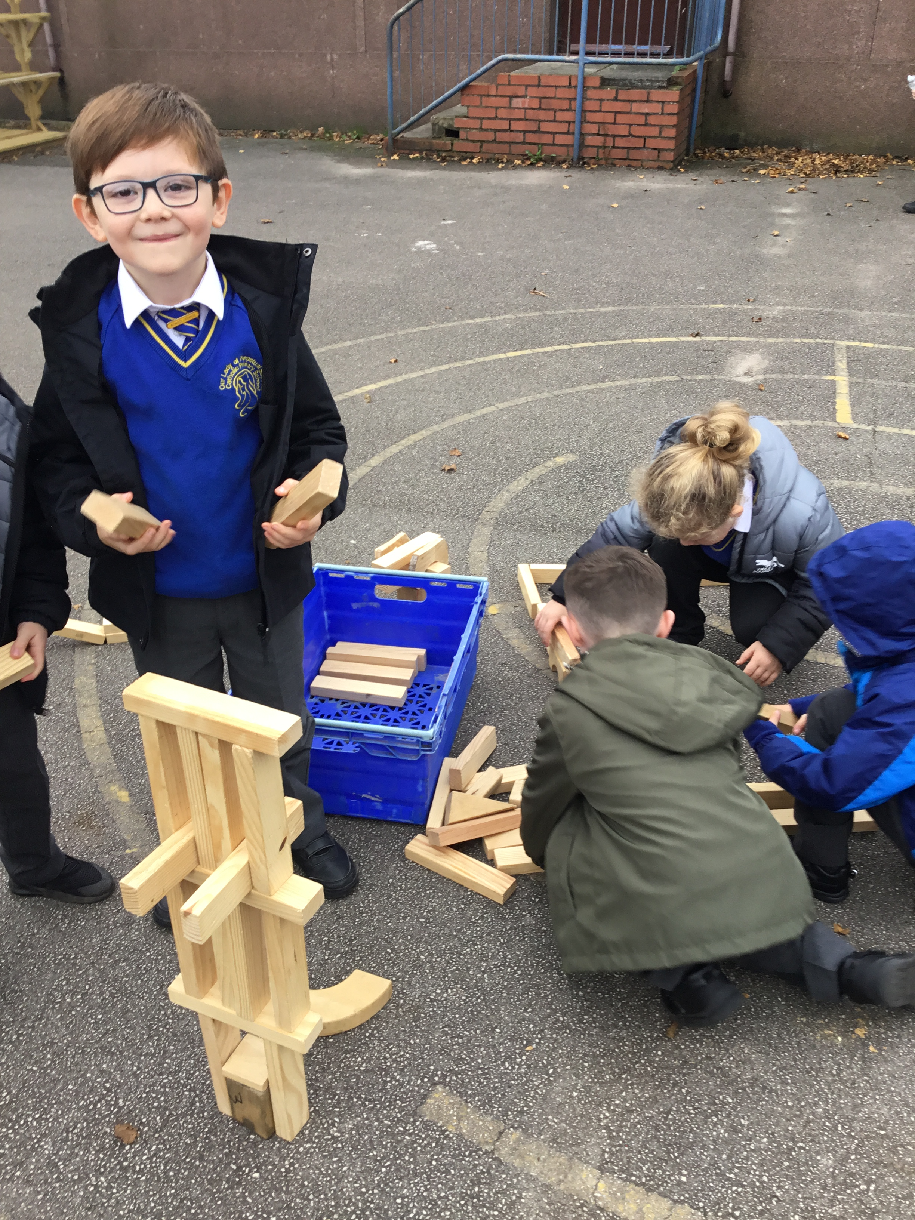
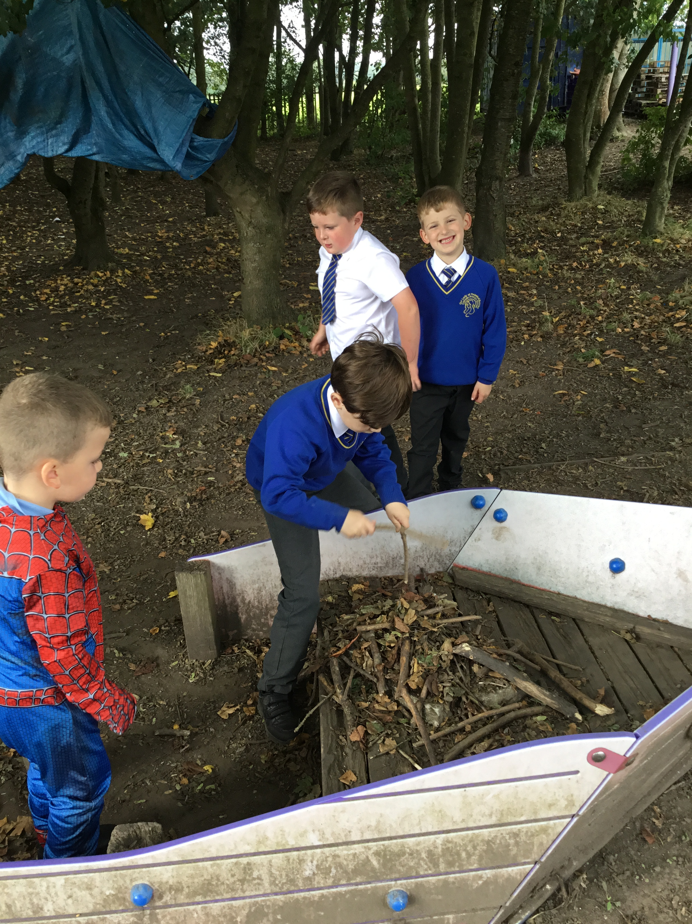
Celebrate
Amazing examples
of play

Slide 3
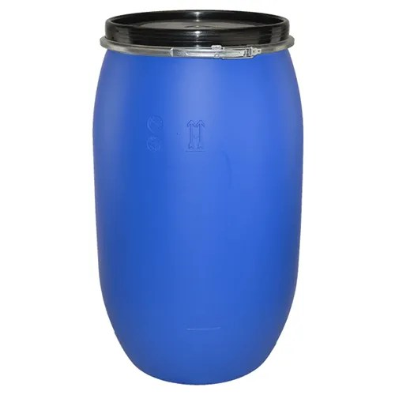
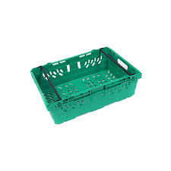

Inform
What will be new over next few weeks?
Plastic drum
Plastic crates
Cardboard boxes

Slide 4

Negotiate
What new rules do we need for
our new activities and equipment?

Slide 5

Crates
Main risk is unstable stacks, or from toppling of crates.
Stack them but don’t stand on stacked crates.
Mid day and play rangers will remain vigilant about correct use in the areas where crates are in use.
Build with them.
Use them as stepping stones (one high).
Be aware of trapping fingers in between crates when stacking.
Don’t throw them.
Don’t stand on a stack of them.

Slide 6
Cardboard boxes
Build shelters, hide inside, make a den
Please don’t intentionally tear up or rip them into pieces
No throwing of boxes
No jumping on boxes
No boxes out if its raining

Slide 7
Plastic drums
Roll them to a partner
Roll over them with care (in the woods not on concrete)
Use them to make dens
Don’t push another child over them
Make sure when rolling nobody's fingers are underneath
Don’t get inside

Slide 8
Innovate
When you’ve finished with something put away.
Use equipment correctly and respect equipment.
If you hit a ball in the bushes go and collect it.
Everybody help to tidy away all equipment and please check the floors- (small world- Lego has been left out a few times)
Make sure correct equipment goes back in the right box.
At the end of playtime make sure the correct amount
of items are collected. (Labels will be on boxes)

Slide 9



Shakira's song "Try Everything," is featured in the 2016 animated film Zootopia. It conveys a powerful message about perseverance and resilience. Also the importance of never giving up in the face of challenges, no matter what stands in your way. Its like a friend cheering us on, saying, "Hey, your doing well, give it a go!“
It encourages exploring new things, bouncing back from falls, and not being afraid to take risks. It's a reminder that life is meant for trying, and each try gets us closer to our goals. The song talks about tough times too. It says it's normal to be scared and make mistakes.
OPAL play encourages exploring, being adventurous (in a safe way) and being determined!
So each day try something new and tell yourself you can do it.

