Slide 1

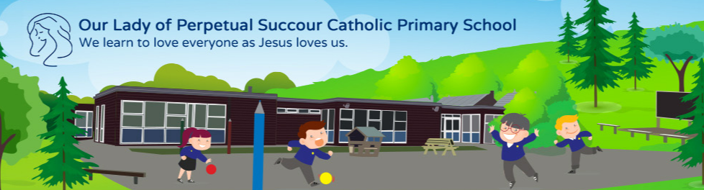
OPAL play here at Our Lady’s.

Slide 2
Why do we plan for play
here at Our Lady’s?

Slide 3
Play enables children to acquire life's essential skills and knowledge that cannot be taught

Slide 4
Play makes up 20% of school life
Per Year
231 hours
37 days
7.4 weeks
Primary Years
1.4 years
We are going to make 20% of that time into amazing playtimes every single day for all of our children.

Slide 5
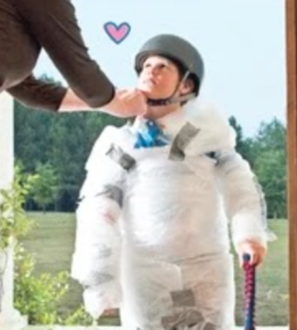
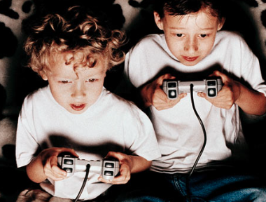
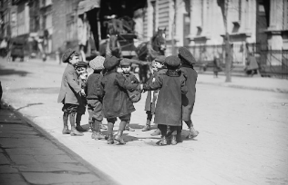
Childhood has changed…
Children have not
UK Children screen time average 6 hours per day
“By the age of seven the average child will have spent a full year of 24-hour days watching recreational screen media.” Dr Aric Sigman
© OPAL CIC 2023
Notes:
Childhood - abstract construction of what adults perceive - recommended screen time for a child below 3 yrs old = 0 according to WHO organisation (not recognised benefits) - this is not a judgement on you, or individuals

Slide 6
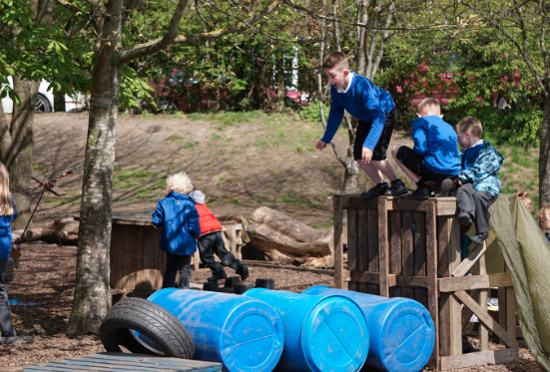
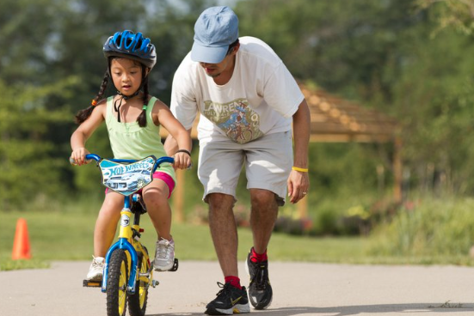
The importance of risk in children’s play
RISK means going beyond what is already known and easily accomplished
Supporting school improvement through play www.outdoorplayandlearning.org.uk
© OPAL CIC 2023

Slide 7
CHILDREN’S PLAY AND LEISURE –PROMOTING A BALANCED APPROACH
SEPTEMBER 2012
Key message: ‘Play is great for children’s well-being and development. When planning and
providing play opportunities, the goal is not to eliminate risk, but to weigh up the risks and
benefits. No child will learn about risk if they are wrapped in cotton wool’.
STRIKING THE RIGHT BALANCE MEANS:
Weighing up risks and benefits when designing and providing play opportunities and activities
Focusing on and controlling the most serious risks, and those that are not beneficial to the play activity or foreseeable play by the user
Recognising that the introduction of risk might form part of play opportunities and activity
Understanding that the purpose of risk control is not the elimination of all risk, and so accepting that the possibility of even serious or life-threatening injuries cannot be eliminated, though it should be managed
Ensuring that the benefits of play are experienced to the full

Slide 8
If we never took a risk our children would not learn to walk, climb stairs, ride a bike or swim: business would not develop innovative products. Scientists would not experiment and discover, we would not have great art, literature, music and architecture.

Slide 9
Risky play combines
fun and stress
turbo charging
brain development
Risky play also develops your executive function, the parts of the brain in charge of decision-making...the only way to learn to make good decisions is by practising making decisions.

Slide 10
The benefits of play…
Communication skills
Literacy
Numeracy
Artistic creativity
Narrative skills
Social and group work skills
Understanding rules
Discussion skills
Mental representation
Strength and endurance
Whole body coordination
Emotional attachment
Emotional and social skills
Hand-eye coordination
Thinking, reasoning, problem solving
Early language development
• Self-regulation:
The ability to be aware of and regulate one’s own cognitive and emotional mental states and behaviour.
Supporting school improvement through play www.outdoorplayandlearning.org.uk
© OPAL CIC 2023
Notes:
Benefits of play - so much research - little tiny bones analogy - balance - 80% degradation from kids in 80s to today - that's a physical degradation because they're not allowed to play - climb things, swing on things - etc - only 50% play outside when outside of school - their bodies and minds are learning

Slide 11
How can we best support play?
offer a safe learning environment – IMPROVE SPACE/ACCESS
let children follow their own play urges – POLICY/PLANNING
support them without interrupting - COMMUNICATION
watch and wait as they discover, invent and explore –RISK BENEFIT APPROACH
UNDERSTAND the play process – KNOWLEDGE/EDUCATION
Take a strategic approach
Create sustainable change in culture and practice

Slide 12
What does this mean for my child?
We would like play in our school to be a freely chosen activity which your child will find satisfying and enjoyable. It will provide them with an opportunity to use their intuition, be physically active, be creative, make their own decisions, be outdoors and overall have fun.

Slide 13
How can parents support OPAL?
Provide loose parts
Provide wellies, suitable clothing/waterproofs
Be tolerant -mud, dirt etc
Recognise the benefits of OPAL to your child’s health and well-being

Slide 14

Provide loose parts!
What’s in your loft…..maybe really useful!
Who do you know….plumber, brickie, waterboard technician, sign writer, office manager…what waste might they have?
Most things offer tremendous play value

Slide 15
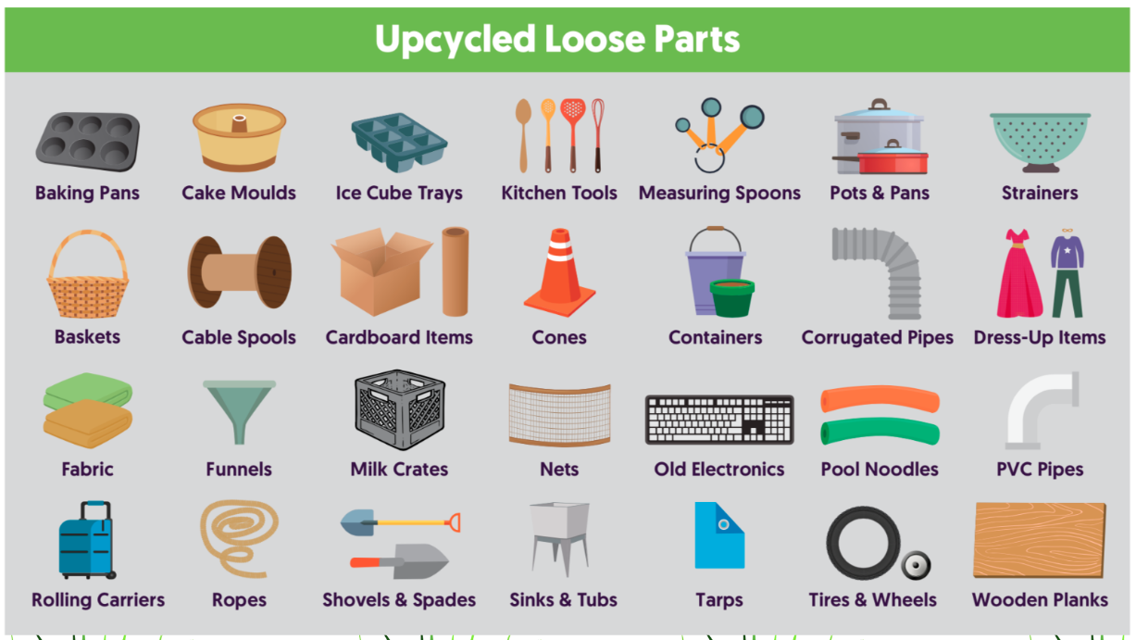

Slide 16
OPAL cited four times as good practice
All Party Parliamentary Group 2015
Participation in the OPAL Programme has the potential to reap considerable benefits for children, parents, schools and the wider community.’ - Independent Report NCB

Slide 17
Thank you so much for listening!
Any questions?

