Slide 1




Friendly Friday

Slide 2
Each week we will
Celebrate our school’s culture of play and your creativity.
Inform you of changes new zones
Negotiate with you about issues such as risk, tidy-up and expected behaviours.
Innovate around what you are currently playing to deepen children’s engagement.

Slide 3
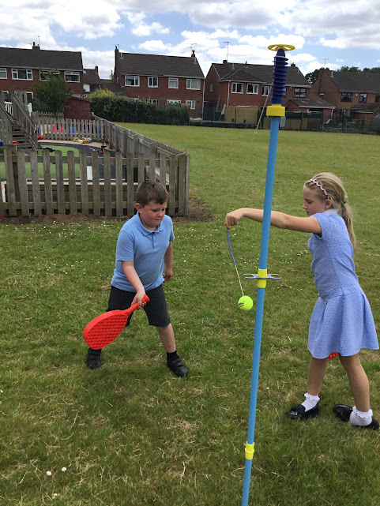
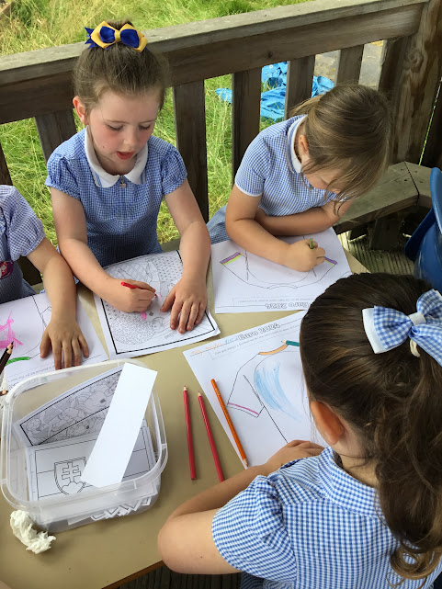
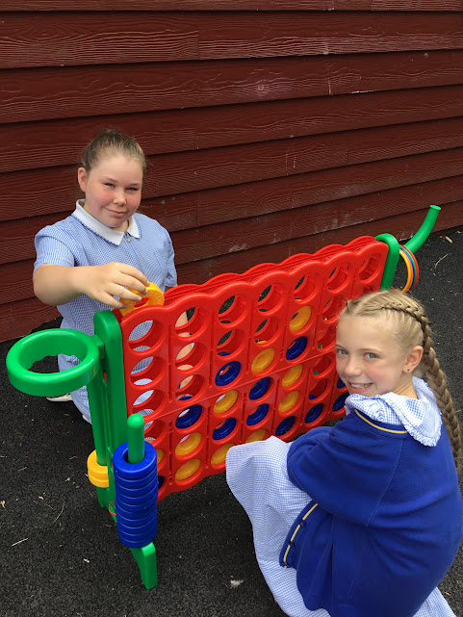
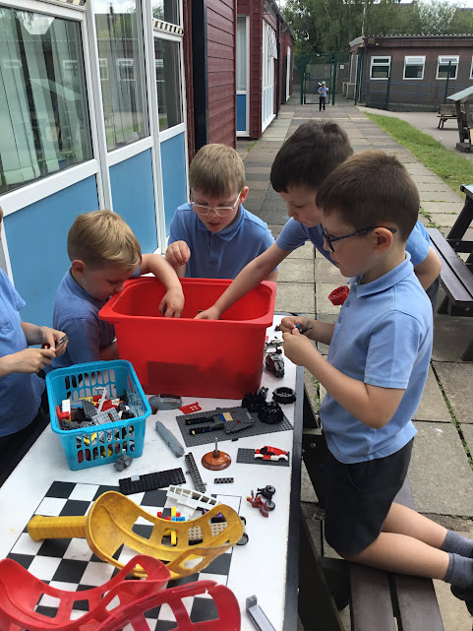
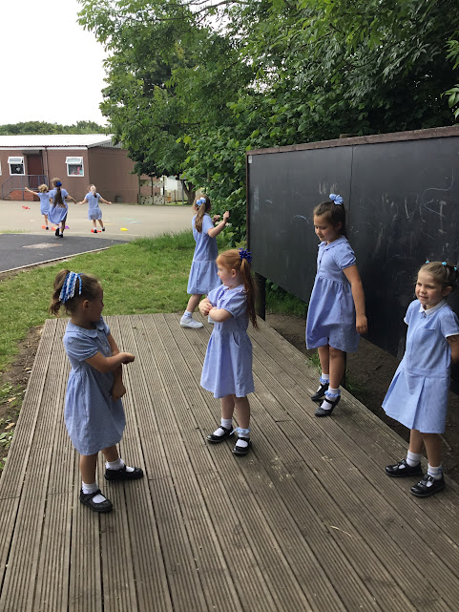
Celebrate
We’ve had so much fun!

Slide 4
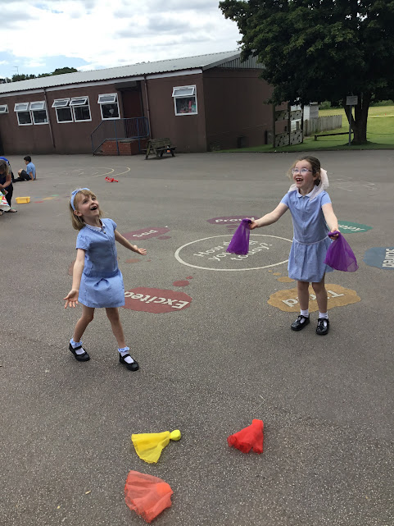
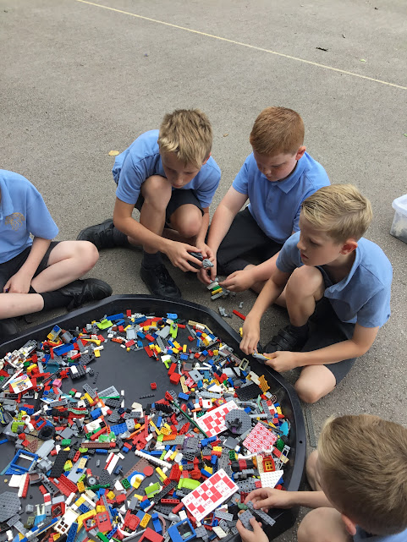
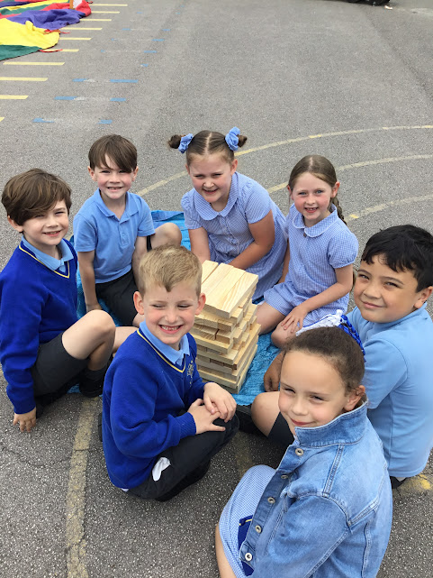
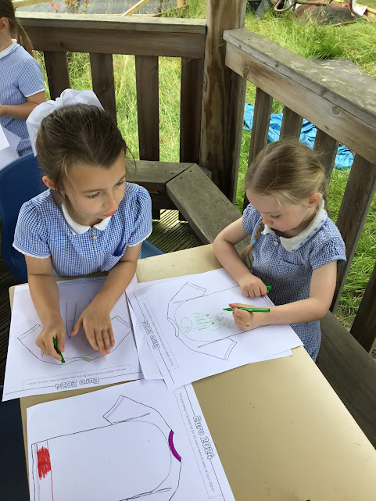

Slide 5
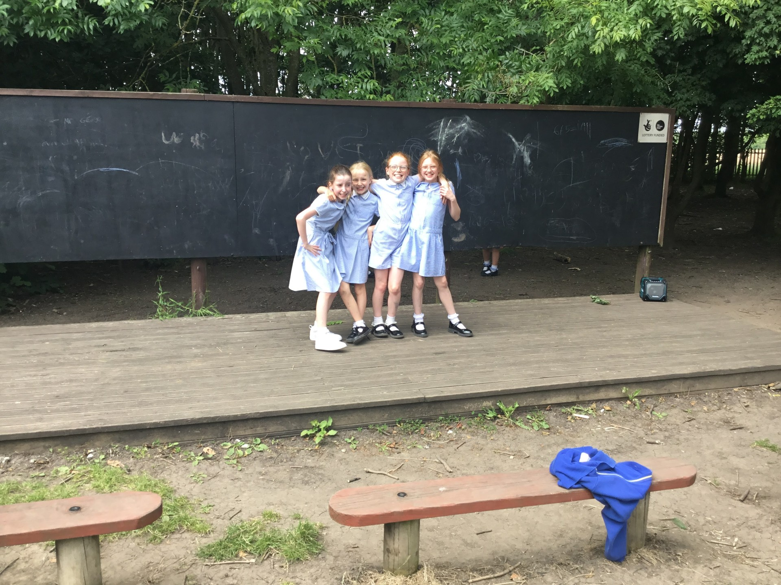
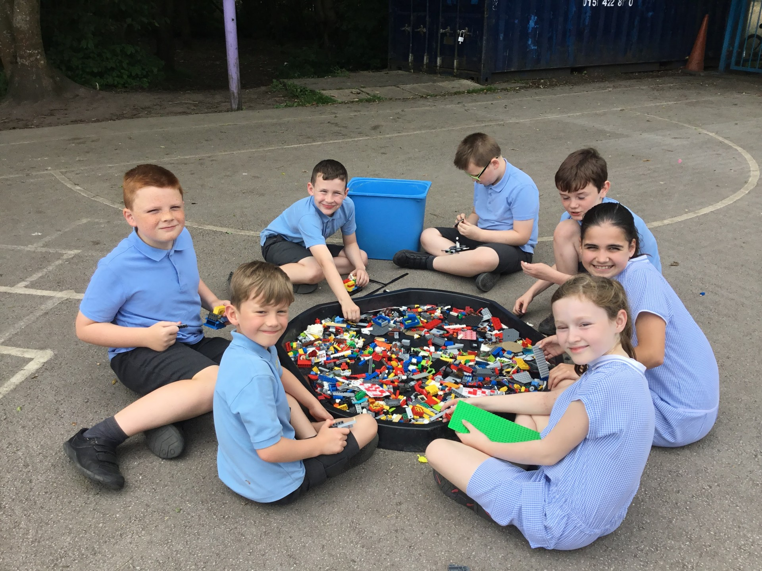
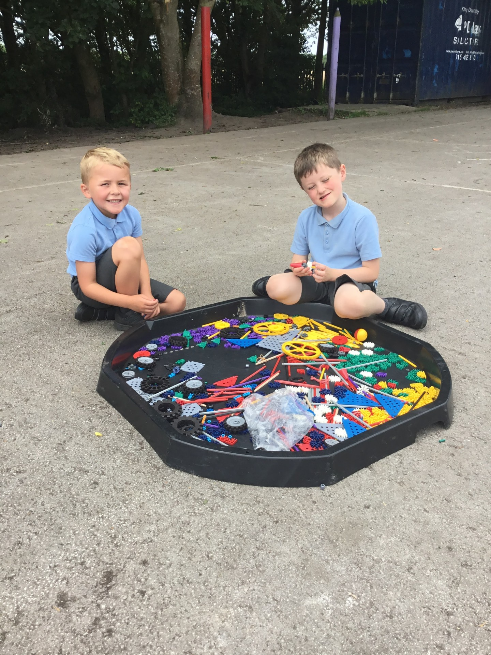
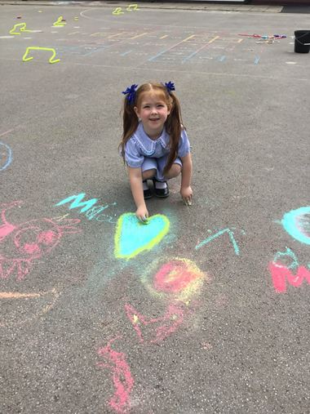
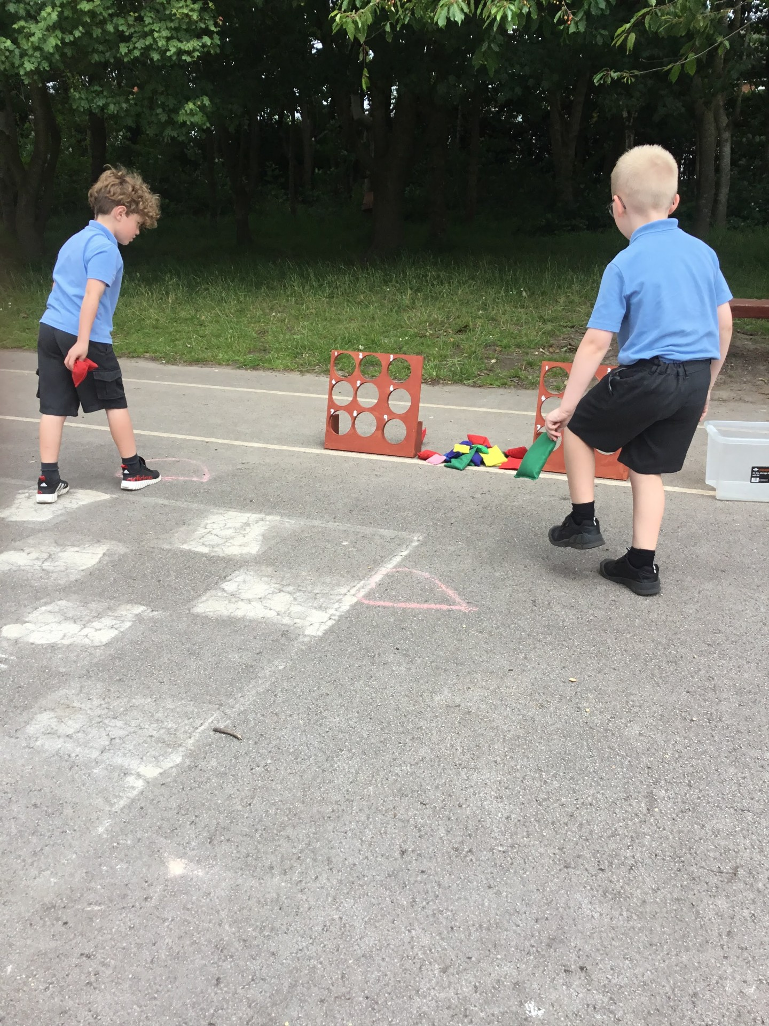

Slide 6
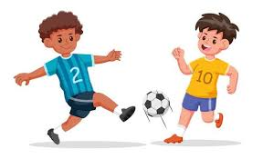
Inform
We will introduce football zone (on field) next week weather dependent.
Each class will have their own day.
Year 1 & 2 Monday
Year 3 Tuesday
Year 4 Wednesday
Year 5 Thursday
Year 6 Friday
No other year groups are to join in on other classes days
Only one football out in the football area only.

Slide 7

Friendly Friday
In July we introduced Friendly Friday
KS1 and KS2 will have the freedom to explore the different zones on either playground.
Now we will be having OPAL play every lunchtime!

Slide 8
Innovate
How can we not use it?
How can we use it?
No pulling or dragging of clothes
No slide tackles
No rough play
Teach each other new tricks
Play fair rules of football
Playing football/ try different positions

Slide 9


Negotiate
What new rules do we need for
our new activities and equipment?

Slide 10
Football
No deliberate kicks.
No tackling too hard or slide tackles.
Only 1 football match in the football area only.
Wellies to be worn when the grass is wet to protect your feet in all weathers.
What rules do we need when playing football?
Negotiate

Slide 11
Tidy up when the first whistle is blown 12.55 p.m.
2nd whistle line up your playground.
Keep the equipment in the zones
Make sure you return equipment in the zone when you have finished.
It is your job to make sure equipment is put away in the correct boxes.
What rules do we need?
Negotiate

