Slide 1
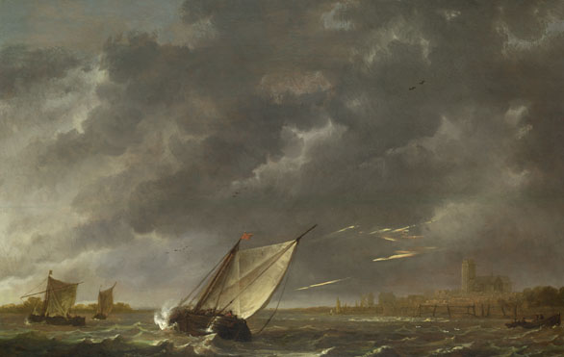
The Tempest
Shakespeare Unit of Work

Slide 2
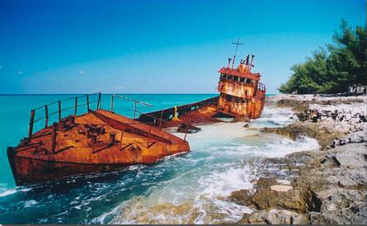
Lesson 1:
Shipwrecked
Learning Objective:
Work in a group, using learning from last lesson to contribute positively in speaking and listening assessments

Slide 3
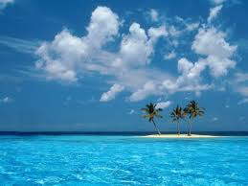
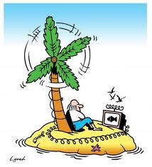
Shipwrecked!
Imagine you are
shipwrecked on an
uninhabited island.
What would your
perfect shipwrecked
island be like?

Slide 4
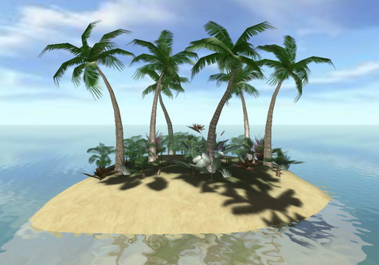
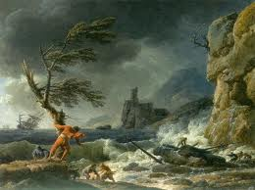
Shipwrecked
Which 3 items would you most want to take with you?
Which 5 things would you most like to find on the island when you arrival (people and electricity are not allowed) and why?

Slide 5
Shipwrecked
Complete these statements in your exercise book:
The three items I would take with me are...................
I choose these items because.....
What five things I would most like to find on the island when I arrive are............
(You must then explain each item in turn)

Slide 6
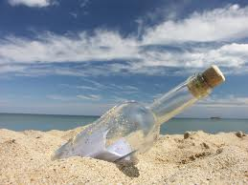
Shipwrecked!
Write a short story about being shipwrecked alone on an island.
Use this structure to help you:
Introduction
Build up
Crisis/dilemma
Solving the problem
Resolution

