Slide 1
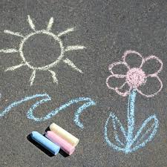

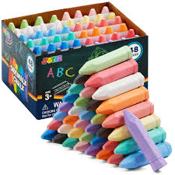
Inform
What will be new this week?
Chalks

Slide 2
Innovate
How can we not use it?
How can we use it?
Don’t break the chalk deliberately
Don’t lick or eat the chalk
Don’t draw on the school building
Draw- pictures
Play games- noughts and crosses
Write- letters, your name, pratice phonic sounds

Slide 3


Negotiate
What new rules do we need for
our new activities and equipment?

Slide 4
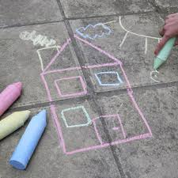
What rules do we need for chalk?
Chalk
Don’t draw on ourselves or others
Don’t wipe hands on our clothes- go and wash chalk off in the outside sinks
Share chalks
Please return the chalks into the boxes and please place lid on top
If you see chalk on the floor pick it up please- don’t stand on it
Negotiate

