Slide 1
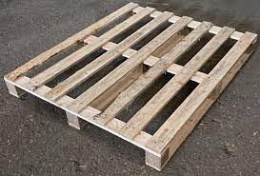
Inform
What will be new?
Pallets

Slide 2
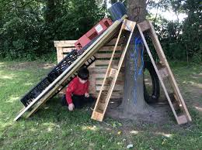
Innovate
How can we not use it?
How can we use it?
No dragging or pulling pallets
Don’t destroy someone else’s den
Don’t take resources from others
Use as steppingstones 1 high
Make a shelter
Build dens

Slide 3


Negotiate
What new rules do we need for
our new activities and equipment?

Slide 4
Negotiate
Crates
Play team will remain vigilant about correct use.
When den building no higher than 4 pallets high
When den building the stability of pallets structures will be checked for safety before playing in them by the play team
Lifting
Ready Steady Lift- bent knees straight back
Ks1 four children each corner
KS2 2 children either side- ask for help if its too heavy.
As they are heavy objects they must not be carried above the head
Look out for damage, loose wood (could cause splinters) or sharp pieces- report to Play Team and it will be removed from the play environment
What rules do we need when with pallets?

