Slide 1




Friendly Friday

Slide 2
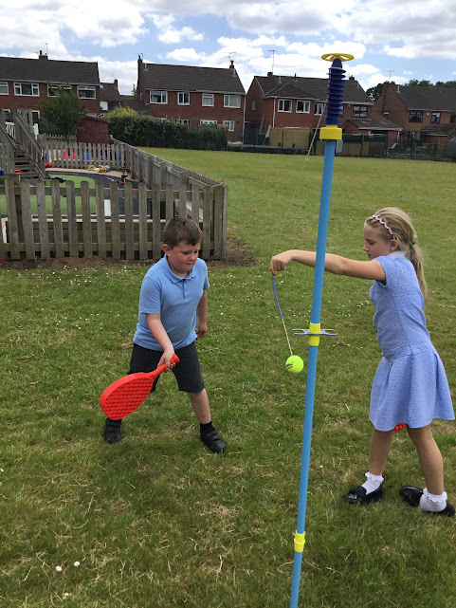
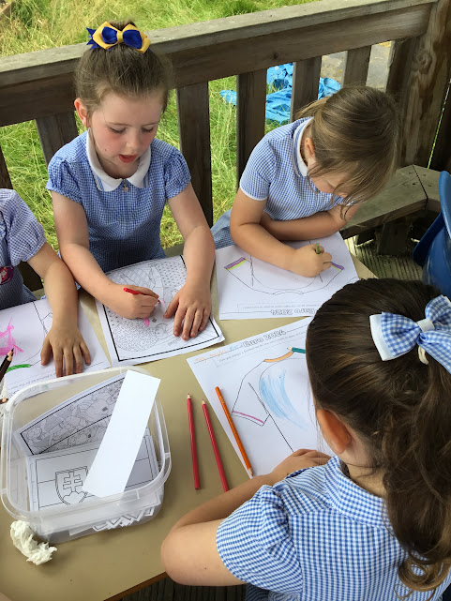
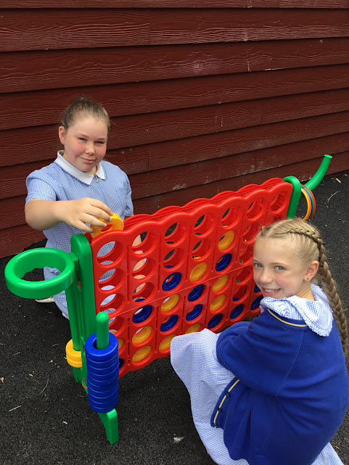
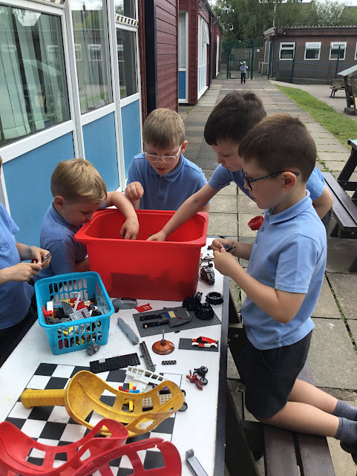
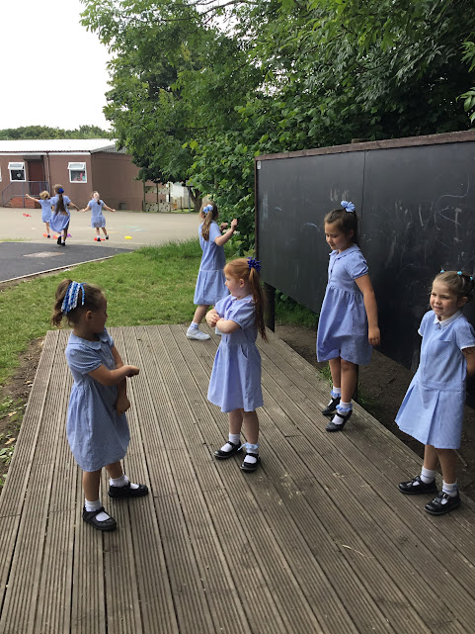
Celebrate
We’ve had so much fun!

Slide 3
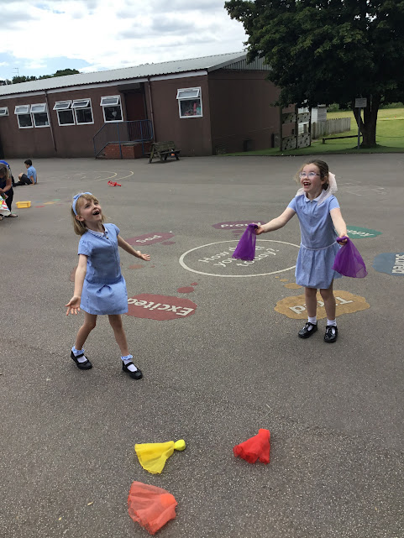
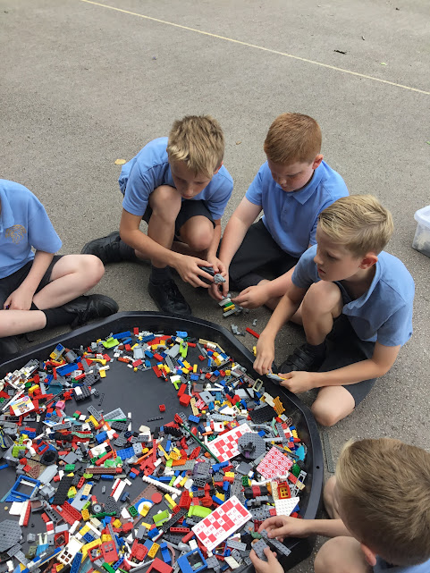
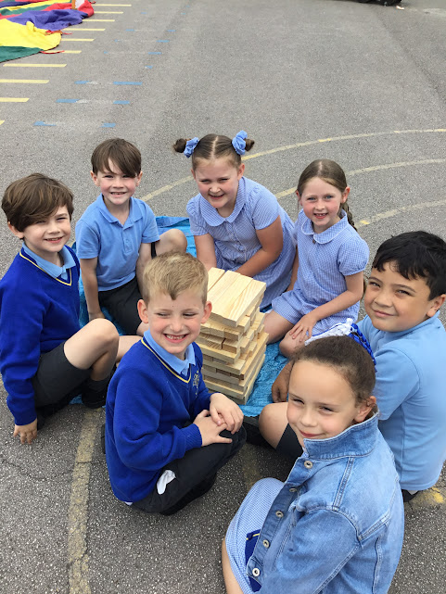
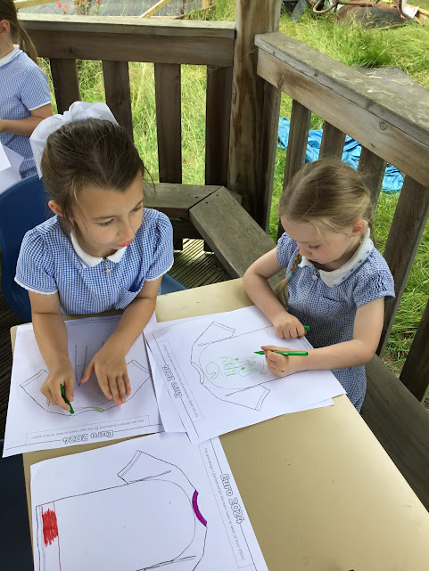

Slide 4
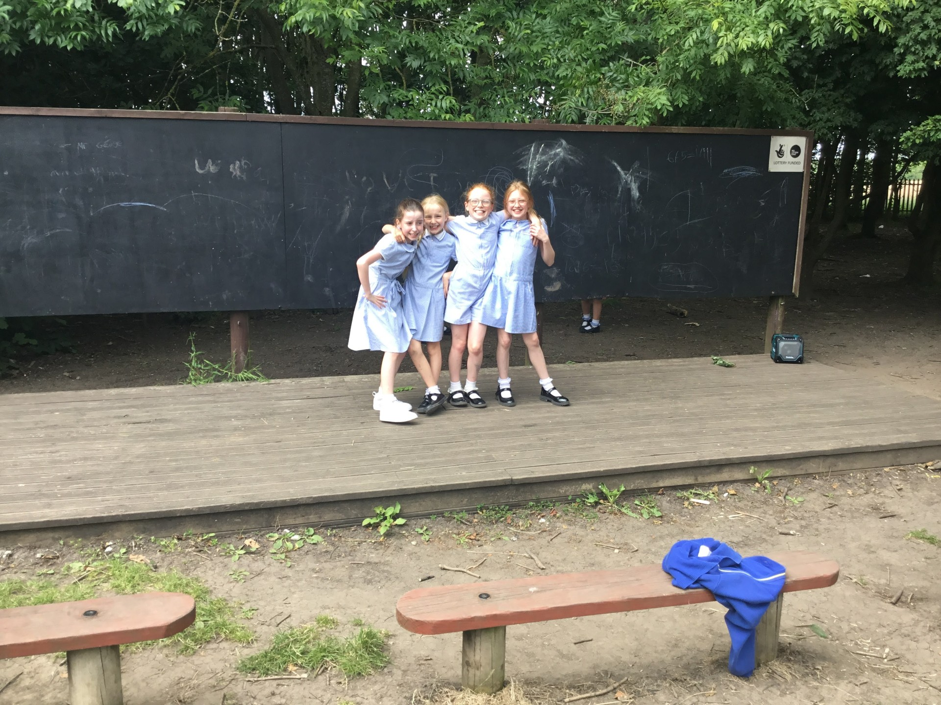
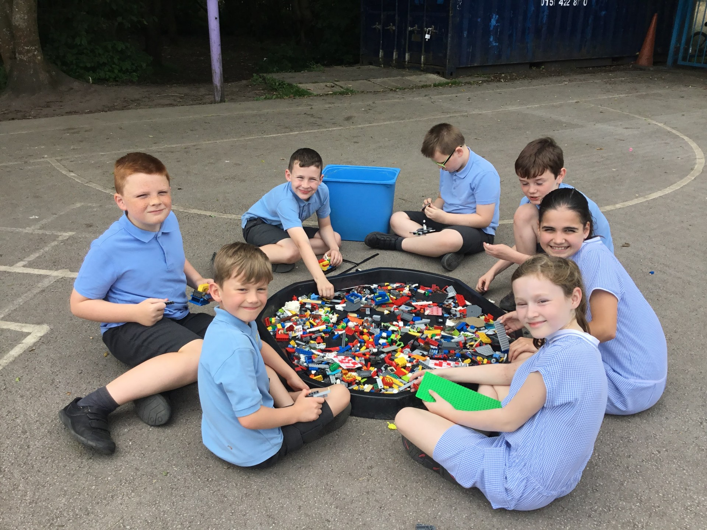
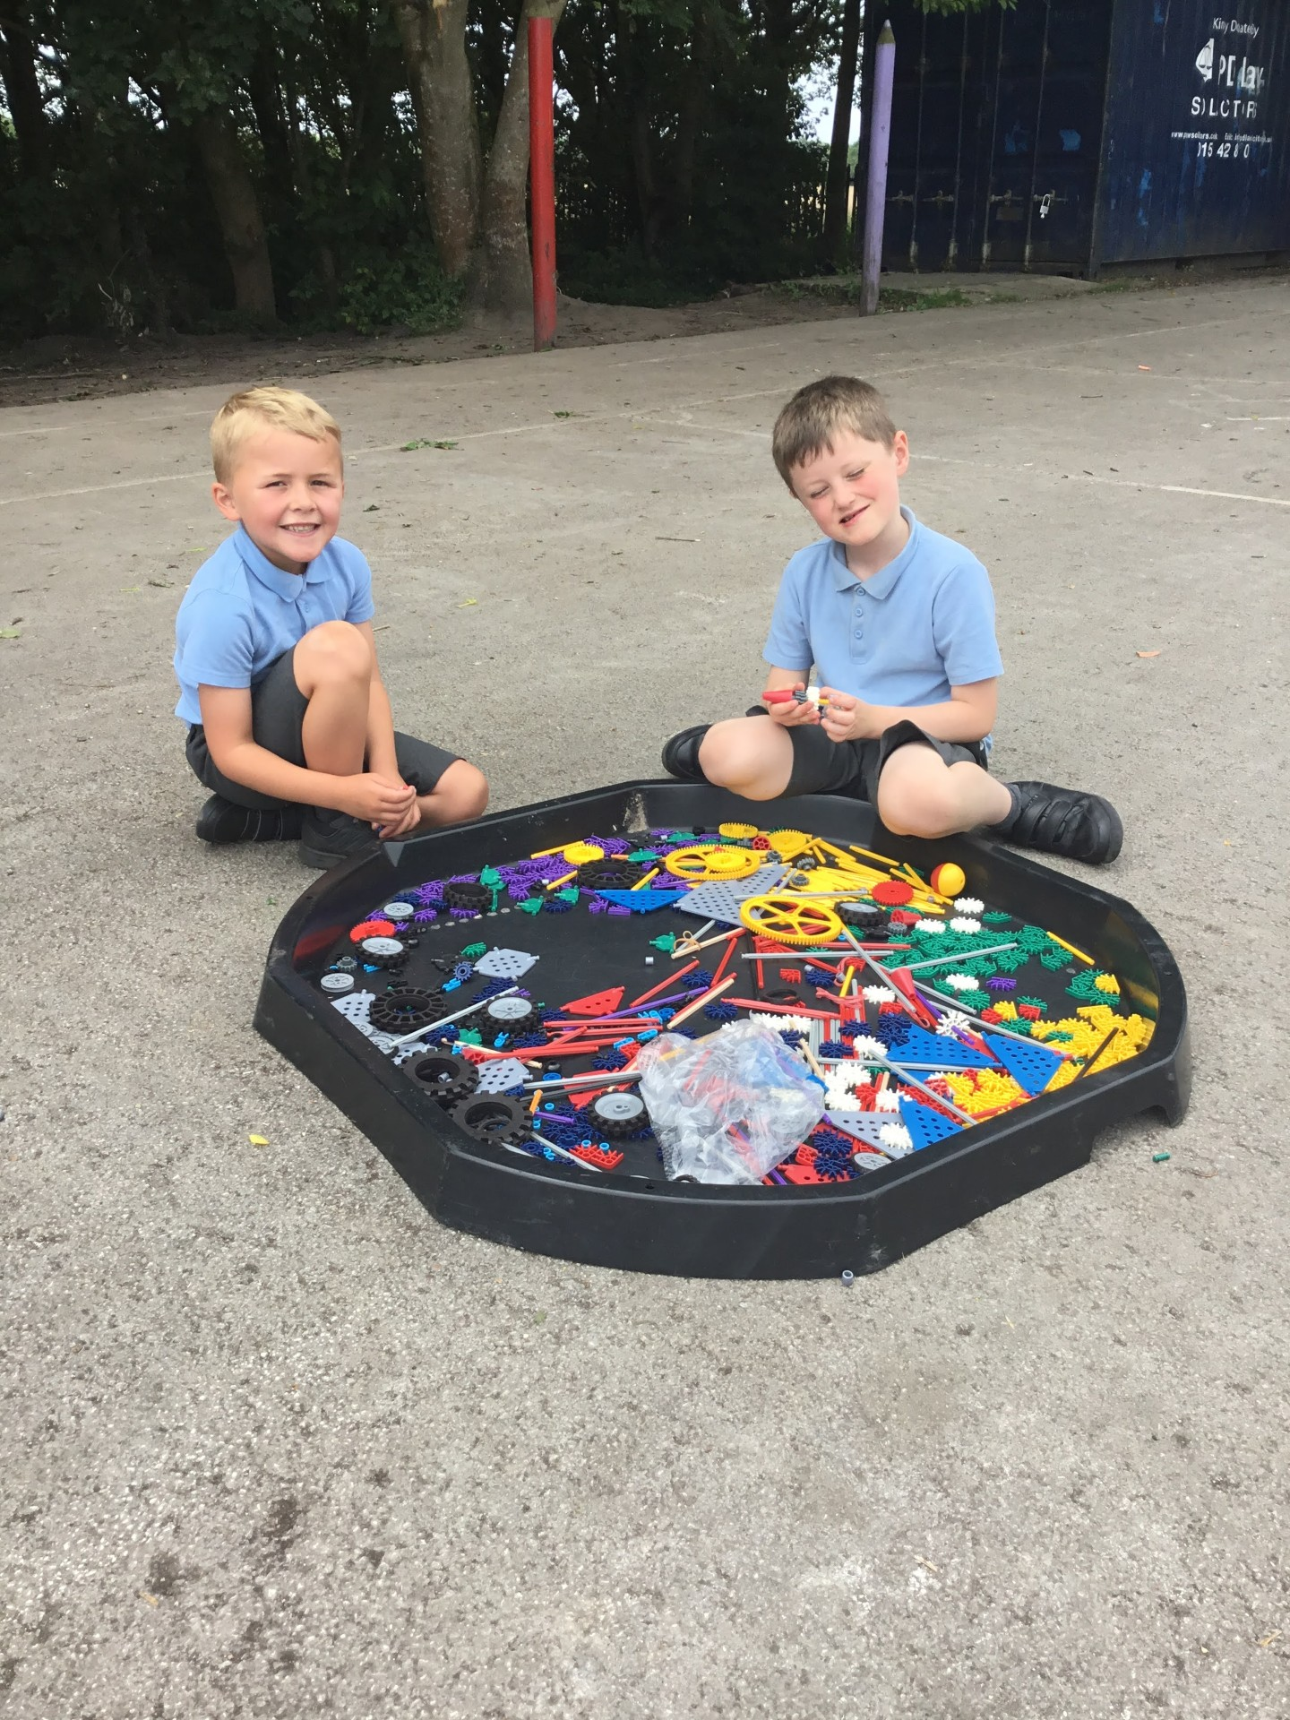
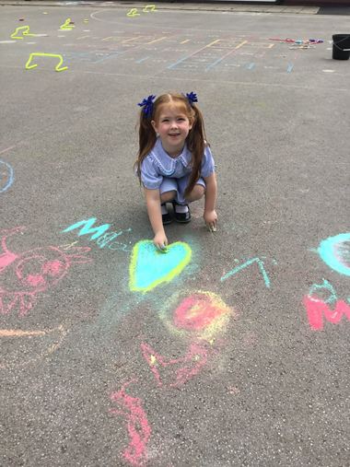
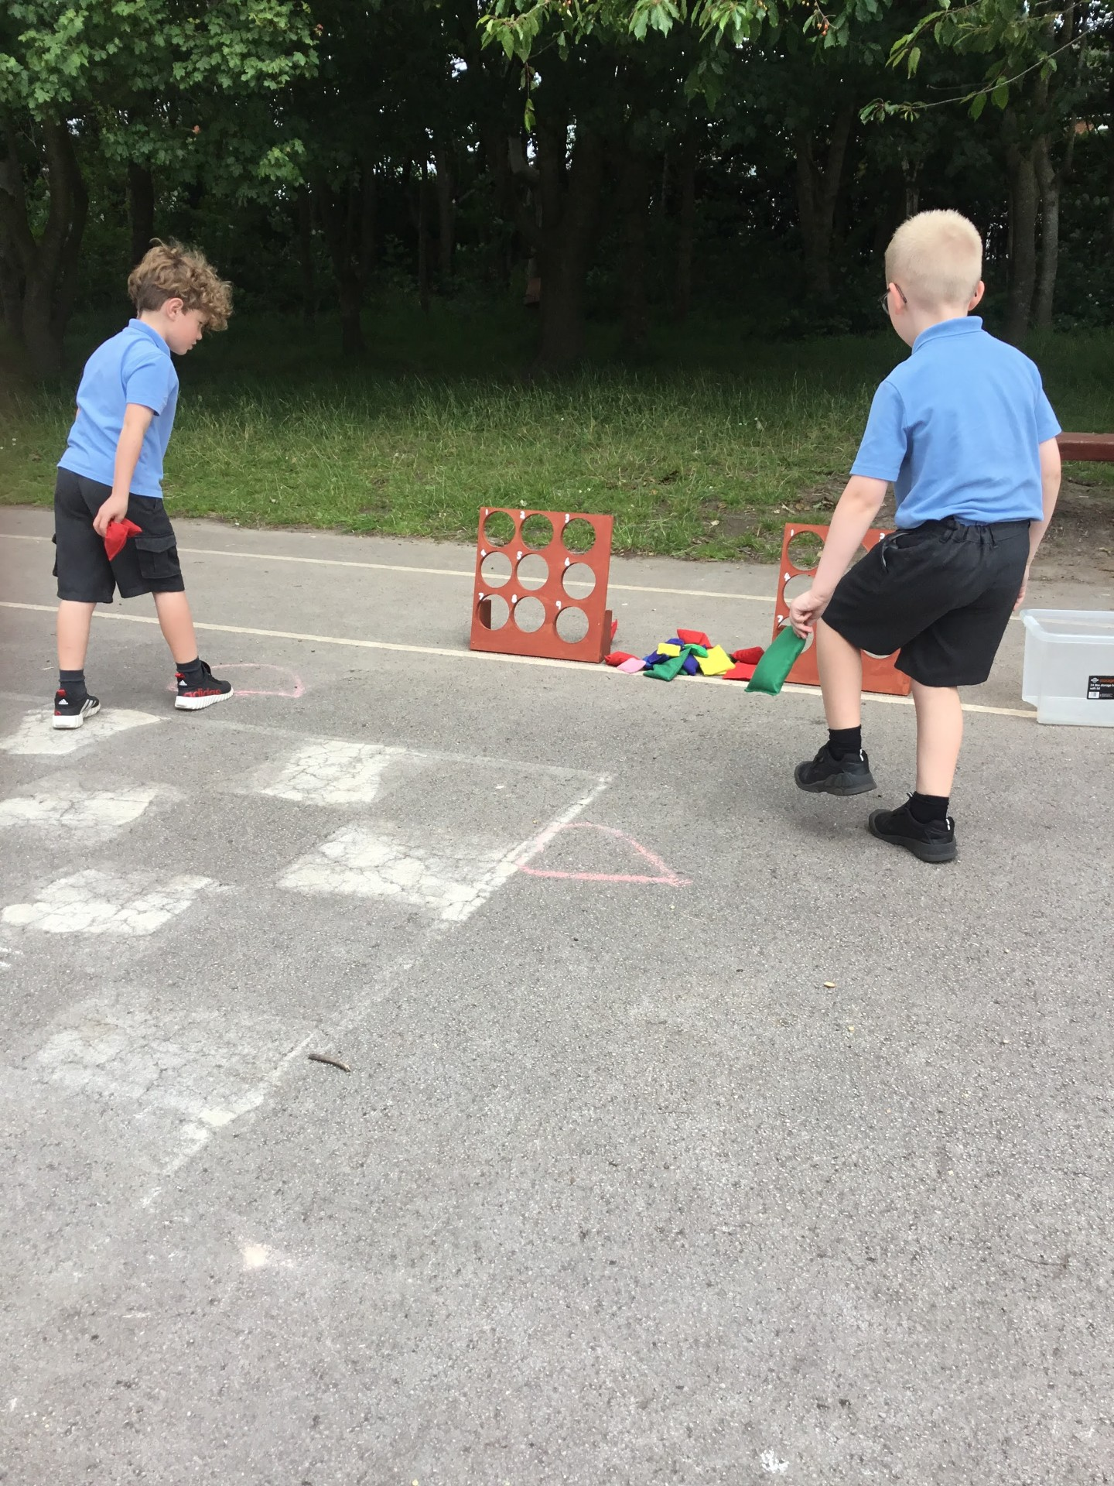

Slide 5
Inform
We will introduce football next week weather dependent.
Each class will have their own day.
Year 1 & 2 Monday
Year 3 Tuesday
Year 4 Wednesday
Year 5 Thursday
Year 6 Friday
No other year groups are to join in on other classes days
Only one football out in the football area only.

Slide 6
Innovate-
Tidy up rules
Respect the equipment.
When you have finished playing with something put it away.
Everyone help even if you didn’t play with it (showing teamwork).
At end of lunchtime make sure each area is tidy.
Check and make sure the correct number of equipment has been collected- Year 6 to monitor
Tidy up carefully and return equipment back into boxes.

Slide 7
Negotiate-
Tidy up when the 1st whistle is blown. (12.50)
2nd whistle line up on normal playground.
Keep equipment in the zones.
Use equipment correctly.
Football:
No deliberate kicks.
No tackling too hard or slide tackles.
Only 1 football match in the football area only.
Wellies to be worn when the grass is wet to protect your feet in all weathers. This allows you to explore your surroundings and access the school field and sports acitvities
No other balls to be out on Friday unless provided in zones.
It is your job to make sure you tidy up and put equipment in correct boxes.

