Slide 1
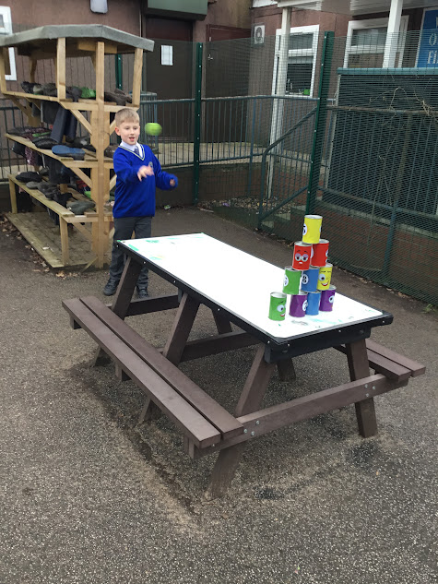
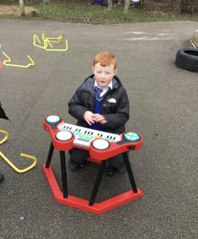


OPAL Play
Assembly

Slide 2
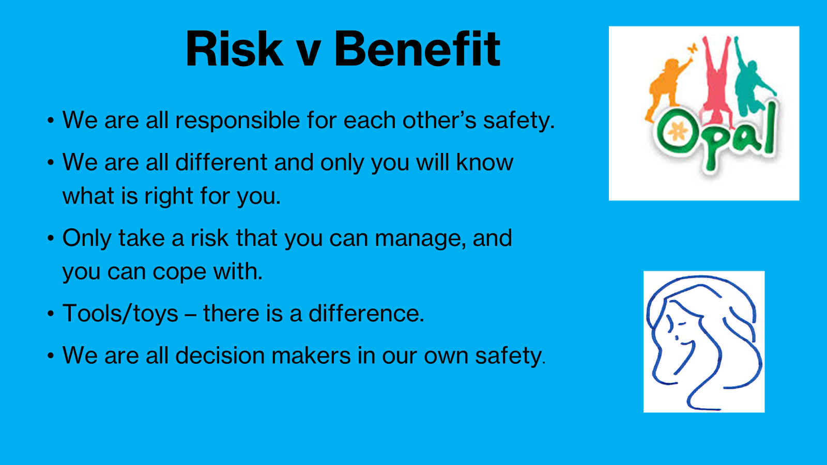

Slide 3
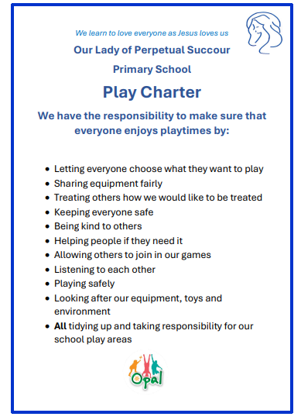

Slide 4
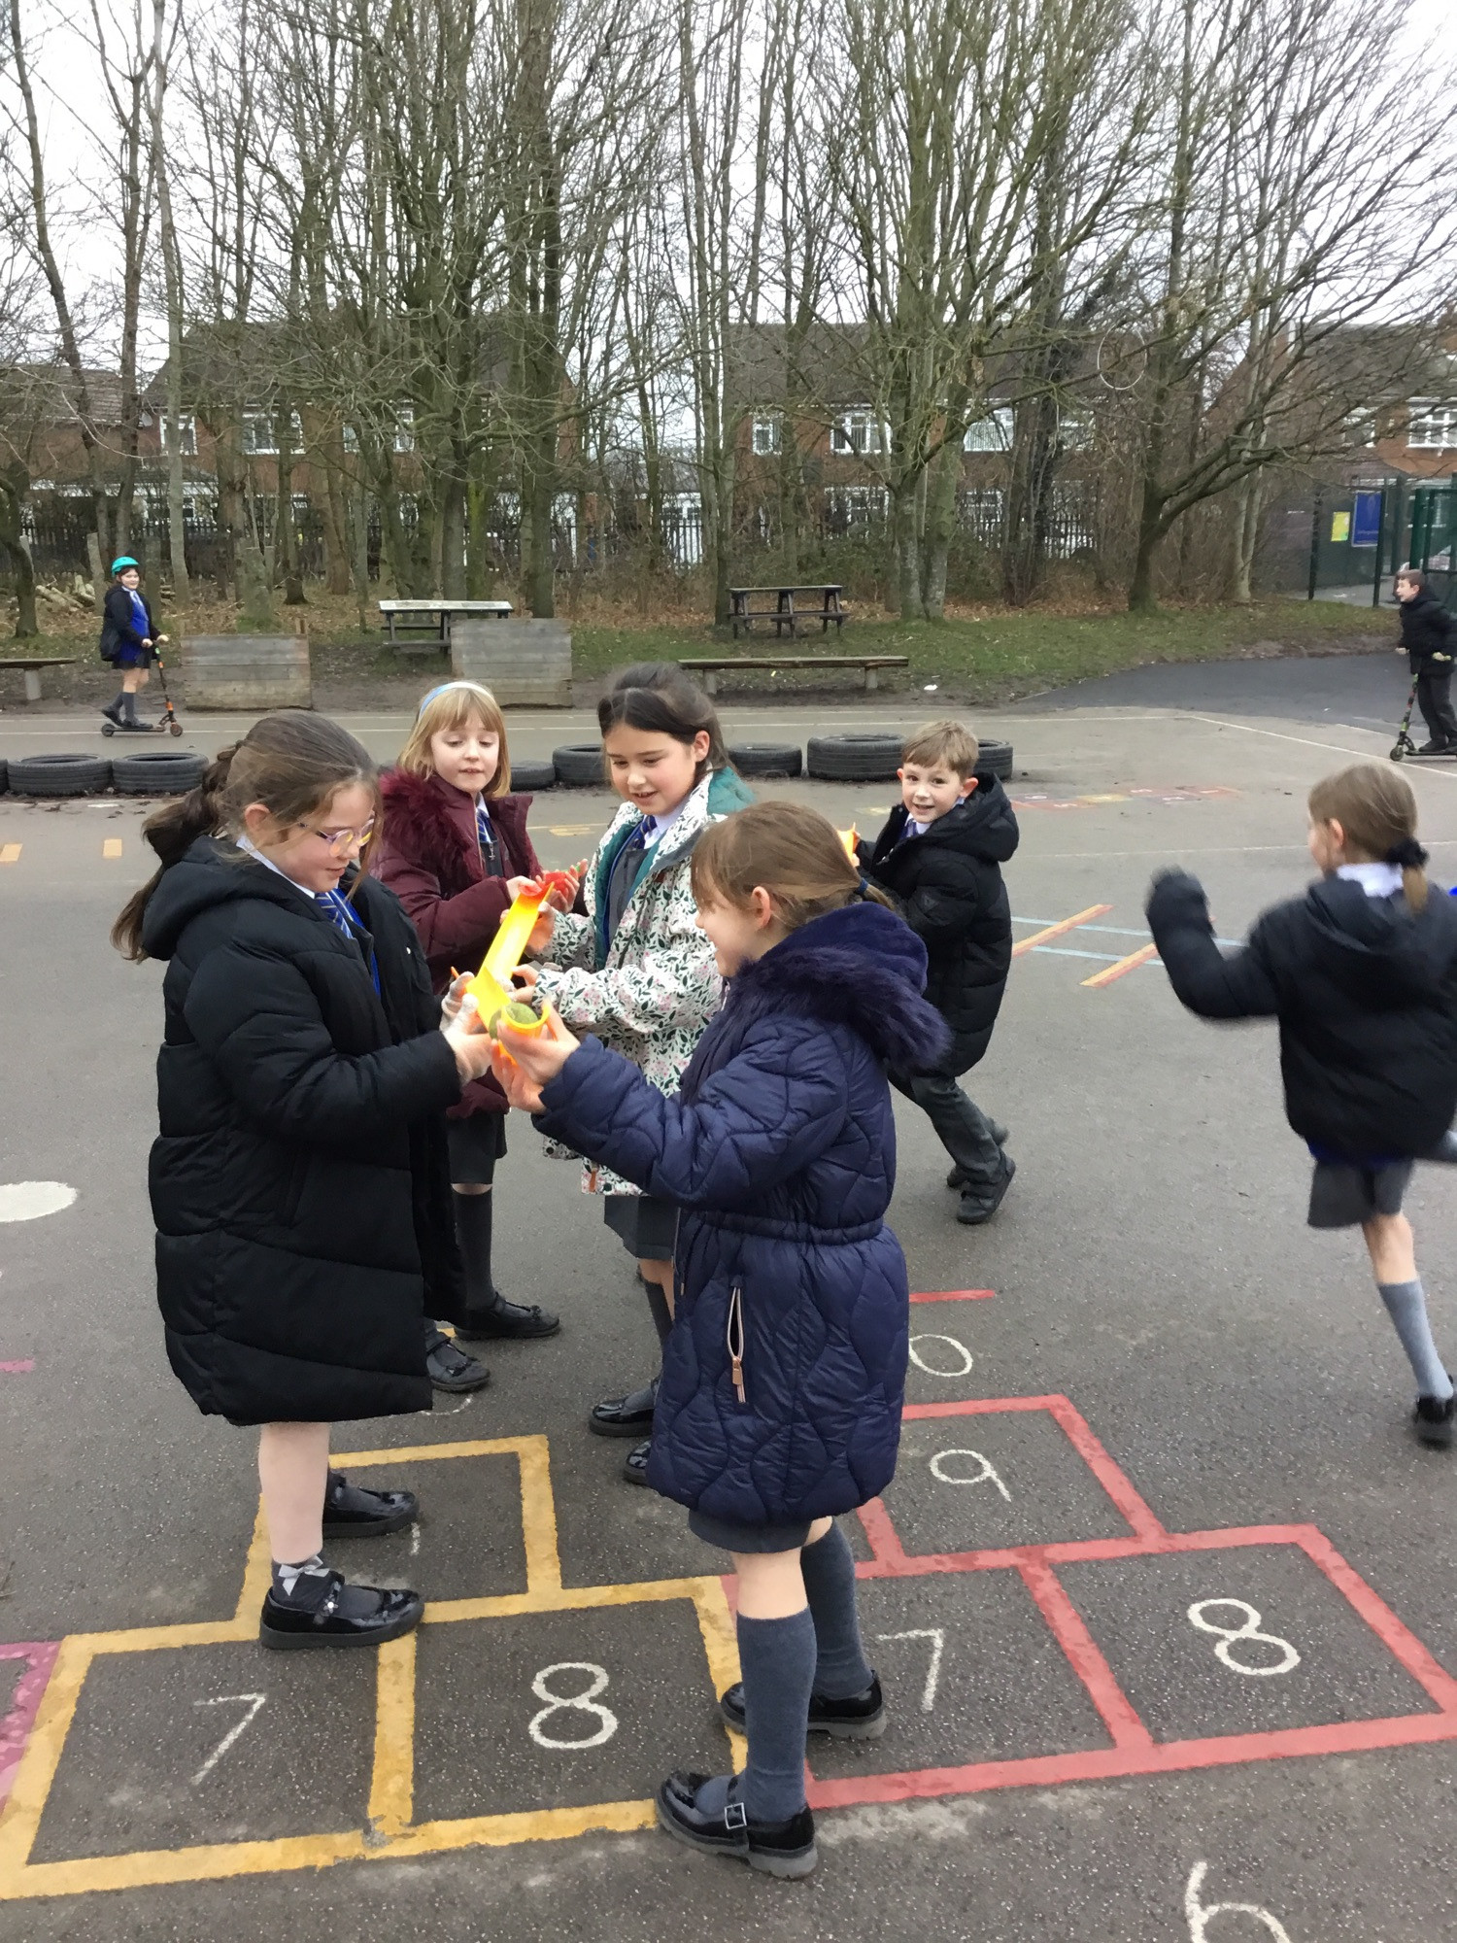
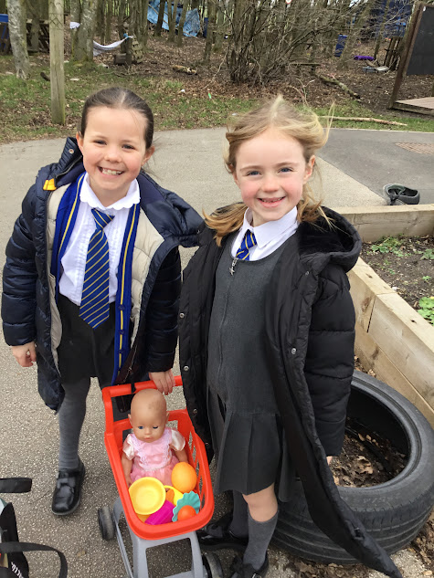
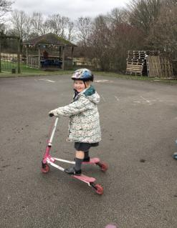
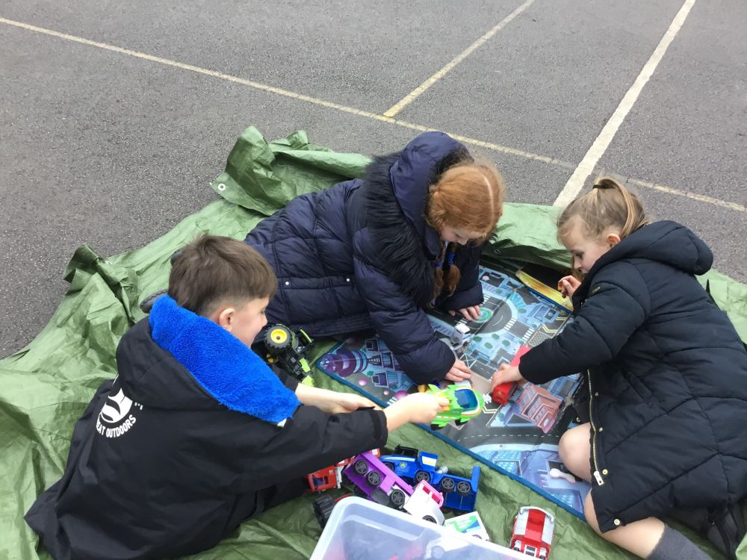


Celebrate
Amazing examples
of play during OPAL loose parts bingo reward extra playtimes

Slide 5
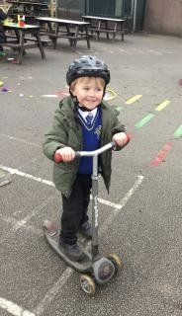
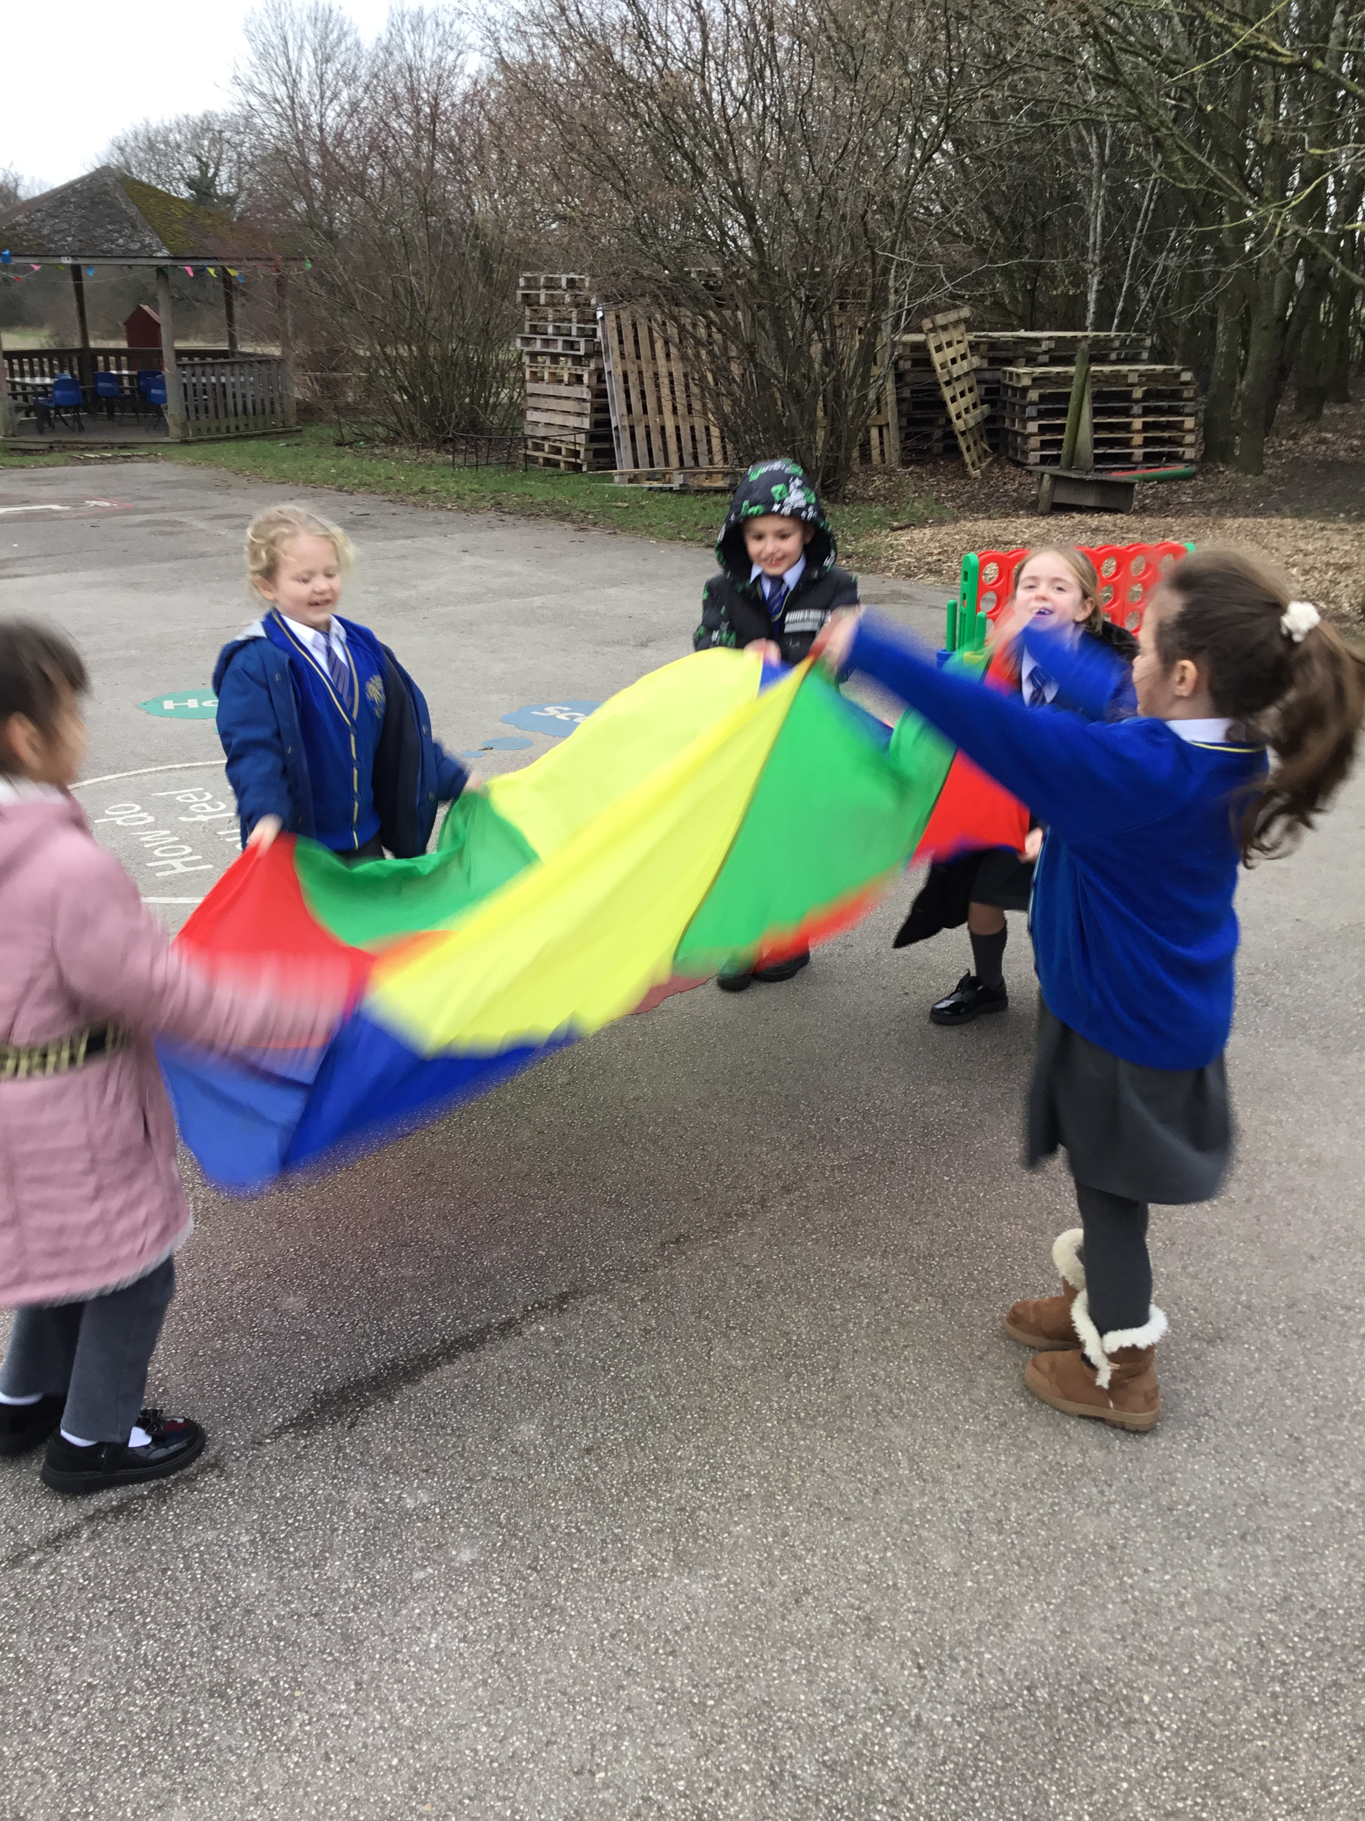
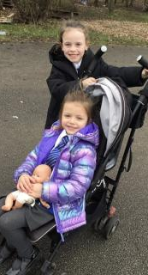

Slide 6
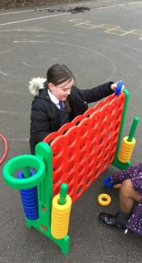
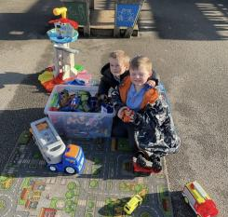
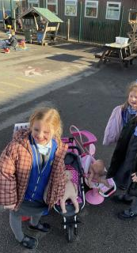

Slide 7


Inform
A huge thankyou to our families who donated items for our loose parts bingo.

Slide 8
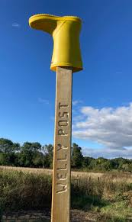
Inform
Welly post
Important:
If wellies are needed for the field area a welly will be put on the welly post located next to the trim trail.
If there's no welly, no wellies are needed.

Slide 9
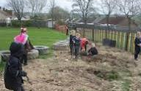
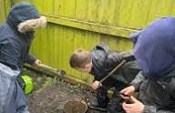
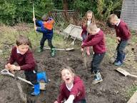
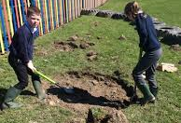
Inform
This week children, staff and Mr. Daniels will be preparing the digging area. I'm sure we will have lots of messy fun!

Slide 10
Innovate- equipment
How can we use it?
How can we not use it?
Choose it
Use it
Put it away!
Don’t damage equipment
Use correctly and don’t disrespect equipment- lots of lost balls, Lego left under benches
When finished leaving equipment on the floor for others to pick up!

Slide 11


Negotiate
What rules do we need reminders, for
existing or new activities and
equipment?

Slide 12
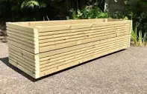
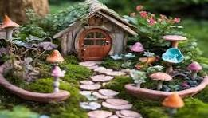
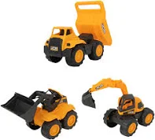
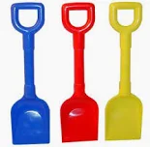
Negotiate
KS1 playground planters
•Do not take garden tools, digging toys or fairy garden items out of the planters.
Don’t throw sand, wood chippings or mud.
Please wash hands after play.
Plastic trowels (garden equipment) are used for digging and are "tools, not toys"
Share equipment/toys in the planters.

Slide 13
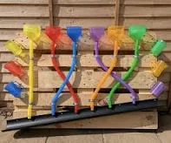
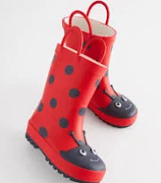
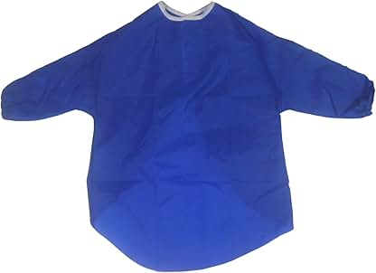
Negotiate
Water Wall
Important:
Wellies are to be worn to stop socks and shoes getting wet.
Aprons are to be worn- to stop clothes from getting wet.
Slip Hazards: Be careful of water spillages on playground-maybe slippery.
Do not intentionally wet yourself.
Please don’t throw water at others.
Please don’t drink the water.

Slide 14
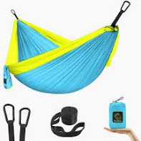
Hammocks
Negotiate
How to safely get in and out of a hammock
Stand in the middle of the hammock facing away from the hammock.
Grasp the far edges for stability, and slowly sit down, shifting their weight to the centre.
Leg Swing:
Once seated hold onto the sides and swing your legs up, one by one, into the hammock.
Safe Exit: To get out, sit up, place one hand on each side, swing your legs to the ground, and stand up.

Slide 15
Hammocks
Negotiate
Be aware when swinging in hammock and be aware of risks- falling out if you swing too high.
Reminder- children to check the ground underneath the hammock for rocks, tree roots
Never stand, jump, or swing too high in the hammock
Use by one person at a time to prevent tipping or overloading.

Slide 16
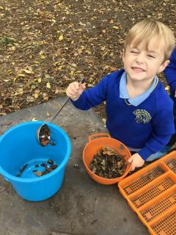
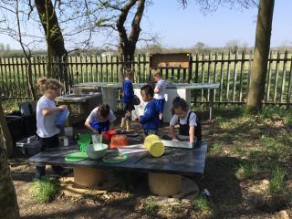
Negotiate
Mud kitchen
Don’t pick up heavy pots- ask play team, play rangers for help
Mud kitchen equipment (pans, cake tins mixing bowls and kitchen utensils) are to stay in the mud kitchen area. They are not taken to be taken to dens.
Recipe clip boards are not to be removed from the mud kitchen.
Pots with resources (pebbles, acorns pinecones, leaves) are not to be taken off the mud kitchen.
Please respect items provided for the mud kitchen as many items have been damaged and broken.
At the end of lunch, the mud kitchen must be tidied up and equipment returned.
Reminders

Slide 17
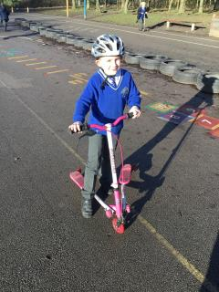
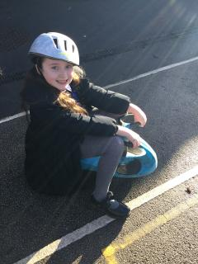
Negotiate
Wheeled areas
Don’t walk on the wheeled area.
Always follow the one-way system.
Always wear a helmet.
Be aware of speed and crashing into others on scooters and wiggle bikes.
Don’t drop helmets on the floor please take care of helmets- give to another child or put onto bars of scooter when you take them off.
You must wear arm and knees pads on the pulleys/ scooter boards.
If you're pushing a friend in a pushchair- don’t run and be aware of scooters and wiggle boards.
Reminders

Slide 18
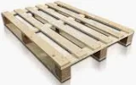

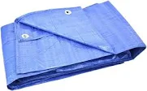
Negotiate
Loose parts
Pallets- to move 4 KS1 Children at either end and 2 KS2 children.
Tyres- safe heights for stacking/ climbing in tyres ‘up to the waist height’.
Roll to move tyres
Tarpaulin- No wrapping of tarps around a person’s body or wrapping a person within a tarp
Dens to have visible access/exit points and not to be fully enclosed
Broken loose parts or other resources- to be placed behind the metal container
Loose parts- Children encouraged to check loose parts and report damage to Play Team.
Ready, steady, lift” – bent knees and straight back
Reminders

