Slide 1
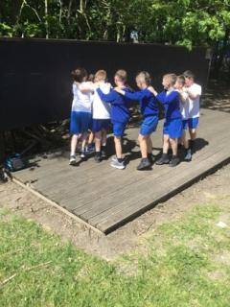
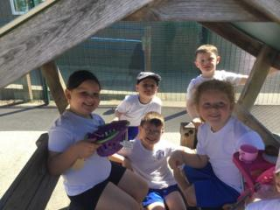
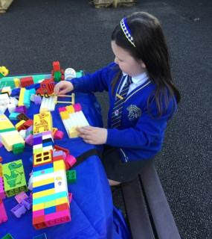


OPAL Play
Assembly

Slide 2
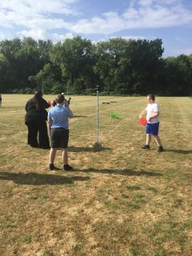
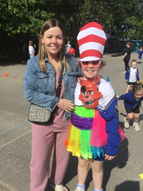
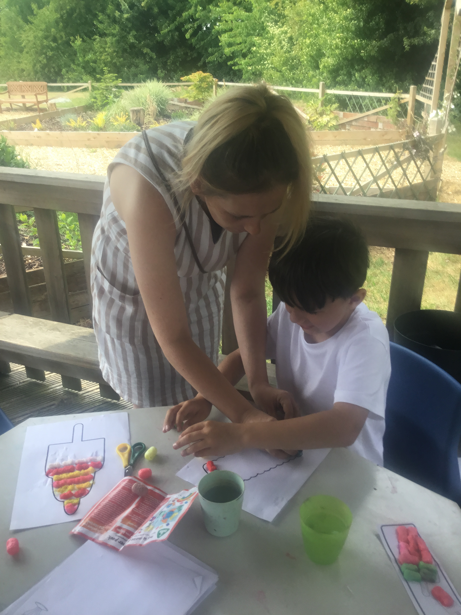
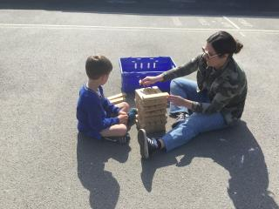
Celebrate
Parents Stay and Play
On Tuesday 20th May, we invited families to our first Parents Stay and Play morning and afternoon sessions.
Thank you to all the children, parents, carers, grandparents and other family members who attended.
It was lovely to see you engaging in the activities freely and I’m delighted to say it was a huge success!

Slide 3
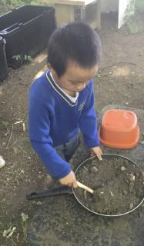
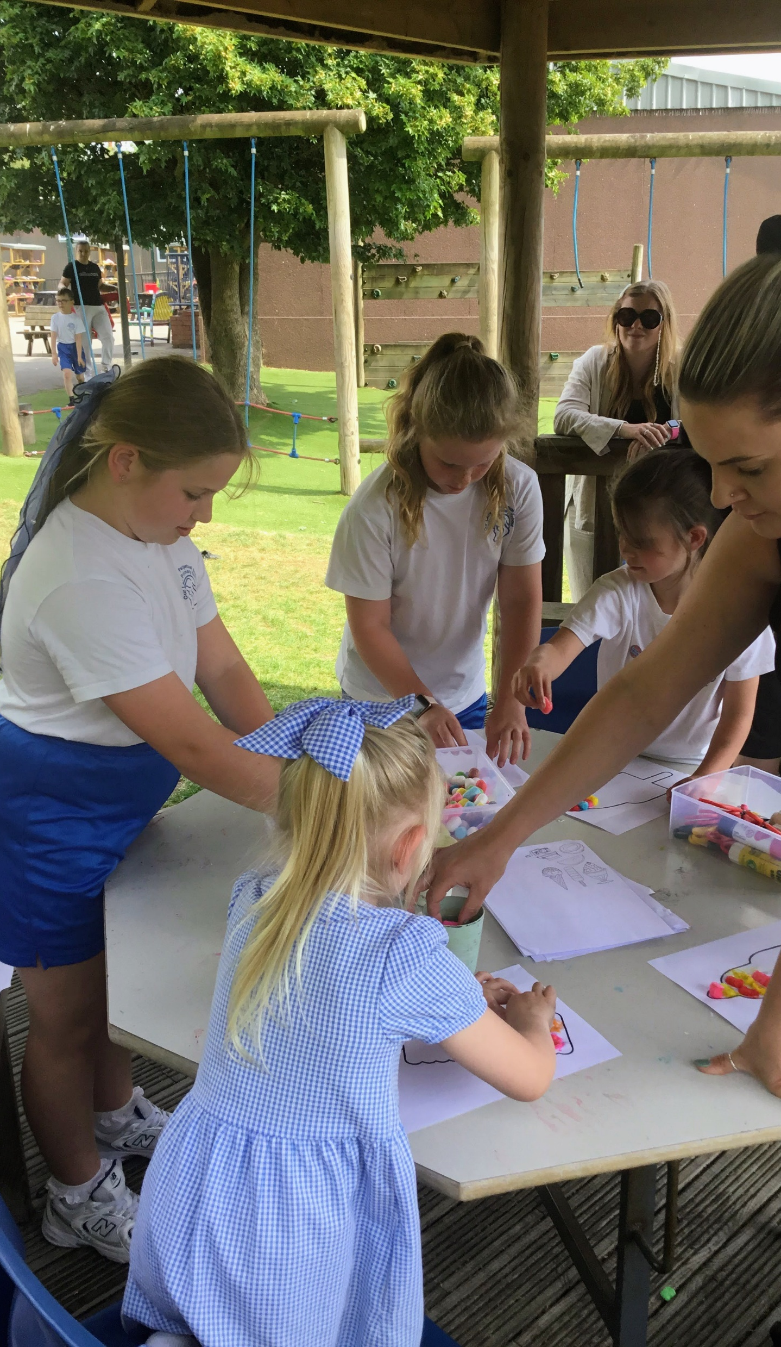
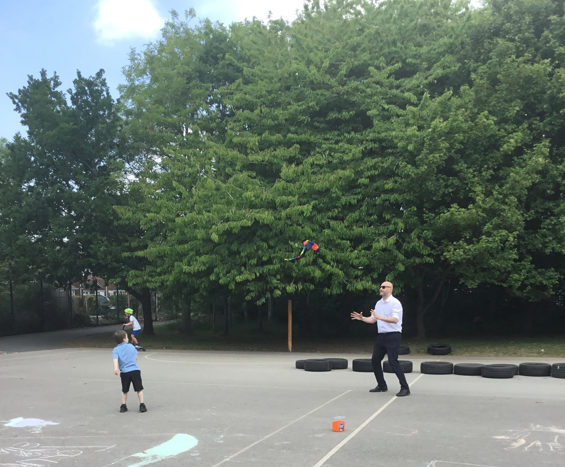
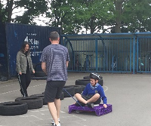

Slide 4
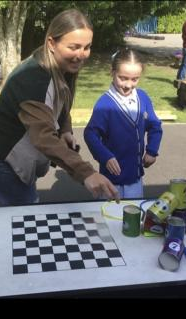
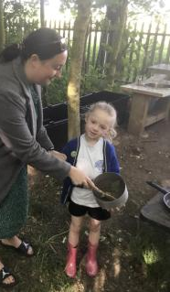
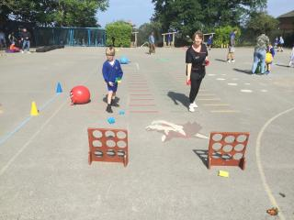
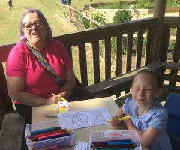

Slide 5
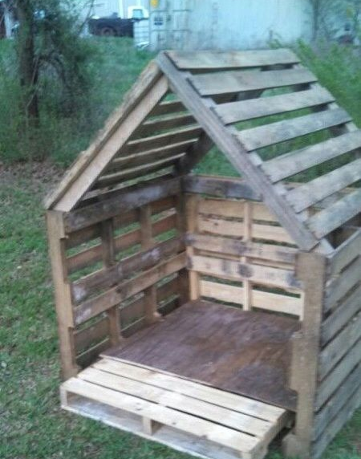
Inform
What will be new over the next few weeks?
Mr Daniels will begin construction of our pallet hut village.

Slide 6


Grand opening of
our new Sand Pit
Today Friday 13th June

Slide 7
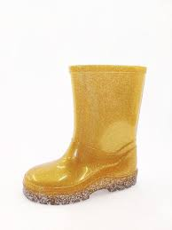

Golden Welly Award
A Golden Welly Award will be introduced next week.
The Play Rangers will choose 1 person to receive the award for:
Good sportsman ship
Outstanding behaviour
Showing initiative during play

Slide 8

Negotiate
What new rules do we need for
our existing and new activities
and equipment?

Slide 9
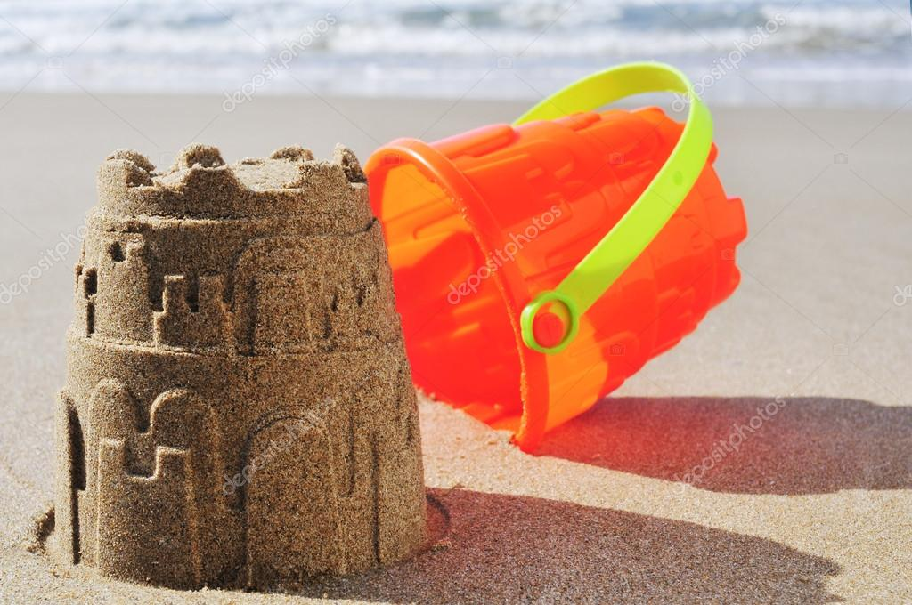

Sand Pit
Sand saying “the sand stays low, or out you go!”
“No doggy digging” to avoid sand in eyes.
DO NOT THROW SAND!
Children are expected to treat the sand pit and its equipment with respect.
Resources, including the sand pit, are to be shared.
Wash hands after sand pit use.
No other equipment is to be taken into the sand pit

Slide 10


Quiet area
For those wanting a quieter playtime –
Choose a book.
Pick a cushion or mat and sit down in the quiet corner (located between Year 3 and Year 4)
This area is for sitting, reading and quiet time ONLY.
When the whistle blows roll away mat neatly and take cushions to KS1 door at the end of playtime.
Please do not get the cushions wet.

