Slide 1
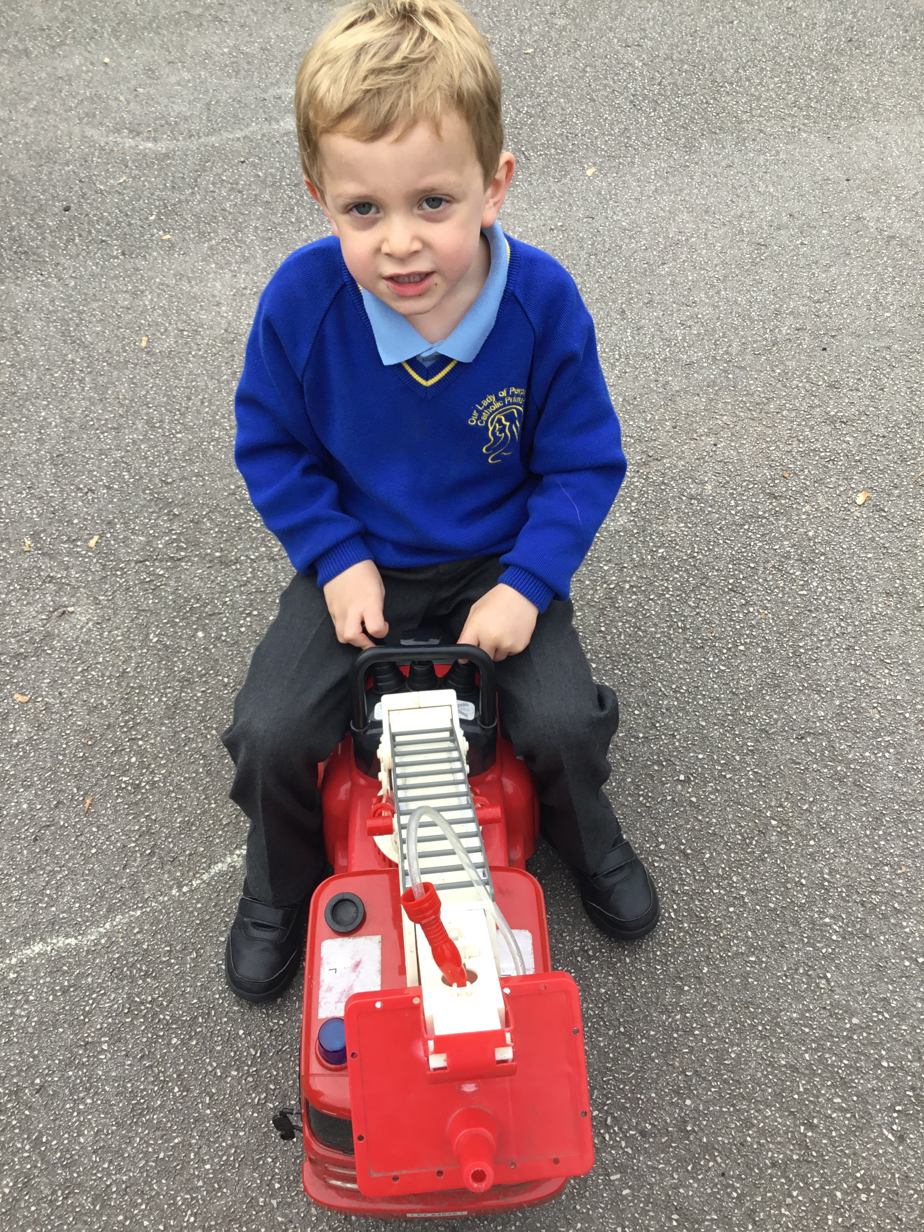
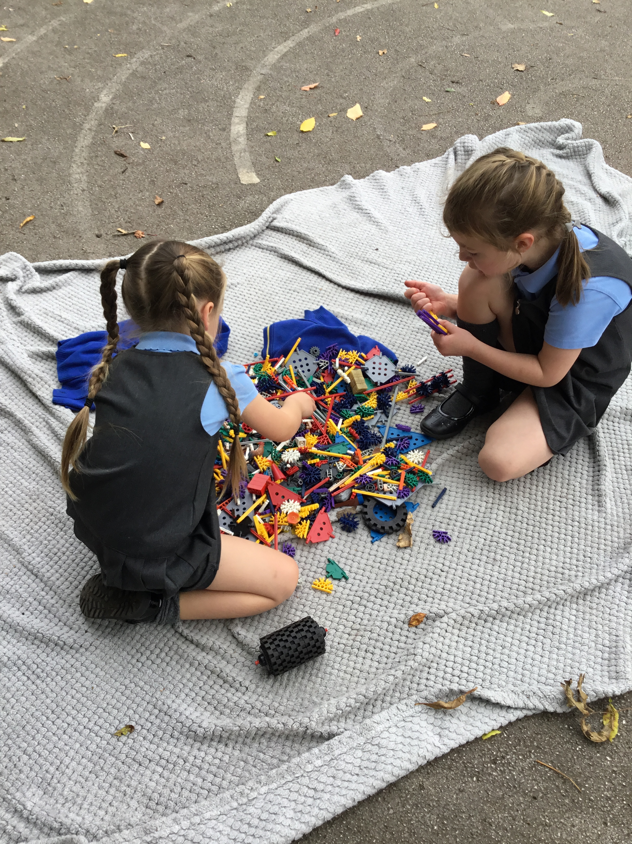

OPAL Play
Assembly

Slide 2
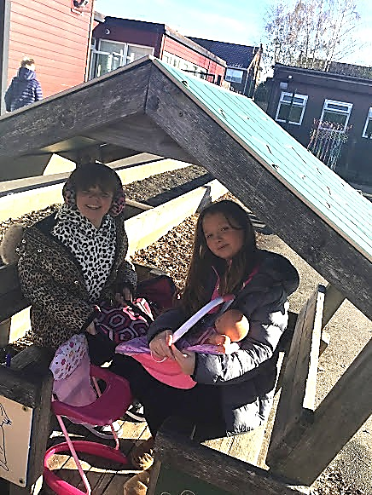
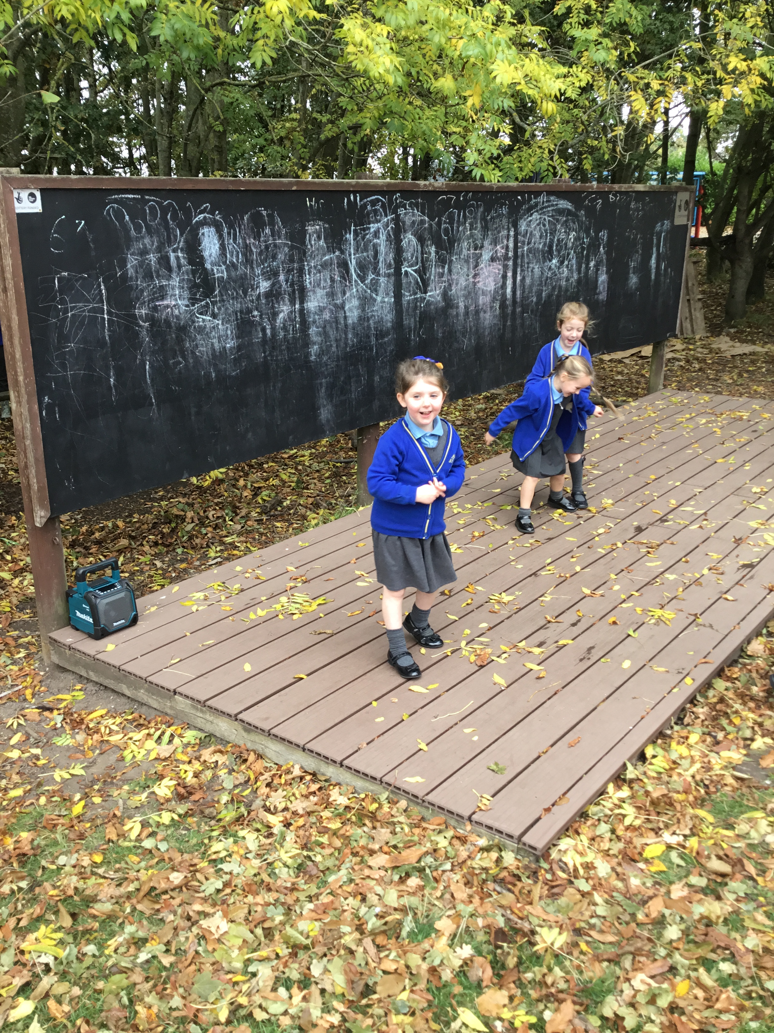
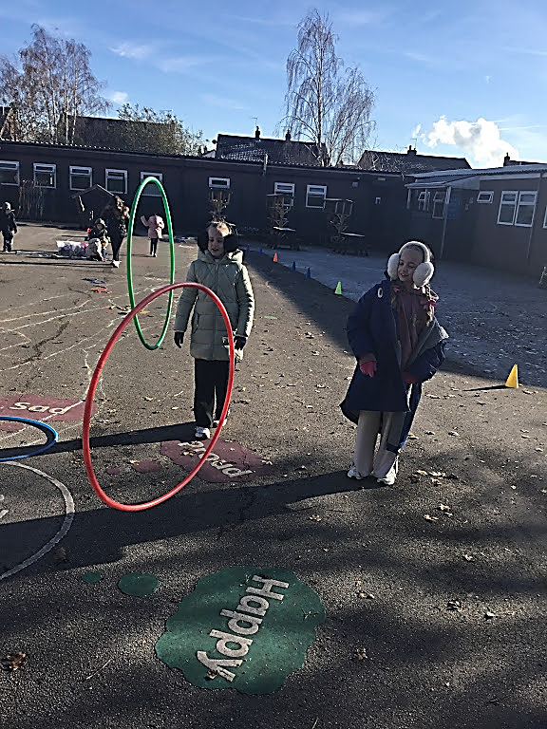

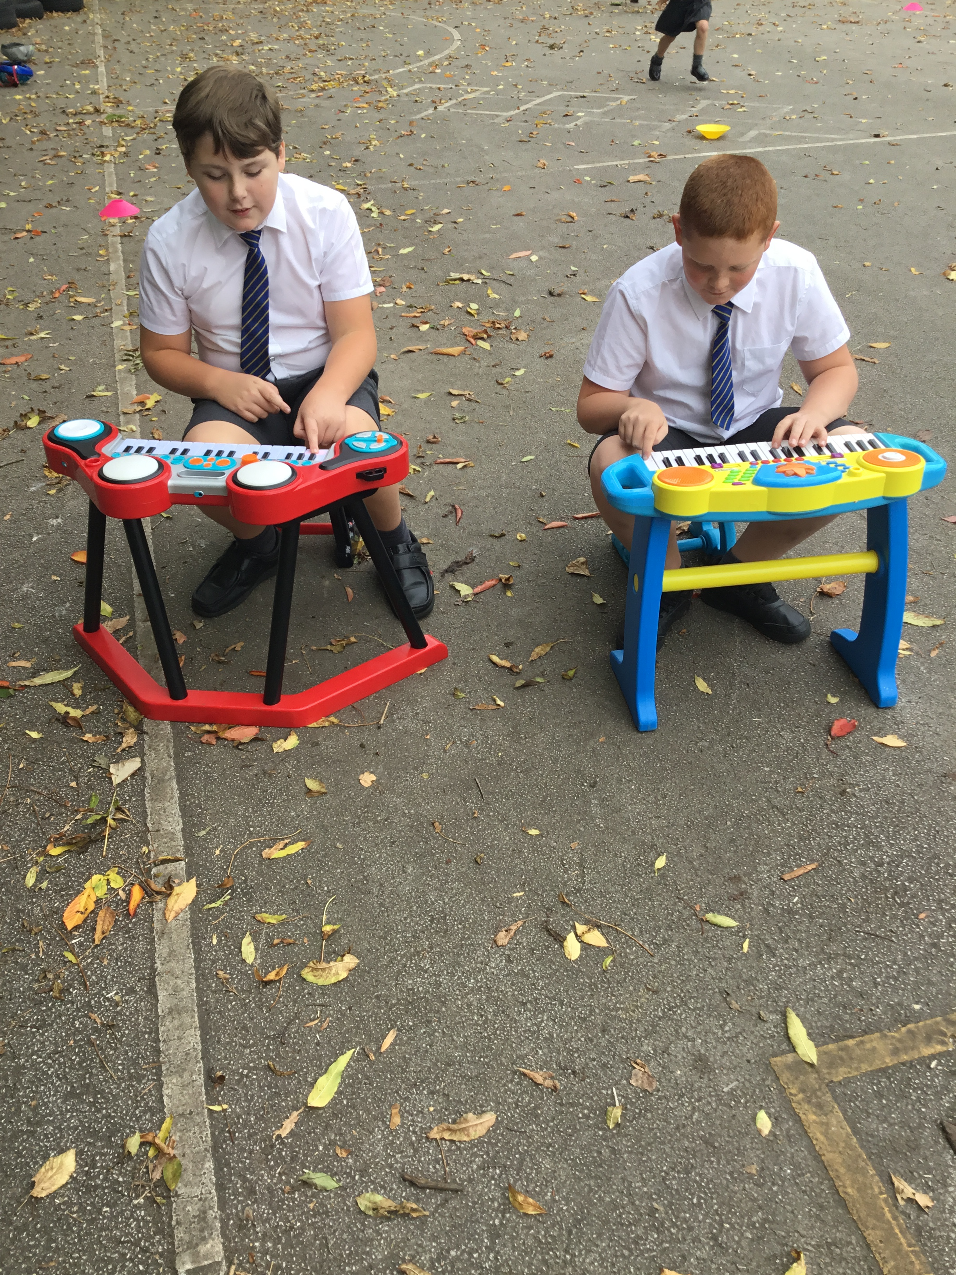
Celebrate
Amazing examples
of play

Slide 3
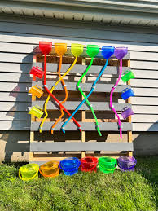
Inform
Over next few weeks Mr. Daniels will start to construct a water zone on the KS1 playground.

Slide 4
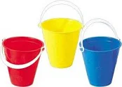

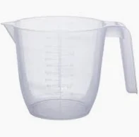
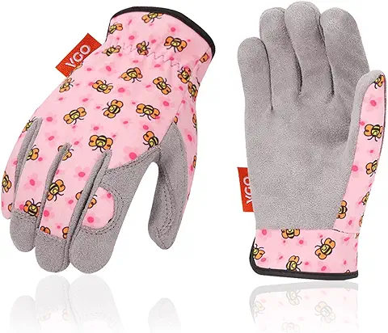
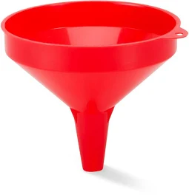

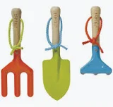
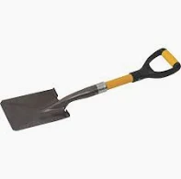

Slide 5
Inform
Loose parts bingo
Following the success of our previous bingo, we will be introducing a loose parts bingo next week.
We will be collecting resources for our Water Zone, Digging Zone and other zones.
More details will be sent; with a bingo card and the different loose parts each class will collect.

Slide 6
Innovate- equipment
How can we use it?
How can we not use it?
Choose it
Use it
Put it away!
Don’t damage equipment
Use correctly and don’t disrespect equipment- lots of lost balls, Lego left under benches
When finished leaving equipment on the floor for others to pick up!

Slide 7

Innovate
Thank you to our Year 6 play rangers who are doing a great job helping support the play team in the zones, promoting positive play and modelling good behaviour.

Slide 8


Negotiate
What rules do we need reminders, for
our existing activities and
equipment?

Slide 9
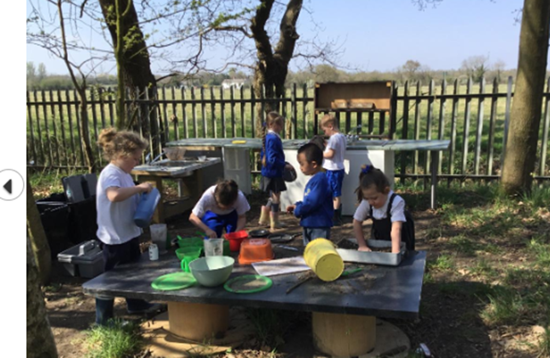
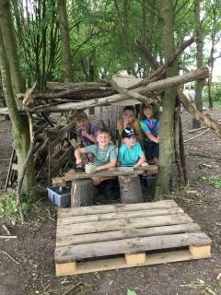
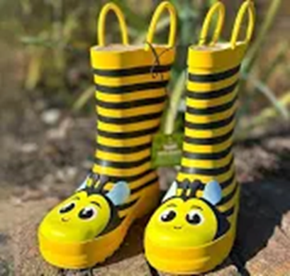
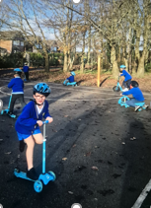
Reminders
Den building
Mud kitchen
Welly storage
Wheeled area

Slide 10

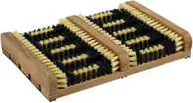
Negotiate
Welly Storage
• Welly boots in pairs upside down.
Toes in a row.
If the two rules above aren’t followed- welly’s left on the floor can't be used the next day (maybe wet)
If you've used the field or the sand zone wellies are to be scrapped on the welly scrubber before putting back on the welly storage.
Reminders

Slide 11
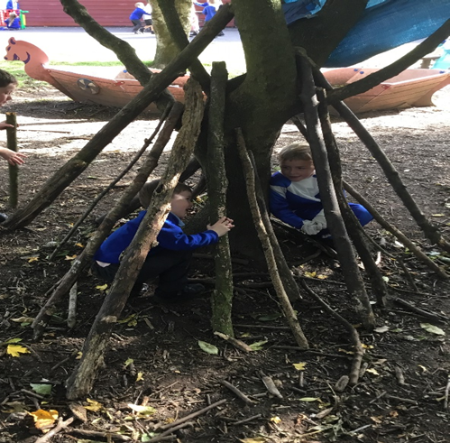
Negotiate
Den building
• A box of utensils and equipment for den use will be provided in a box which must be returned at the end of lunchtime. Use equipment correctly.
Be considerate of other people’s space and don’t destroy other dens unless they are finished.
Allow others to join in.
If you don’t make the right choices or any unkind behaviour or actions are used, entry into the woods zone will be stopped for a day each time an incident is reported!
Don’t take equipment from the mud kitchen for dens.
Behaviour
Reminders

Slide 12

Negotiate
Mud kitchen
• Please respect items provided for the mud kitchen as many items have been damaged and broken.
Recipe clip boards are not to be removed from the mud kitchen.
At the end of lunch, the mud kitchen must be tidied up and equipment returned.
Kitchen equipment (pans, cake tins mixing bowls and kitchen utensils) are to stay in the mud kitchen area. They are not taken to be taken to dens.
Pots with resources (pebbles, acorns pinecones) are not to be taken off the mud kitchen.
Reminders

Slide 13
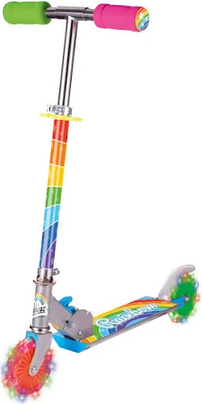
Negotiate
Wheeled areas
Be aware of speed and crashing into others on scooters and wiggle bikes.
Always follow the one-way system.
Always wear a helmet.
Take care of helmets- please give to another child or return to the box when you take them off.
Don’t drop helmets on the floor
You must wear arm and knees pads on the pulleys/ bread crates.
Reminders

