Slide 1
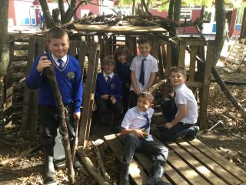
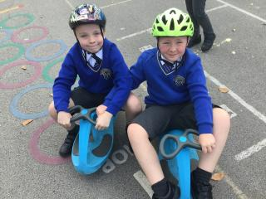

OPAL Play
Assembly

Slide 2
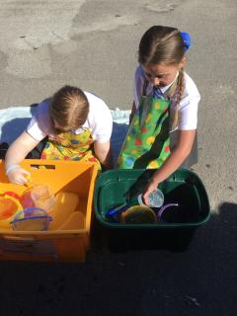
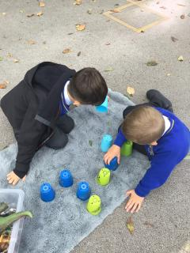
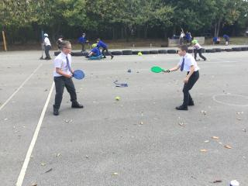

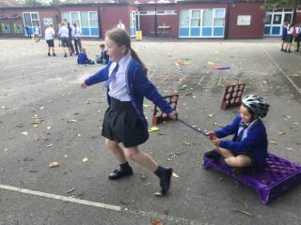
Celebrate
Amazing examples
of play

Slide 3
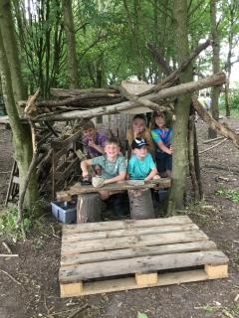
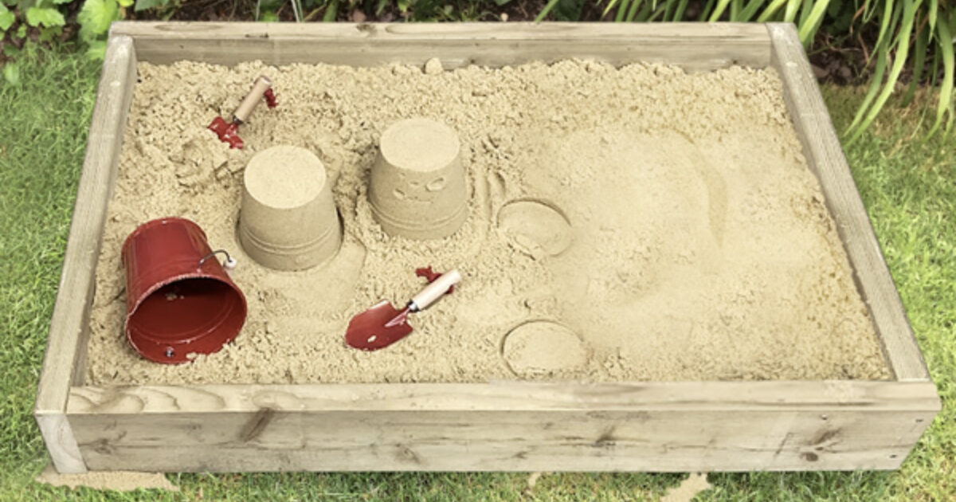
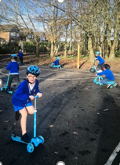
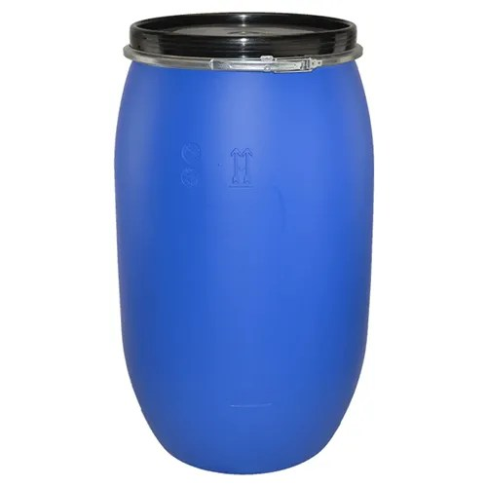
Inform- reminders
Den building
Sand pit
Wheeled area
Plastic drum

Slide 4


Negotiate
What new rules do we need for
our new activities and equipment?

Slide 5
Negotiate
Plastic drum
•Make sure when rolling nobody's fingers are underneath.
No throwing.
Don’t pick the up, roll to move.
Please don’t push another child over them.
Build dens.
Roll over them with care- on soft grass- not concrete.
Reminders

Slide 6
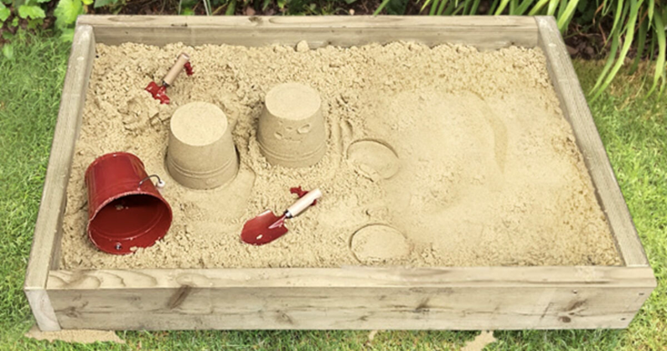
Negotiate
Sand
•Keep the sand low or out you go!
No doggy digging to avoid sand in eyes.
Tidy equipment back into the wooden hut at the end of play.
Wellies to be worn from October onwards.
Shake as much sand off before you get out of the sand pit.
Reminders

Slide 7
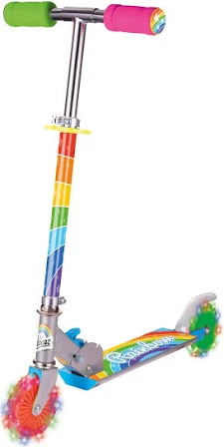
Negotiate
Wheeled areas
•Be aware of speed and crashing into others on scooters and wiggle bikes
Always follow the one-way system
Always wear a helmet
Take care of helmets- please give to another child or return to the box when you take them off
Don’t drop helmets on the floor
You must wear arm and knees pads on the pully bread crates
Reminders

Slide 8
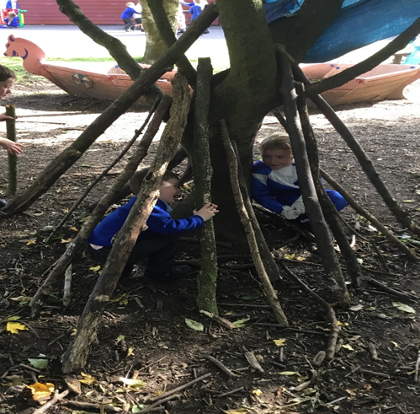
Negotiate
Den building
•Build dens with sticks, tarpaulin, rope, pallets, crates and plastic drums.
Be considerate of other people’s space.
Don’t destroy others dens unless they are finished.
Allow others to join in.
Ask before changing other children's dens.
Reminders

Slide 9
Innovate
Take care of equipment
Costumes- dress up, put on a show
Ask others to join in
Not respecting equipment- losing balls, damaging equipment
Please don’t kick space hoppers
If costumes fall on floor don’t stand on them- get muddy

Slide 10
Innovate
Thank you to the new play rangers who are doing a great job helping to tidy away the equipment at the end of lunchtime.

