Slide 1
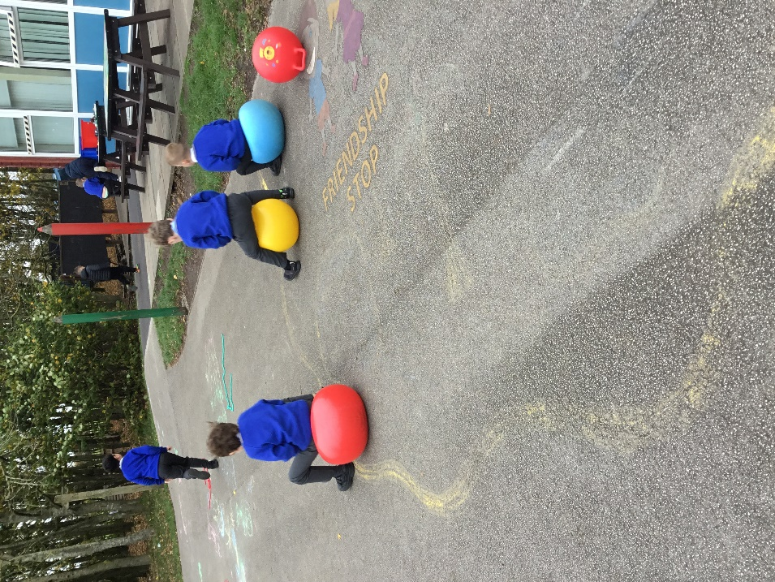
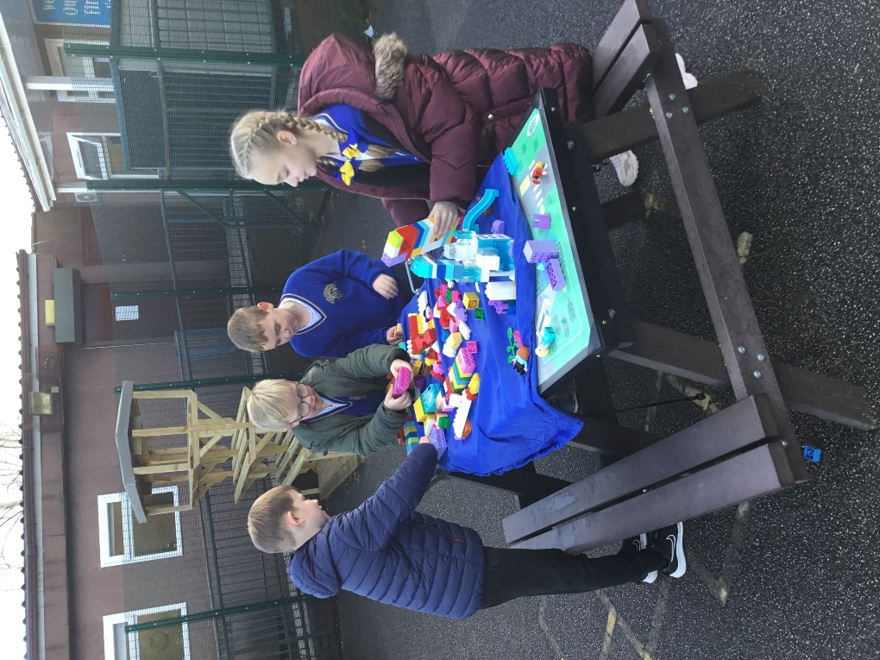
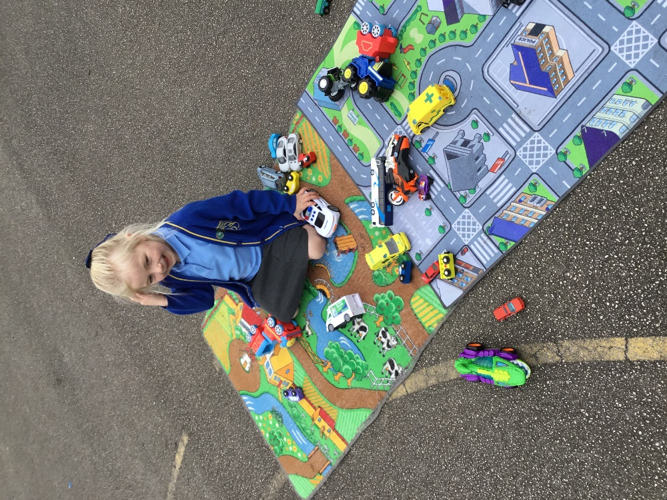


OPAL Play
Assembly

Slide 2
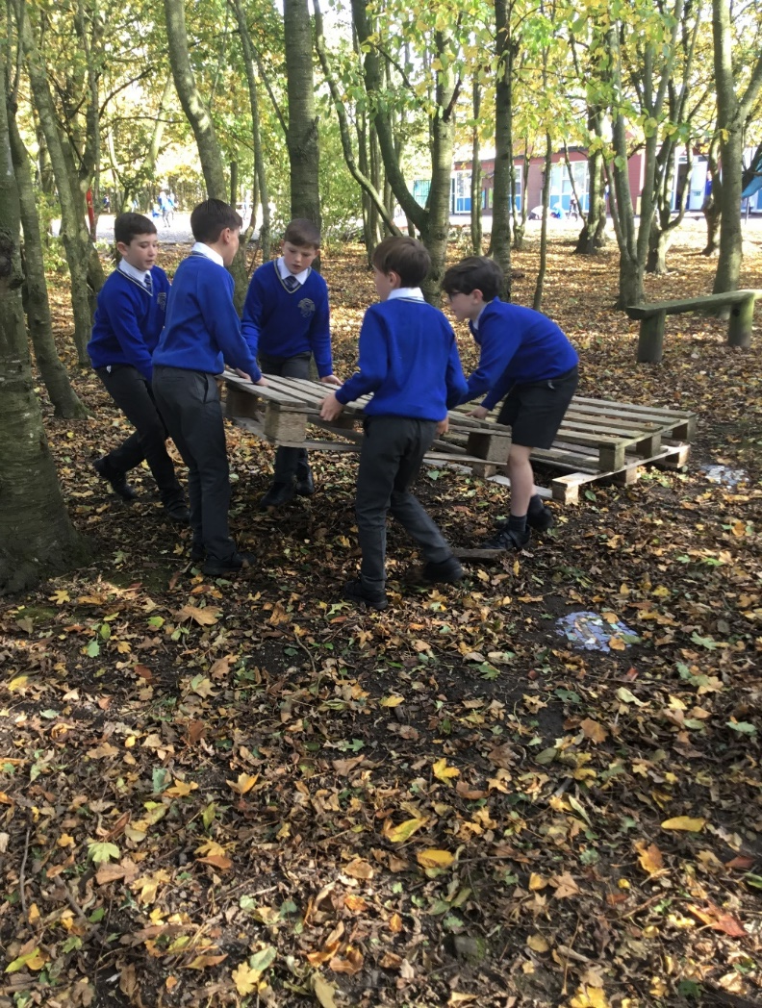
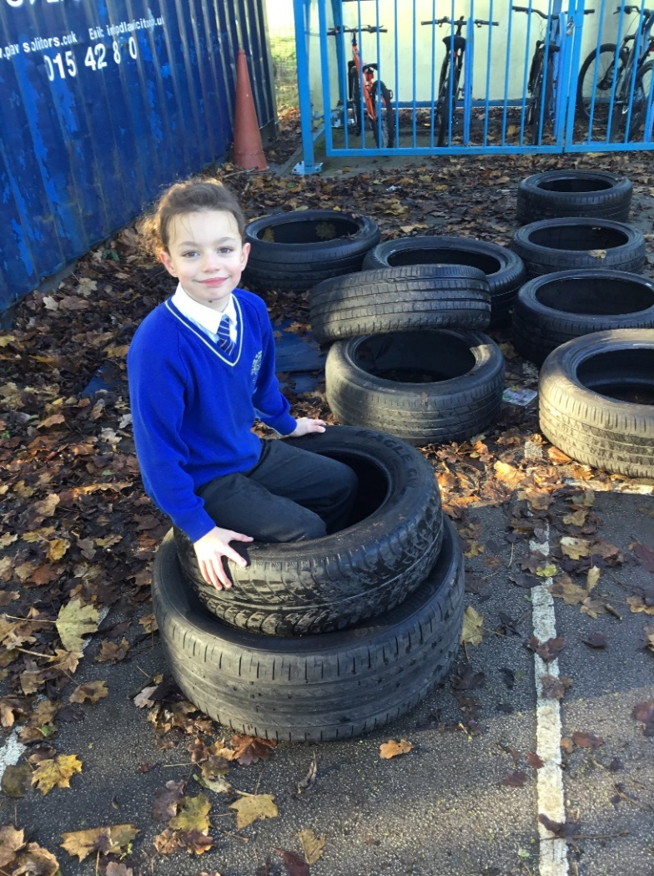

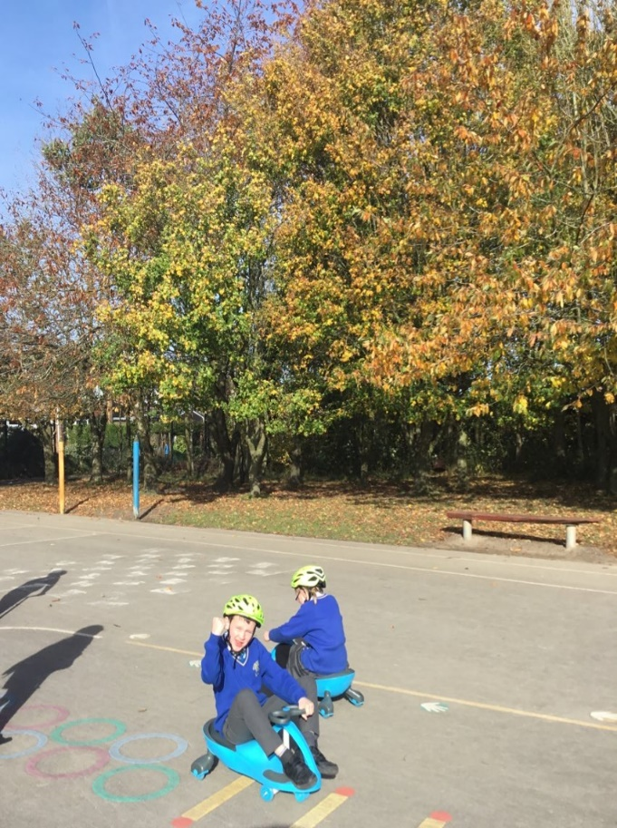
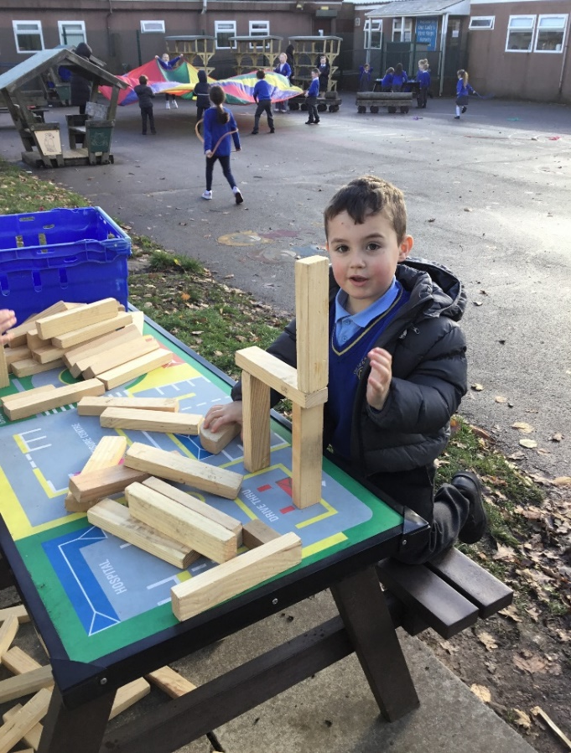
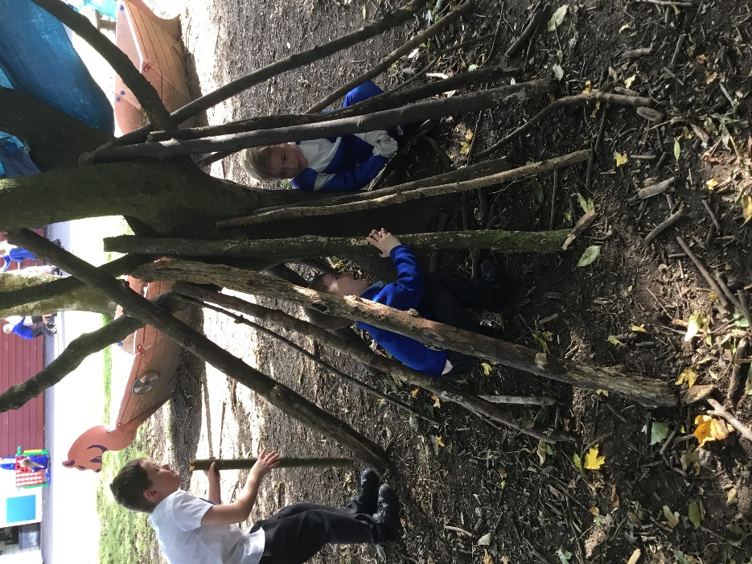
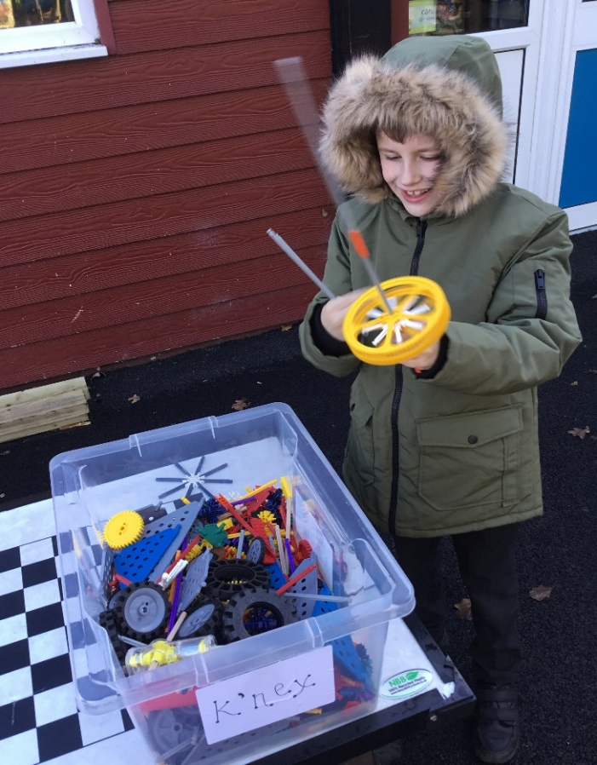
Celebrate
Amazing examples
of play

Slide 3
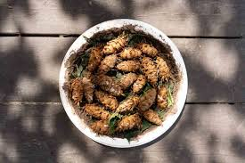
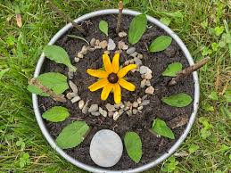
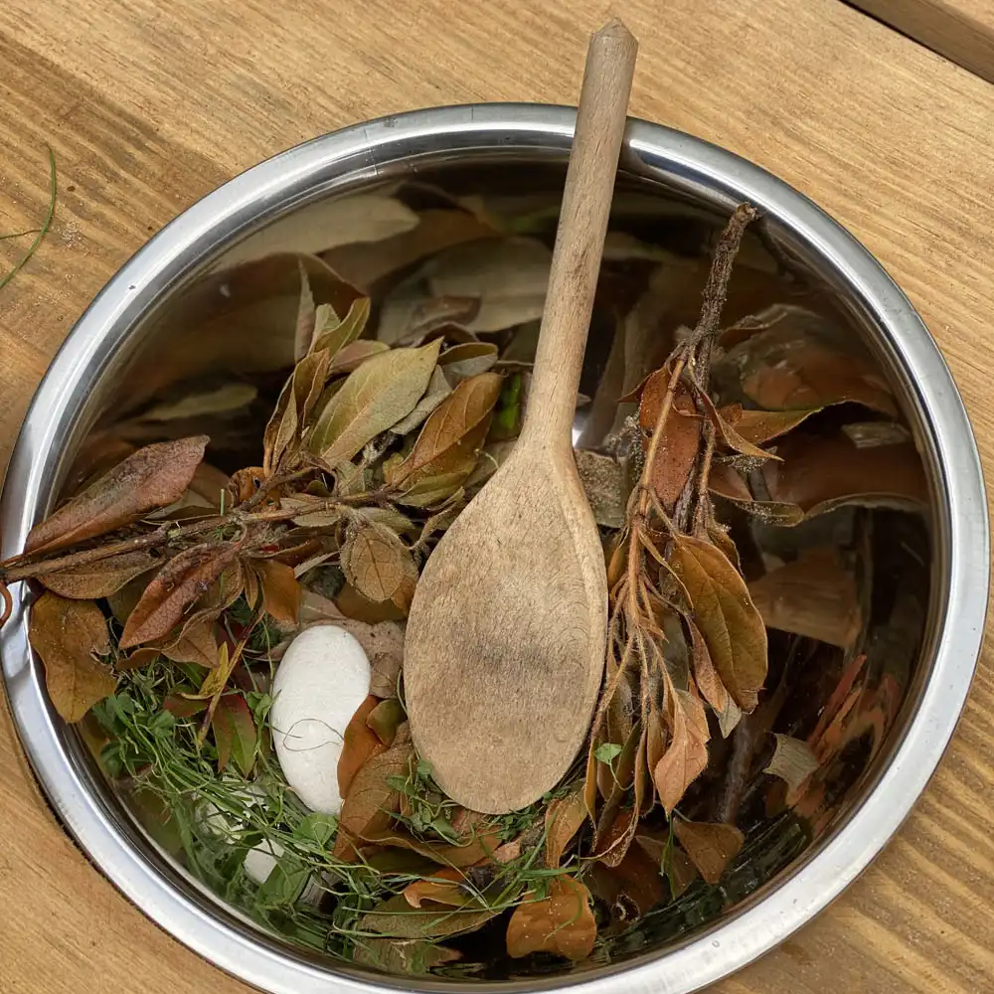
Inform
Our Mud Kitchen will open in the next week or two!
So.. Come along and cook up a feast!
Make a mud pie, pine cone stew or a leaf salad
Its located in the woods at the back near the fence
You need wellies to use the woods and mud kitchen

Slide 4
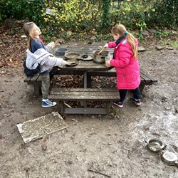
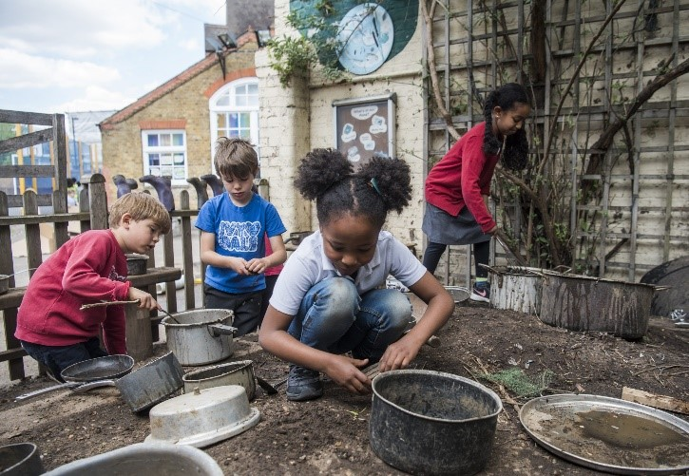
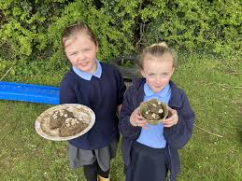
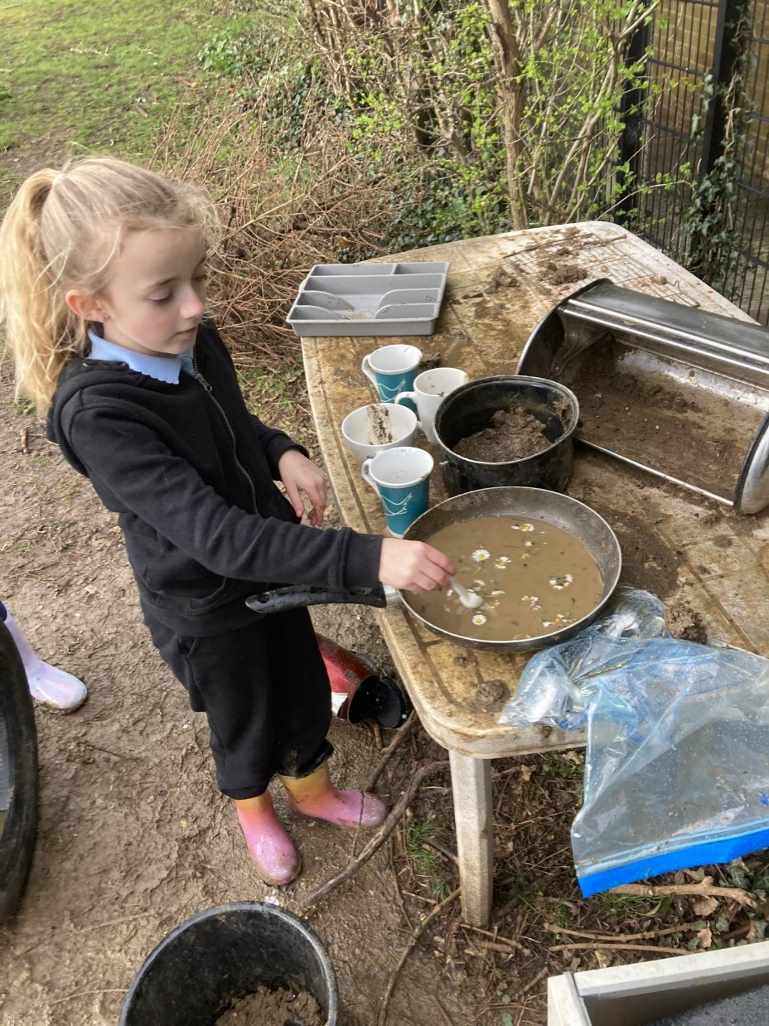
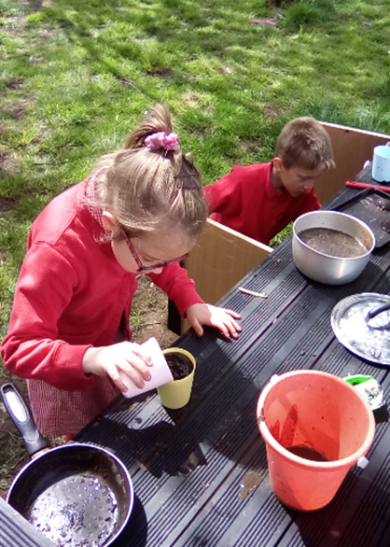
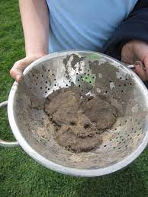
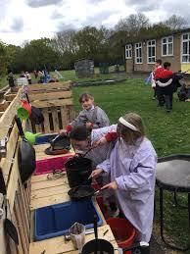
Innovate

Slide 5
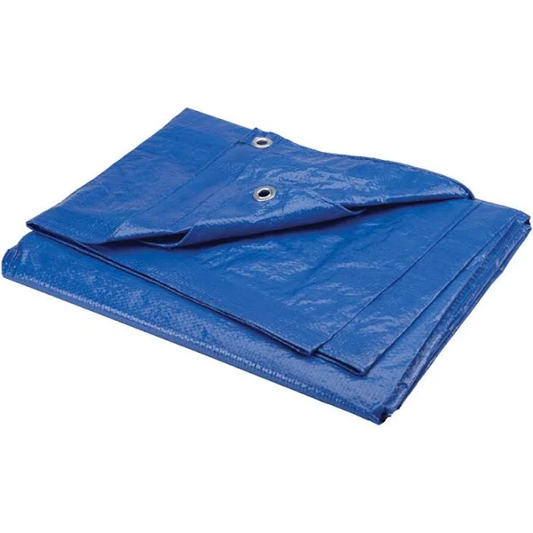
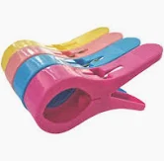
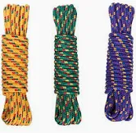
Inform
What will be new over next few weeks?
Tarpaulin
Plastic pegs
Rope

Slide 6
Innovate
How can we use it?
How can we not use it?
Build different structures dens, houses
Make a quiet space
Create social spaces
Play tug of war
No dragging or pulling tarpaulin
Don’t destroy someone else’s den
Don’t take resources from others
No keeping equipment rom previous days

Slide 7
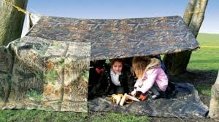
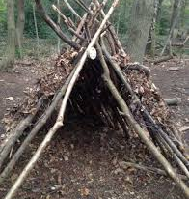
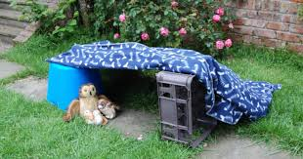

Slide 8


Negotiate
What new rules do we need for
our new activities and equipment?

Slide 9
Negotiate
Rope, tarpaulin and pegs
Play team will remain vigilant about correct use.
Don’t tie rope around any parts of our body.
Be careful when using pegs- risk of pinching fingers. (Shown in assembly)
Don’t wrap tarpaulin around our body
Be respectful of other children's den creations- don’t destroy another den
Be kind and share equipment
Den equipment to be tidied away at the end of lunchtime
What rules do we need when with rope, tarpaulin and pegs?

Slide 10
Negotiate
Please remember
If you wear a dressing up costume, please put it back in the box when you take it off- as costumes are being stood on and getting muddy
Use and respect equipment correctly- space hoppers are to be hopped on NOT kicked!
What rules do we need?

Slide 11


Thank you to the play rangers who are doing a great job.
Giving you all and being committed each day working in the different zones and helping the Play Team to tidy away the equipment at the end of lunchtime.

