Slide 1
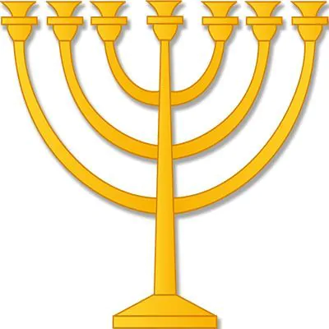
JUDAISM

Slide 2
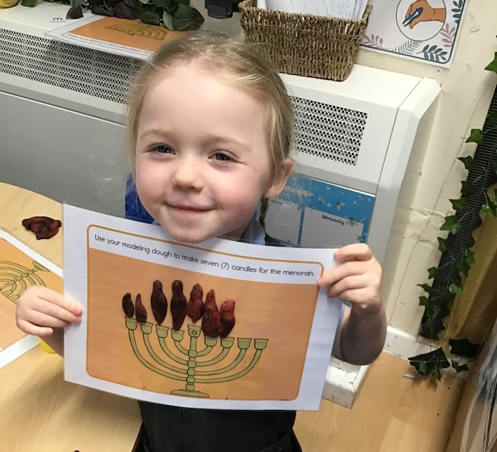
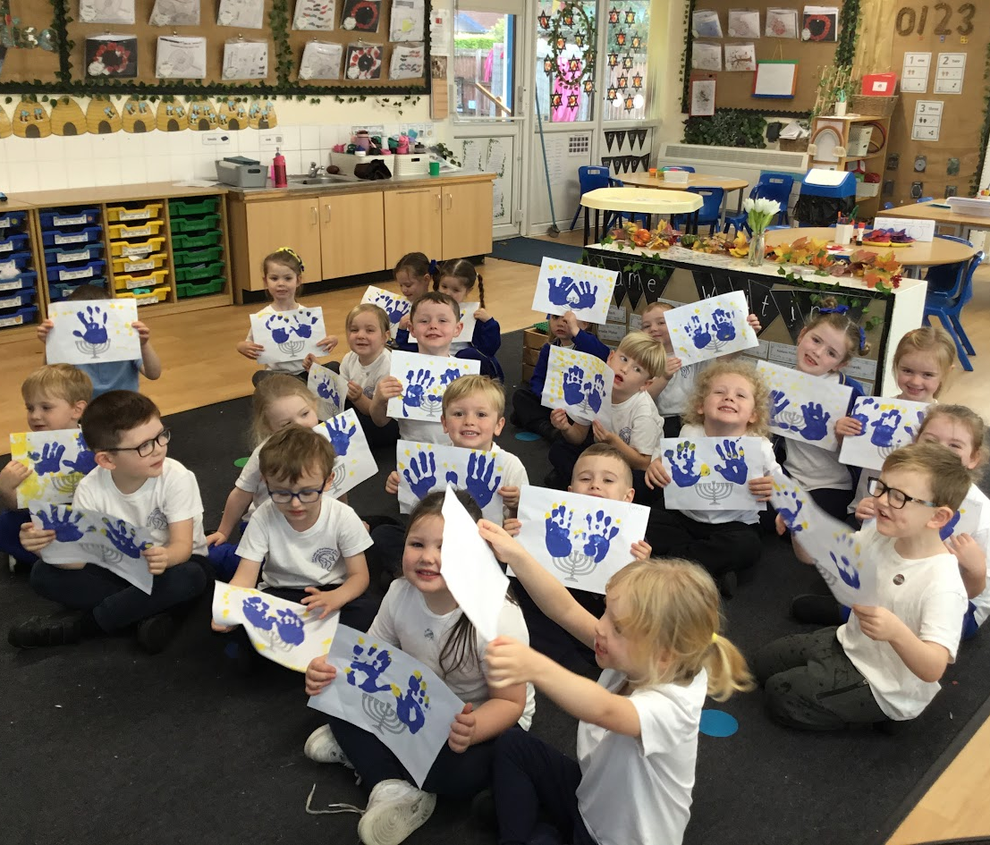
RECEPTION – Learning about the Menorah

Slide 3
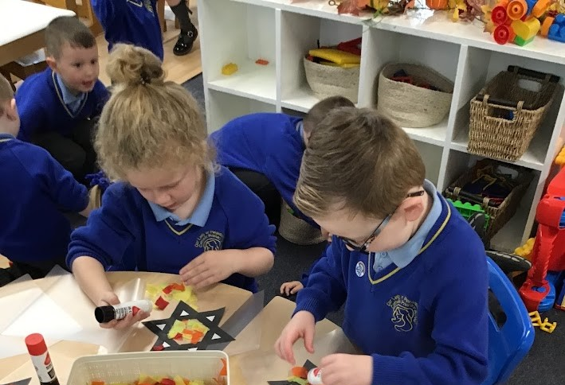
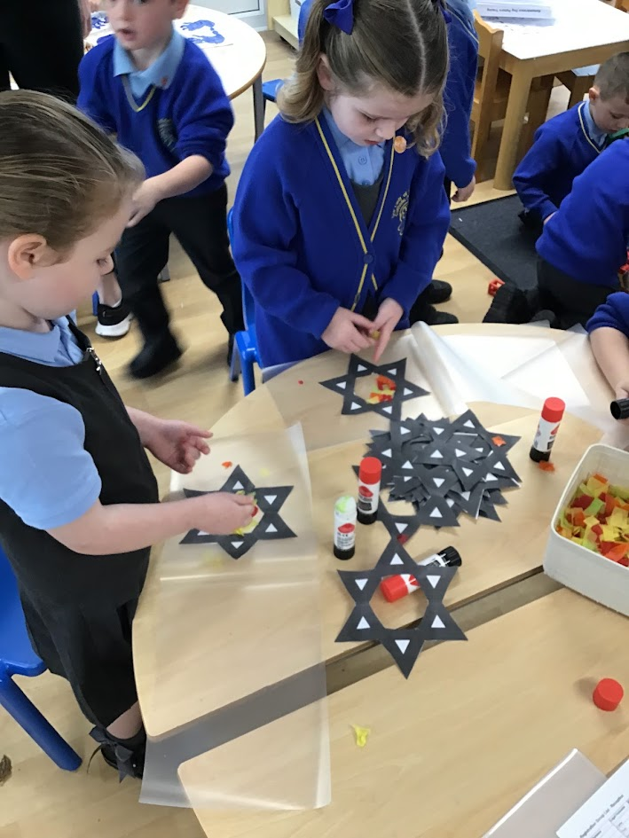
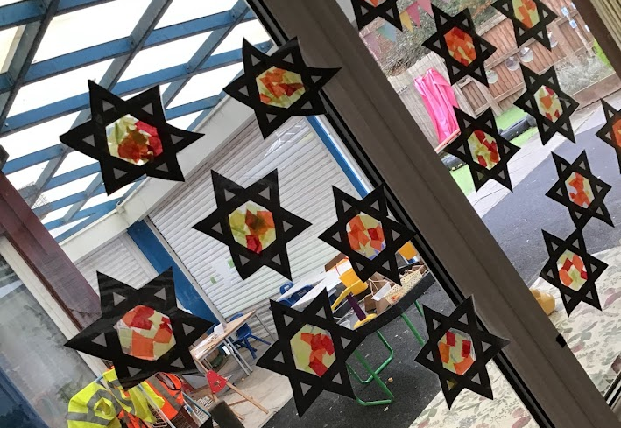
Reception class making their own stained glass ‘Star of David’

Slide 4
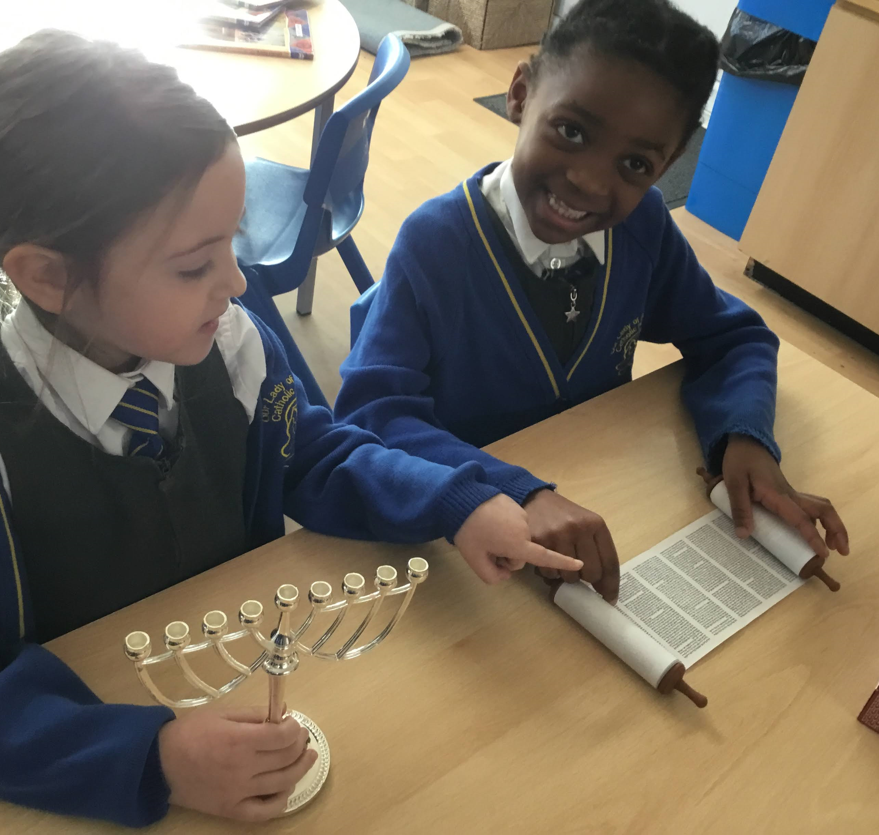
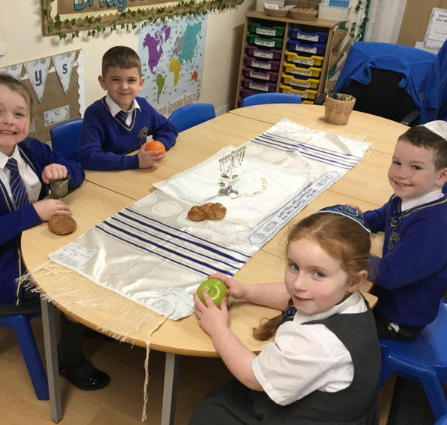
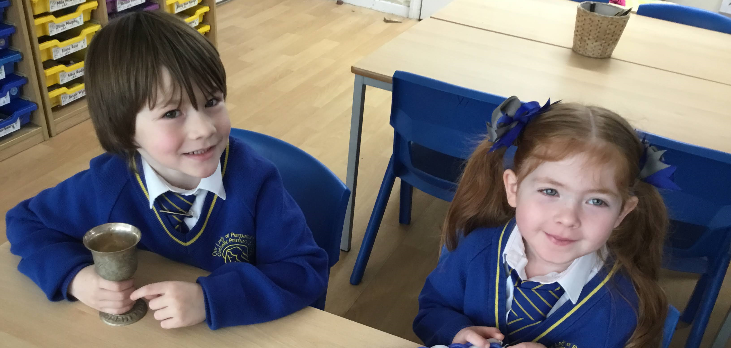
Year 1 –
Studying Jewish artefacts

Slide 5
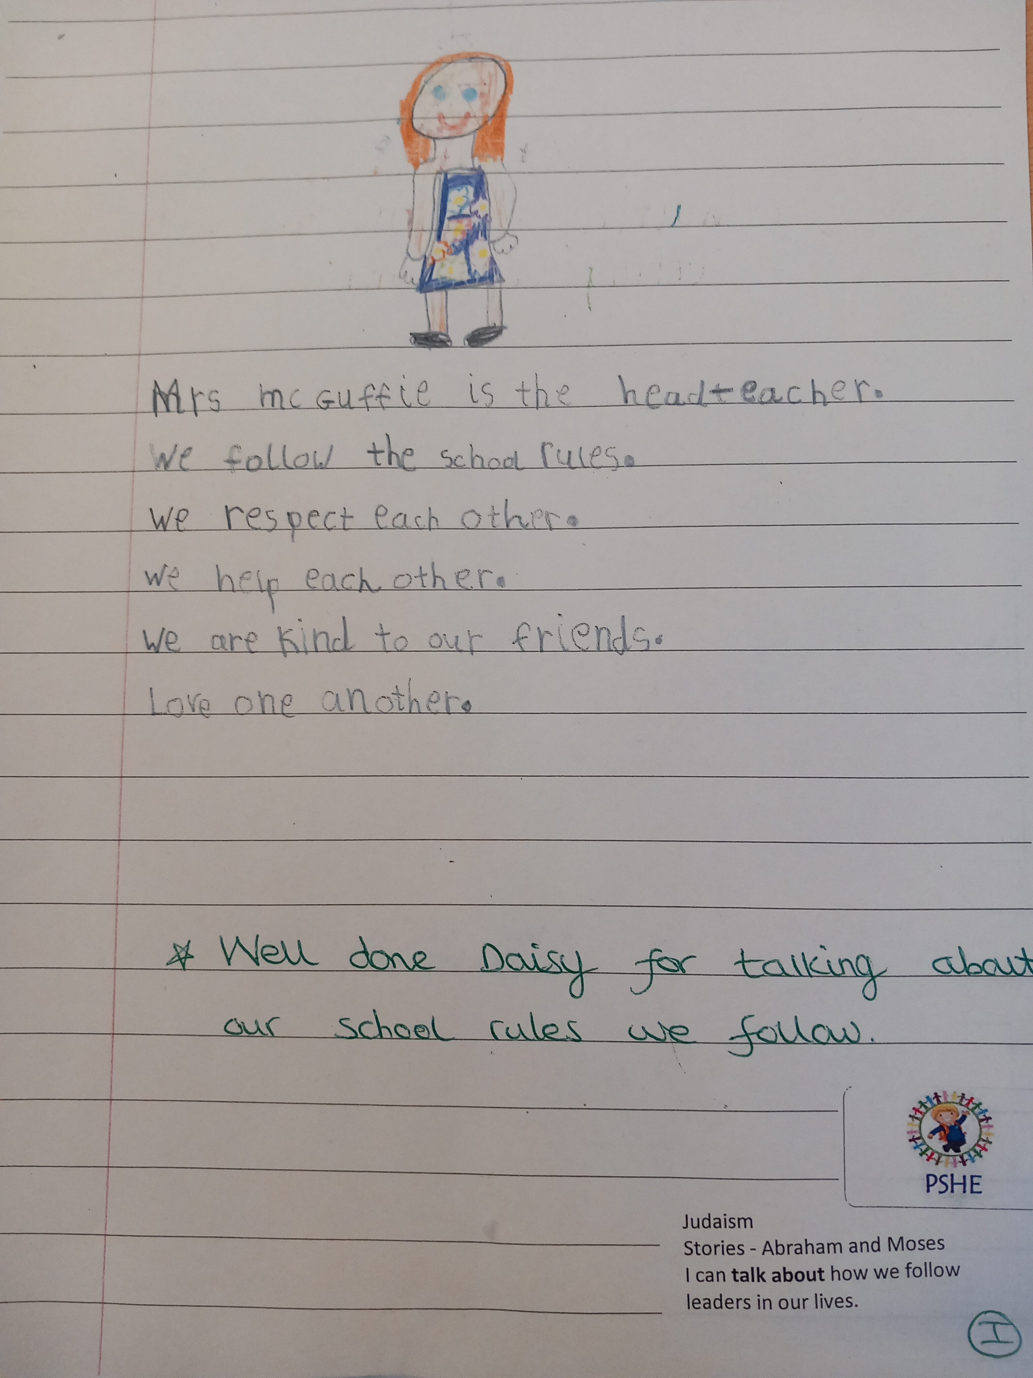
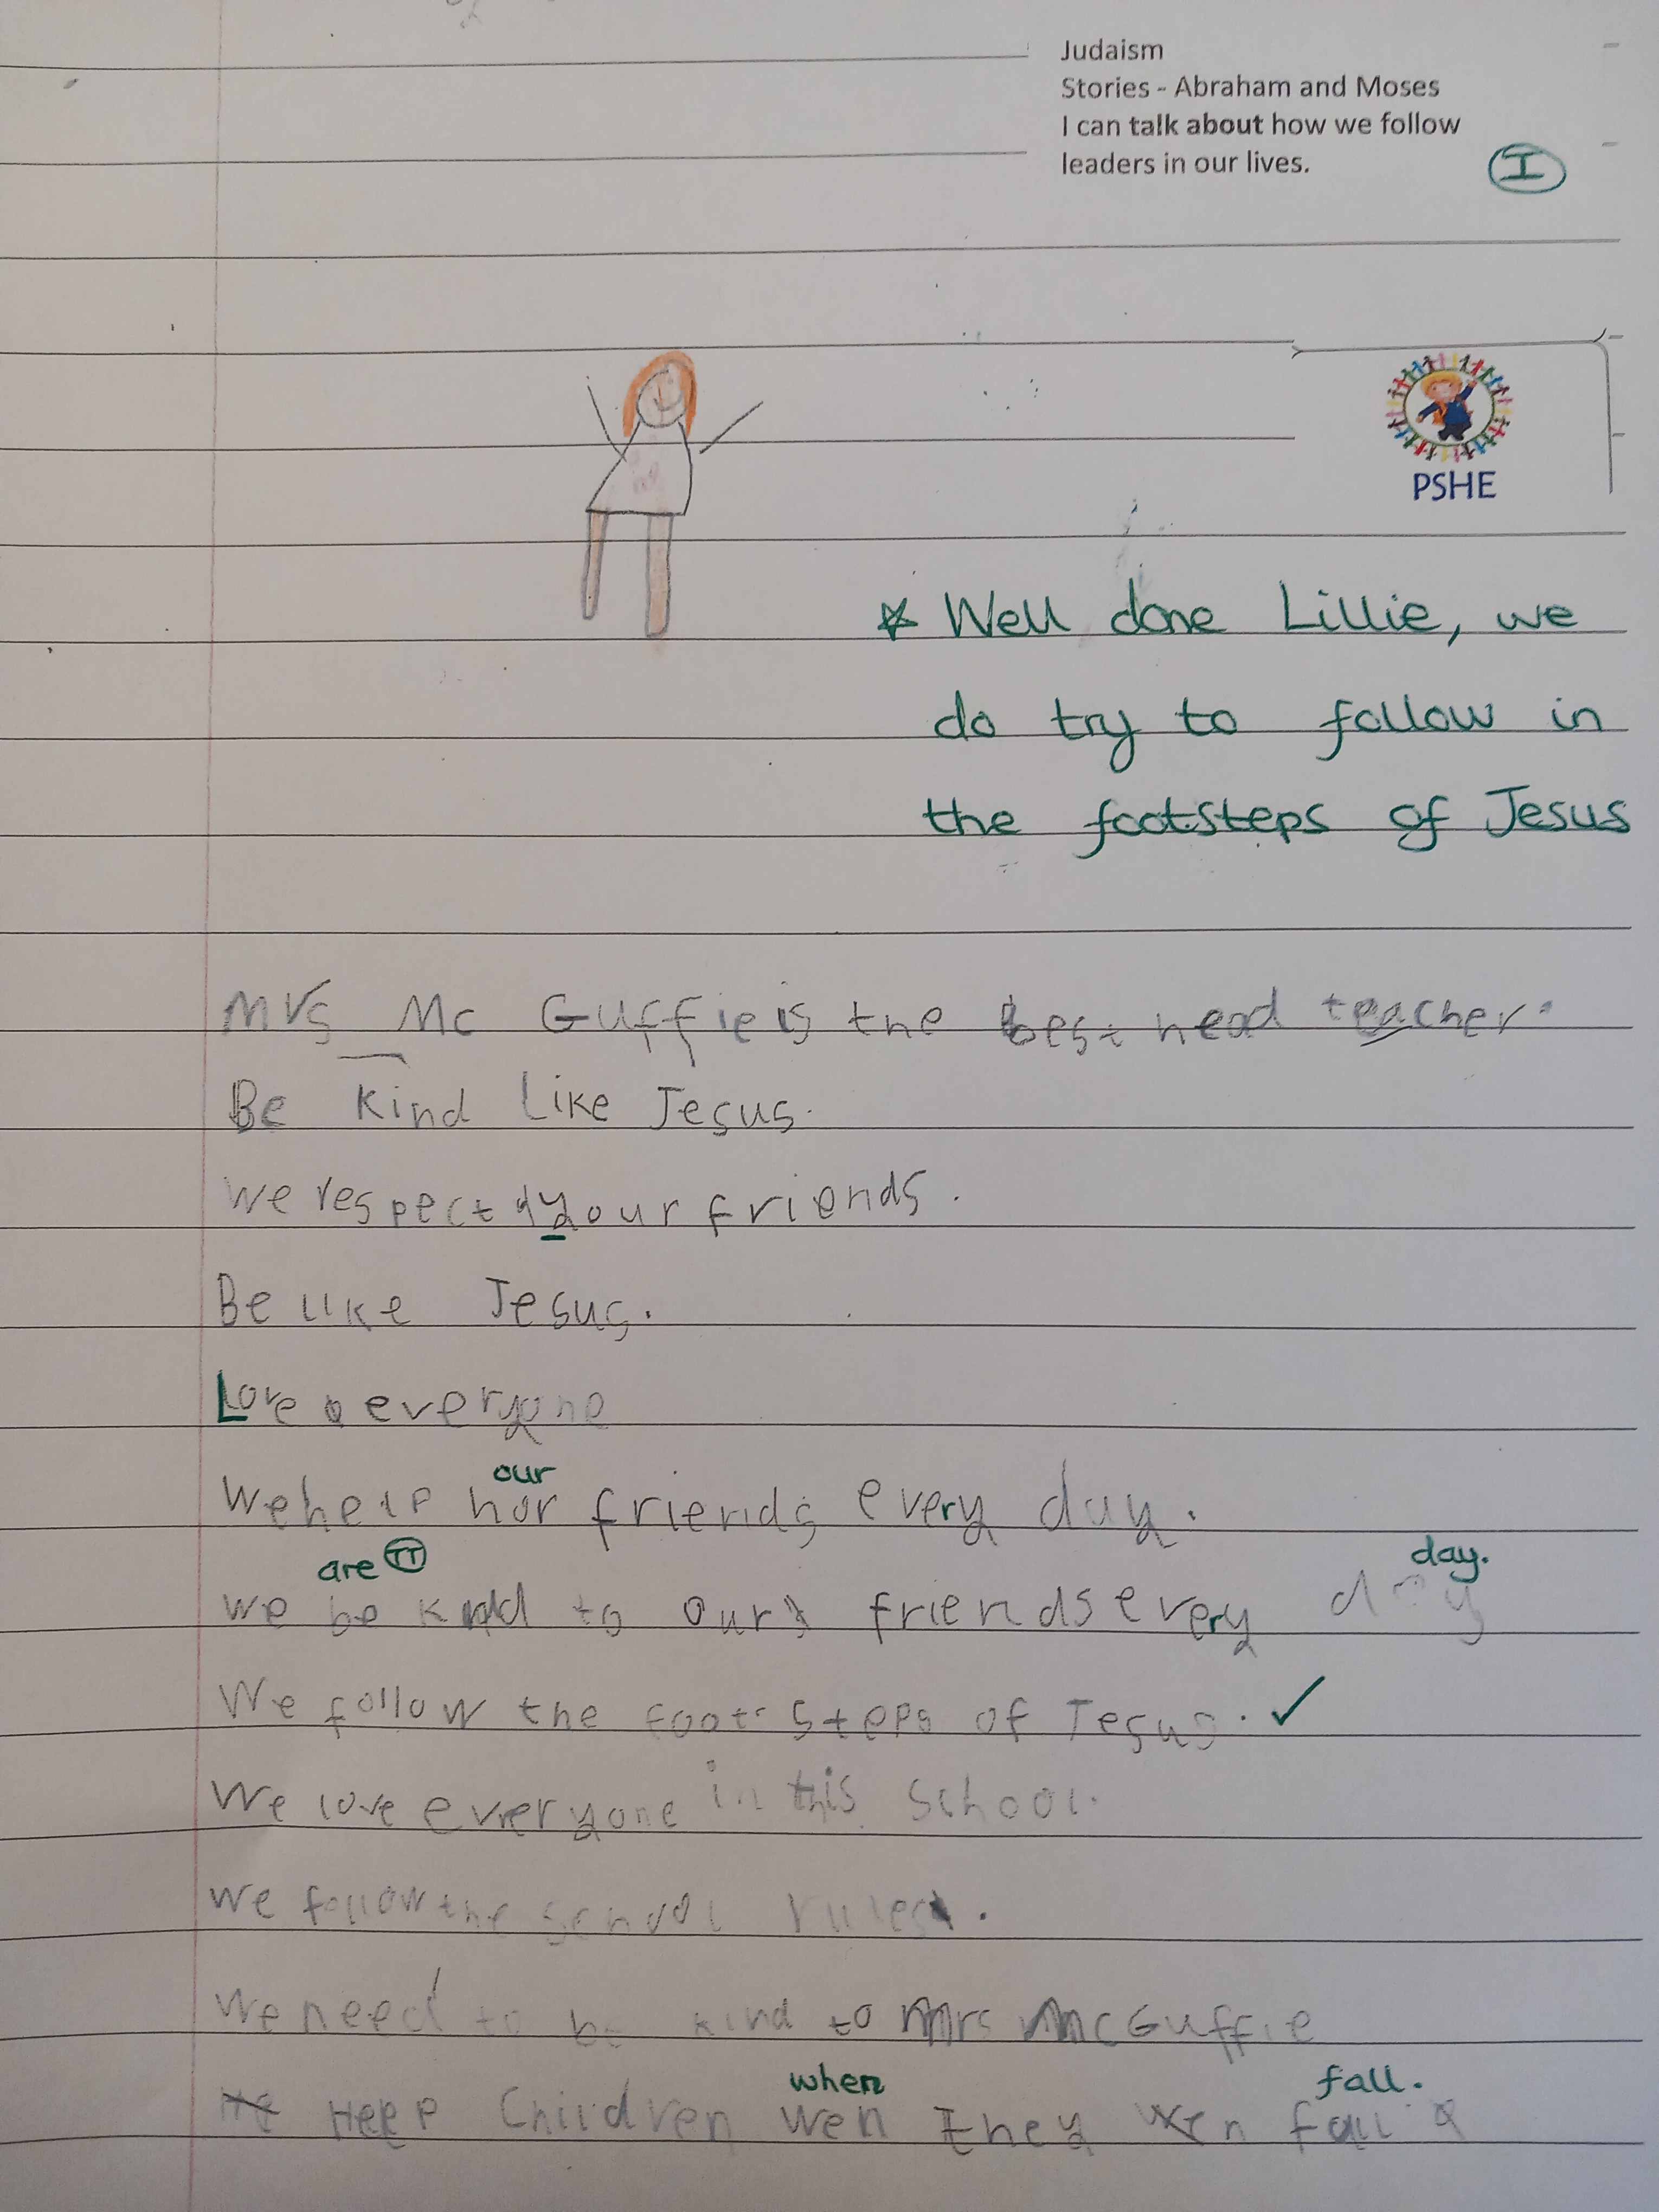
Year 1 writing about how we follow leaders in our lives.

Slide 6
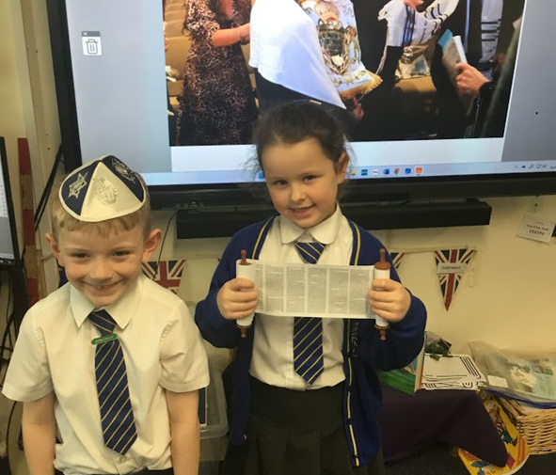
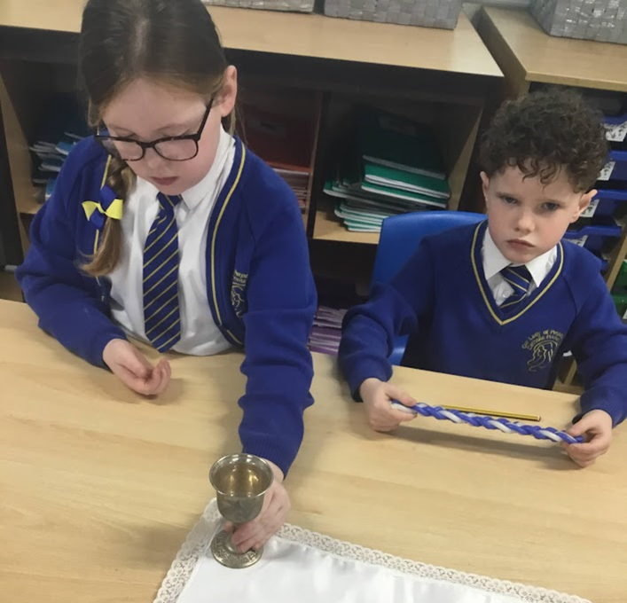
Year 2 learned about Shabbat and how Jewish people prepare for it. We looked at the special objects that are placed on the table ready for the Shabbat meal.

Slide 7
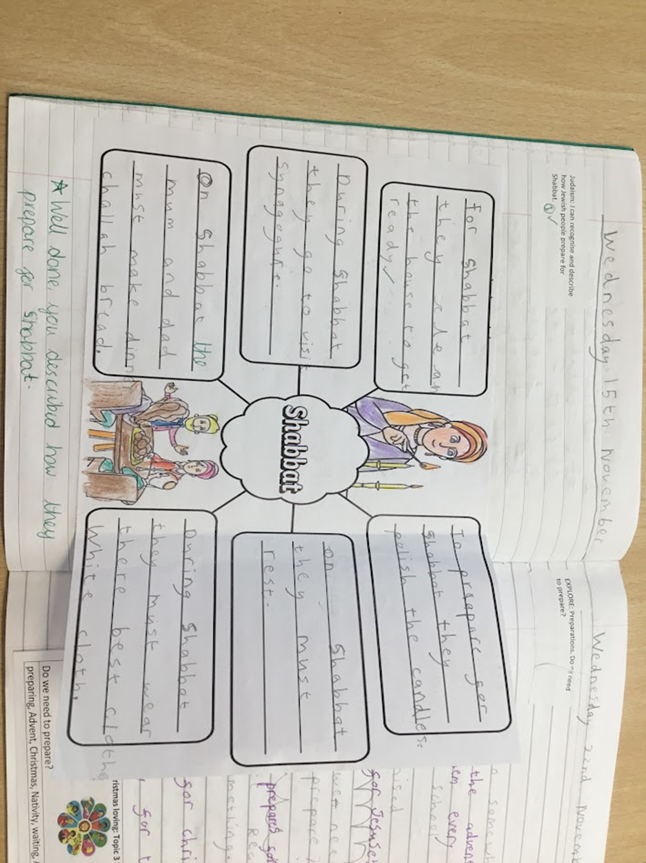
Year 2 describing how the Jewish people prepare for Shabbat.

Slide 8
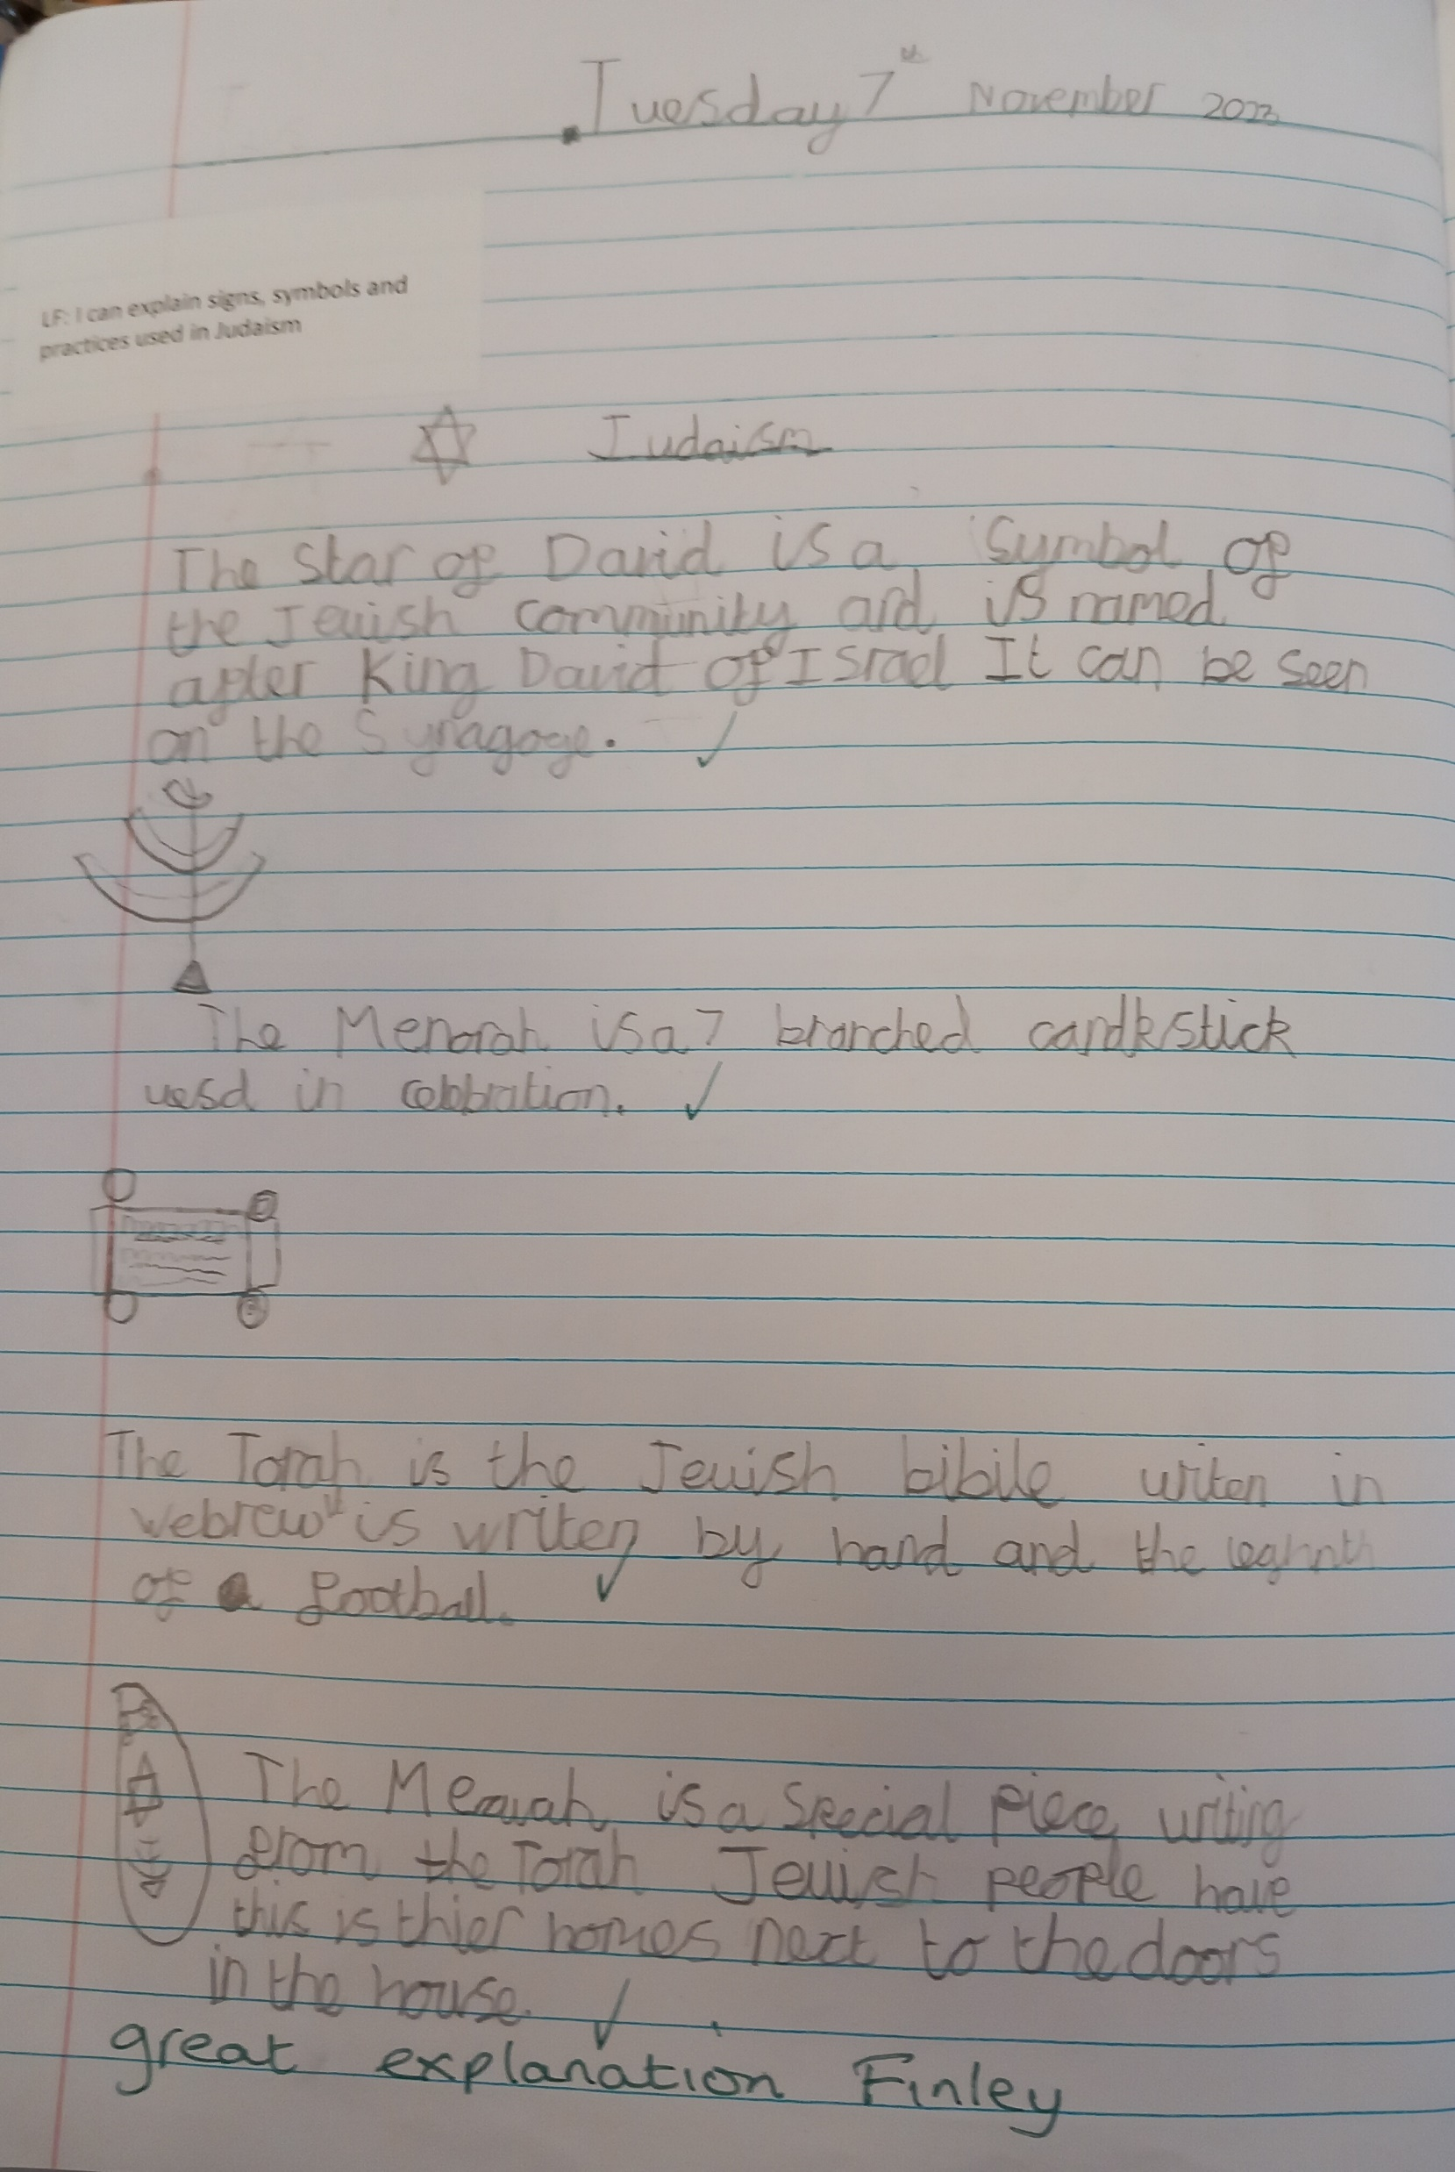
Year 3 – explanation of Jewish signs and symbols.

Slide 9
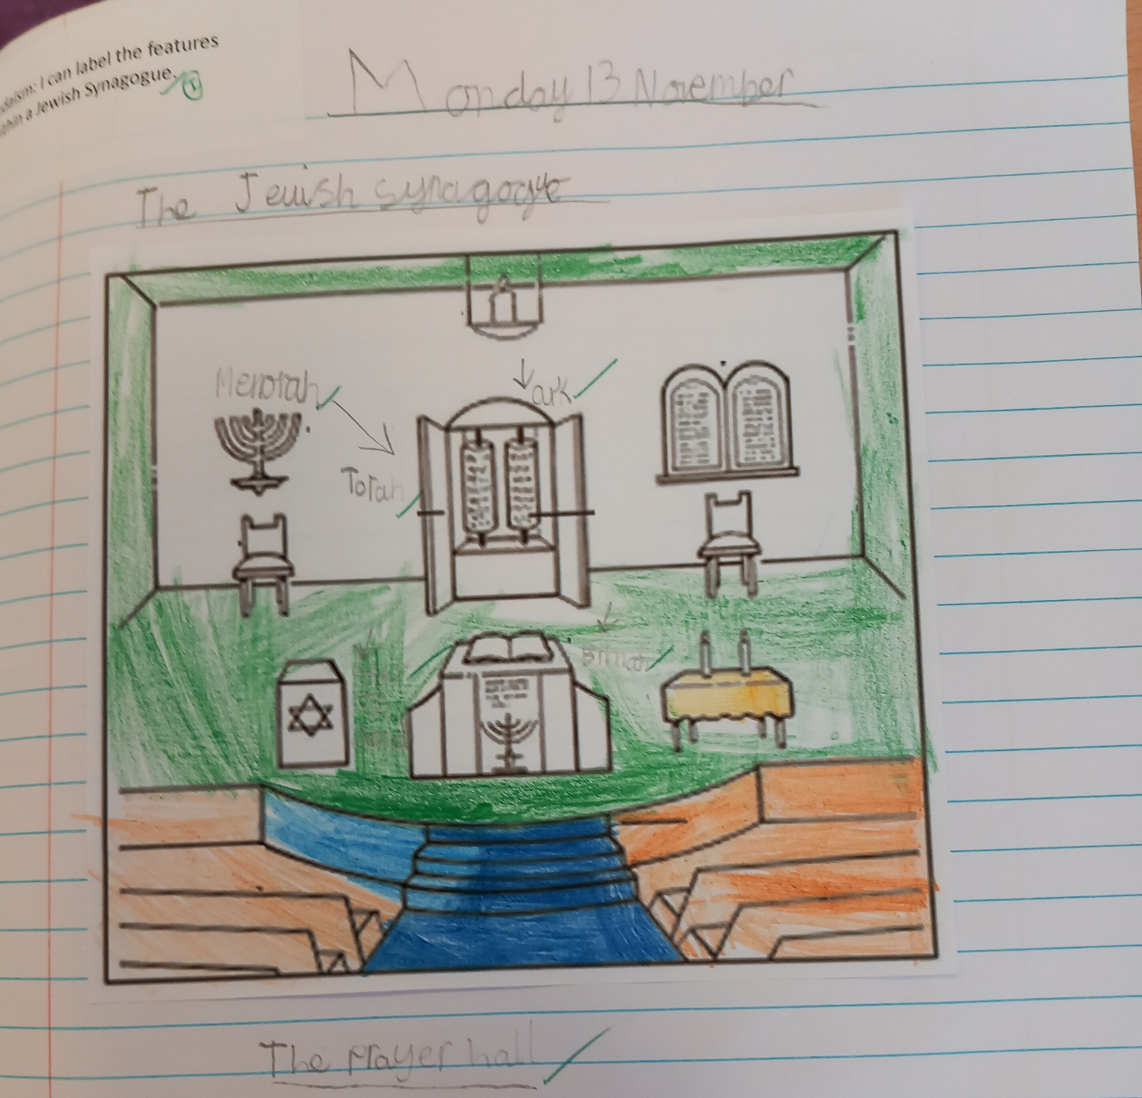
Year 3 – labelling the Synagogue

Slide 10
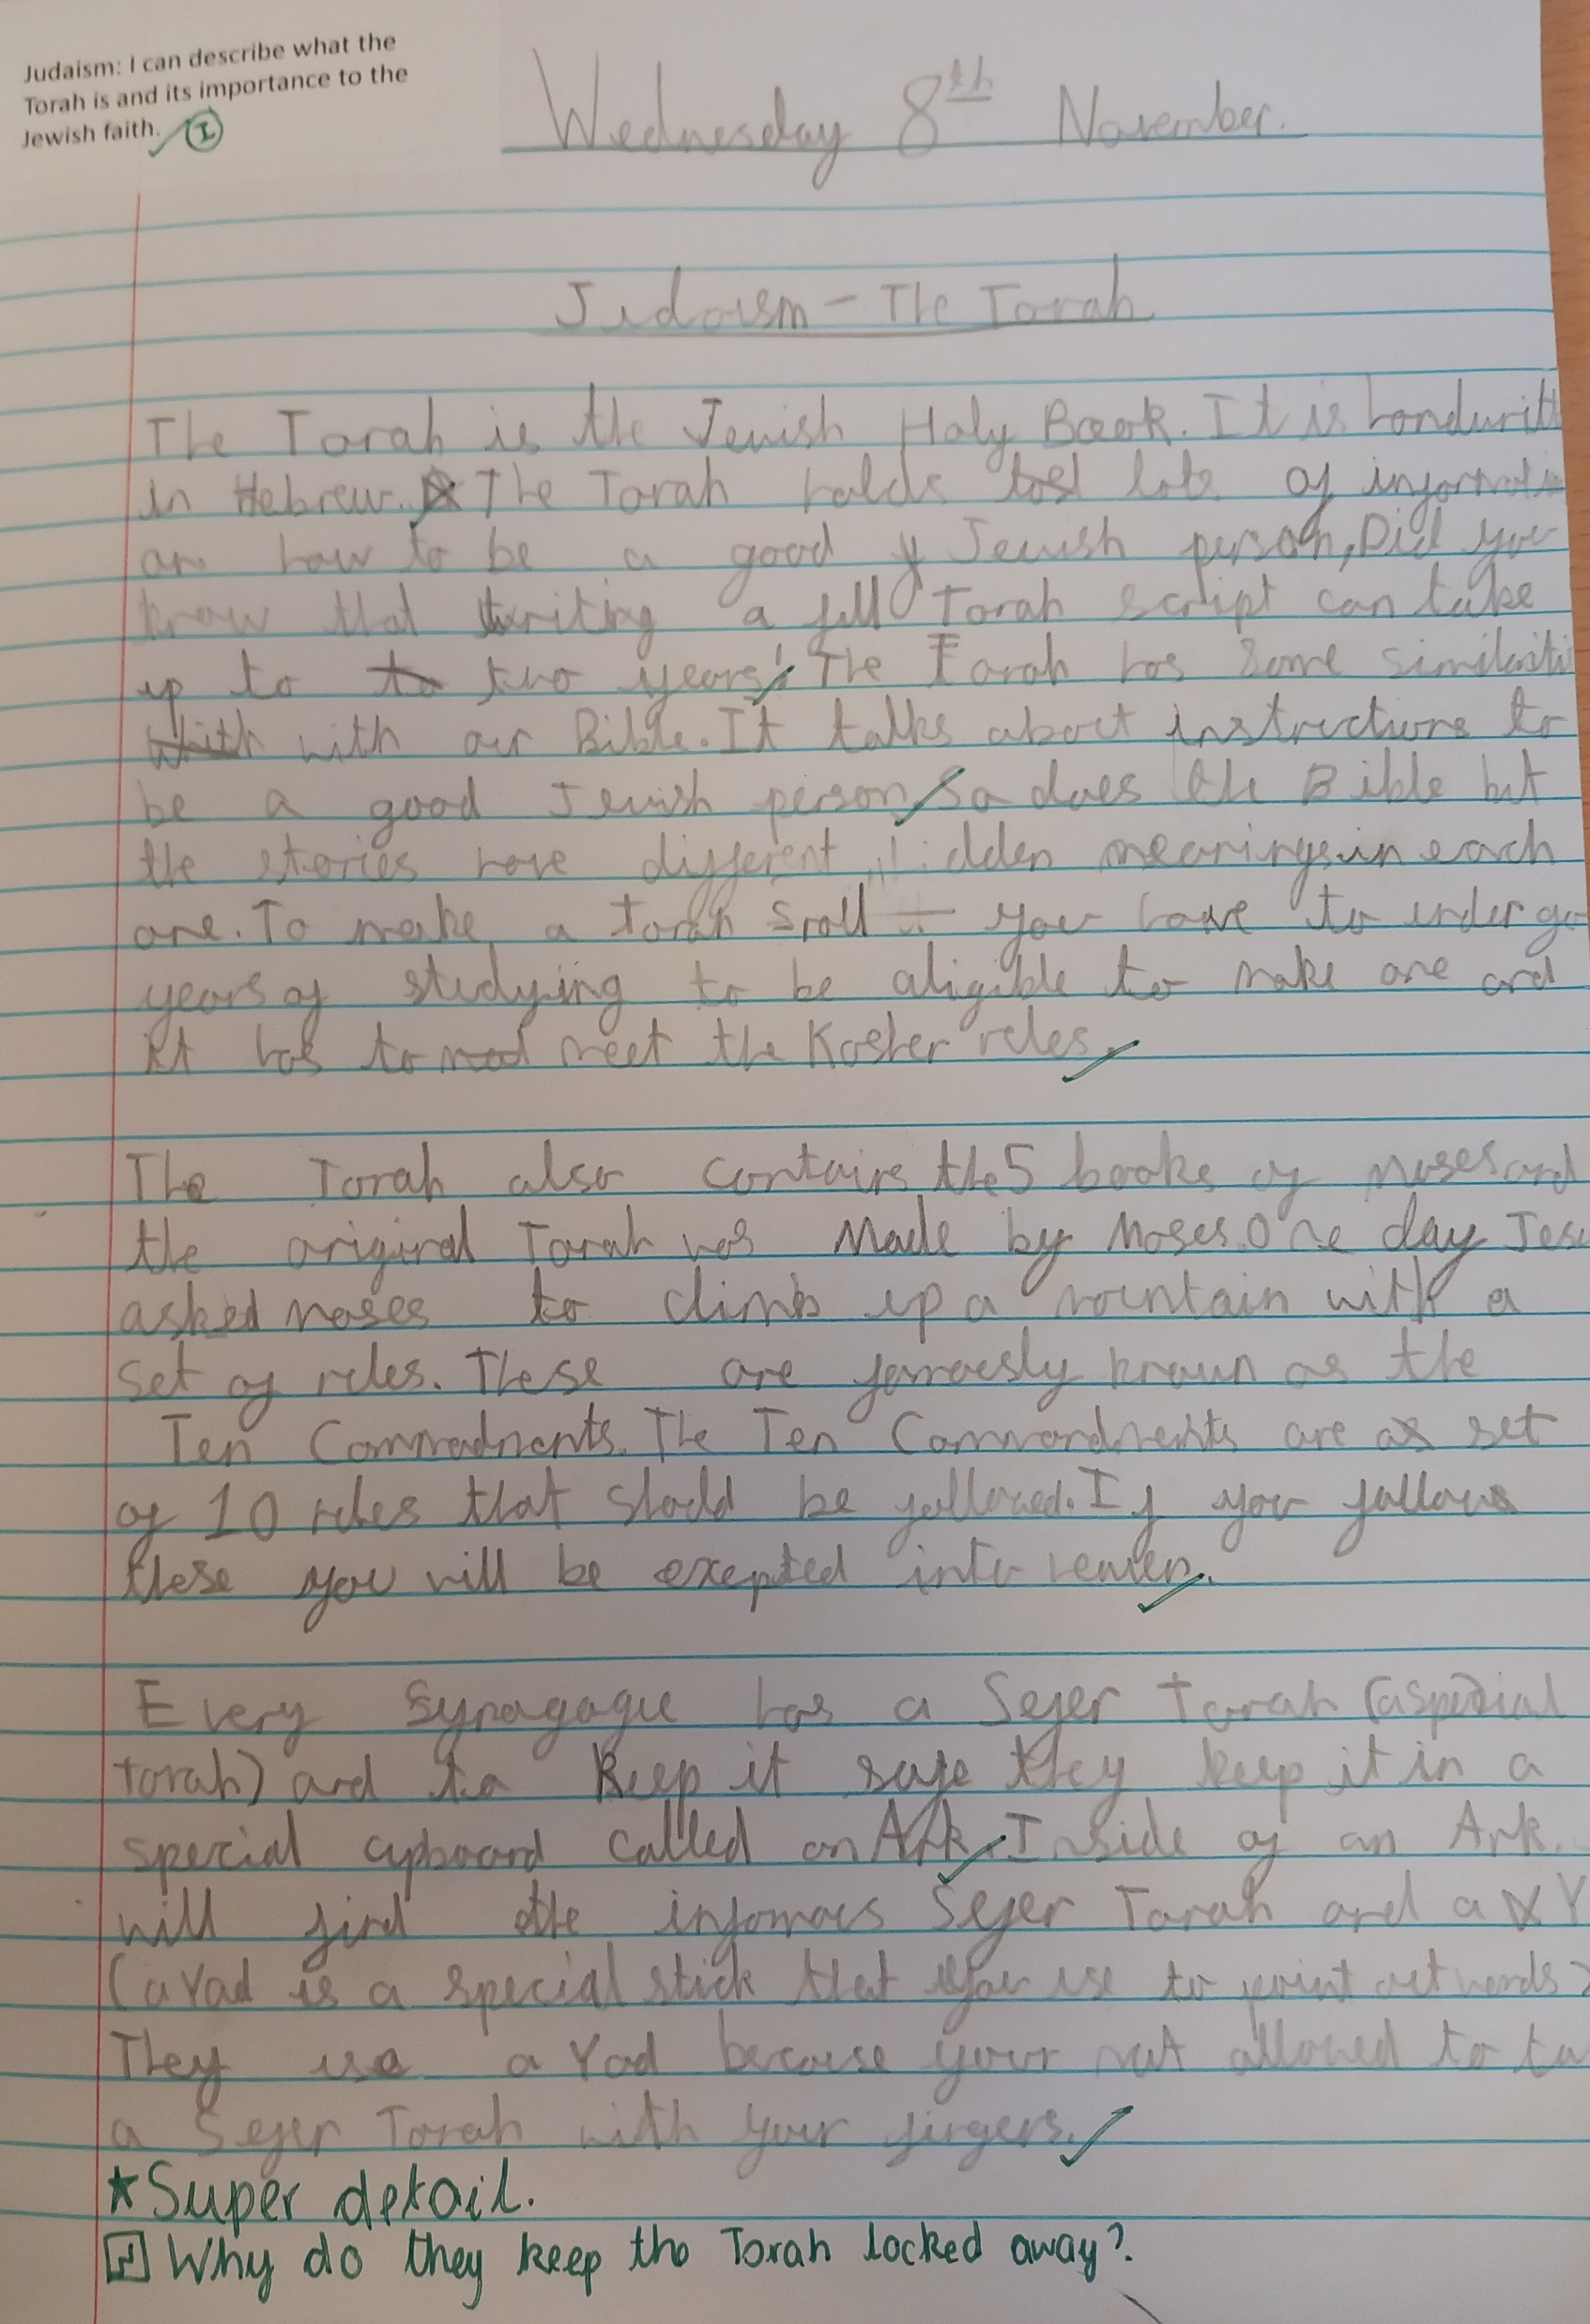
Year 4 explanation of what the Torah is and why it is important to the Jewish people.

Slide 11
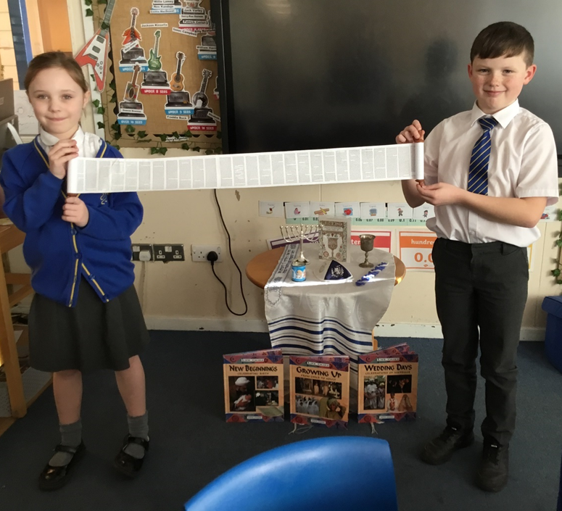
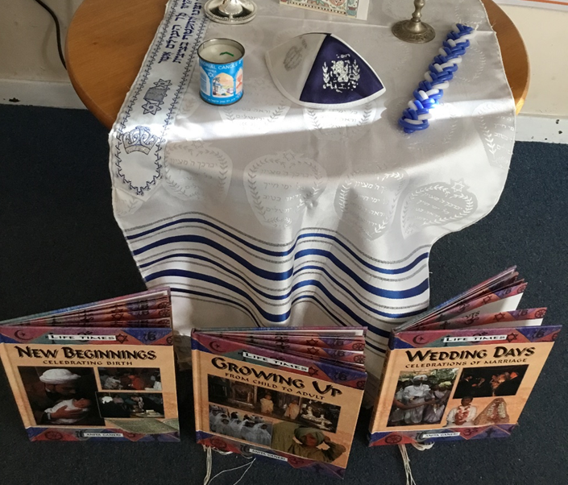
Year 4 enjoyed looking at the Jewish Torah and other artefacts.

Slide 12
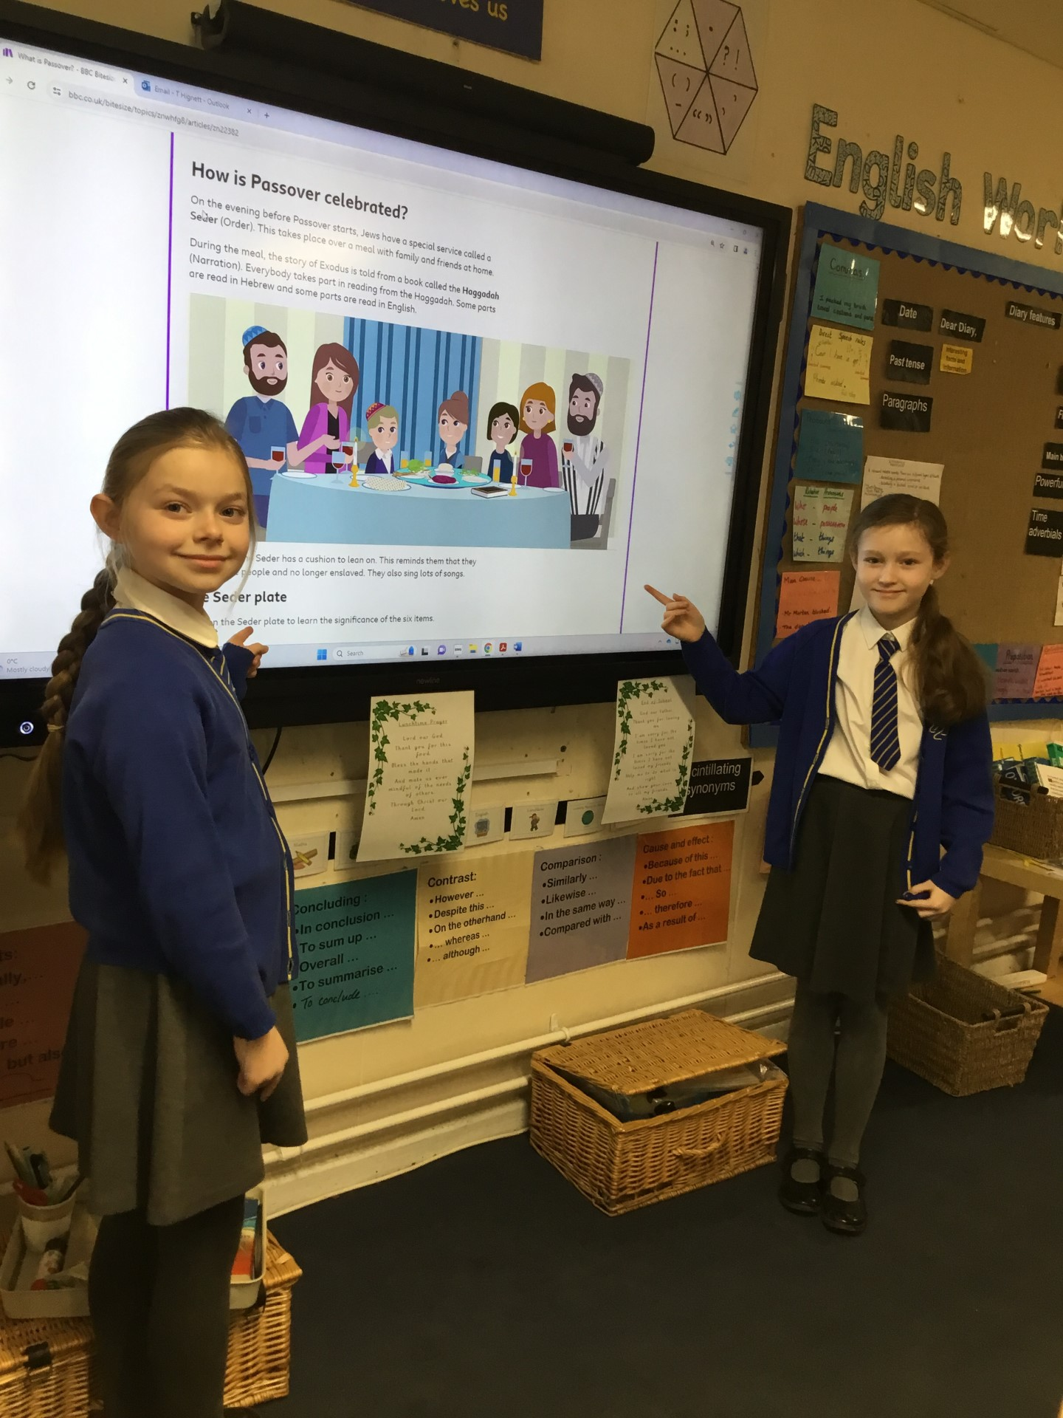
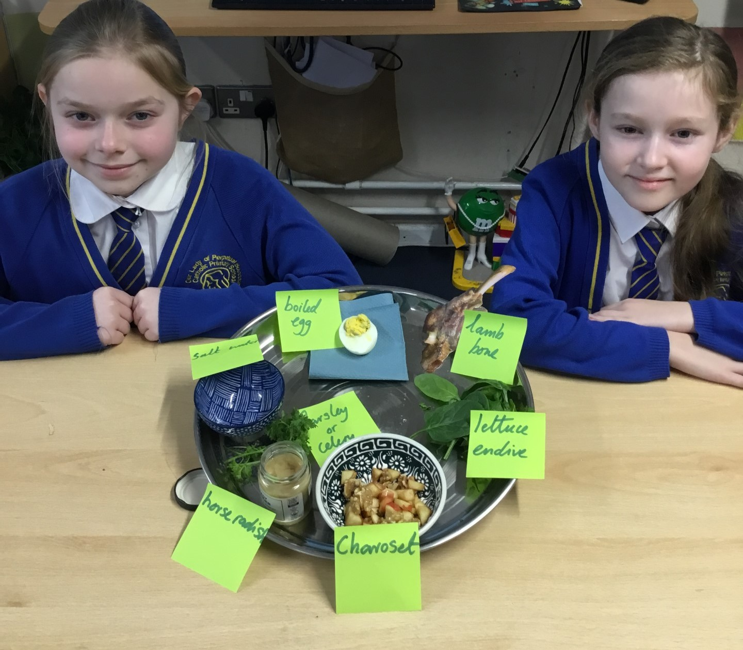
Year 5 have been studying the Passover

Slide 13
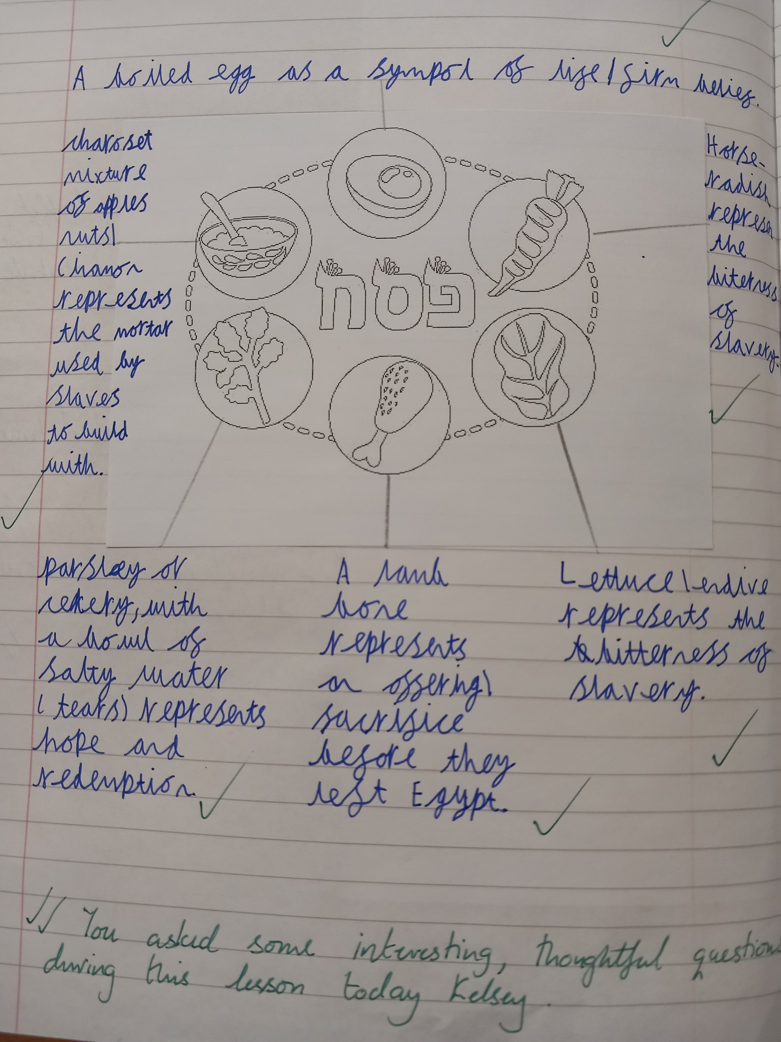
Year 5 – writing about the items a Jewish family add to their Seder plate and what each item represents.

Slide 14
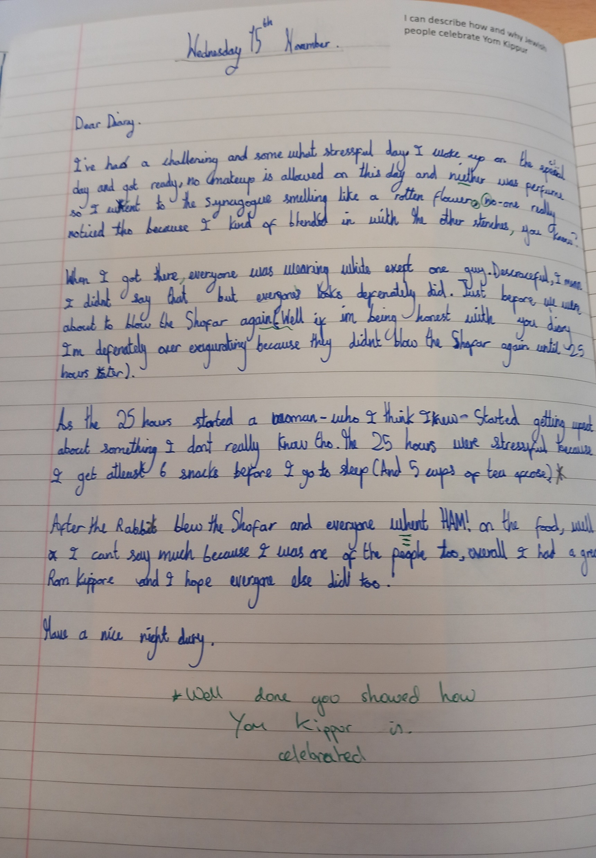
Year 6 diary write about their day of observing
Yom Kippur

Slide 15
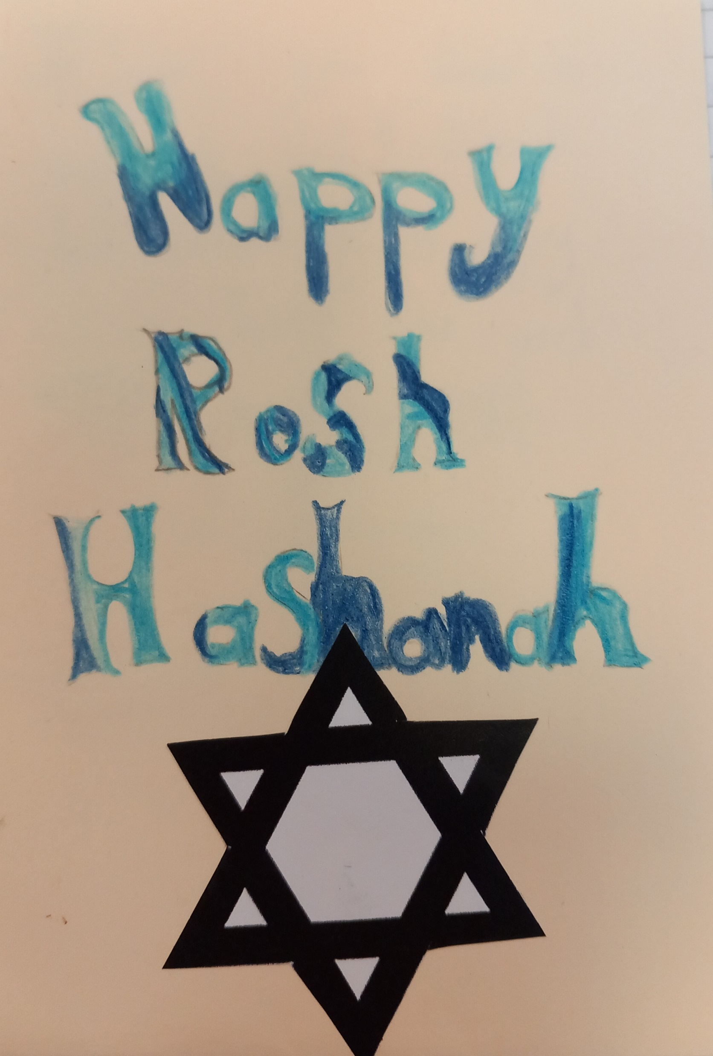
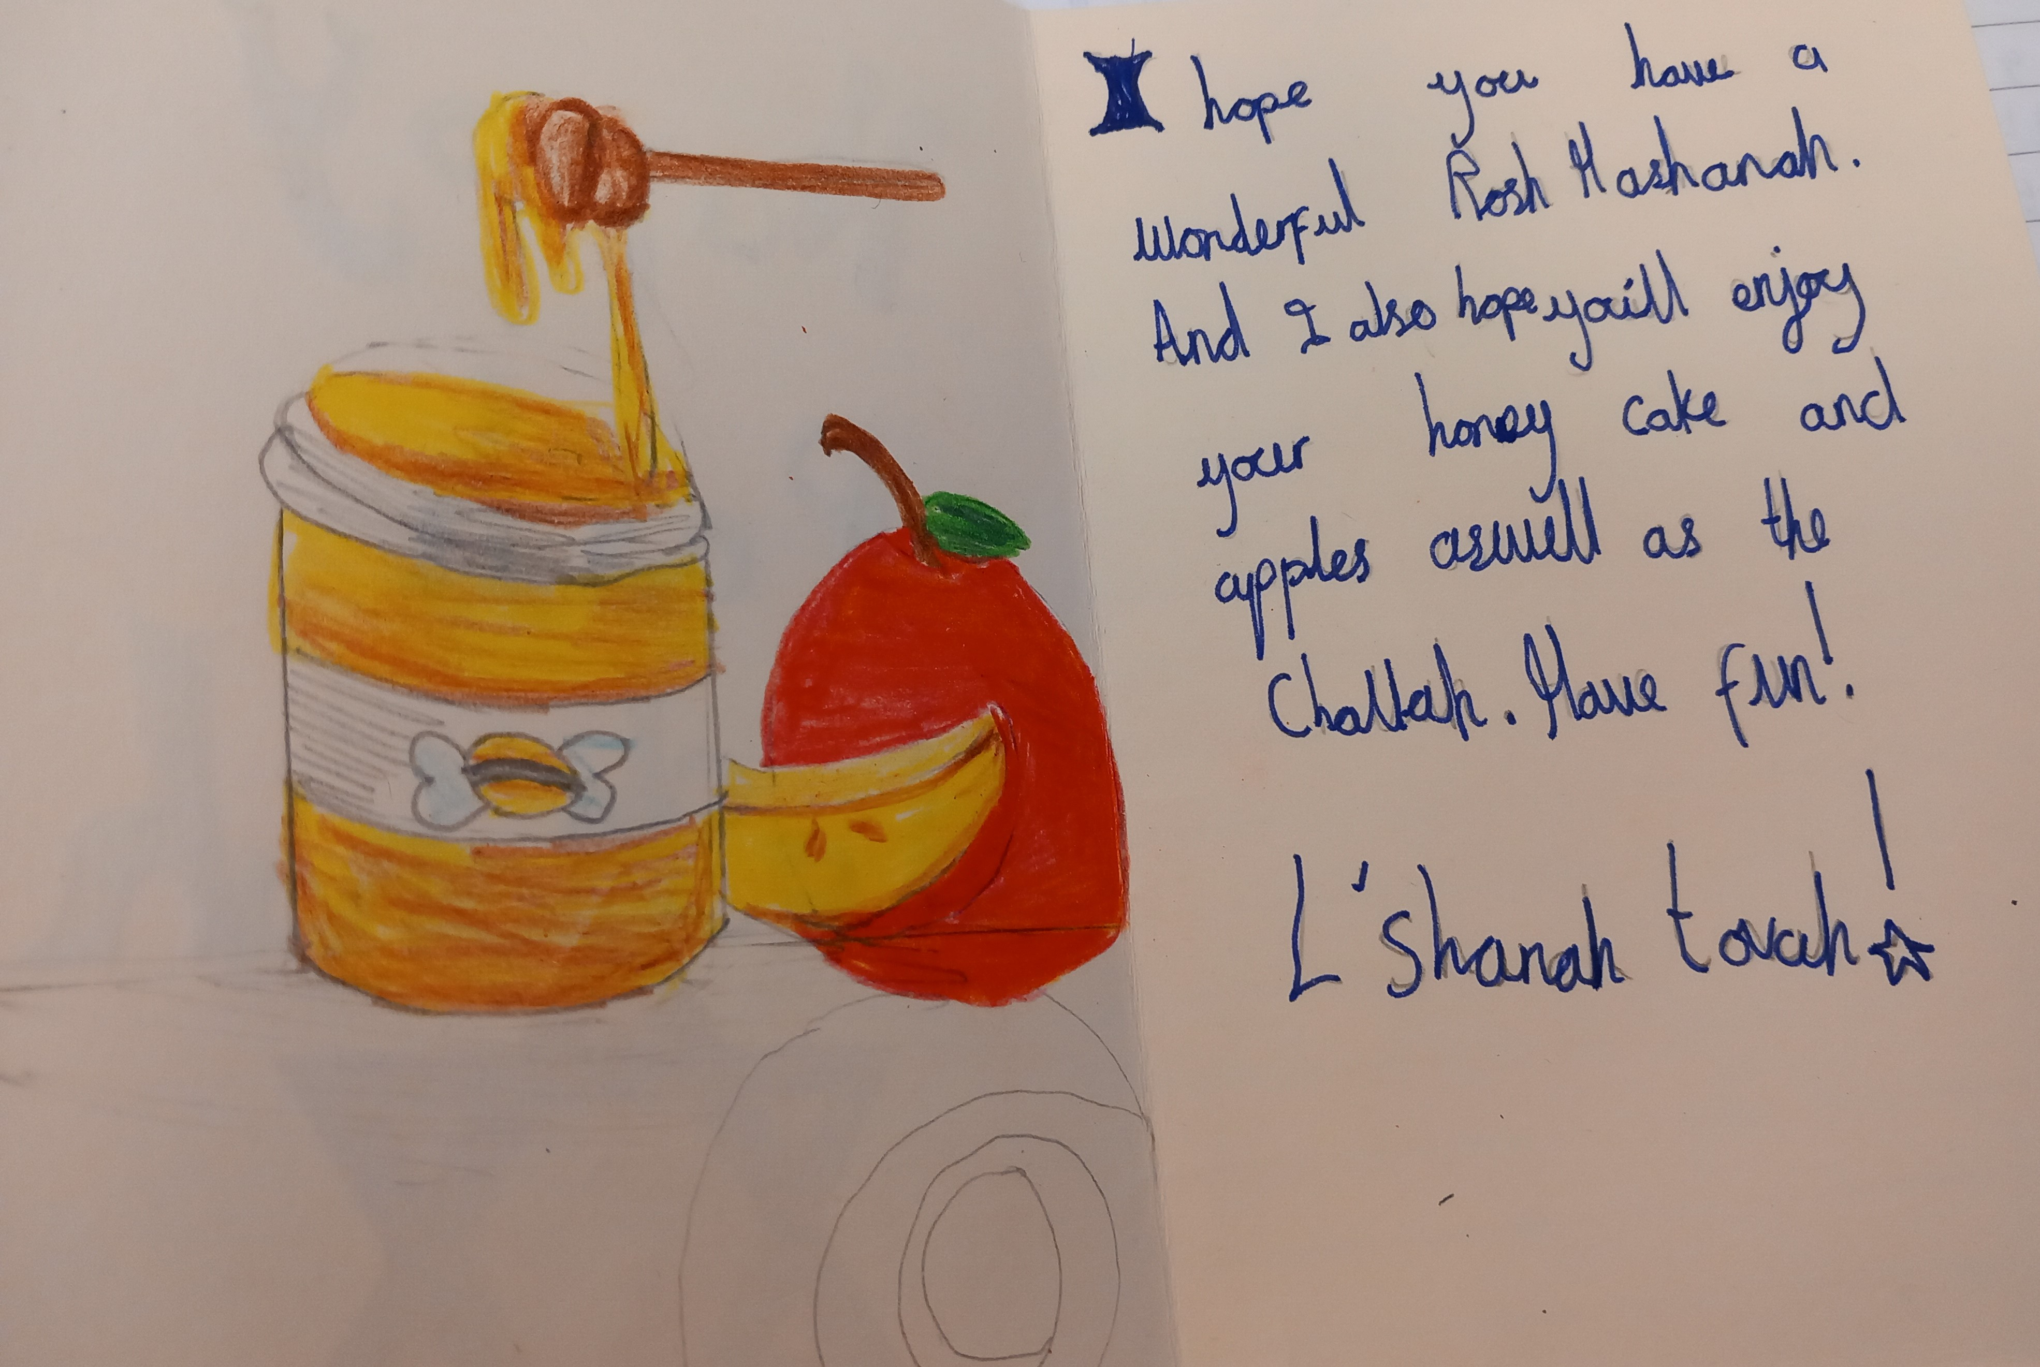
Year 6 design of a
Rosh Hashanah card

