Slide 1
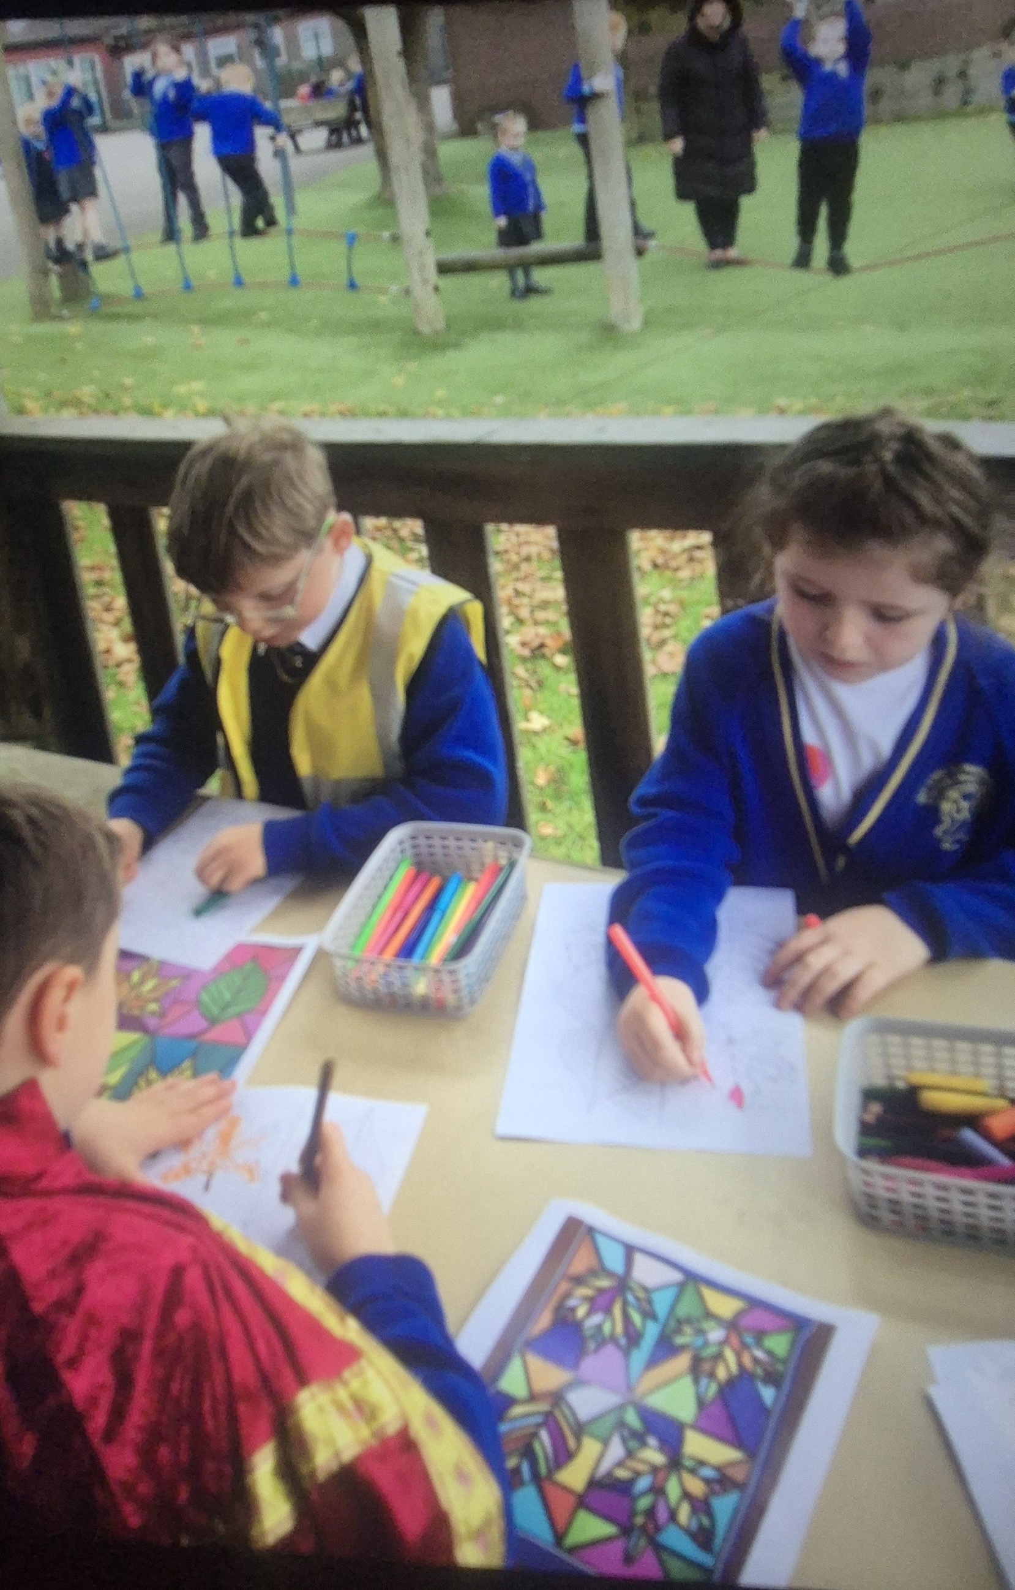
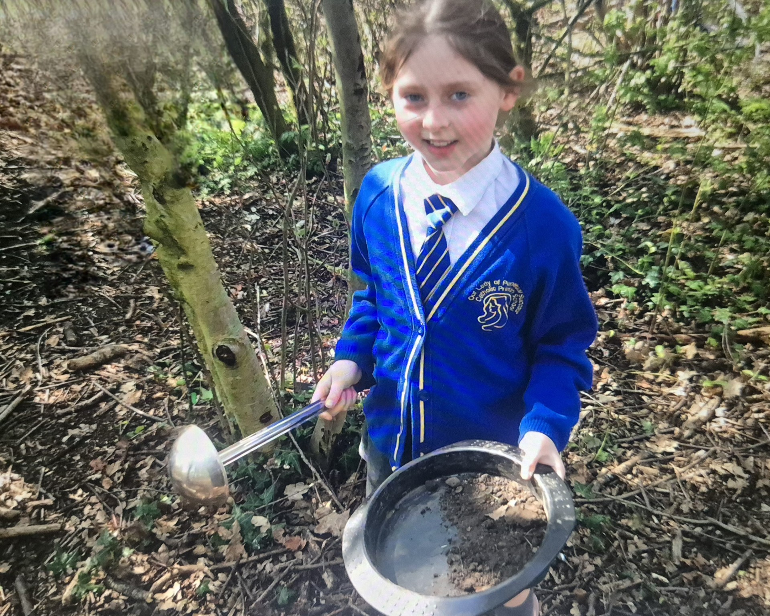
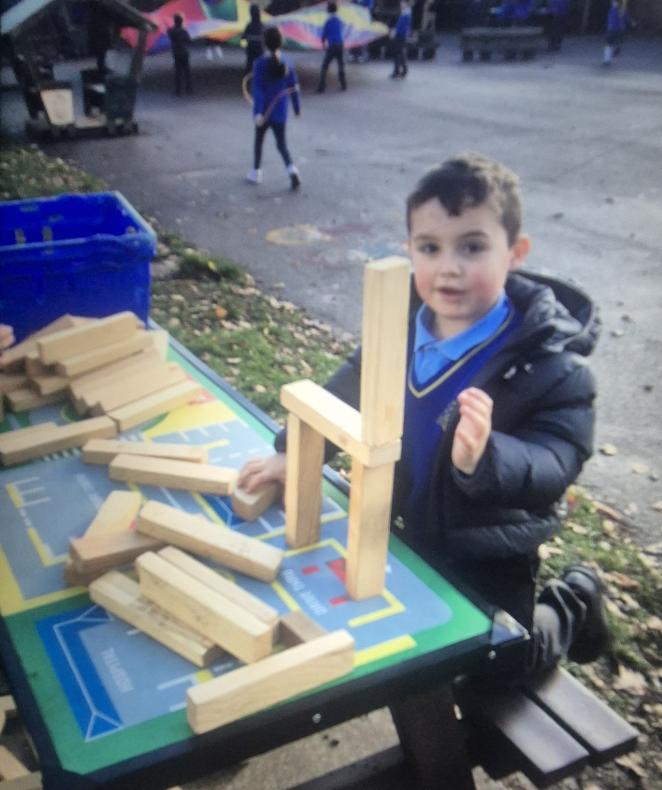


OPAL Play
Assembly

Slide 2
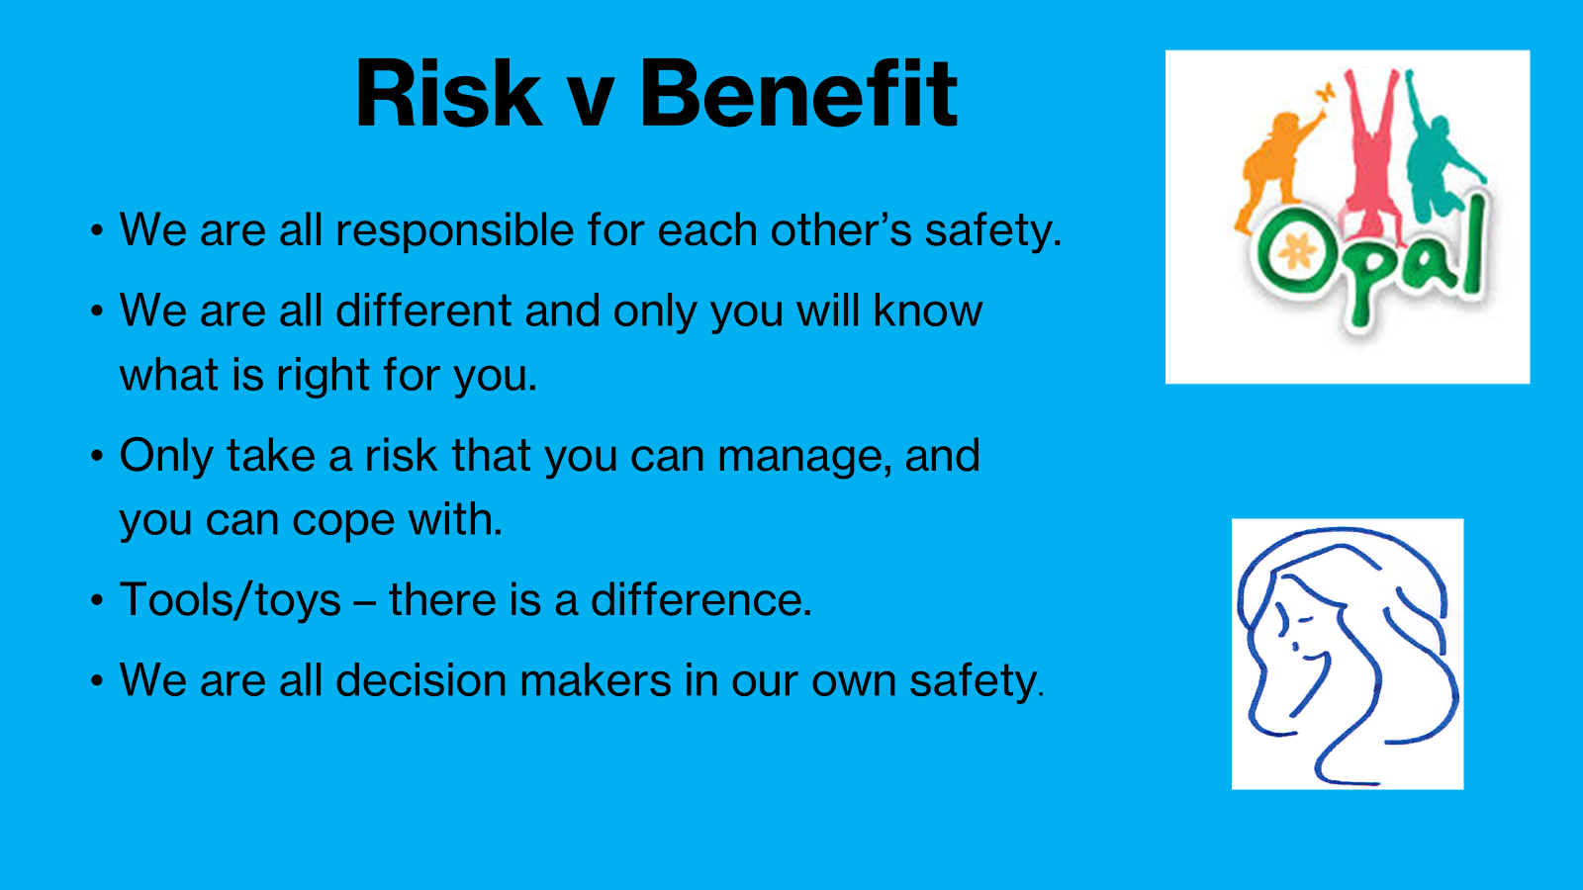

Slide 3
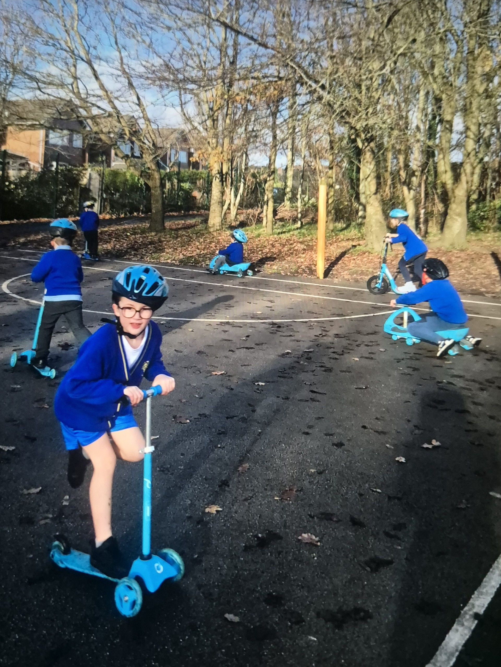
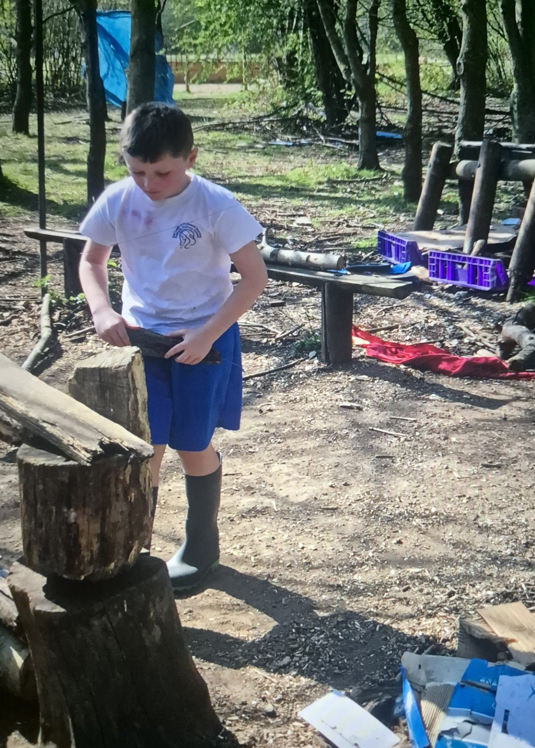

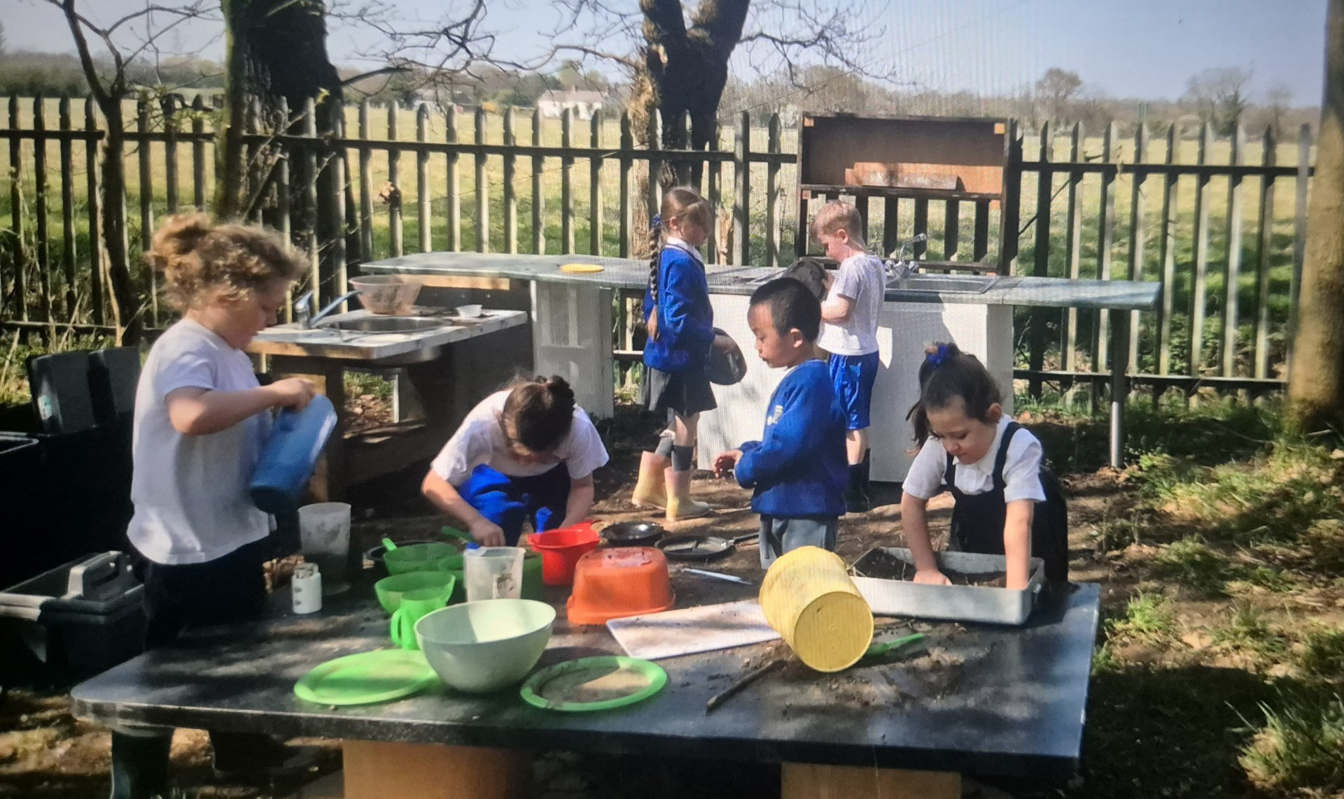
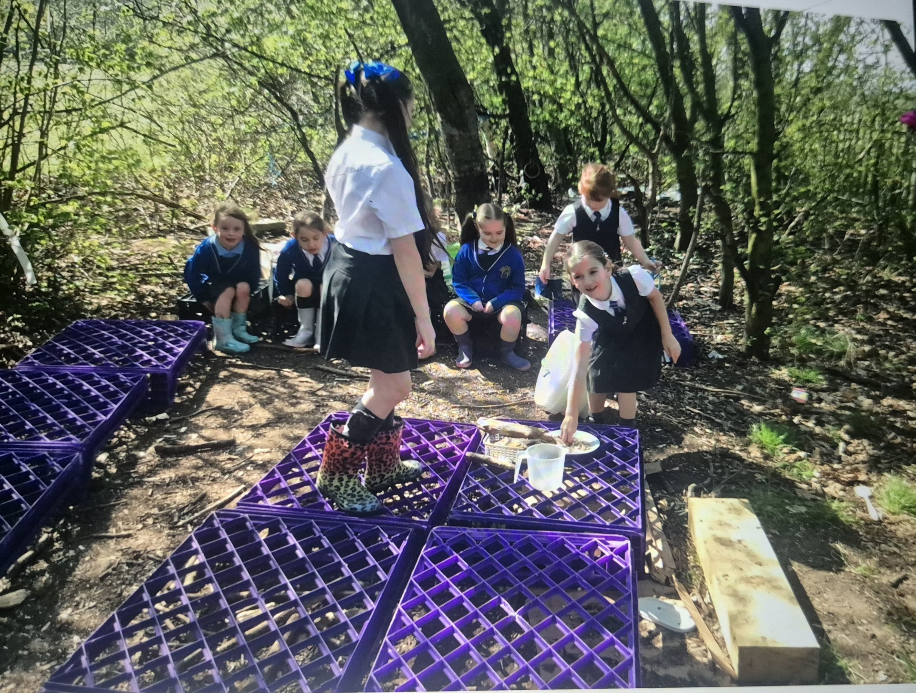
Celebrate
Amazing examples
of play

Slide 4

Celebrate
• We have been given a donation from Halton Helping Hands to develop our grounds. We will use this towards the construction of our new sand pit

Slide 5
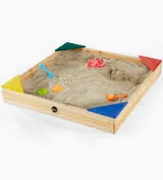
Inform
What will be new over next few weeks?
Construction of our new sand pit will begin over the next few weeks.

Slide 6
OPAL Certificates
We are about to introduce OPAL Certificates.
The Play Team will choose two children each week for going above and beyond at lunchtimes and always following our Play Charter rules.
You will receive a certificate in Friday assembly.

Slide 7

Journeys
Over the next couple of months, we are going to be thinking about journeys – these are creative ways we can move from one zone to another when we are outside for OPAL play

Slide 8
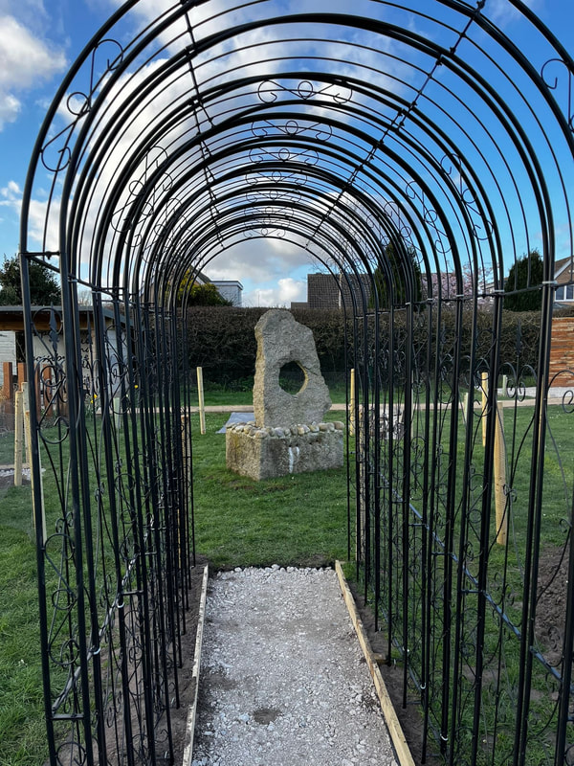
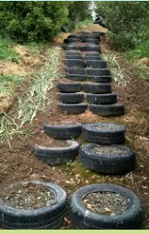

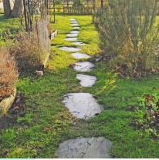
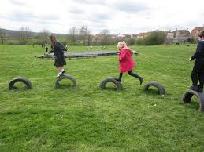
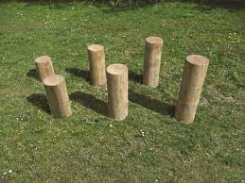

Slide 9

Football
We will introduce football next week (weather dependent) if dry without wellies!
Each class will have their own day.
Year 1 & 2 Monday
Year 6 Tuesday
Year 5 Wednesday
Year 4 Thursday
Year 3 Friday

Slide 10


Negotiate
What new rules do we need for
our new activities and equipment?

Slide 11

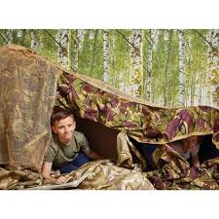
Reminders
Costumes/Fabric
Design your own outfits, put on a show, turn yourself into a superhero or hold a fashion show.
Put all the fabric/dressing up items away in the box at the end of lunch.
Please don't take costumes near the mud or wet
No wrapping things around your neck.
Do not swirl the fabric or dressing up clothes around otherwise they’ll get dirty or damaged
Use fabric blankets to make dens.
Negotiate

Slide 12
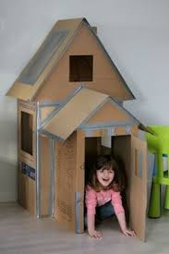
Negotiate
Cardboard boxes
• Please don’t tear the boxes up or rip them into pieces remember that someone else may want to play with them another day.
No throwing boxes.
No jumping on the boxes.
No boxes if it is raining.
Put all waste in the yellow bin.
Tidy and pile near the storage area at the end of lunch.
Reminders

Slide 13
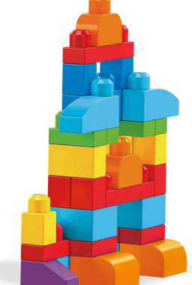
Reminders
Mega blocks
Don’t take them near the water or mud play.
• If you see pieces on the floor pick them up!
• There isn’t a huge amount so please share
Negotiate

Slide 14
Negotiate
Tidy up time
Listen for the 1st whistle
Look around and help each other to put everything away
Even if you’ve not tidied with something help put it away
Take care when putting equipment into the storage boxes- as some have been damaged
What rules do we need when tidying up?

