Slide 1
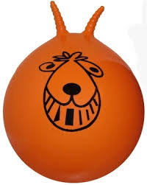
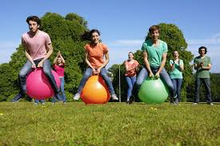
Inform
Space Hoppers

Slide 2
Innovate
How can we use it?
How can we not use it?
Races with friends
Bounce on them
Do an obstacle course
No kicking
Don’t throw them
No more than 1 person on at a time
No hitting others with them
Share them

Slide 3
Space hoppers are a fun bouncing activity, it improves physical fitness and makes exercise fun.
Be kind and share
Don’t hit people with them
Have lots of fun
Be careful when bouncing you dont collide with other children or objects.
Don’t kick them
What rules do we need to play with space hoppers
Negotiate

