Slide 1
Make up your own Shakespearian Insults – Choose a word or phrase from each column and put them together!
A | B | C
simpering | mad-headed | dog
wretched | lily-livered | nave
insolent | iron-witted | noise-maker
bawling | languageless | slave
blasphemous | stretch-mouthed | filth
poisonous | glass-gazing | foot-sore
abominable | frosty-spirited | hag-seed
slovenly | foul-spoken | boil
Notes:
The Tempest is a play full of conflicts. How many can pupils think of?
Because of this, many insults are traded. Ask pupils to create their own by choosing a word from column A, one from B and one from C. They will want to share these!
Working with a partner, they should then make up a conversation of insults between Caliban and Prospero.

Slide 2
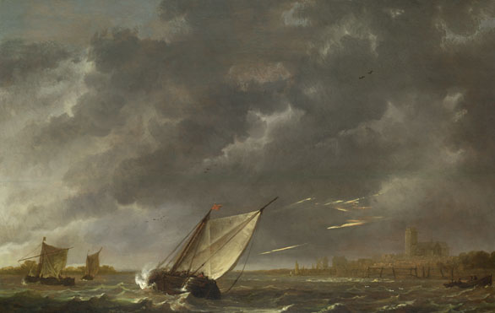
Lesson 4: A Magical Island with a Magical Character . . .
Learning Objective
Explore Prospero’s character

Slide 3
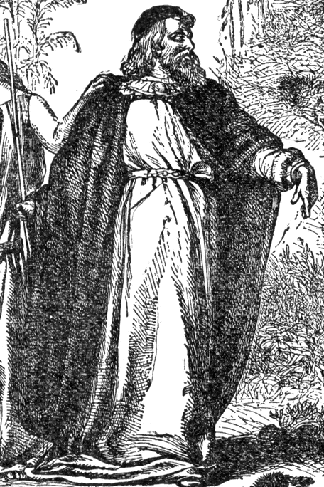
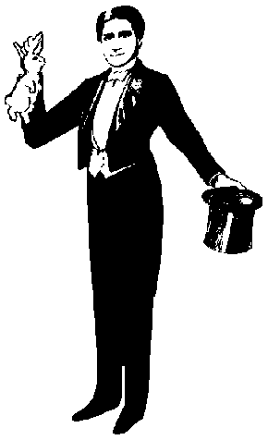
Prospero possesses magical powers. What characteristics, appearance and skills do you associate with a magician? Use the pictures below to create a mind map of your ideas.

