Slide 1
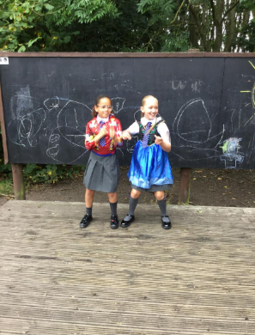
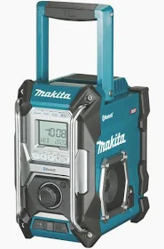
Stage Zone/Costumes
Inform
We have bought a music speaker

Slide 2


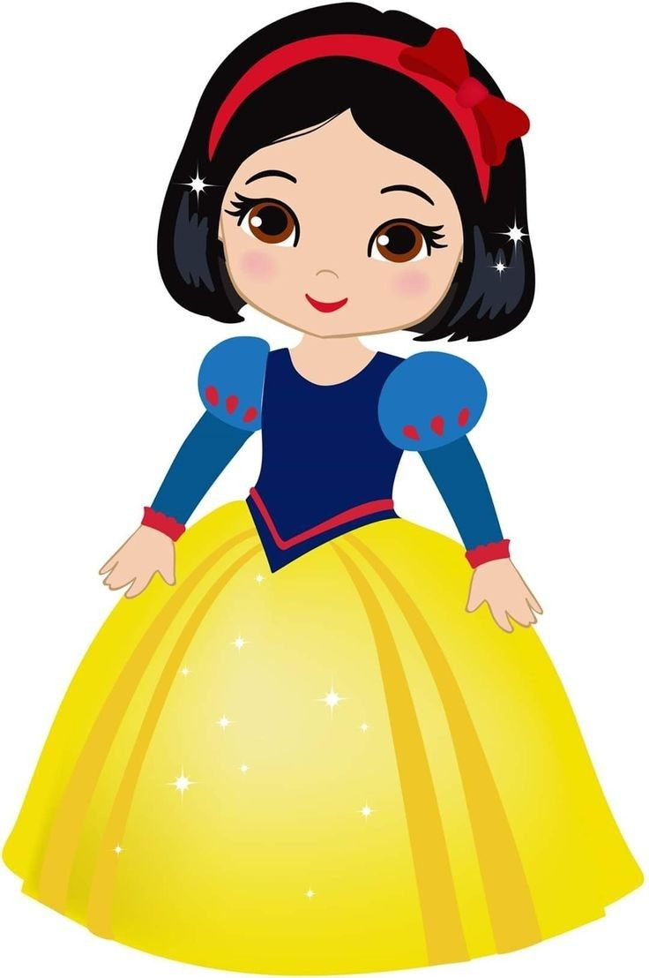
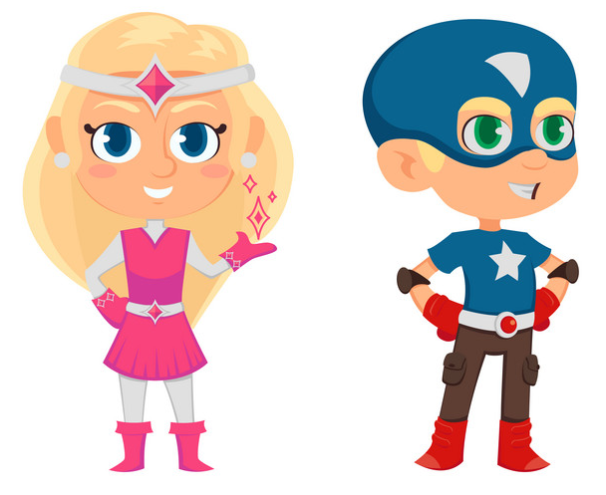
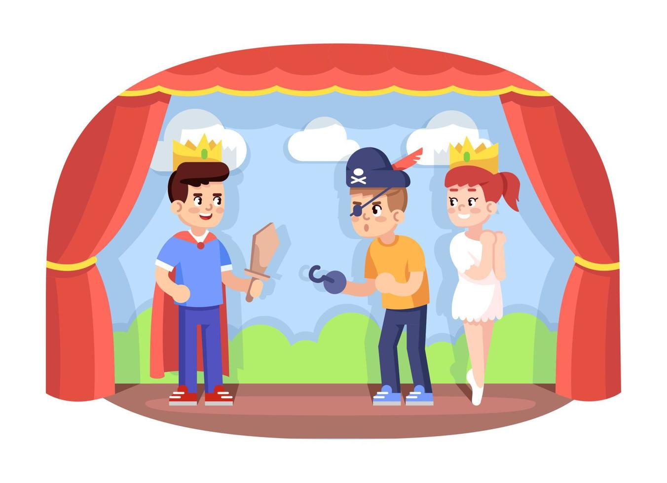

Innovate
Sing
Dance
Dress up
Music
Perform

Slide 3
Dress up you can be a Disney princess, an action hero or a builder..
Take care of the costumes.
If you see costumes on the floor, please pick them up.
Before you put a costume on think will it fit me.
Put costume back into the boxes
What rules do we need to play with costumes
Negotiate

Slide 4
Be imaginative in the Stage Zone
Be aware when entering (getting on) and exiting (getting off)he stage area
No running on the stage due to wet conditions will be slippery
Wellies to be worn in wet weather
Play team will set u the music please don’t touch the music speaker
What rules do we need for the Stage Zone
Negotiate

