Slide 1
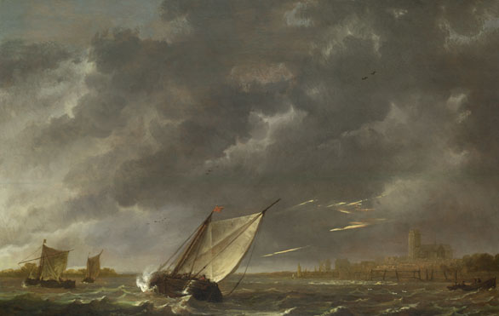
Lesson 2:
Introducing The Tempest
Learning Objective
Introduce the background and history of the play

Slide 2

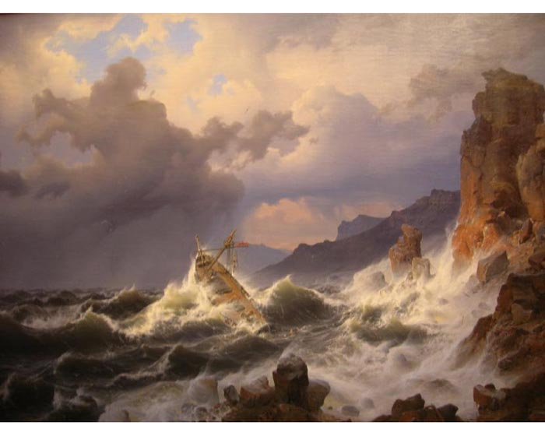
What is a tempest?
1. A violent windstorm, frequently accompanied by rain, snow, or hail.
2. Furious agitation, commotion, or tumult; an uproar:

Slide 3

Notes:
Using this image, taken from a programme, and any prior knowledge of the play that they might have, students should create a brainstorm showing what the expect to find in the play. Eg its possible themes, events, setting, characters, storyline. Emphasise that you are interested in their expectations, not just what they actually know. When new impetus is required, introduce the next image (slide 3) – ask pupils to adapt or develop ideas in the light of it and repeat this process for the third image.

Slide 4


Slide 5
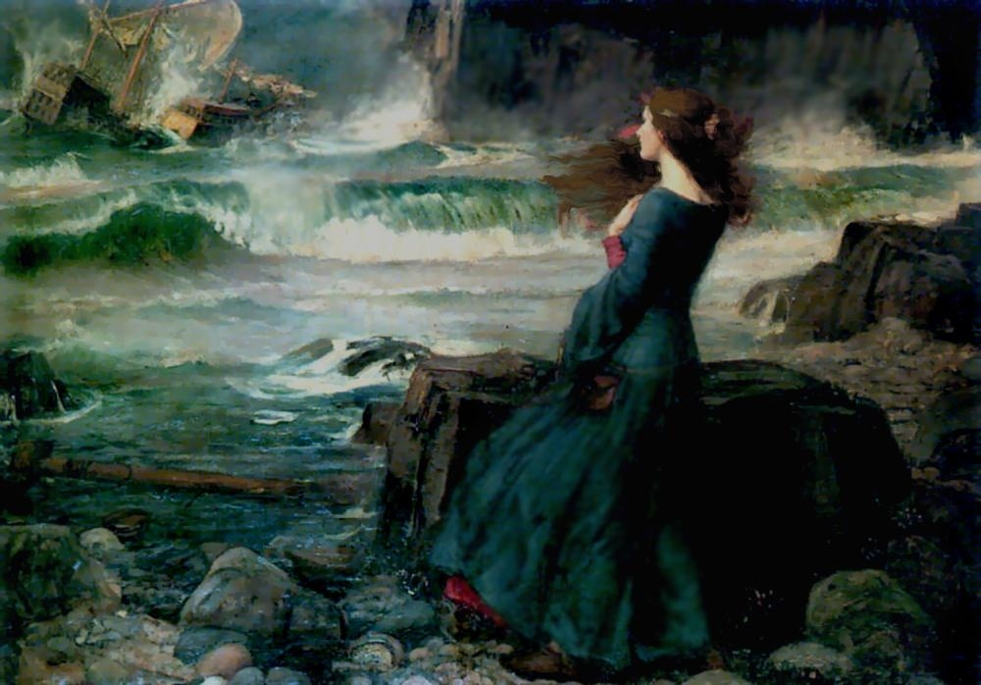
Notes:
Painting – John William Waterhouse (1849 – 1917)

Slide 6
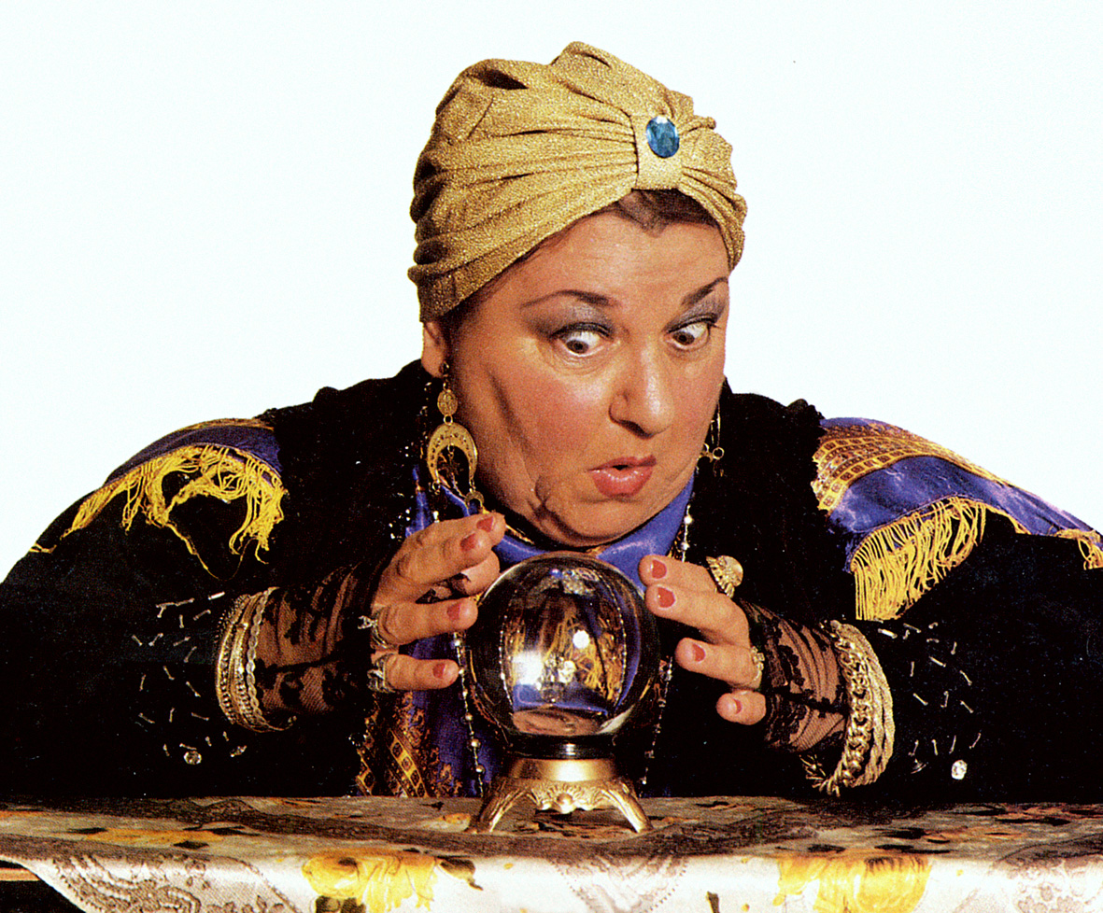
I predict...

Slide 7
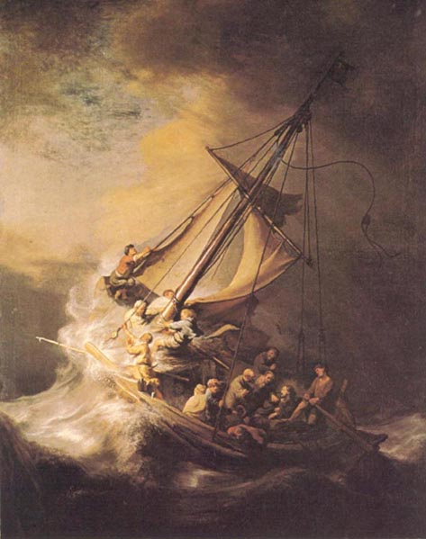
Voyages of Discovery
Read the sheet and then answer the
following questions in full sentences:
When was The Tempest written?
Name two places that were yet to be discovered.
Why would the Elizabethans have been interested in the play?
Name two beliefs held by people in the 17th century .

