Slide 1
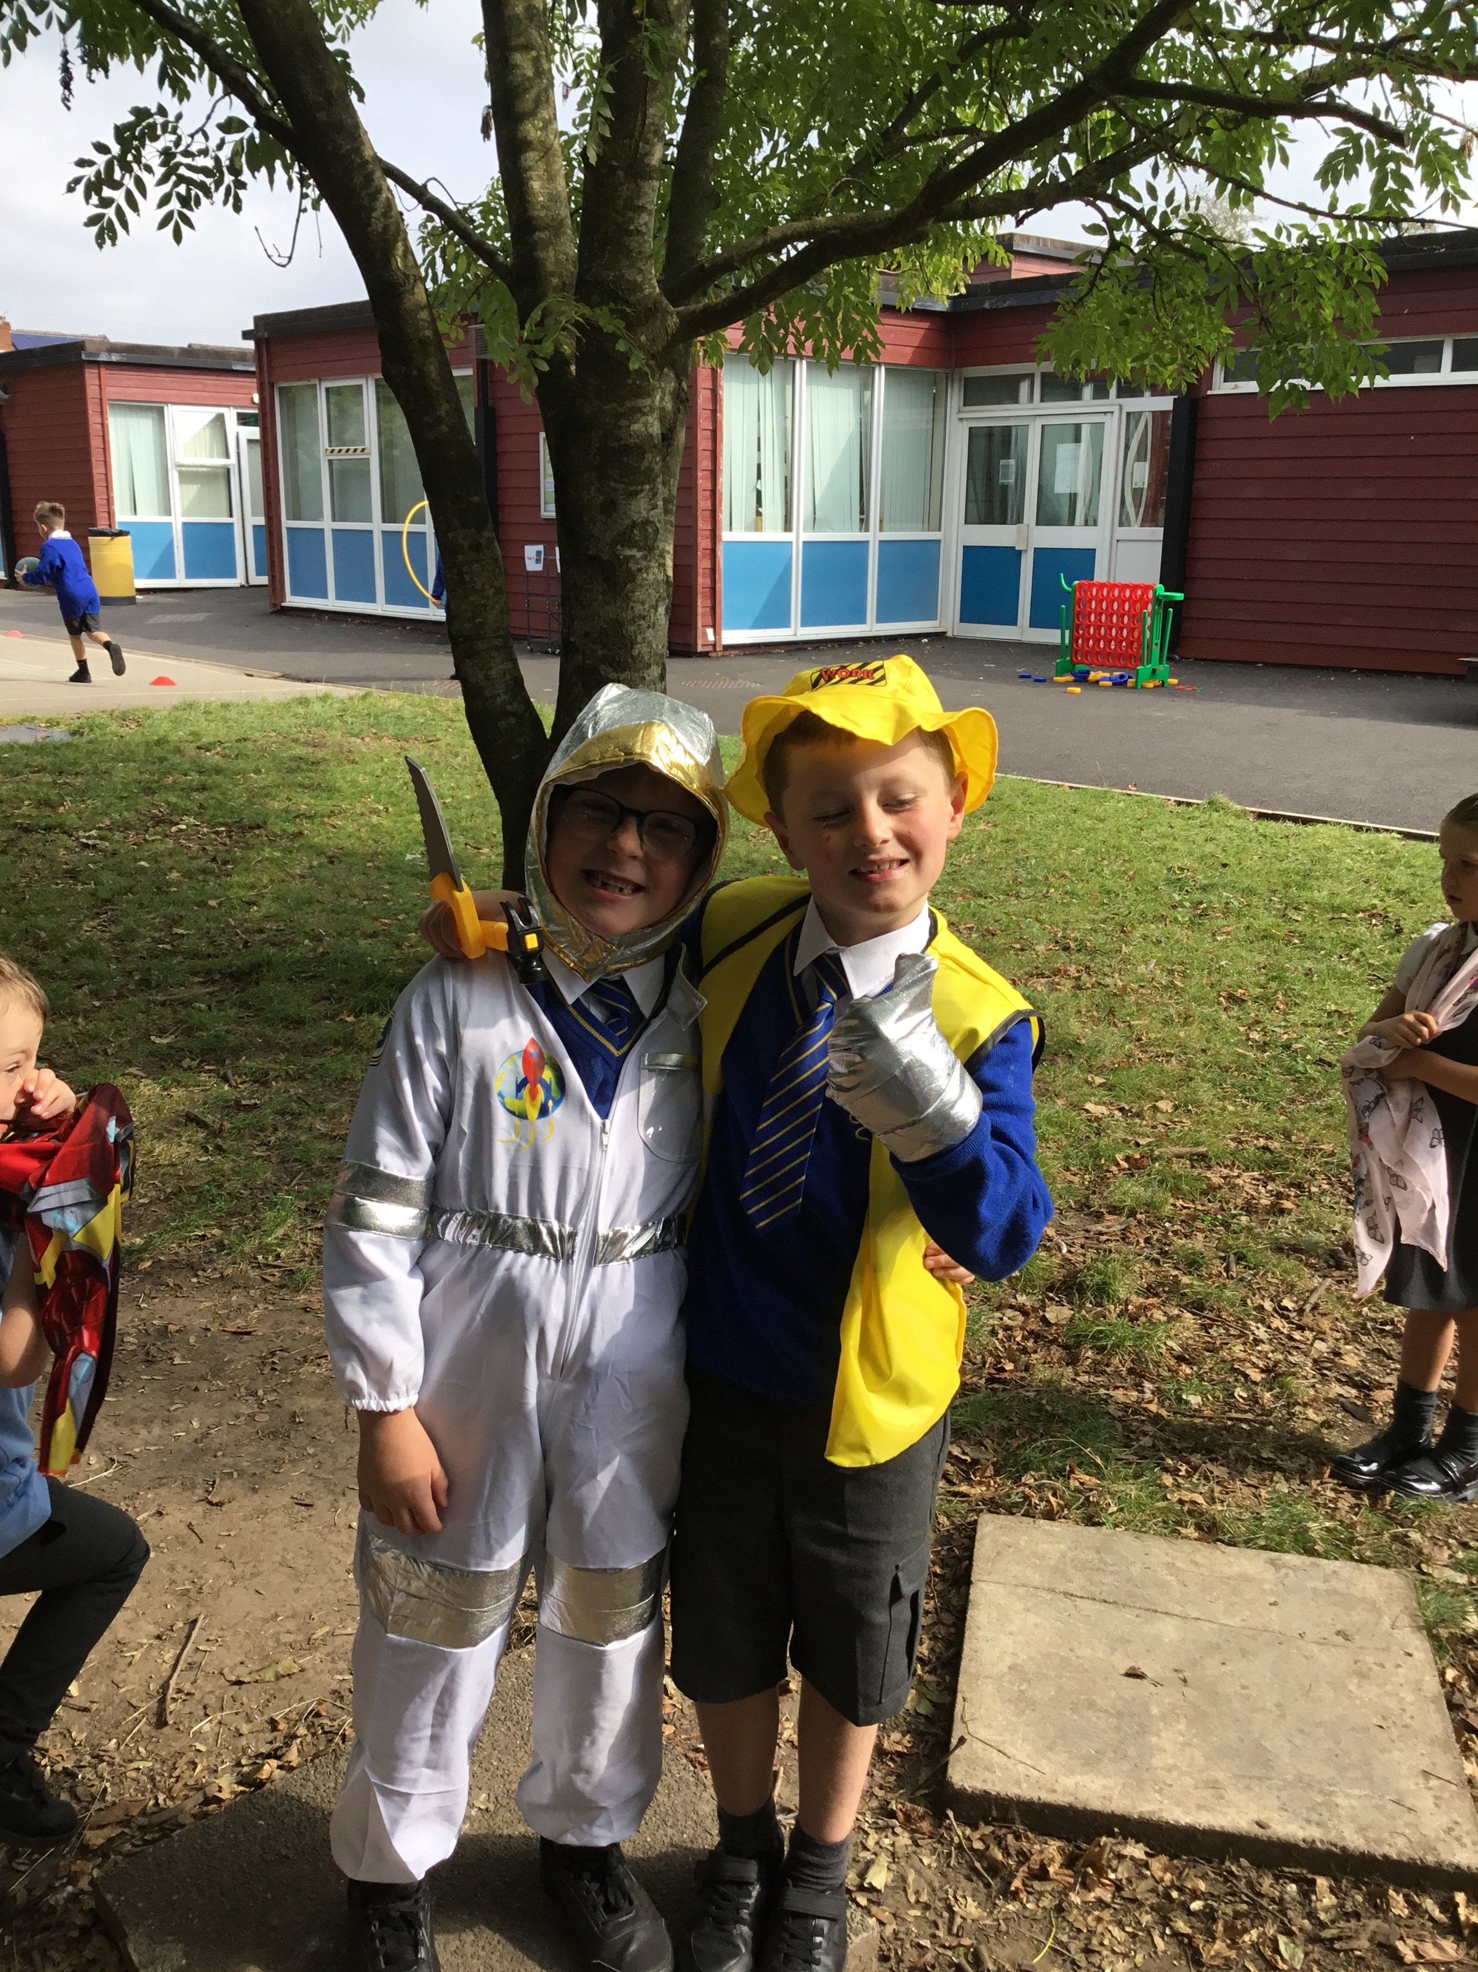
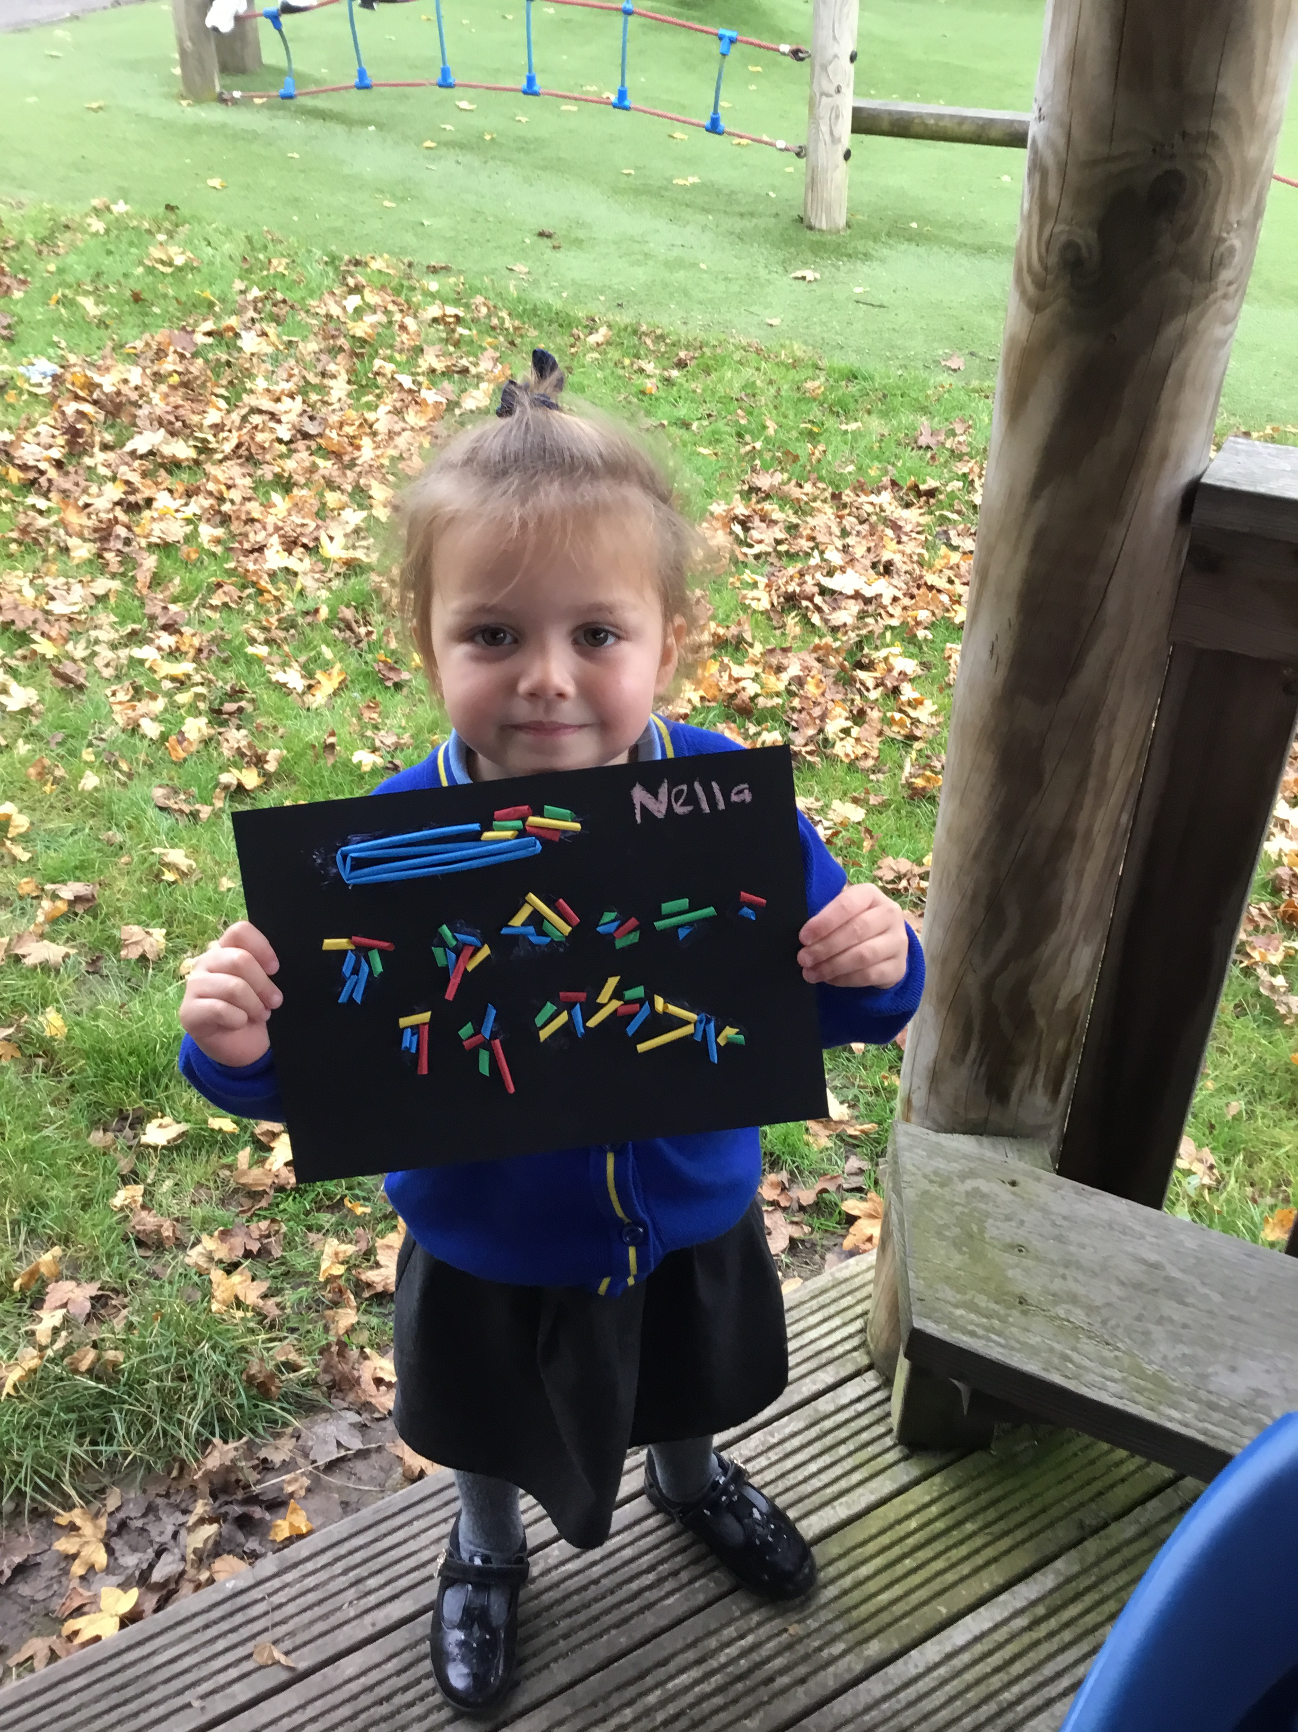
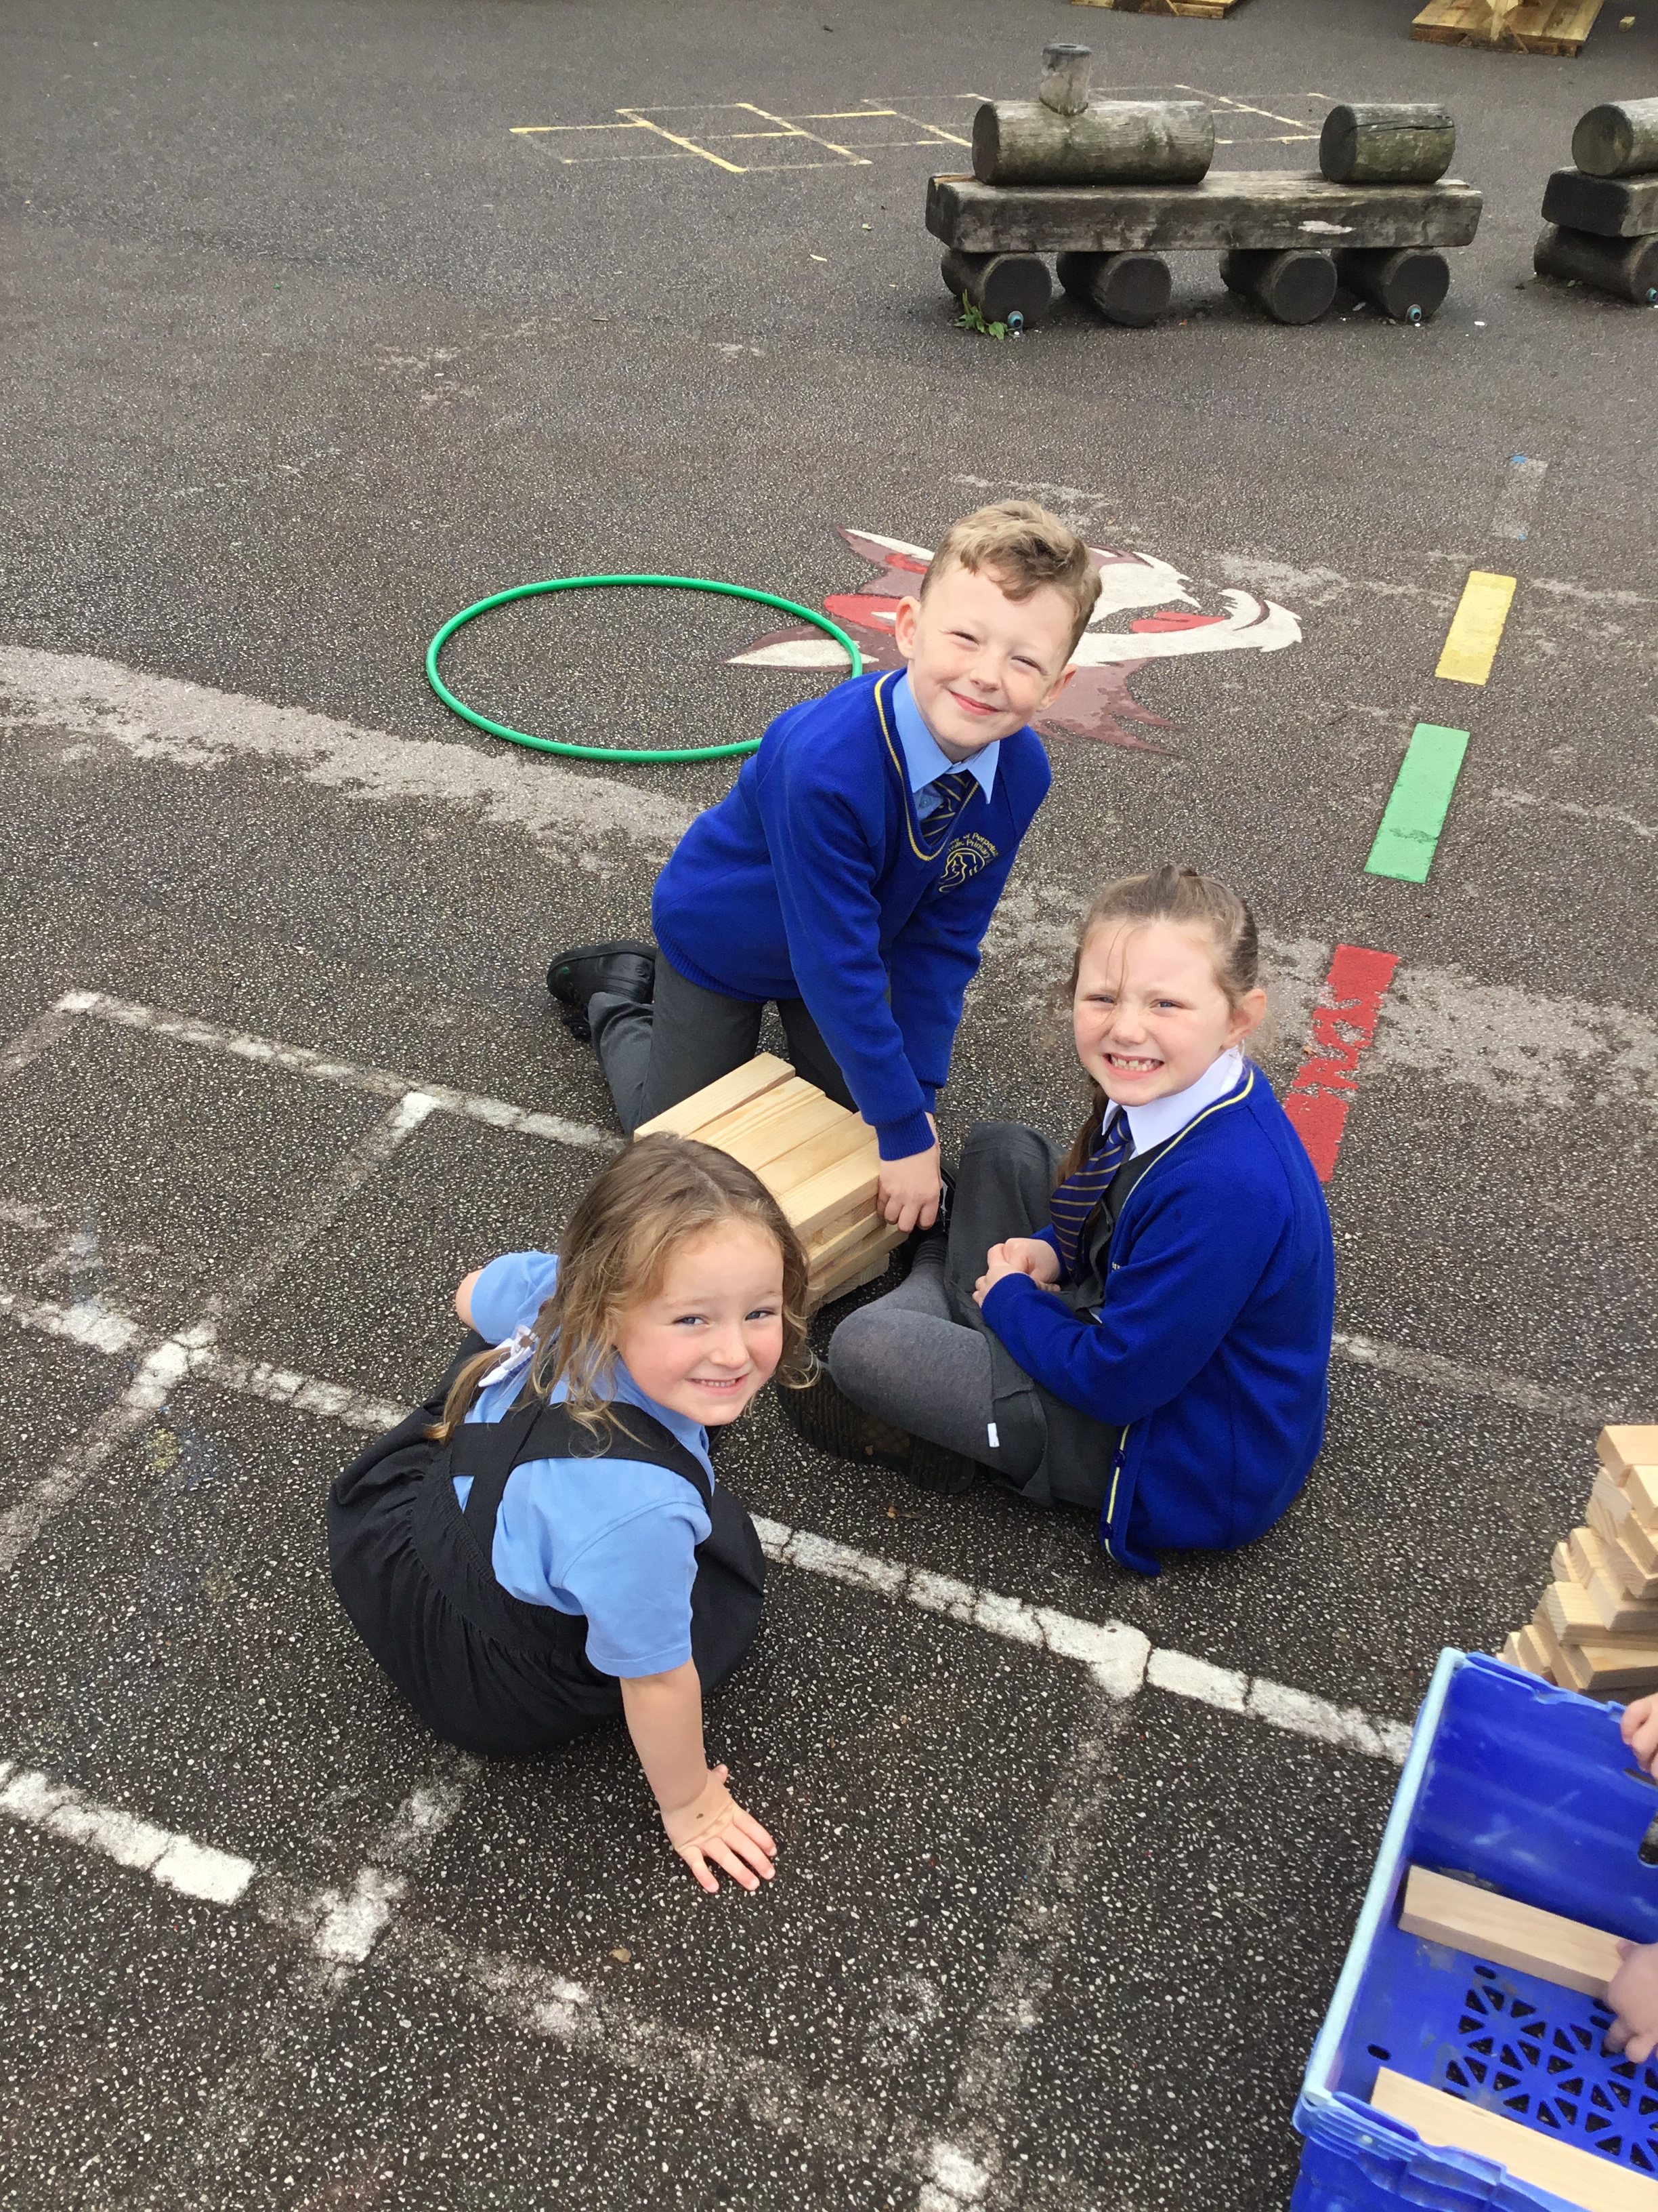


OPAL Play
Assembly

Slide 2
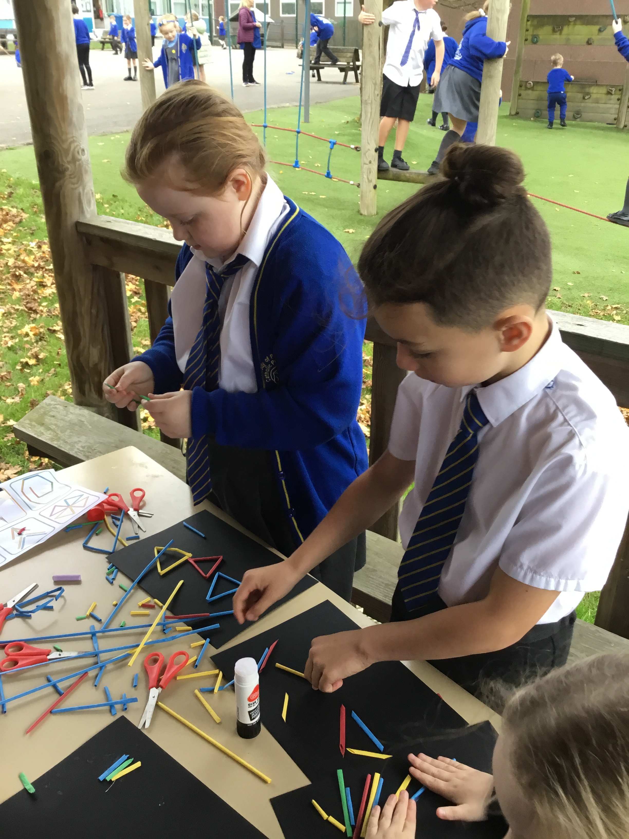
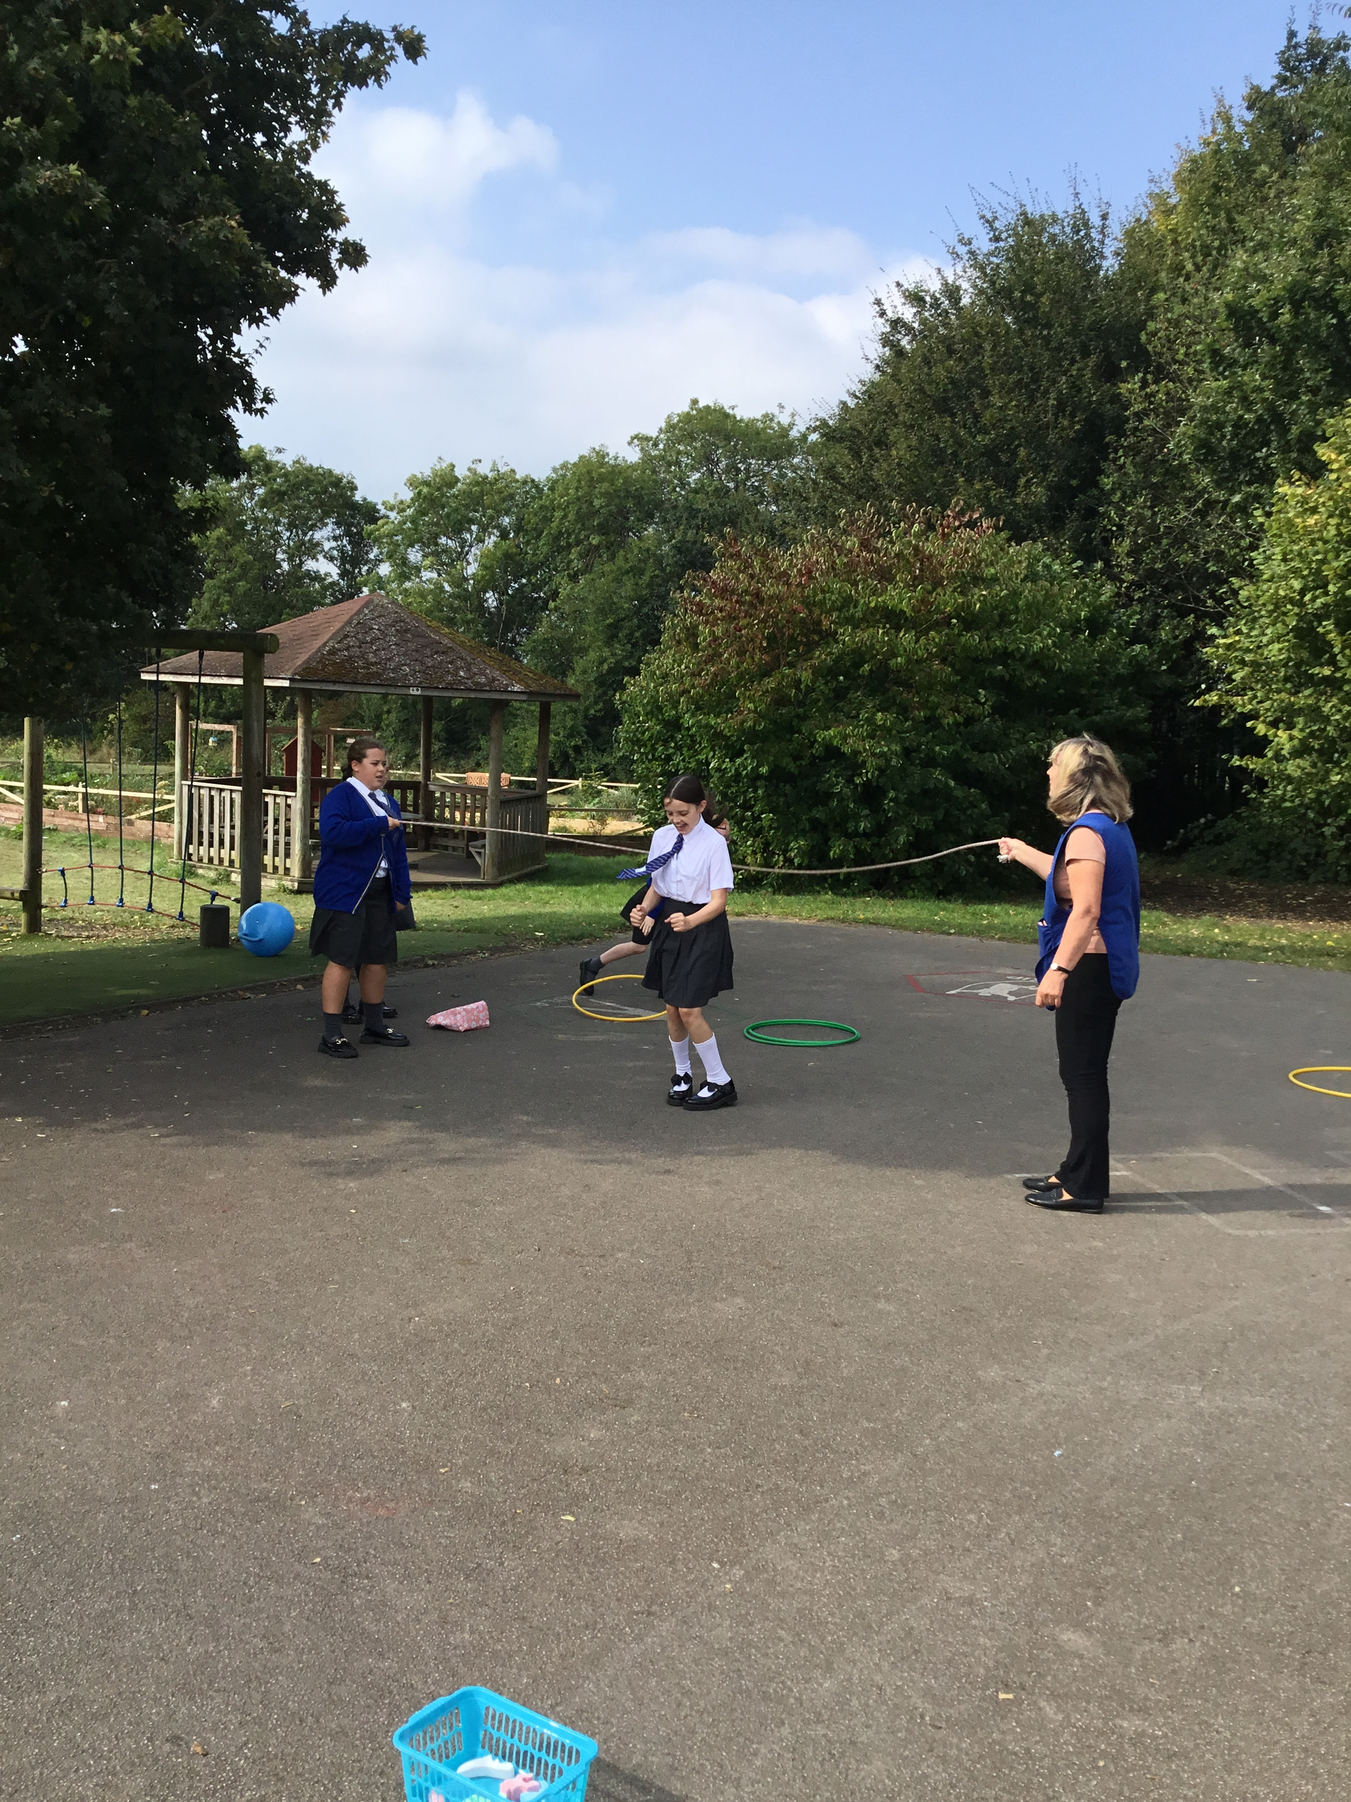

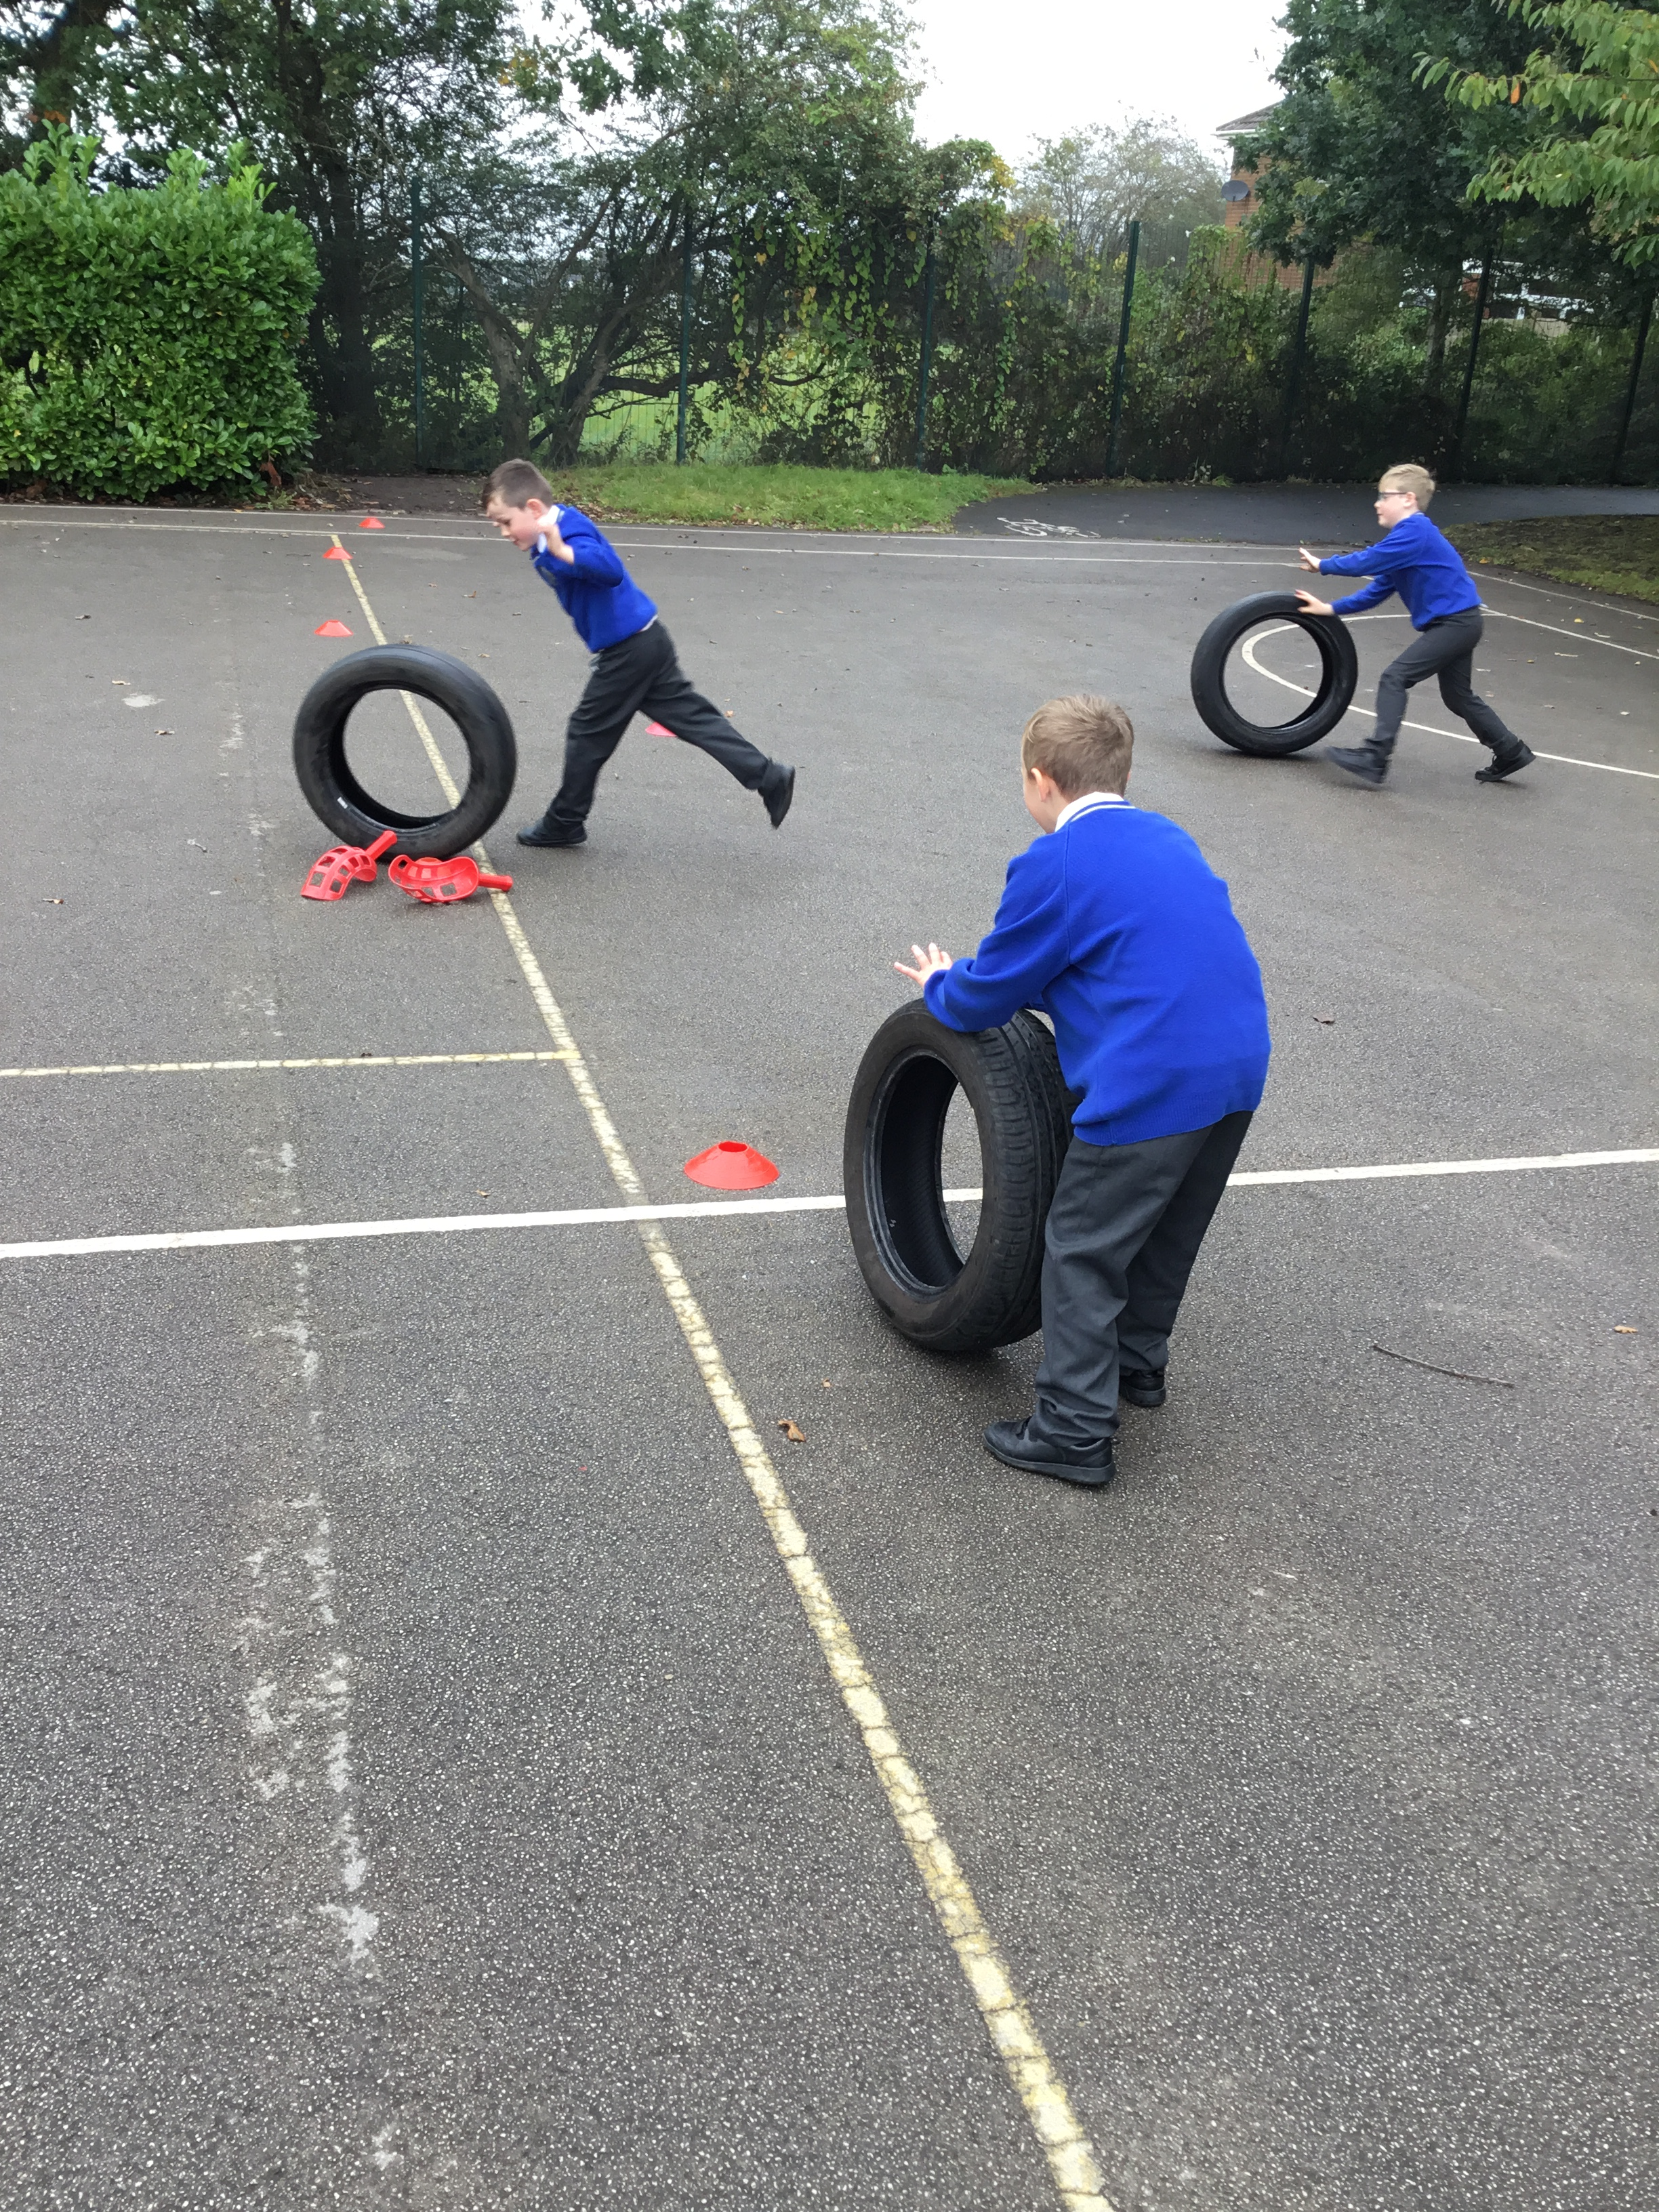
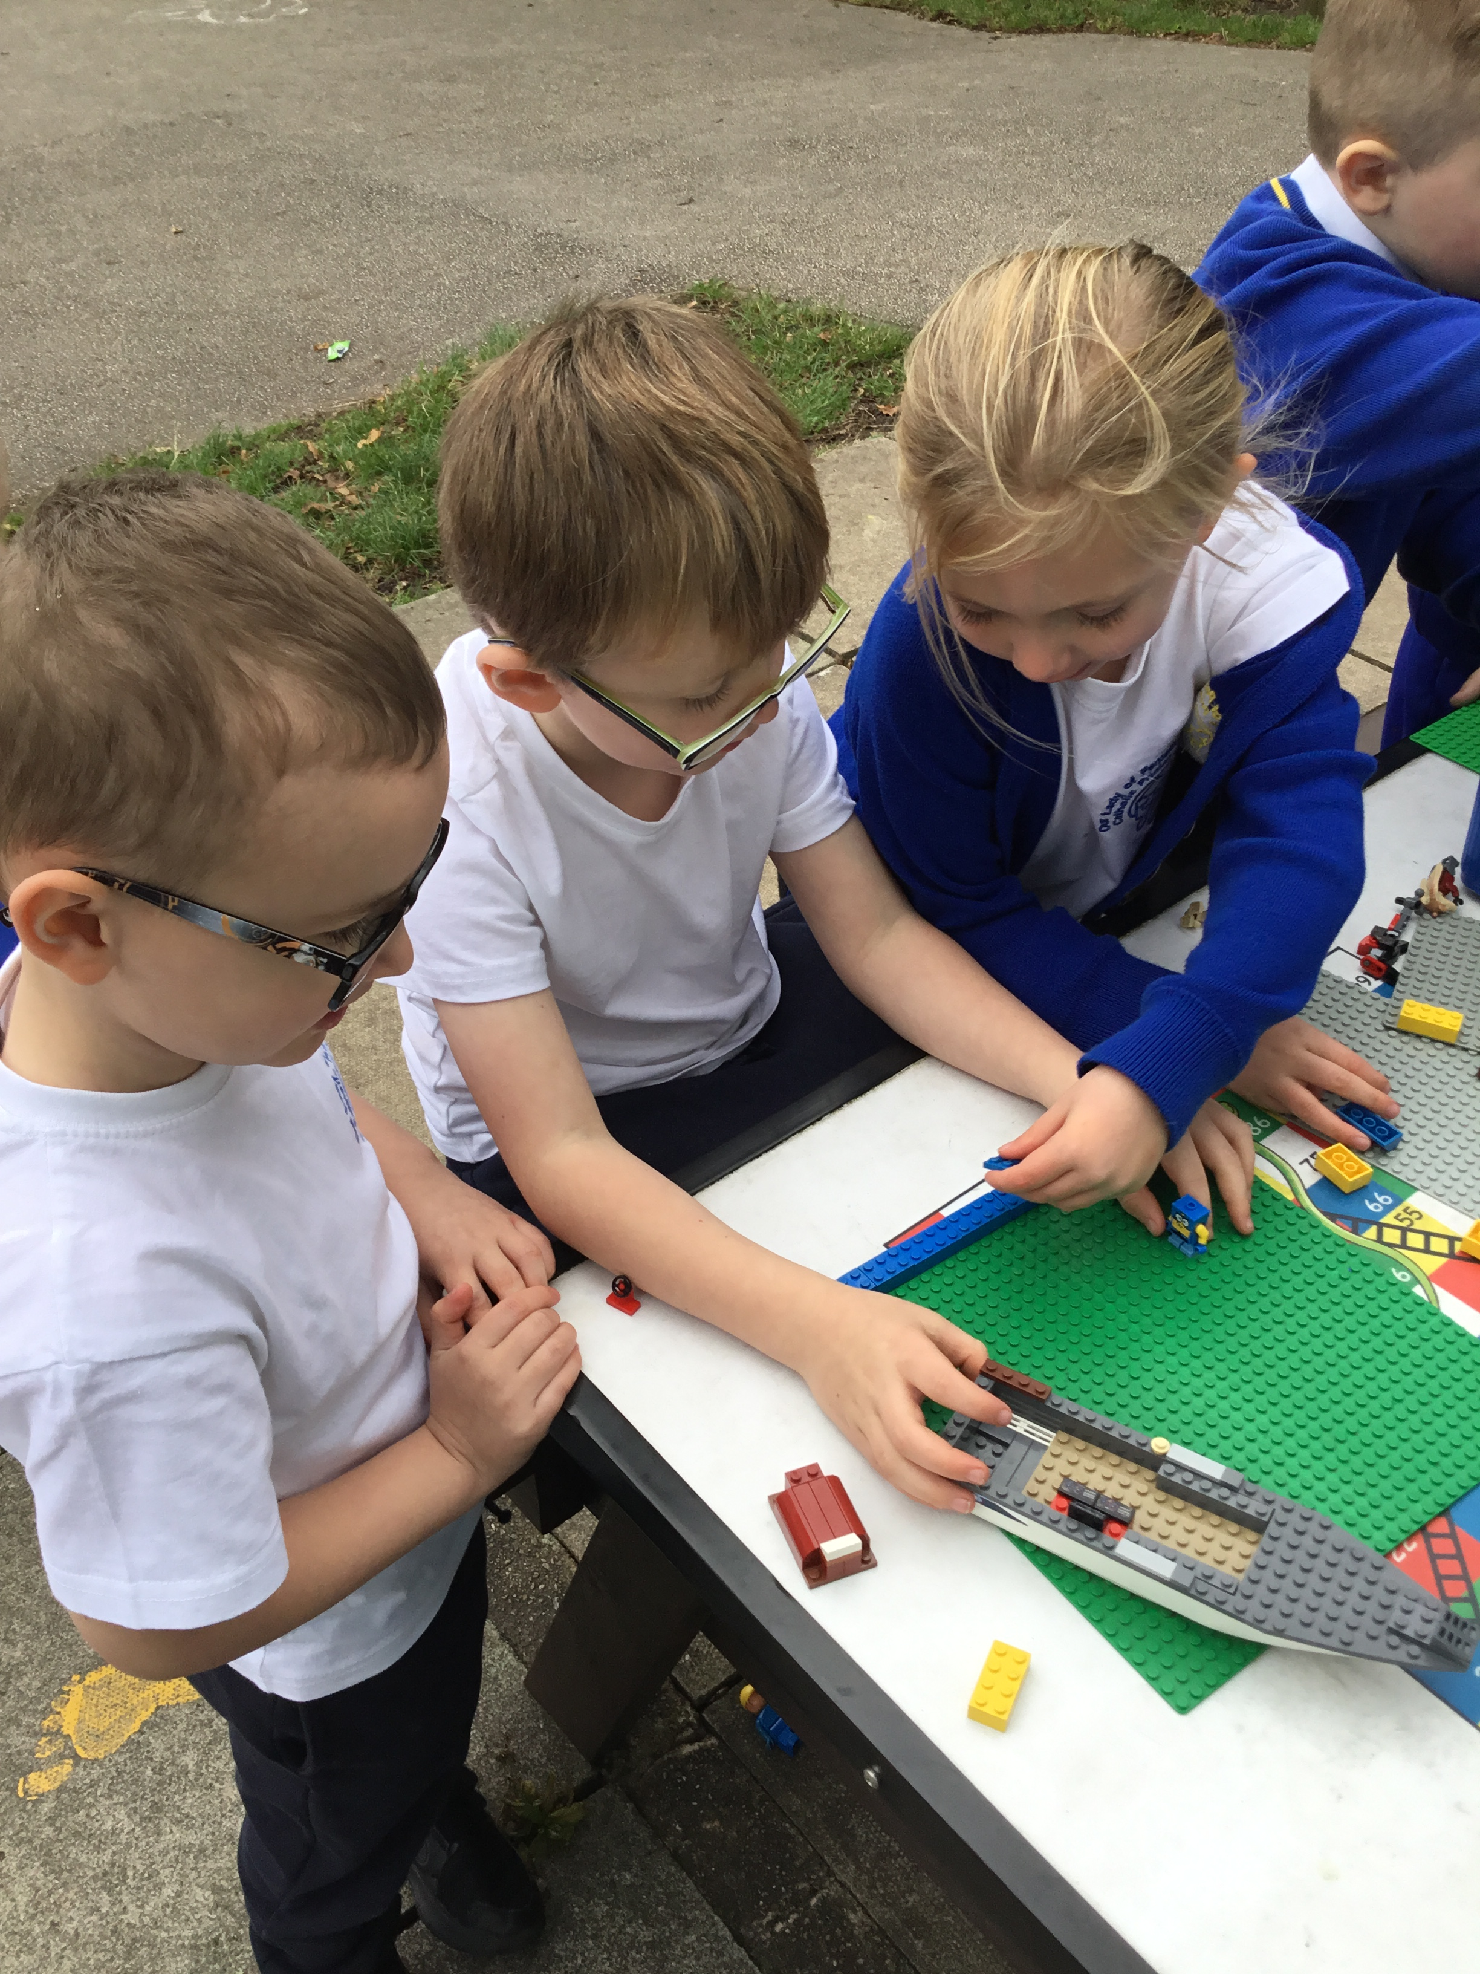
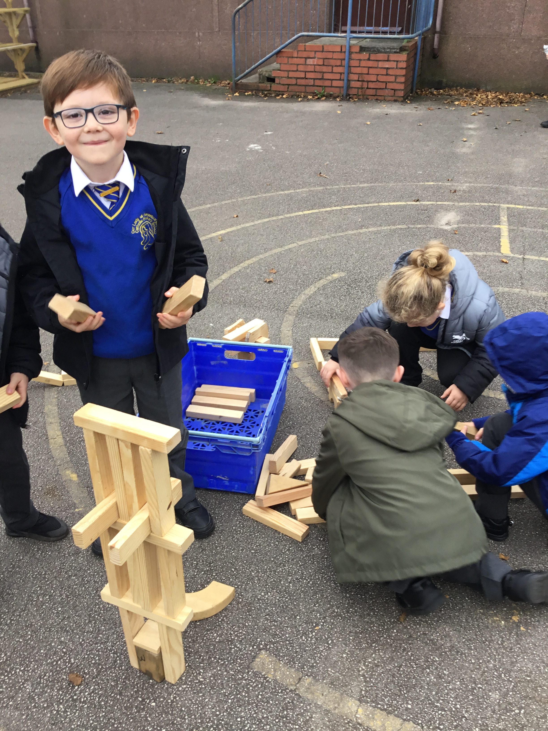
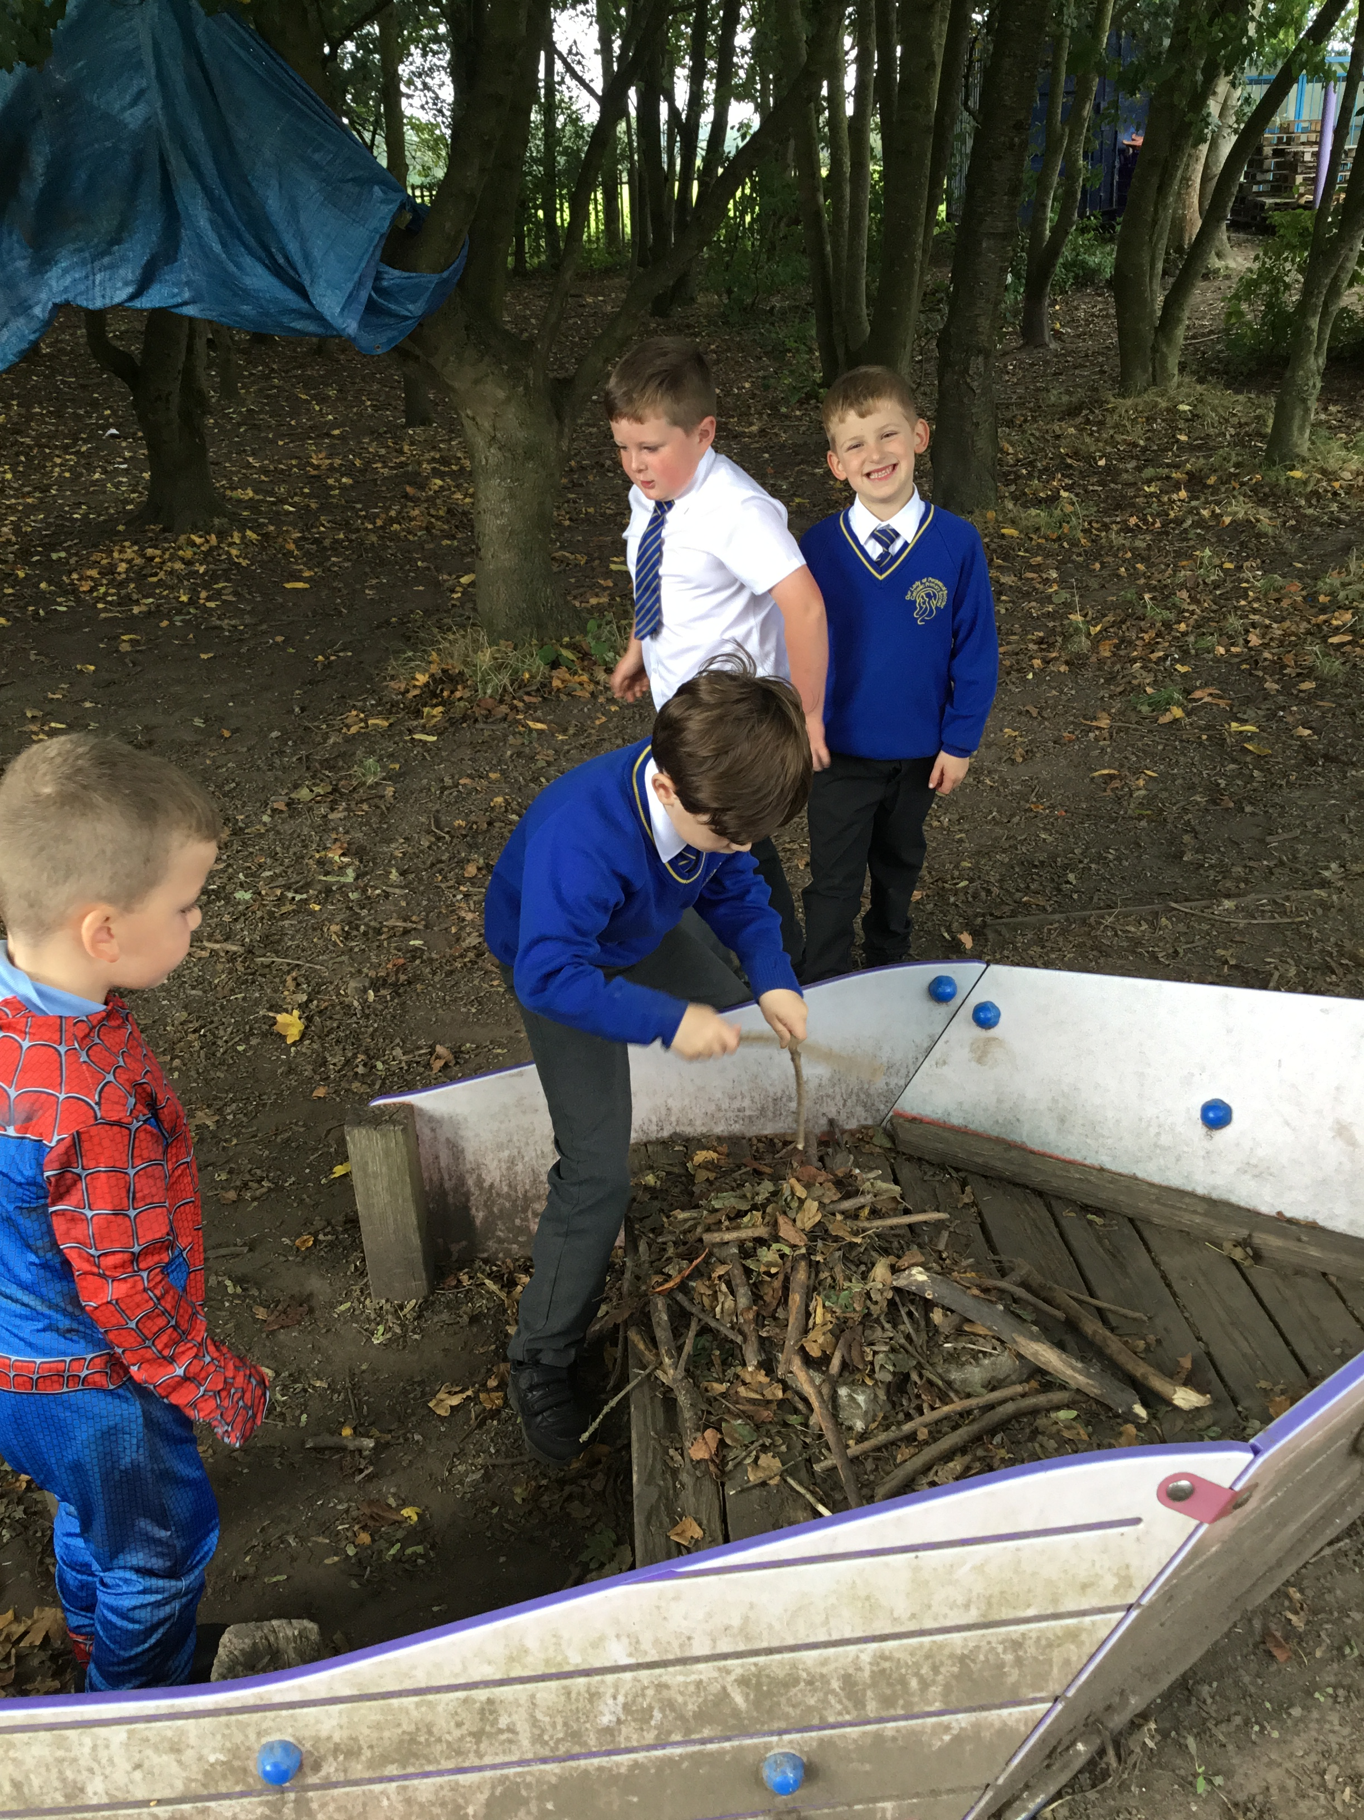
Celebrate
Amazing examples
of play

Slide 3
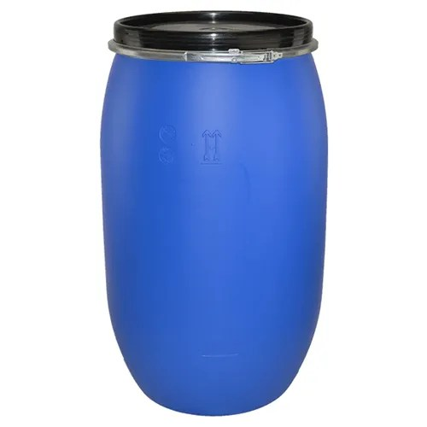

Inform
What will be new over next few weeks?
Plastic drum
Cardboard boxes

Slide 4
Innovate
How can we not use it?
How can we use it?
Towers not higher than shoulder length
Don’t climb or stand on the drums
Don’t rip up the boxes as it litters the woods
Push them, roll them, roll over them on soft grass (not concrete)
Make an obstacle course
Make dens, forts, bridges

Slide 5


Negotiate
What new rules do we need for
our new activities and equipment?

Slide 6

Negotiate
Plastic drums
Play team will remain vigilant about correct use.
Don’t stand on top of them as there’s a risk of falling
Don’t get inside the drums
Don’t try to pick them up as they are heavy
What rules do we need when with plastic drums ?

Slide 7
Negotiate
Cardboard boxes
Please don’t intentionally tear or rip up boxes as it litters the woods
Don’t throw boxes incase the hit others
No boxes out if its raining
No jumping on boxes
What rules do we need when with plastic cardboard boxes?

Slide 8
Negotiate
What rules do we need?
Polite reminder
When you have finished using equipment put it away
If you hit a ball in the bushes, please go and collect it
Make sure all equipment is tidied away. Check the floors as Lego and small world has been found under benches
Put equipment in correct boxes- boxes are labelled

