Slide 1
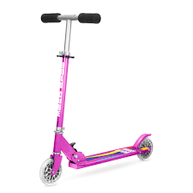
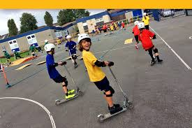
Inform
What will be new this week?
Wheeled Play

Slide 2
Innovate
How can we not use it?
How can we use it?
Only one person at a time
Don’t speed on scooters as you will find it difficult to stop
Ride all over the playground
Scooting
Transporting
Wiggling- wiggle bikes

Slide 3


Negotiate
What new rules do we need for
our new activities and equipment?

Slide 4

What rules do we need for the wheeled area?
Scooters
Be aware of speed and crashing into others on the wiggle bikes and scooters.
Always follow one way system- clockwise only
Take care when taking off helmets please back in the box or give to another child.
Be aware of the fingers trap on wheeled boards.
Always wear a helmet.
Please don't just drop helmets on the floor.
Scooters/wiggle bikes are to be reburned to behind the container- not thrown down the slope!
Negotiate

