Slide 1
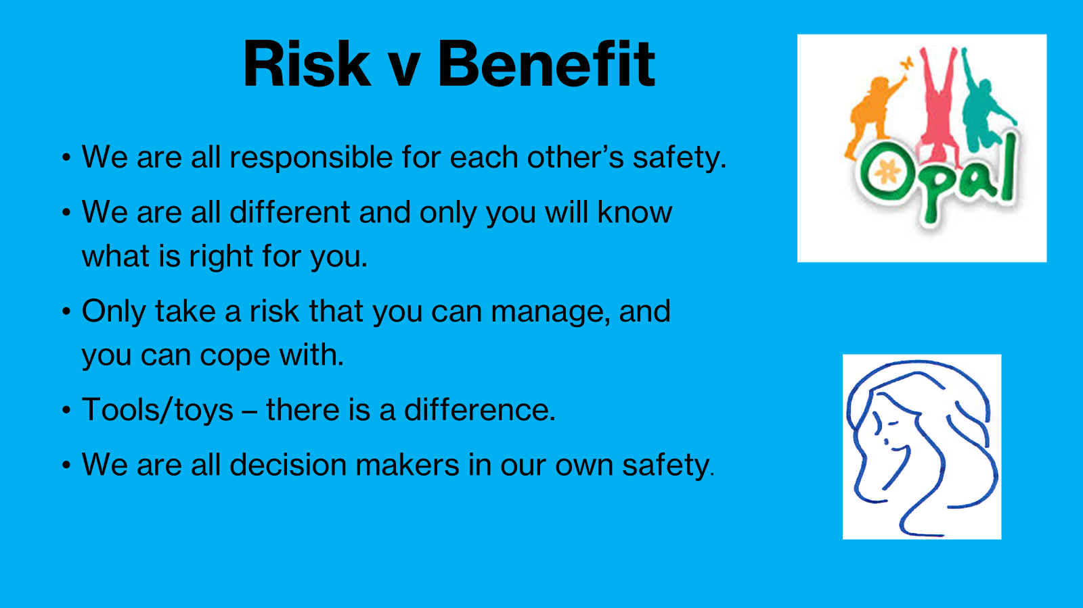

Slide 2
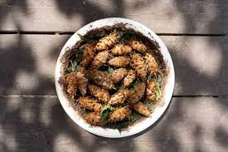
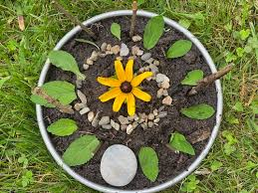
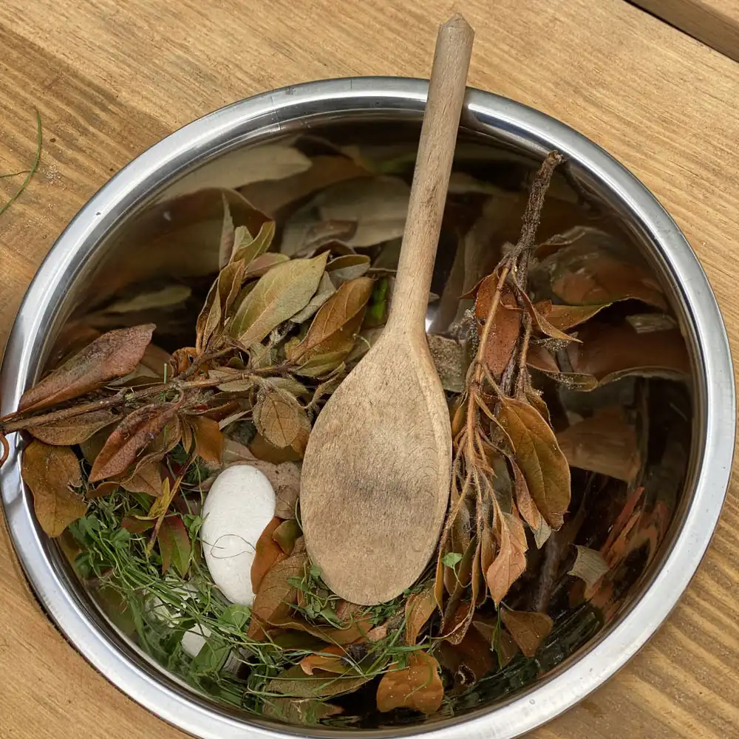
Inform
Our Mud Kitchen will open in the next week or two!
So.. Come along and cook up a feast!
Make a mud pie, pinecone stew or a leaf salad
Its located in the woods at the back near the fence
You need wellies to use the woods and mud kitchen

Slide 3
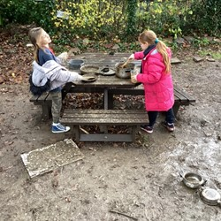
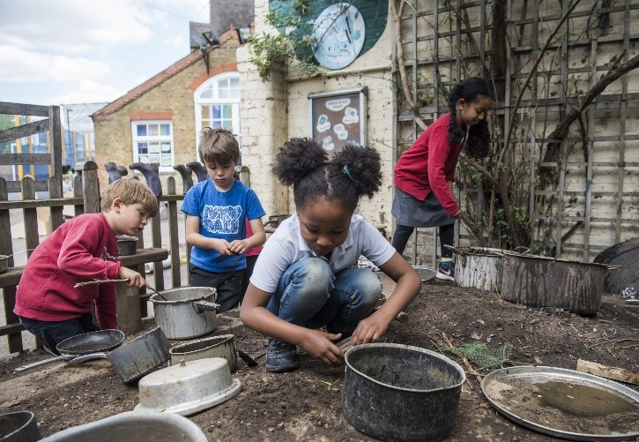
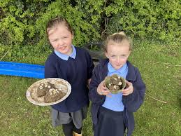
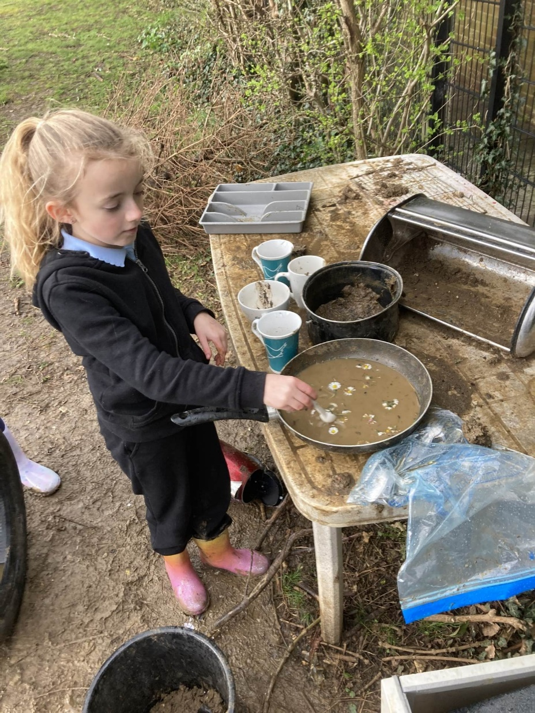
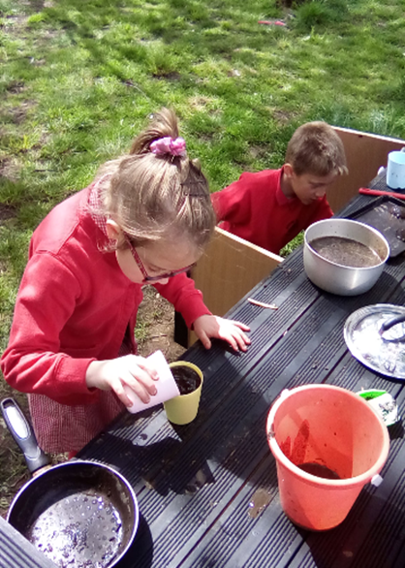
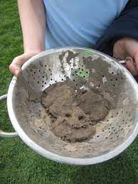
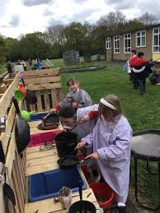
Innovate

Slide 4


Negotiate
What new rules do we need for
our new activities and equipment?

Slide 5
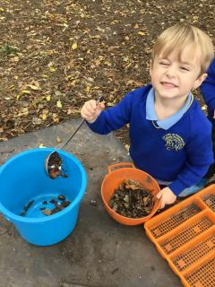
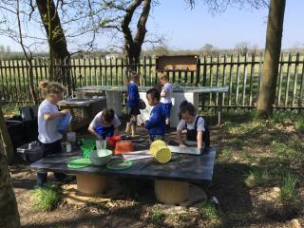
Negotiate
Mud kitchen
Don’t pick up heavy pots- ask play team, play rangers for help
Mud kitchen equipment (pans, cake tins mixing bowls and kitchen utensils) are to stay in the mud kitchen area. They are not taken to be taken to dens.
Recipe clip boards are not to be removed from the mud kitchen.
Pots with resources (pebbles, acorns pinecones, leaves) are not to be taken off the mud kitchen.
Please respect items provided for the mud kitchen as many items have been damaged and broken.
At the end of lunch, the mud kitchen must be tidied up and equipment returned.

Slide 6
Innovate- equipment
How can we use it?
How can we not use it?
Make mud pies
Make leaf salads
Respect the equipment!
Don’t throw mud
Don’t take equipment to dens
Keep pots with pebbles, pinecones, leaves shells in the mud kitchen
Don’t pick up heavy pots/pans- ask for help!

