Slide 1
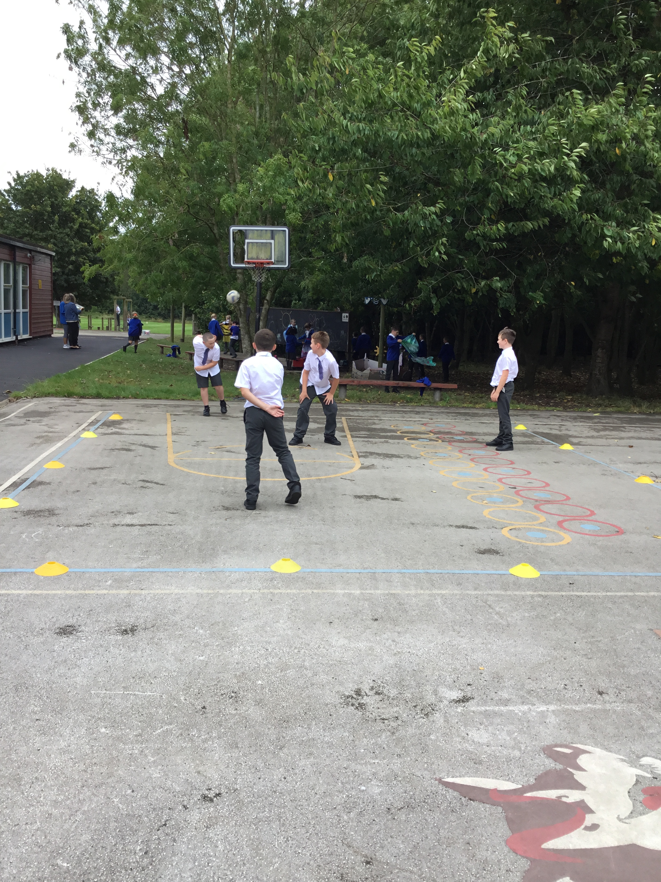
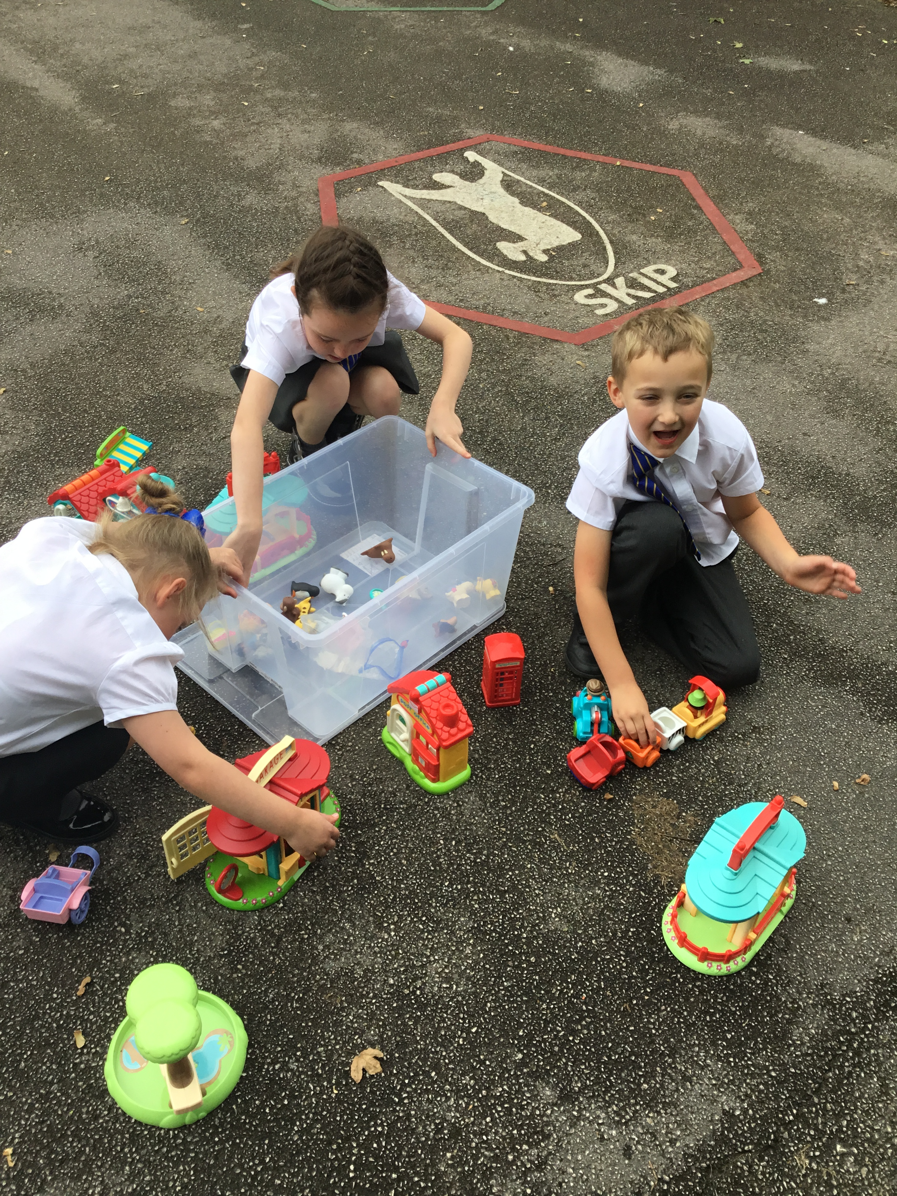
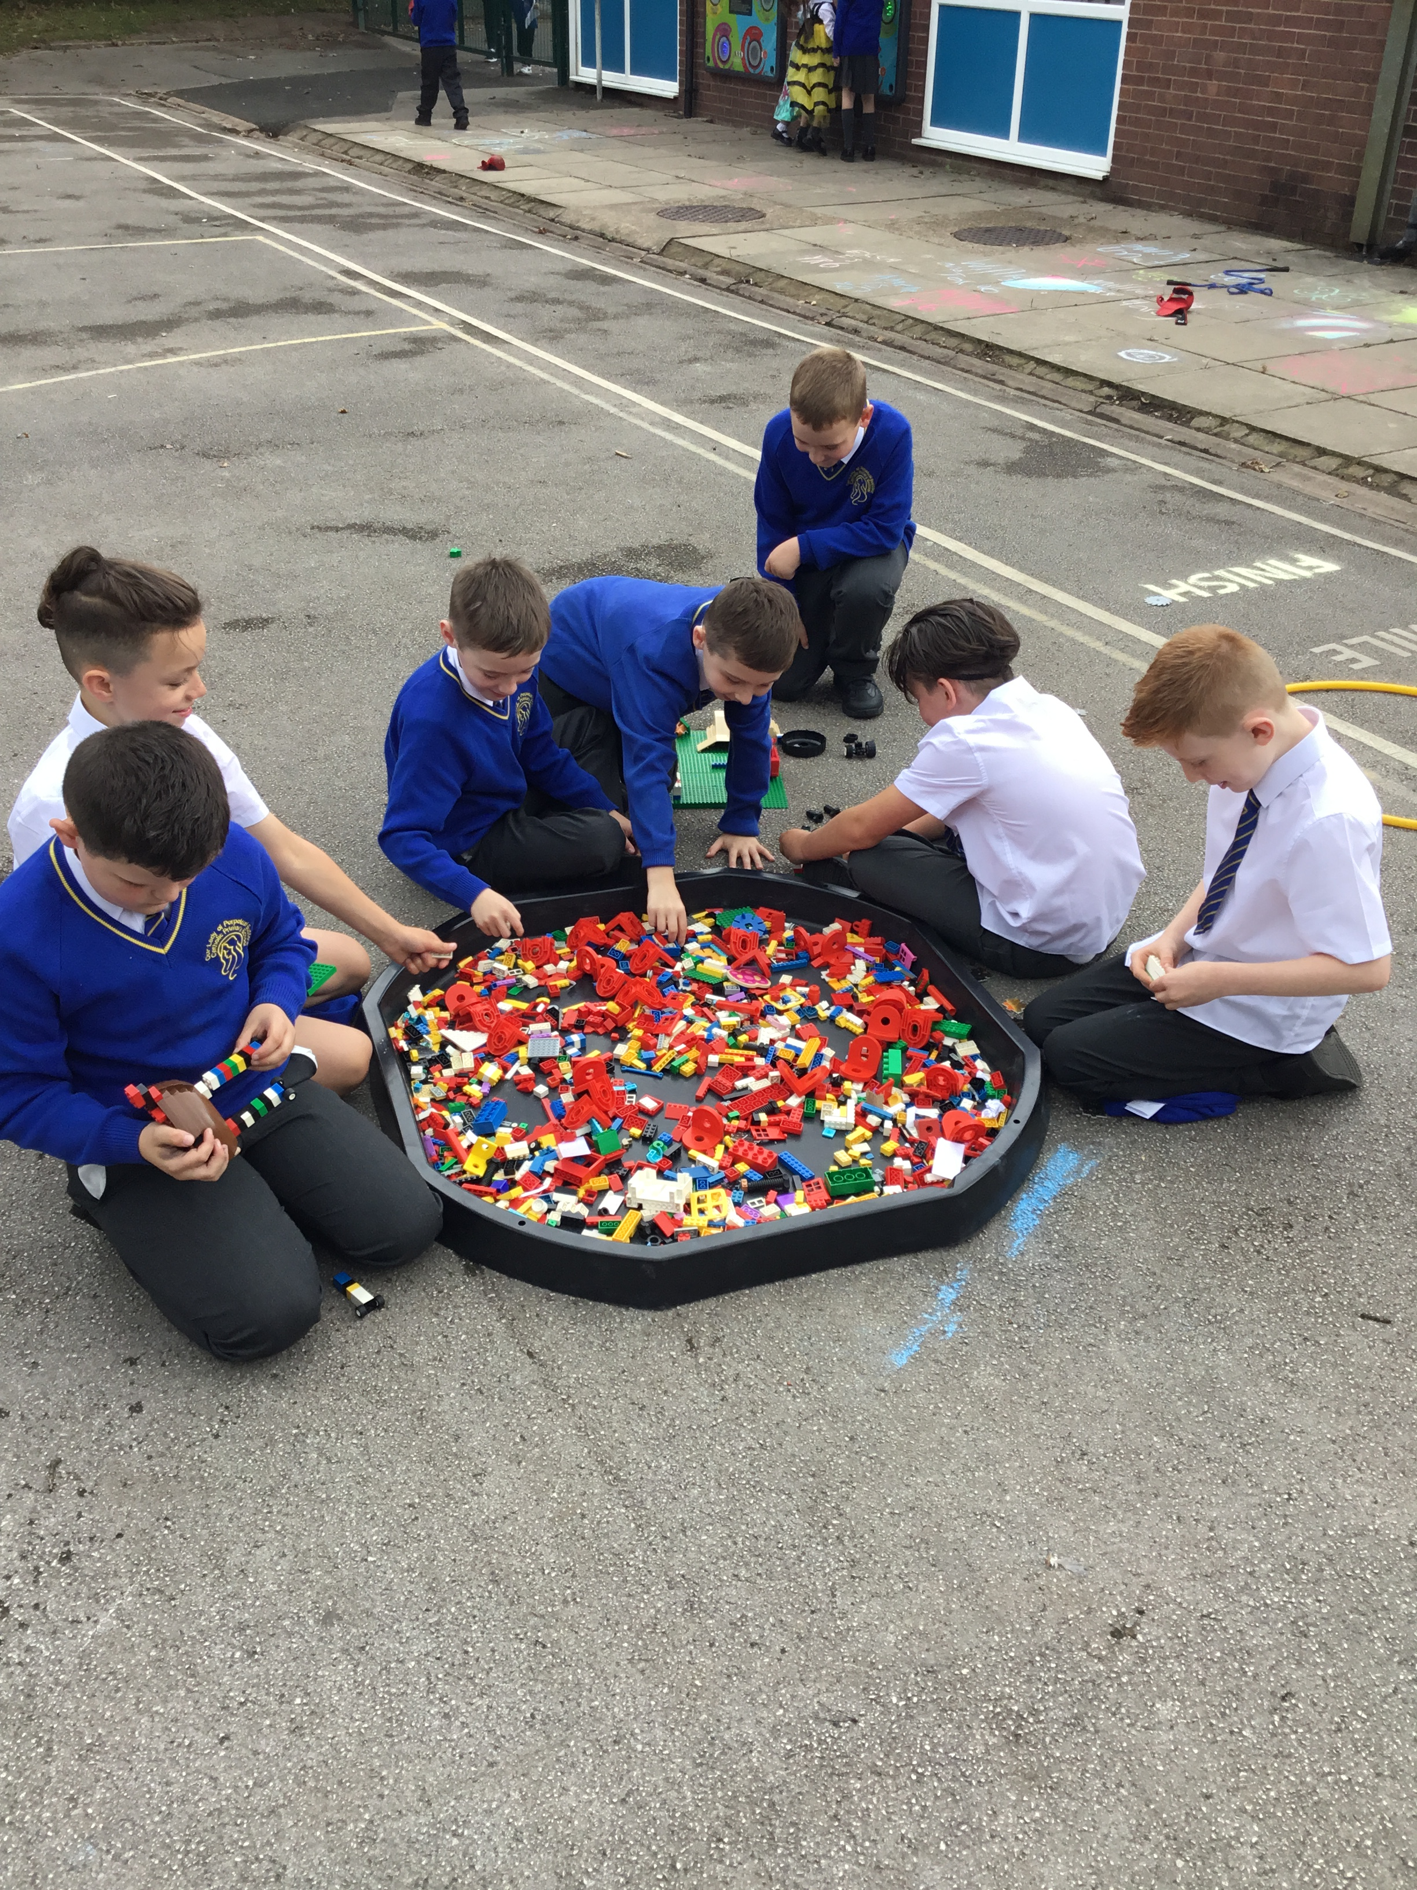


OPAL Play
Assembly

Slide 2
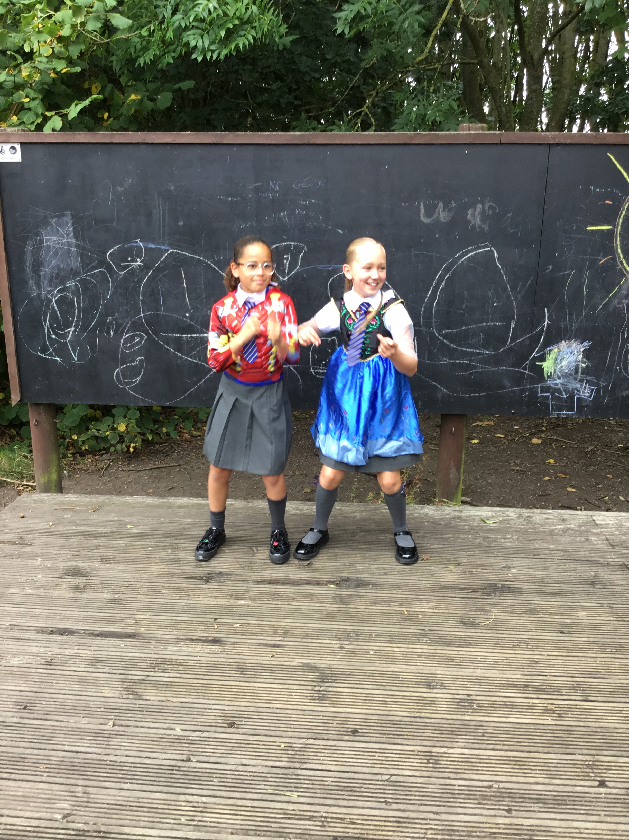
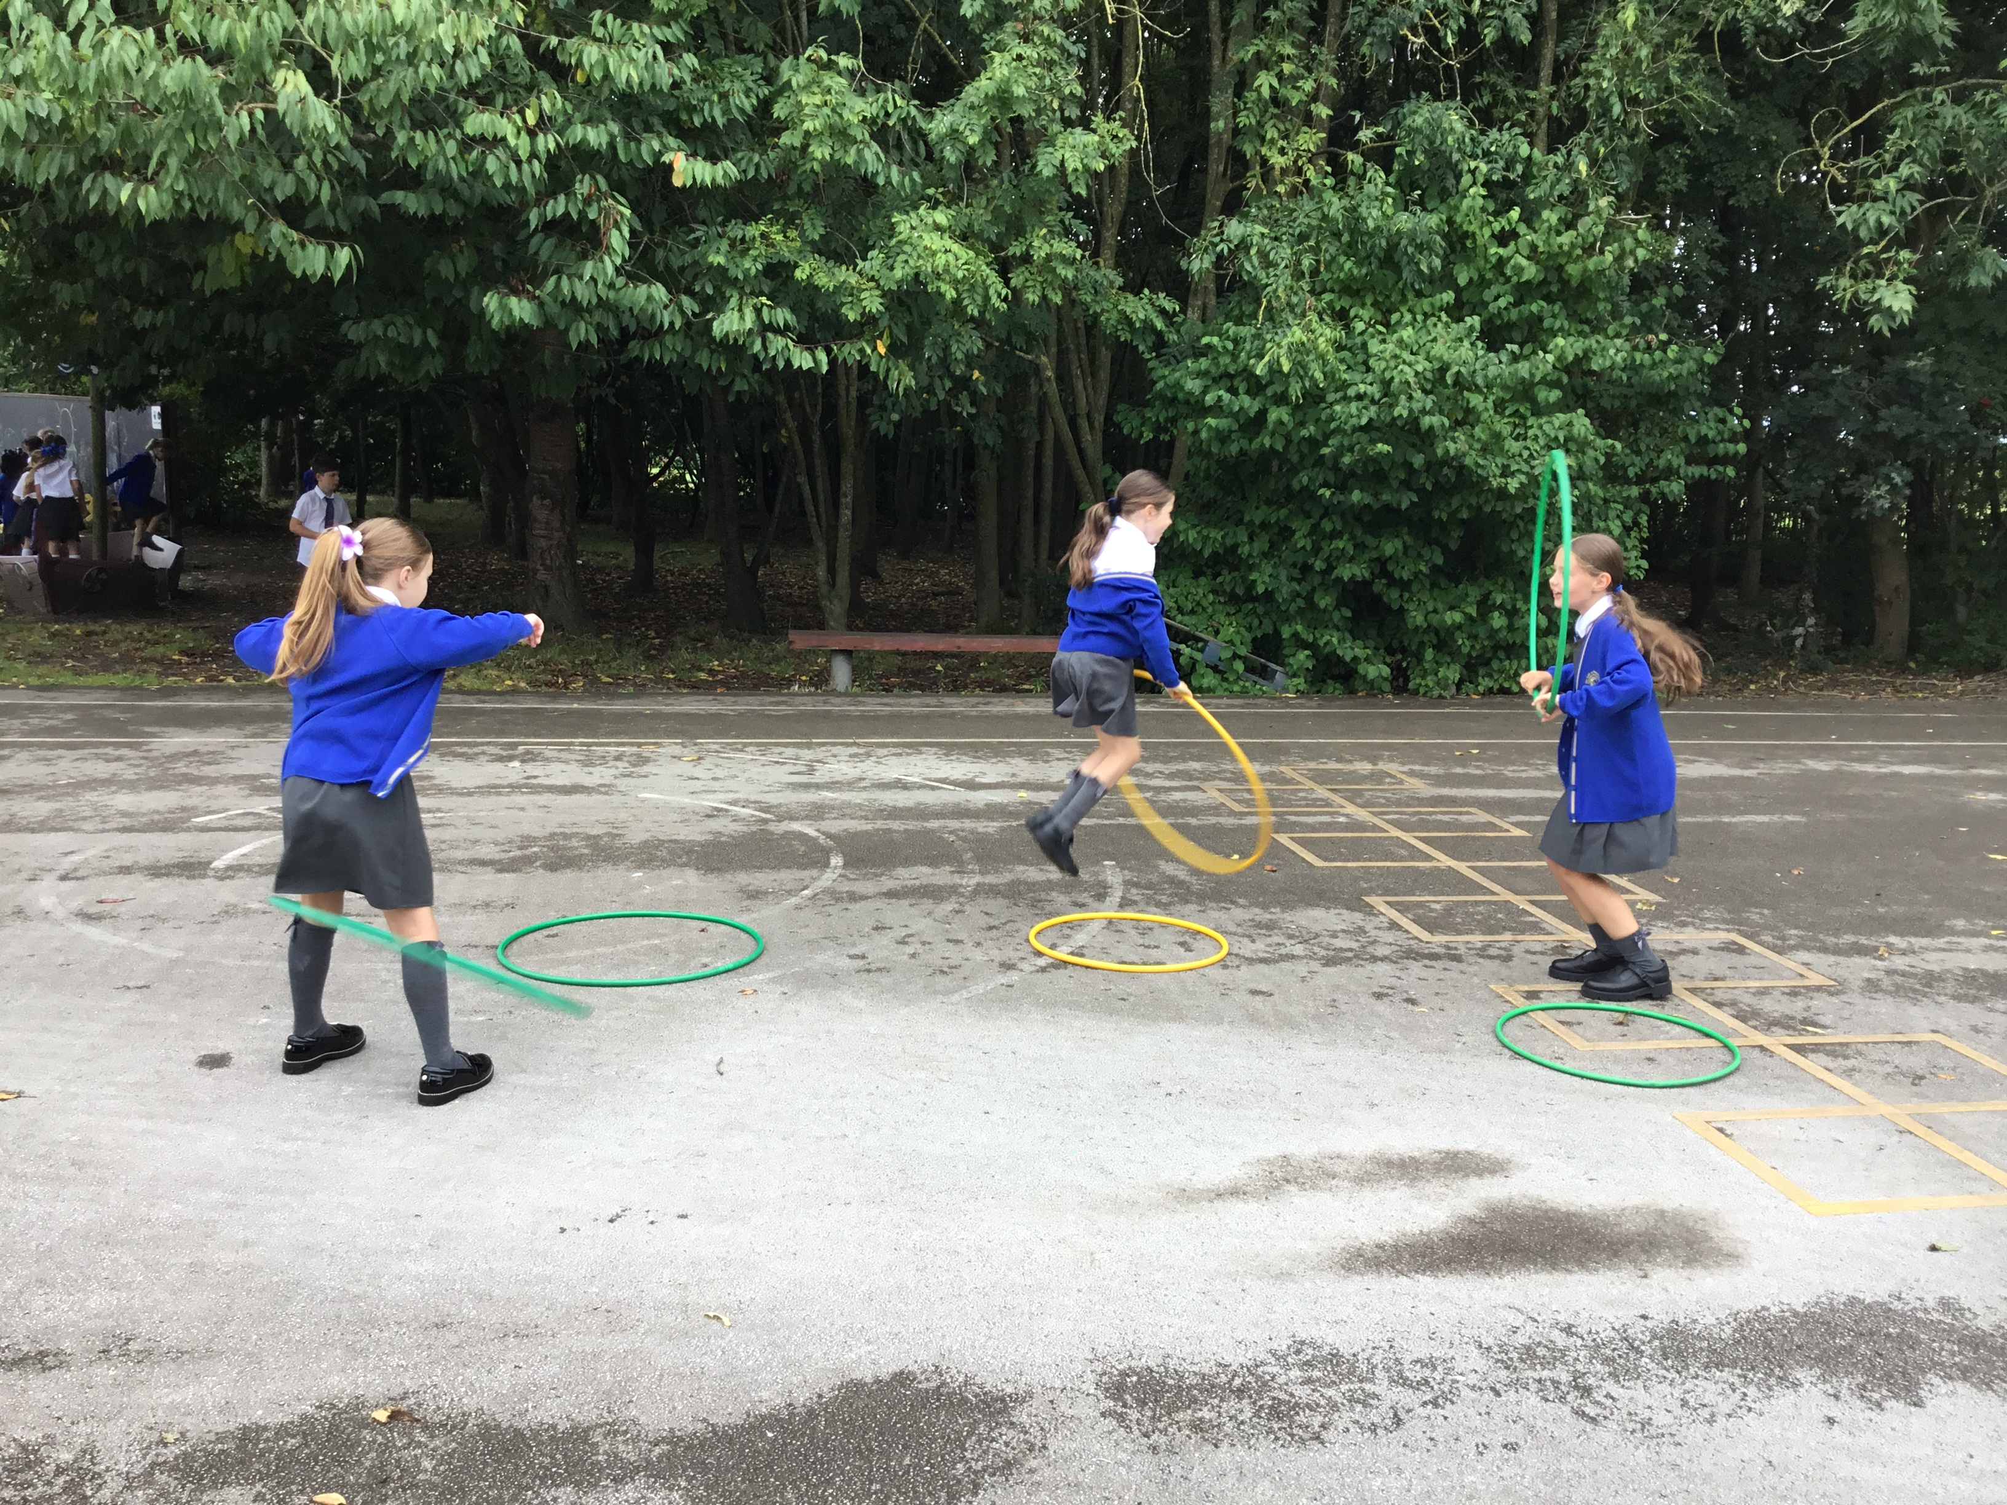
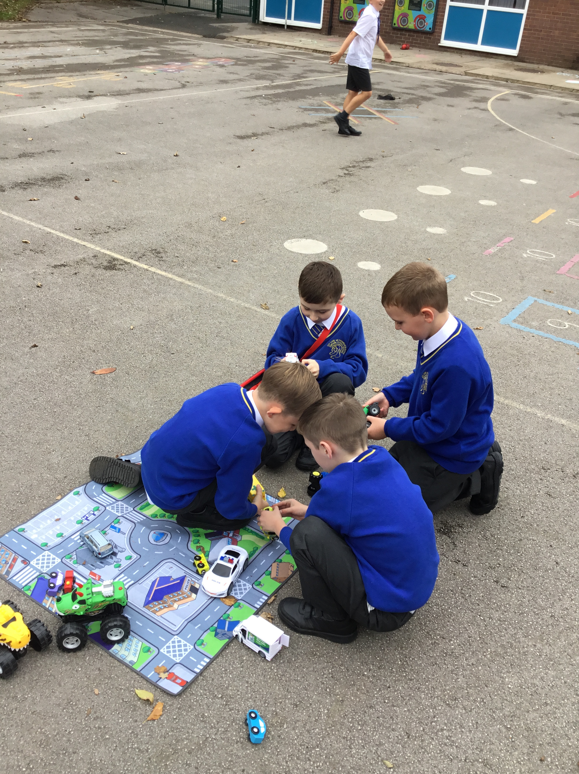
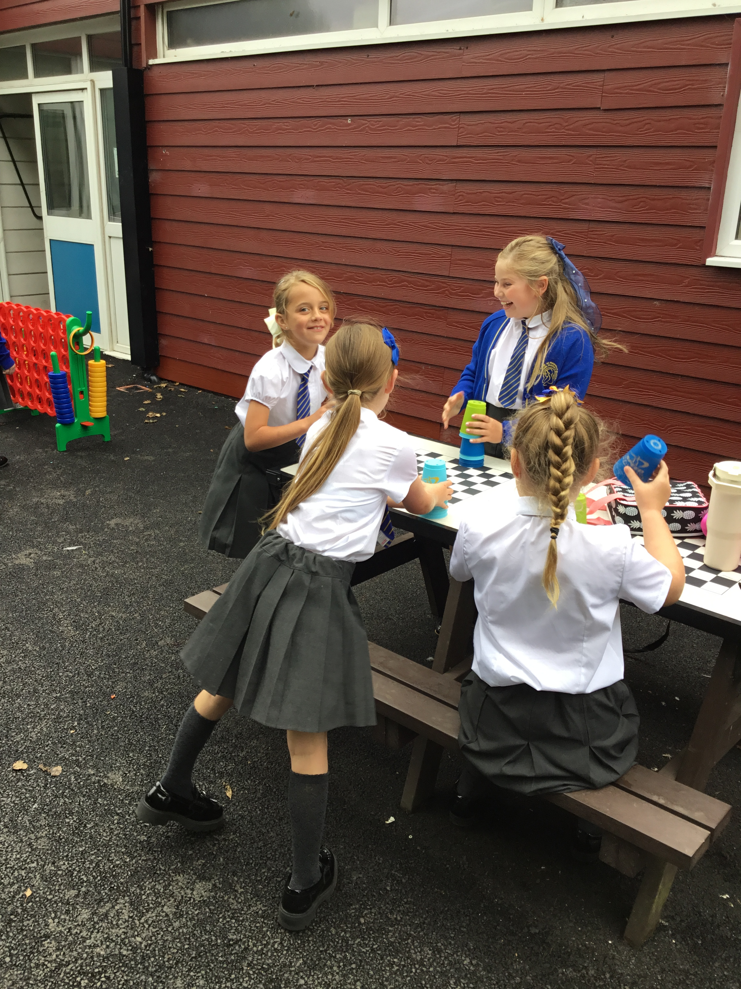

Celebrate
Amazing examples
of play

Slide 3
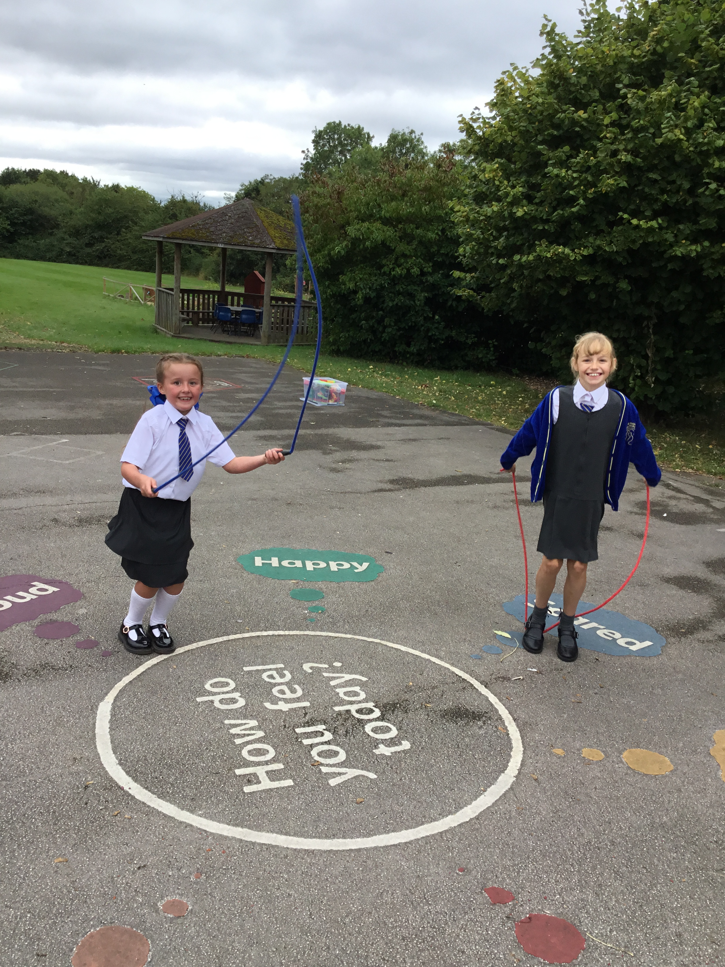
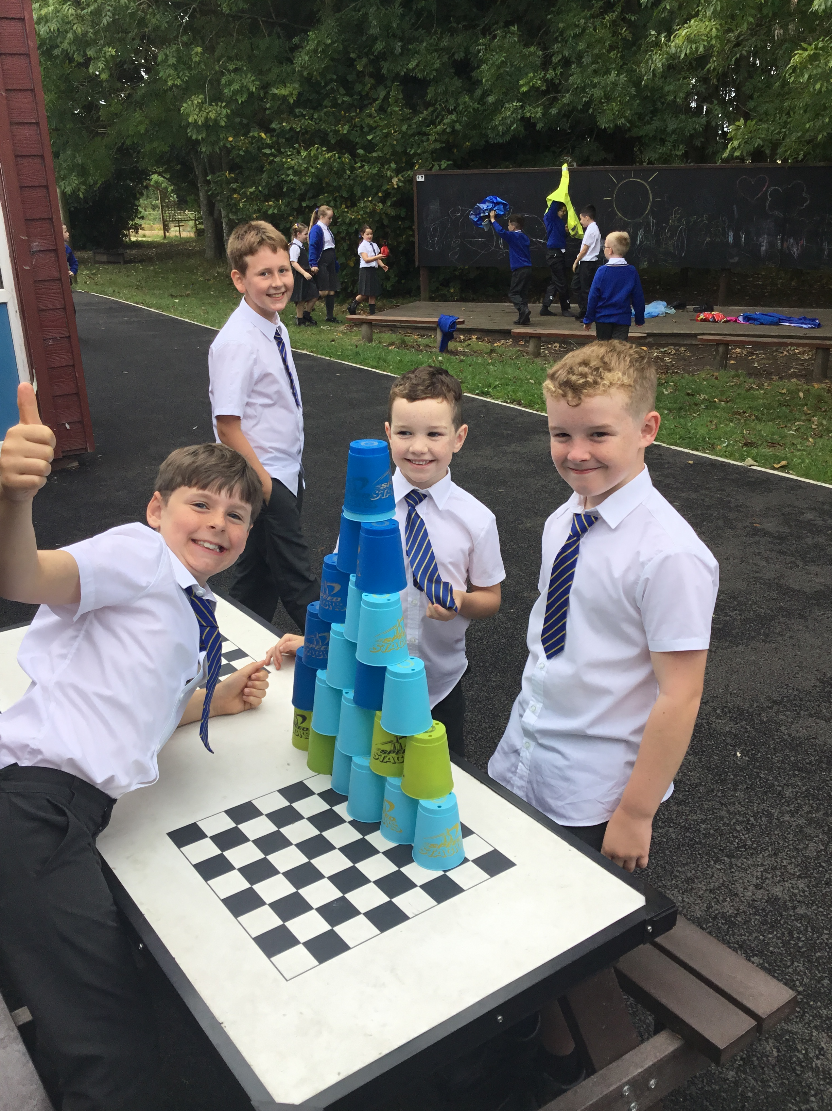
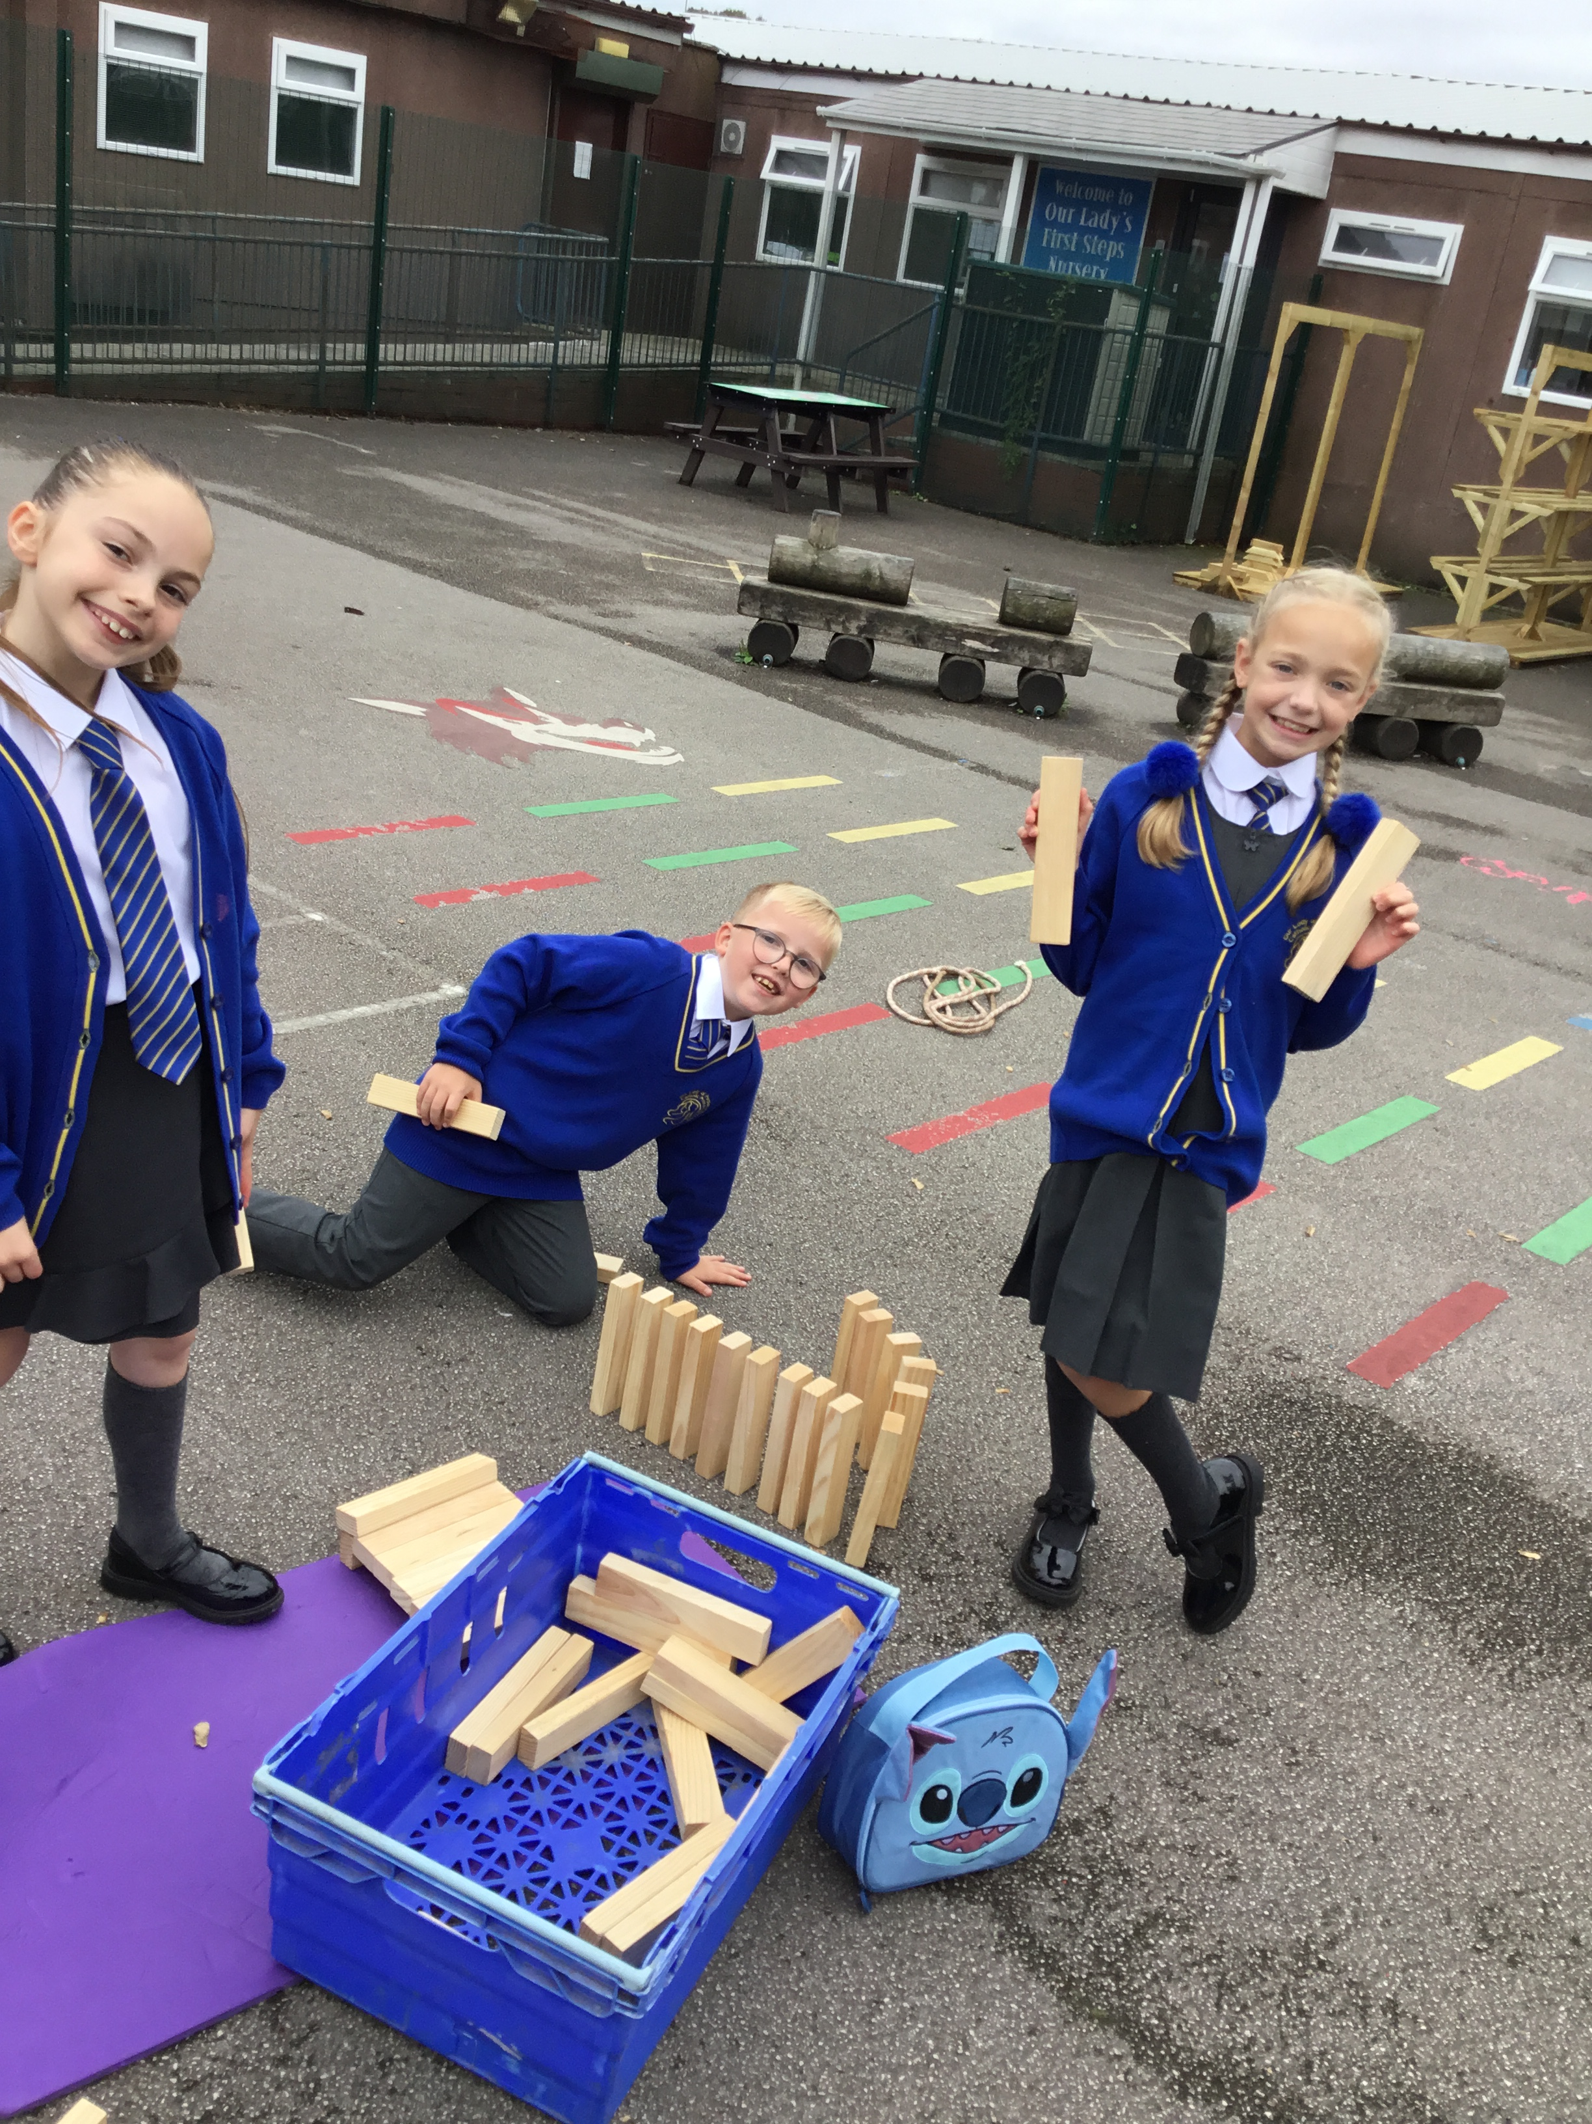

Slide 4
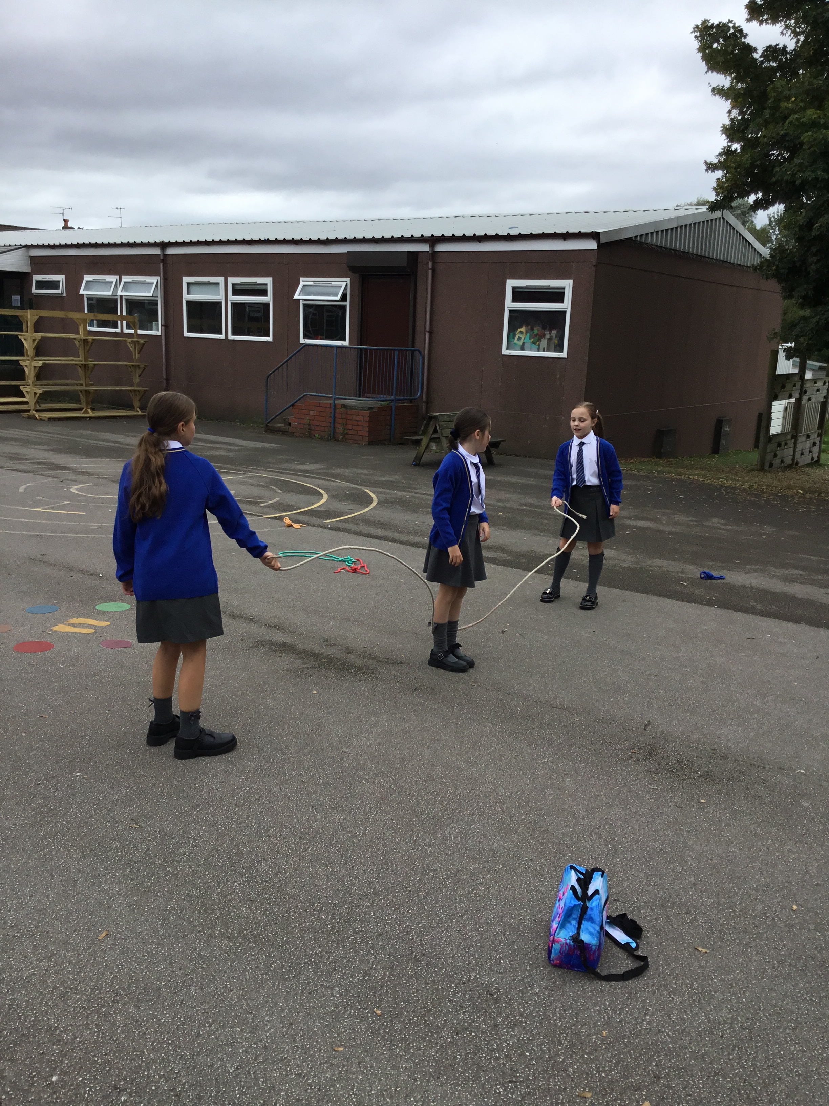
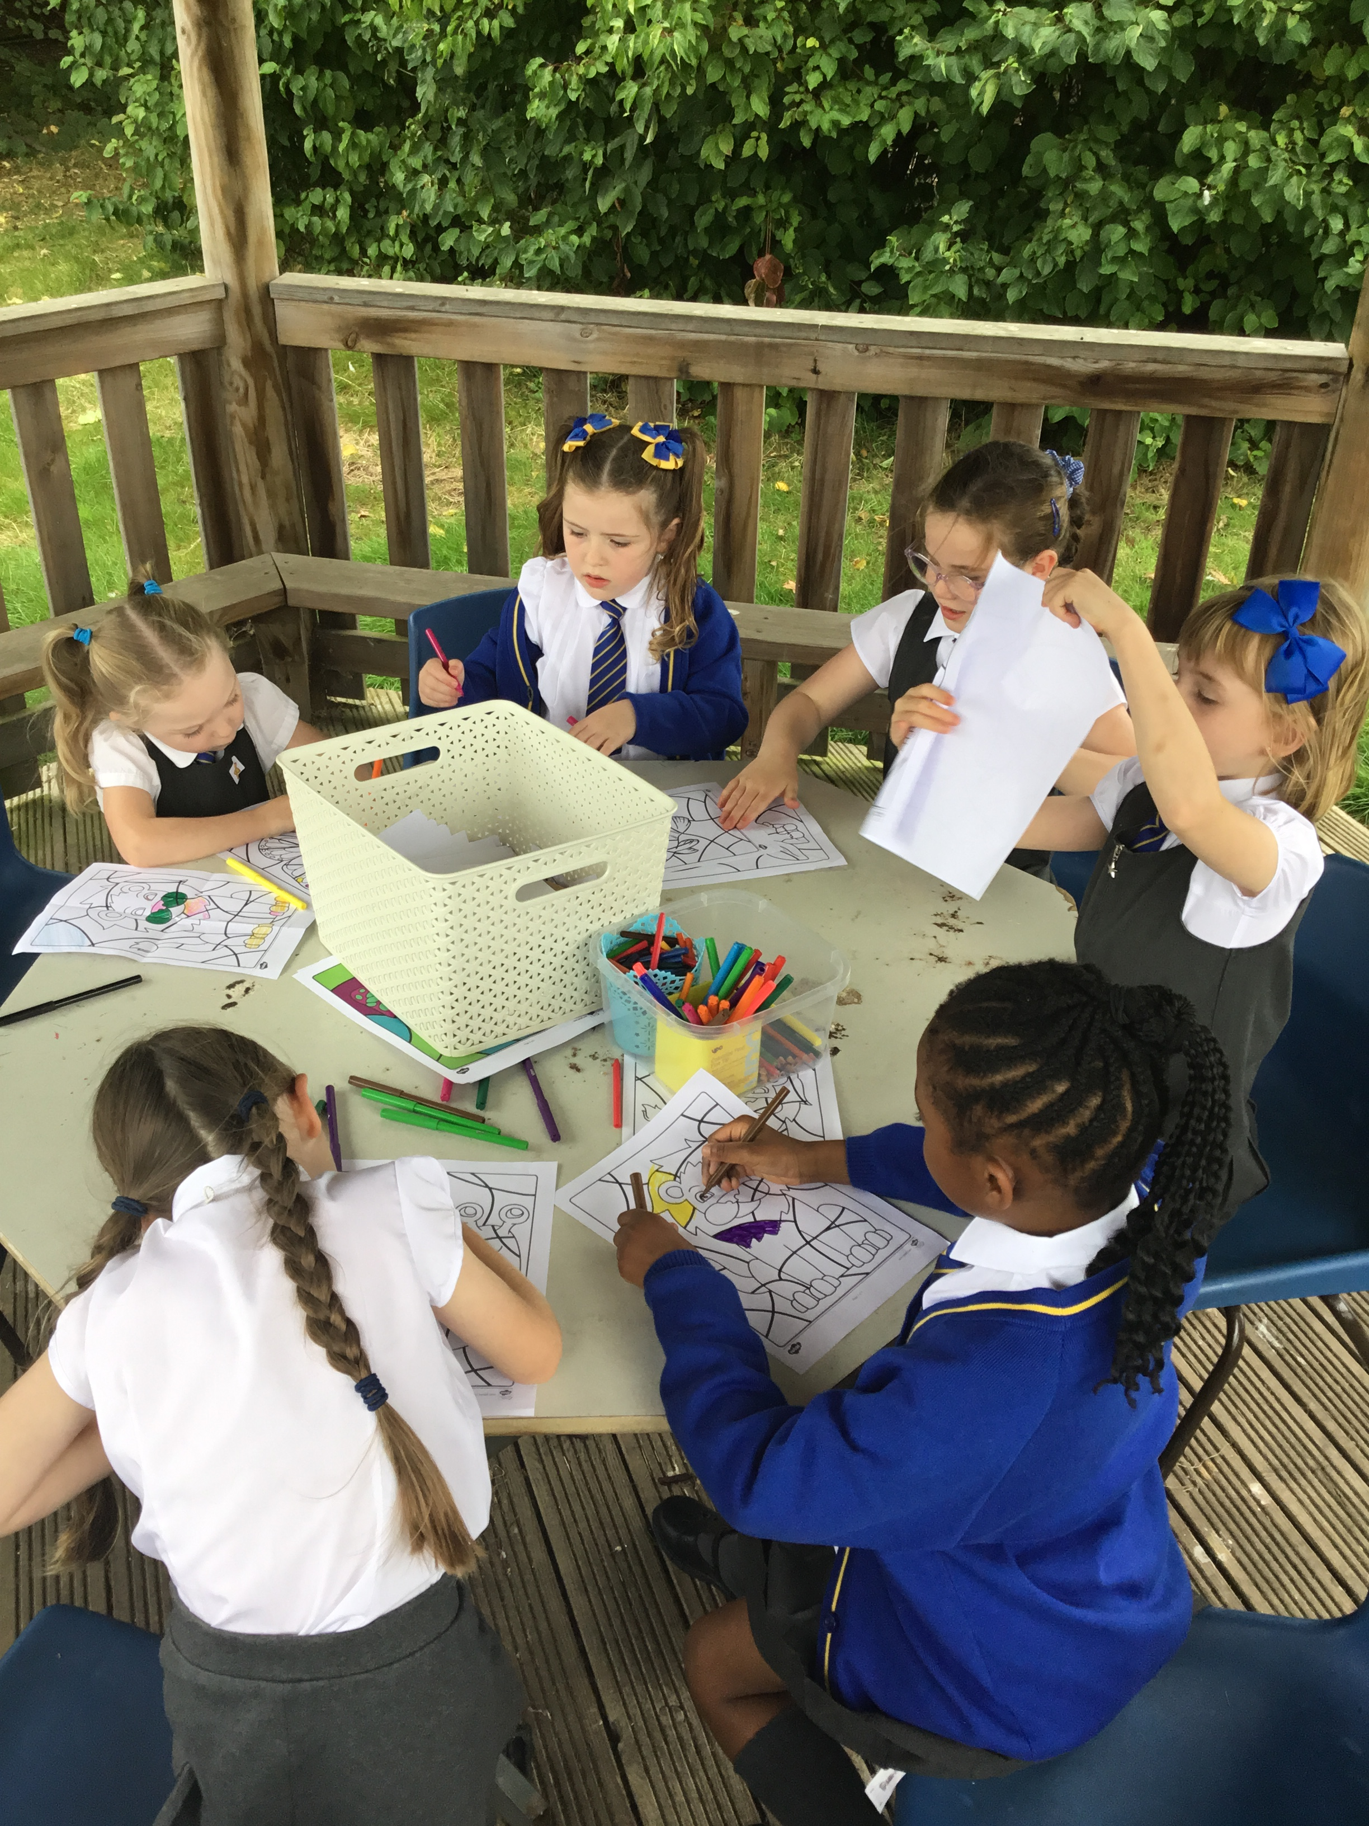
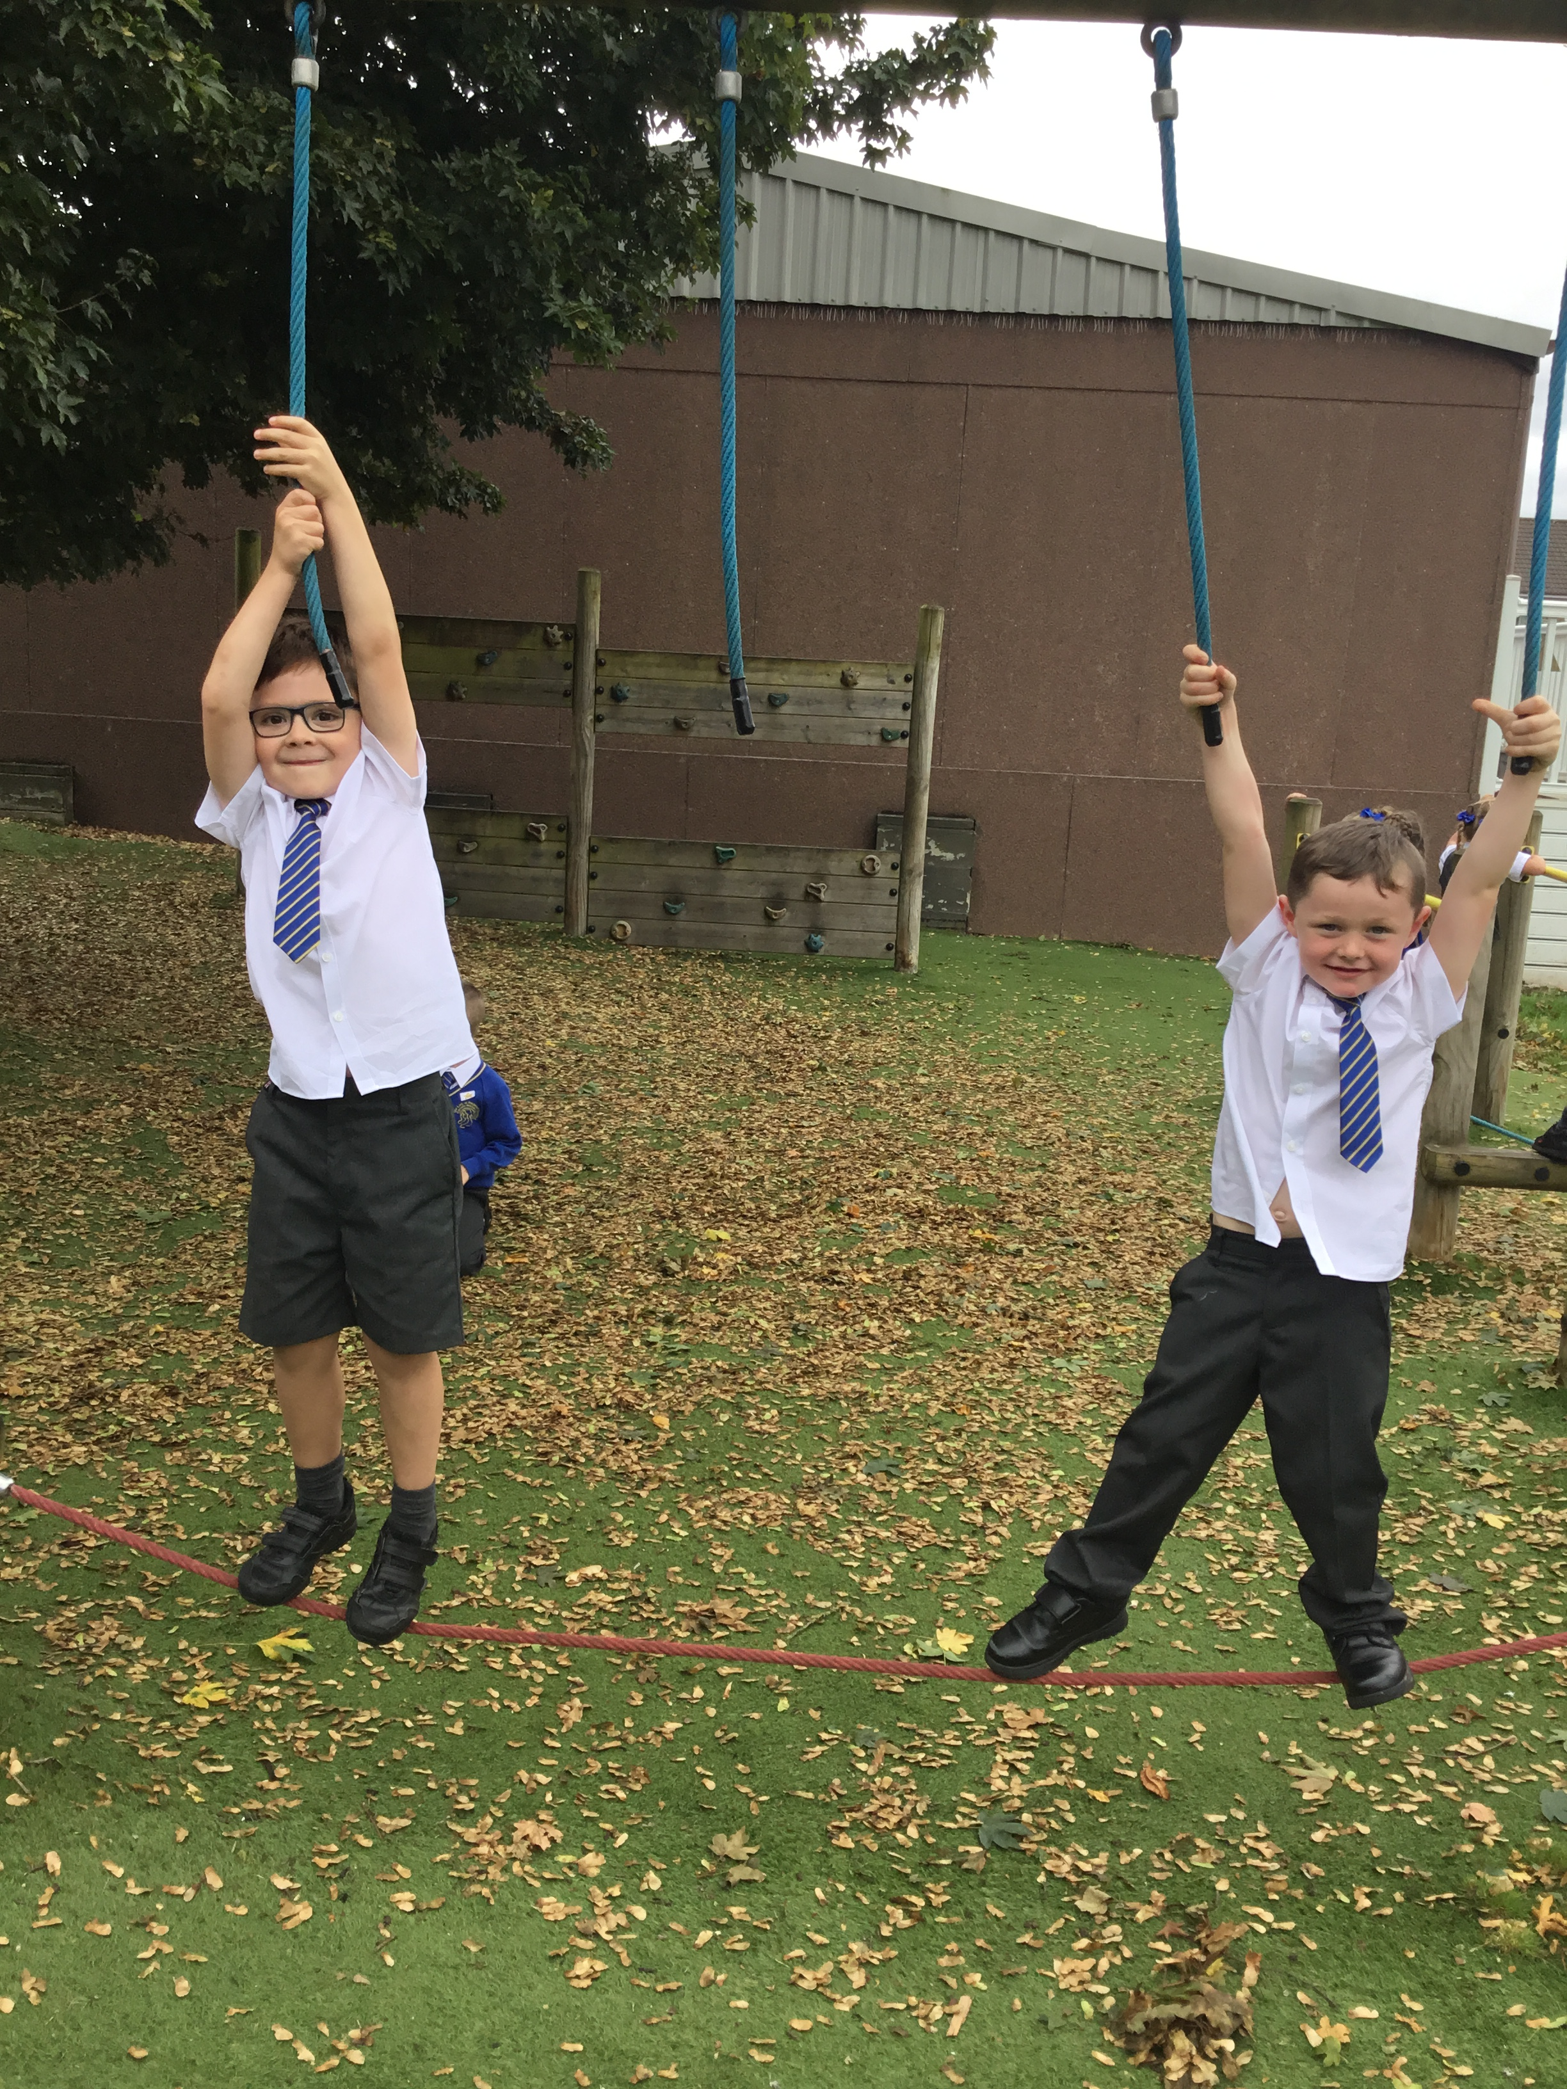

Slide 5
What do we already have in our zones?
Construction-Lego Knex
Role play- dressing up costumes
Stage-Music speaker and performance zone
Wheelie Zone- Scooters
Active zone- Space hoppers, bats/balls football
Creative Zone-arts and crafts

Slide 6
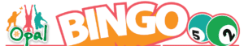
Inform
Eyes down for
Opal Loose Parts Bingo!
Each class will be taking part in a whole school OPAL bingo
Each class will be given a bingo board with lots of items to collect.
You will work as a team to collect as many items as possible.
The more the better to make our OPAL journey even more fun.
Items are to be given to your class teacher.
The first class to collect all the items will get an extra 20 minutes of OPAL play during the day.

Slide 7
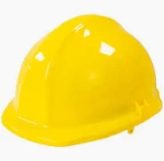
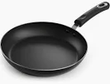
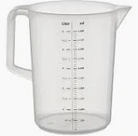
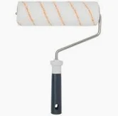

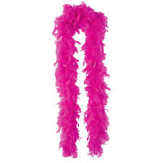
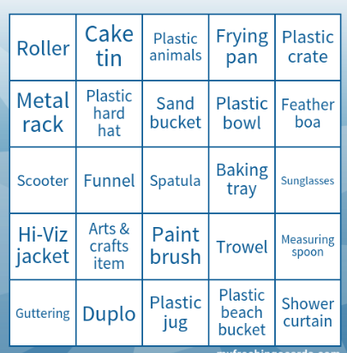

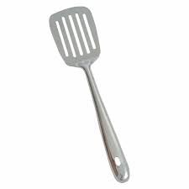
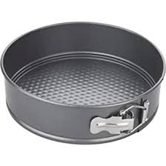
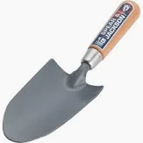
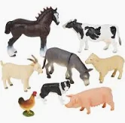

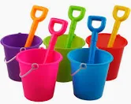

Slide 8
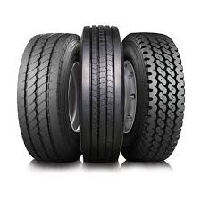
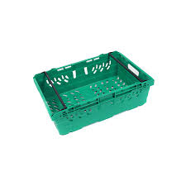
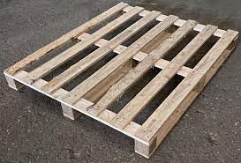
Inform
What will be new?
Tyres
Plastic crates
Pallets

Slide 9
Innovate
How can we not use it?
How can we use it?
No dragging or pulling pallets
Don’t destroy someone else’s den
Don’t take resources from others
Use as steppingstones 1 high
Make a shelter
Do an obstacle course
Build dens

Slide 10
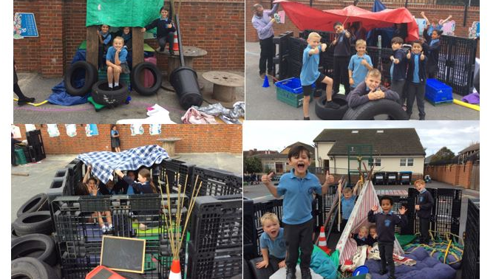

Slide 11
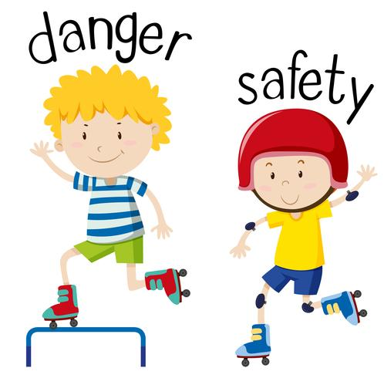

Negotiate
What new rules do we need for
our new activities and equipment?

Slide 12
Negotiate
Tyres
Stack no higher than your shoulders
Look before you roll
Don’t try to carry the tyres
Don’t roll tyres into your friends.
What rules do we need when with tyres?

Slide 13

Negotiate
Crates
Play team will remain vigilant about correct use.
Stack height limit of belly button on tarmac and shoulder height on soft grass.
Stack them for dens but please don’t stand on stacked crates.
Main risk is unstable stacks or toppling of crates so be aware!
Be careful of trapping fingers when stacking crates.
Don’t throw crates.
What rules do we need when with crates?

Slide 14
Negotiate
Crates
Play team will remain vigilant about correct use.
When den building no higher than 4 pallets high
When den building the stability of pallets structures will be checked for safety before playing in them by the play team
Lifting
Ready Steady Lift- bent knees straight back
Ks1 four children each corner
KS2 2 children either side- ask for help if its too heavy.
As they are heavy objects they must not be carried above the head
Look out for damage, loose wood (could cause splinters) or sharp pieces- report to Play Team and it will be removed from the play environment
What rules do we need when with pallets?

Slide 15
Negotiate
Equipment
Use equipment correctly
Take care of the equipment
Only equipment out is to be used
Be responsible for positive play
Everybody tidy up when the whistle blows
What rules do we need for equipment?

