Slide 1
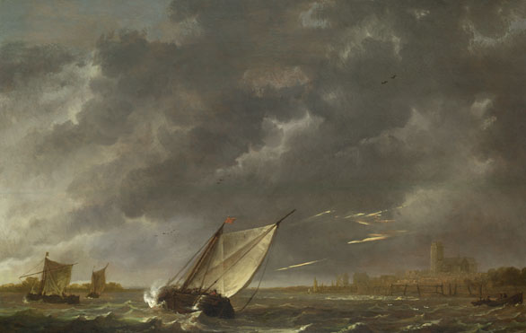
Lesson 5:
Dramatic Impact
Learning Objective
Exploring how to create a powerful impact on the audience

Slide 2
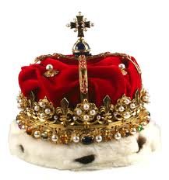
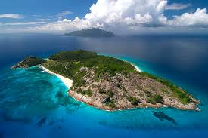
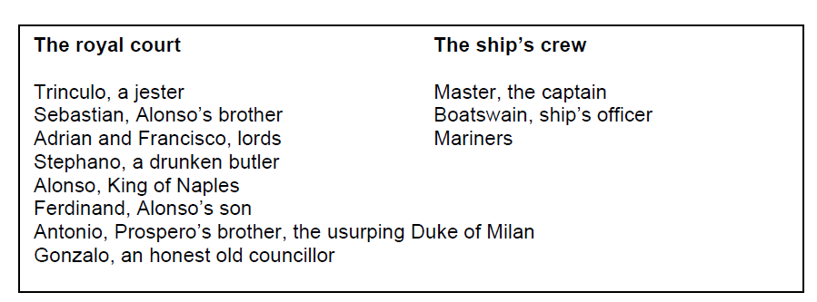
Power, hierarchy and disruption
The Tempest begins with a ship caught up in a sea storm. On the ship
are the following characters, listed in no particular order:
On the sheets for this lesson, make notes on how you would present Act 1, Scene 1.
Design a stage set for the scene.

