Slide 1
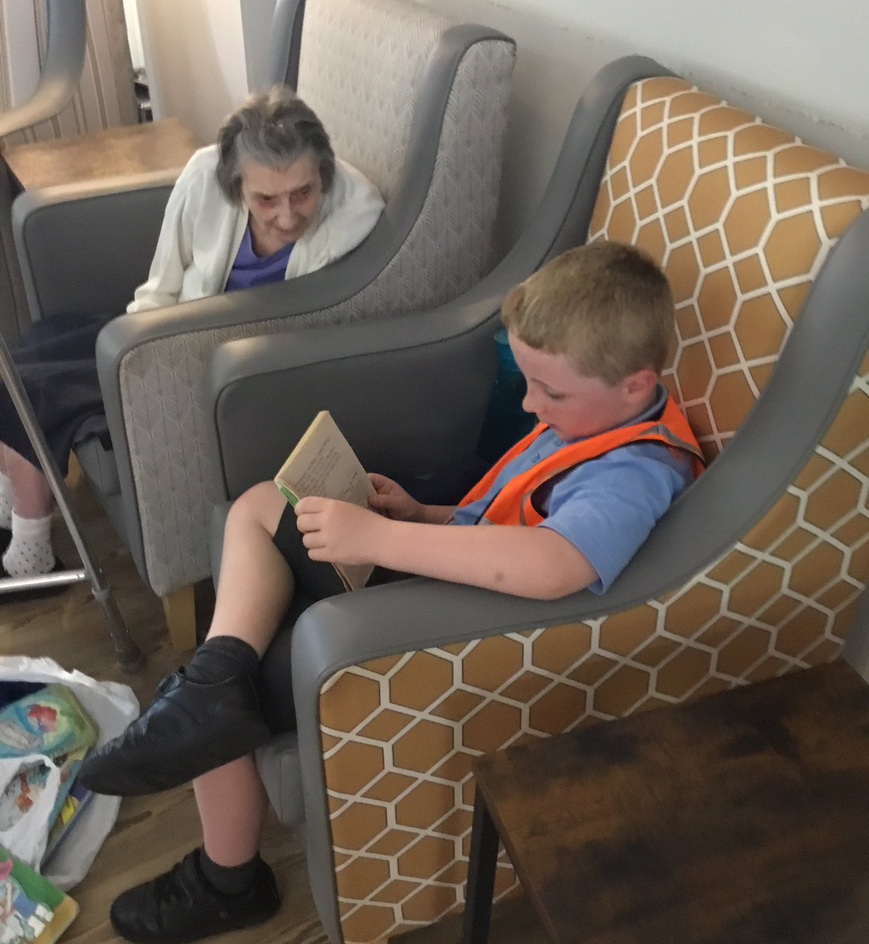
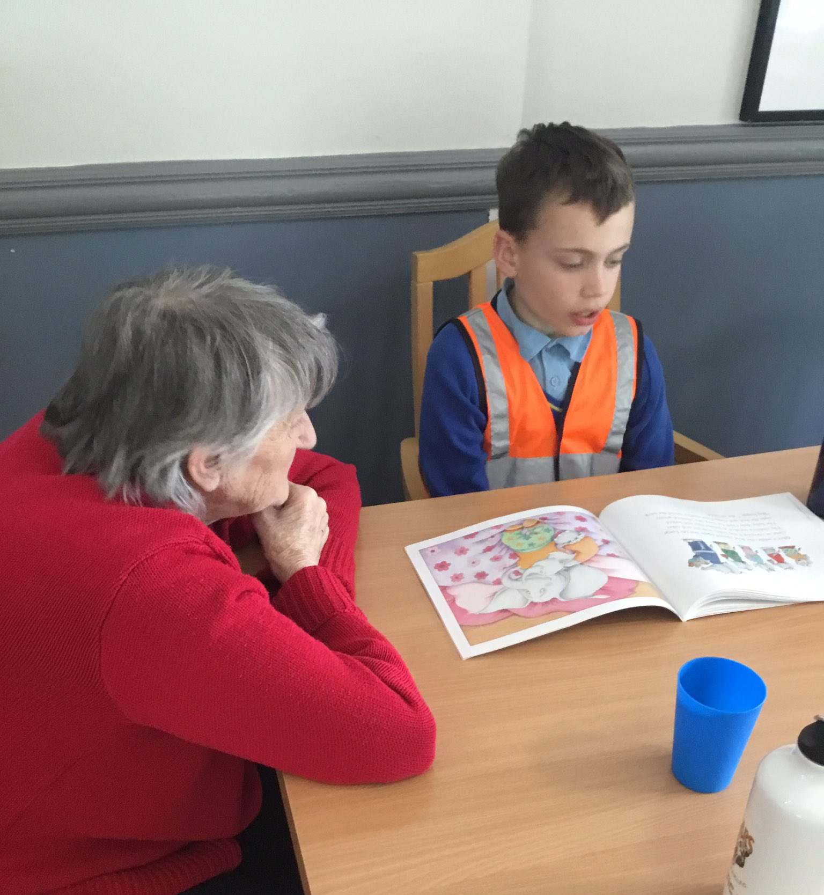
Trewan House
Matthew 7:12 - "Do to others as you would have done to yourself" At his general audience on 15th June 22 Pope Francis said, “Elderly people have so much to give us because there is the wisdom of life,” He also urged Christians to bridge the gap between older and younger generations so that the elderly may pass on the “memory of life, the experience of life, the wisdom of life. In the measure that we can help young people and old people connect, there will be more hope for the future of our society,”
Our plans to make soup did not work as the crops did not take, so instead of them coming to have a bowl of soup with us, we visited the home and shared games and stories with the residents.
Next year, if we have more success, then the residents will share our crops when we make them soup and visit them or invite them to come to school.

Slide 2
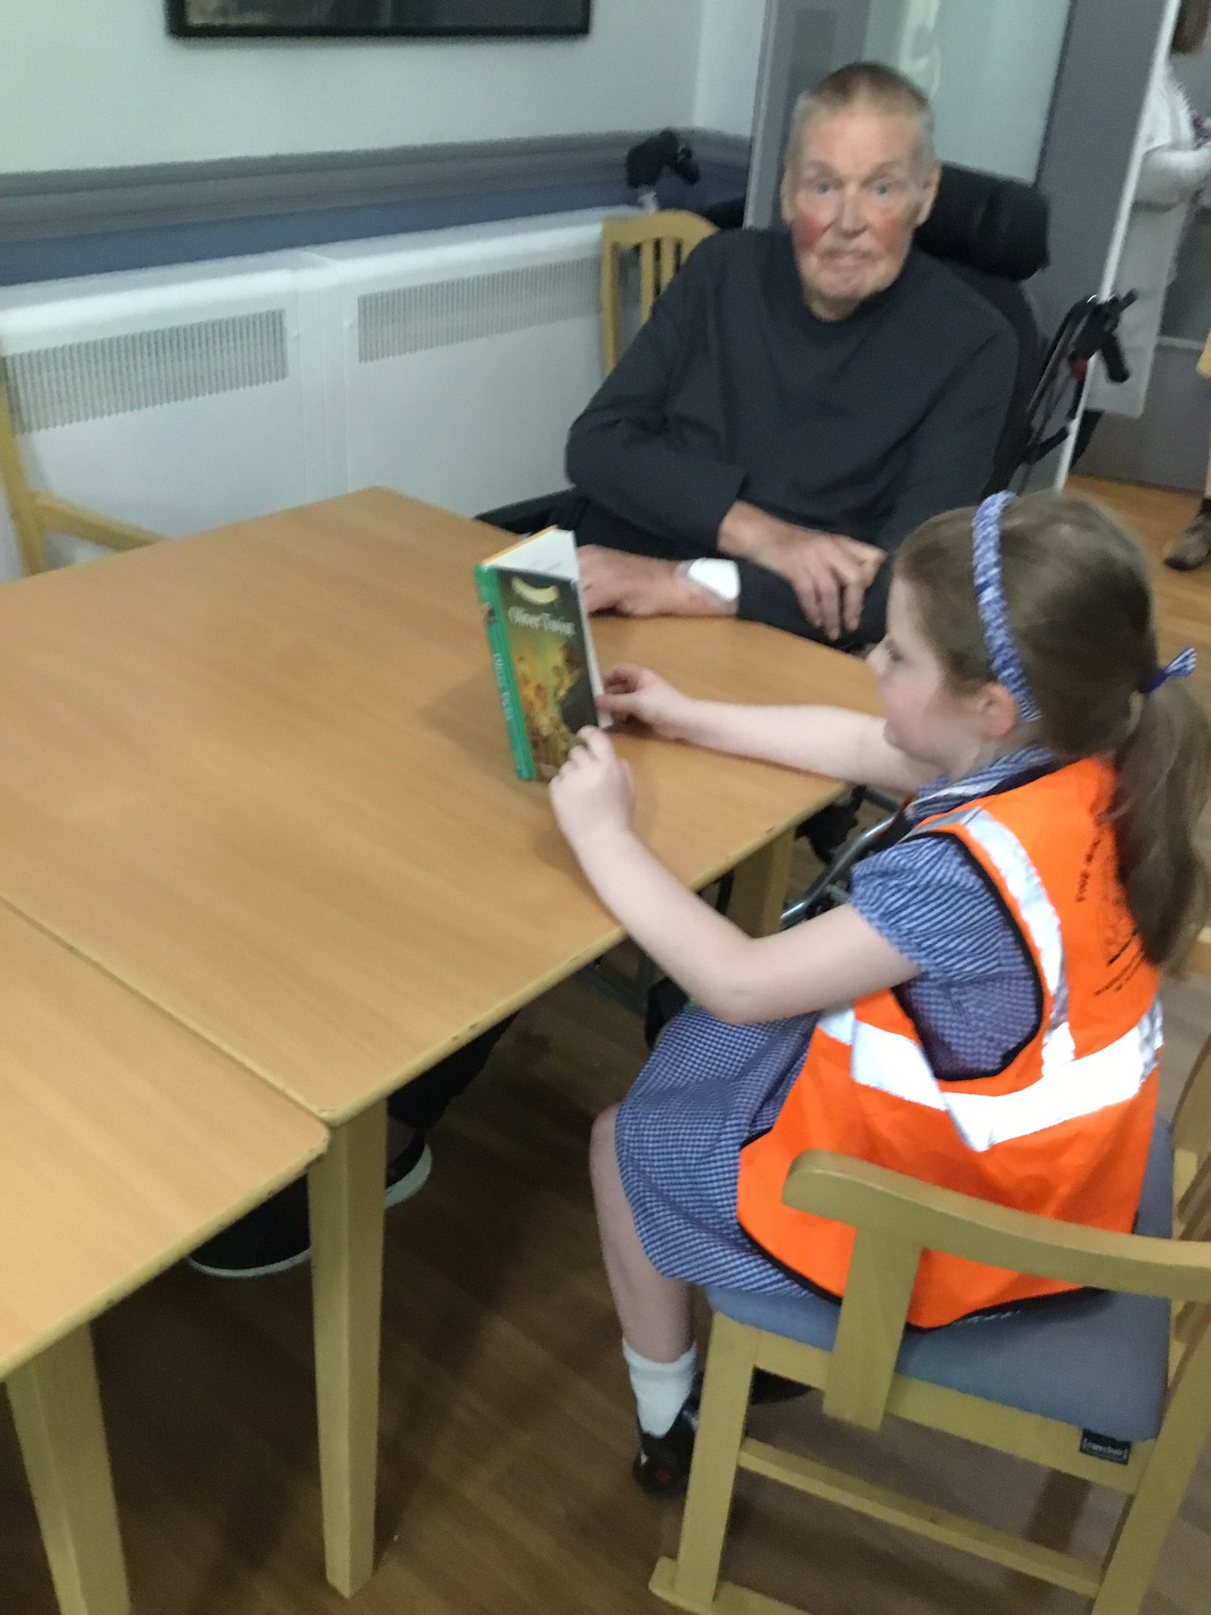
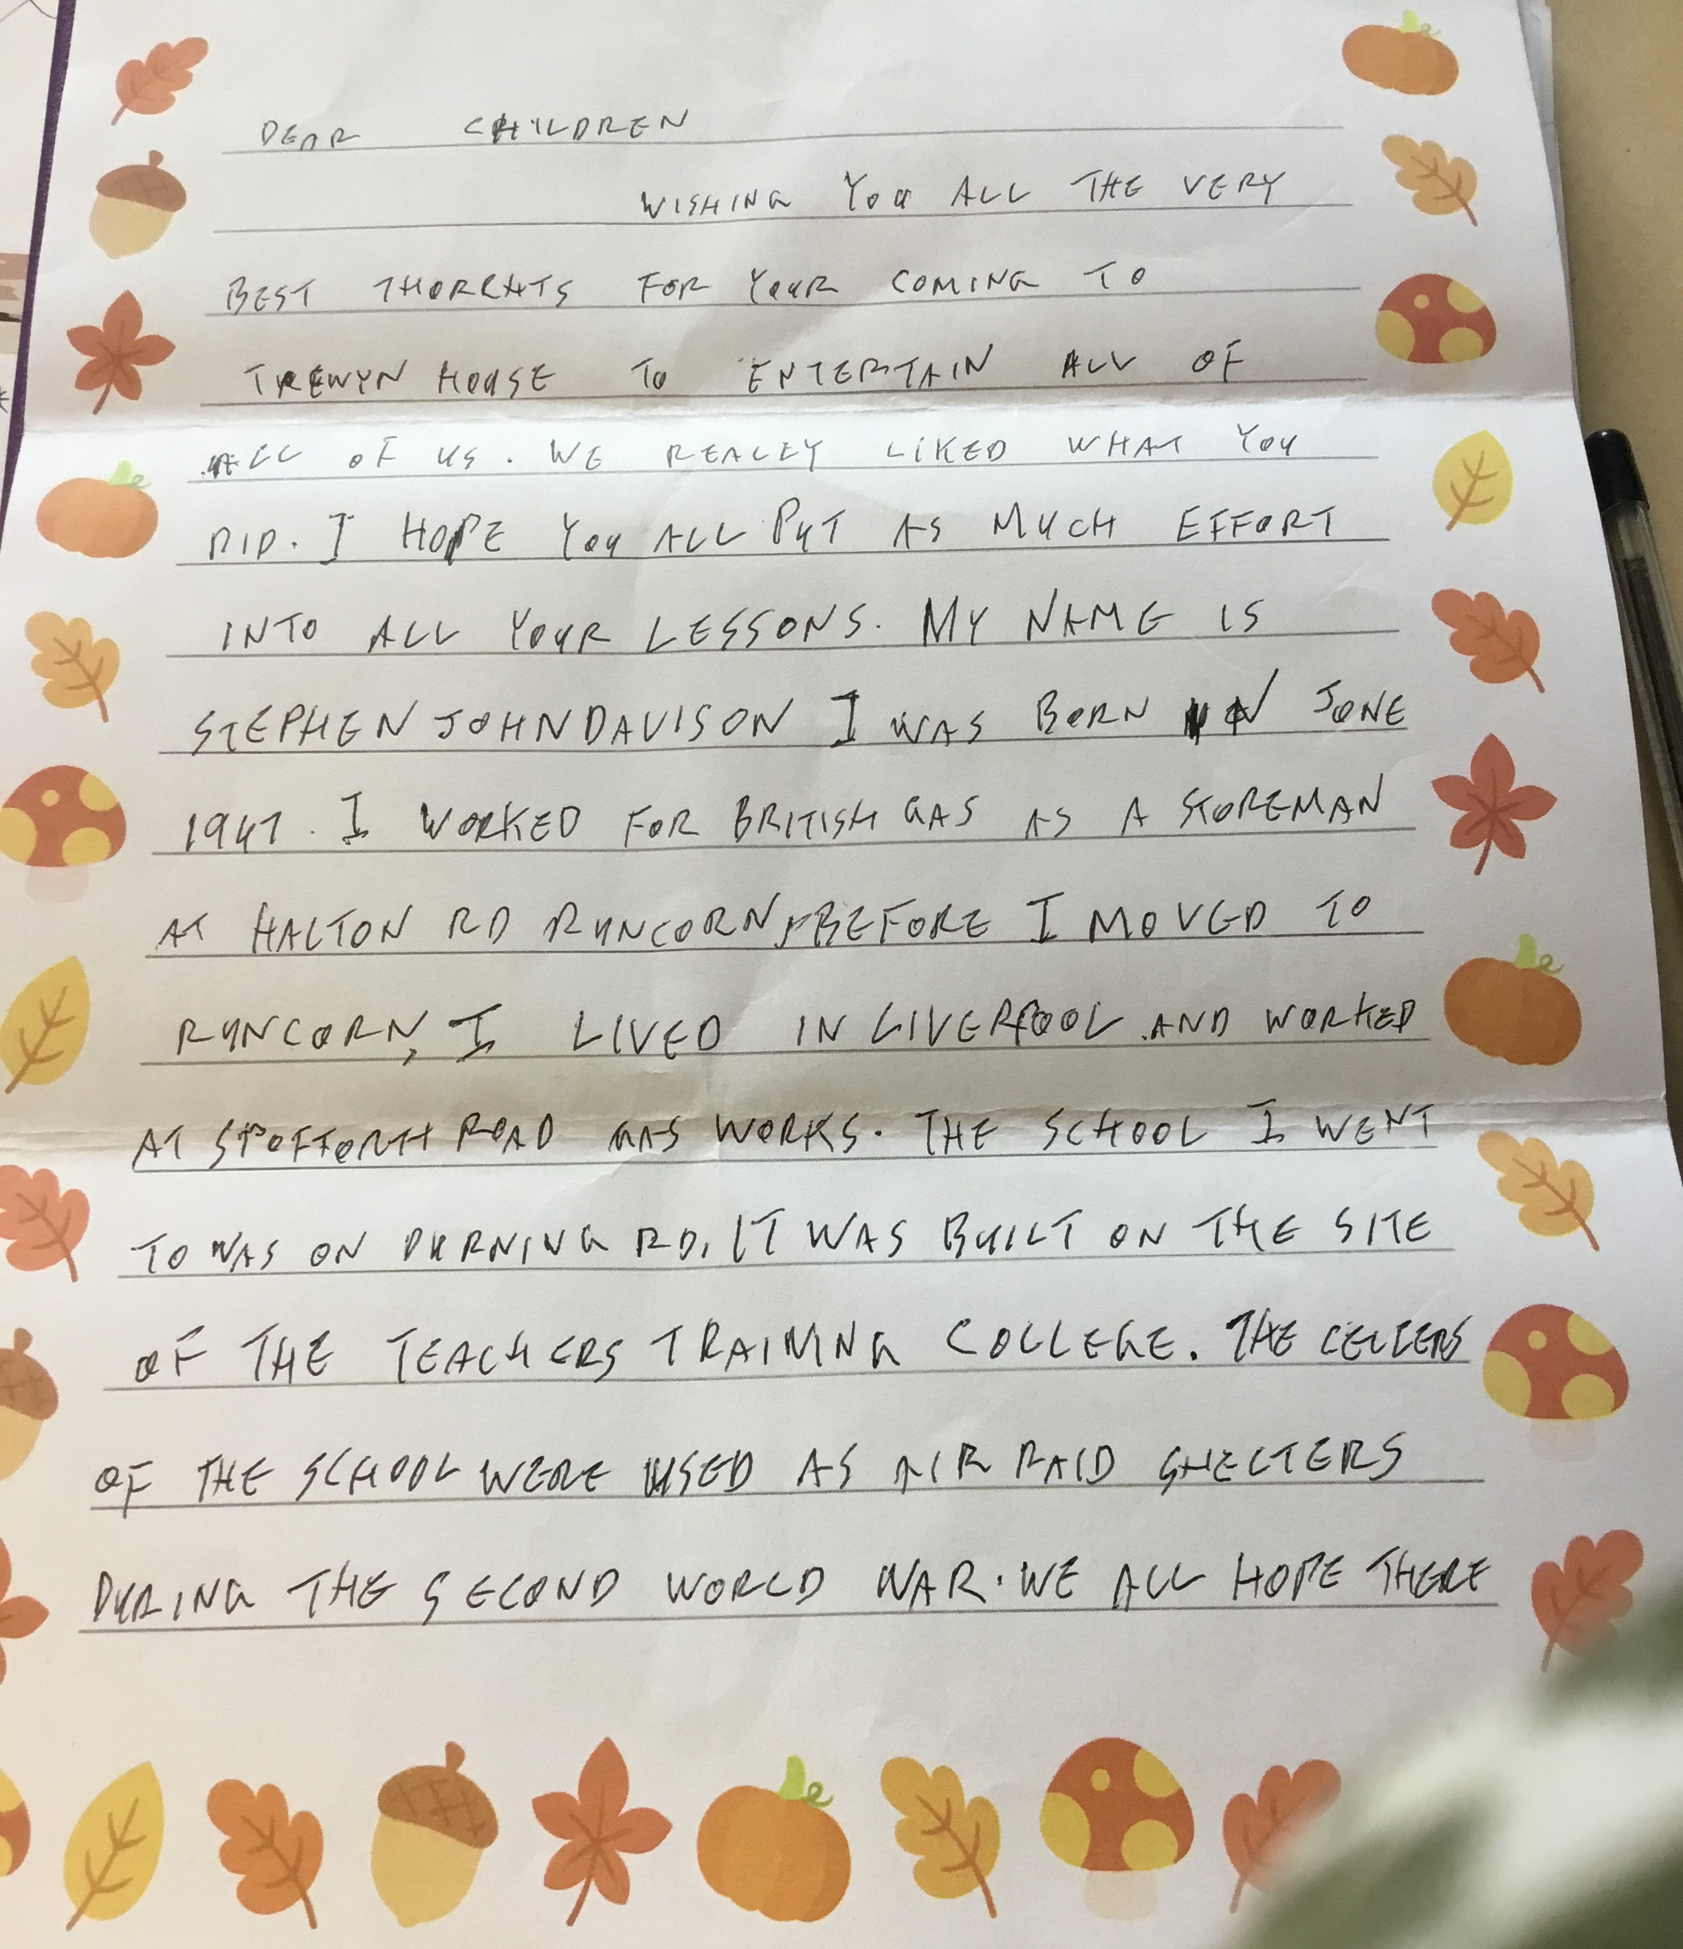
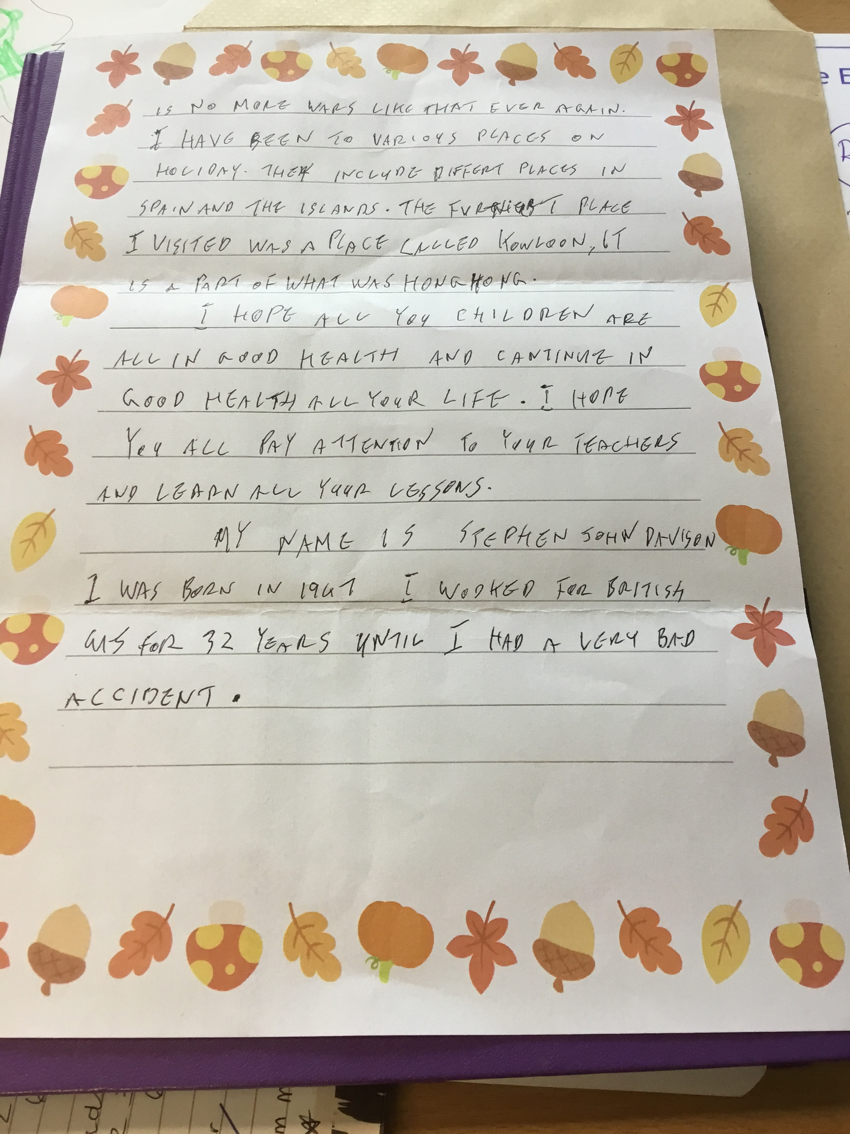
The residents wrote to us too.

Slide 3
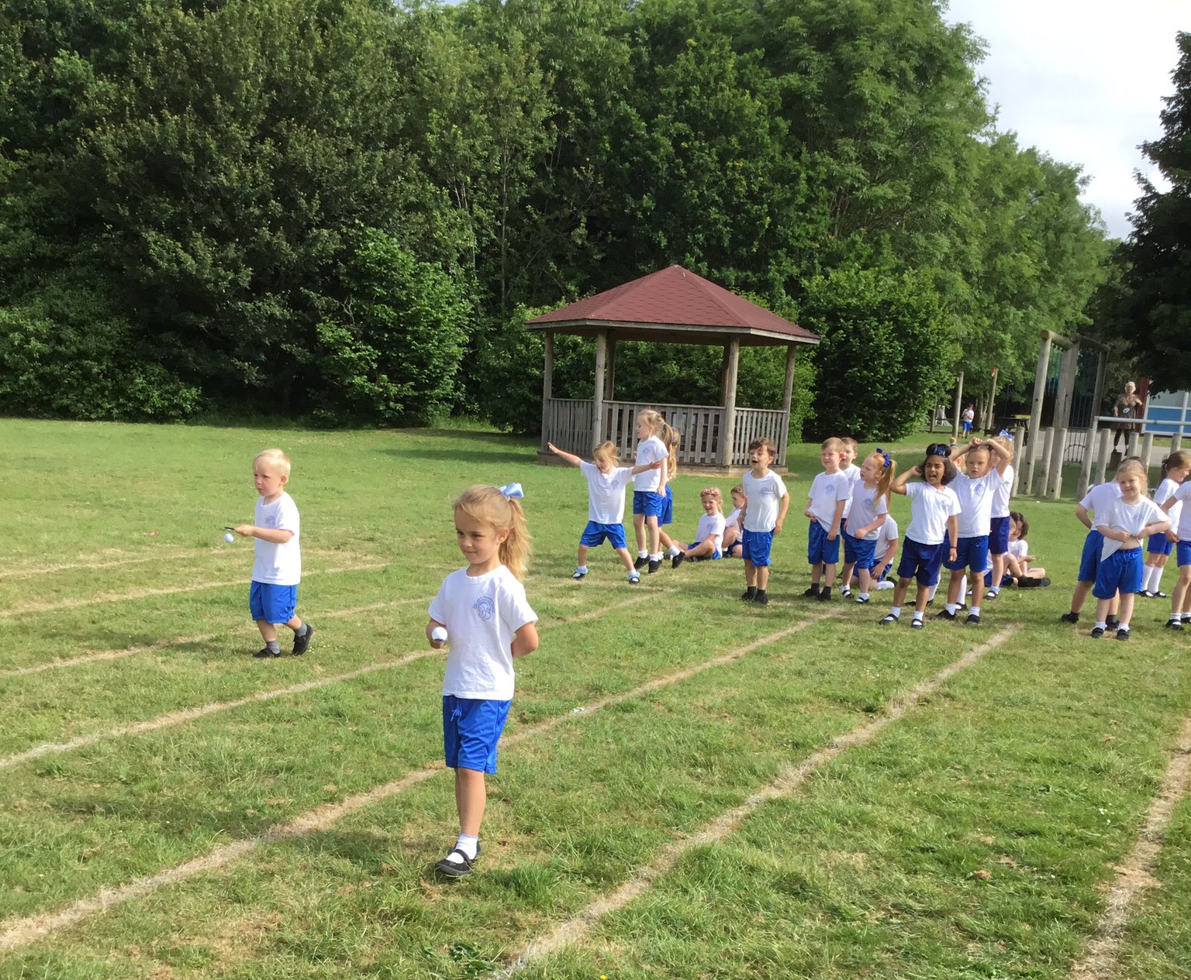
Our school before and after the prayer garden

Slide 4
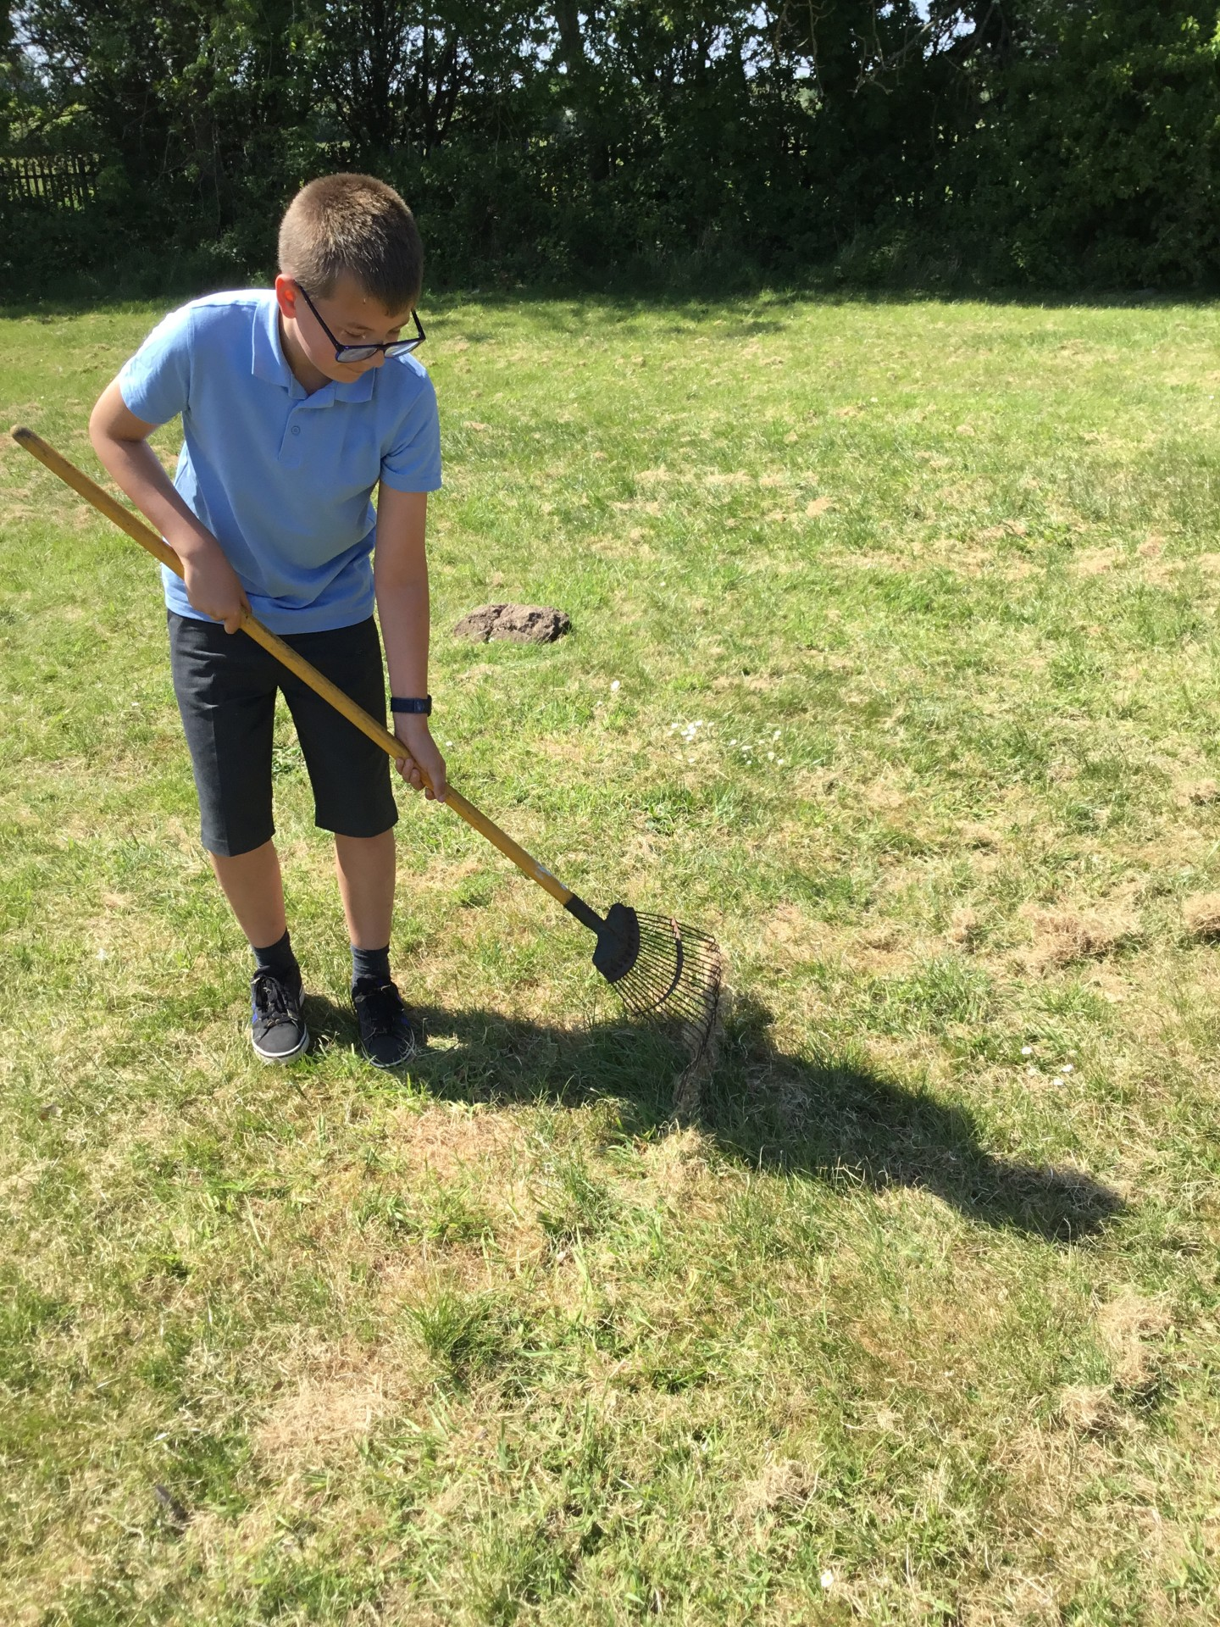
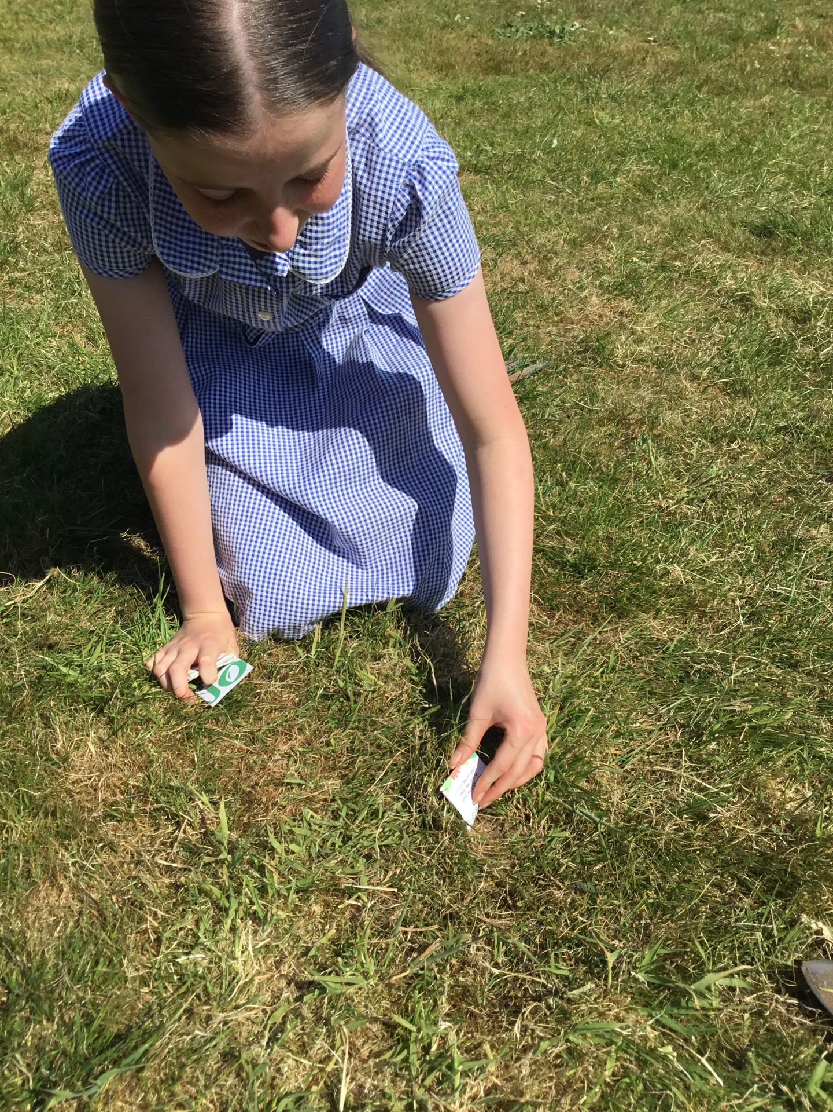
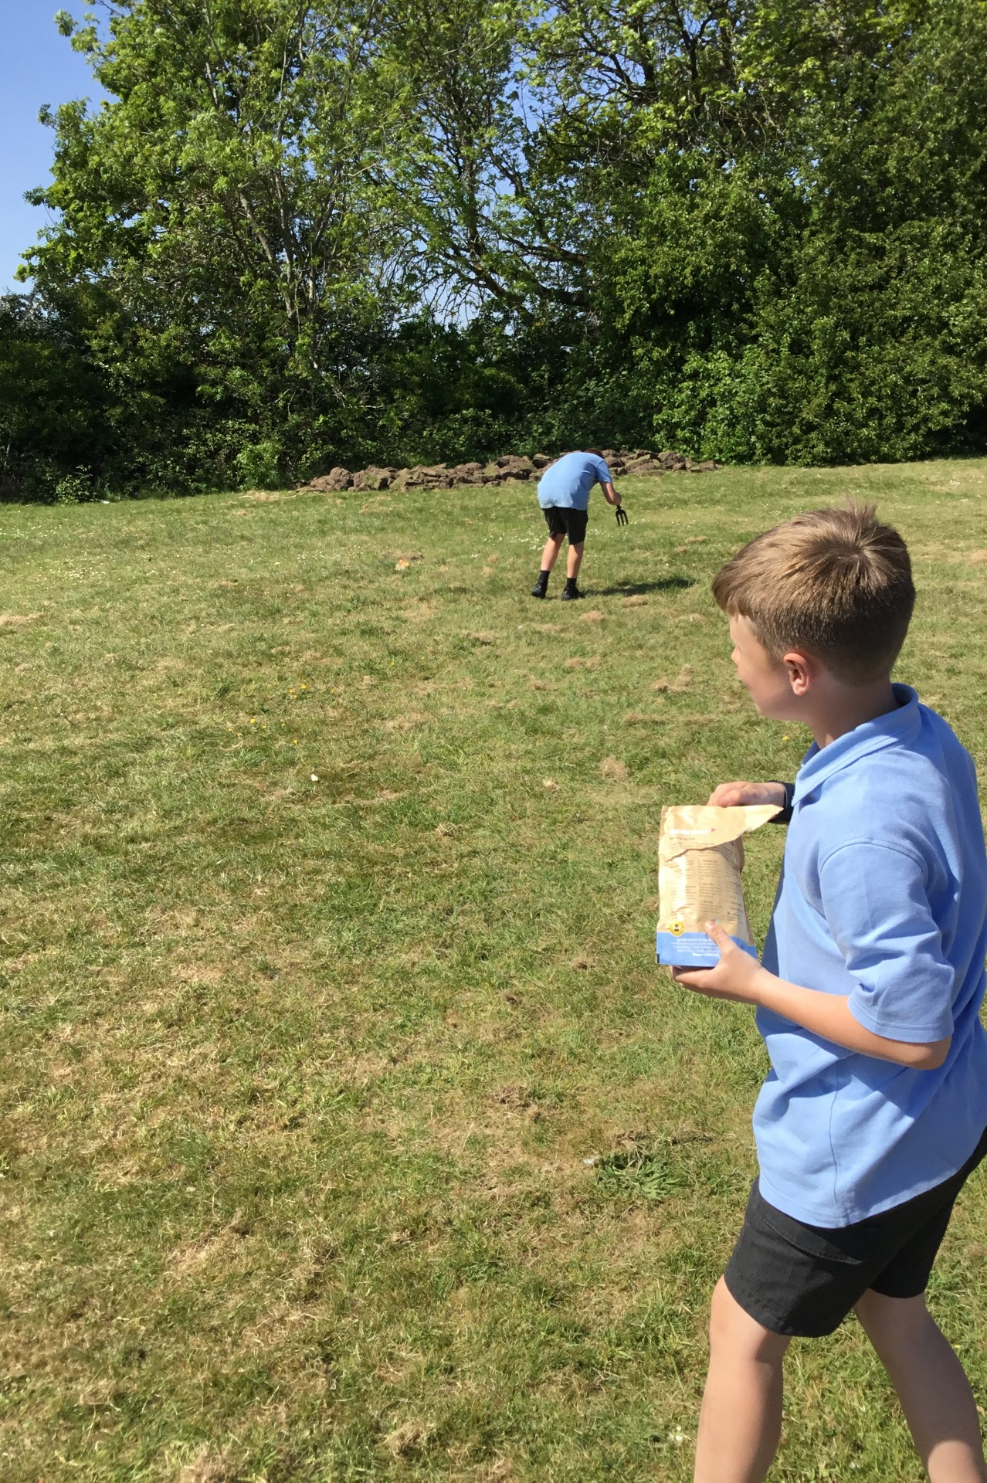
Sowing the seeds for our wildflower meadow

