Slide 1
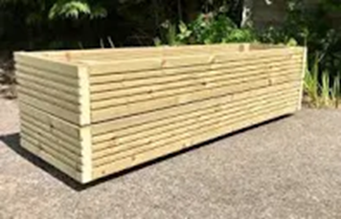


Planters
Inform

Slide 2


Negotiate
What rules do we need reminders, for
existing or new activities and
equipment?

Slide 3

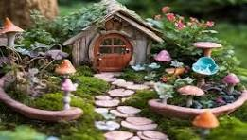
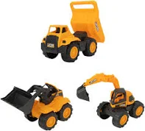
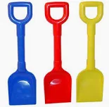
Negotiate
KS1 playground planters
•Do not take garden tools, digging toys or fairy garden items out of the planters.
Don’t throw sand, wood chippings or mud.
Please wash hands after play.
Plastic trowels (garden equipment) are used for digging and are "tools, not toys"
Share equipment/toys in the planters.

