Slide 1
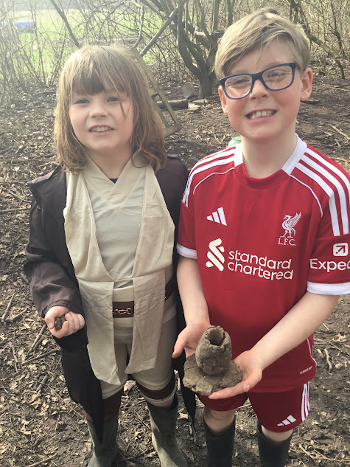
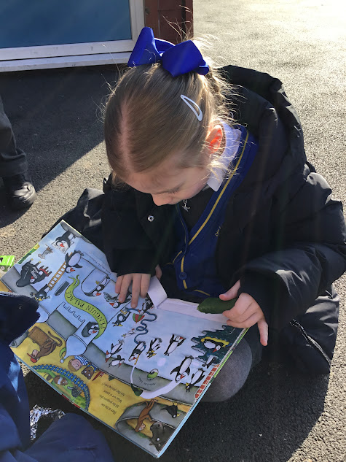


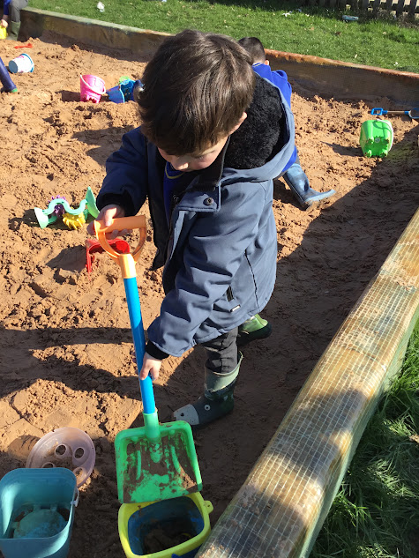
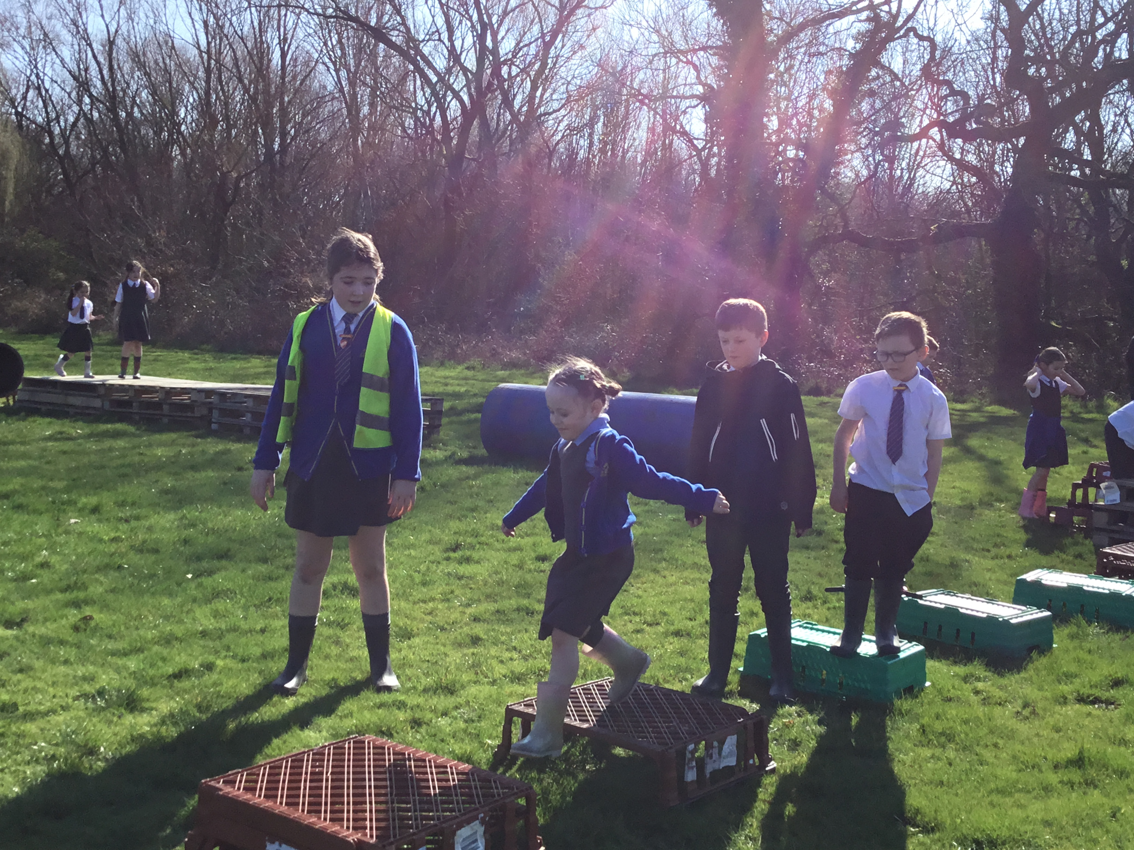
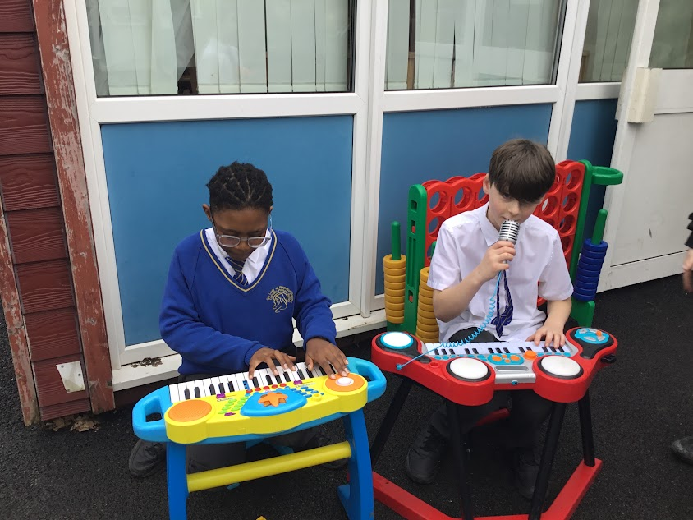
OPAL Play
Assembly

Slide 2

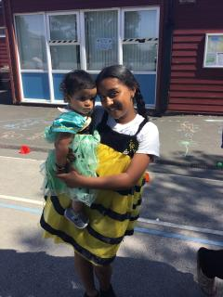
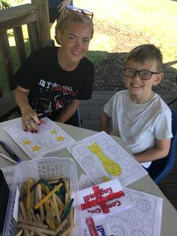
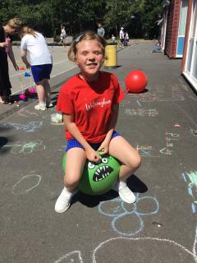
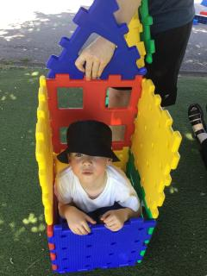
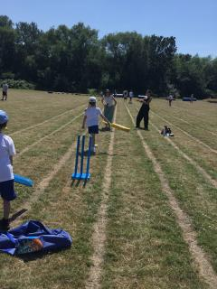
Celebrate
Stay & Play

Slide 3
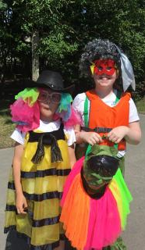
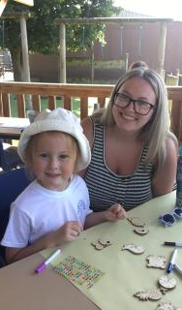
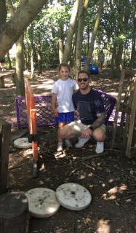

Slide 4

Celebrate
The Stay and Play sessions were a huge success!
Thank you to the mums, dads, siblings, grandparents, aunties, uncles and friends who attended, making the event a true family occasion.

Slide 5
Innovate- equipment
How can we use it?
How can we not use it?
Please respect equipment
Choose, use, put away!
Report any broken equipment to the play team

Slide 6


Negotiate
What rules and reminders do we need, for
existing or new activities and
equipment?

Slide 7
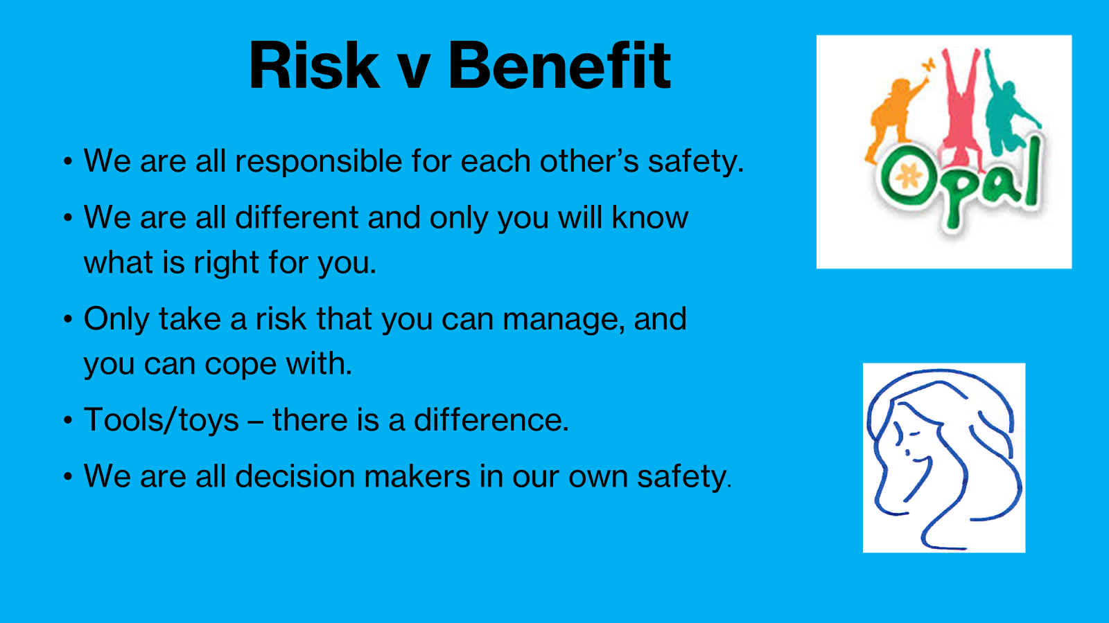

Slide 8
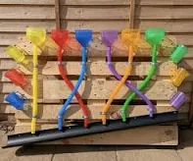
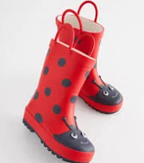
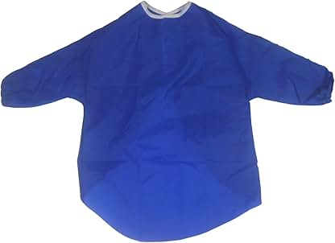
Negotiate
Water Wall
Important:
Wellies should be worn to prevent socks and shoes from getting wet.
Aprons should be worn to prevent clothes from getting wet.
Slip hazards: Please be careful of water spillages on the playground, as they may make the surface slippery.
Please do not intentionally wet yourself

Slide 9
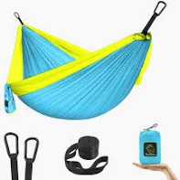
Hammocks
Negotiate
Be aware when swinging in hammock and be aware of risks- falling out if you swing too high.
Reminder- children to check the ground underneath the hammock for rocks, tree roots
Never stand, jump, or swing too high in the hammock
Only one person at a time to prevent tipping or overloading.

Slide 10
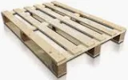
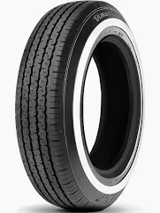
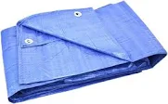
Negotiate
Loose parts
Pallets- to move 4 KS1 Children at either end and 2 KS2 children.
Tyres- safe heights for stacking/ climbing in tyres ‘up to the waist height’.
Roll to move tyres
Tarpaulin- No wrapping of tarps around a person’s body or wrapping a person within a tarp
Dens to have visible access/exit points and not to be fully enclosed
Broken loose parts or other resources- to be placed behind the metal container
Loose parts- Children encouraged to check loose parts and report damage to Play Team.
Ready, steady, lift” – bent knees and straight back
Reminders

