Slide 1
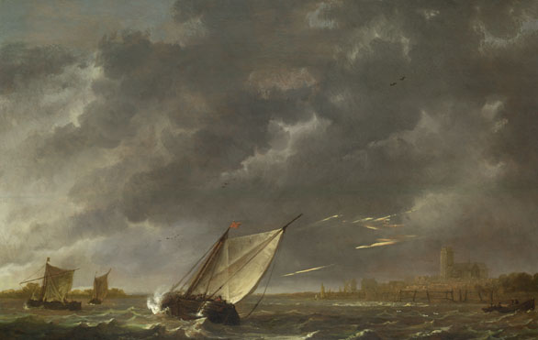
Lesson 3:
Island Settings
Learning Objective
Examine the effectiveness of the setting and how Shakespeare makes it dramatic

Slide 2
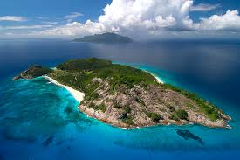
Mind Map
All the characters in The Tempest find themselves together on an unnamed and otherwise uninhabited island.
Make a list of all the books, plays, films and television programmes that you can think of which are also set on islands.
Why do you think island make such an effective setting in film and literature? Consider the ways in which an island setting would influence the structure, characterisation, language and plot of a text.

Slide 3

Reading Act 1 Scene 1
Look at the list on characters on the sheet.
Read through the scene and have a go at answering the questions in the boxes.

