Slide 1

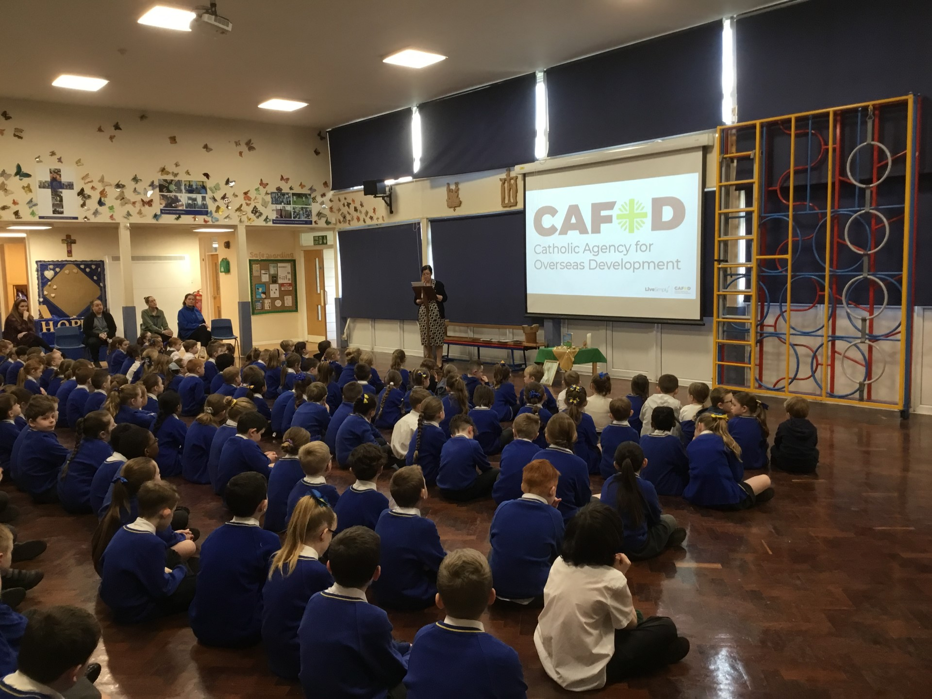
Live Simply Award
“What kind of world do we want to leave to those who come after us, to children who are now growing up?”
Pope Francis

Slide 2
Actions
Global action 1 - Cafod’s Big Lent Walk
Global action 2 - Cafod Tea party/coffee morning
Global action 3 - Harvest Festival assembly
Local action 1 -Local foodbank/FareShare
Local action 2 – Local Litter Pick
Local action 3 - Prayer Garden allotment
School action 1 - Prayer Space/WellbeingGarden
School action 2 - Photography Competition
School action 3 - Wellbeing Area

Slide 3

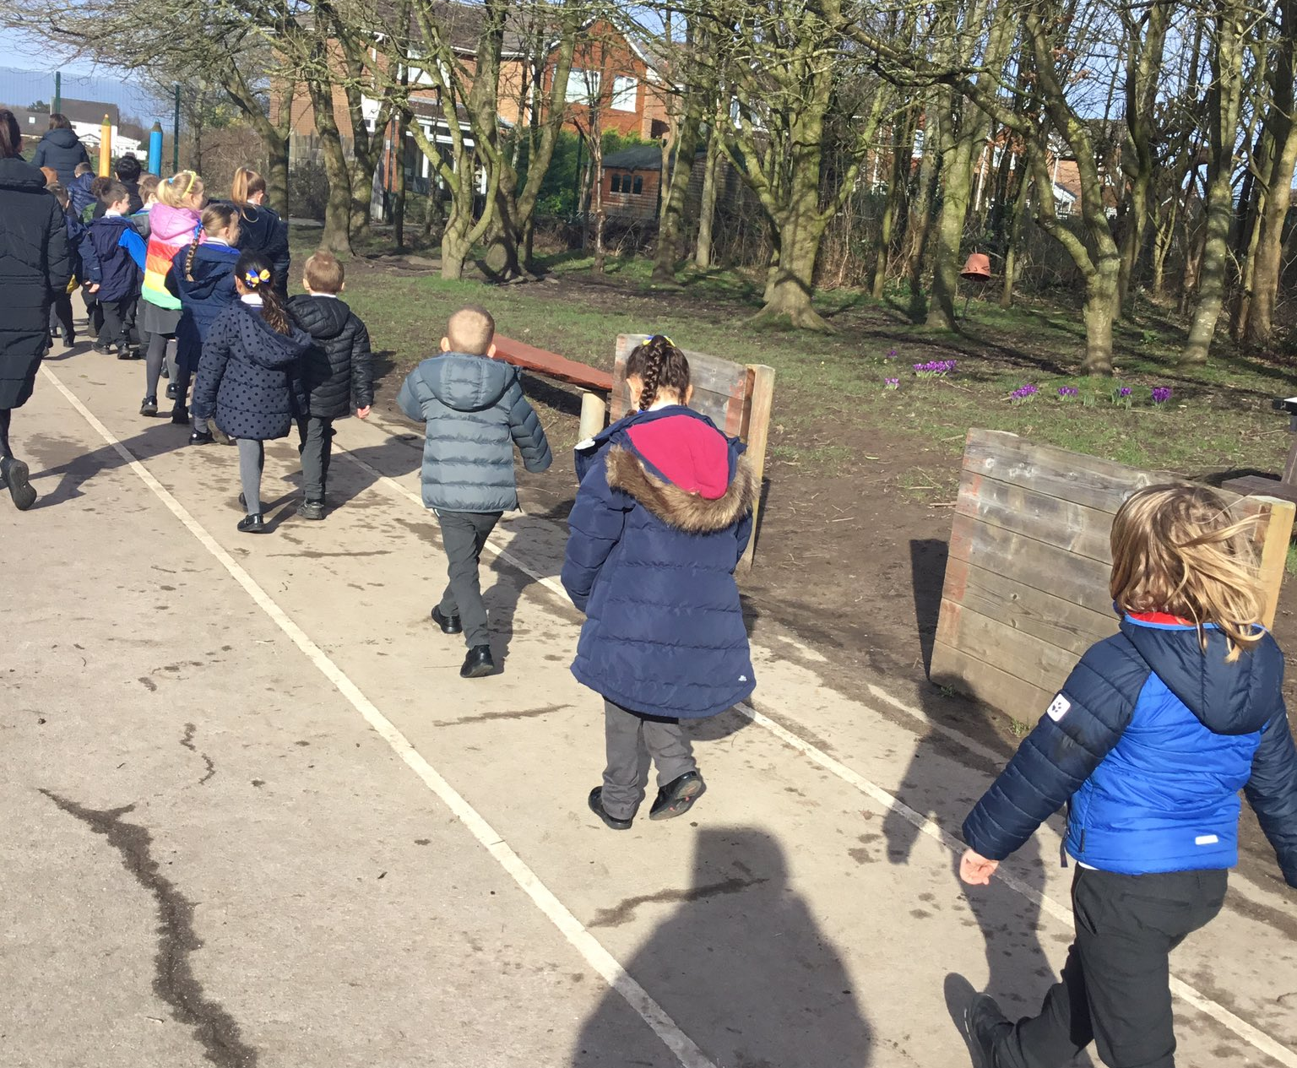
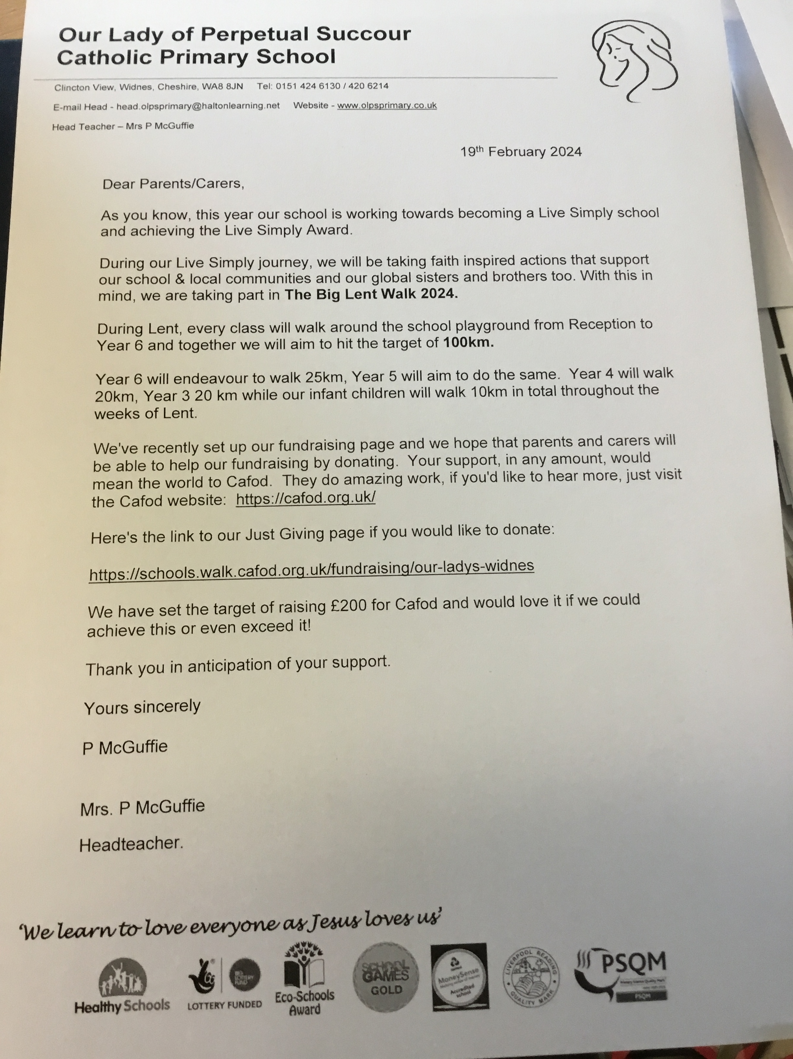
Evidence for Global action 1 – taking part in the Lent Walk fundraising and raising awareness of CAFOD.
It is so important to help our Global neighbours. The children were inspired when we announced The Big Lent Walk.

Slide 4





Thank you!
Together we raised £240.00 for CAFOD’s Big Lent Walk.
We joined hundreds of schools across England and Wales to help CAFOD support families in extreme poverty around the world.
Here’s what our money could buy:
£16 could buy a life jacket to keep a fisherman safe at sea
£47 could buy a cooler for a fisherman to keep his catch fresh at sea
£120 could buy a GPS fish finder to track fish and find shore in a storm

Slide 5
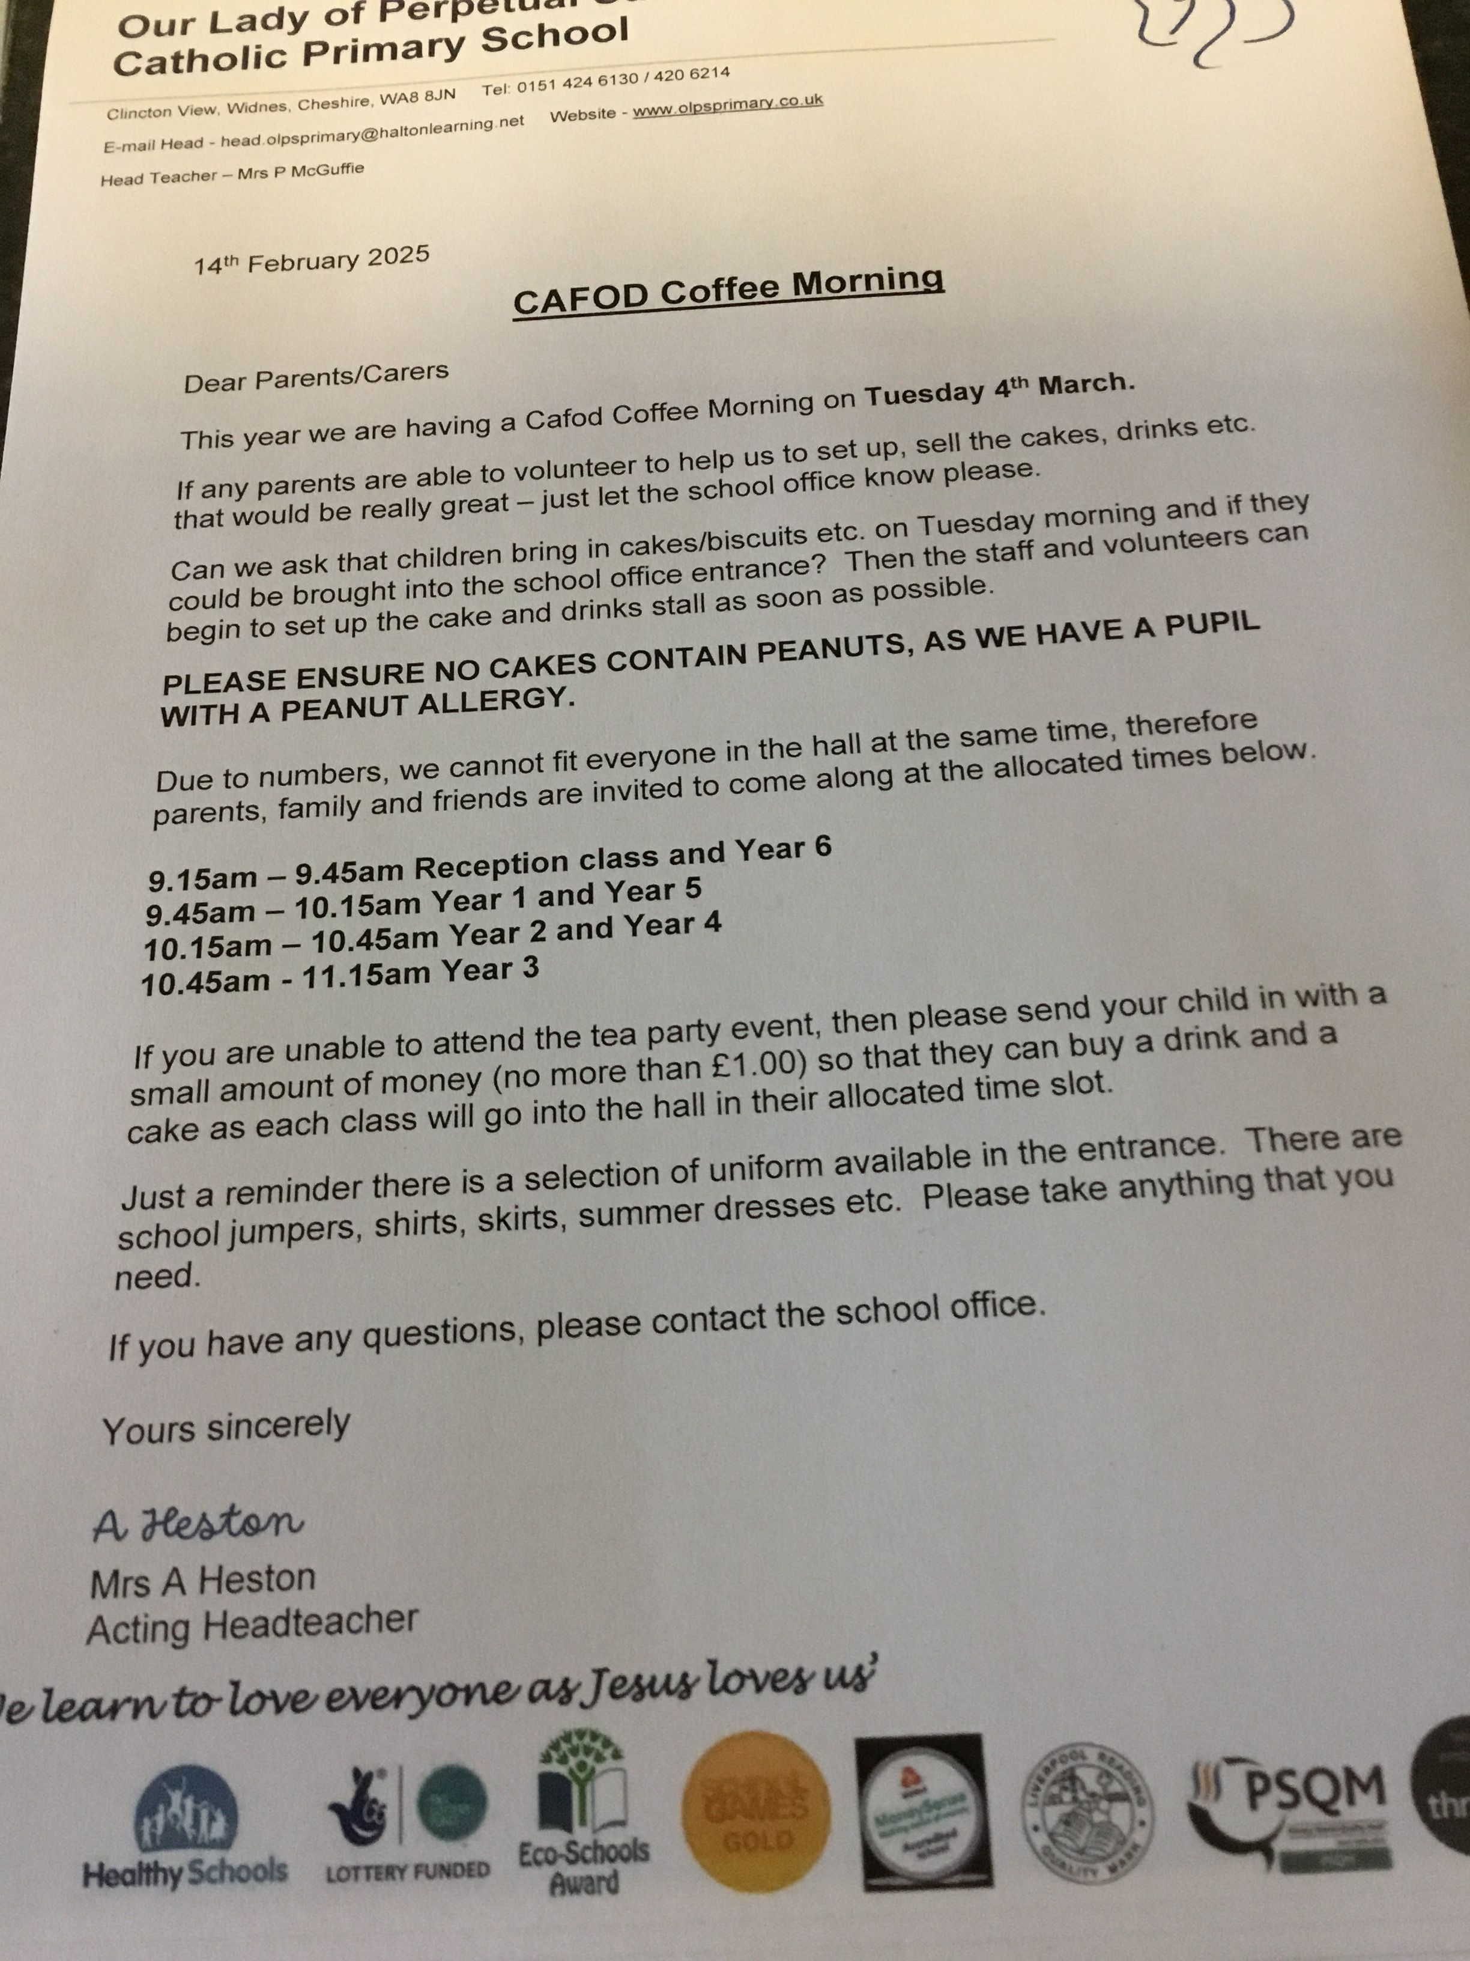
Evidence for action 2 –
Holding a CAFOD Tea party for parents and our local community.
Children were able to reflect on the importance of being kind, sharing with others and fundraising to help those in need. They could think about the importance of living in peace and their contribution to this in the world today.

Slide 6
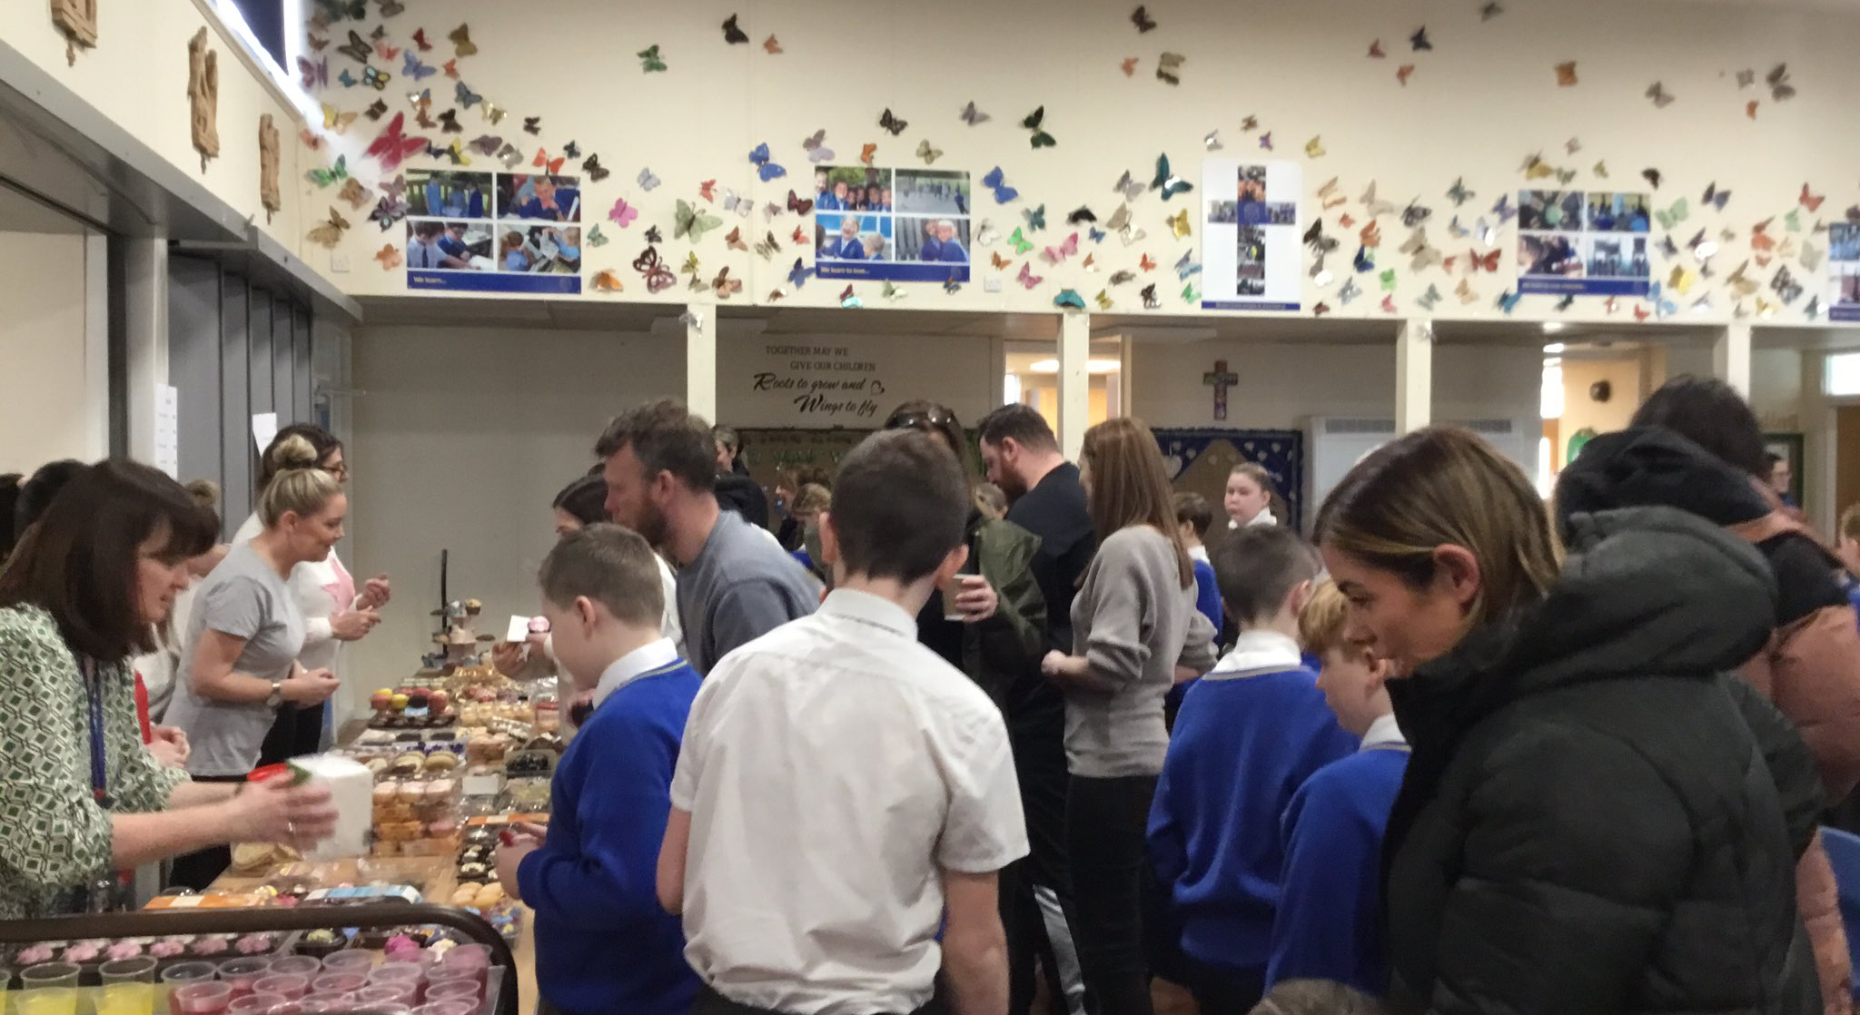
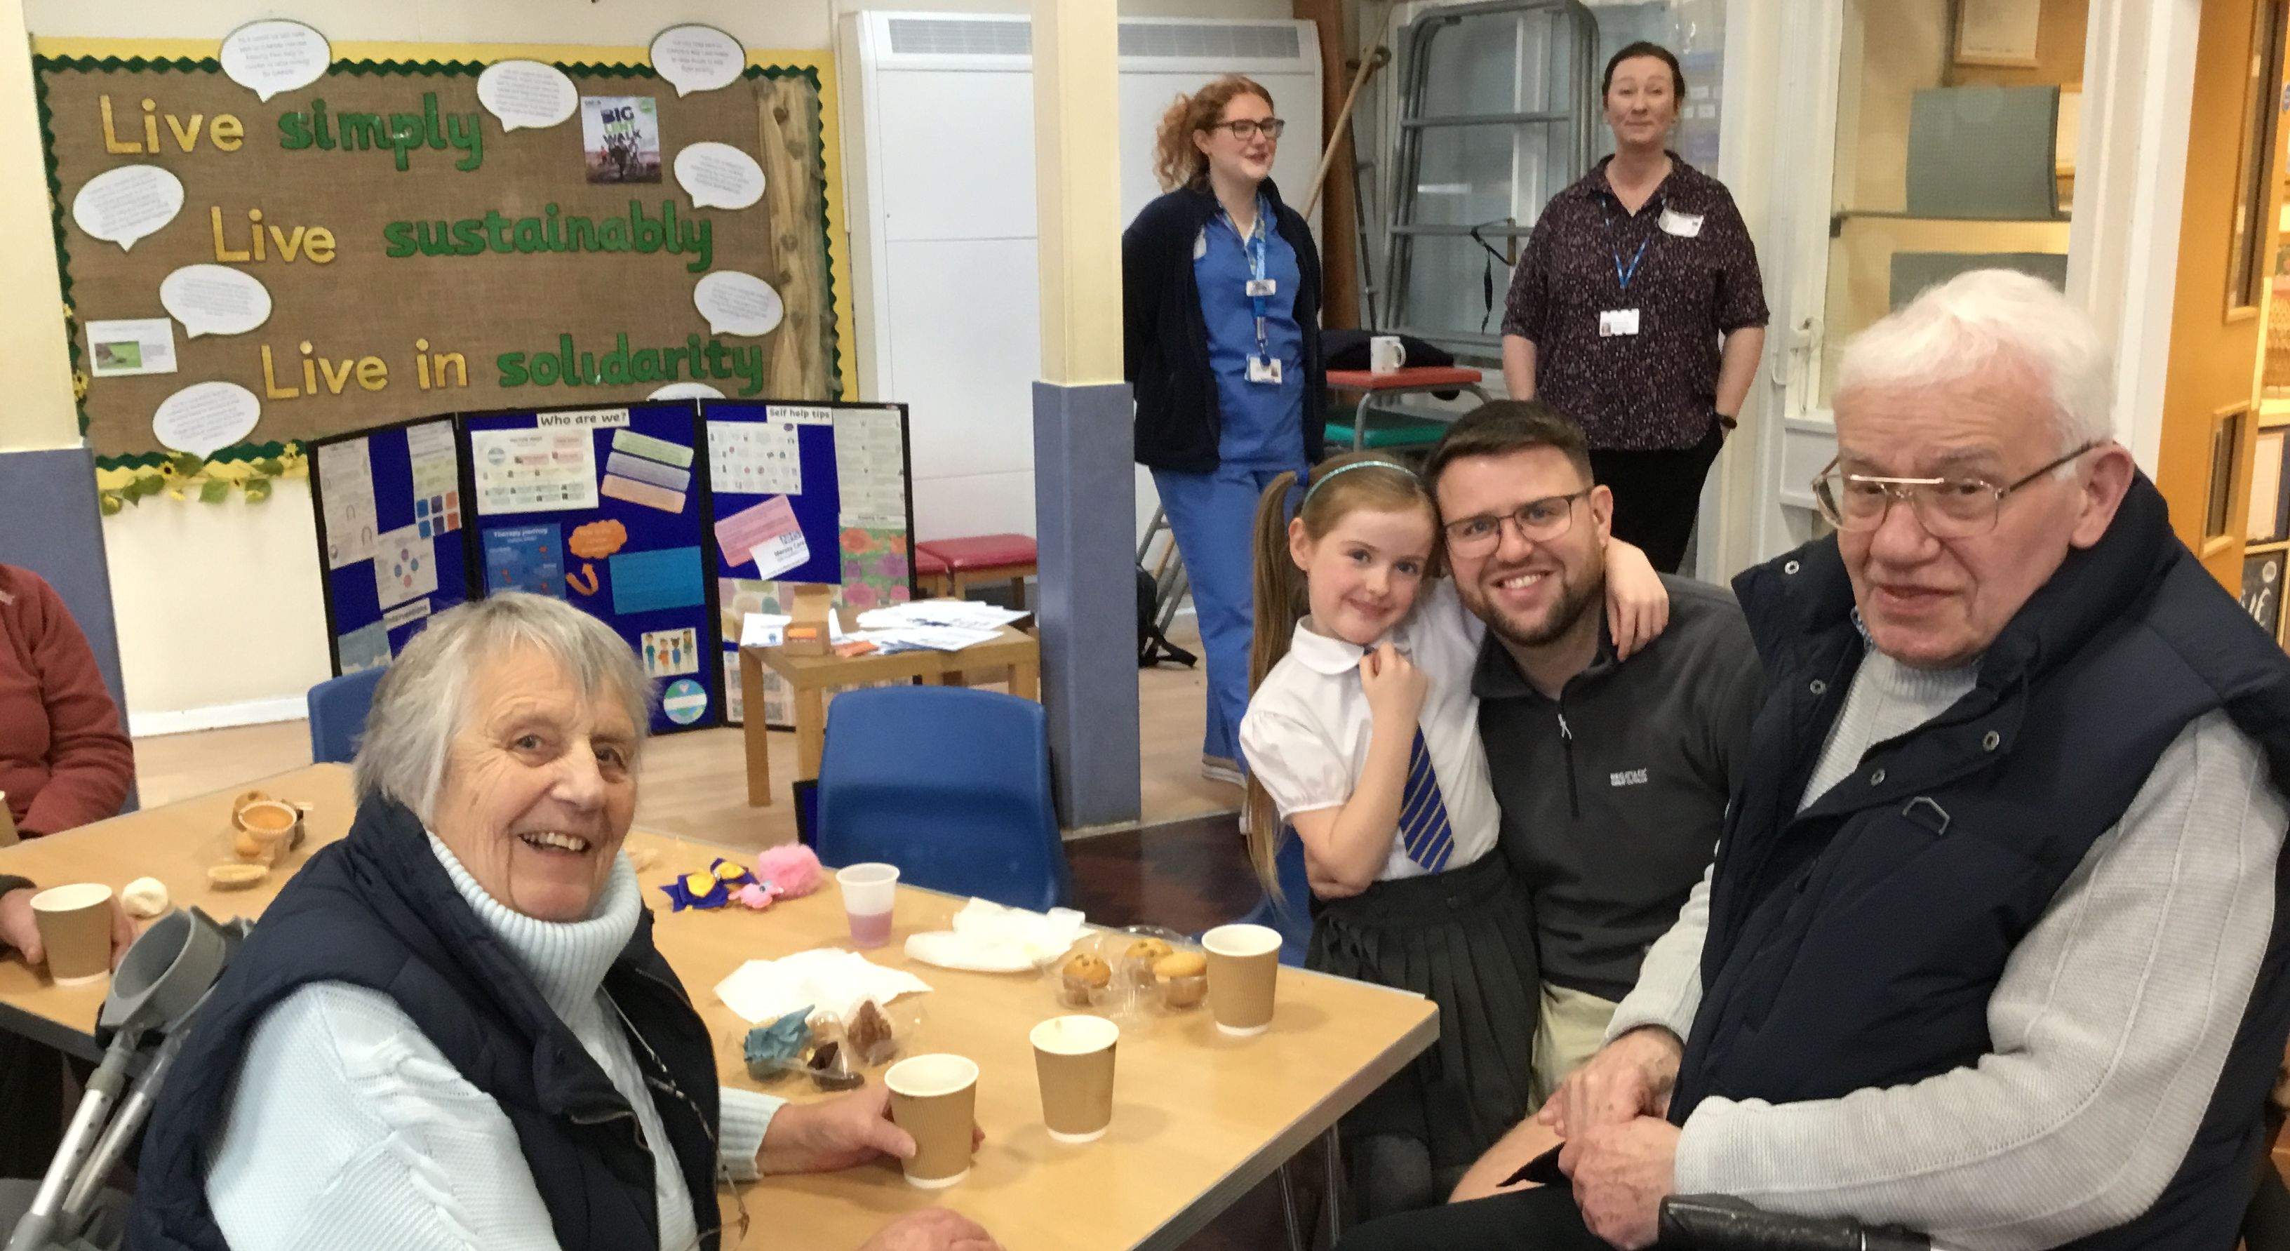
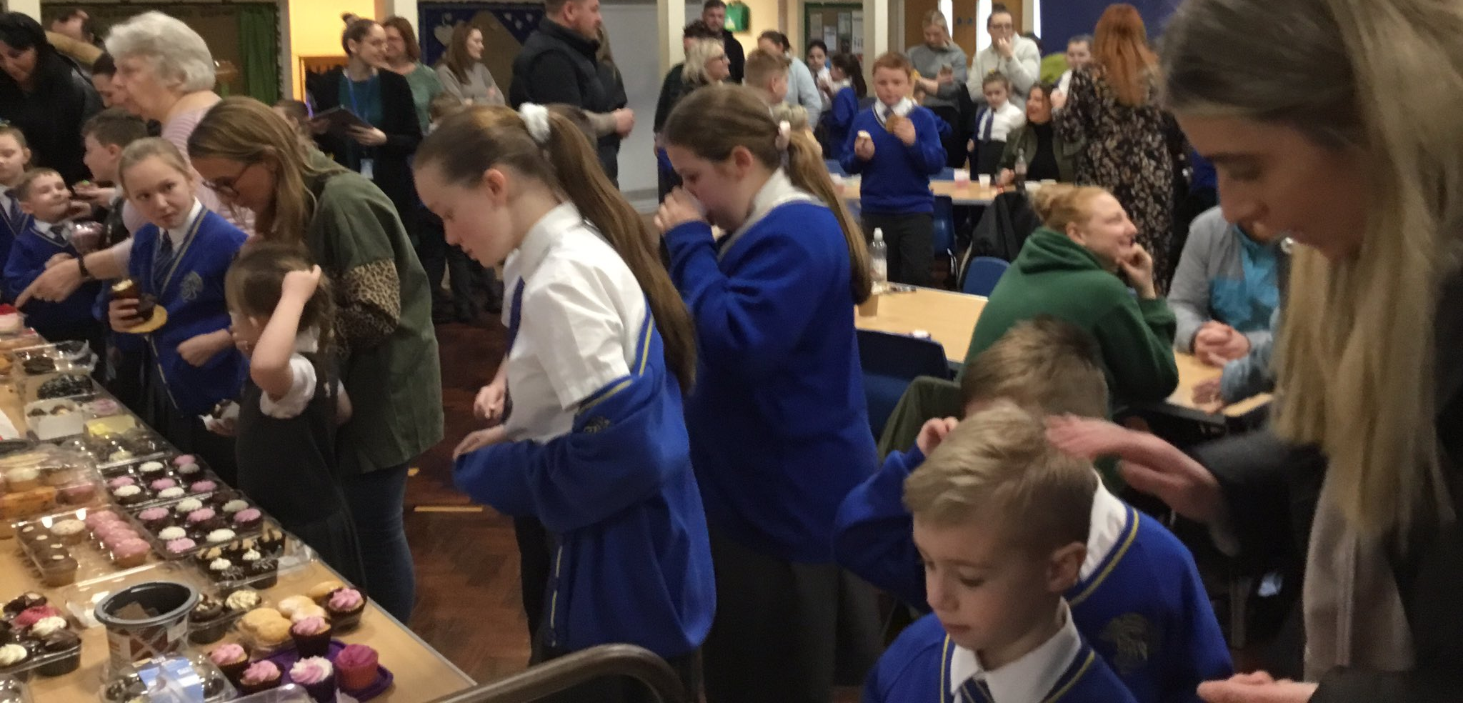
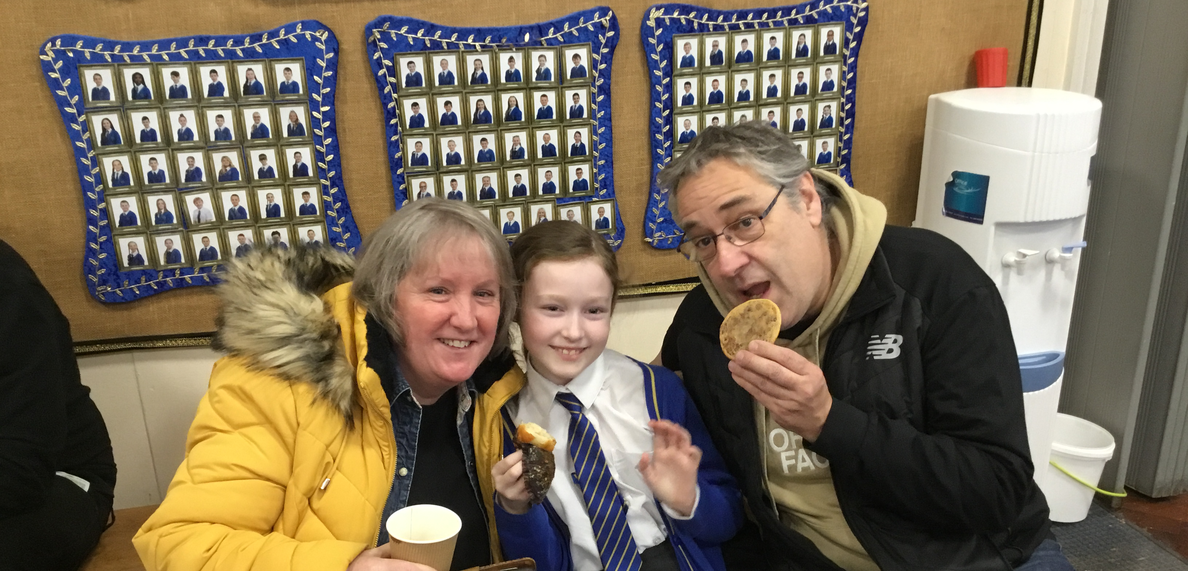

Slide 7
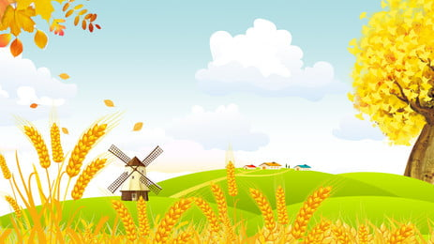
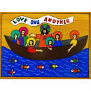
Evidence for action 3 – Harvest Festival
Welcome to our class assembly all about Harvest.
Let us begin by making the sign of the cross.
Please bring up your class plaque as we sing
‘Gather together’.
Welcome to our Year 1
Harvest Assembly
For I was hungry, and you fed me, thirsty and you gave me drink - Matthew 25:35

Slide 8
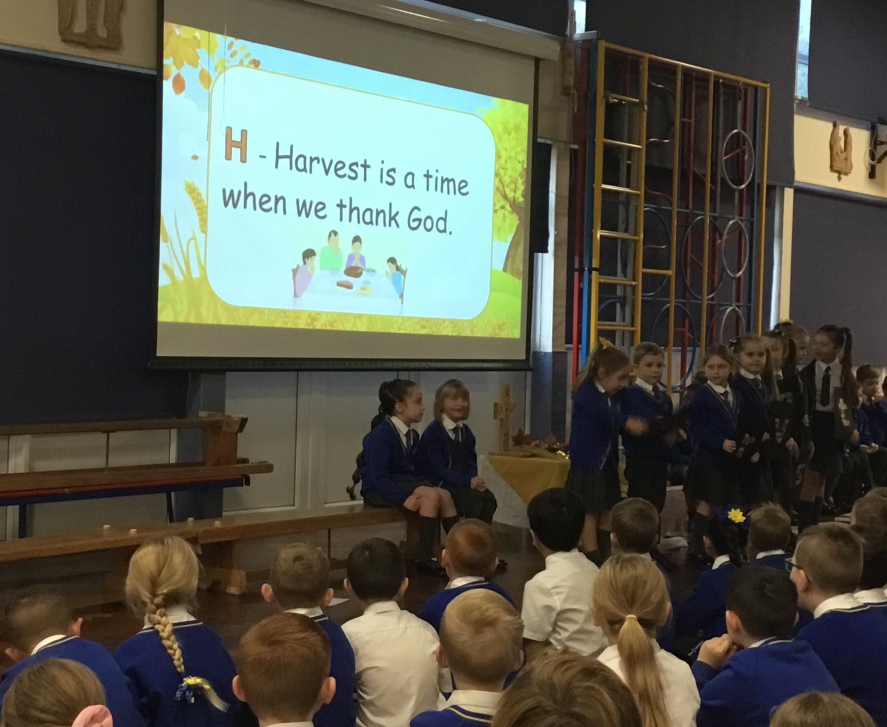
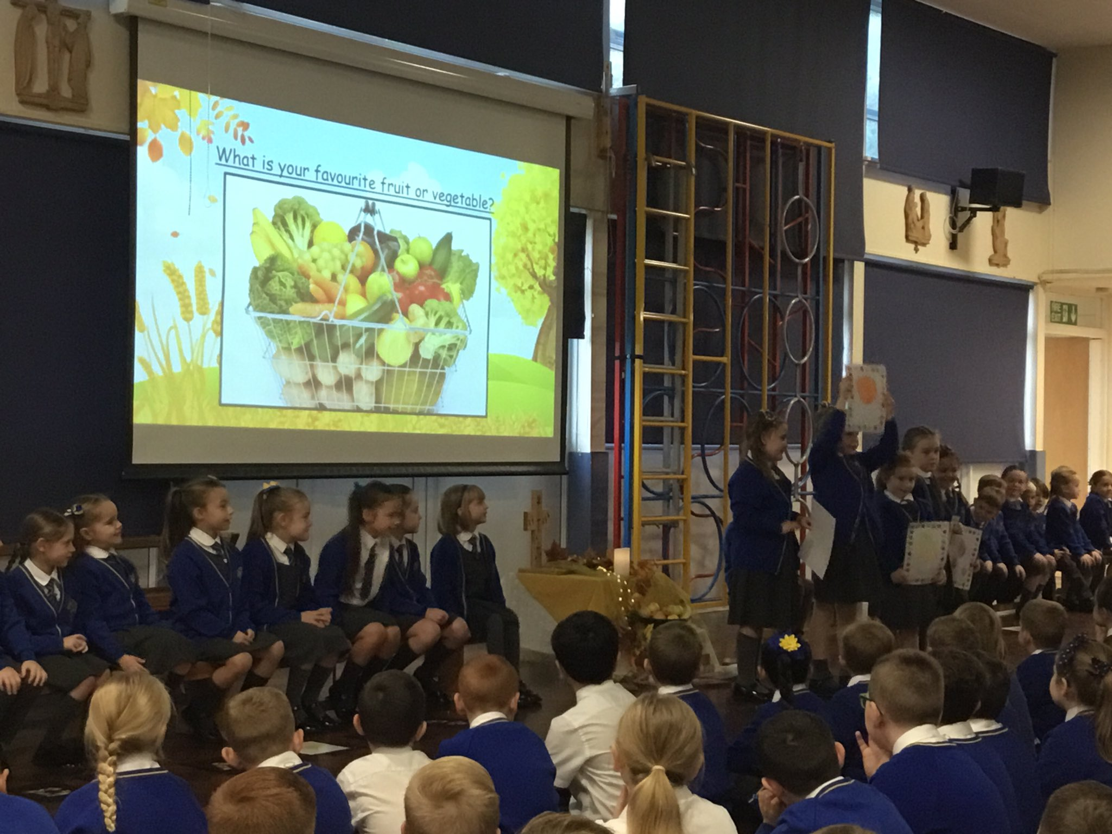
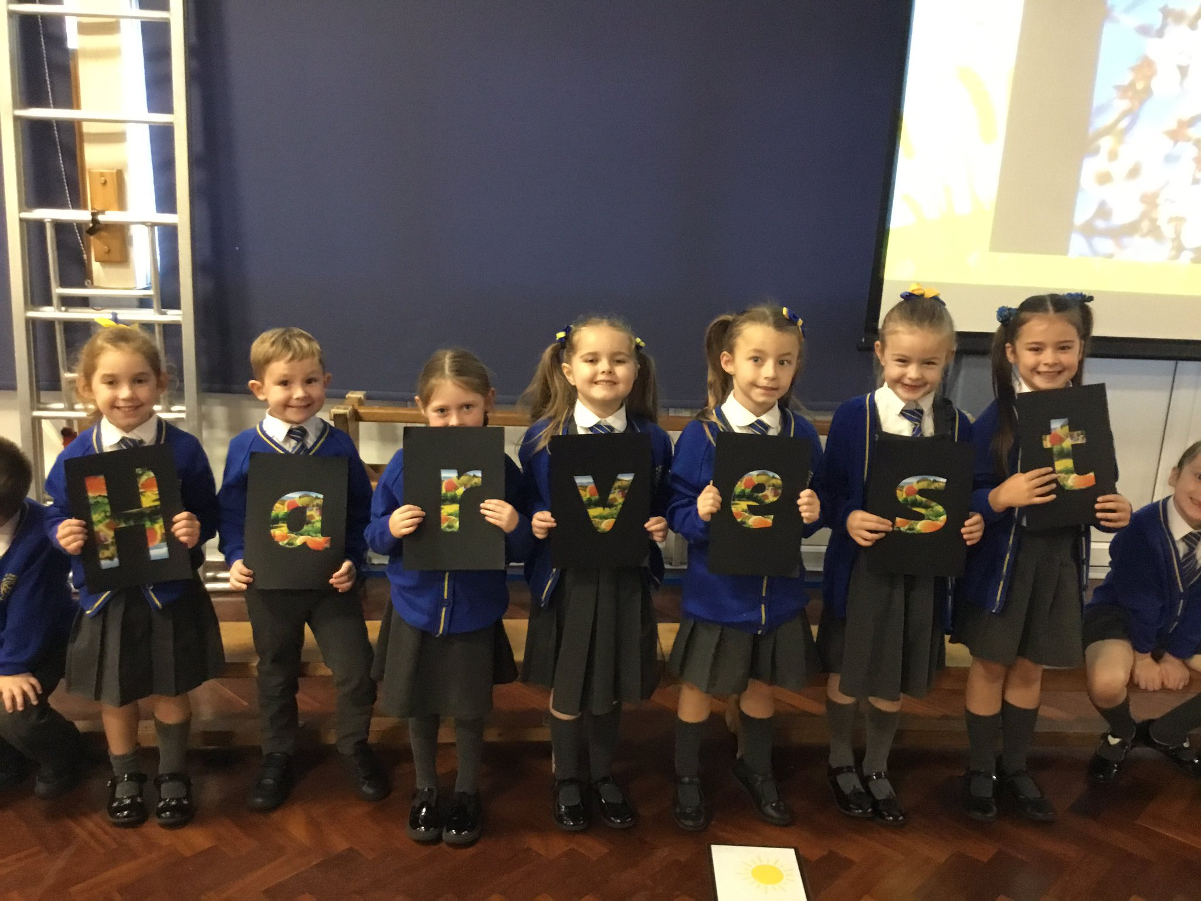
Children were able to understand the importance of Fair Trade and how it helps farmers to get a better deal.
Gather together to celebrate.

Slide 9
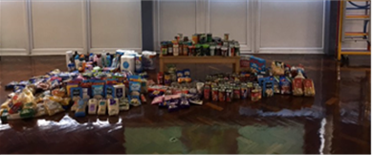

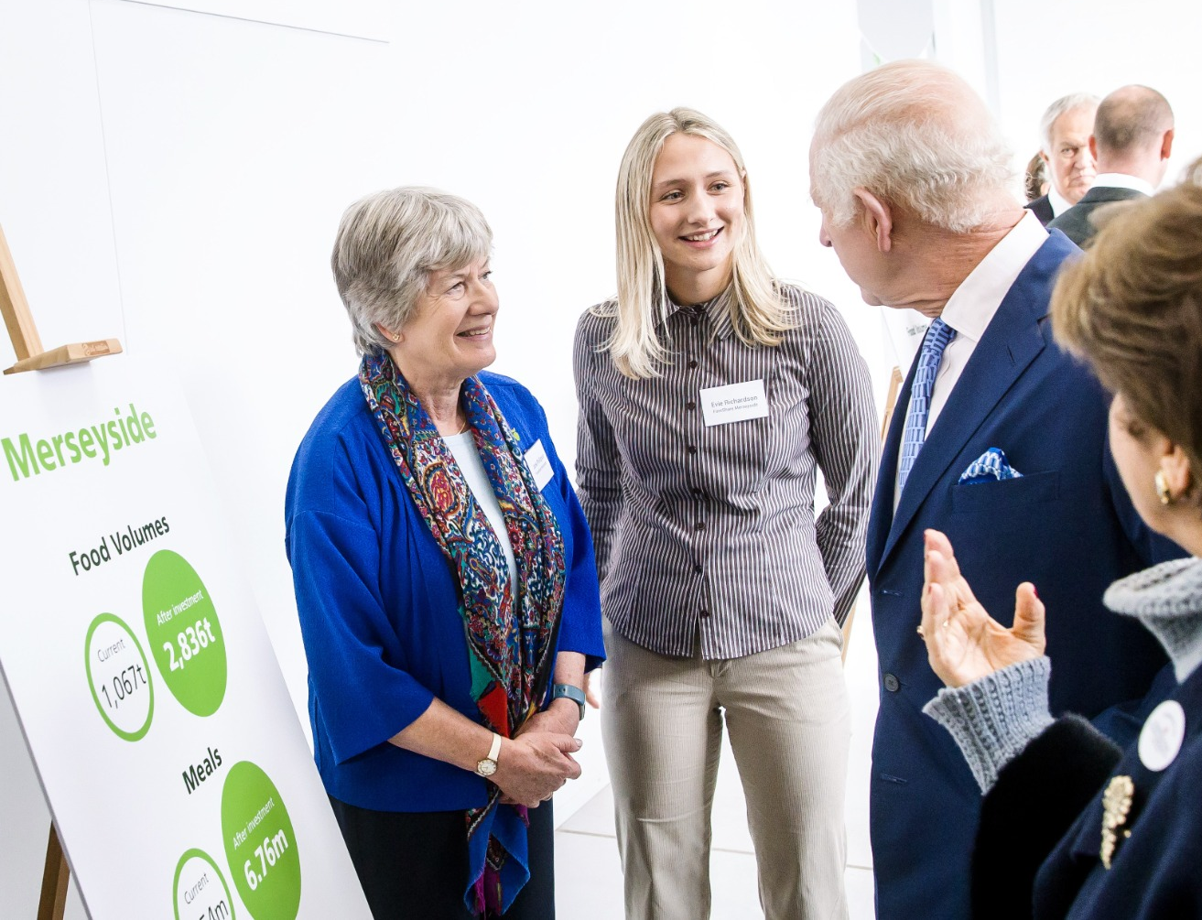
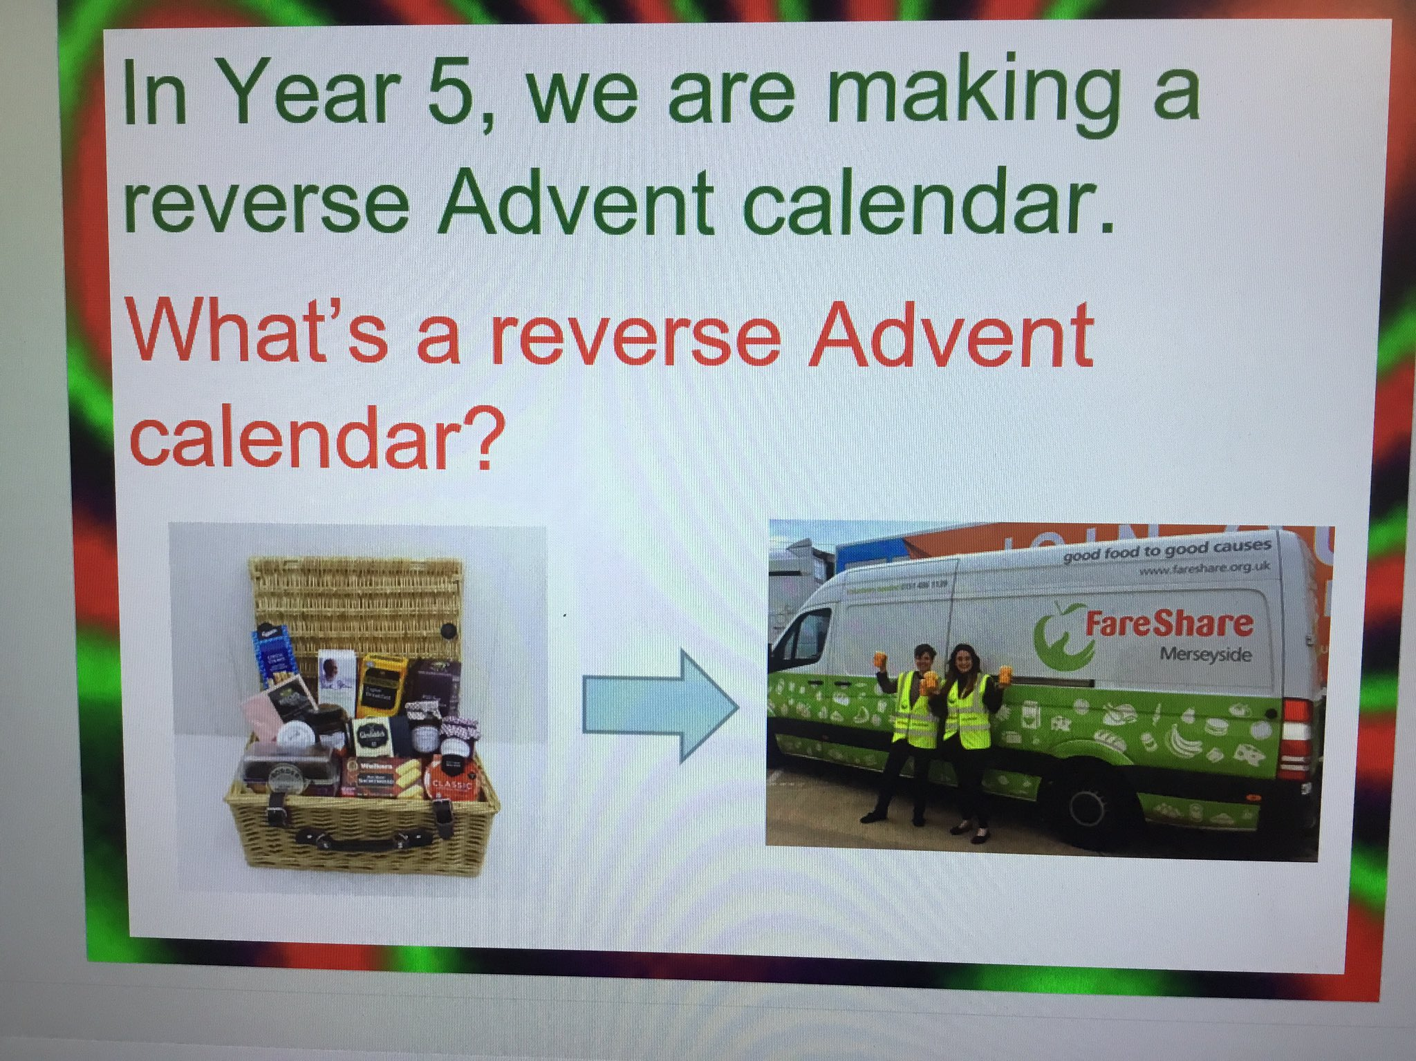
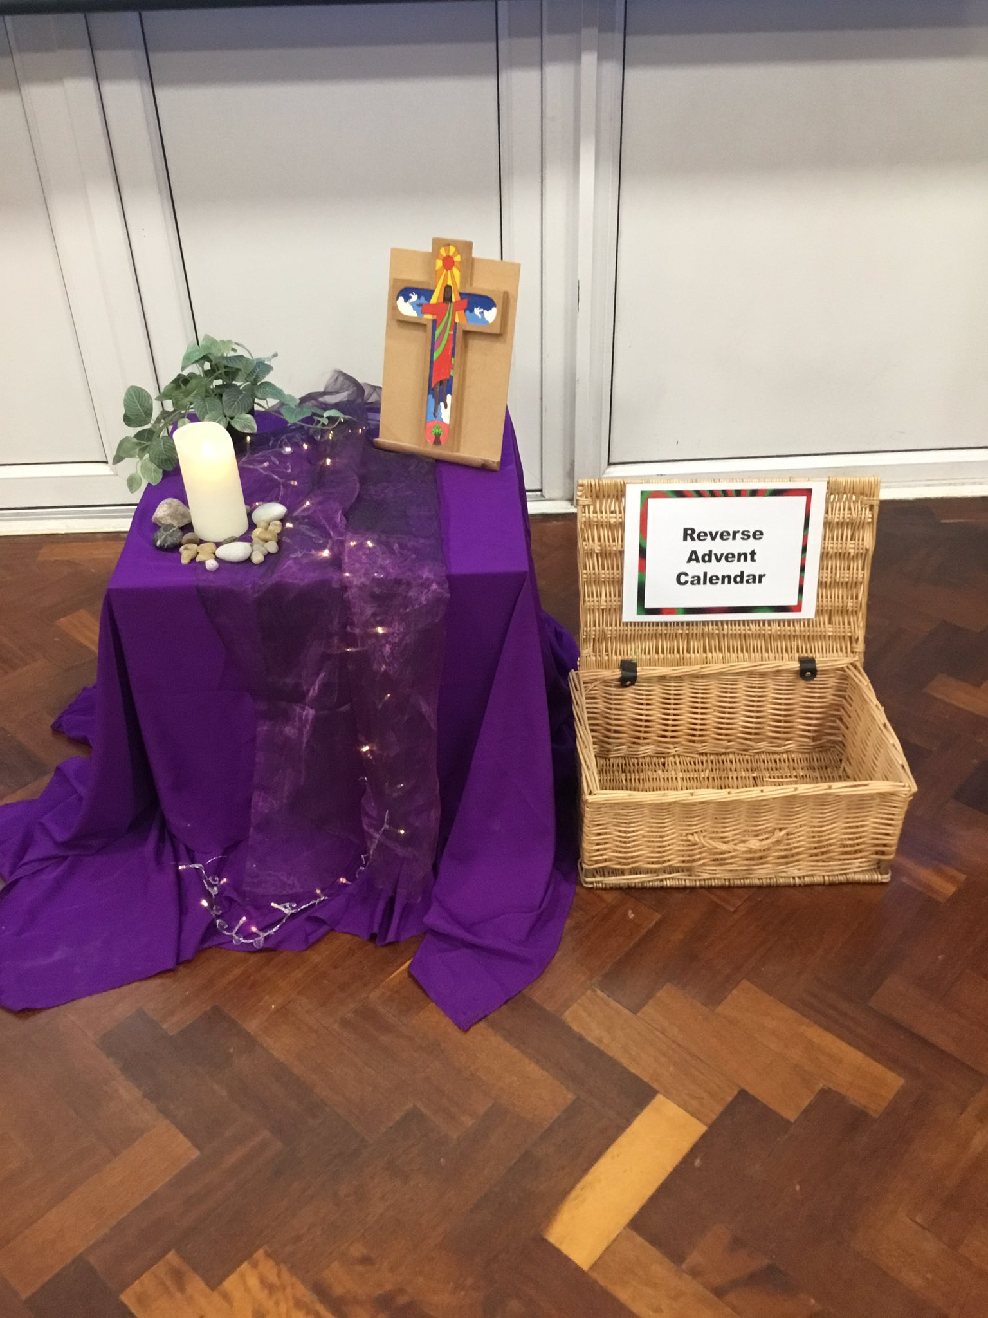
Evidence for action 4 – Local Foodbank/Fare Share
Fare Share and Widnes Foodbank were able to explain about their work.
Evie from Fare Share was even able to tell us all about when she met King Charles!

Slide 10
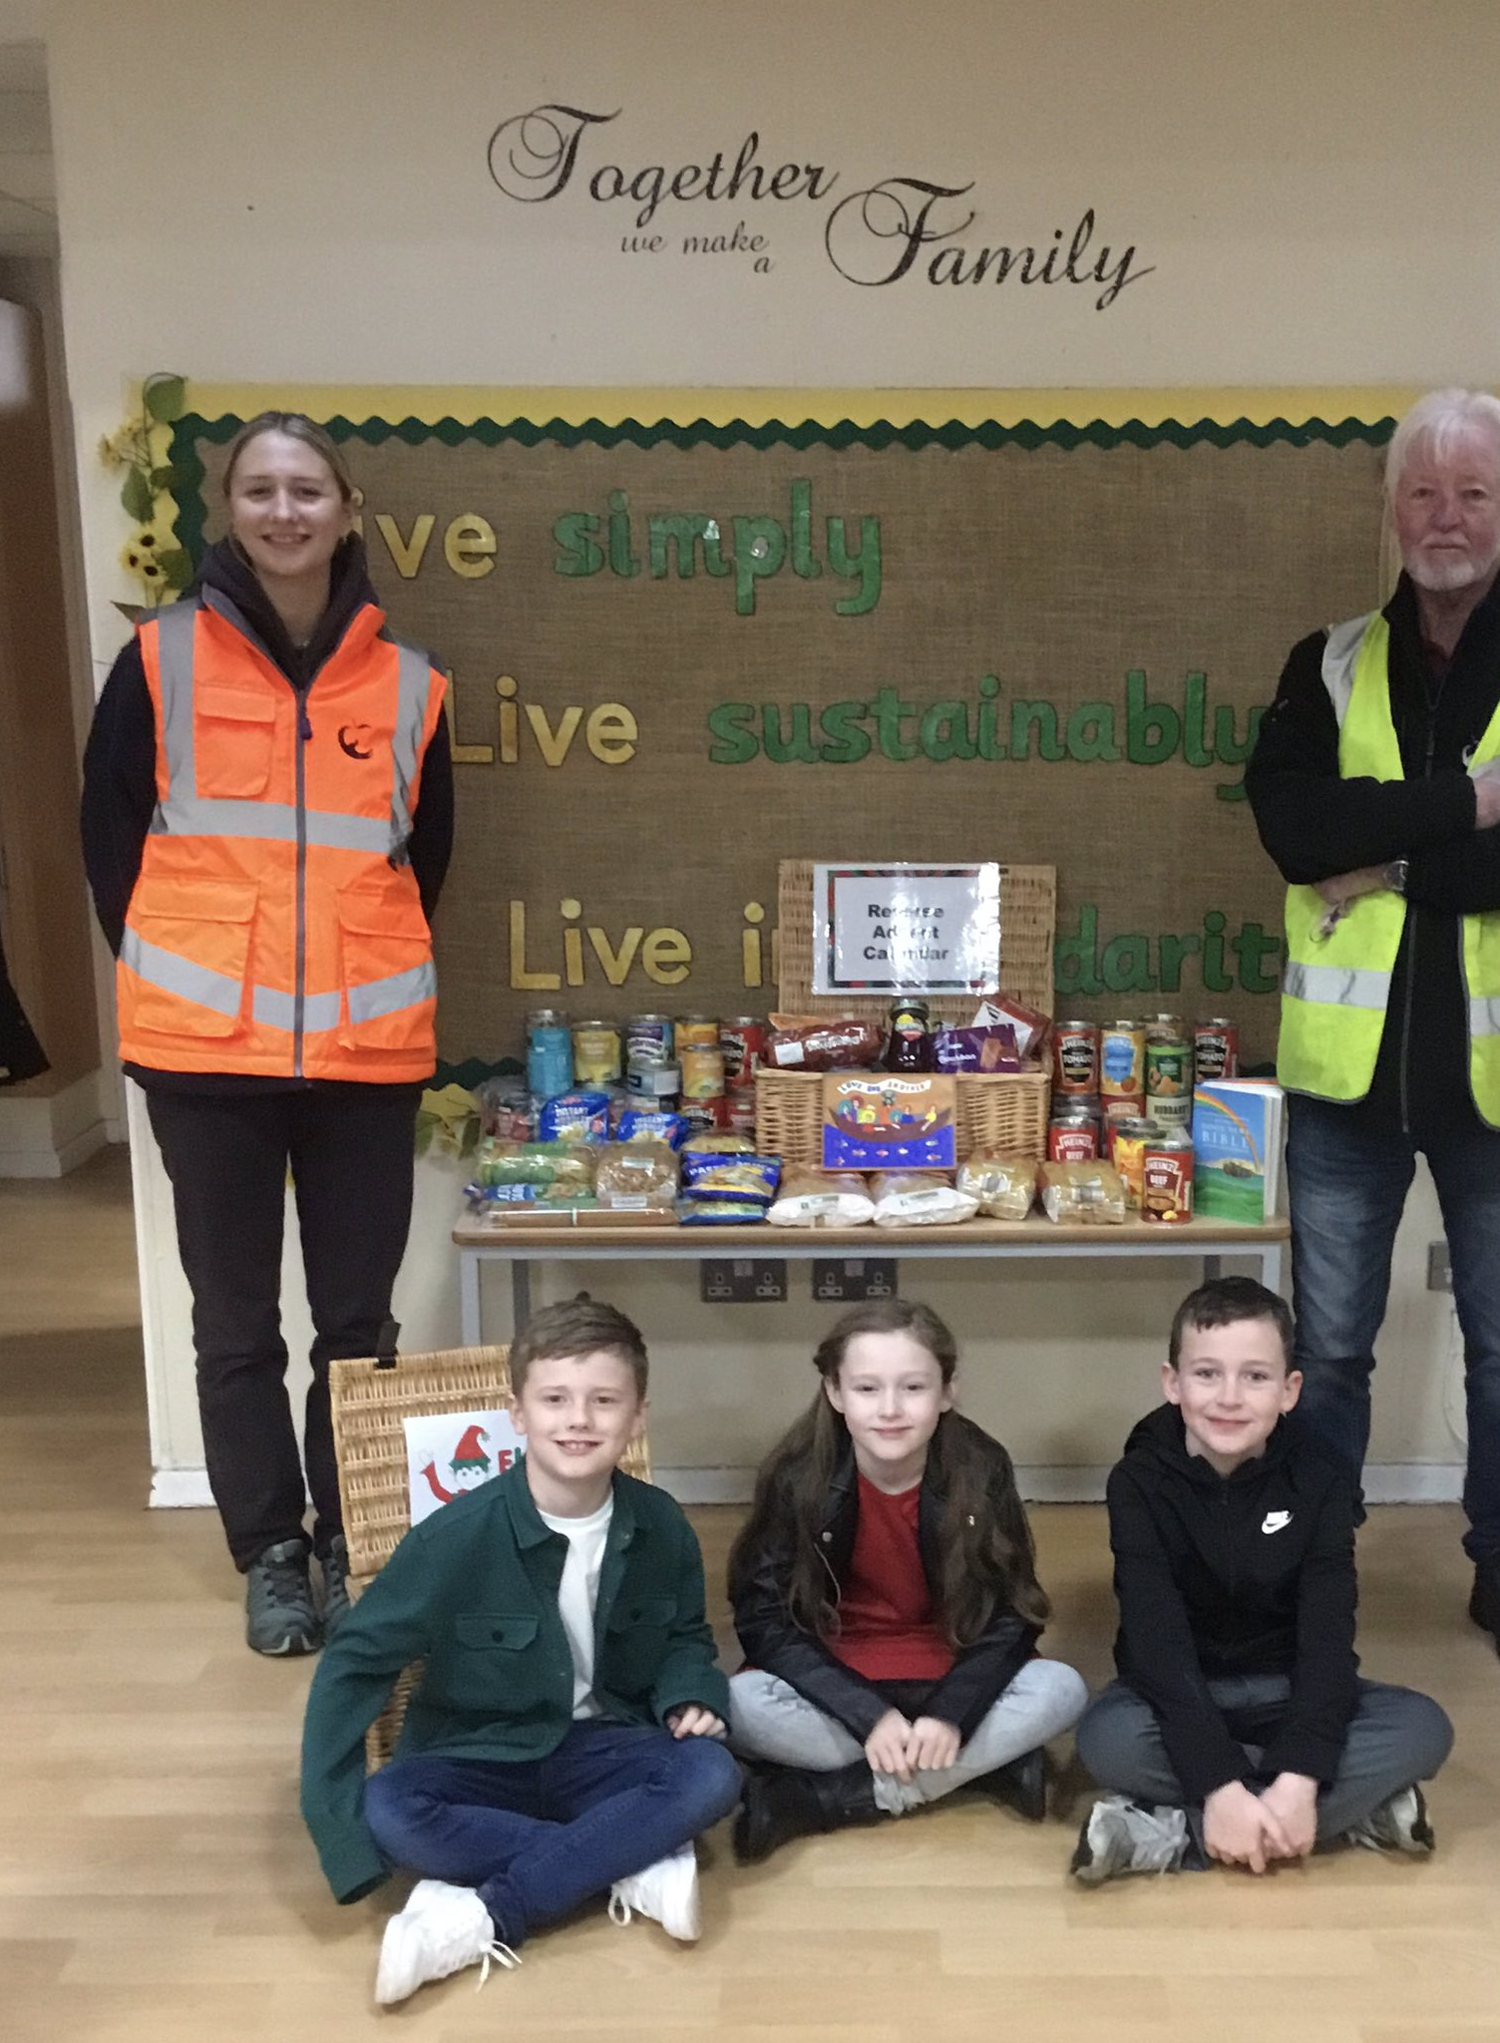
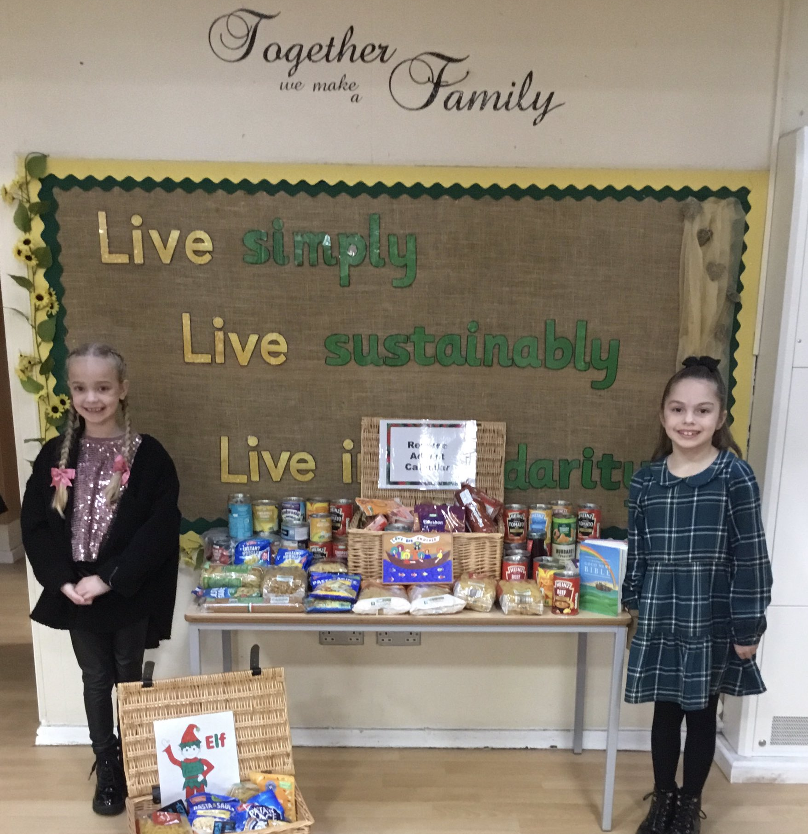
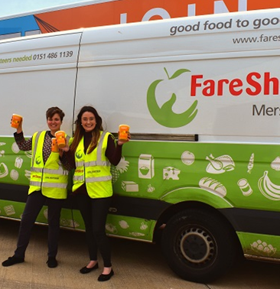
A big thankyou to all our parents from Fare Share, for your donations for our ‘Reverse Advent Calendar.’ It was lovely to see Evie again.

Slide 11
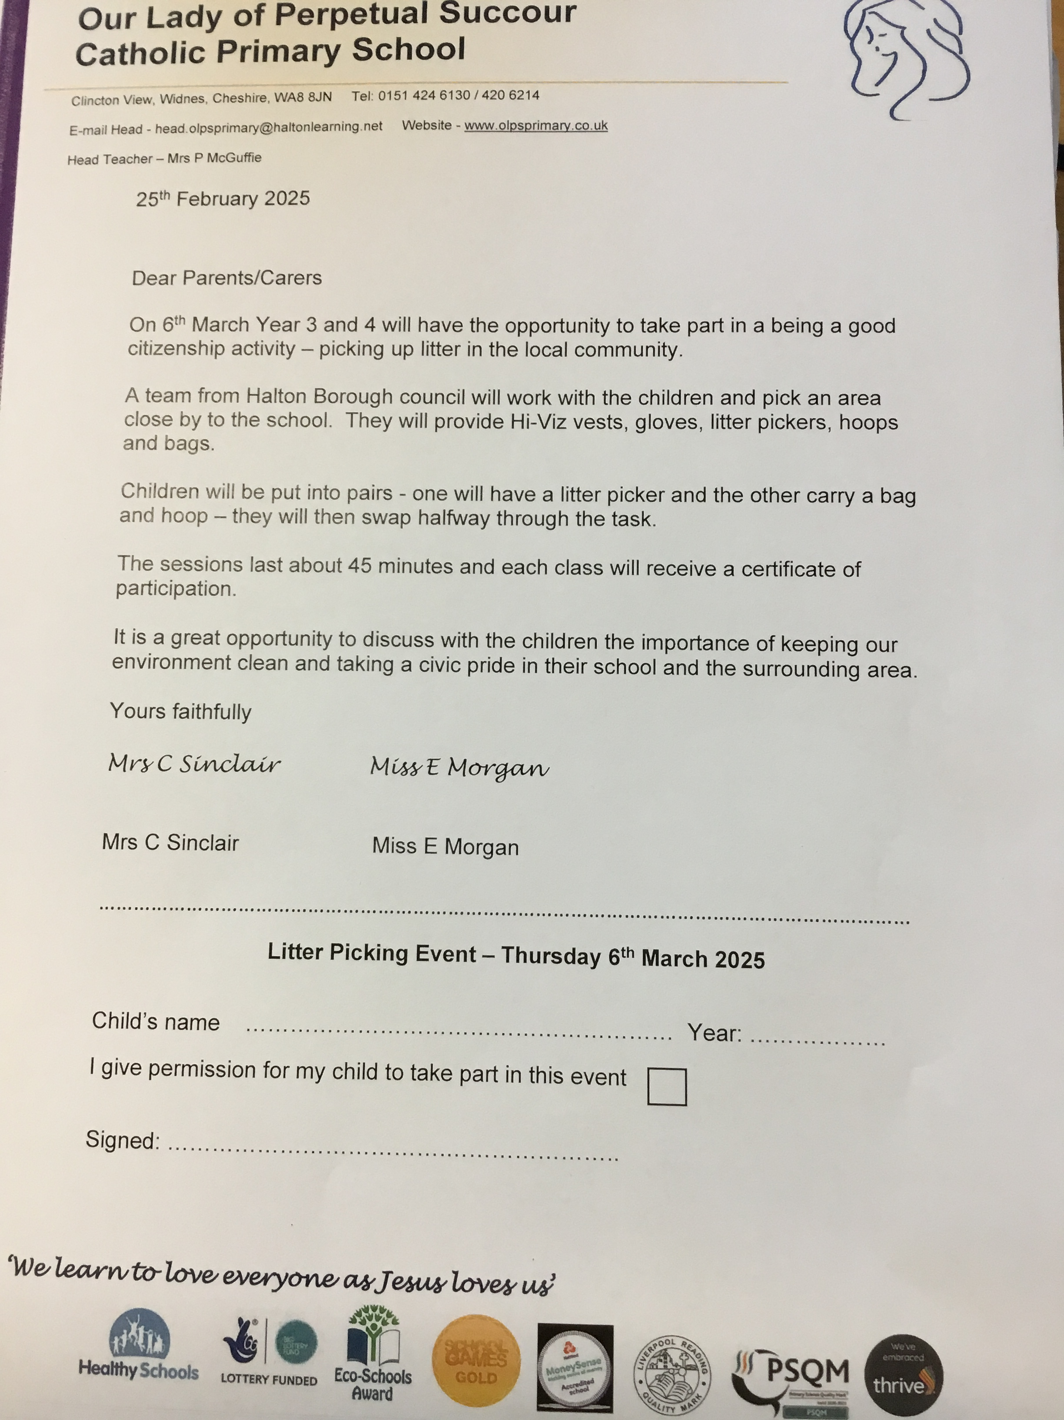
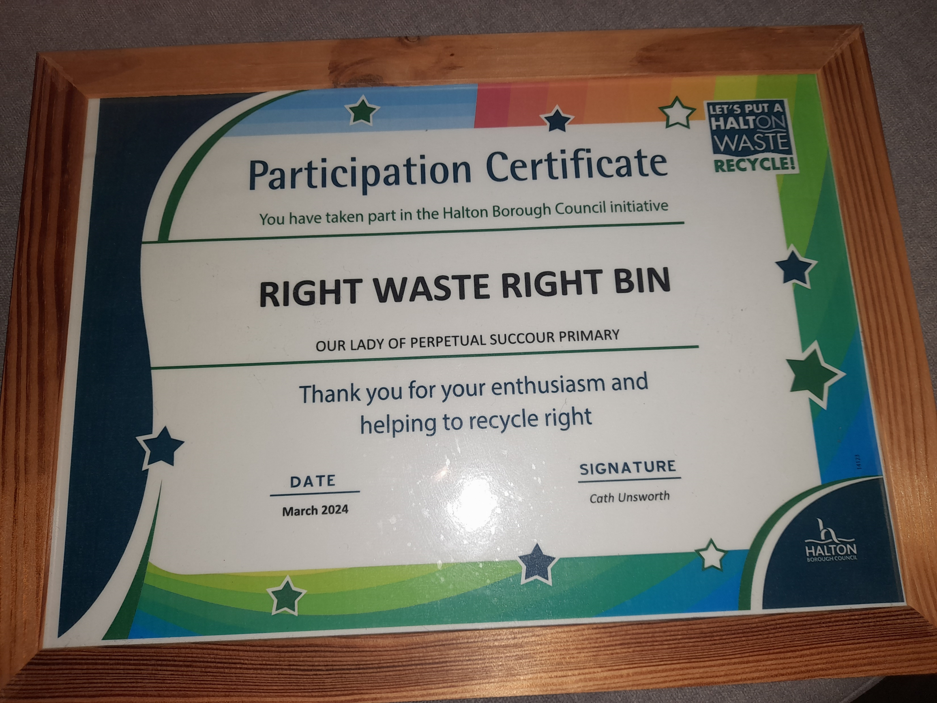
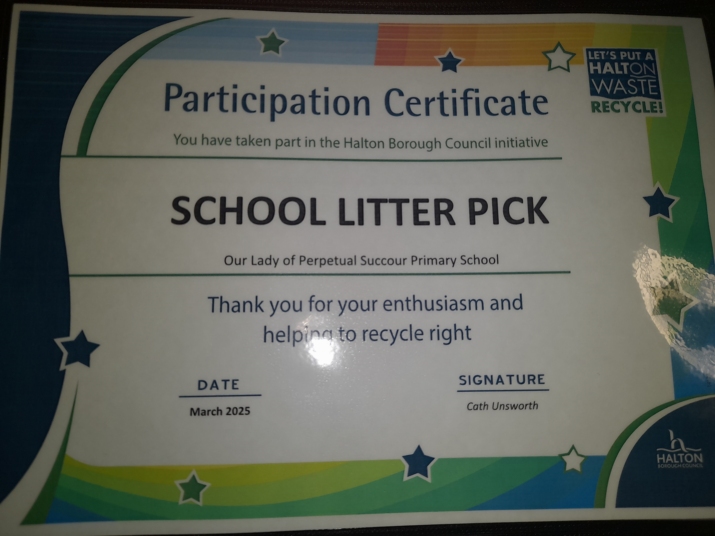
Evidence for action 5 – Litter Picking
Children recognise that our Earth is special, and that God needs us to look after it and protect it.

Slide 12
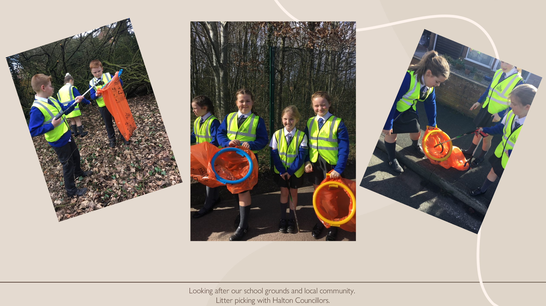
We began our Litter Picking with a prayer to remind us why we are taking this action.

Slide 13
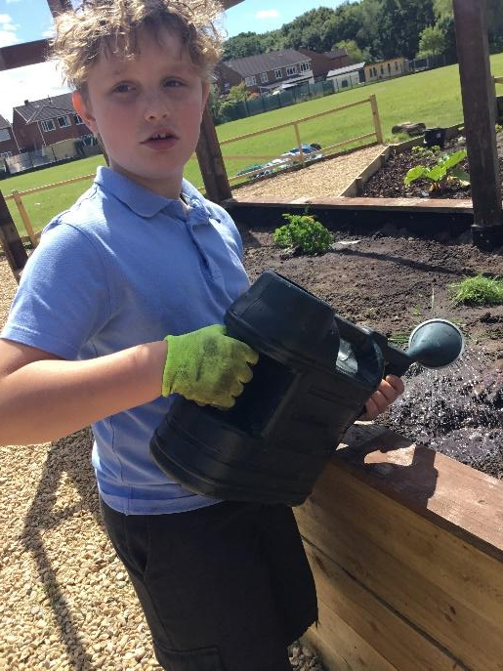
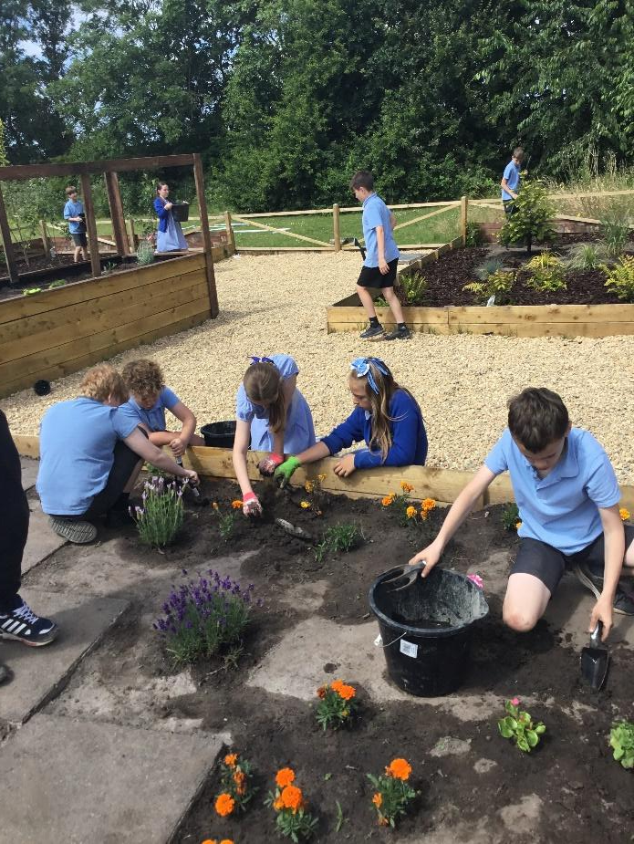
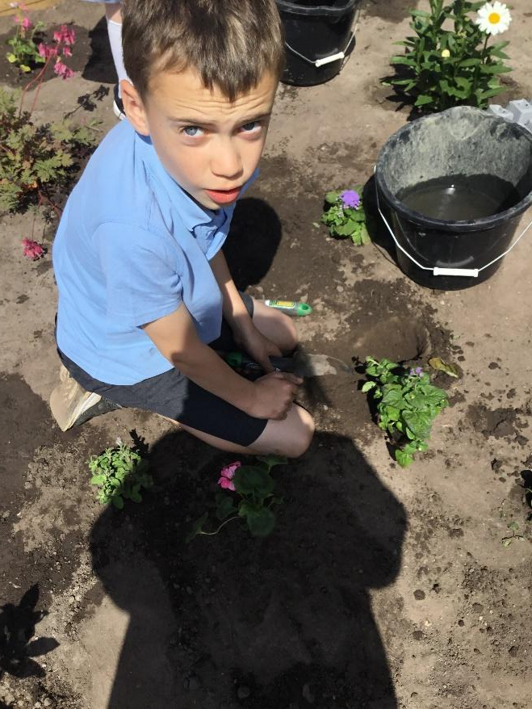
Evidence for action 6 – Allotment in our Prayer garden
The children loved learning about nature in their own school. They brought nature into their Collective Worship.

Slide 14
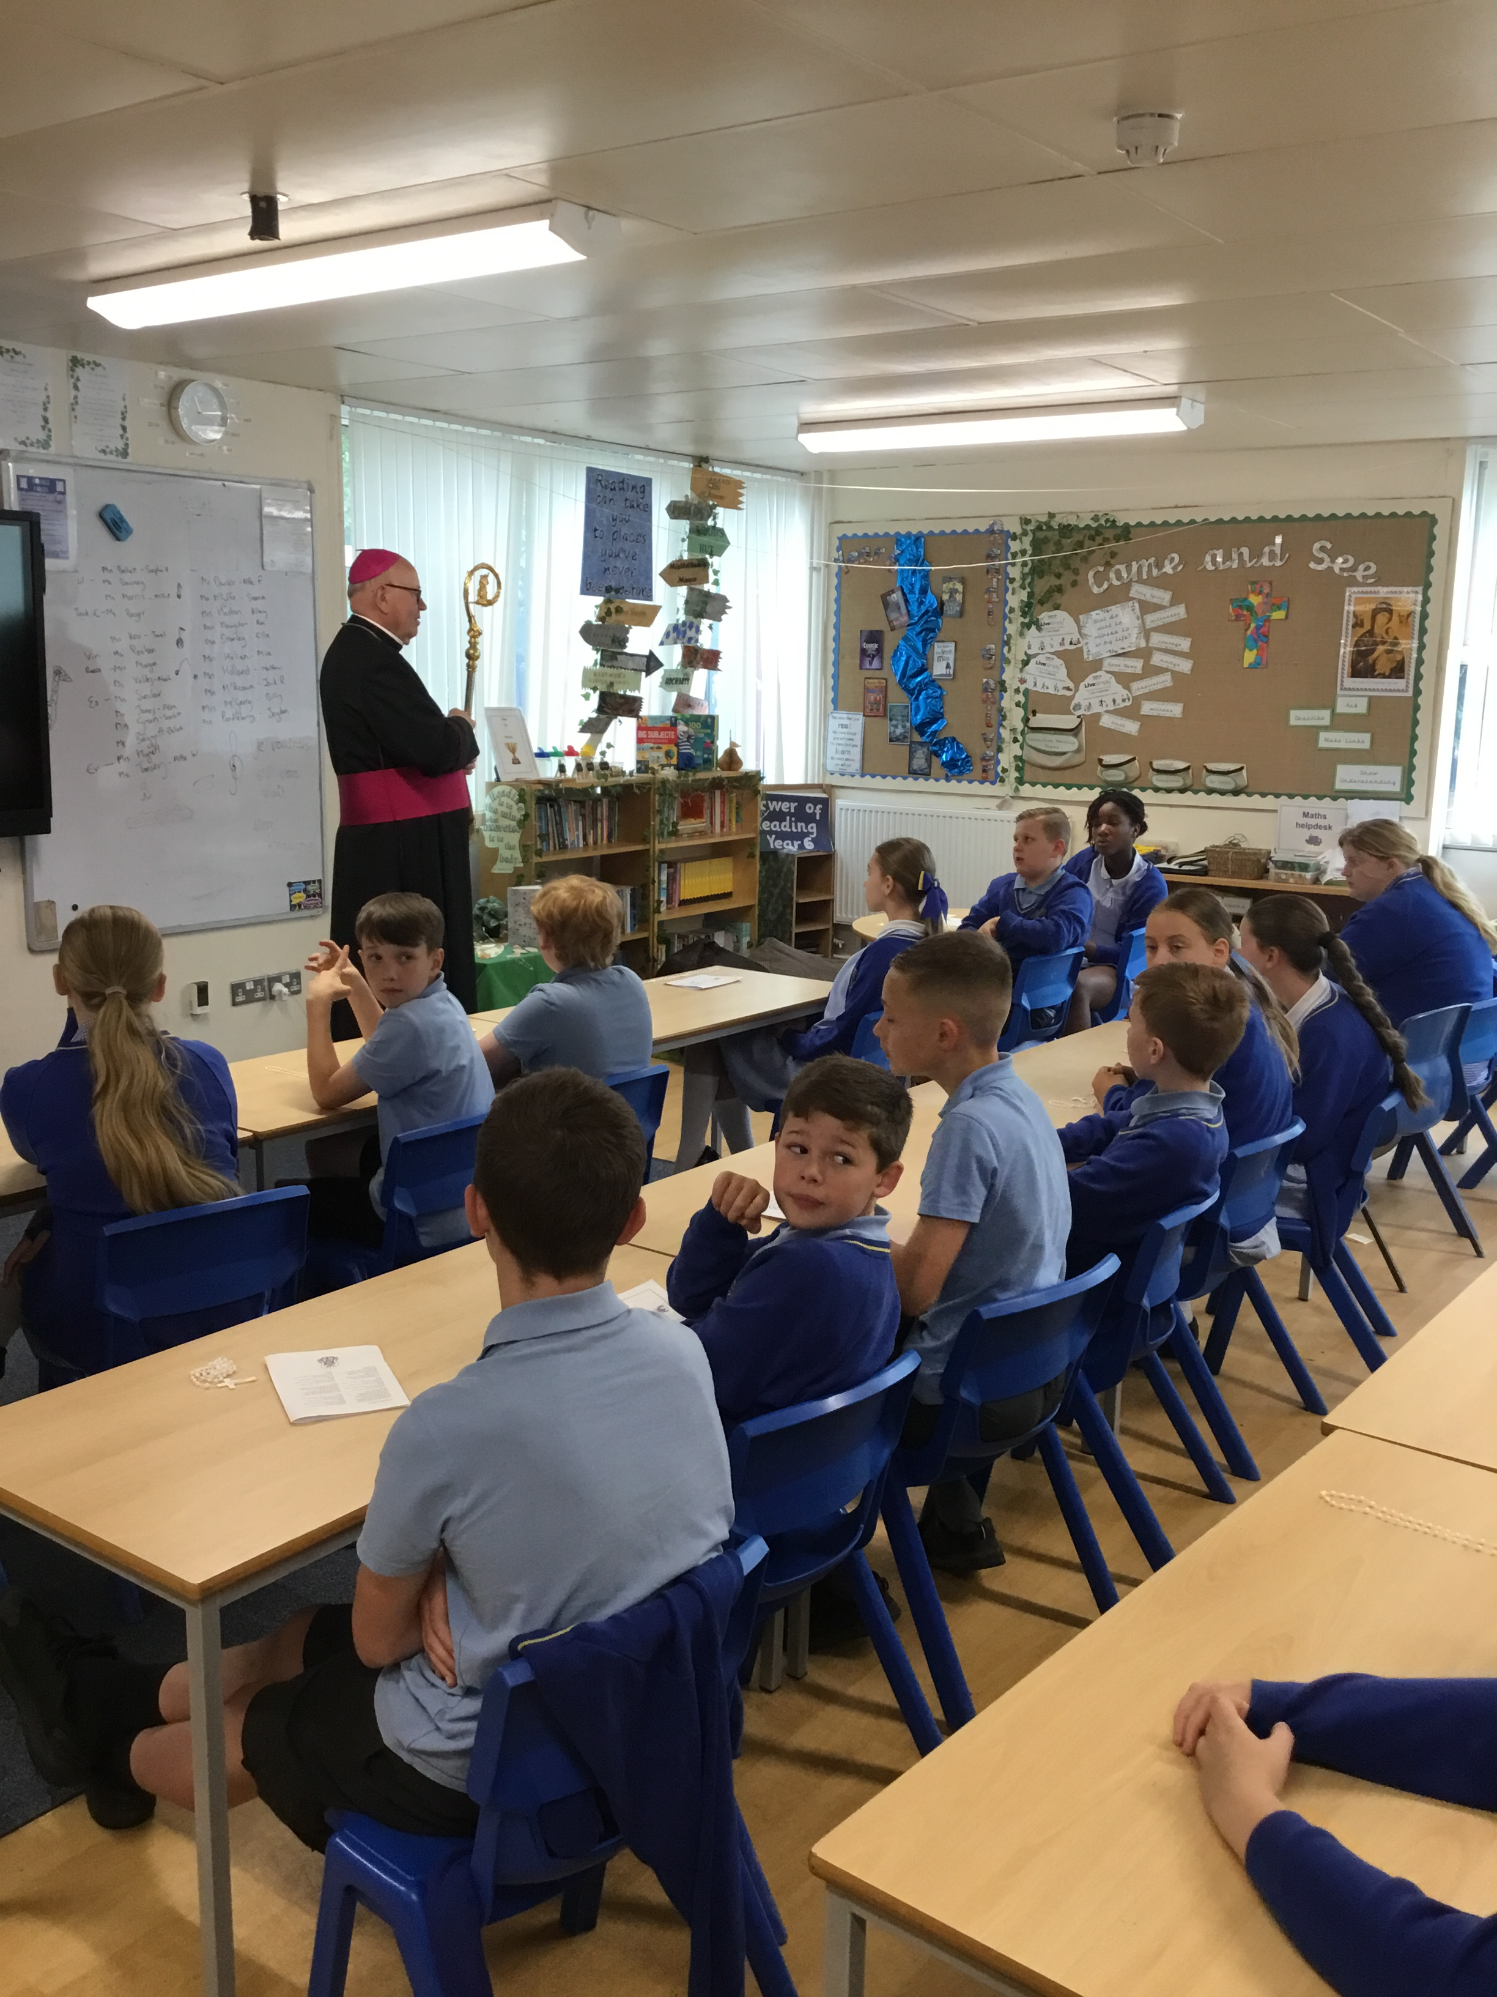
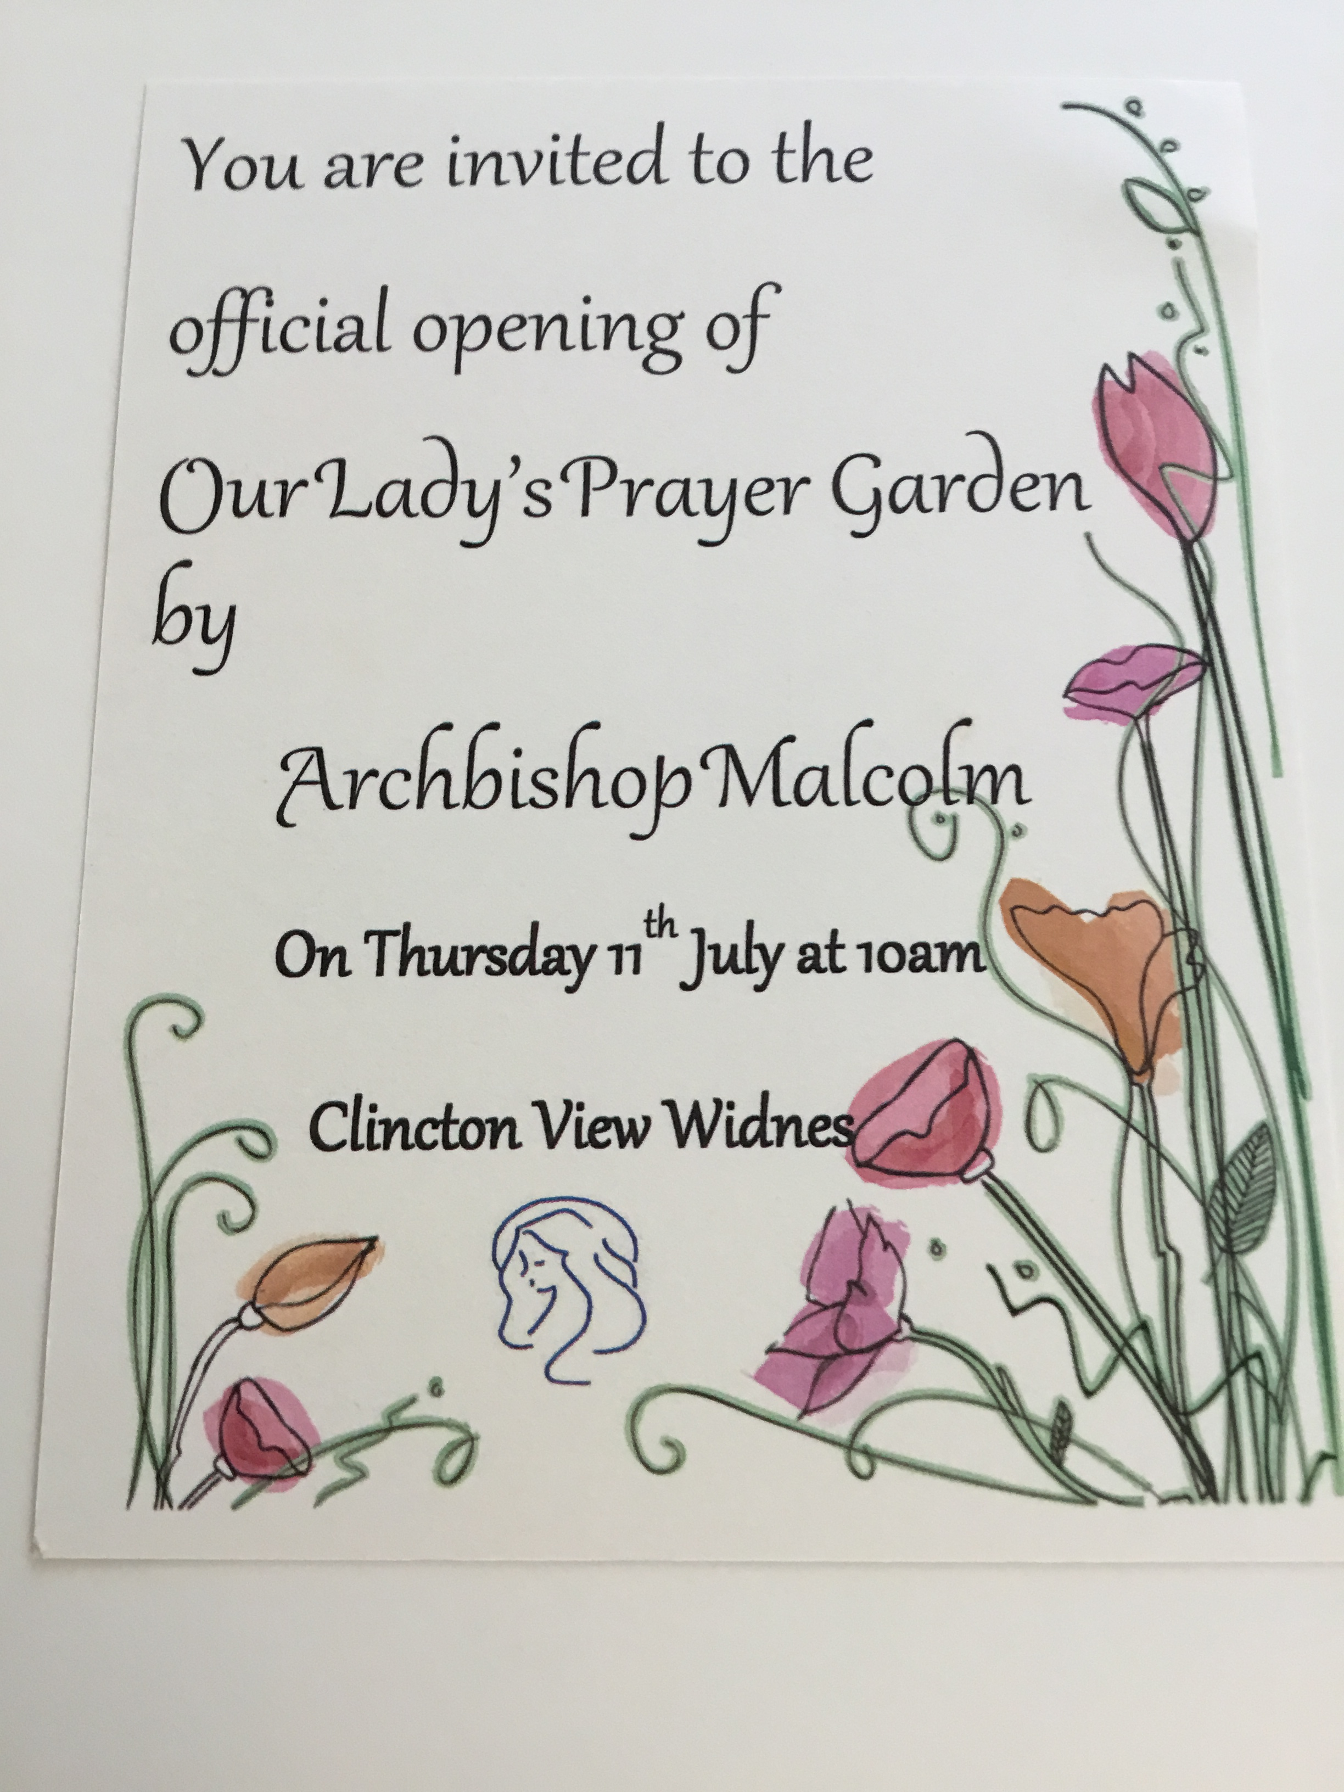
Be glad, earth and sky! Roar, sea and every creature in you; be glad field and everything in you! The trees in the woods will shout for joy. Psalm 96 11-12

Slide 15
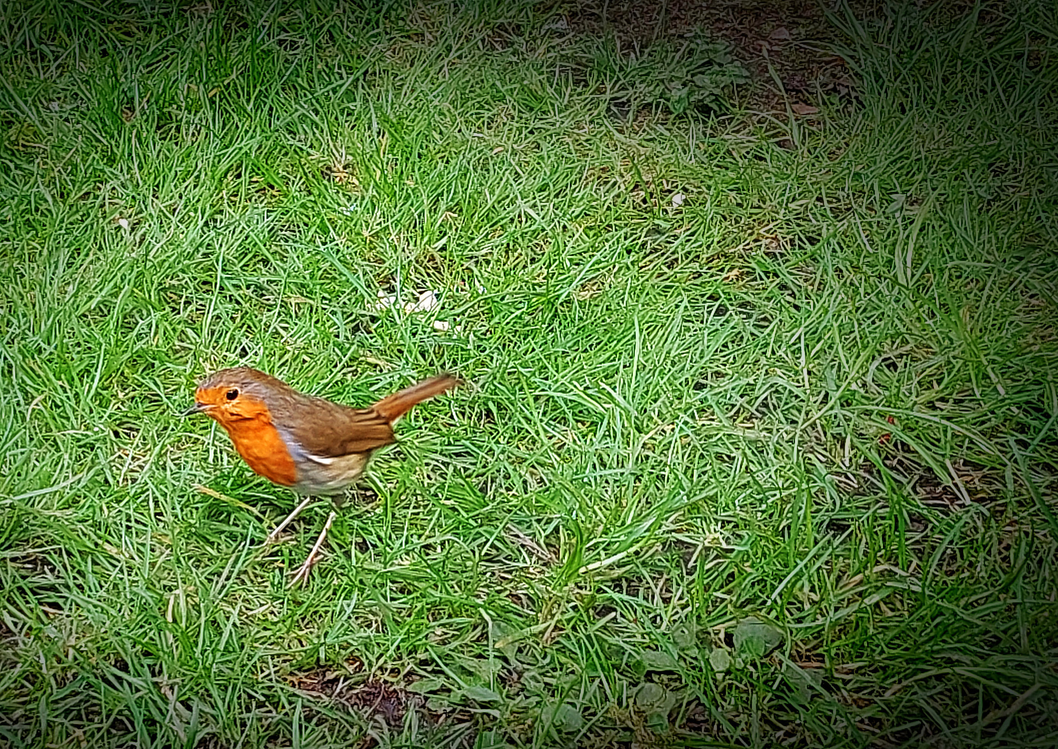
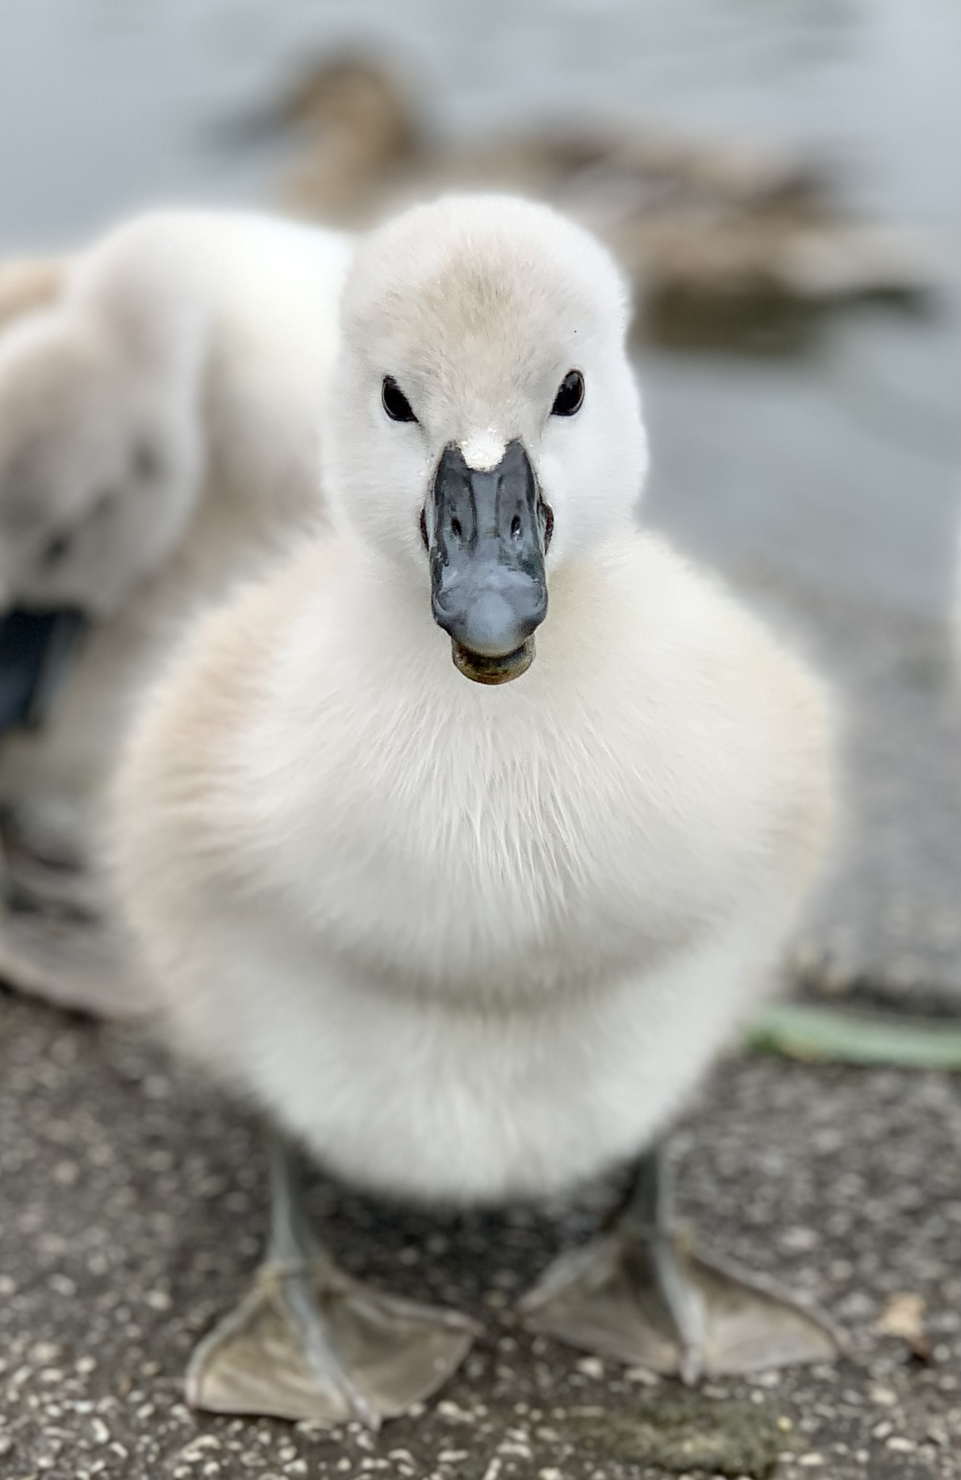
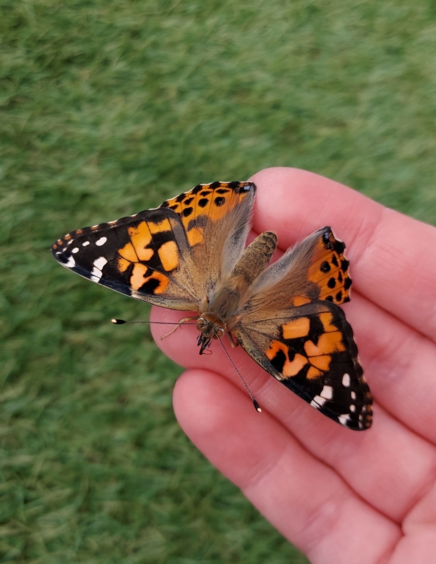
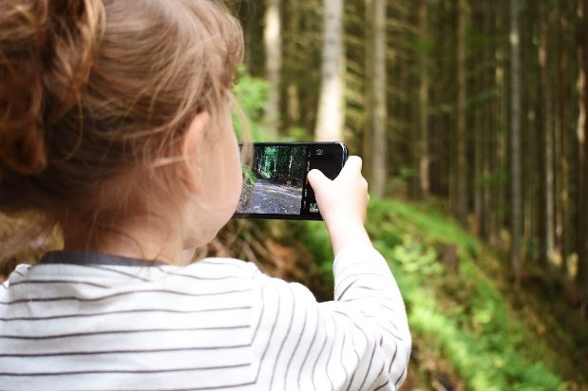
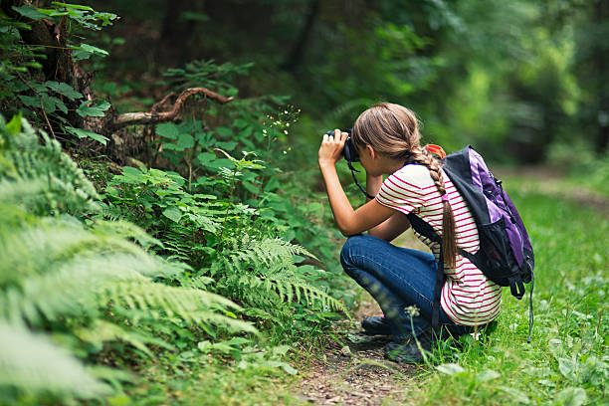
Evidence for action 8 – our school photography competition.
God’s wonderful world.
Some of the amazing entries:
Dear Parents/Carers.
As we work together to achieve our Live Simply Award with CAFOD we have thought about the ways that the children can look at the wonder of the world around them and decided that one of our actions could be is to launch a photography competition.
Most of the children have either their own phone, or could use their parents, to photograph something in God’s wonderful world that they see, perhaps when they visit the local park or go to the woods or even just when they are playing in their own garden.
Inspired by scripture, these photographs can then be shared with their teacher using the school website email system that all children can access. See attached information as a reminder.
The entries can then be printed and displayed for all the children in the school to see and we will hold an exhibition in our school hall so that the whole school community can see the entries and vote for our winners and 2 runners up.
We look forward to receiving some wonderful photographs for us all to share with our school community.
Yours sincerely
Mrs A Heston
And amazement seized them all, and they glorified God and were filled with awe, saying,
“We have seen extraordinary things today.” Luke: 5:26

Slide 16
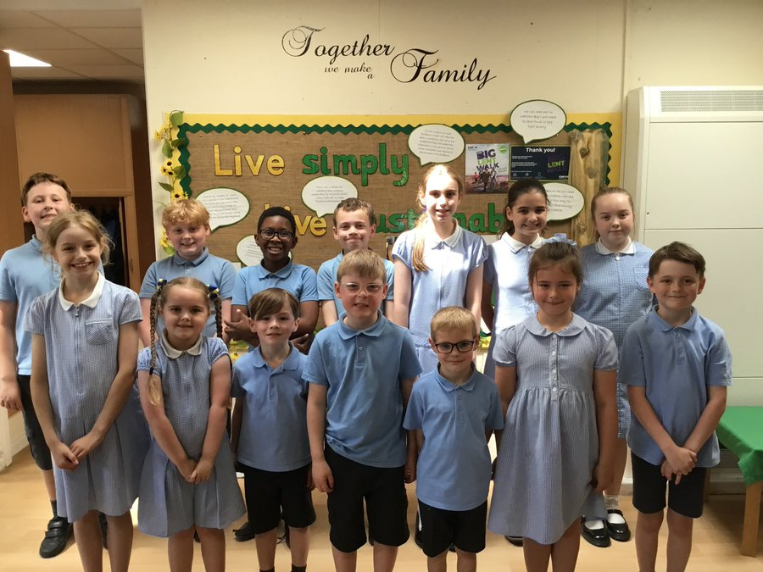
Live Simply Photography Competition.
Thank you to all the children who entered our Live Simply Photography competition. The pictures were beautiful! They are displayed around the Live Simply Display in the school hall and are so inspiring! They are also on our school website. Nature truly is a wonder!
We hope our winners enjoy spending their gift vouchers – well done!

Slide 17
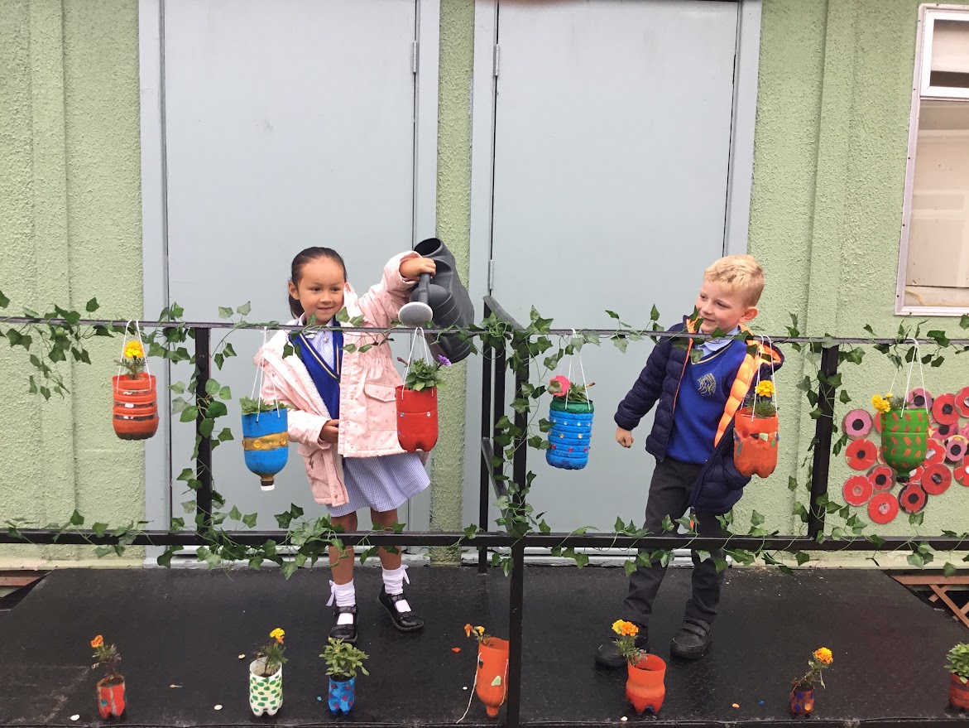
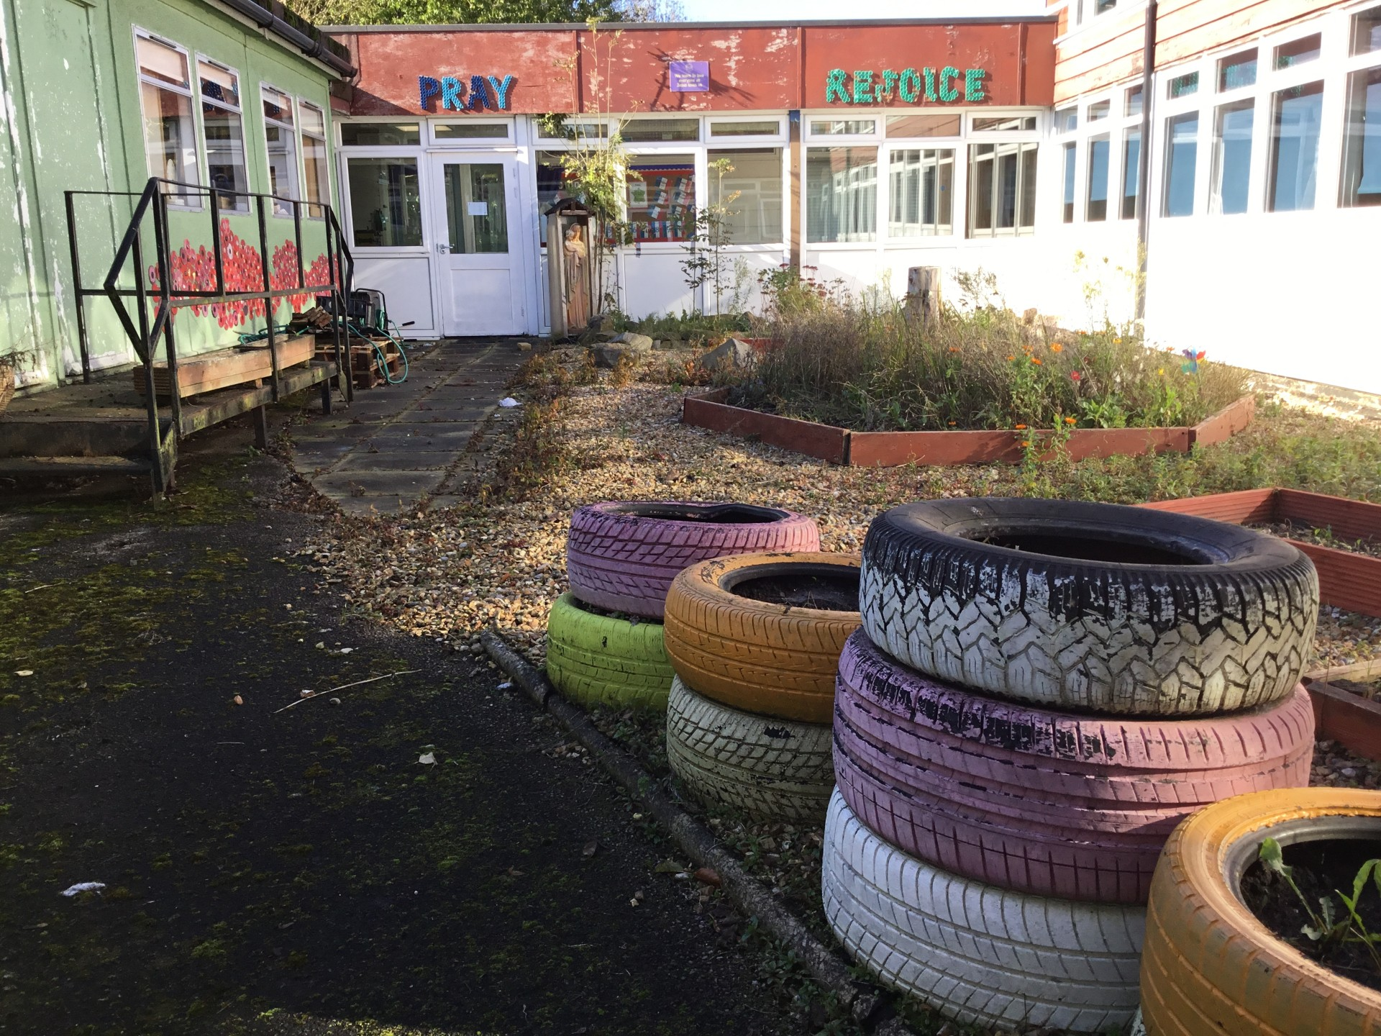
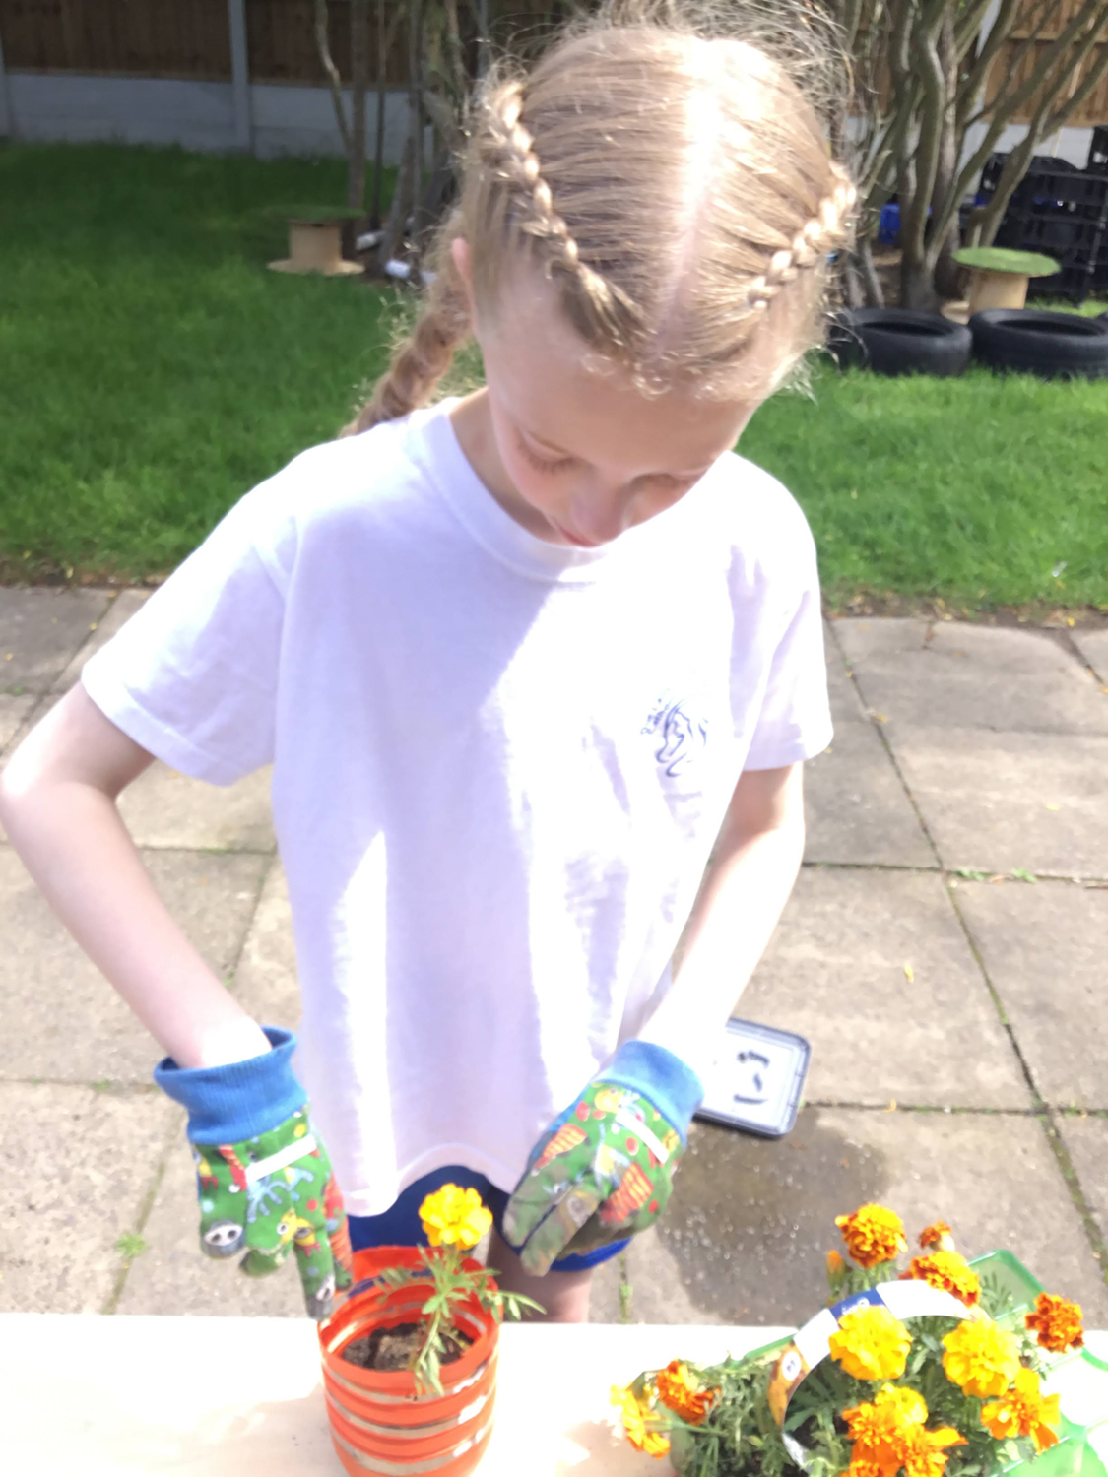
Evidence for action 9 – our wellbeing garden
It was like this: And now…..

Slide 18
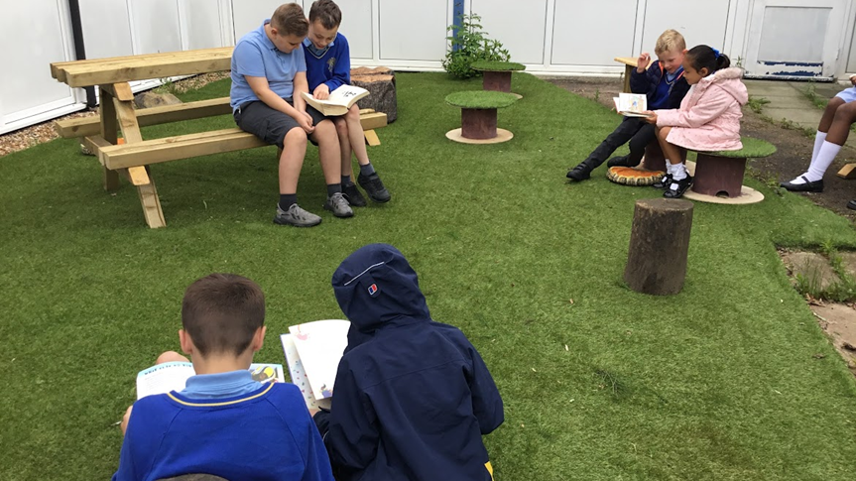
‘The Earth is the Lord’s and all that is in it, the world and those who live in it.’ Psalm 24:1

Slide 19
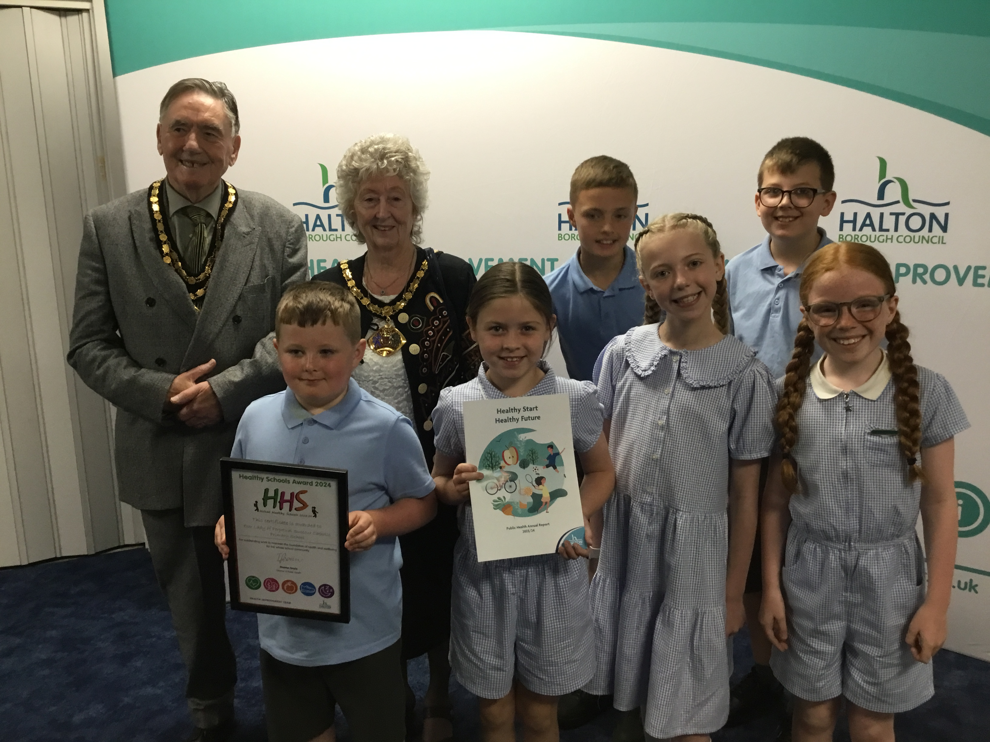
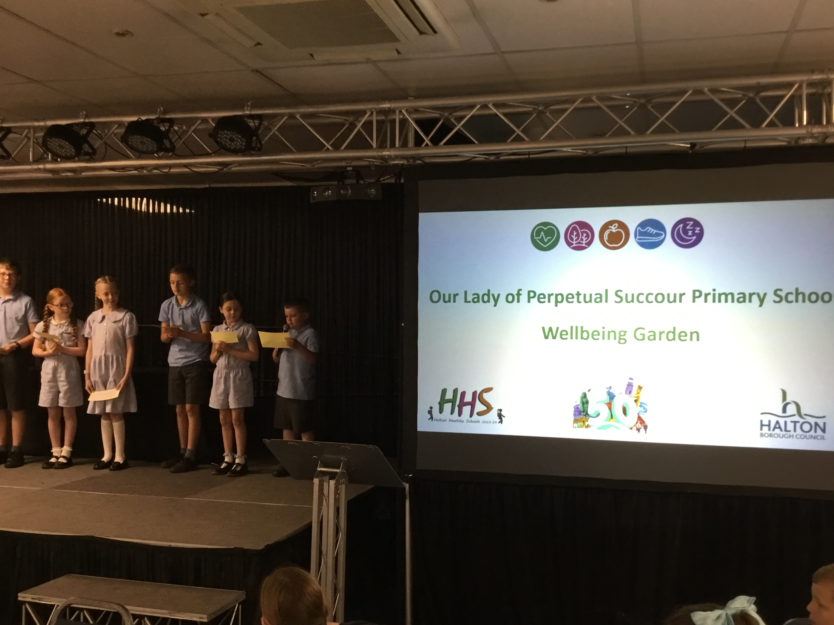
Our wellbeing ambassadors delivered a presentation to Halton Borough Council outlining all that we had done to recycle and reuse - making furniture, plastic bottle plant holders and so much more! We were so proud of them!

Slide 20
Quotes from parents/pupils/staff
“How great that the children got to take part in a photography competition! We all have phones so it was something that we could do with ease! My child loved looking for potential photo opportunities and took so many before deciding on his entry! It made us all look at the beauty all around us!” Year 6 parent.
“Thank you to all the children and their families for their kind donations to Fare Share! It really makes a difference to so many people’s lives who live close by!” Evie - Fare Share Employee.
“I loved presenting to other schools, the Mayor and the Health Improvement Team. It was great to tell them all about our Prayer and Wellbeing Garden here at school. I felt very proud!”
Luna Year 6
“Thanks to the wonderful staff at Our Lady’s – I loved the CAFOD coffee morning. It was great to see so many together chatting and supporting such a great charity!” Grandparents of a Year 4 child.
“It was good helping to plan the prayer/wellbeing garden. It was fun working with Naveah and painting the reels that became seats for us all to use.” Deacon Year 4.

