Slide 1
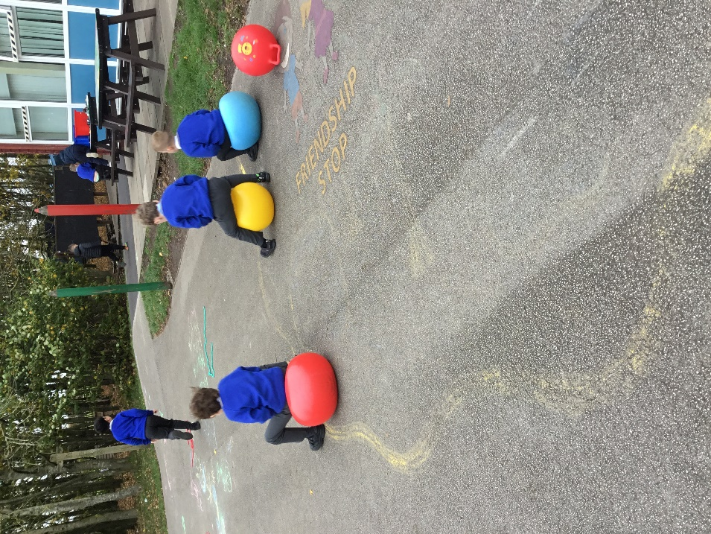
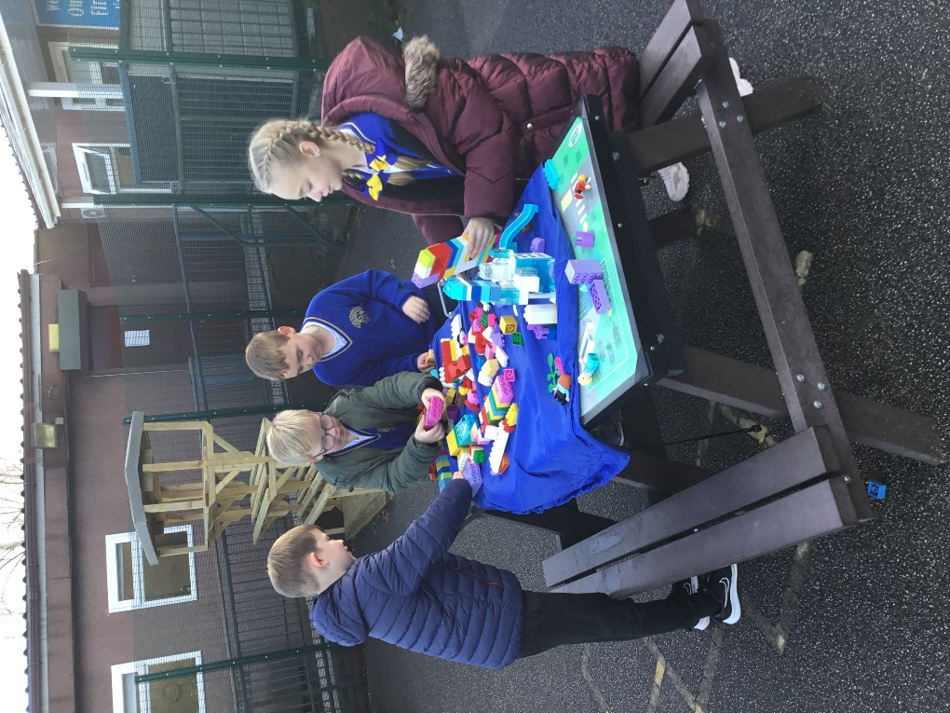
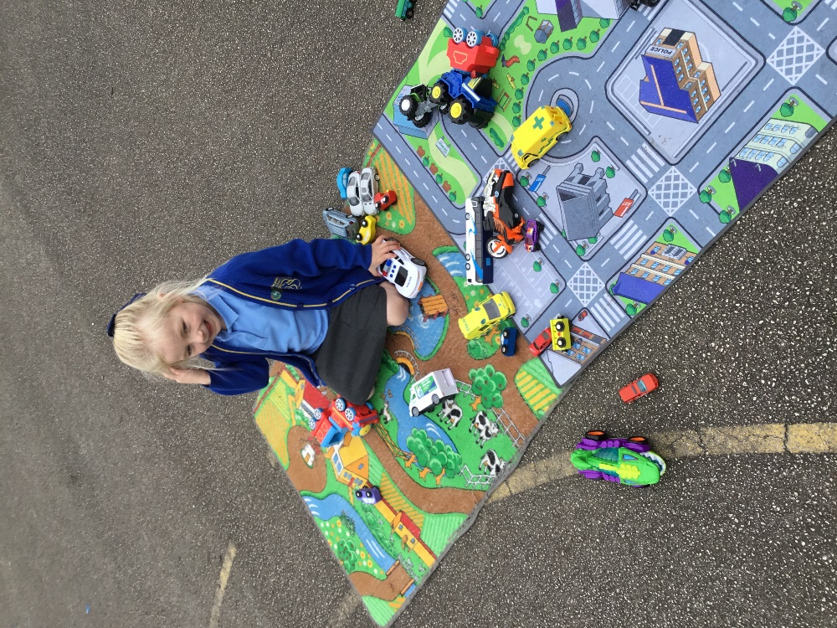


OPAL Play
Assembly

Slide 2
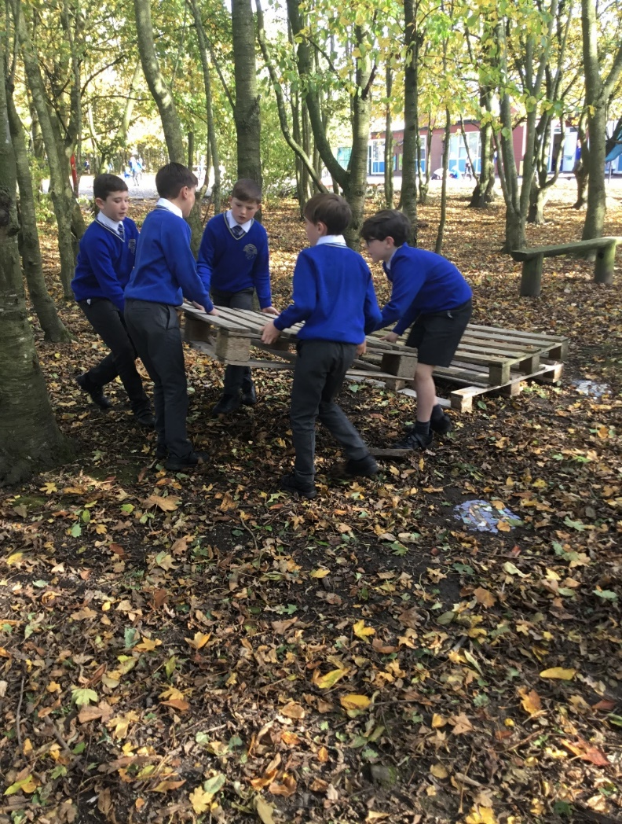
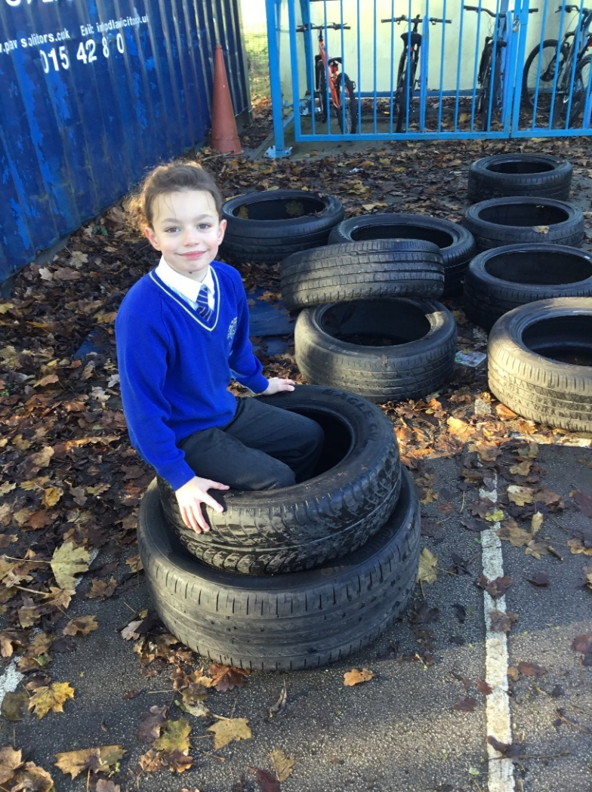

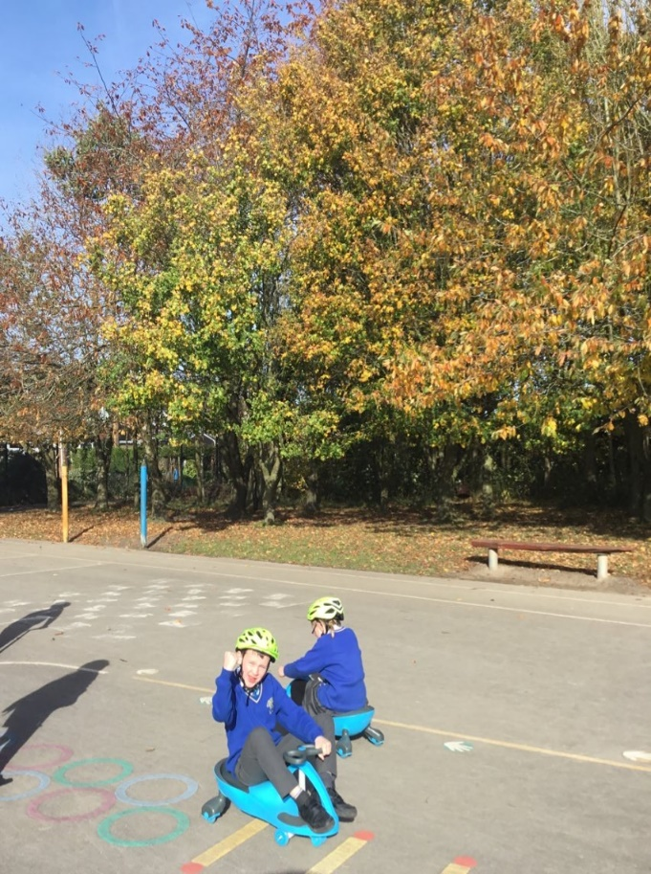
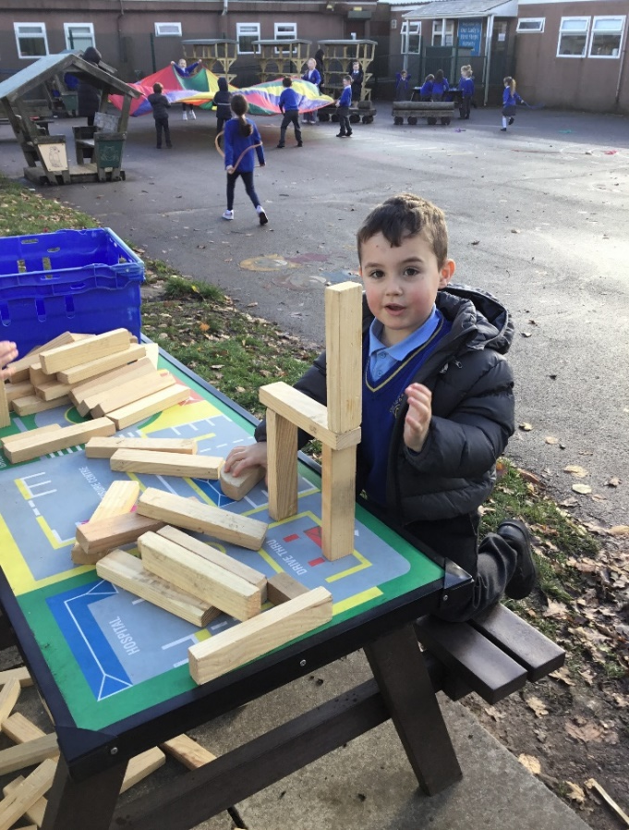
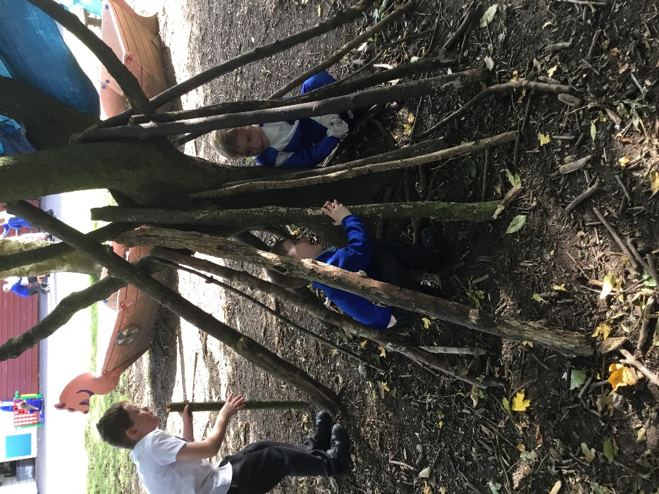
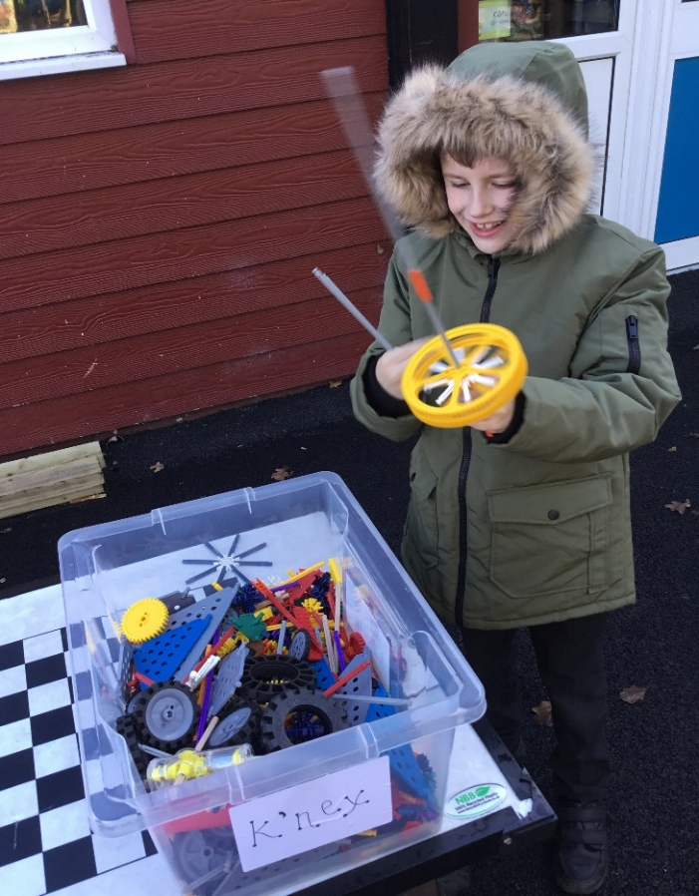
Celebrate
Amazing examples
of play

Slide 3
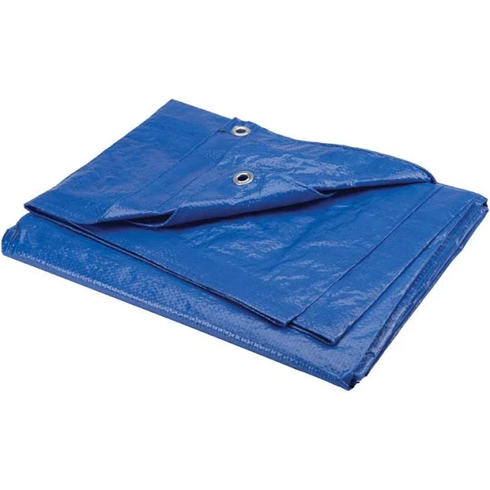
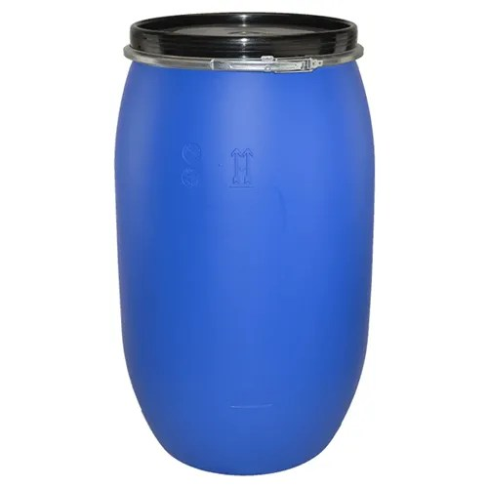
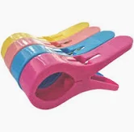
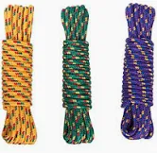
Inform
What will be new over next few weeks?
Tarpaulin
Plastic drum
Plastic pegs
Rope

Slide 4
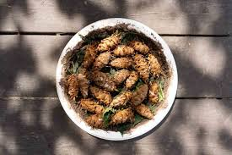
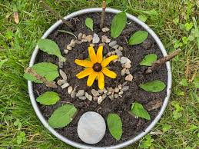
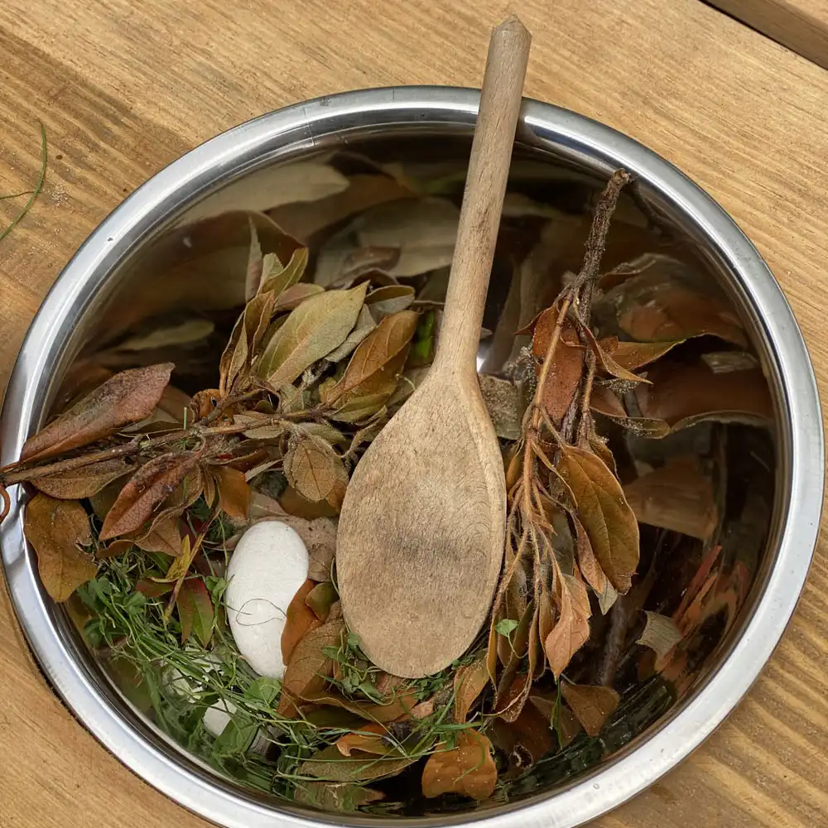
Inform
Our Mud Kitchen will open in the next week or two!
So.. Come along and cook up a feast!
Make a mud pie, pine cone stew or a leaf salad
Its located in the woods at the back near the fence
You need wellies to use the woods and mud kitchen

Slide 5
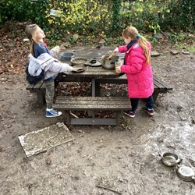
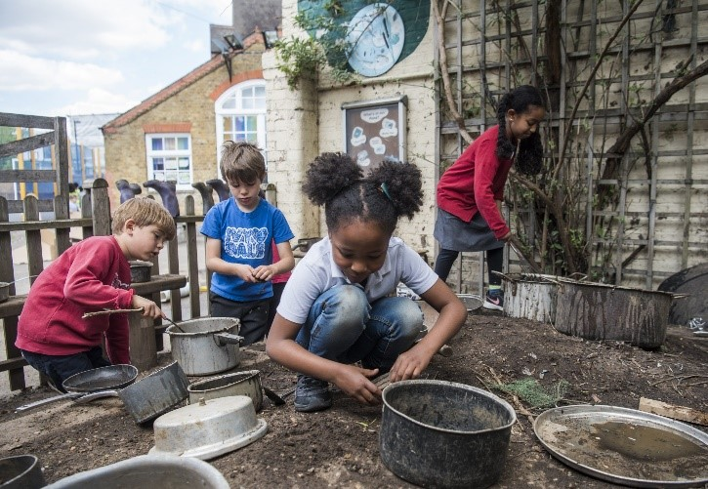
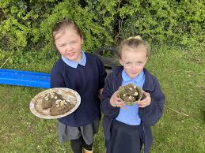
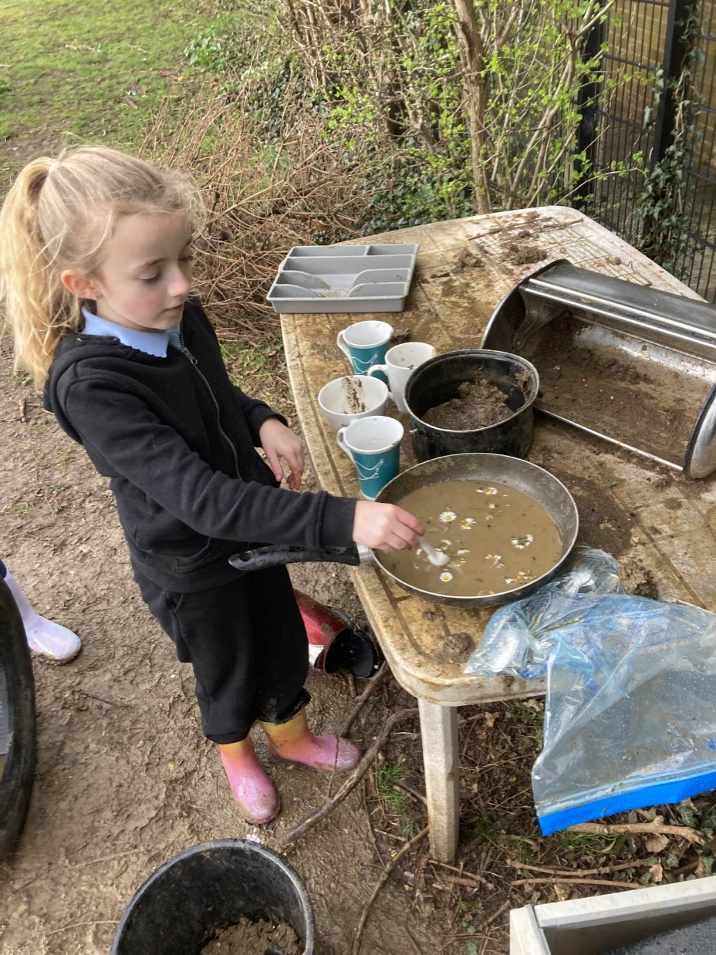
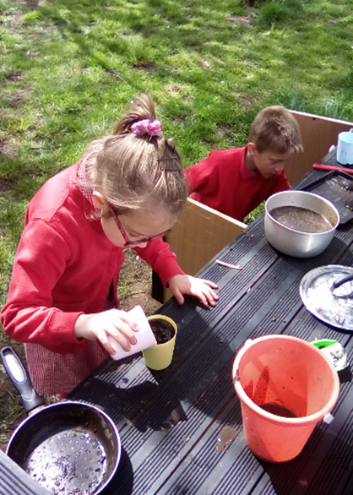
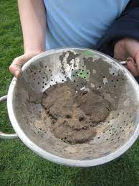
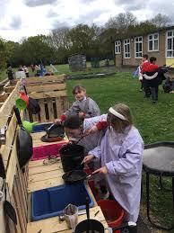

Slide 6

Negotiate
What new rules do we need for
our existing and new activities
and equipment?

Slide 7
Plastic drums
Roll them to a partner
Roll over them with care (in the woods not on concrete)
Use them to make dens
Don’t push another child over them
Make sure when rolling nobody's fingers are underneath
Don’t get inside

Slide 8
Wheeled areas
Be aware of speed and crashing into others on the wiggle bikes and scooters.
Always follow one way system.
Take care when taking off helmets please back in the box or give to another child. Please don't just drop them on the floor.
Be aware of the rapping fingers trap on wheeled boards.
Always wear a helmet.

Slide 9
Den building
Use branches, sticks, tarpaulin, rope, crates plastic drums and material to build dens
Only with the help of an adult can pallets can be stacked to build a den.
Be considerate of others space
Please don’t destroy other children's dens unless they are finished
Allow others to join in
Ask before making changes to another child's dens

Slide 10
Innovate
Thank you to the play rangers who are doing a great job helping to tidy away the equipment at the end of lunchtime.
Use equipment correctly and respect the equipment- please don’t kick space hoppers.
If your looking for a dressing up costume and costumes fall on the floor. Please pick them up to stop them being stood on and getting muddy

