Slide 1
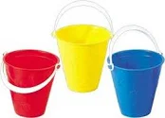

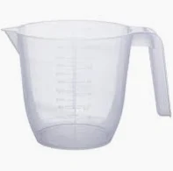

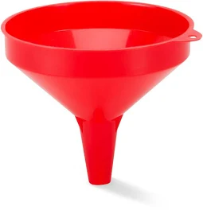

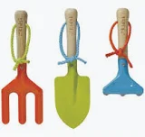
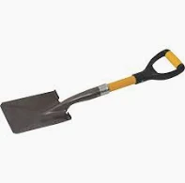

Slide 2
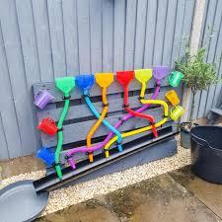
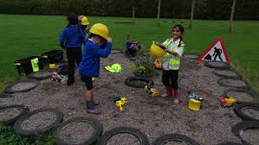
Starting today
Monday 19th January
We will be collecting resources for two new upcoming zones, a Water Zone and a Digging Zone that will be introduced in the coming weeks and for our existing zones too.

Slide 3
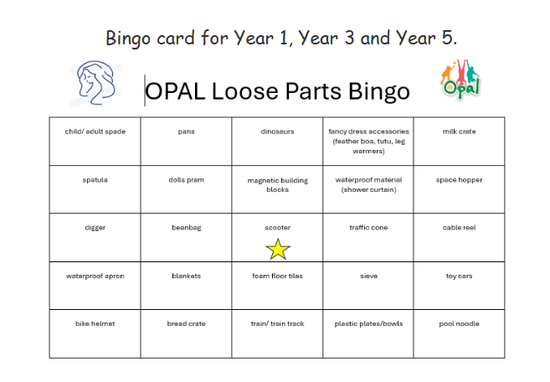
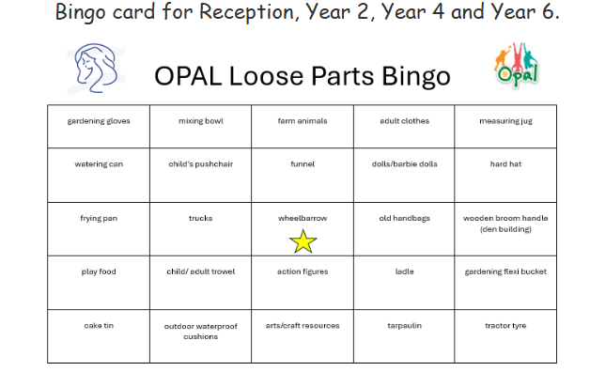
Each class will work as a team to collect items on the bingo board.
Below are the class bingo cards.

Slide 4
OPAL Bingo Challenge
To win this challenge:
Working as a class, collect all the items on your bingo card
.
1 line- 5 in a row- 10 minutes OPAL playtime
2 lines- 10 in a row- 15 minutes OPAL playtime
Full house- 30 minutes OPAL playtime
Bonus- If you collect the stared item your class will get a 20-minute OPAL playtime

