Slide 1
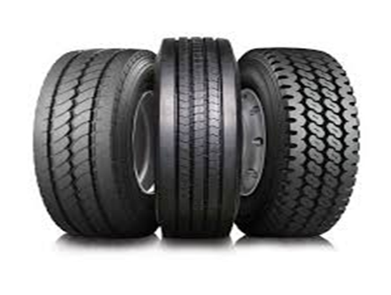
Tyres
Inform

Slide 2
Innovate- equipment
How can we use it?
How can we not use it?
Roll them, climb on them
Play hopscotch
Make an obstacle course
Don’t try to carry tyres or pick up the tractor tyres
Don’t roll them into your friends
Don’t roll tyres near the wheeled zones

Slide 3

Negotiate
Tyres
Safe stacking no higher than your waist
Look before you roll
Don’t try to carry the tyres
Don’t roll tyres into your friends.
What rules do we need when with tyres?

