Slide 2
When does it happen?
Phonics takes place in Nursery, Reception, Year 1 and part of Year 2.
In Reception a Phonics lesson will be between 20-30 minutes every day. Split into 2 groups.
At the end of Year 1 there is a Phonics screening check which is a Phonics test which the children need to pass. If they don’t pass it they have to repeat it in Year 2.

Slide 3
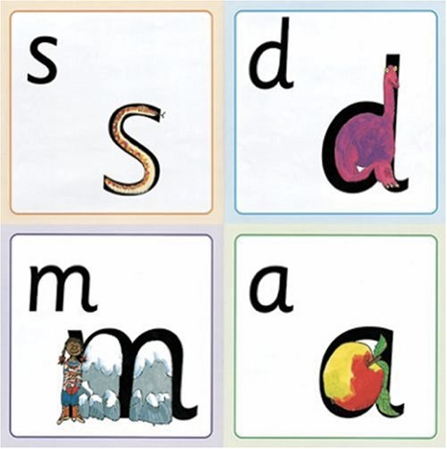
Name the pictures

Slide 4
Teaching letter formation

Slide 5
Teaching sounds
The first thing we teach children is the correct pronunciation of sounds. This prevents children from reading and writing words incorrectly.
We don’t use letter names.
We call these sounds ‘pure’ sounds.
These need to be pronounced correctly to avoid the children spelling words incorrectly e.g. children may incorrectly write words as ‘fuh’ instead of ‘f’.

Slide 6
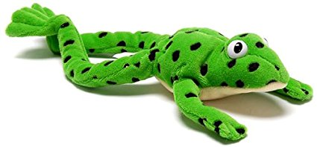
Reading with Fred Talk (Segmenting and blending)

Slide 7
‘Special Friends’, ‘Fred Talk’, read the word

Slide 8
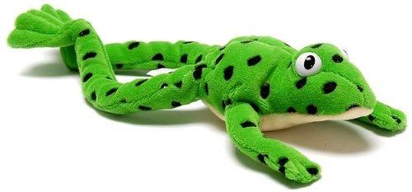
Fred games and Fred talk throughout the day
l
-u
?
Shall we have some
What would you like to
Let’s put on your
-ch
-n
-ay
-l
p
?
-oa
-t
c
.

Slide 9
Nonsense words

Slide 10
Red Words

Slide 11
Key Phrases
Green Words – words that can be sounded out using our phonics
Red Words – words that cannot be sounded out e.g. I, said, was
Fred Talk – (Fred is the frog) he can only talk in sounds e.g. sh-o-p

Slide 12
Lesson
Lesson
structure

Slide 13
Reading records

Slide 14
What can you do?
Listen to your child read the same Storybook again and again
Encourage them to use ’Special Friends’, ‘Fred Talk’, ‘read the word’
Discuss the story and encourage their storyteller voice.

Slide 15
Top tips
Short regular reading is much better than one long period.
Reading opportunities are everywhere- encourage your child to read labels, captions, signs, food packets, magazines and books etc.
Make reading enjoyable, children gain lots from listening to you read too.
Make time to discuss the story, these discussions form the basis of all comprehension skills.

Slide 16
Useful website

Slide 17
Any other questions
Q&A

