Slide 1
Our Lady of Perpetual Succour Catholic Primary School SINGAPORE MATHS
An introduction to Singapore Maths for Parents

Slide 2
Aims of the session:

Slide 3
Singapore Education
Setting the scene
Singapore hasn’t always had great Maths performance.
It was ranked 16th out of the 26 countries participating in the 1983 SIS study.
The government recognised this was not good enough for an economy entirely dependent on its human resources, so they started examining leading teaching concepts in the early 1980s.
Notes:
1980s Singapore changed it’s education system based on the Cockroft report (UK 1982) and an Agenda for Action US NCTM 1980s. It put a focus on comprehension and problem solving.

Slide 5
TIMSS Benchmark 2011
Grade 4 is the same age as UK Year 5
Since 1995 Singapore has been at the top of mathematics education
Notes:
make note of 94% in Intermediate or higher.

Slide 6
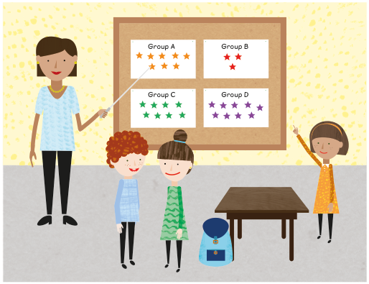
Core essentials of a lesson
1
Metacognition
Visualisation
Generalisation
Number Sense
Communication
2
3
4
5
Notes:
Discuss the points listed.
Introduce the concept of CPA approach
Extension -why can’t you make a rectangle that has the area of 5 squares

Slide 7
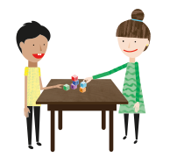
Working with pupils core competencies
Problem solving is at the heart of mathematics
The focus is not on rote procedures, rote memorisation or tedious calculation but on relational understanding.
Pupils are encouraged to solve problems working with their core competencies,
in particular:
1
Visualisation
2
Generalisation
3
Make decisions
Notes:
Practice always comes last, once ideas are clearly embedded.

Slide 8
How lessons are taught
Concepts merge from one chapter to the next. Chapters are broken down into chunks called lessons.
Lessons typically are broken into three parts and can last one or more days.
Pupils master topics before moving on.
The three parts to a lesson are:
1
Anchor task — the entire class spends a long time on one question guided by the teacher
2
Guided practice — practice new ideas in groups guided by the teacher
3
Independent practice — practice on your own
Notes:
Practice always comes last, once ideas are clearly embedded.

Slide 9
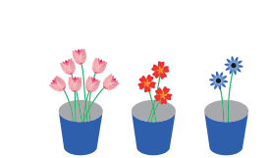
Add three numbers
Add three numbers
In focus
Can you add to ﬁnd out how many ﬂowers there are in total?
Notes:
Do this as an anchor task. Using tens frames and counters

Slide 10
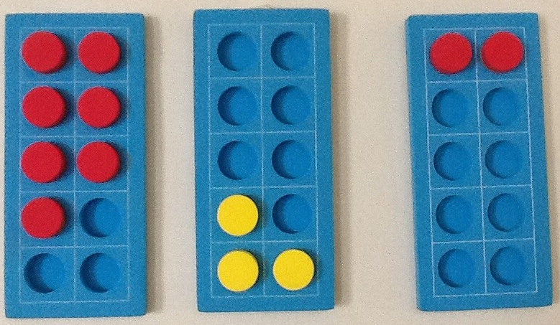
Ten-frames
Promotes discussion about ‘missing numbers’ and pairs of numbers. Children can manipulate numbers in various ways.

Slide 11
Add three numbers
Let’s Learn

Slide 12
Add three numbers
Guided Practice

Slide 13
Work in groups
1
Place the cards on the boxes
2
Arrange so the sum of the horizontal numbers is equal to the sum of the vertical number

Slide 15
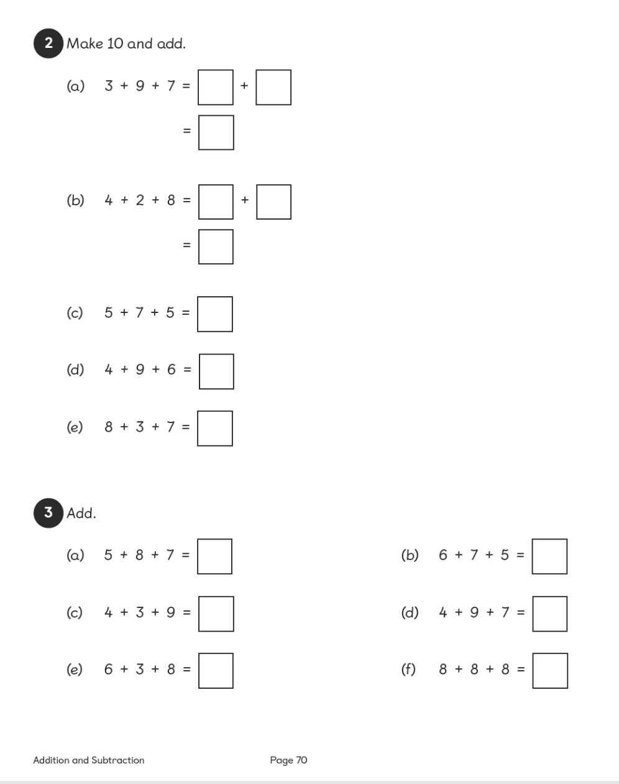

Slide 16
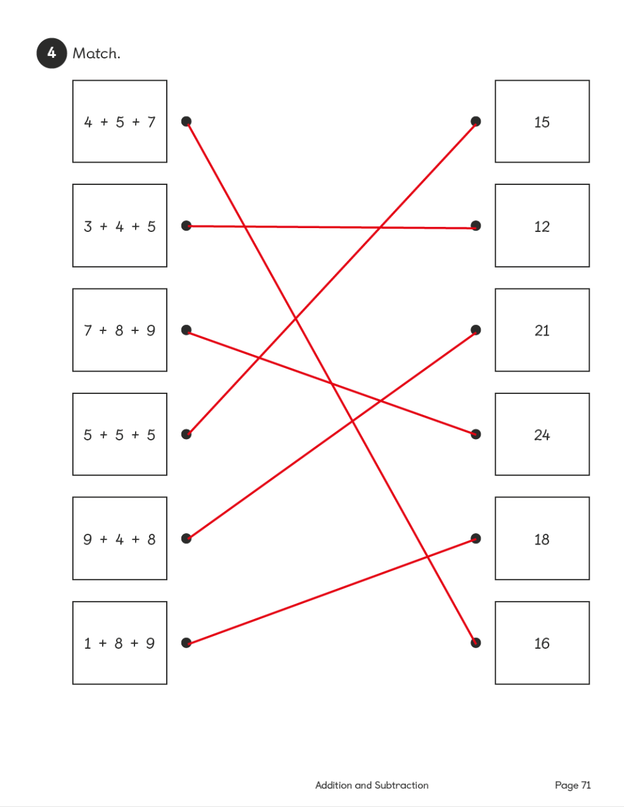

Slide 17
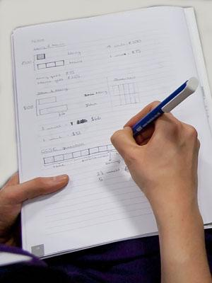
Lesson Structure
Anchor Task
Structuring
Guided Practice
Independent Practice
Journaling (not every lesson)

Slide 18
Journal Format and Use
Use:
Journals can be used in a variety of different ways. Recording may not occur every lesson.
Key to their use is how they recorded the preferred method of a child .
Another important aspect is they should also show a child’s
choice of process in their independent work.
Notes:
Show some examples of journal writing

Slide 19
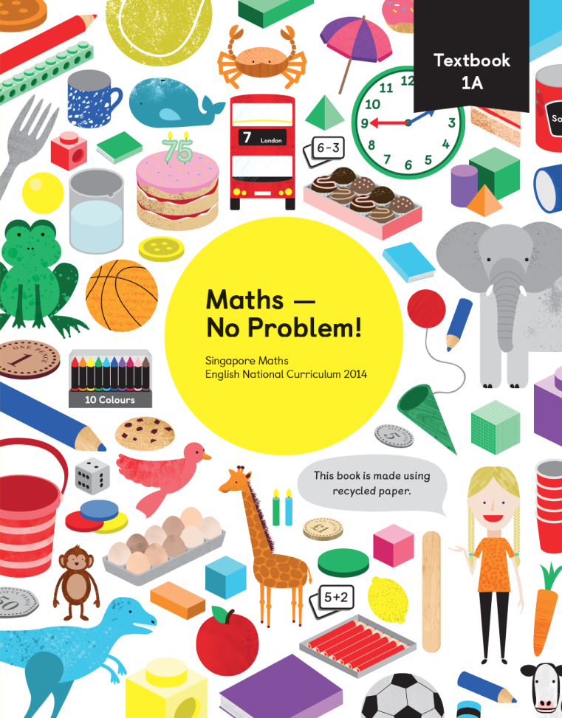
Textbooks and Workbooks
Textbooks provide clear progression and ideas for anchor tasks.
Workbooks follow the principle of
variation as prescribed by Zoltan Dienes.
Notes:
Talk about textbooks as a book to read

Slide 20
Zoltan Dienes
Play (informal)
Structured Learning (formal)
Practice
Notes:
Discuss the points listed.
Introduce the concept of CPA approach
Extension -why can’t you make a rectangle that has the area of 5 squares

Slide 21
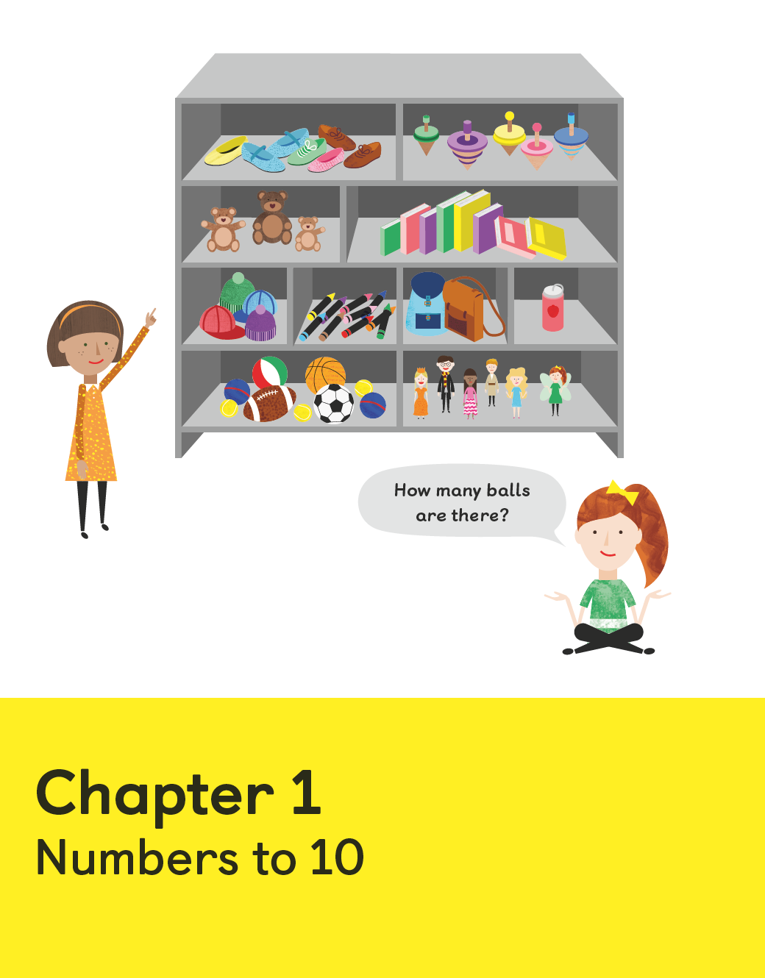
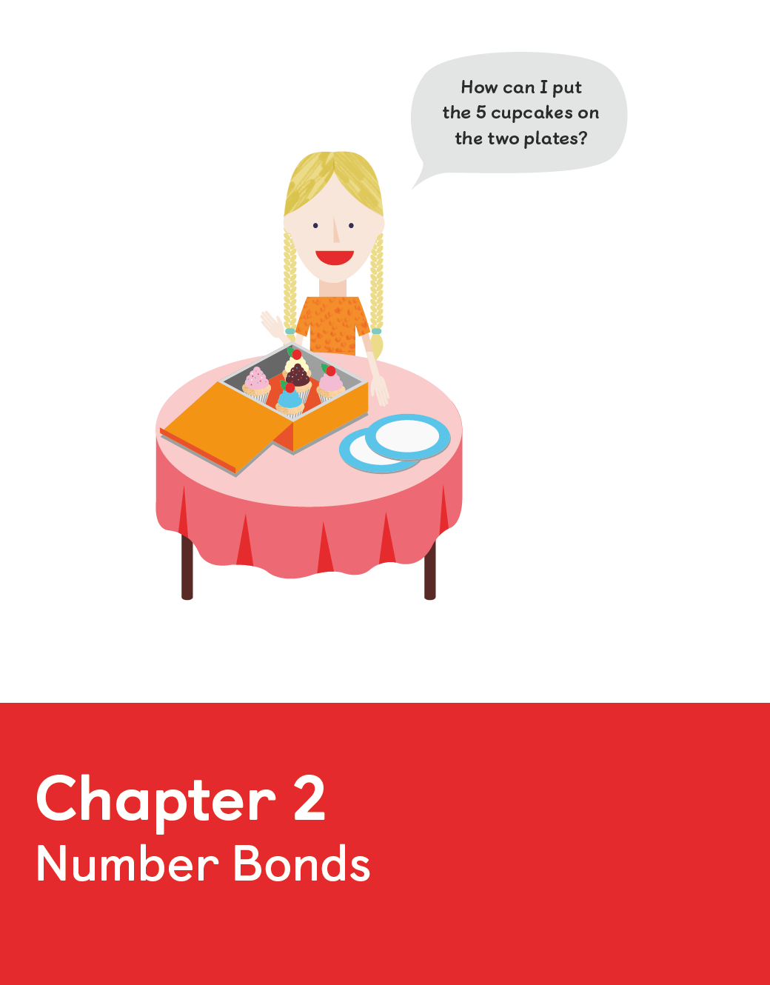
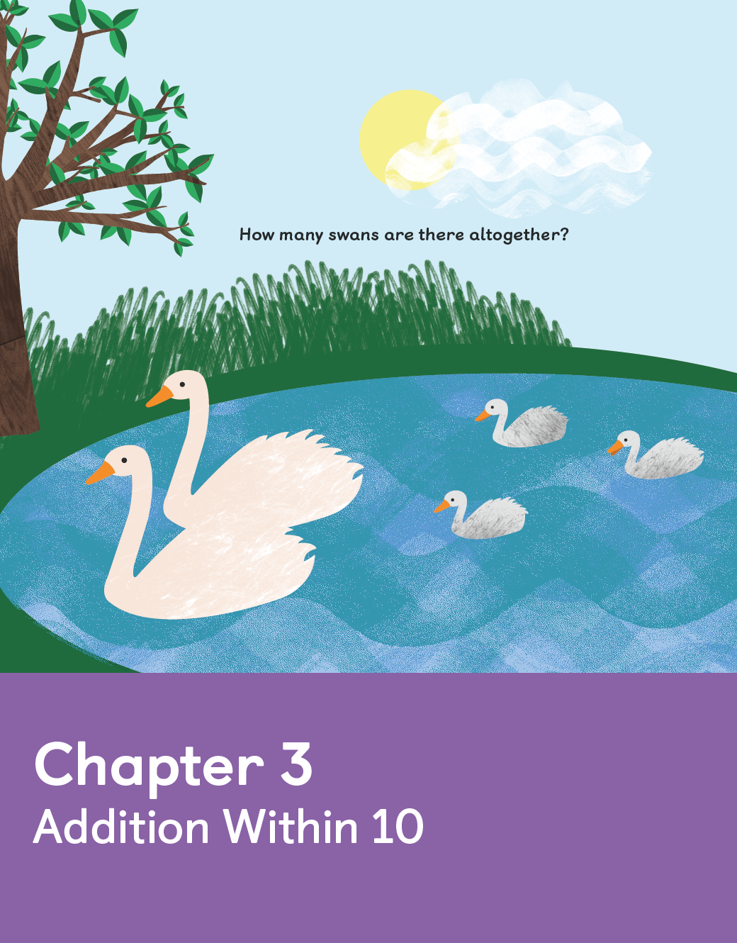
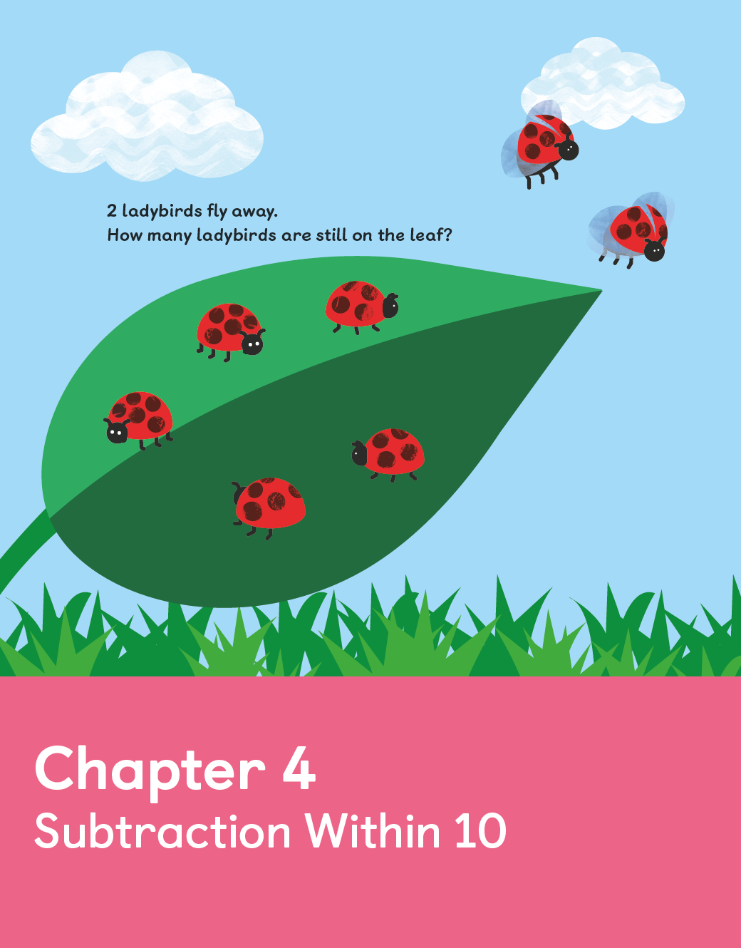
Mastering concepts
Number
1
Concepts will be fully developed before moving on. Pupils will have
had plenty of practice to embed ideas.
2
Struggling learners are not left behind as there is ample time to remediate when necessary, advanced learners have enough opportunities to deepen their understanding.

Slide 22
Differentiation
Children are expected to complete the same core tasks by the end of a
lesson.
Extension takes the form of enrichment rather
than acceleration.

Slide 23
Some Enrichment Examples
How many different ways can you create 10 using 3 different numbers - can be any number
Have a series of statements on slips of paper - pupils to determine if they are true or false - record in books. Statements can be glued into books. A variation of this would be that pupils create their own true/false statements and then test on a partner/group.
Number relationships/patterns. What do you notice about the numbers in one of the questions. Example - 6 -2 are both even numbers. and their answer is an even number. Can you create a question that is the same? Or their difference is 4. Can you think of other questions that will equal 4?
Ask pupils to write/or discuss to teacher who acts as scribe as to what they had to do - an explanation if someone was absent.
Come up with a story for the spending of a certain amount of money - or a story based on the numbers used in the questions.
Wrong answers. Give the pupils a number line with wrong answers/order. Can they find what the problem is? Colour/circle discuss with an adult.

Slide 24
Number bonds
A lot of emphasis is put on number bonds and in particular a recognition
that numbers can be split up and put together in different ways.
1
2
This formulates a basis for number sense which is applied as a platform for decision making
3
The number bond diagram is consistently used as a visual way of showing how
numbers can be split into their component parts, often as a means of describing
what children are thinking

Slide 25
Use of number bonds and the number bond diagram
5
3
2
Notes:
make number bonds on tens frames

Slide 26
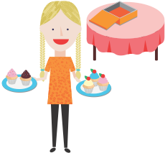
Making number bonds
Lesson 1
Lesson 1
In focus
How many cupcakes are there on each plate?
Is there another way to put the cupcakes on the two plates?
Notes:
Do as an anchor task

Slide 27
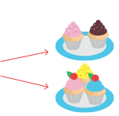
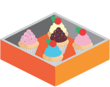
Making number bonds
Let’s Learn
1
2
2 and 3 make 5
5
3
This is a number bond

Slide 28
Making number bonds

Slide 29
Making number bonds

Slide 30
Making number bonds
Notes:
Do this one

Slide 31
Making number bonds
Guided Practice
Notes:
What do they notice - talk about variation

Slide 32
Introduction of the Bar Model
1
Students are introduced to the bar model method in year 2, first as a means to
solve word problems in length and mass.
2
Although students will only see the bar model in year 2 for the first time, the foundations
have been laid in previous years with the ground work done on part-part-whole relationships and comparisons using concrete objects and more ‘concrete’ pictorial
representations.
3
The bar model is used to solve problems using addition, subtraction, multiplication and division to begin with.
Notes:
Read the Mr Lim problem - have a go

Slide 33
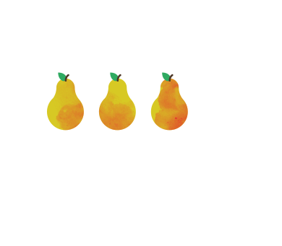
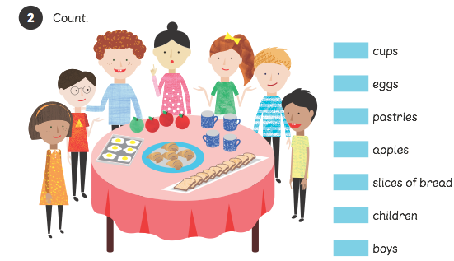
Foundations for the Bar Model
Concrete — modelling with real objects
1
Based on Jerome Bruner’s theory of representations, students first start by acting out problems with the real objects. When the problem is counting apples, the children should be counting real apples.

Slide 34
Foundations for the Bar Model
Representation — modelling with different objects
2
Moving away from always dealing with the real objects we can now start to model situations with other objects, for example counters, or with pictorial representations.
5
3
2

Slide 35
Bar Model
Transition to the bar model
Notes:
Discuss the points listed.
Introduce the concept of CPA approach
Extension -why can’t you make a rectangle that has the area of 5 squares

Slide 36
Bar Model
Transition to the bar model
Notes:
Discuss the points listed.
Introduce the concept of CPA approach
Extension -why can’t you make a rectangle that has the area of 5 squares

Slide 37
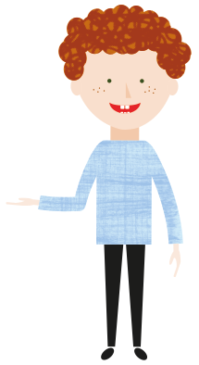
Bar Model
Solving word problems — length
Lulu wants to swim 50 metres.
She has swum 35m.
How far is she from the finishing line?
Why do we subtract ?
50m
35m
?
50 - 35 = 15
Lulu is 15 metres from the finishing line
Notes:
Lulu wants to swim 50 metres.
She has swum 35m
How far is she from the finishing line?
Ask before we show.

Slide 38
Bar Model
Solving word problems — length
Should we add
or subtract?
Emma buys 18m of red cloth and 15 m of blue cloth
What is the total length of cloth that she buys?
18m
15m
?
=
Emma buys of cloth altogether.

Slide 39
Bar Model
Solving word problems — length
Ruby has a ribbon that is 80 cm long.
She cuts a piece that is 48 cm long to make a bow.
What is the length of ribbon left?
What equation
can we write?
80cm
48cm
?
=
The length of ribbon left is
.
Notes:
Discuss the points listed.
Introduce the concept of CPA approach
Extension -why can’t you make a rectangle that has the area of 5 squares

Slide 40
Bar Model
Solving word problems — mass
The mass of a pear is 135 g.
A watermelon is 375 g heavier than the pear.
What is the mass of the watermelon?
Do we add or subtract?
135 g
375 g
pear
watermelon
? g
?
The mass of the watermelon is
grams.
Notes:
Discuss the points listed.
Introduce the concept of CPA approach
Extension -why can’t you make a rectangle that has the area of 5 squares

Slide 41
Bar Model
Solving word problems — mass
An empty suitcase has a mass of 3 kg.
Charles packs 9 kg of clothes into the suitcase.
He also packs 4 kg of books into the suitcase.
What is the total mass of the suitcase with the clothes and books?
3 kg
9 kg
4 kg
? kg
The total mass of the suitcase with the clothes and books is
kg.
Notes:
Discuss the points listed.
Introduce the concept of CPA approach
Extension -why can’t you make a rectangle that has the area of 5 squares

Slide 42
Bar Model
Solving word problems — mass
.Elliott bought 4 bags of rice.
Each bag has a mass of 3 kg
3
3
3
3
4 × 3 = 12
The total mass of the 4 bags of rice is 12 kg.
Notes:
Elliott bought 4 bags of rice.
Each bag has a mass of 3 kg
What is the total mass of the rice?

Slide 43
Bar Model
Solving word problems — mass
The total mass of 5 bags of flour is 40 kg.
Each bag of flour has the same mass.
What is the mass of each bag of flour?
?
40 kg
40 ÷ 5 = 8
The mass of each bag of flour is 8 kg.
Notes:
Discuss the points listed.
Introduce the concept of CPA approach
Extension -why can’t you make a rectangle that has the area of 5 squares

Slide 44
Bar Model
Solve using the bar model
There are three times as many boys as there are girls in a hall.
There are 78 boys in the hall.
(a) How many girls are there in the hall?
(b) How many children are there in the hall?
Notes:
Discuss the points listed.
Introduce the concept of CPA approach
Extension -why can’t you make a rectangle that has the area of 5 squares

Slide 45
Bar Model
Solve using the bar model
Sam put 14 coins in his coin box on Monday.
On Tuesday, he put 7 more coins in the box than he did on Monday.
On Wednesday, he put 7 more coins in the box than he did on Tuesday.
How Many coins did he put in the coin box on the three days altogether?
Notes:
Discuss the points listed.
Introduce the concept of CPA approach
Extension -why can’t you make a rectangle that has the area of 5 squares

Slide 46
Bar Model
Solve using the bar model
In a basket, 5/9 of the fruits are apples and the rest are
oranges. 3/10 of the apples are green. There are 15
green apples.
How many fruits are there in the basket?
Notes:
Discuss the points listed.
Introduce the concept of CPA approach
Extension -why can’t you make a rectangle that has the area of 5 squares

Slide 47
Bar Model
Solve using the bar model
John had 19 geese, chickens and ducks altogether.
He had 3 more chickens than ducks and two fewer
geese than ducks.
How many geese did he have?
Notes:
Discuss the points listed.
Introduce the concept of CPA approach
Extension -why can’t you make a rectangle that has the area of 5 squares

Slide 48
Bar Model
Solve using the bar model
Tim has a bowl and some sugar. Together they
weigh 110 grams. Sue empties the bowl and puts
in three times the amount of sugar.
It now weighs 290 grams.
How much does the bowl weigh?
Notes:
Discuss the points listed.
Introduce the concept of CPA approach
Extension -why can’t you make a rectangle that has the area of 5 squares

Slide 49
Bar Model
Solve using the bar model
There is a group of people of which half is made
up of children. Of the adults, one third are men
and 36 are women.
How many people are there altogether?
Notes:
Discuss the points listed.
Introduce the concept of CPA approach
Extension -why can’t you make a rectangle that has the area of 5 squares

Slide 50
Bar Model
Solve using the bar model
Mrs. Singh bought a set of furniture for $1760.
This was 20% less than the usual price. Later: Mrs. Singh sold the same set of
furniture for 5% more than the usual price.
How much did Mrs. Singh sell the set of furniture for?
Notes:
Discuss the points listed.
Introduce the concept of CPA approach
Extension -why can’t you make a rectangle that has the area of 5 squares

Slide 51
More Problems
I think of three different numbers. When I add the numbers up two at a time, I get 49, 57 and 64.
What are the three numbers?
The ratio of Sumin’s money to Meili’s money was 4:1. After Sumin had spent £26, Sumin had £2 less than Meili.
How much money did Sumin have at first?
Notes:
Primary School Leaving Exam (Year 6) – Last two questions

Slide 52
I think of three different numbers. When I add the numbers up two at a time, I get 49, 57 and 64.
What are the three numbers?
49
113
64
113
?
57

Slide 53
The ratio of Sumin’s money to Meili’s money was 4:1. After Sumin had spent £26, Sumin had £2 less than Meili. How much money did Sumin have at first?
Before
Sumin
Meili
£26
After
Sumin
£2
Meili

Slide 54
CPA approach -Jerome Bruner
Bruner’s theory: Knowledge representation develops in 3 stages
Enactive - based on hands-on sensory experiences of physical objects together with the consequences that go after.
Iconic - Knowledge can now be represented using models and pictures. Learners know how to make mental images of their world.
Symbolic - Learners can think in abstract. So abstract terms and symbol systems can be used to represent knowledge like numbers, mathematical symbols, letters and language.
80m
48m
?
2
3
6
7
4
2
8
9
7
1
1
+
Notes:
Discuss the points listed.
Introduce the concept of CPA approach
Extension -why can’t you make a rectangle that has the area of 5 squares

Slide 55
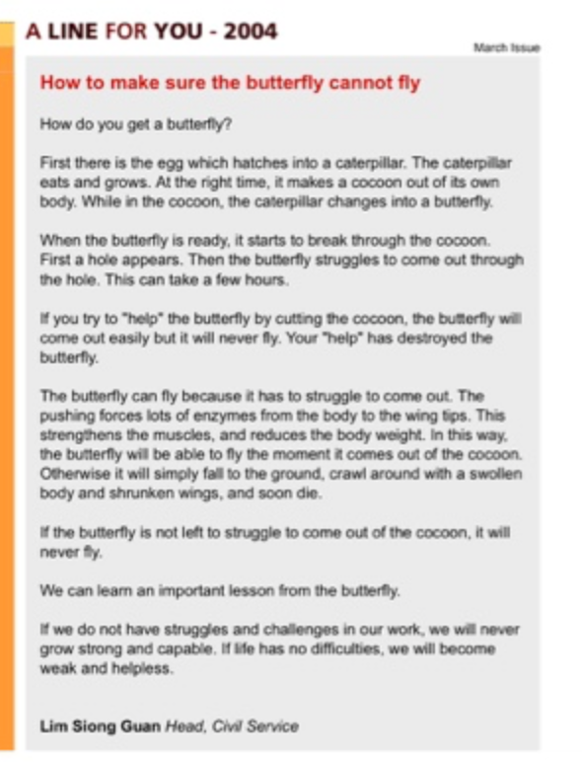

Slide 56
THANK YOU

