Slide 1
Our Lady of Perpetual Succour Catholic Primary
We learn to love everyone as Jesus loves us.

Slide 2
Our Lady of Perpetual Succour Catholic Primary
English Curriculum Intent

Slide 3
ENGLISH
Knowledge of English, and a command of the spoken and written word, is an essential resource for a child’s learning in school. It is a tool used across the whole school curriculum, as well as being a subject in its own right.
English at Our Lady's is not only a daily discrete lesson, but is at the cornerstone of the entire curriculum. It is embedded within all our lessons and we strive for a high level of literacy for all. Through using high-quality texts, immersing children in vocabulary rich learning environments and ensuring new curriculum expectations and the progression of skills are met, the children at Our Lady's are exposed to a creative and continuous English curriculum.
We nurture and develop a love of reading, creative writing and purposeful speaking and listening.

Slide 4
English is at the heart of the curriculum.

Slide 5
ENGLISH
Reading
At Our Lady’s children learn not just the mechanics of reading, but to become accomplished, comprehending readers; developing a love of reading for life. Each class has a designated communication friendly reading area, resourced with high quality texts and inspiring learning opportunities, which help our children to:
Gain a life-long enjoyment of reading and books.
Be able to read with expression, clarity and confidence;
Apply a knowledge of structured synthetic phonics in order to decode unfamiliar words with increasing accuracy and speed;
Develop a good linguistic knowledge of vocabulary and grammar;
Read and respond to a wide range of different types of texts;
Develop a deeper level of emotional intelligence and empathy;
Read fluently, and with confidence, in any subject.
Our Reading Buddies and Y6 Librarians promote and share books, taking them out onto the playground. This is peer support, run by the children for the children: and certainly contributed towards our Liverpool Reading Quality Mark accreditation.

Slide 6
Reading opens up a world of opportunities, developing a deeper level of knowledge, emotional intelligence and empathy.

Slide 7
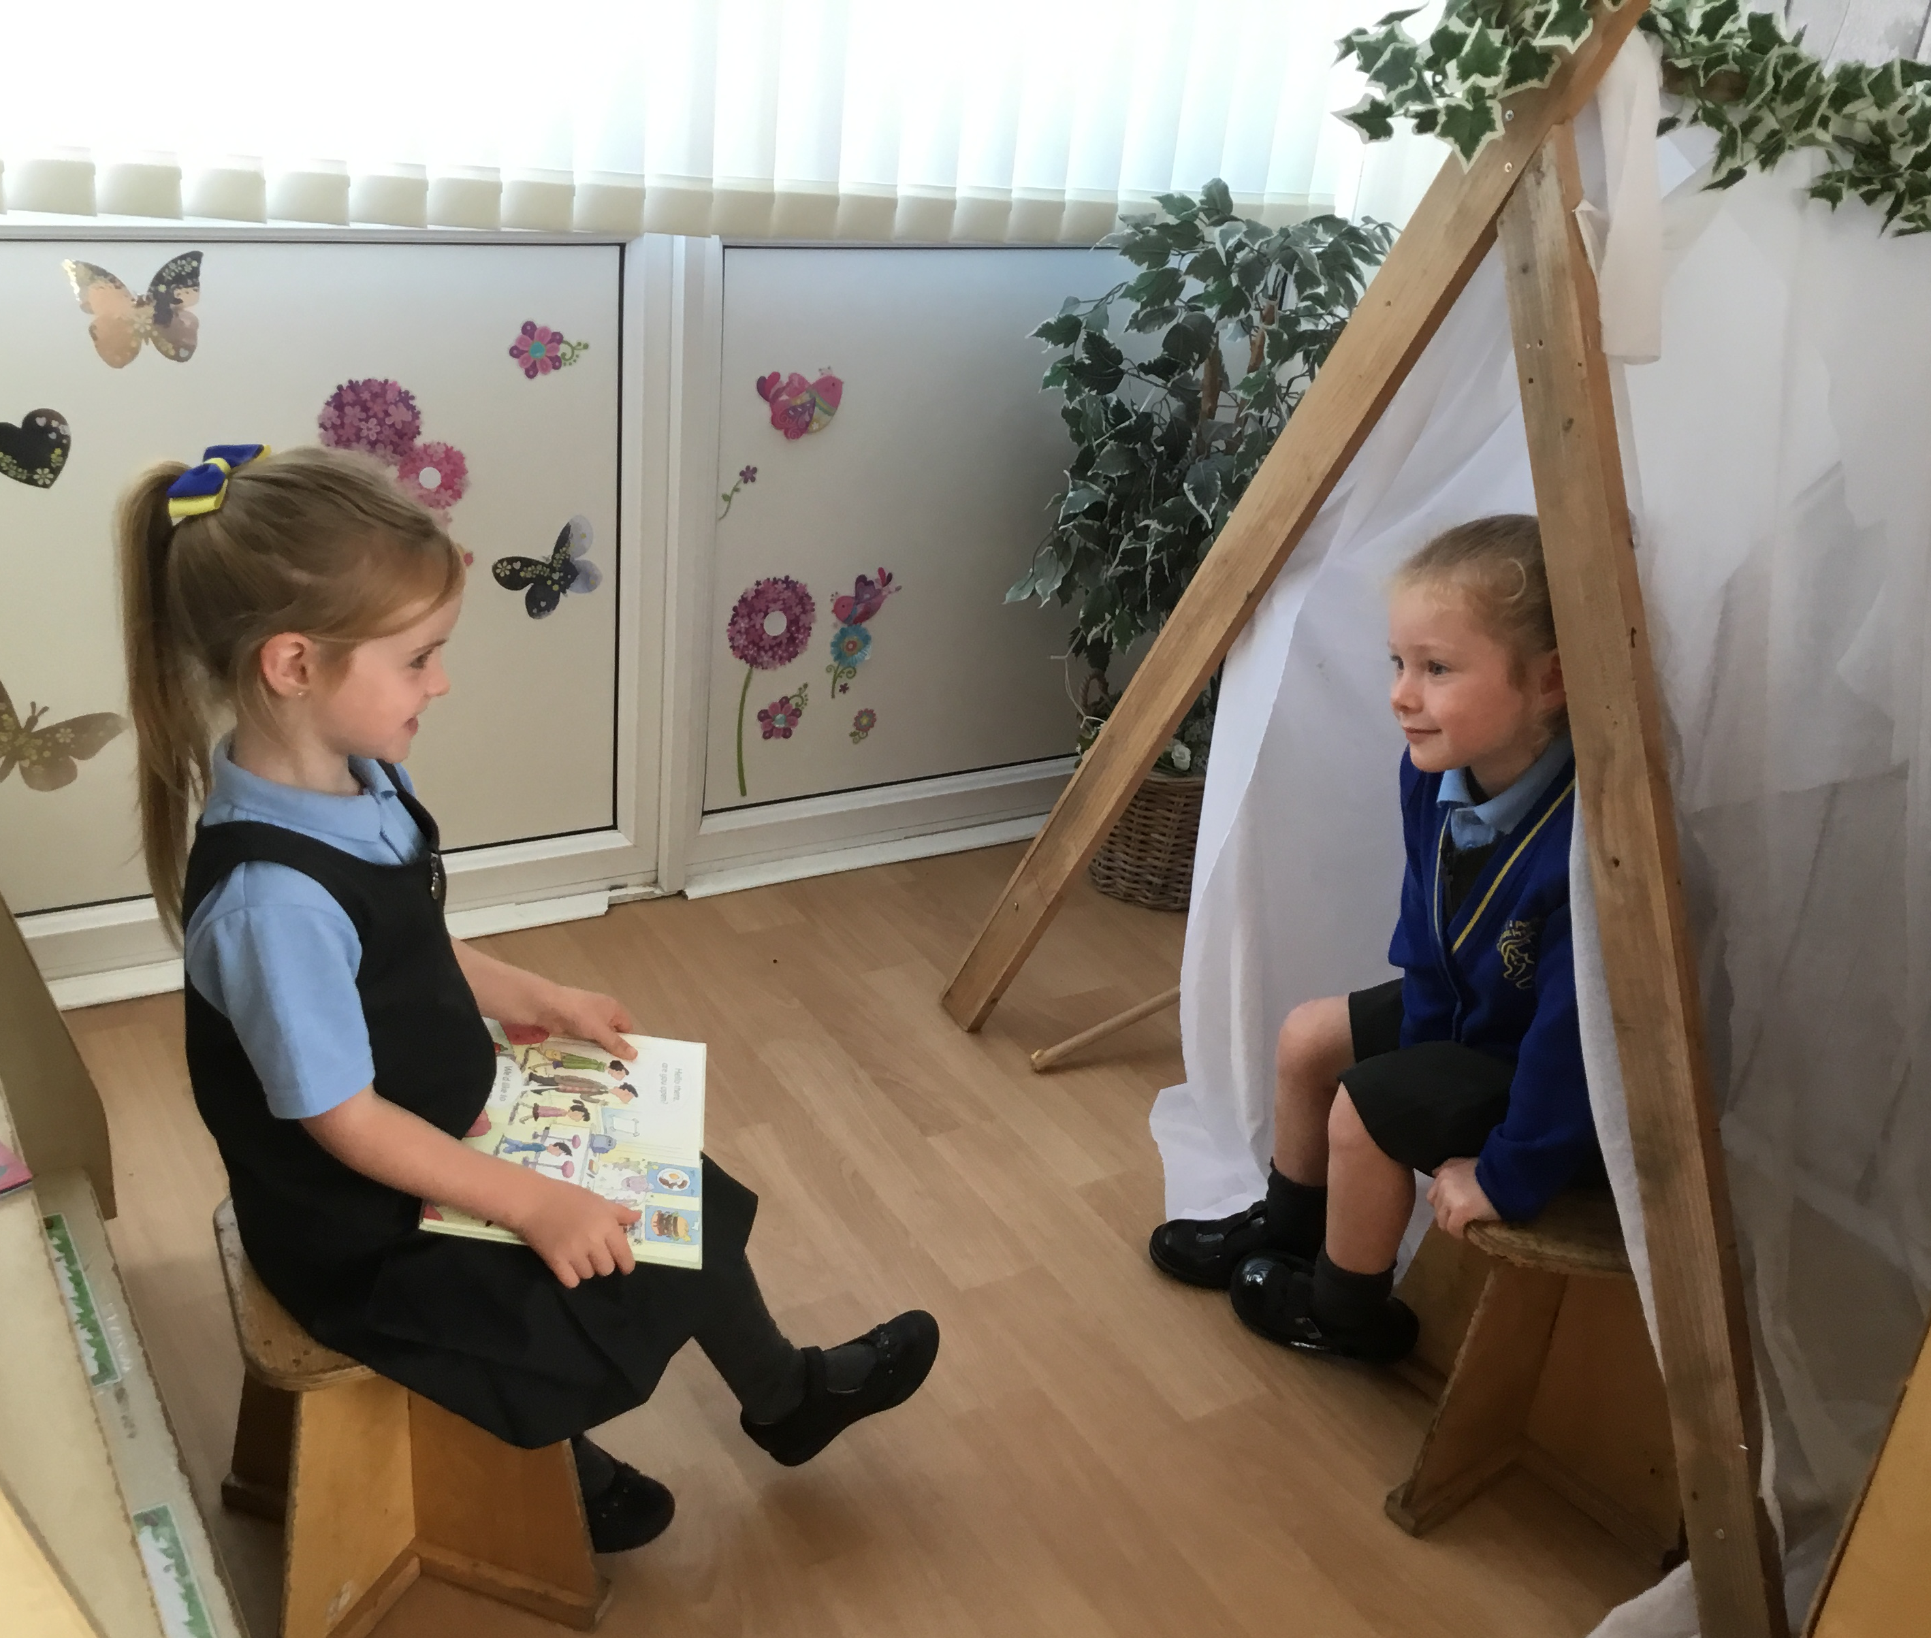
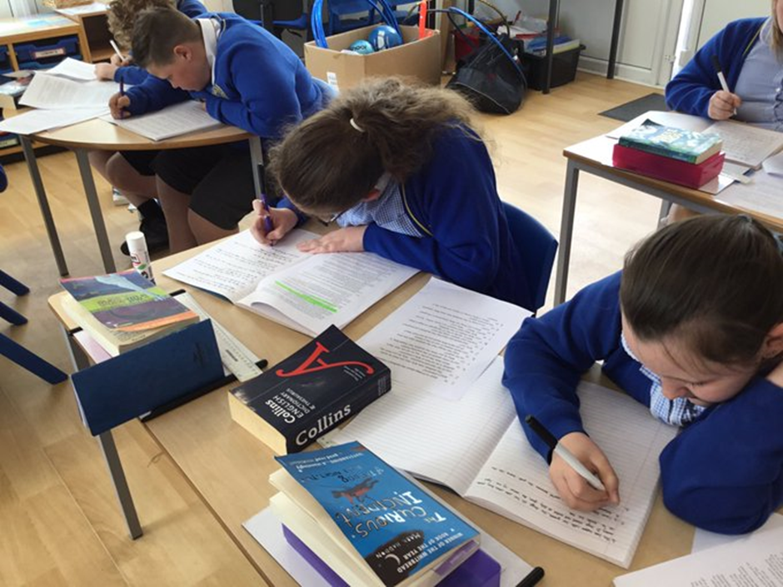
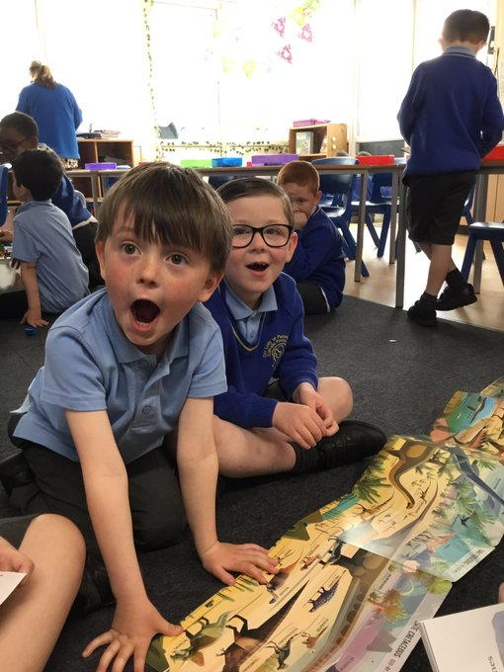
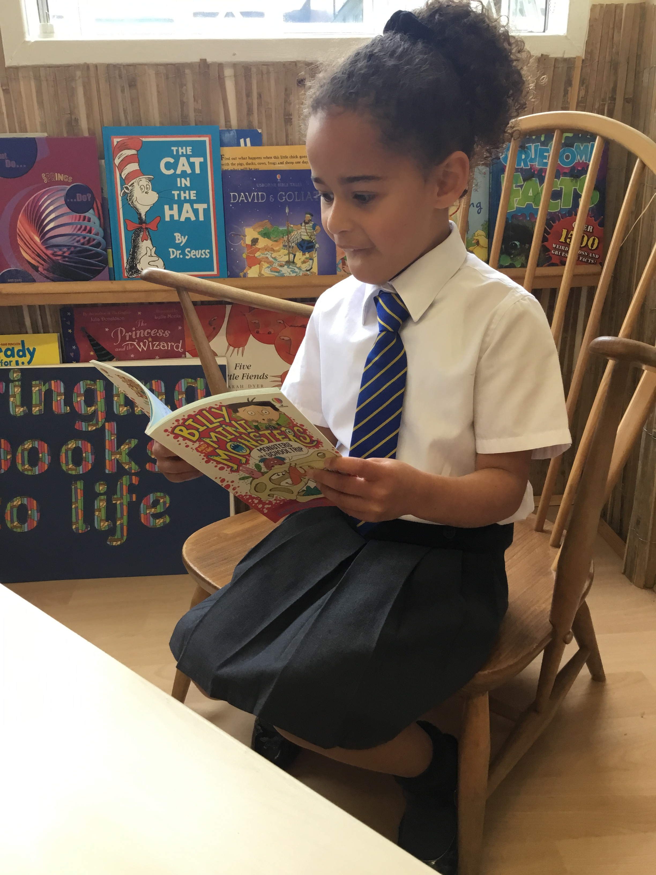
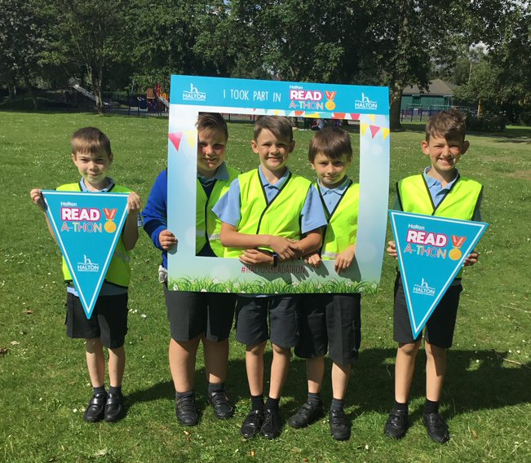
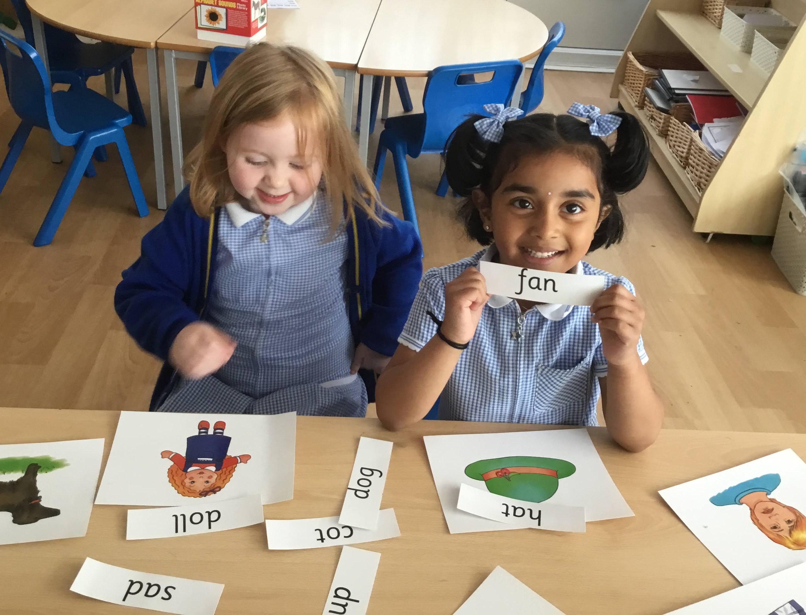
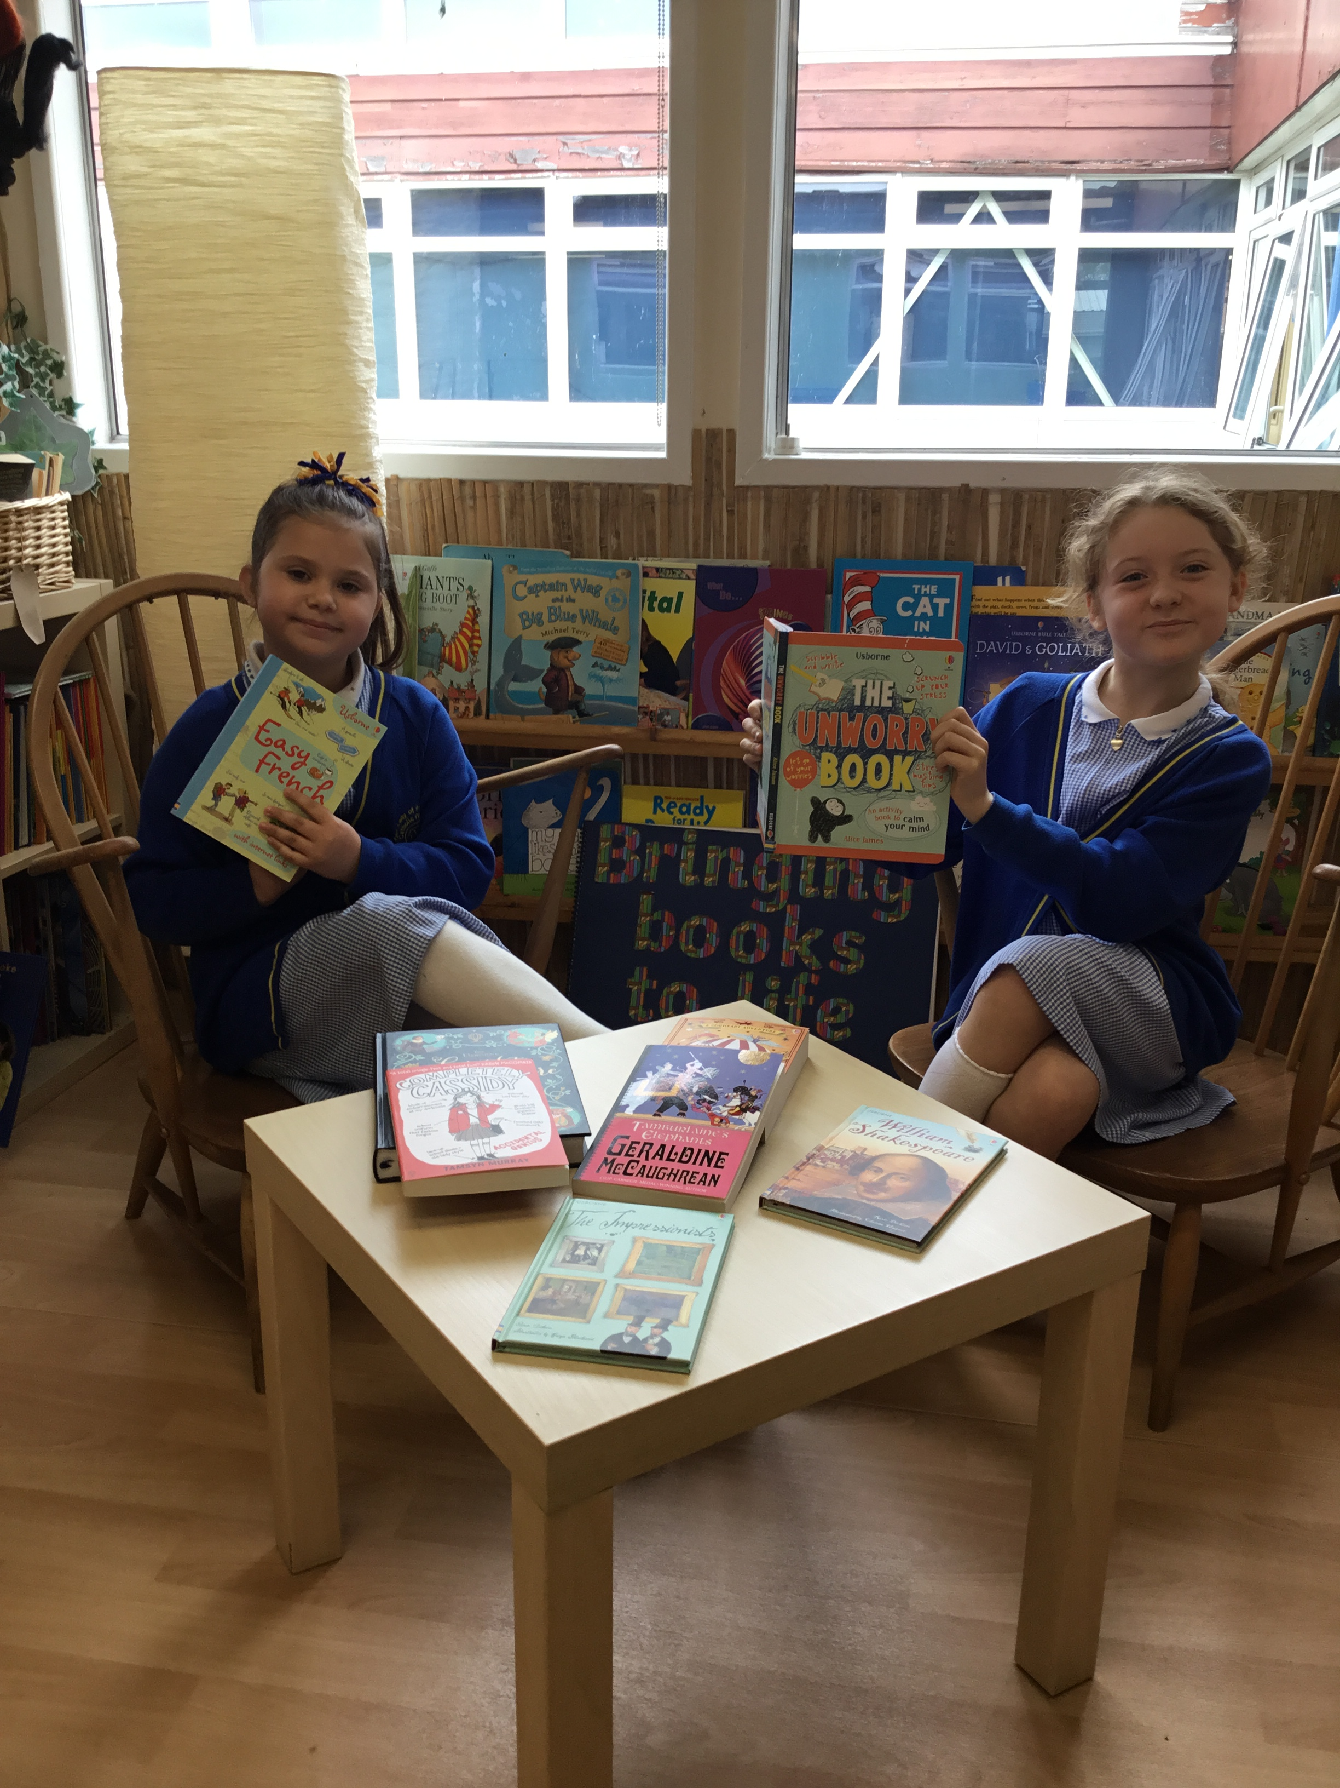
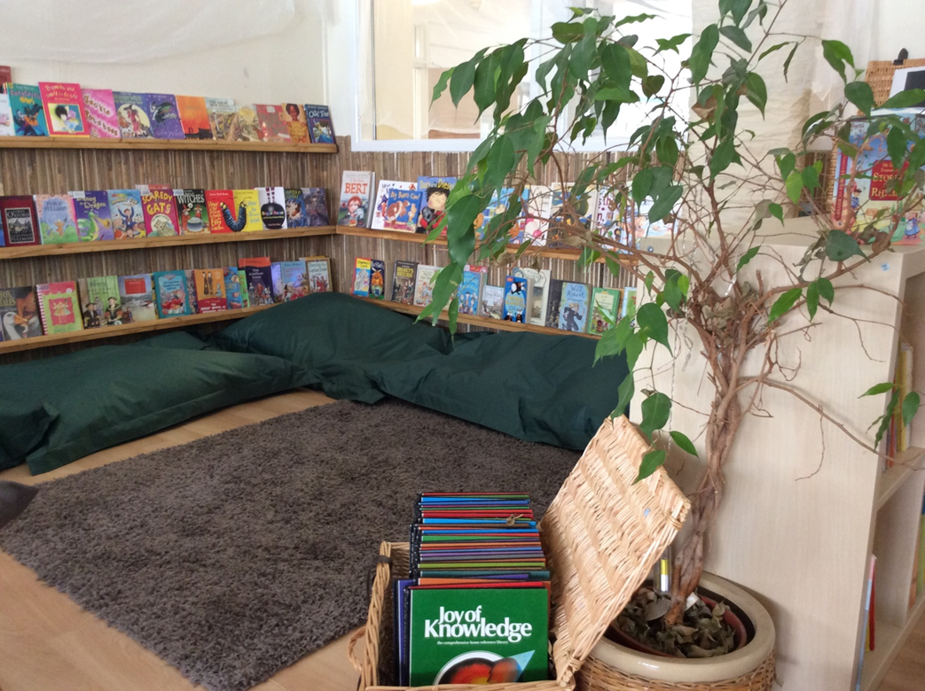

Slide 8
Writing
At Our Lady’s we aim to ensure all of our children develop a genuine love of language and the written word, through a text-based approach; this links closely to the way we teach reading, with carefully selected, high quality texts at the heart of the literacy curriculum.
Careful links are also made across the curriculum to ensure that children’s English learning is relevant and meaningful: frequently linking our reading and writing with the topic that we are covering in Dimensions, as well as exploring exceptional literature in its own right.
We ensure that children develop an understanding of how widely writing is used in everyday life and therefore, how important and useful the skills are that they are learning. Our intentions in writing are for children to:
Write for a purpose
See themselves as real writers
Take ownership of their writing
See writing as an interesting and enjoyable process
Acquire the ability to organise and plan their written work
Celebrate their writing by entering competitions and sharing our best practice

Slide 9
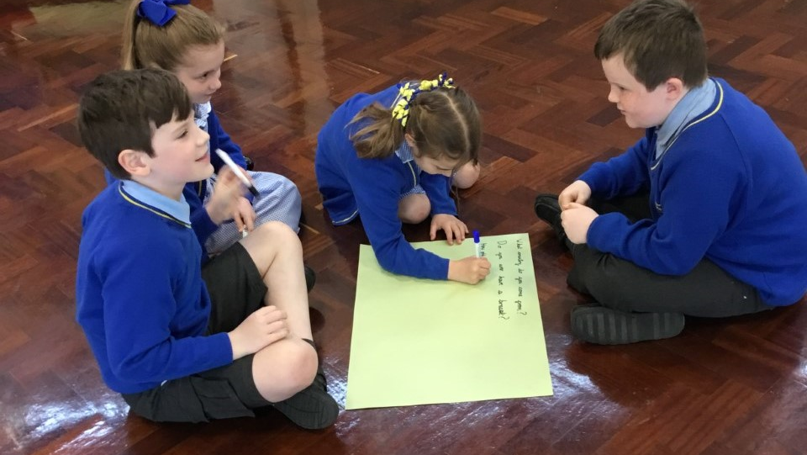
Children develop a genuine love of language and the written word.

Slide 10
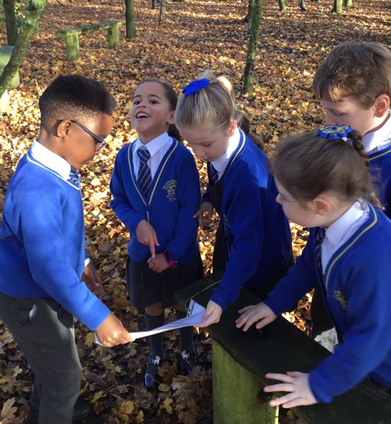
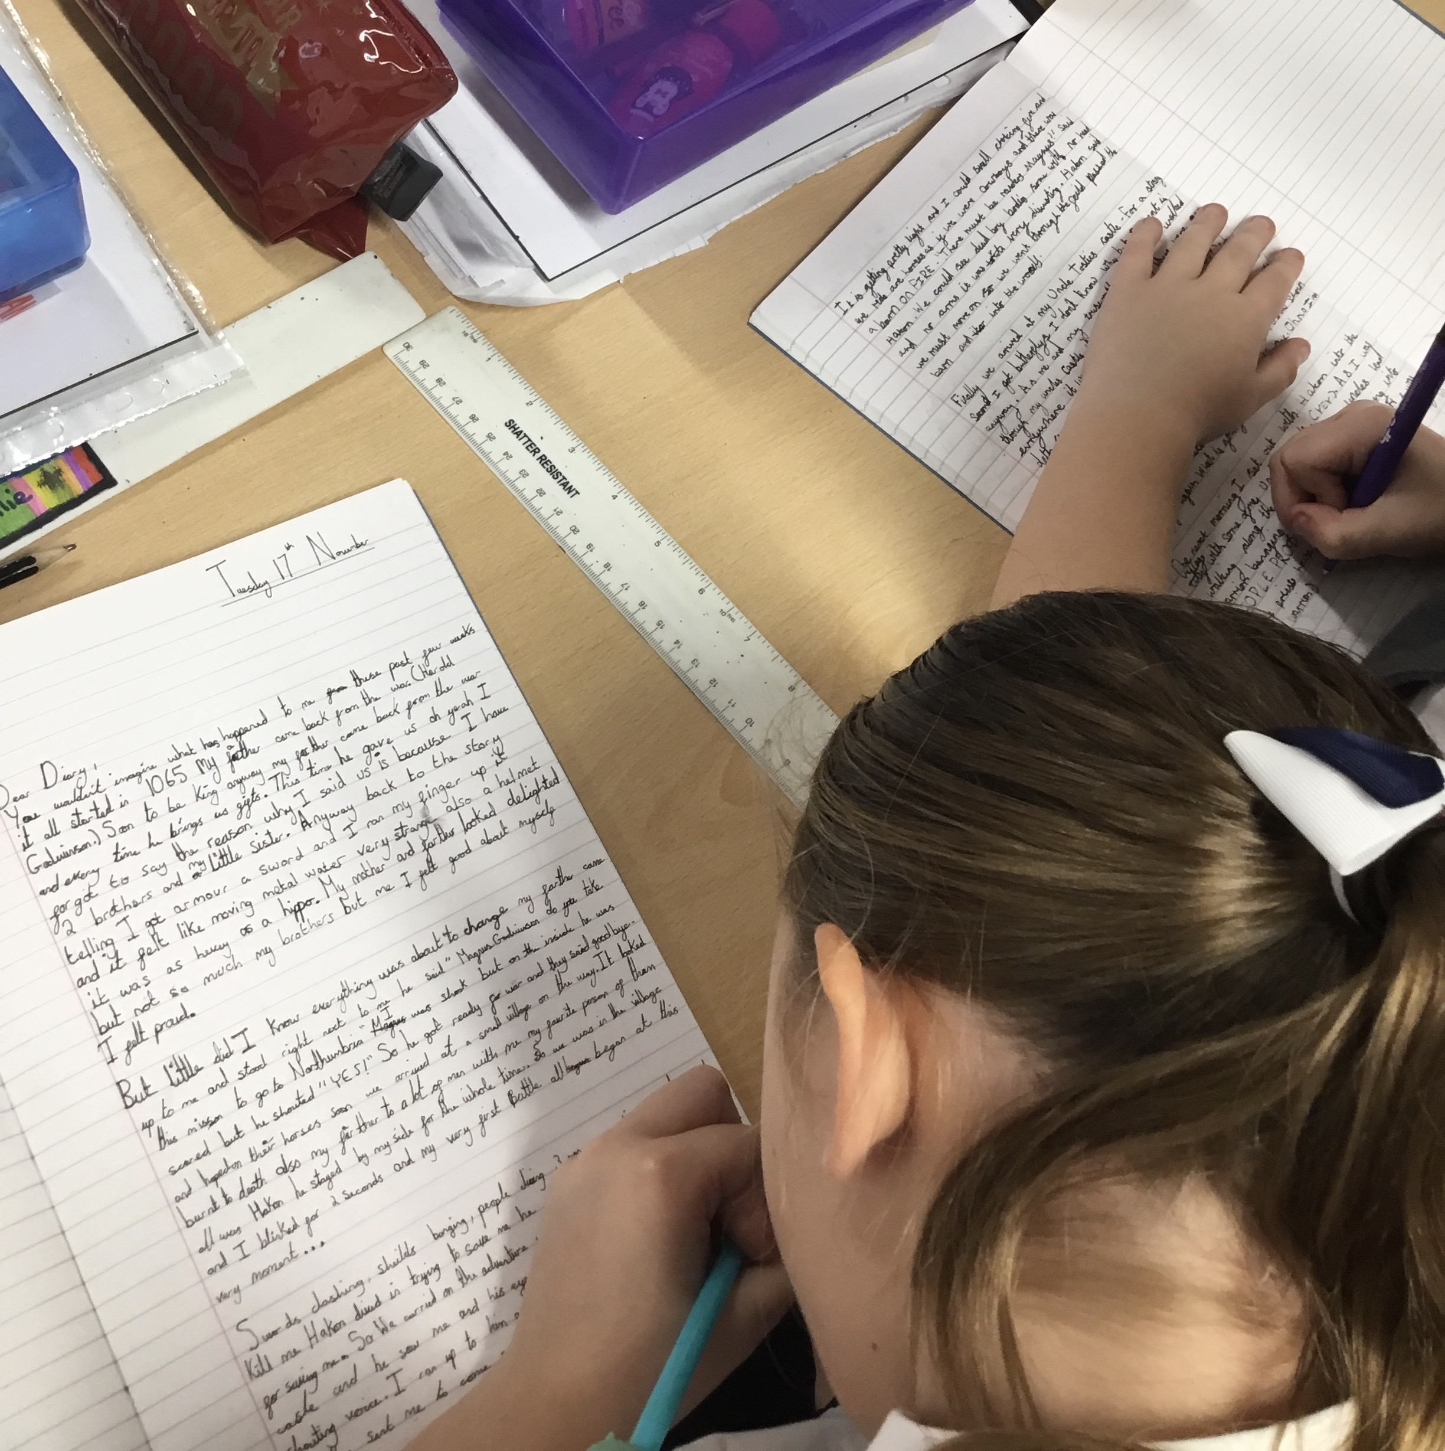
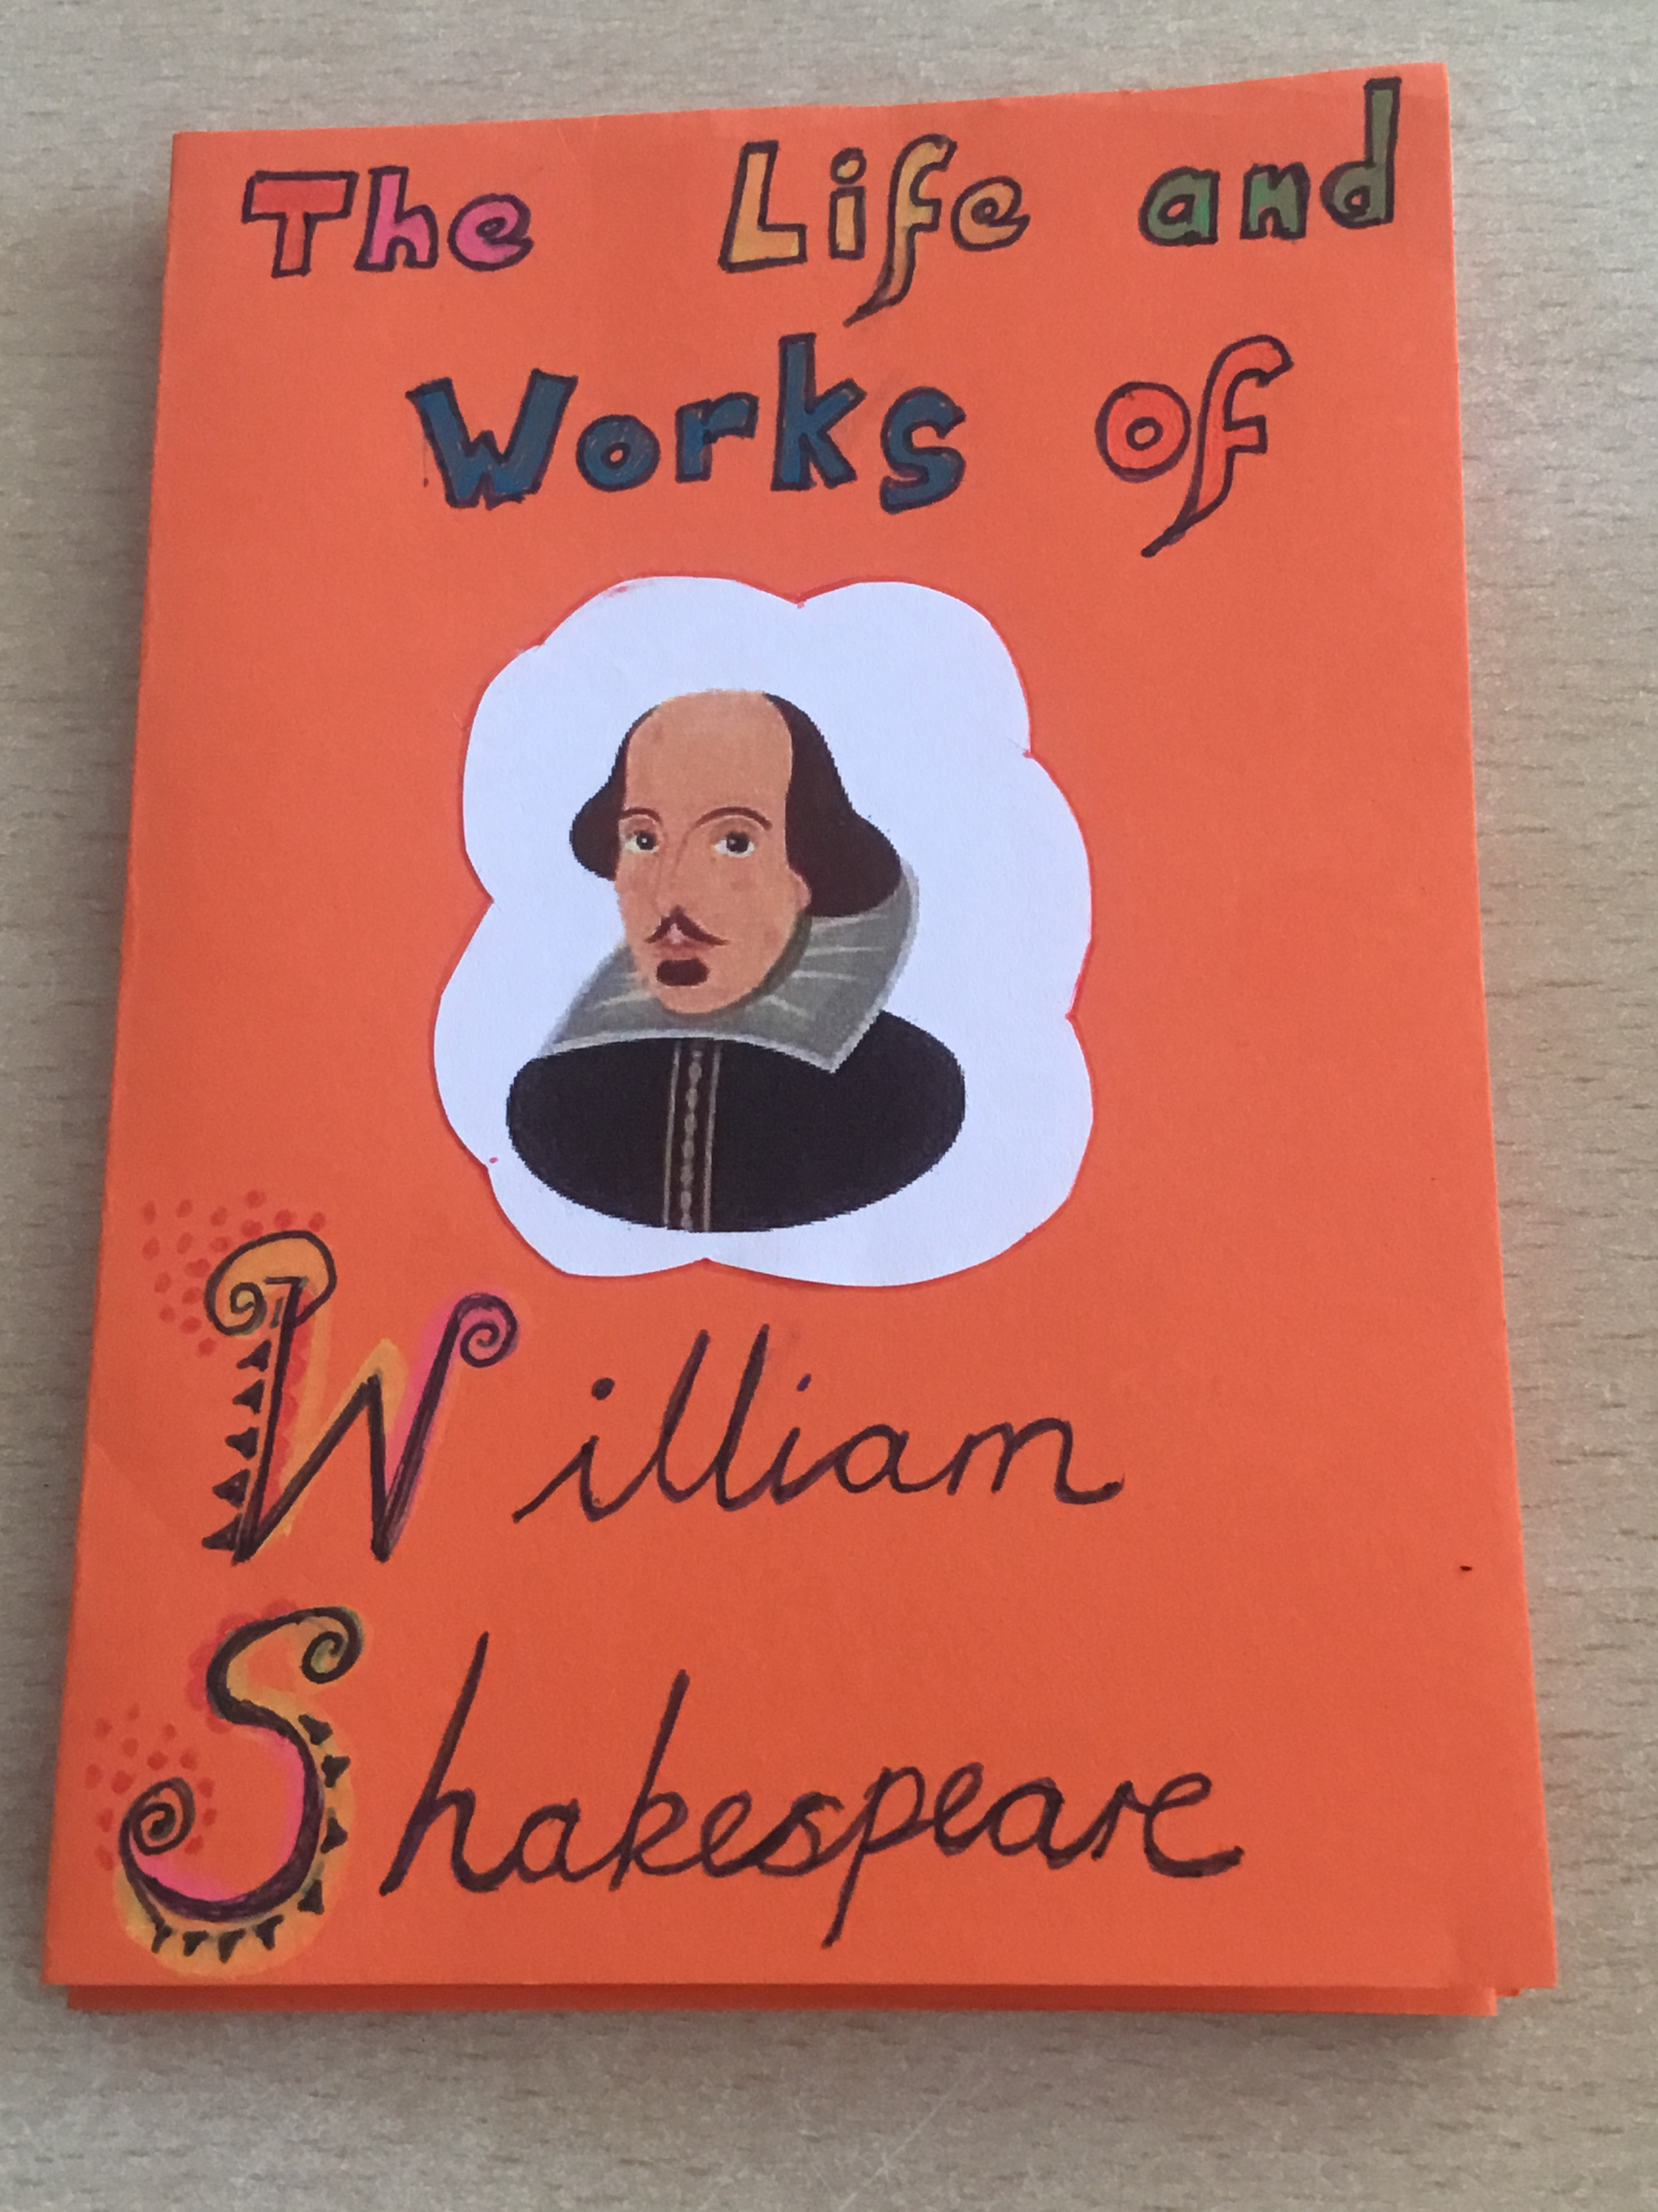
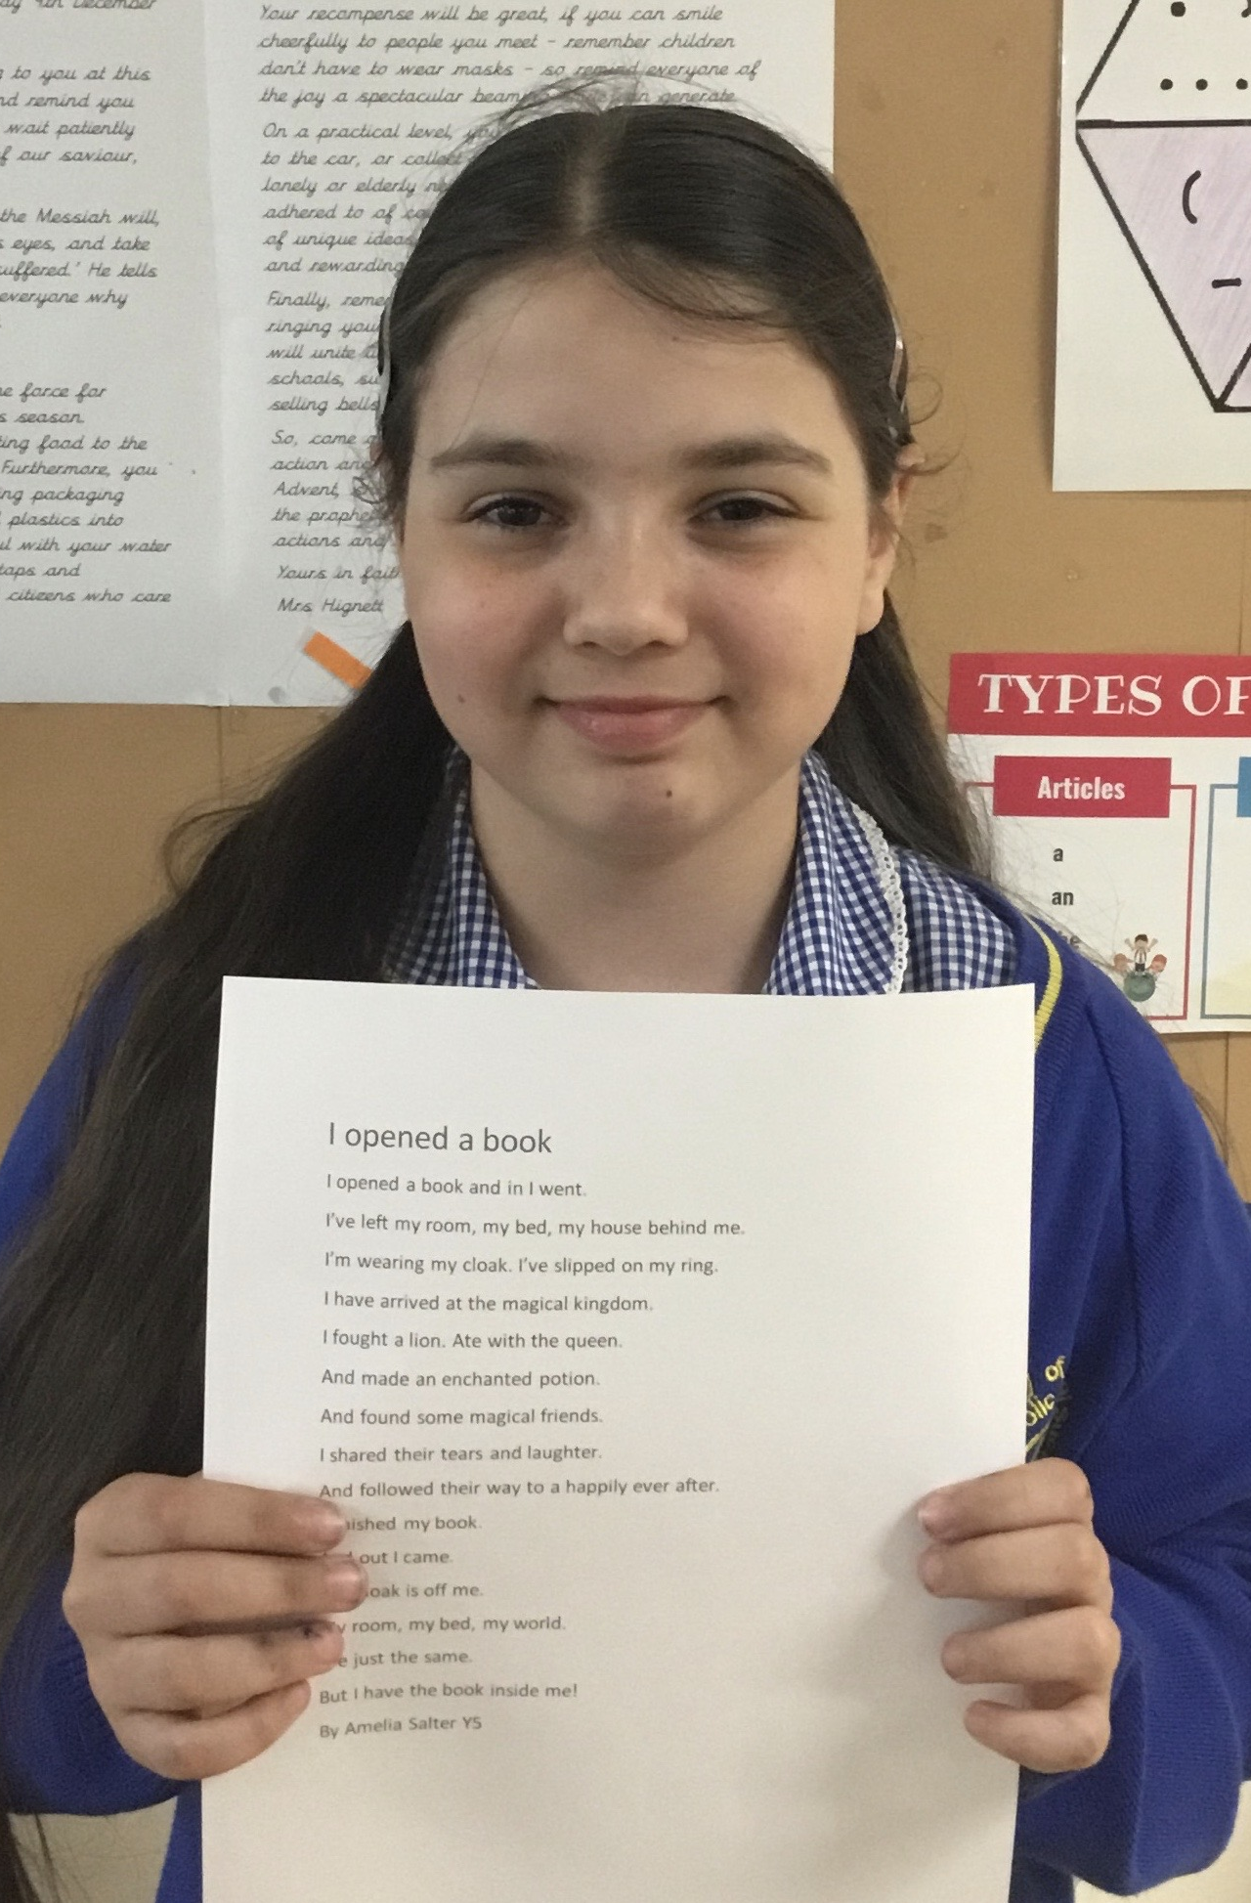
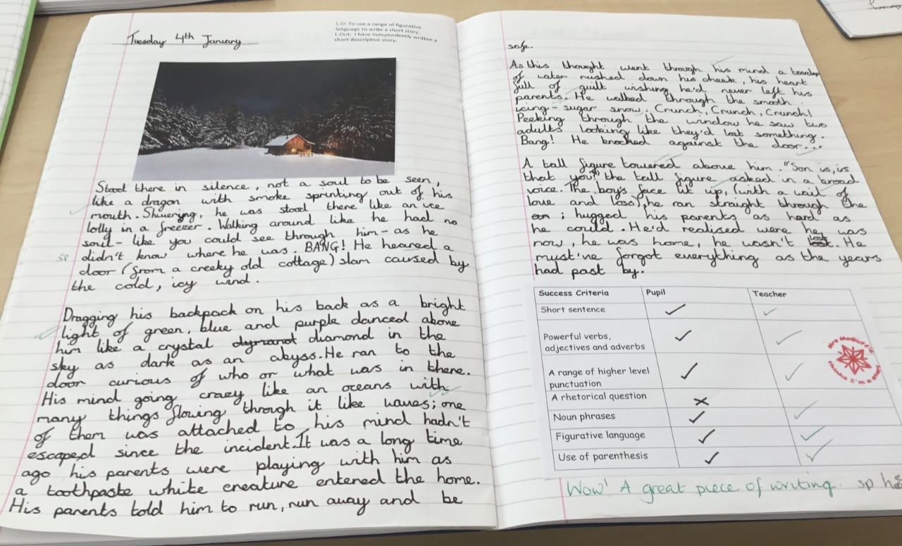
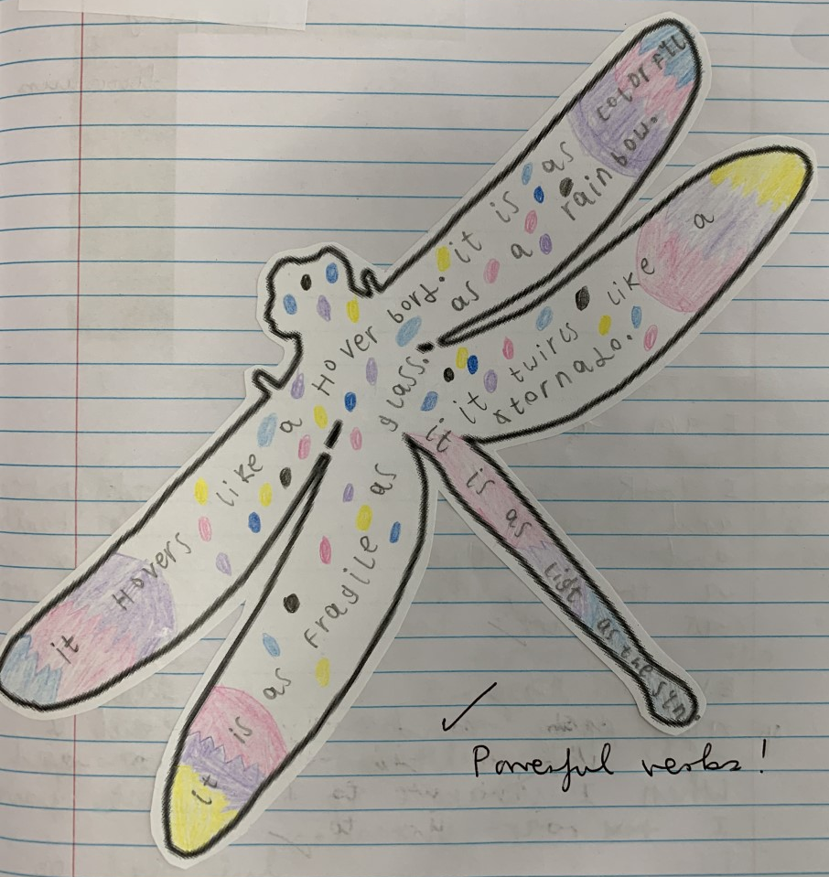

Slide 11
Speaking and listening
Here at our Lady’s, opportunities to develop and hone children’s oracy skills are embedded not only in the English curriculum but also across the wider curriculum. Teachers are resourceful in their planning - beginning in Reception and continuing through all Primary years the children develop their capacity to express themselves effectively for a variety of purposes. This is fostered in our Communication Friendly Spaces, as well as through carefully structured lessons. Working with adults and other children, their activities include listening, giving opinions, replying to instructions and questions, describing experiences and feelings.
All children are given many opportunities to extend upon early skills to recount events, tell stories, take on dramatic roles, report, summarise and predict.
Children are also provided with opportunities to compose, recite and perform poetry. All classes take part in literary events throughout the year, where published writers work with the children to enrich their literary skills. Both KS1 and KS2 children take part in annual dramatic public performances. The infants often perform a Christmas nativity, whilst the juniors enjoy ending the year with a summer show.

Slide 12
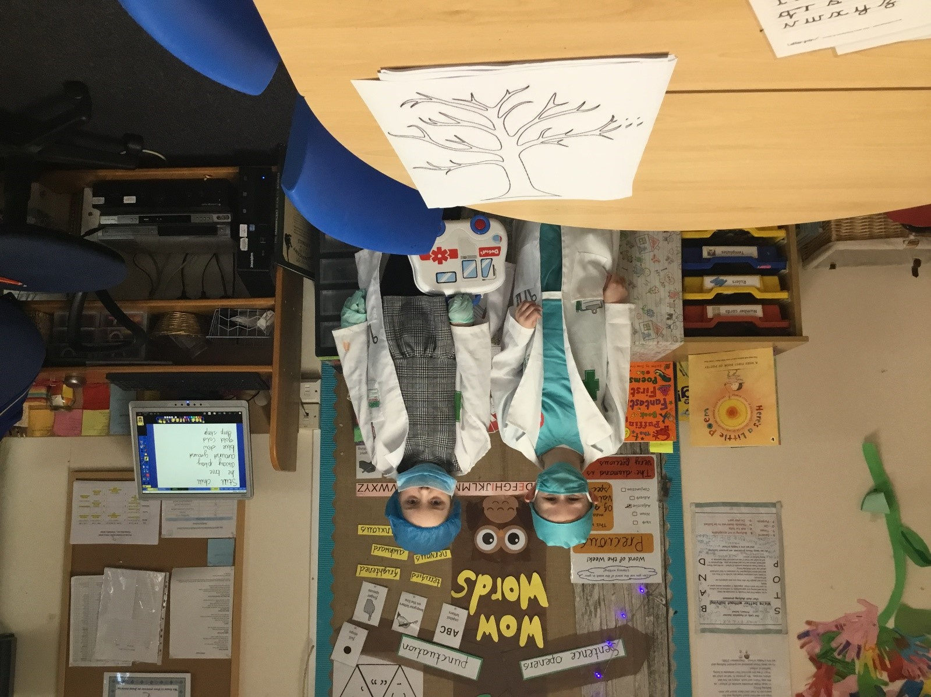
Oracy skills are embedded across the whole curriculum.

Slide 13
