Slide 1
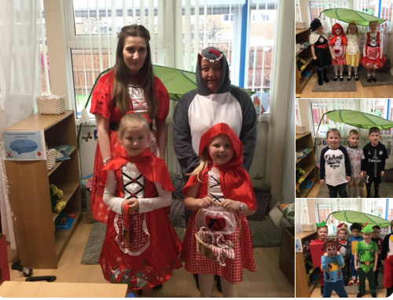
World Book Day 2019

Slide 2
The day began by sharing books with our families!

Slide 3
Mums, Dads, Uncles....all are welcome!

Slide 4
Guess the book!

Slide 5
Supercalifragilous!

Slide 6
Is nothing safe?!....

Slide 7
Expeliamous!

Slide 8
Favourite characters in Y1

Slide 9
How funny Y4 looked arriving at Ditton Library!

Slide 10
Don’t mess with these guys!

Slide 11
Whole School Text: Where The Wild Things Are

Slide 12
We can’t wait for World Book Day next year.......watch this space in 2020!

